Slide 1
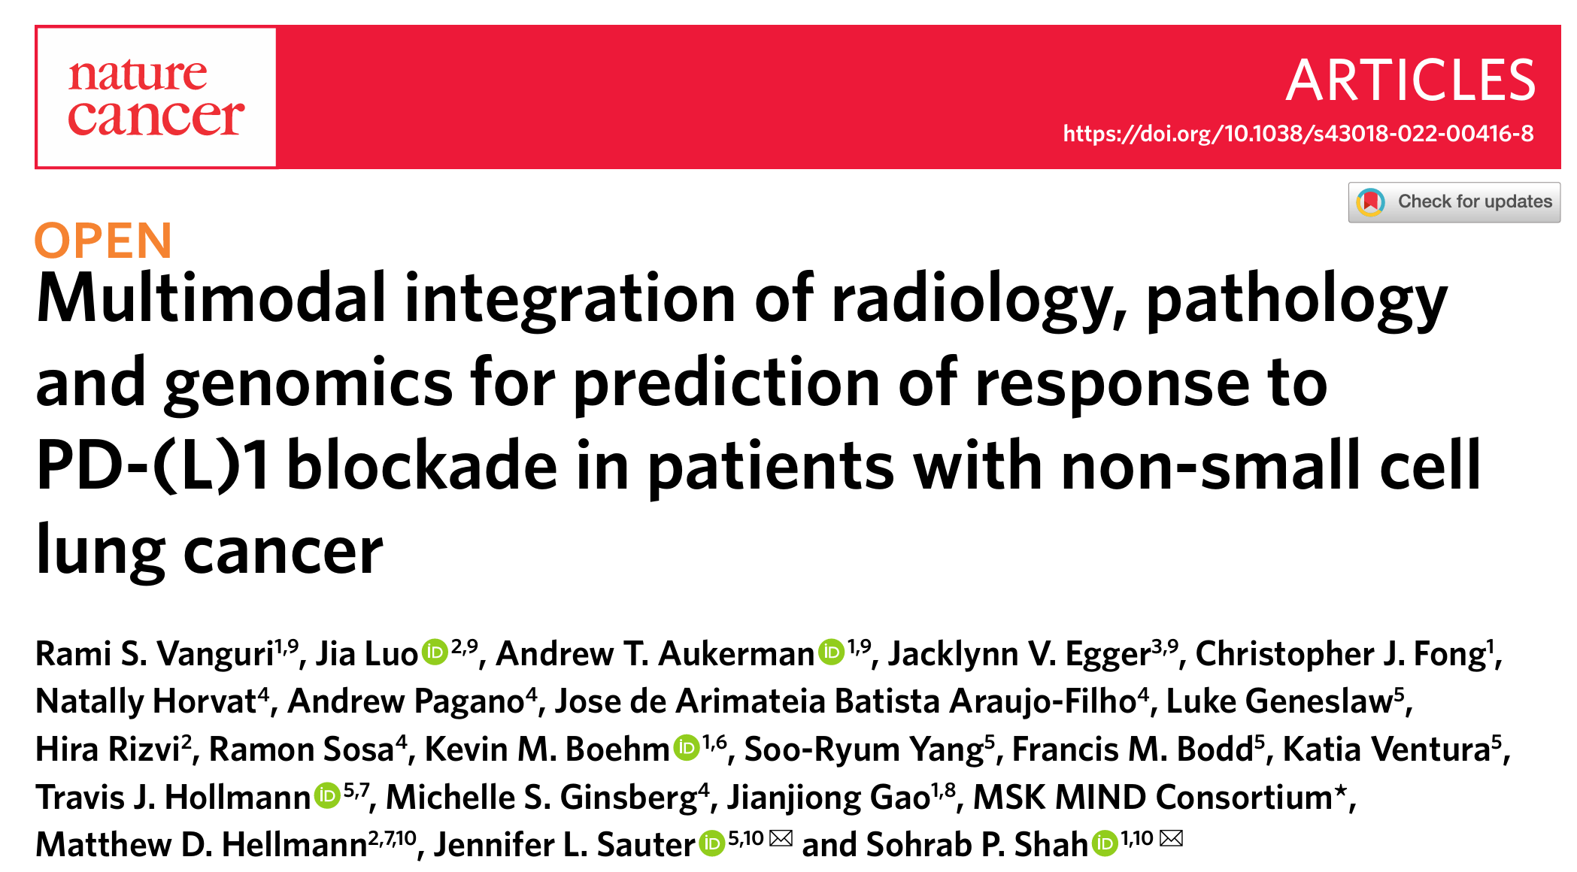
PAPER PRESENTATION
One model · three kinds of data · one better prediction.
Nirmal Adhikari (22261712) · BMSE · Inha University

Slide 2
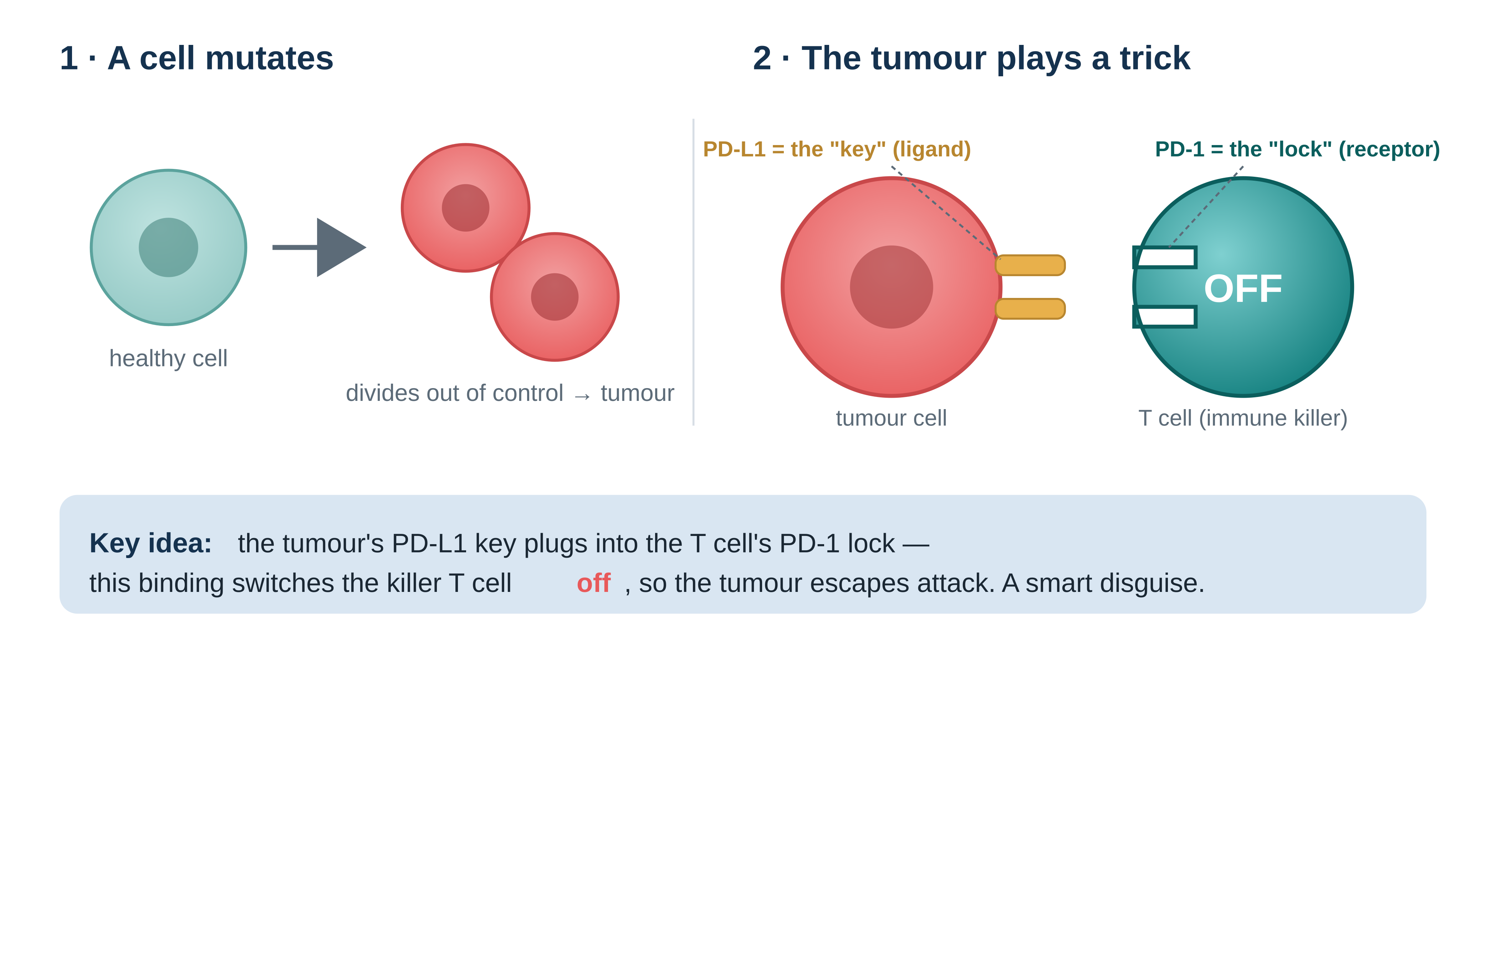
THE BIOLOGY · PART 1
How a tumour hides from the immune system
Vanguri et al., Nature Cancer 3:1151–1164 (2022)
2

Slide 3
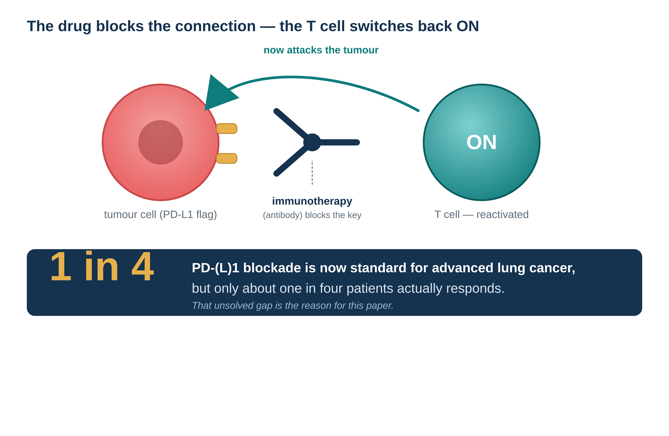
THE BIOLOGY · PART 2
Immunotherapy: taking the brakes off the immune system
Vanguri et al., Nature Cancer 3:1151–1164 (2022)
3

Slide 4
THE DISEASE
What is NSCLC?
Most lung cancers
NSCLC subtypes in this study's cohort (n=247)
Lung cancer splits into two main types. Non-Small Cell Lung Cancer (NSCLC) is by far the more common one.
Adenocarcinoma 79%
Squamous 15%
Advanced stage only
Large cell 3%
This paper studies stage IV NSCLC — cancer that has already spread beyond the lung.
NSCLC, NOS 3%
Why this cancer?
NSCLC is where PD-(L)1 immunotherapy is most widely used, so it is the natural place to test who responds.
Percentages are the study cohort's own histology mix (Fig. 1c / Table 1).
Vanguri et al., Nature Cancer 3:1151–1164 (2022)
4

Slide 5
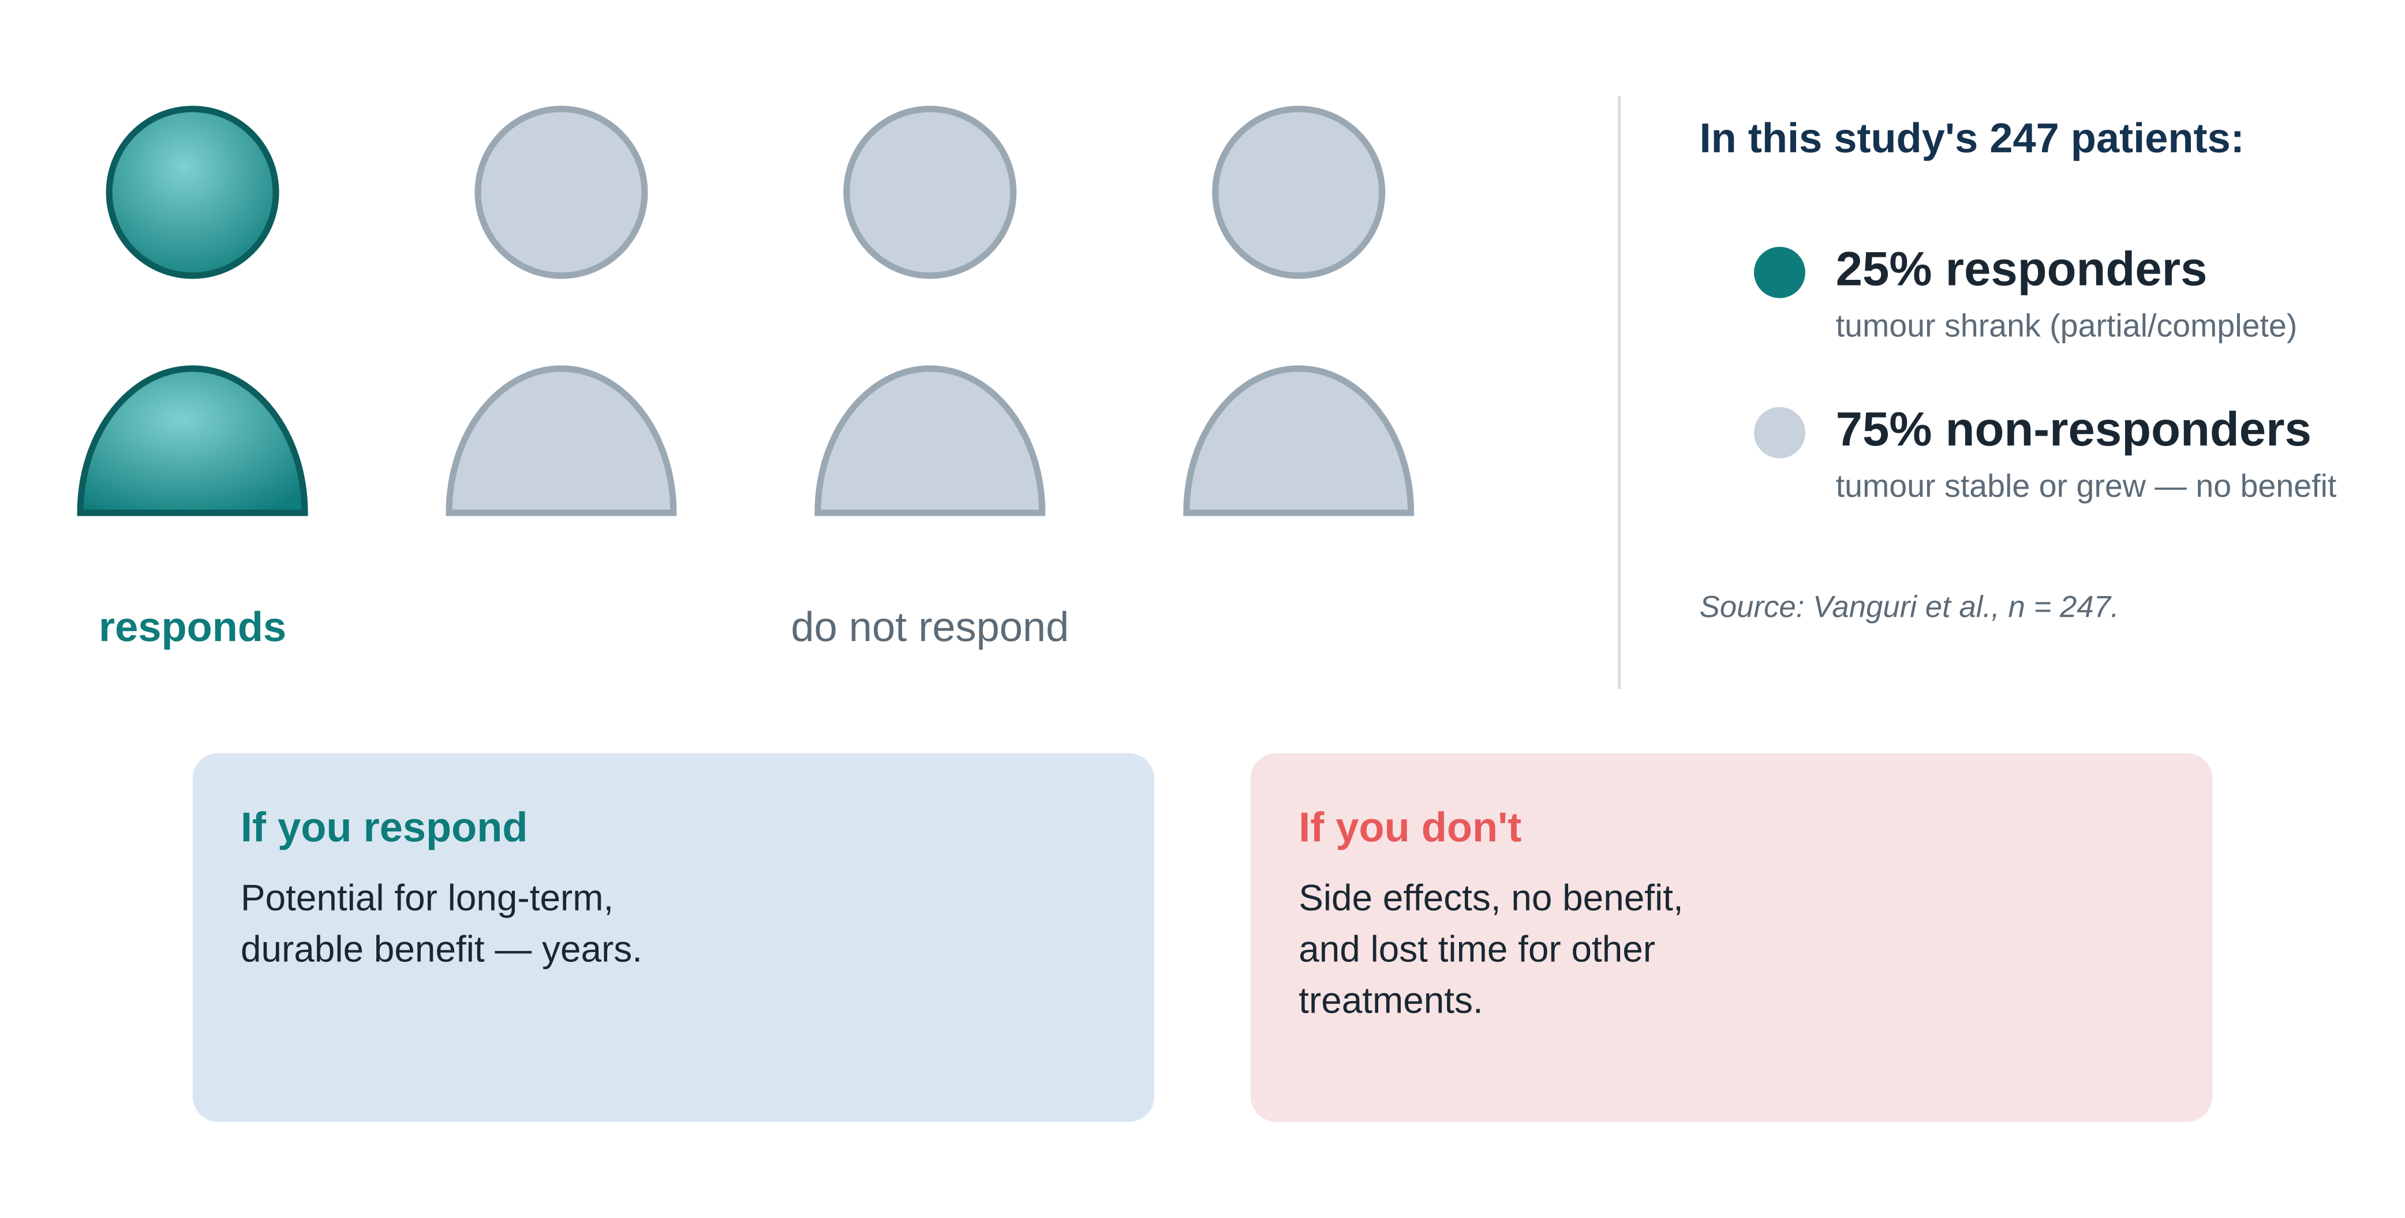
THE STAKES
Who actually responds? Only about 1 in 4
Vanguri et al., Nature Cancer 3:1151–1164 (2022)
5

Slide 6
THE TOOL WE NEED
A biomarker: a measurable clue that predicts response
Biomarker = any measurable biological signal that tells you something clinically useful. Here: a test run before treatment that predicts whether a patient will respond.
Radiology
Pathology
Genomics
Respond?
CT scan
PD-L1 stained slide
tumour gene panel
imaging-based
tissue-based
DNA-based
An ideal biomarker is accurate, uses data already collected, and works for every patient.
Vanguri et al., Nature Cancer 3:1151–1164 (2022)
6

Slide 7
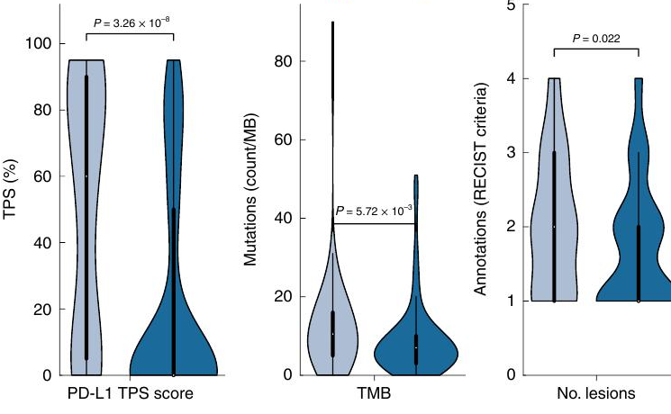
BEFORE THIS PAPER
Two approved biomarkers — real, but not enough
PR/CR (responders)
SD/PD (non-responders)
PD-L1 TPS — a pathologist scores what % of tumour cells show the PD-L1 protein. AUC ≈ 0.73
TMB — counts DNA mutations per million bases. AUC ≈ 0.61
Why they fall short
The differences are real — the P-values are tiny. But the two groups overlap heavily. Wherever you draw a cut-off, many patients are misclassified. (AUC 0.5 = coin-flip; 0.73 is only modest.)
Figure 1d — distribution of each biomarker between responders and non-responders.
Vanguri et al., Nature Cancer 3:1151–1164 (2022)
7

Slide 8
THE PROPOSED APPROACH
Stop using one test — combine all three
Every patient already generates three kinds of data during routine care. The idea: feed all three into a single model instead of relying on any one biomarker.
1
Radiology
2
Pathology
3
Genomics
the CT scan
the PD-L1 slide
the gene panel
tumour shape & texture, per lesion
staining pattern, read automatically
which genes are mutated, plus TMB
All three together → one model (called DyAM) → one prediction. No new tests needed — this data is already collected.
The next slide opens up what DyAM actually does.
Vanguri et al., Nature Cancer 3:1151–1164 (2022)
8

Slide 9
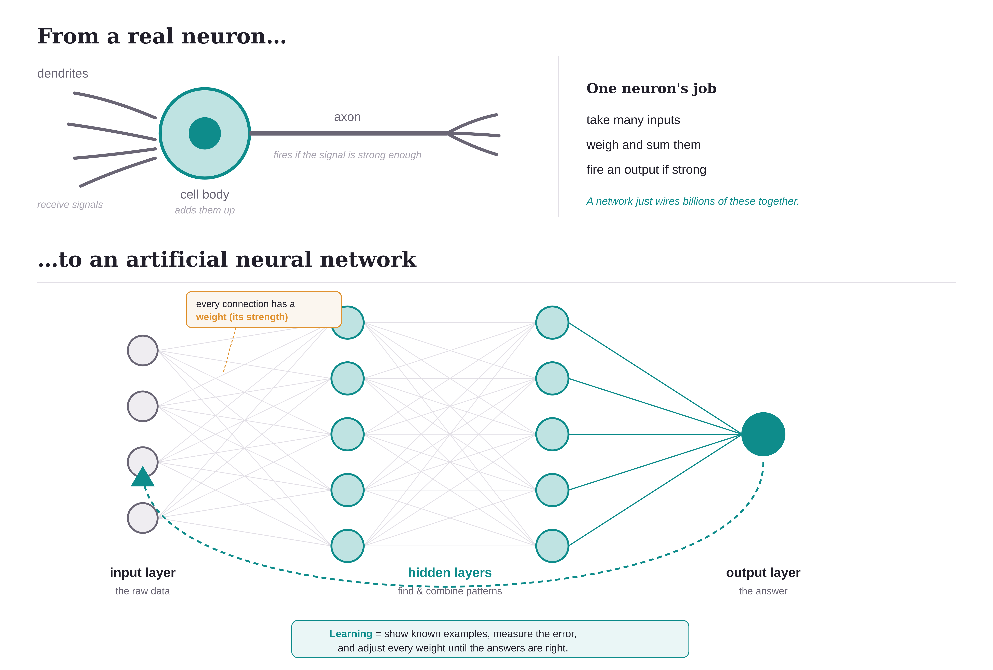
A STEP BACK
What is a neural network?
Your brain solves hard problems with billions of simple cells working together. A neural network borrows that idea: stack many simple units, and the group can learn patterns no single one could.
Three things to remember
1
It is a stack of layers Data enters, passes through hidden layers that detect and combine patterns, and a final answer comes out.
2
Weights are what it knows Each connection has a strength. These weights are the network's "knowledge."
3
It learns from examples Show it cases with known answers; it adjusts the weights to reduce its mistakes — no rules are hand-coded.

Slide 10
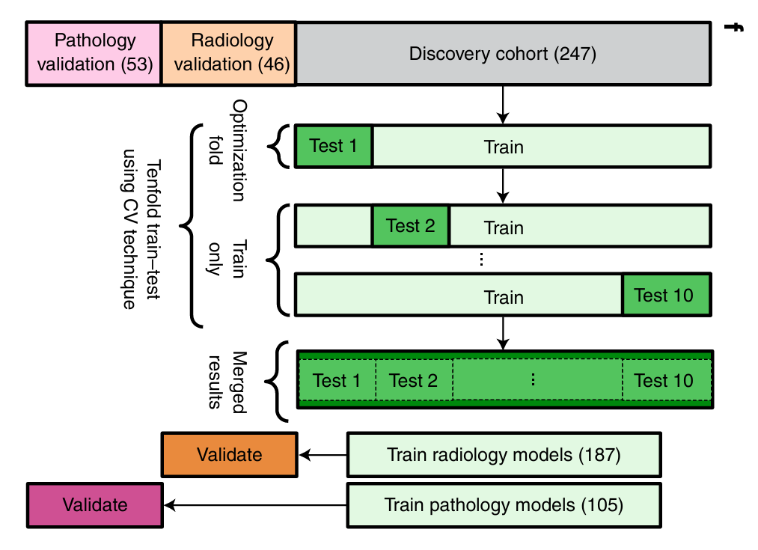
HOW THE MODEL IS TRAINED
Training: keep the test honest with cross-validation
1
Discovery cohort = 247 patients The full set used to build the model.
2
Split into 10 equal folds Patients are randomly divided into ten groups.
3
Rotate which fold is the test Train on 9 folds, test on the 1 held out; repeat ten times. Every patient is tested once on data the model never trained on — this keeps the AUC honest.
4
Merge results, then validate Held-out predictions merge into one cohort-wide score. Radiology (187) and pathology (105) models are also checked on separate validation patients.
Figure 1f
Vanguri et al., Nature Cancer 3:1151–1164 (2022)
10

Slide 11
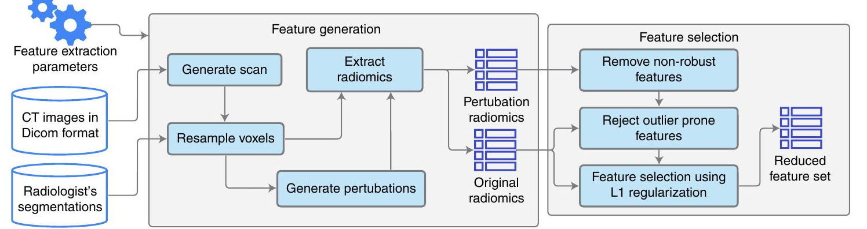
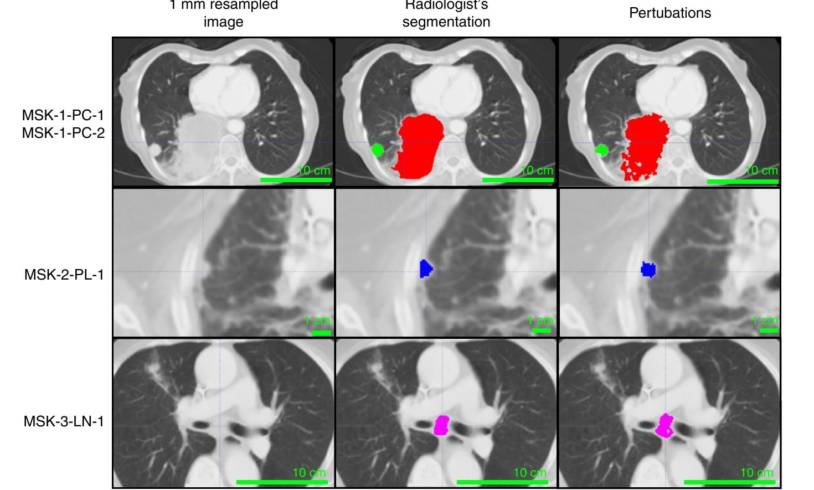
HOW RAW DATA BECOMES NUMBERS
Feature processing: from a CT scan to clean numbers
Figure 2a — extraction & selection pipeline.
1
Outline each tumour An expert traces every lesion on the CT. Nothing can be measured until the region is marked.
2
Extract radiomics Software computes ~1,688 numbers per lesion — texture, shape, intensity. These numbers are the "features."
3
Keep only stable features The outline is nudged many times; features that swing wildly are discarded, then L1 regularization trims to a small, robust set.
Why stability matters: a biomarker that flips when the outline shifts a millimetre cannot be trusted in a real clinic.
Figure 2b — each tumour outlined; the right column jiggles the outline to test stability.
Vanguri et al., Nature Cancer 3:1151–1164 (2022)
11

Slide 12
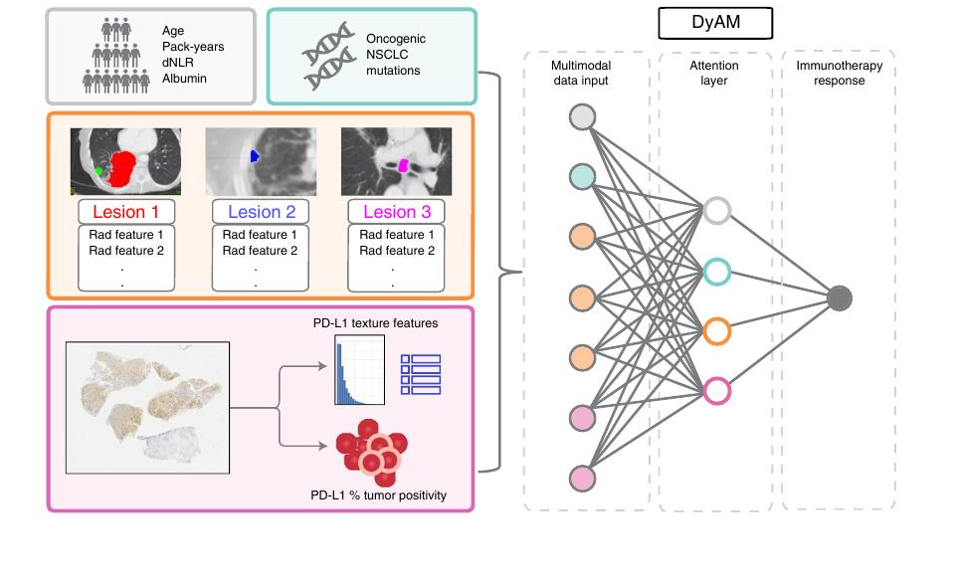
THE MODEL, SIMPLY
Inside DyAM: every clue becomes a number
1 · Four data sources in
Clinical + genomics (top boxes), CT scan split into each tumour = lesion (orange), PD-L1 slide (pink).
2 · Each becomes numbers
Every lesion and slide is turned into a list of measured features — the dots in the input column.
3 · Attention weighs them
The middle layer learns how much each source matters, and ignores any that are missing.
4 · One answer out
All of it collapses to a single node: respond, or not.
Figure 1e — the study's own schematic of the DyAM model.
Vanguri et al., Nature Cancer 3:1151–1164 (2022)
9

Slide 13
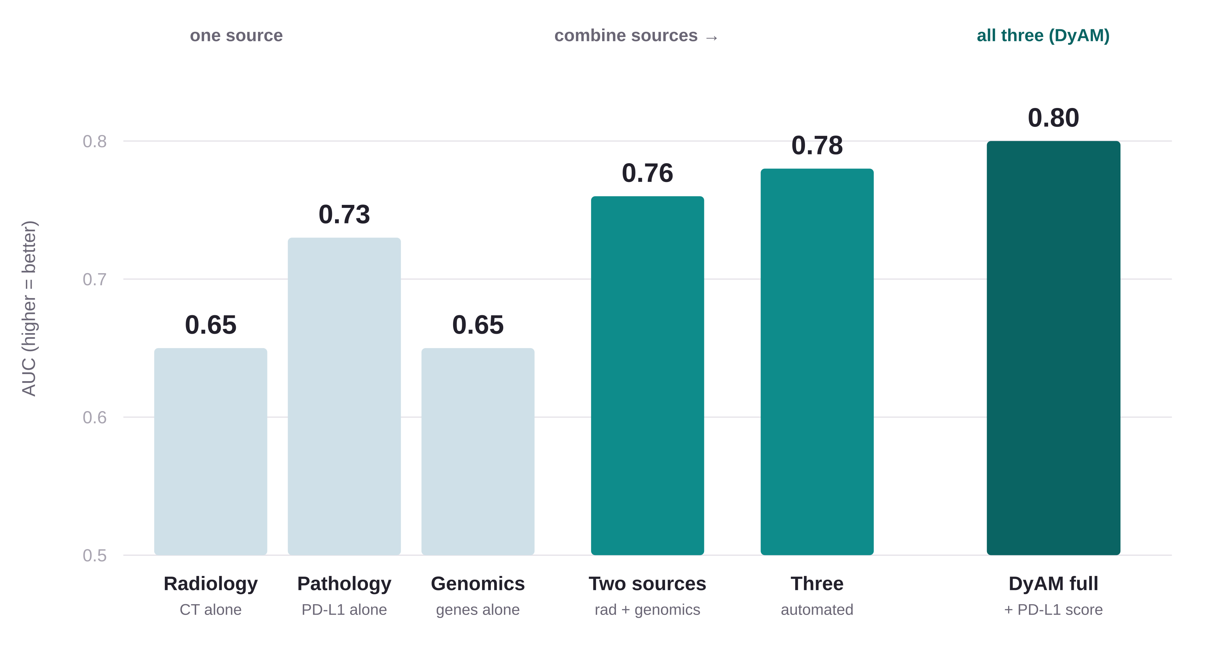
RESULTS · THE CENTRAL FINDING
No single test is enough — combining wins
Each data source was first tested alone. All three are only modest — the best single test (PD-L1) reaches just 0.73. Combining them climbs steadily, and the full DyAM model reaches AUC 0.80.
AUC 0.80
the full combined model
(AUC: 0.5 = coin-flip, 1.0 = perfect)
Each added source helps less than the last — diminishing returns, because the sources share some information.
Vanguri et al., Nature Cancer 3:1151–1164 (2022)
13

Slide 14
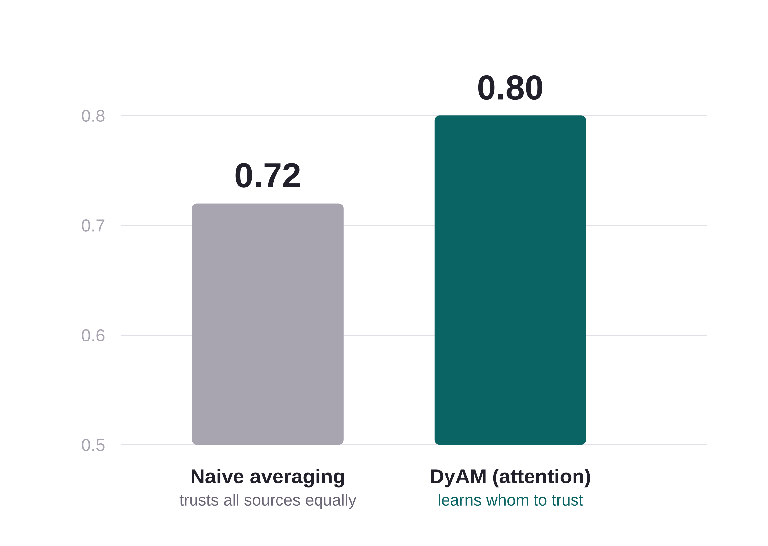
RESULTS · WHY THE MODEL DESIGN MATTERS
Combining is not enough — combine smartly
There are two ways to merge the sources. Naively averaging the test scores actually does worse than the best single test. DyAM instead learns how much to trust each source — and that earns the jump to 0.80.
1
Naive averaging = 0.72 Treats every source as equally trustworthy for every patient — even the noisy ones.
2
DyAM attention = 0.80 Learns, per case, which source carries the signal and leans on it; down-weights the rest.
Same ingredients, smarter weighting. This is the paper's core methodological point — the attention mechanism, not just "more data," delivers the gain.
Vanguri et al., Nature Cancer 3:1151–1164 (2022)
14

Slide 15
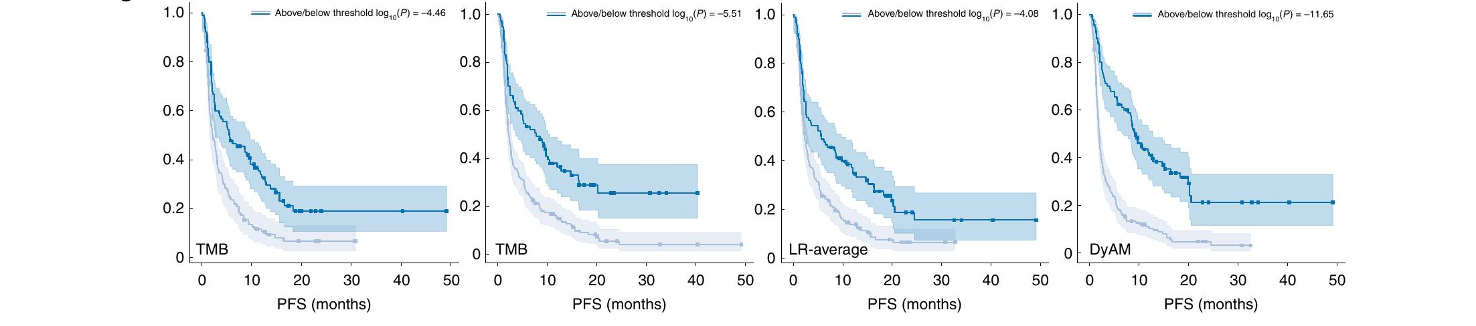
RESULTS · WHY IT MATTERS CLINICALLY
It separates good and poor outcomes — early
Accuracy only helps if it changes care. These survival curves split patients the model called low-risk (dark) vs high-risk (light). A good model pulls them apart — and DyAM (far right) pulls them apart the most, and earliest.
Figure 5b — left to right: TMB, TPS, naive averaging, DyAM. (2nd panel is TPS; mislabelled TMB in the source.) Vertical axis = fraction progression-free; horizontal = months.
At 4 months: only 21% of the predicted low-risk group had worsened, versus 79% of the high-risk group. Early enough to guide a real treatment decision.
Vanguri et al., Nature Cancer 3:1151–1164 (2022)
15

Slide 16
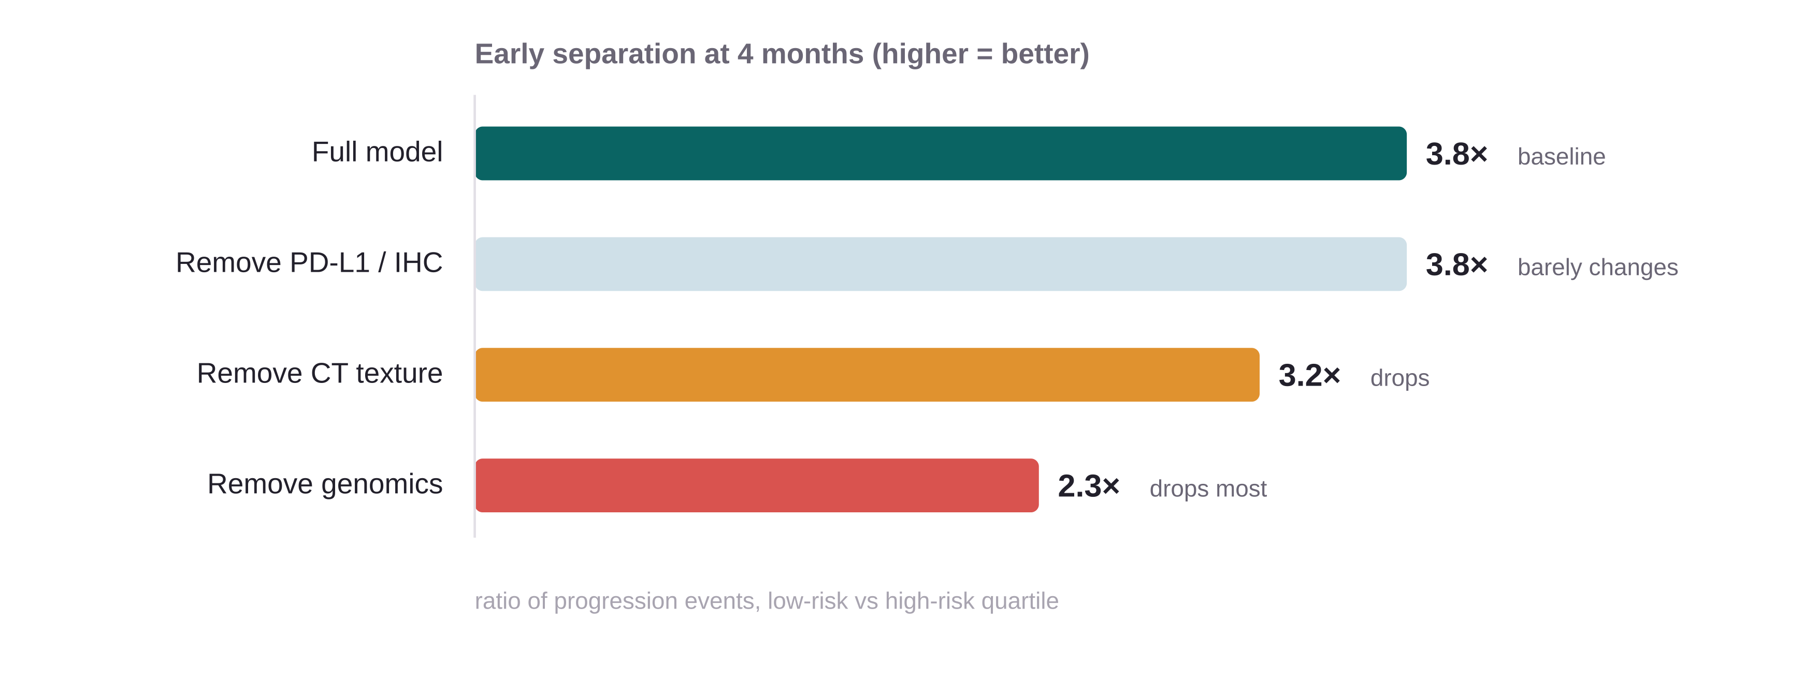
RESULTS · CAN WE TRUST IT?
Interpretable and robust
A useful clinical model must show its reasoning and survive missing data. DyAM's attention weights reveal which sources drive each prediction — so it is not a black box.
1
CT texture & genomics drive it Removing either sharply weakens early separation — these carry the most signal.
2
Robust to missing data Dropping PD-L1/IHC barely changes performance; the masking design lets it work with whatever a patient has.
3
Not a fluke All multimodal results beat permutation-test baselines, and held up on the separate radiology and pathology validation cohorts.
Effect of switching off one source (attention-reweighting analysis, Fig. 6c).
Vanguri et al., Nature Cancer 3:1151–1164 (2022)
16

Slide 17
DISCUSSION
What's strong, what to be cautious about
A real contribution
Honest cautions
✓
Uses data already collected — No new tests — CT, PD-L1 and sequencing are routine in advanced NSCLC.
!
One centre, 247 patients — A modest, single-institution cohort.
✓
Beats every single biomarker — 0.80 vs 0.73 for the best standalone marker.
!
No external validation — Not yet tested at other hospitals or scanners.
✓
Works with missing data — Masking lets it predict from whatever a patient has.
!
Needs expert effort — Tumours are outlined and slides read by hand.
✓
Not a black box — Attention weights show which source drove each prediction.
!
Not decision-grade yet — AUC 0.80 is promising — a decision aid, not a replacement for a clinician.
Vanguri et al., Nature Cancer 3:1151–1164 (2022)
17

Slide 18
CONCLUSION
In one sentence
No single test reliably predicts immunotherapy response — but combining radiology, pathology and genomics with a model that learns how much to trust each source does meaningfully better: AUC 0.80 vs ≤0.73, with early, clinically useful separation of responders from non-responders.
Why it matters
What's next
Beyond lung cancer
A proof-of-principle that routine, multimodal data can sharpen who benefits from immunotherapy.
Larger, multi-site cohorts and automated segmentation to move from aid to tool.
The recipe is not NSCLC-specific — the same fusion approach could extend to other cancers and diseases.
Vanguri et al., Nature Cancer 3:1151–1164 (2022)
18

Slide 19
THANK YOU
Questions & Discussion
Nirmal Adhikari (22261712) · BMSE Convergence I · Vanguri et al., Nature Cancer (2022)

