Slide 1
PAPER PRESENTATION
Combining Radiology, Pathology and Genomics to Predict Who Responds to Immunotherapy in Lung Cancer
Vanguri, Luo, Aukerman et al. Nature Cancer 3, 1151–1164 (2022)
The big picture: one model, three kinds of data, one better prediction.
Presented by [Nirmal Adhikari (22261712)] · [BMSE Convergence I] · [2026-06-11]
Inha University
Notes:
(~30s) One sentence: this paper shows that combining a CT scan, a stained tissue slide, and a tumour gene panel with machine learning predicts immunotherapy response better than any single test today. The punchline number to remember is AUC 0.80.

Slide 2
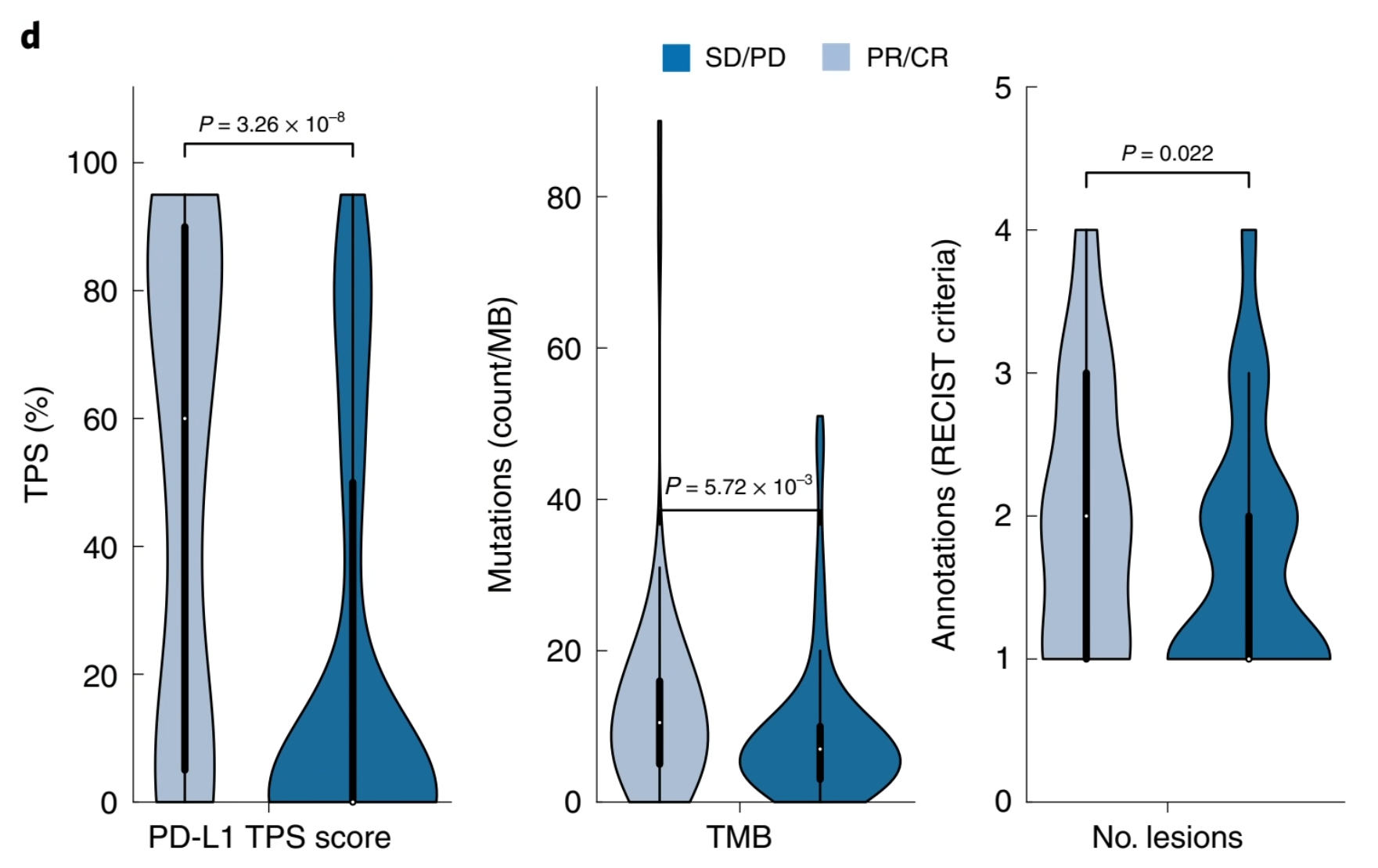
THE PROBLEM
We can't predict who will benefit
Immunotherapy is now standard for advanced lung cancer, and can give years of benefit — but only to about 1 in 4 patients. We can't reliably tell in advance who.
The two approved tests — PD-L1 and TMB — each look at only one kind of data, and each is only modestly accurate on its own.
The intuition: on any single test, responders and non-responders overlap too much. A line drawn anywhere misclassifies many patients.
Source: Fig. 1d — light = responders, dark = non-responders. Vanguri et al., Nature Cancer 3:1151–1164 (2022).
Inha University
2
Notes:
(~1.5 min) Acknowledge the audience knows immunotherapy. Spend your words on the gap: prediction. Point at the violin plot: the two coloured shapes overlap heavily, so no single cutoff separates them cleanly. Define AUC in one line if needed: 0.5 is a coin flip, 1.0 is perfect; PD-L1 alone is ~0.73, TMB ~0.61.

Slide 3
THE KEY IDEA
Combine three views of the same patient
Radiology
CT scan — shape & texture of the tumour
Pathology
One prediction:
respond or not?
Model weighs each
and combines them
PD-L1 tissue slide — pattern of staining
(the “DyAM” model)
Genomics
tumour gene panel — which genes are altered
Like a tumour board: three specialists each give an opinion, and a combined judgement is reached — and it can still decide even if one specialist's report is missing. No new tests are needed; this data is already collected.
Inha University
3
Notes:
(~2 min) This is the heart of the talk. Walk left to right: three everyday data types feed one model that combines them into a single answer. Use the tumour-board analogy out loud — it lands well with a biomedical audience. Emphasise: the data already exists in routine care, so the contribution is the smart combination, not new experiments.

Slide 4
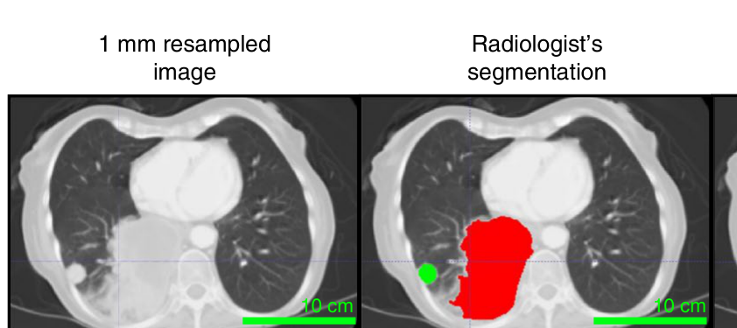
HOW IT WORKS
Two simple steps
1
Turn each data type into numbers
A computer can't read a scan or a slide directly. So each tumour is outlined and described by numbers — its shape, texture, staining pattern, mutations. These numbers are called features.
Source: Fig. 2b — a lung tumour on CT (left); the same tumour outlined by a radiologist in red (right). Vanguri et al., Nature Cancer 3:1151–1164 (2022).
2
Let the model weigh and combine them
The model learns how much to trust each data type (called “attention”), and simply skips any data that is missing for a patient. That lets it use whatever each patient happens to have.
Inha University
4
Notes:
(~2 min) Keep it conceptual — do not show equations. Step 1 is the key insight for a non-AI audience: images and genes must become numbers before any model can use them; the CT figure makes this concrete. Step 2: 'attention' just means the model learns which data matters, and 'masking' means it tolerates missing data — important because most patients don't have all three.

Slide 5
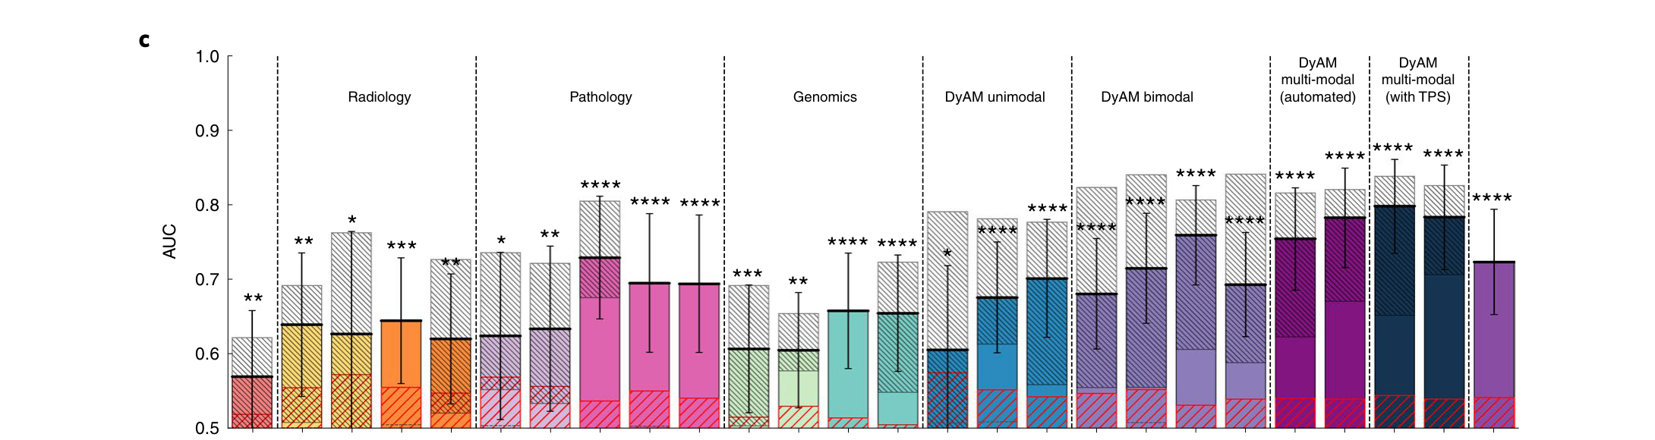
THE RESULT
Combining beats every single test
AUC 0.80
the full combined model
Best single test reached only ~0.73
More data added = higher accuracy: 0.73 → 0.76 → 0.78 → 0.80
Smartly combining (0.80) beats simply averaging the tests (0.72) — how you combine matters
Source: Fig. 5c — each bar is a model's AUC (higher = better). Vanguri et al., Nature Cancer 3:1151–1164 (2022).
AUC: 0.5 = guessing, 1.0 = perfect.
Inha University
5
Notes:
(~1.5 min) The single most important slide. Point at the rising bars from left (single tests) to right (combined). Two numbers: 0.80 for the full model, 0.72 for naive averaging — the gap shows the win comes from the smart combination, not just from having more data. Re-state AUC plainly for the less-technical audience.

Slide 6
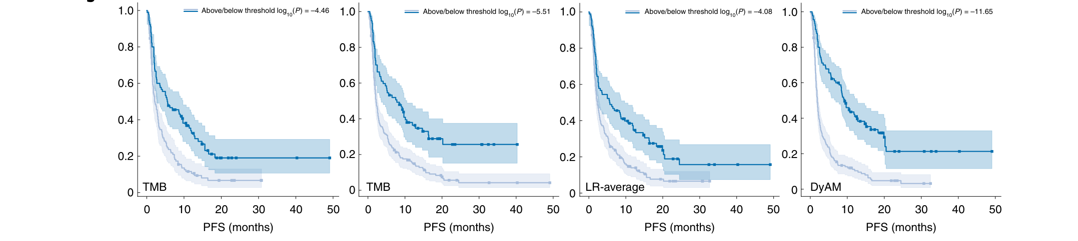
WHY IT MATTERS CLINICALLY
It separates good and poor outcomes — early
Source: Fig. 5b — survival over time, split into predicted high- vs low-risk groups. Vanguri et al., Nature Cancer 3:1151–1164 (2022).
Higher, flatter curve = better outcome. The combined model (far right) pulls the two groups furthest apart — and does it early. By 4 months, only 21% of the low-risk group had worsened, versus 79% of the high-risk group.
Inha University
6
Notes:
(~1.5 min) Translate the plot: each line is the fraction of patients still doing well over time; higher is better. The clinical value is not just the accuracy number but EARLY separation — telling responders from non-responders within a few months matters for real decisions. 21% vs 79% at 4 months is the memorable contrast.

Slide 7
PUTTING IT IN PERSPECTIVE
What's strong, what to be cautious about
Why it's a real contribution
What to be cautious about
Uses data already collected in routine care
Clearly beats every single biomarker
Works even when some data is missing
Can show which data drove each prediction
One hospital, 247 patients — fairly small
Not yet tested at other hospitals
Needs experts to outline tumours / read slides
AUC 0.80 is promising, not yet ready to decide alone
Inha University
7
Notes:
(~1 min) Balance shows you read it critically. The limitation to volunteer: single hospital, no external validation — so we don't yet know it transfers elsewhere. And be honest that 0.80 supports a doctor's decision rather than replacing it. Volunteering these pre-empts most questions.

Slide 8
IN ONE SENTENCE
Takeaway and discussion
No single test reliably predicts immunotherapy response — but combining radiology, pathology and genomics with a model that weighs each source does meaningfully better (AUC 0.80 vs ≤0.73).
And the method isn't lung-specific — the same recipe could extend to other cancers and diseases.
Questions?
Inha University
8
Notes:
(~1 min) Land the one-sentence takeaway, then open the floor. Seed the three questions so the silence isn't awkward. If asked which data mattered most: the paper found CT texture and genomics contributed most; PD-L1 texture was the most redundant.

