Slide 1



Workshop Talk
Continuous Sign Language Recognition Baselines & Boundary Diagnostics
Based on our BigComp 2026 workshop paper: Motion Cues for Robust Continuous Sign Language Recognition: Baselines and Diagnostics
Authors: Nirmal Adhikari, Chingiz Tursunbaev, Wookey Lee*
Voice AI Research Center, Inha University, South Korea
Presenter: [Nirmal Adhikari] {adhikareen@gmail.com}

Slide 2
Roadmap
1
CSLR Frameworks & Baselines
2
Observations & Motivation
3
Motion-Guided Approach
4
Results & Analysis
5
Limitations and Future Work
6
Conclusion

Slide 3
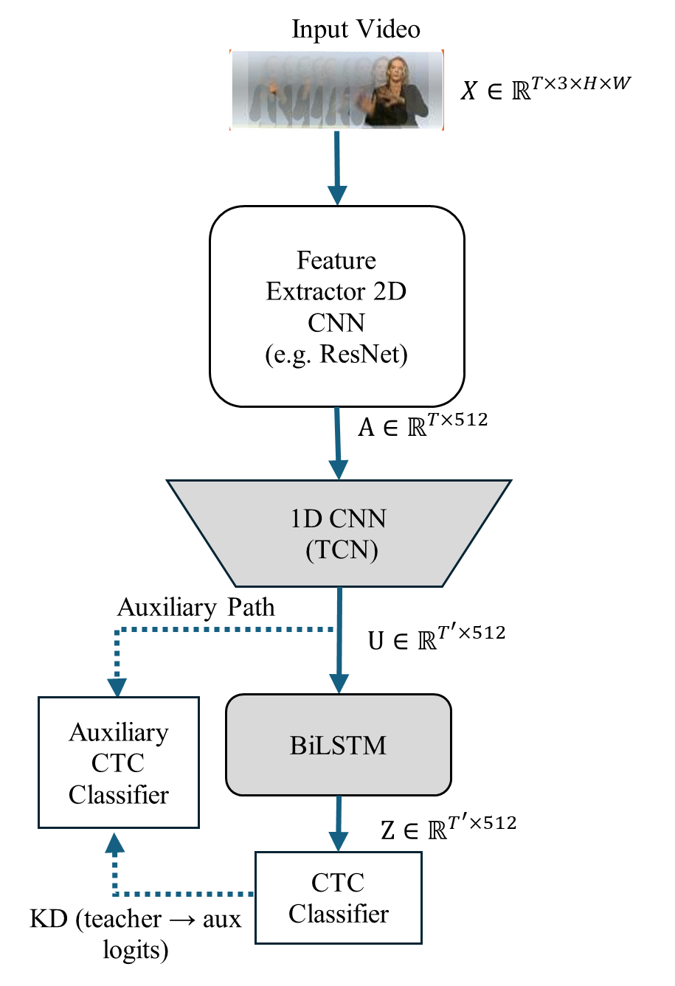
Standard CSLR pipeline (CTC-based)
Input: sign video frames
Visual encoder: ResNet + TCN (per-frame features)
Temporal module (e.g., BiLSTM)
CTC loss (weak supervision; no boundary labels)
Decoder: greedy / beam → WER + del/ins/sub
Settings
Two representative backbones: ResNet-34 and ResNet-18 baselines
Decoding Method: Beam Search
Knowledge Distillation (KD) use from the BiLSTM CTC logits to TCN CTC logits
Dataset: RWTH-PHOENIX-Weather 2014^{[1]} (CSLR, German Sign Language) and CSL-Daily^{[2]}
Reporting
Word Error Rate (WER) with deletion/insertion breakdown reporting
Other/SOTA scores

Slide 4
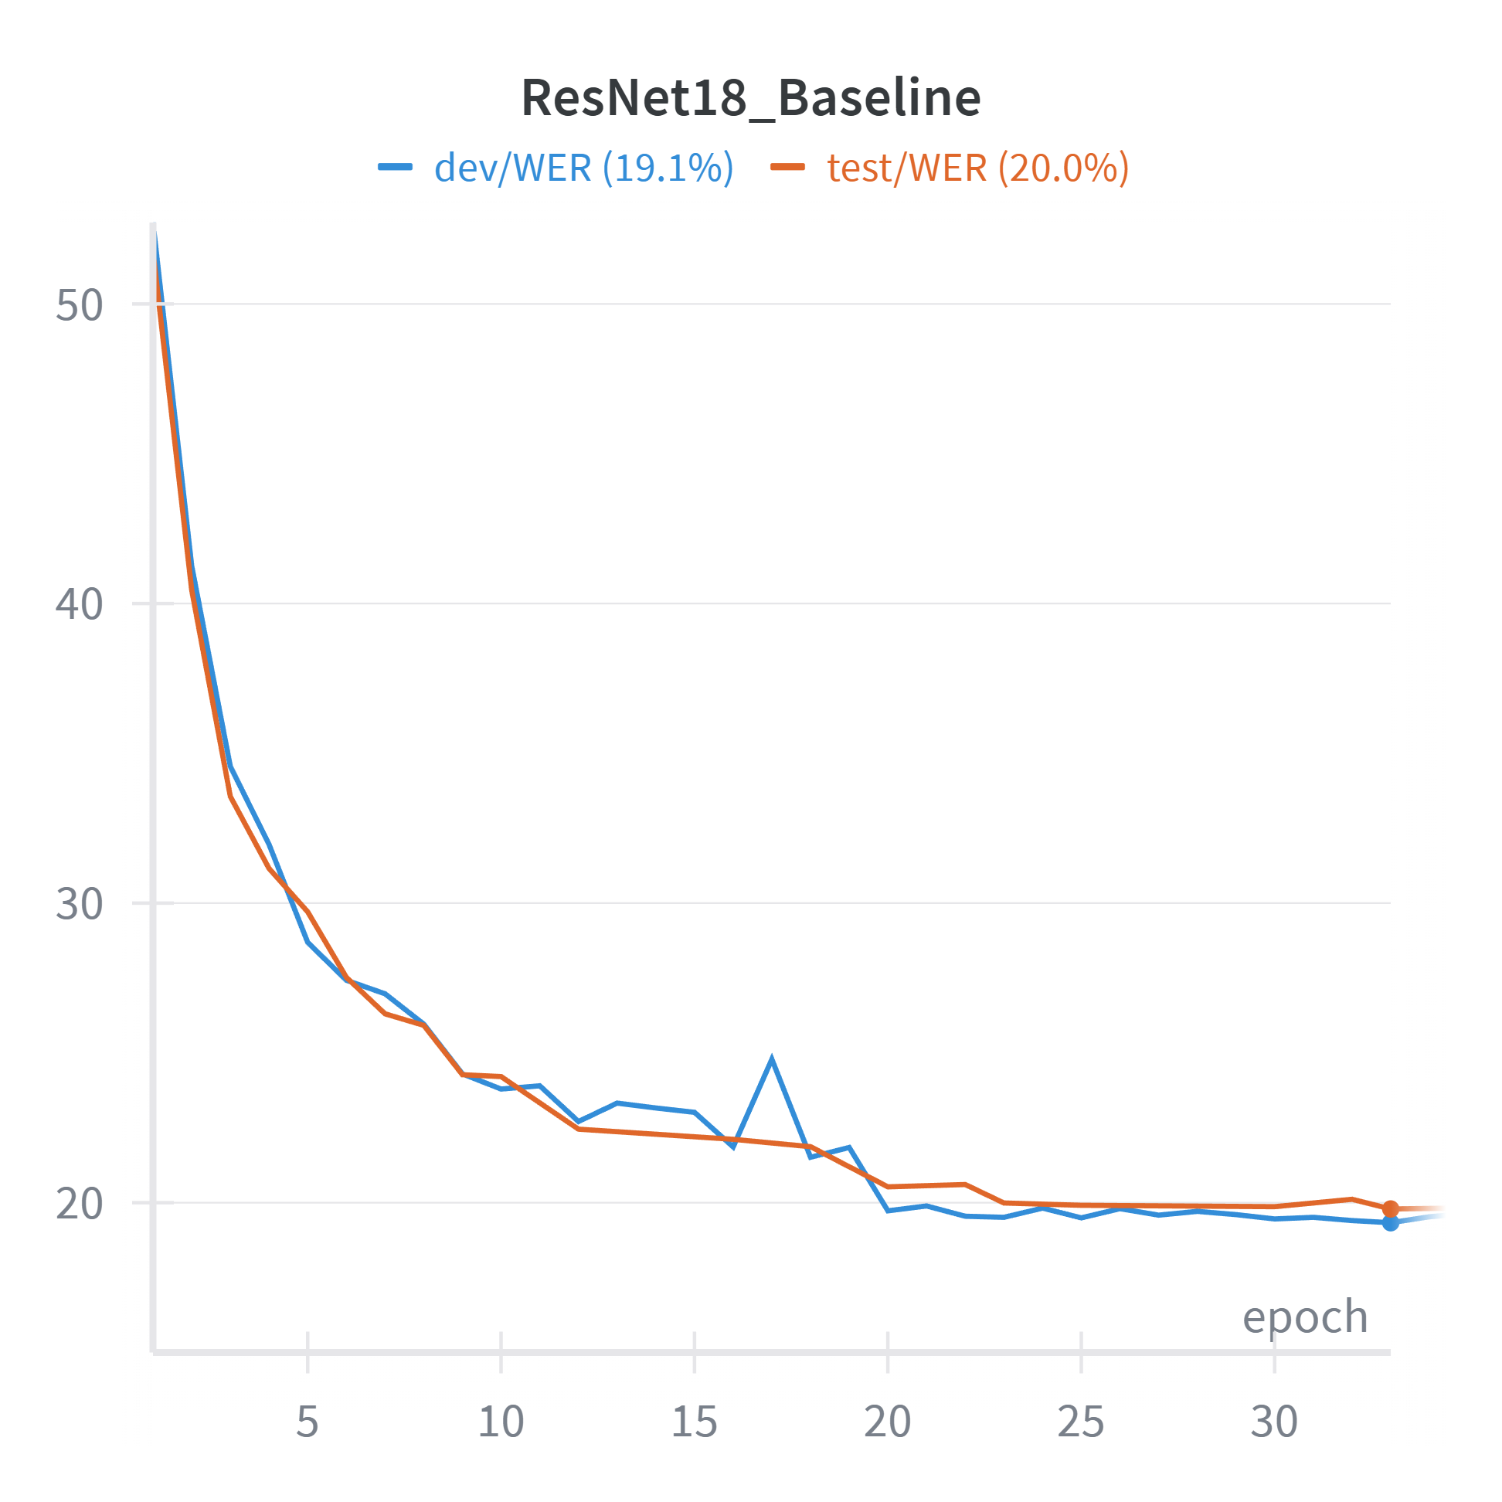
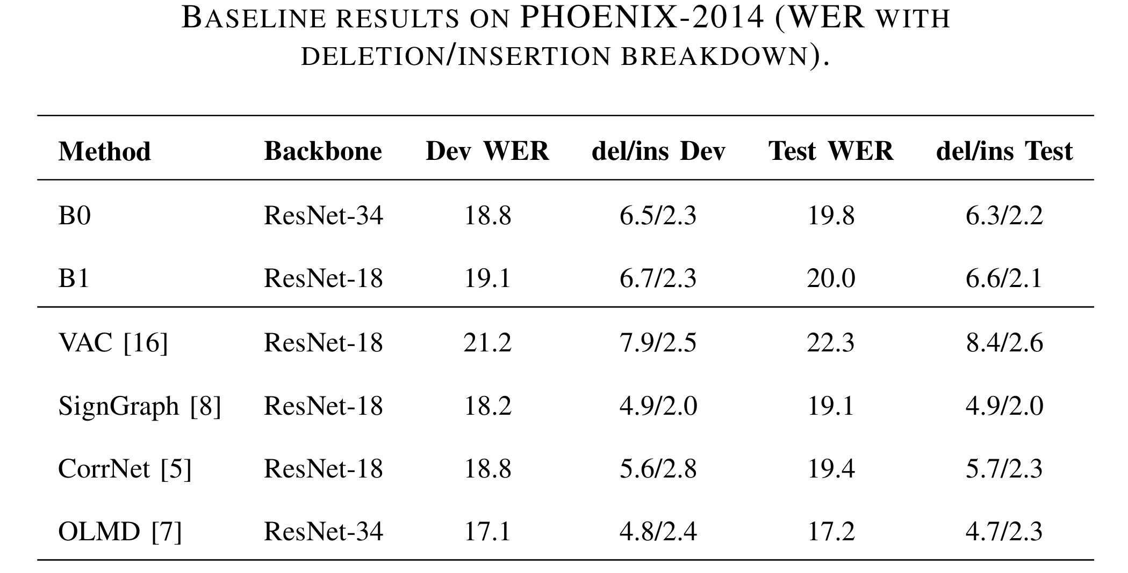
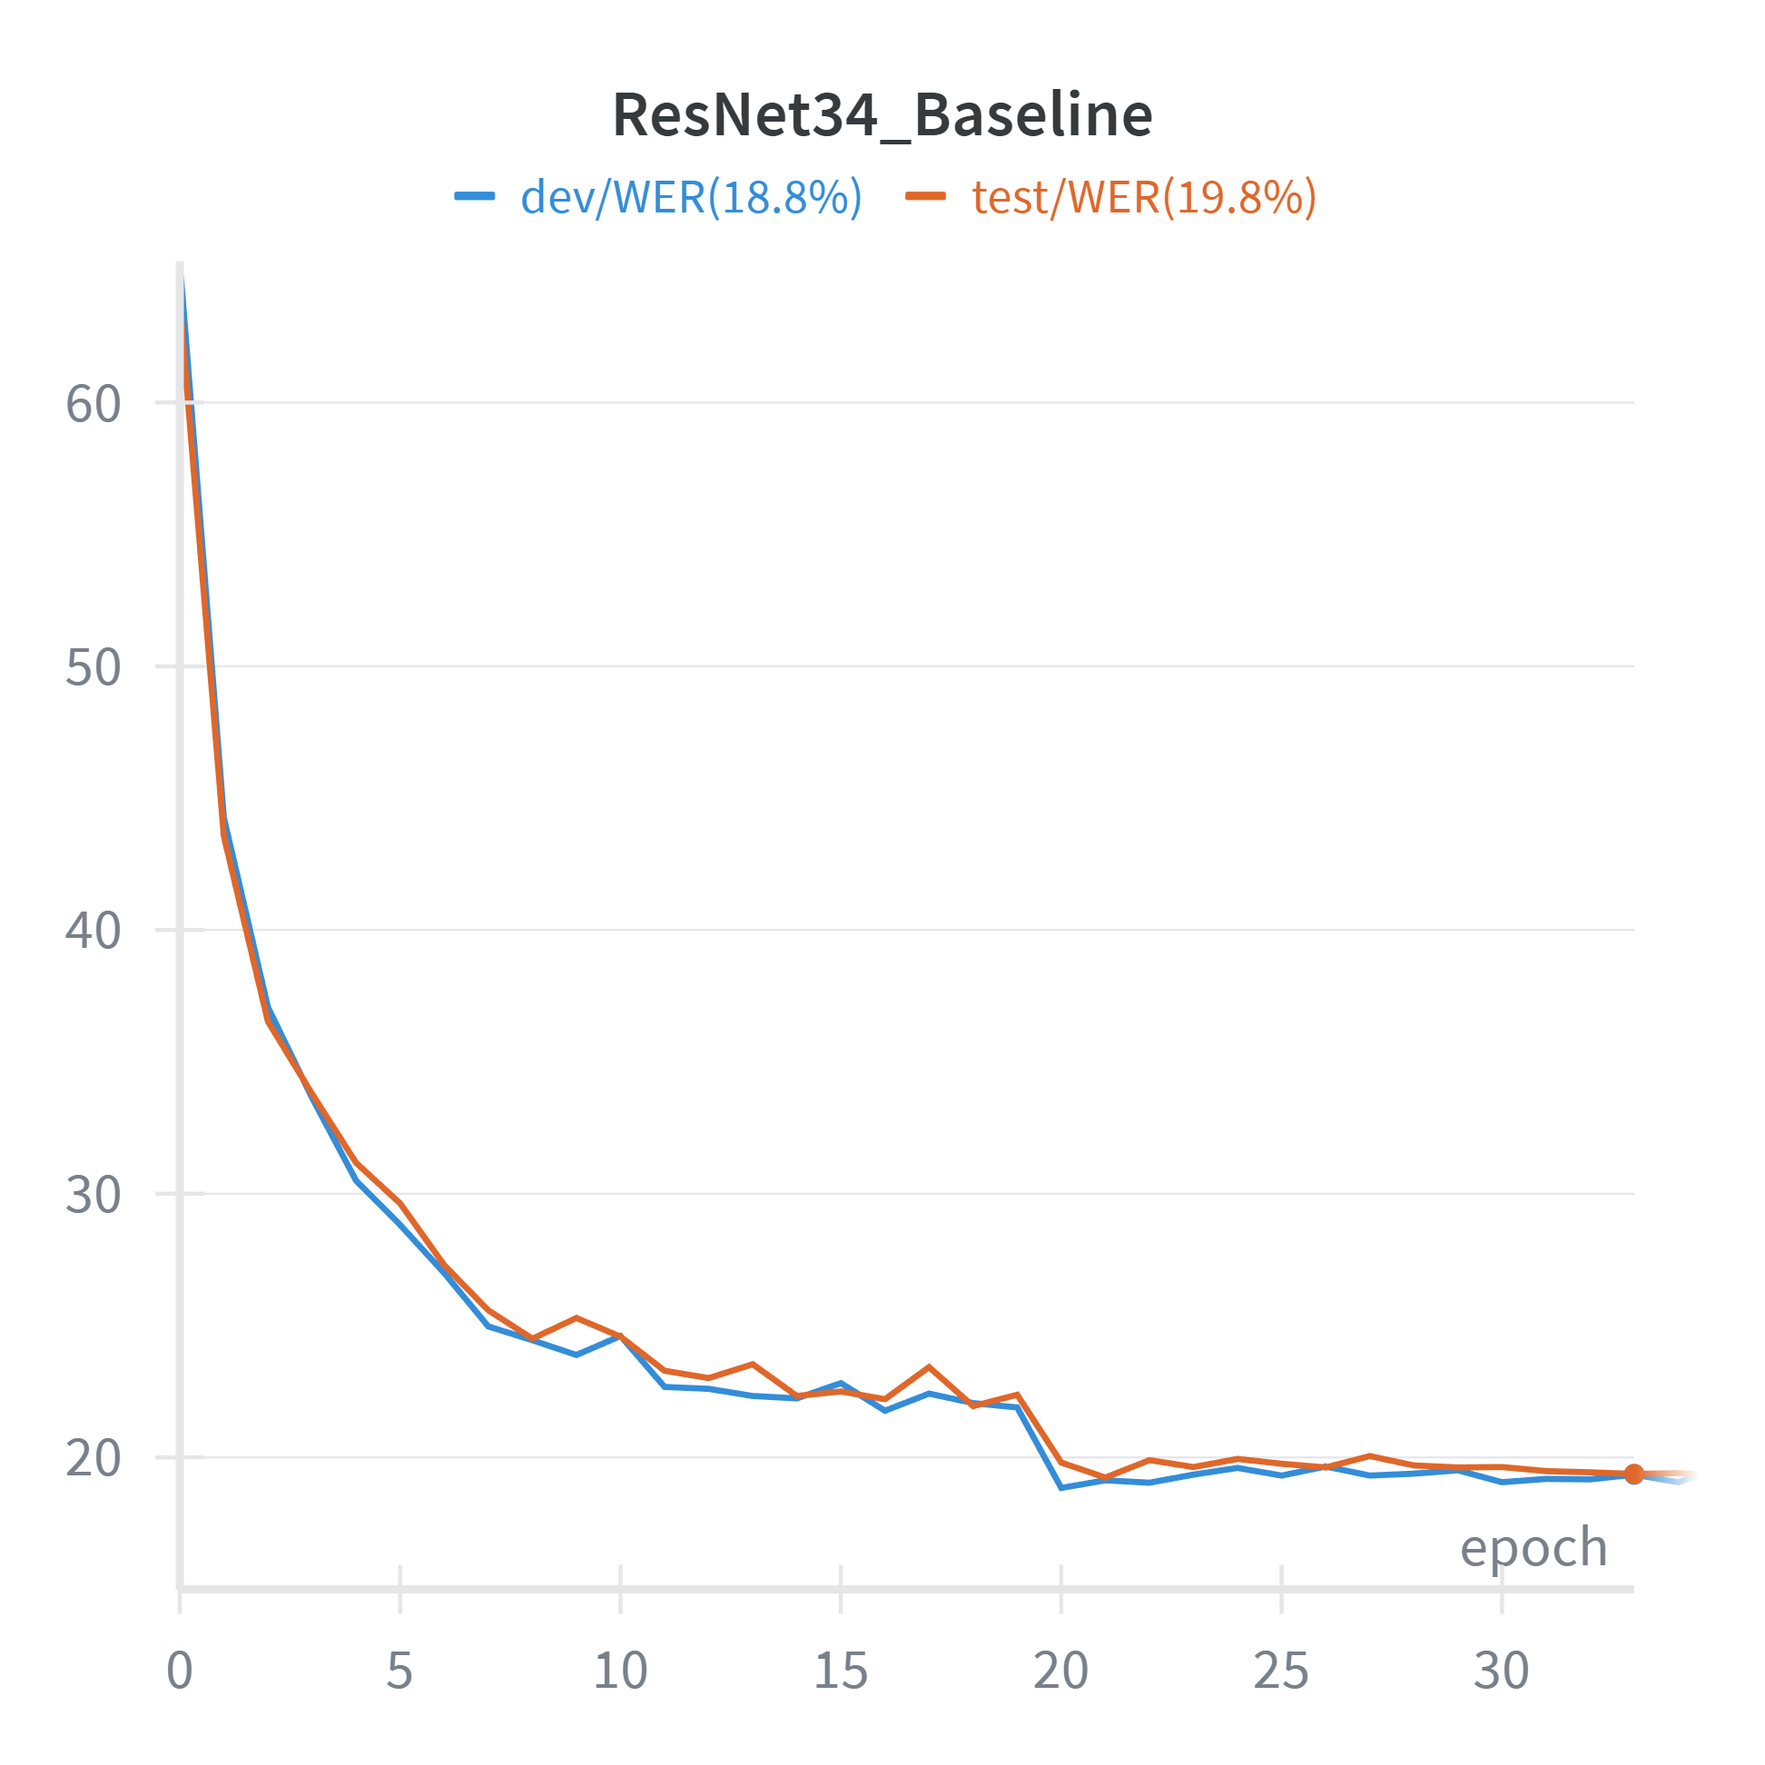
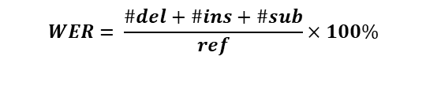
Baseline Experiments
$$WER= \frac{\#del+\#ins+\#sub}{ref}×100\%$$
[3]
[4]
[5]
[6]
Ablation:
B1* | ResNet-18 | 19.3 | 7.0/2.4 | 20.6 | 6.9/2.5
B1*: B1 without beam search but with greedy decoding
$$ref→Glosses count in grount truth (GT)$$

Slide 5
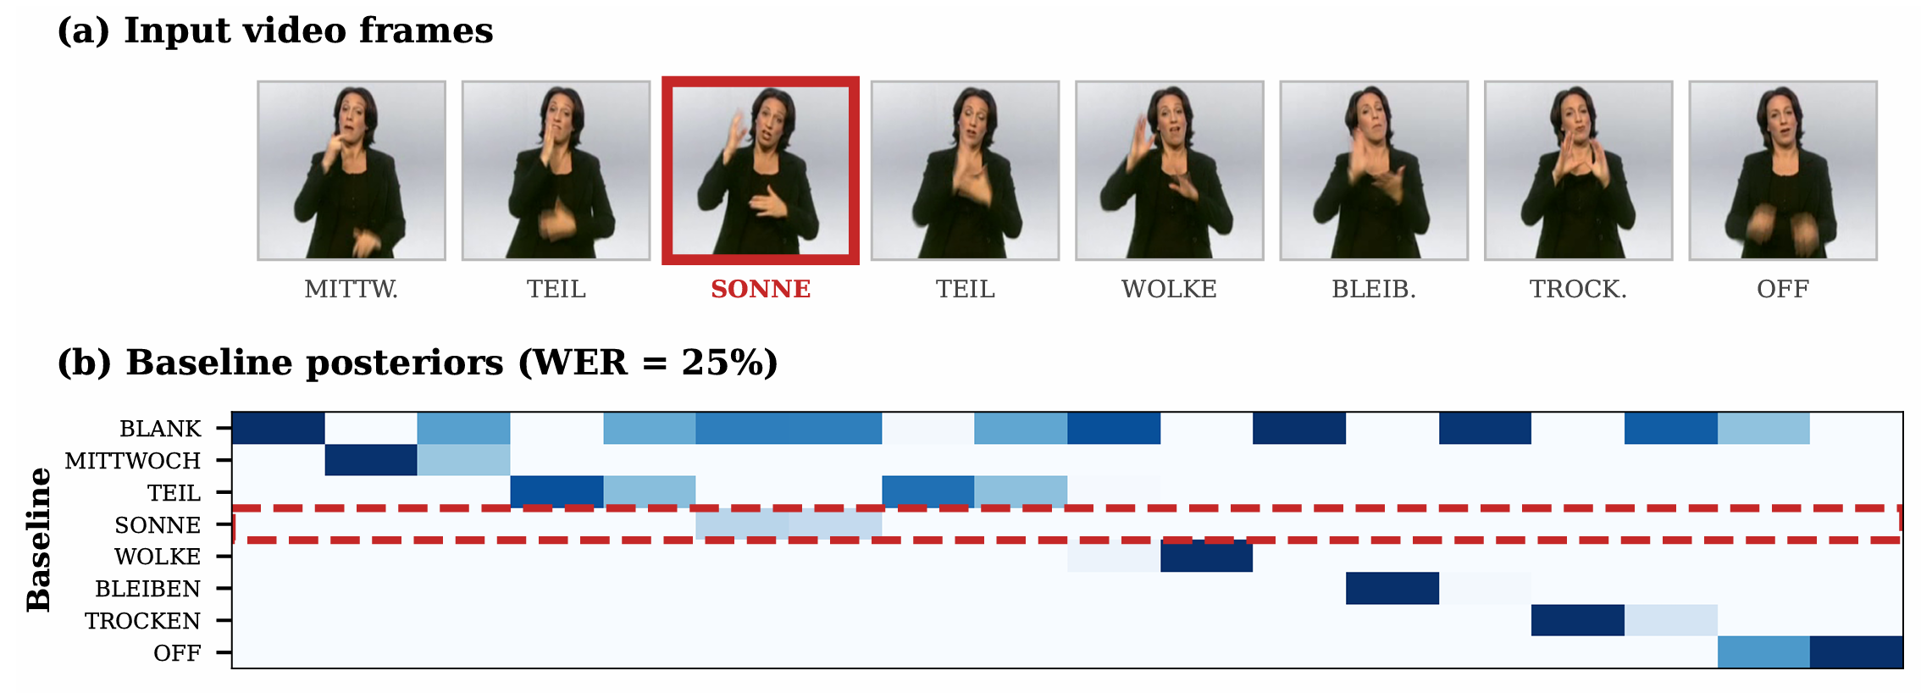
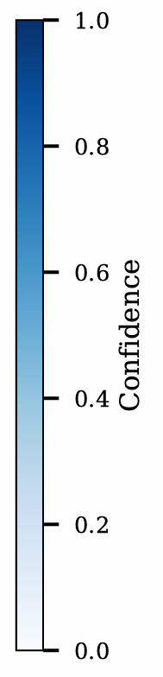
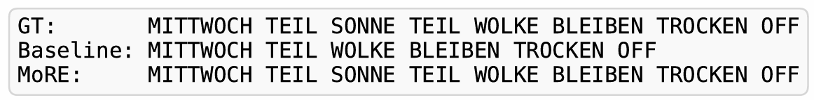
Key Observations and Implications
Observations (from baseline + breakdown):
Our baseline achieves competitive WER on PHOENIX-2014
The error breakdown contains non-trivial deletion and insertion components
Decoding choice affects reported WER (greedy vs beam can differ), so evaluation must be controlled
Implication:
These patterns are consistent with alignment sensitivity in CTC-based CSLR, motivating boundary-aware analysis/modeling as the next step.

Slide 6
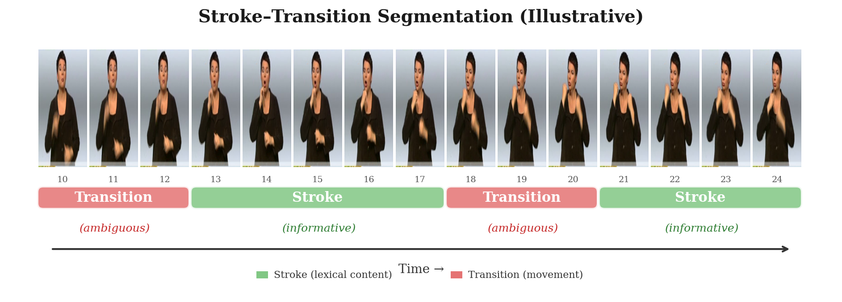
Stroke–Transition Perspective for CSLR (Motivation)
Fig: Stroke-Transition Segmentation (Illustrative)
Key idea: not all frames are equally informative for recognizing a sign
Stroke vs transition: stroke carries the main sign evidence; transition connects signs and can be visually mixed (co-articulation, fast motion, signer variability)
CTC link (hypothesis): ambiguous intervals → lower confidence over time → may increase deletion/insertion after decoding
Illustrative concept; we do not predict or evaluate stroke/transition boundaries in this paper.
Co-articulation: end of one sign blends into start of the next.

Slide 7
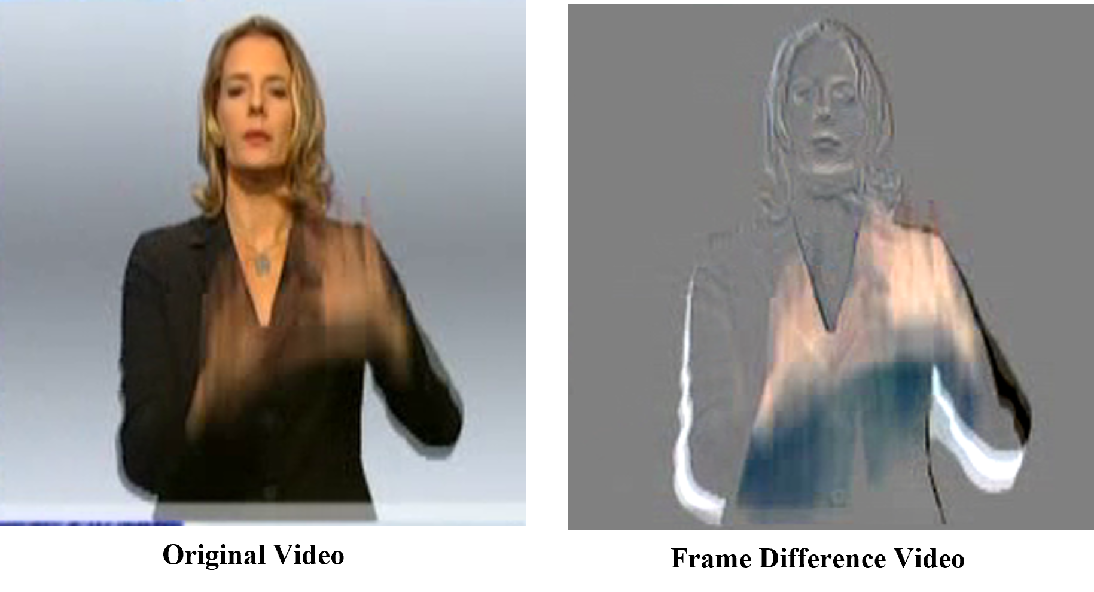
Motion Proxy for Qualitative Analysis
We compute a simple motion signal: normalized frame difference between consecutive frames.
It highlights high-change intervals (often rapid movement), which can be often visually ambiguous.
We use it as a where-to-look diagnostic when analyzing recognition errors.
Important: this proxy is not a boundary detector, and we do not claim it equals “transition”.

Slide 8
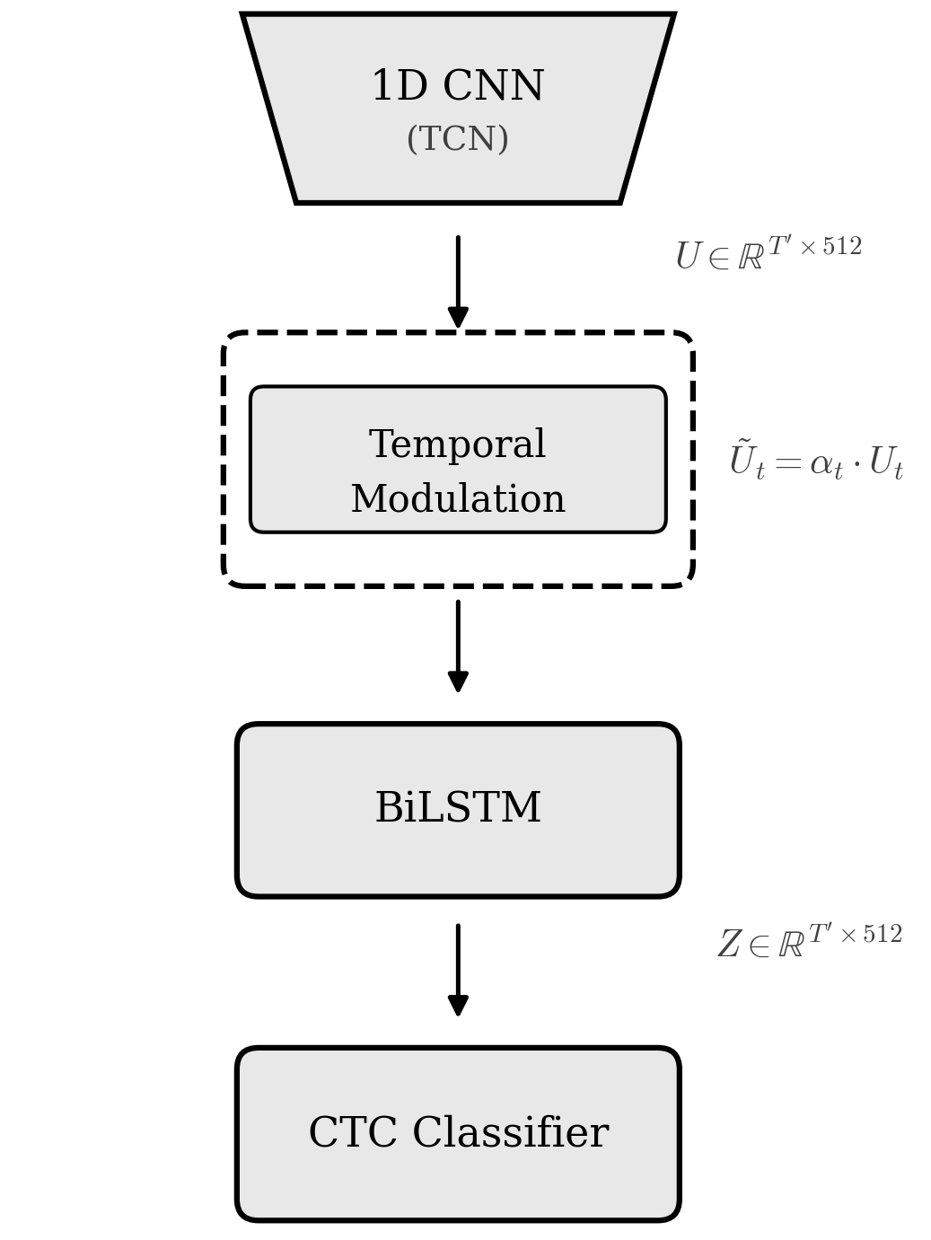
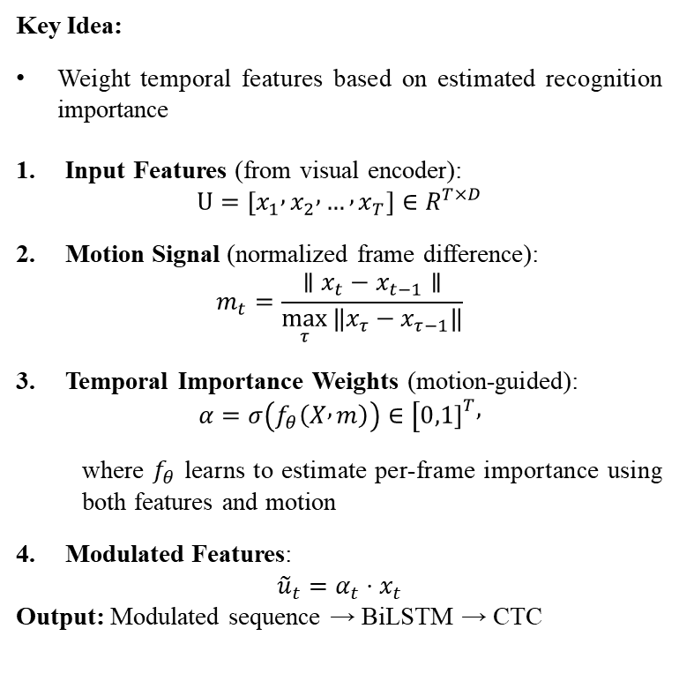
Dynamic Feature Modulation
Key Idea:
Weight temporal features based on estimated recognition importance
Input Features (from visual encoder): $U=\left[x_{1} , x_{2} , … , x_{T}\right]∈R^{T×D}$
Motion Signal (normalized frame difference): $m_{t}=\frac{∥x_{t}−x_{t−1}∥}{\max_{τ}{‖x_{τ}−x_{τ−1}‖}}$
Temporal Importance Weights (motion-guided): $α=σ\left(f_{θ}\left(X , m\right)\right)∈[0,1{\left.]\right.}^{T},$
where $f_{θ}$ learns to estimate per-frame importance using both features and motion
Modulated Features: ${\tilde{u}}_{t}=α_{t}⋅x_{t}$
Output: Modulated sequence → BiLSTM → CTC

Slide 9
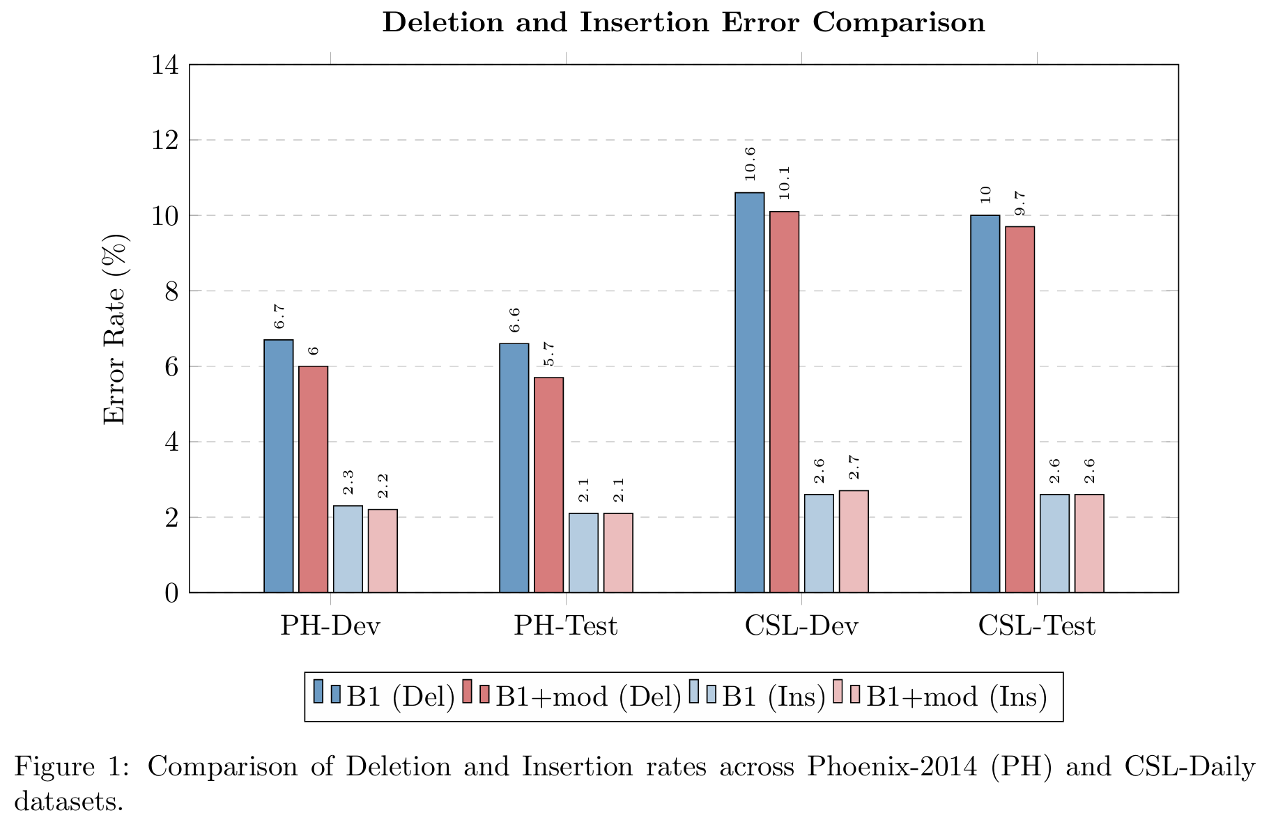
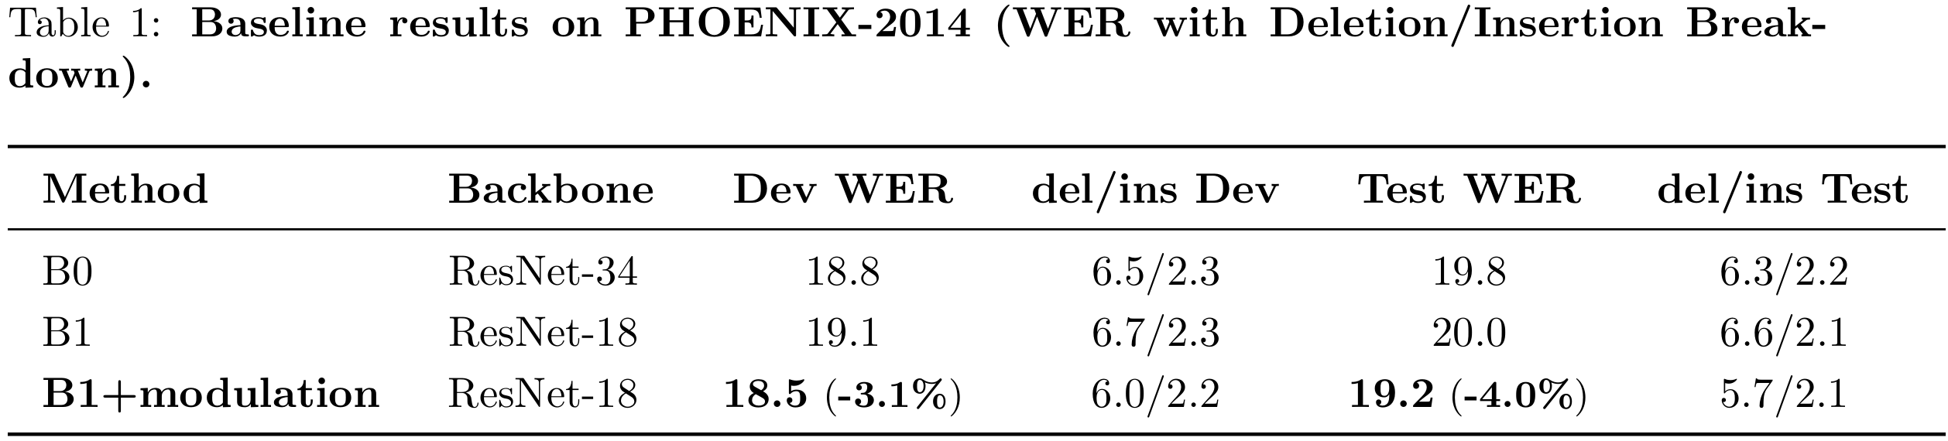
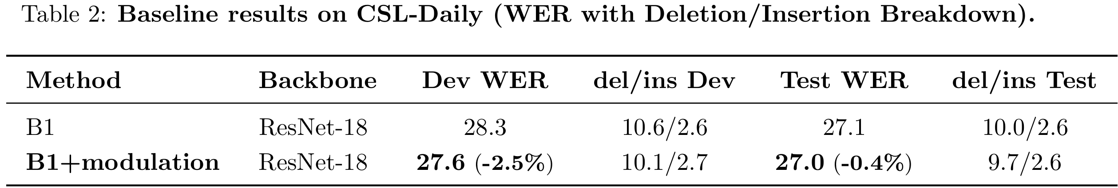
Baseline + Modulation Experimental Results

Slide 10
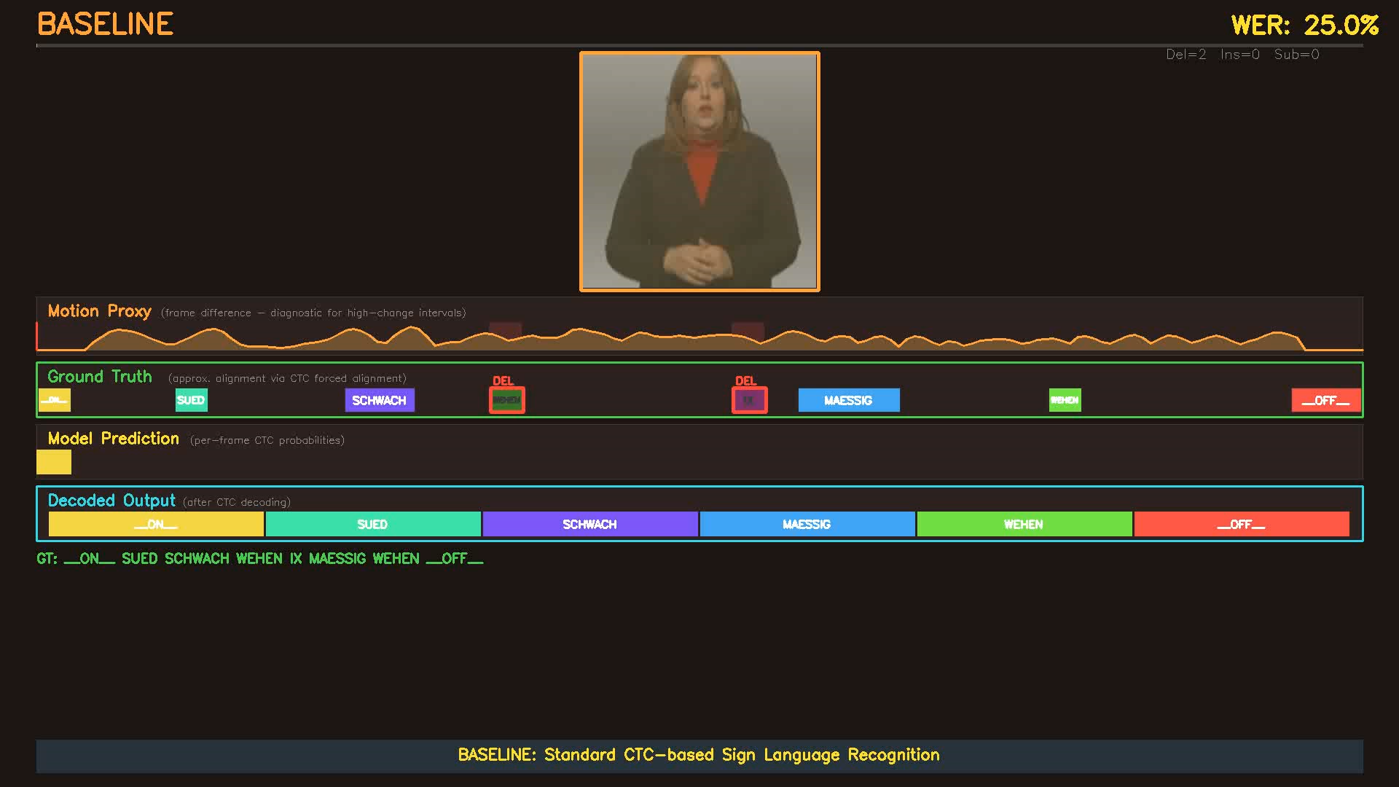
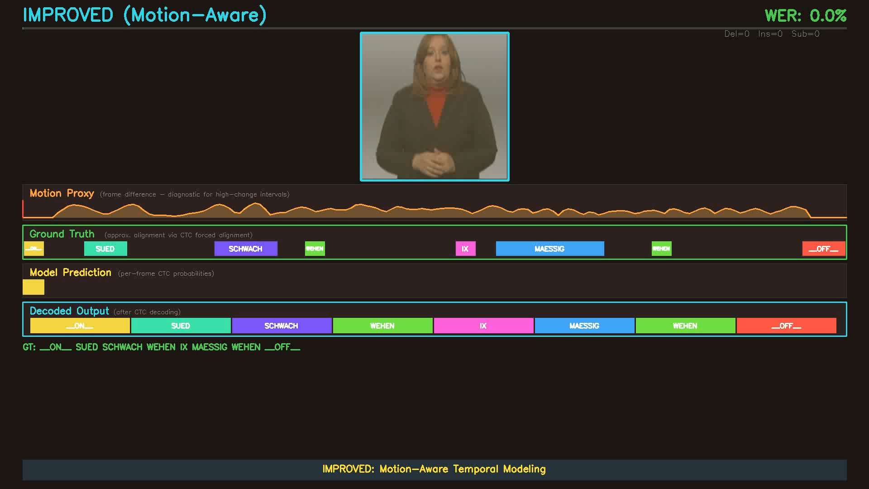
Visual Demonstration

Slide 11
Limitations and Future Direction
Limitations:
Evaluated on controlled studio datasets — in-the-wild generalization unknown
No explicit boundary supervision — learned implicitly from CTC
Single-stream modeling — does not distinguish hand/face/body motion
Future Directions:
Learned motion representations (optical flow, self-supervised features)
Boundary-aware loss design with soft temporal constraints
Multi-cue modeling for sign language's multi-articulatory structure

Slide 12
Conclusion
Reproduced standard CSLR baselines with competitive WER on PHOENIX-2014
Error analysis reveals deletion-dominant patterns at high-motion intervals
Stroke–transition perspective motivates motion-aware temporal modeling
Dynamic feature modulation improves WER
Future: explicit boundary modeling, richer motion features, more datasets

Slide 13
References
[1] Koller et al., CVIU 2015 — Continuous SLR: Large Vocabulary Statistical Recognition
[2] Zhou et al., CVPR 2021 — Sign Back-Translation for SLT
[3] Min et al., ICCV 2021 — Visual Alignment Constraint (VAC)
[4] Gan et al., CVPR 2024 — SignGraph
[5] Hu et al., CVPR 2023 — CorrNet
[6] Yu et al., AAAI 2025 — OLMD: Orientation-aware Long-term Motion Decoupling

Slide 14
THANK YOU
QUESTIONS?

