Slide 1

Problem Statement
"Air Pure Innovations" is a startup born out of the air quality crisis in India, with 14 cities ranking among the world’s top 20 most polluted urban centers. The company is in the early stages of product development and is unsure whether there is a strong, sustained demand for its air purifier product. Before committing to production and R&D, they need to answer critical questions: 1. What pollutants or particles should their air purifier target? 2. What are the most essential features that should be incorporated into the air purifier? 3. Which cities have the highest demand for air purifiers, and what is the market size in these regions? 4. How can R&D be aligned with localized pollution patterns?

Slide 2
Top 5 and Bottom 5 areas with highest average AQI
TOP 5 AREAS | BOTTOM 5 AREAS
BYRNIHAT (AQI - 284) | CHAMARAJANAGAR (AQI - 45)
DELHI (AQI - 239) | VIJAYAPURA (AQI - 44)
HAJIPUR (AQI - 234) | MADIKERI (AQI - 43)
BAHADURGARH (AQI - 226) | PALKALAIPERUR (AQI - 43)
GURUGRAM (AQI - 204) | TIRUNELVELI (AQI - 33)

Slide 3
Top 2 and Bottom 2 prominent pollutants for each state of southern India
STATES | TOP 2 POLLUTANTS | BOTTOM 2 POLLUTANTS
ANDHRA PRADESH | P.M 10 & P.M 2.5 | NO2 & SO2
KARNATAKA | P.M 10 & P.M 2.5 | NO2 & NH3
KERALA | P.M 10 & P.M 2.5 | NH3 & SO2
MAHARASHTRA | P.M 10 & P.M 2.5 | SO3 & NH3
PUDDUCHERRY | P.M 10 & O3 | P.M 2.5 & CO
TAMILNADU | P.M 10 & P.M 2.5 | O3 & NH3
TELANGANA | P.M 2.5 & P.M 10 | NO2 & CO
* GOA IS ALSO PART OF SOUTH INDIA BUT WE DO NOT HAVE AQI DATA FOR GOA

Slide 4
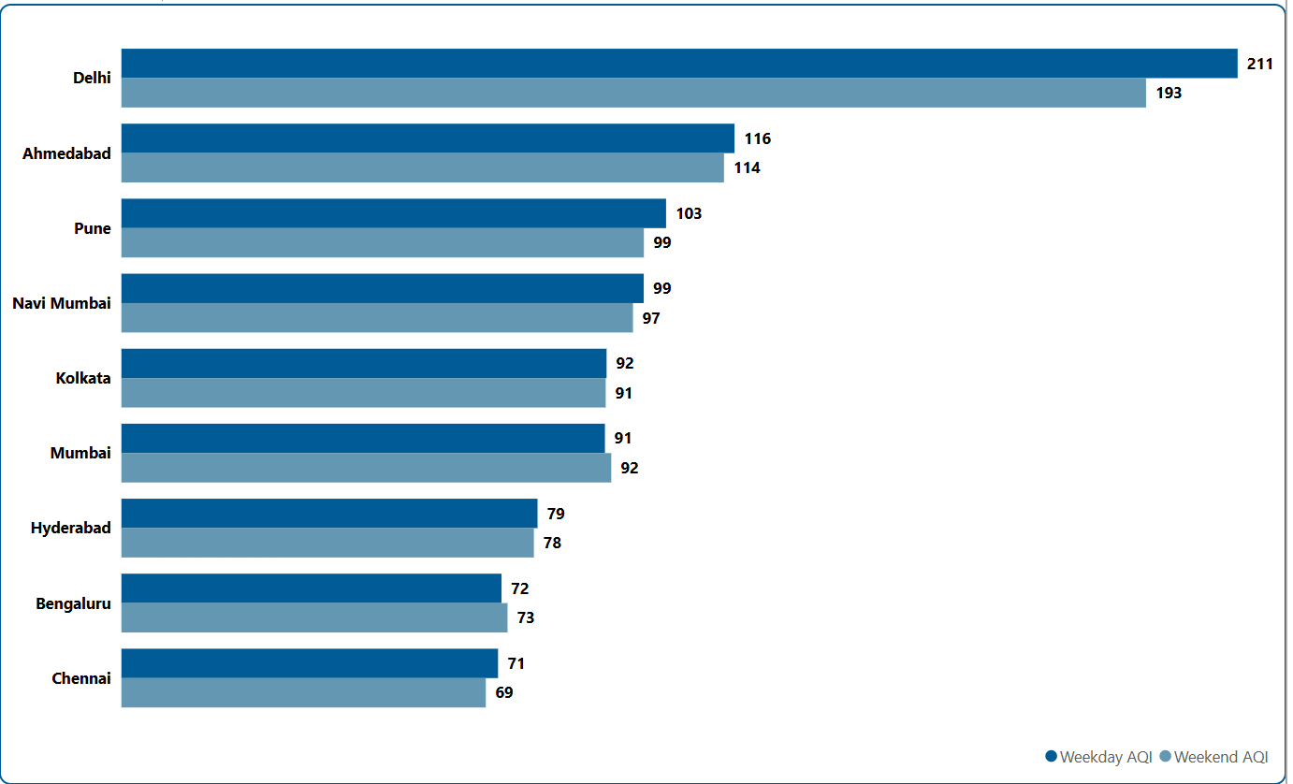
Does AQI improve on weekends vs weekdays in Indian metro cities
"Our analysis indicates that AQI tends to improve on weekends in most metro cities; however, there are exceptions such as Mumbai and Bengaluru. Therefore, while we can generally infer an improvement in AQI on weekends, it is not universally consistent."

Slide 5
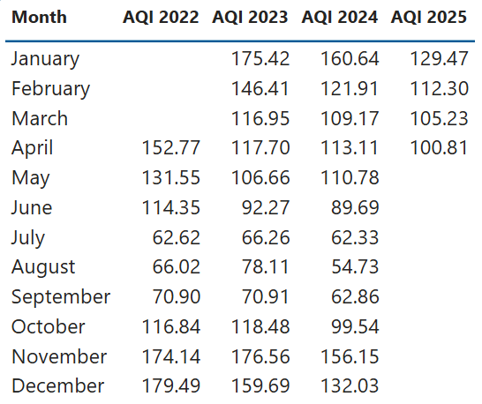
Which months consistently show the worst air quality
"The analysis reveals that January, February, November, and December consistently record the worst air quality levels across top 10 states based on highest distinct area count, highlighting a recurring seasonal pattern in pollution levels."

Slide 6
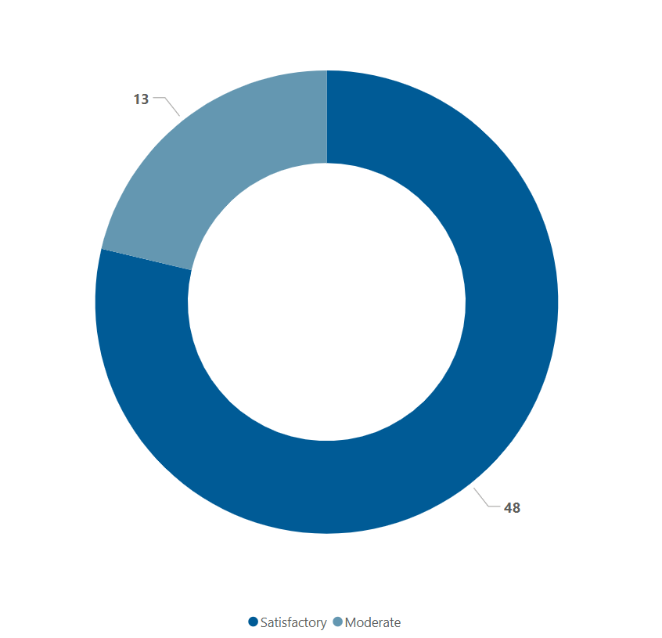
For the city of Bengaluru, how many days fell under each air quality category
“Our analysis of air quality in Bengaluru between March and May 2025 reveals that the city experienced 48 days categorized under 'Satisfactory' air quality and 13 days under 'Moderate' conditions. This suggests that during this three-month period, Bengaluru generally maintained relatively healthier air quality levels, offering some respite from pollution."

Slide 7
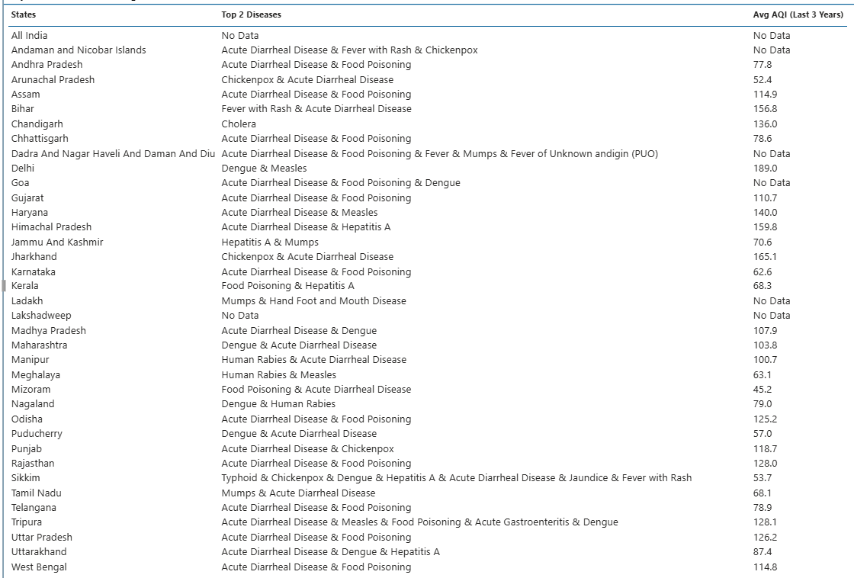
Top 2 most reported disease and corresponding average AQI
"Our analysis shows that the most commonly reported diseases—such as Acute Diarrheal Disease, Food Poisoning, and Dengue—are not directly caused by poor air quality. However, these illnesses often emerge in regions with high pollution levels, highlighting the need to view environmental health holistically, even though AQI may not be a direct contributing factor."

Slide 8
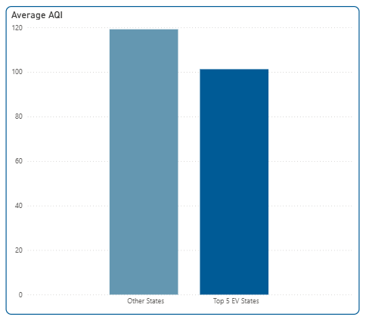
Top 5 states with high EV adoption and their average AQI
TOP 5 STATES
UTTAR PRADESH (EV COUNT - 908934)
MAHARASHTRA (EV COUNT - 636611)
KARNATAKA (EV COUNT - 470810)
TAMILNADU (EV COUNT - 323064)
RAJASTHAN (EV COUNT - 302766)
“Based on our analysis, when we identify the top five states in terms of EV adoption—considering only electric (BOV) and pure EV fuel types—and categorize all states into two groups (Top 5 and Others), we observe that the Top 5 states generally exhibit lower AQI levels compared to the Others. However, this presents only part of the picture. When we attempt to assess the relationship between EV count and average city-level AQI, no clear correlation emerges. This is because a city's average AQI is influenced by several other factors such as population density, geographic conditions, weather patterns, and the presence of industries. Still, if we isolate EV adoption as the sole variable—disregarding other contributing factors—there appears to be an inverse relationship between EV count and average AQI.”
* WHILE CALCULATING EV COUNT FUEL TYPE CONSIDERED IS “ELECTRIC(BOV)” & “PURE EV”.

Slide 9
Which age group is most affected by air pollution-related health outcomes — and how does this vary by city?
A team of researchers, including those at the International Institute for Population Sciences, Mumbai, looked at fine particulate matter (PM2.5) pollution levels across over 700 districts. Data for analysis was taken from the National Family and Health Survey (fifth round) and the National Ambient Air Quality Standard (NAAQS). Among newborns and children aged under five, the chances "appeared to be almost two-fold and more than two-fold higher, respectively, in the districts of India where the PM2.5 concentration is up to the NAAQS level," the authors said in the study published in the journal Geo-Health.
Analysing the interaction between PM2.5 exceeding NAAQS (of 40 micrograms per cubic meter) and household air pollution, the team found that it substantially increased deaths among newborns by 19 per cent, children by 17 per cent and adults by 13 per cent. While national studies provide aggregated data so we don’t city wise data Conclusion: The very young are disproportionately affected by air pollution in India, exhibiting the highest risk levels compared to other age groups.

Slide 10
Who are the major competitors in the Indian air purifier market, and what are their key differentiators
Brand | Price Range | Filtration Stages | Notable Features | Standout Strength
Philips | ₹10 k–36 k | 3–4 (HEPA, carbon) | App control, AQI display, whisper-quiet | Long filter life, sensor quality
Coway | ₹13 k–25 k+ | 3-stage True HEPA | Smart mode, AQI sensor, 7-yr warranty | Reliability & service
Xiaomi | ₹11 k–20 k | 3-stage HEPA + carbon | Smart app, voice control | Value + connectivity
Eureka Forbes | ₹13 k–20 k | 4-stage with plasma | Wi-Fi, AQI display | Indian focus with features
Honeywell | ₹8 k–30 k | 3–4-stage HEPA | High CADR, AQI, ionizer | Robust performance
Dyson | ₹40 k+ | HEPA + carbon | Fan function, premium design | Multifunction premium
Sharp / Havells | ₹30 k–40 k | HEPA + ion/TiO₂ | Haze mode, IoT, sensors | Smart tech integration

Slide 11
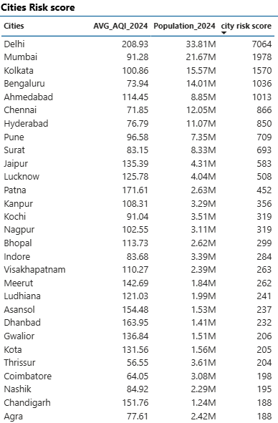
What is the relationship between a city’s population size and its average AQI — do larger cities always suffer from worse air quality?
Based on our analysis, plotting the relationship between a city’s population and its average AQI—while keeping other factors constant—reveals a noticeable pattern: States with larger populations generally tend to have higher air pollution levels. This is likely due to a higher concentration of pollution sources such as vehicles, construction activity, and industrial operations. However, exceptions exist—such as Byrnihat (Meghalaya), which has a small population but still records high AQI levels. Additionally, smaller urban centers with dense industrial activity or unfavorable weather conditions may experience air quality as poor—or worse—than major metropolitan areas. In summary, population shows a correlation with AQI, but it is not a deterministic factor.

Slide 12
How aware are Indian citizens of what AQI (Air Quality Index) means — and do they understand its health implications?
According to CHINTAN group survey only 10% of poor urban were aware of terms like AQI or PM2.5, and Awareness among middle-class residents was 71% and overall, 33% of respondents knows about negative health impacts of air pollution. measures taken to reduce air pollution exposure by middle-class residents is to reduce individual exposure to air pollution by buying air purifiers and indoor plants and other the other hand poor urban chooses comparatively less costly solutions, like increasing their water intake and using N-95 masks. This shows that middle-class people’s interest in buying air purifiers. There is another study by The Clean Air Collective and conducted by CMSR Consultants, a research group, across 17 cities and 5,000 respondents, found. The study noted that only 13% people always seek information about air quality in their city while 12% never seek such information. Delhi has the highest number of people (100%) who have heard about air pollution, followed by Chennai, Bengaluru, Pune and Kolkata (all above 98%). This study also shows that people are less aware about air pollution and its health impacts in india. Conclusion: Awareness of air pollution and its health impacts in India remains limited, especially among poorer urban populations. While middle-class residents show higher awareness and often take protective measures such as buying air purifiers, poorer communities tend to rely on simpler, low-cost methods. Even among the general public, only a small fraction actively seeks air quality information. This indicates a significant gap in public understanding and response to pollution risks, highlighting the urgent need for widespread awareness campaigns across all socio-economic groups.

Slide 13
Which pollution control policies introduced by the Indian government in the past 5 years.
According to recent research, the Indian government has introduced seven key pollution control policies over the past five years:
1) National Clean Air Program (NCAP)
2) Bharat Stage VI (BS-VI) Emission Norms
3) Vehicle Scrappage Policy
4) Graded Response Action Plan (GRAP)
5) FAME-II (Faster Adoption and Manufacturing of Hybrid and Electric Vehicles)
6) Crop Residue Management Initiatives
7) City-Specific Clean Air Action Plans
Among these, the National Clean Air Program (NCAP) has had the most significant impact on reducing air pollution. Under this policy, out of 131 targeted cities, 97 cities showed measurable improvement in air quality, with 55 cities meeting or exceeding the 20% reduction target in PM₁₀ levels. Leading cities such as Varanasi, Dhanbad, and Mumbai recorded PM₁₀ reductions between 40% and 81%, demonstrating the program's effectiveness.
Other Policies | Limitations
BS-VI Vehicle Norms | Positive but diluted impact due to rapid vehicle growth and weak enforcement in smaller cities
FAME-II (EVs) | Too early-stage; EV share in total fleet still small
GRAP (Delhi NCR) | Reactive and short-term; doesn’t address root causes like stubble burning
Stubble Management | Persisting crop-burning in Punjab/Haryana limits gains in NCR

Slide 14
Which Tier 1/2 cities show irreversible AQI degradation?
Based on our analysis, the worst air quality (AQI) is typically observed in and around the National Capital Region (including Delhi, Noida, Gurugram, and surrounding districts), as well as in the Indo-Gangetic Plain, which spans across Uttar Pradesh, Bihar, Jharkhand, and West Bengal.
Tier 1 cities with consistently poor AQI: Delhi, Gurugram, Noida, Mumbai, Bengaluru, Chennai, Pune, Ahmedabad.
Tier 2 cities with persistent AQI issues: Byrnihat, Faridabad, Ghaziabad, Kanpur, Patna, Agra, Meerut, Varanasi.
While several other cities also experience occasional AQI spikes during certain seasons, they do not display a consistent or long-term pattern of poor air quality.

Slide 15
How do AQI spikes correlate with pediatric asthma admissions?
A global study of 8,129 pediatric asthma patients across multiple regions found that exposure spikes—defined as pollutant levels exceeding two standard deviations above baseline—for PM₂.₅, PM₁₀, NO₂, SO₂, and ozone were significantly associated with moderate-to-severe asthma attacks, as opposed to mild symptoms. A five-year time-series study in Mysore reported that for every 10 µg/m³ increase in NO₂, pediatric asthma admissions increased by 2.42%. PM₁₀ showed a linear association too (relative risk modest but measurable). Delhi-based research (pre-2010) found that 32.1% of children suffered from respiratory issues, and there was a clear positive link between elevated PM₁₀ levels and prevalence of lower respiratory tract symptoms. A national-level MDPI study analyzing air quality, greenspace, and asthma prevalence among children (2005–2017) in India highlighted that long-term high PM₂.₅, PM₁₀, NO₂, SO₂ exposure correlated with increased asthma prevalence, especially in regions with low vegetation cover. Conclusion: AQI spikes—particularly elevated PM₂.₅, NO₂, SO₂, and ozone—correlate strongly with both short-term asthma flare-ups and longer-term worsening of respiratory health in children. Urgent mitigation measures, better monitoring, and pediatric-focused alert systems are essential to protect vulnerable populations.

Slide 16
Do pollution emergencies increase purifier searches/purchases?
Google Trends data across Asia (incl. during pollution crises) show that interest in air purifiers surges during air quality emergencies, often fueled by media coverage and collective concern, sometimes also due to social/herd behavior. Several brands have reported a 30–40% increase in air purifier sales across India during episodes of high pollution, especially during winter smog in cities like Delhi and Mumbai. Data from MarkNtel Advisors shows a CAGR of ~7–15% in the Indian air purifier market, driven largely by urban pollution concerns and health awareness. Conclusion: Yes, pollution emergencies reliably lead to a surge in air purifier attention and buying behavior. Search interest monetarily spikes during high-AQI days. Purchase trends reflect that urgency: sales rise 30–40% during smog seasons, and market growth is fueled by ongoing air quality fears.

Slide 17
What do existing products lack (e.g., smart AQI syncing, compact designs)?
1) Inaccurate or Unreliable Built‑In Sensors. 2) Limited Smart Connectivity & Ecosystem Compatibility. 3) Poor VOC / Gas Detection. 4) Bulkiness & Limited Portability. 5) Noise at High Speeds. 6) High Ongoing Maintenance Costs. (Recurring expenses for filters) 7) Limited Filtration for Microbes, Allergens, Odors.

Slide 18
Which cities have the highest demand for air purifiers, and what is the market size in these regions
CITY | 2025 Market Size (USD Million) | Key Traits & Demand Drivers
Delhi(NCR) | 595.7 | Severe air pollution, high disposable income
Mumbai | 362.9 | Pollution & humidity, premium products
Bengaluru | 205.9 | Tech adoption, smart buyers
Kolkata | 194.8 | Industrial emissions, affordability focus
Chennai | 151.8 | Airborne disease, monsoonal climate

