Slide 1

predicting SBA Loan Outcomes with Machine Learning
Small Business Administration (SBA) loans play a pivotal role in fostering economic growth by providing capital to entrepreneurs. While these loans have a significant impact on small businesses, they also present a risk of default, which can have consequences for both lenders and borrowers. This presentation delves into the development of a robust predictive model designed to identify high-risk SBA loans, enabling proactive intervention and fostering sustainable economic development.

Slide 2
Dataset Overview: Understanding the Data
SBAnational Dataset
Key Features
The data used for this project is sourced from the SBAnational dataset available on Kaggle (https://www.kaggle.com/datasets/maddraf/sbanational-csv). This dataset encompasses a vast collection of historical SBA loan data, containing 899,164 records and 27 features. The dataset is a valuable resource for understanding the characteristics of SBA loans and predicting future outcomes.
Term: Loan duration in months
GrAppv: Loan amount requested by the borrower
SBA_Appv: Loan amount approved by the SBA
NewExist: Indicator for a new business or an existing business (1 for new, 2 for existing)
RevLineCr: Indicator for a revolving line of credit (1 for yes, 2 for no)
LowDoc: Indicator for a low-documentation loan (1 for yes, 2 for no)
NAICS: North American Industry Classification System code, categorizing the business type

Slide 3
Data Preprocessing: The Foundation for Success
1
Handling Missing Values
2
Removing Irrelevant Features
Missing values are addressed using the dropna() function in Python, eliminating records with any missing information. This ensures a complete and consistent dataset for modeling.
Features like LoanNr_ChkDgt and Name are removed as they do not provide meaningful insights into loan risk. This step focuses on selecting features with predictive power.
3
Outlier Treatment
4
Data Type Conversions
The interquartile range (IQR) method is used to identify and remove outliers in numerical features like GrAppv and SBA_Appv. This approach helps to mitigate the influence of extreme values on model training.
Currency features (GrAppv, SBA_Appv) are converted to numerical data types for efficient processing and analysis.

Slide 4
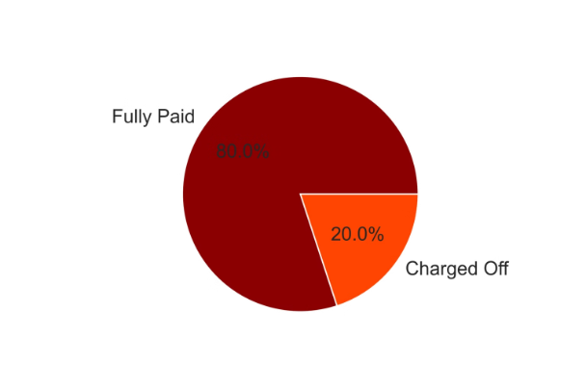
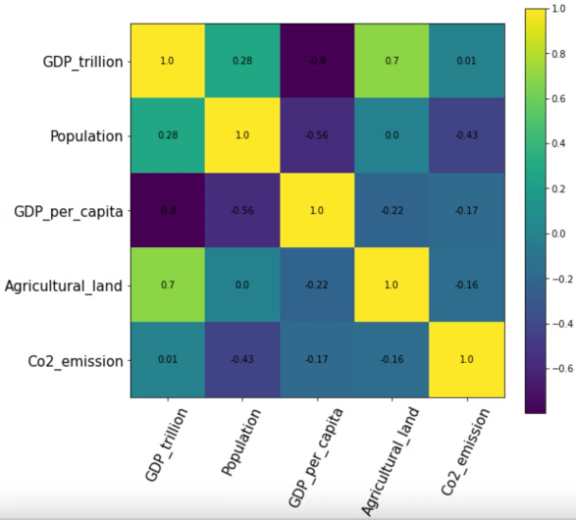
Exploratory Data Analysis: Uncovering Insights
Target Variable Distribution
Correlation Heatmap
The target variable, MIS_Status, indicates whether a loan was paid in full or charged off. This distribution provides insights into the prevalence of defaults within the dataset. It is important to note the class imbalance, where one class dominates the other.
A correlation heatmap reveals significant relationships between features, aiding in understanding which variables are strongly associated with loan risk. For example, a strong correlation between a feature and the target variable suggests a strong predictive power. Other visualizations can further explore these relationships.

Slide 5
Model Selection & Training: Our Methodology
Exploring Models
Train-Test Split
Gradient Boosting: The Champion
A range of machine learning models are explored, including Logistic Regression, Decision Tree, Random Forest, AdaBoost, KNN, and SGD. Each model brings its own strengths and weaknesses, and we aim to identify the best performer for our specific task.
The dataset is split into training and testing sets (80% for training and 20% for testing). This division allows us to evaluate the model's performance on unseen data, ensuring its generalizability to real-world scenarios.
Gradient Boosting emerged as the most promising model due to its superior performance and ability to effectively handle diverse data types. Its ensemble approach combines multiple weak learners to create a strong predictor, resulting in accurate predictions for SBA loan defaults.

Slide 6
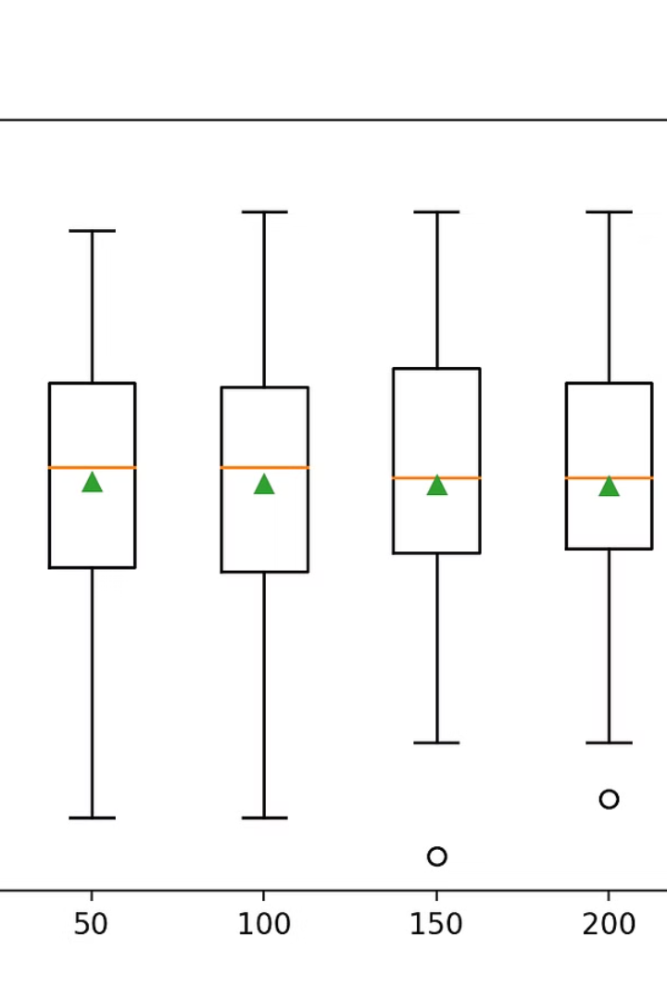


Gradient Boosting: A Deep Dive
Hyperparameter Tuning
Boosting Accuracy
Gradient Boosting involves tuning key hyperparameters like learning rate, max depth, min samples split, and n estimators. These parameters influence the model's complexity and performance. RandomizedSearchCV is used to efficiently optimize these parameters, maximizing model accuracy.
Tuning these hyperparameters optimizes the model's ability to identify complex patterns in the data and make accurate predictions. It strikes a balance between model complexity and generalizability, ultimately leading to improved performance.

Slide 7
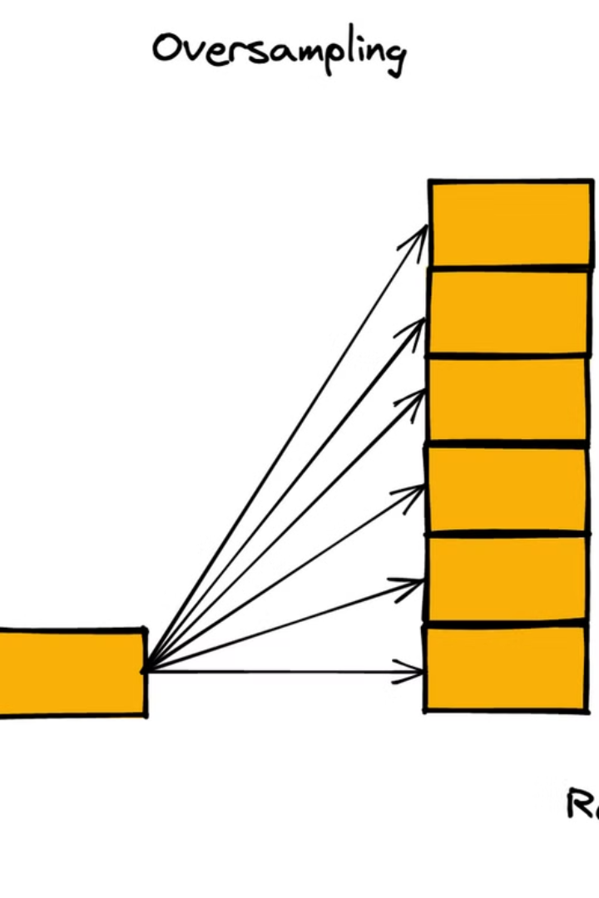
Addressing Class Imbalance: SMOTE
1
The Challenge of Imbalance
Class imbalance, where one class (defaults) is significantly underrepresented compared to the other (paid in full), can bias the model. This can lead to overfitting and inaccurate predictions for the minority class.
2
SMOTE to the Rescue
Synthetic Minority Over-sampling Technique (SMOTE) is employed to address this imbalance by generating synthetic samples for the minority class. This technique creates artificial data points that are similar to the existing minority class, balancing the dataset without introducing bias.
3
Performance Enhancement
The application of SMOTE leads to a significant improvement in the model's performance, particularly in terms of recall and F1-score, which are crucial metrics for accurately identifying defaults.

Slide 8
Model Evaluation: Superior Results
94 %
95%
Accuracy
Precision
The model achieves a high accuracy of 94%, indicating its ability to correctly classify most loans as either paid in full or charged off.
The model has a precision of 95%, meaning that 91% of the loans predicted to be defaults are actually defaults. This high precision highlights the model's ability to avoid false positives.
96%
95%
Recall
F1-score
With a recall of 90%, the model correctly identifies 96% of all actual defaults. This high recall is crucial for minimizing the number of missed defaults and preventing potential financial losses.
The F1-score of 95% represents a balanced measure of precision and recall. This score emphasizes the model's ability to accurately identify defaults while minimizing false positives and false negatives.

Slide 9



Conclusion & Future Directions: Looking Ahead
Key Achievements
1
Superior Performance
2
The Gradient Boosting model with SMOTE demonstrates superior performance in predicting SBA loan defaults, accurately identifying high-risk loans and contributing to sustainable economic development.
Future Enhancements
Future improvements could involve gathering more data to increase model robustness, exploring additional features like credit scores and economic indicators, implementing deployment strategies for real-world application, and enhancing the application interface for greater user-friendliness.
3

Slide 10
Predicting SBA Loan Defaults: A Transformative Tool
Empowering Lenders
1
By identifying high-risk loans proactively, the model empowers lenders to make informed decisions, mitigate risk, and optimize lending practices.
Supporting Entrepreneurs
2
The model helps entrepreneurs access the right resources and support, enabling them to navigate the complexities of business ownership and achieve sustainable growth.
Fostering Economic Development
3
Through its ability to identify and manage risk, the model promotes a more resilient and thriving small business ecosystem, contributing to overall economic development.

