Slide 1


Integrated thermo structural analysis of Advanced composite structures
ENGINEERING DESIGN DIVISION
DEPARTMENT OF MECHANICAL ENGINEERING
(Presentation on the capabilities of the FEM code)
Note: The code is developed as part of the master’s thesis work. The developed code was submitted in April of 2019

Slide 2
OBJECTIVE
The aim is to develop a Finite Element code to compute the response of Functional Graded Material structures, under the action of combined mechanical and thermal loading. The capability is developed as part of the COMSAP package.

Slide 3
INTRODUCTION
COMSAP package is developed to execute numerical analysis of structures. The package is being developed to facilitate direct modeling and analysis of Functionally Graded material (FGM) structures. The package is also equipped to analyse more common and conventional materials like monolithic, composites, etc. Currently this package is used as a tool in academics.
The aim of the work is to construct a code for integrated thermal and structural analysis and augment it with the existing COMSAP package. This module is to be developed in C-language.

Slide 4
Research gap
Martinez-Paneda E and Gallego R (2015), have studied the possibilities to model FGM in commercial software. The author mentions a method developed by Rousseau and Tippur (2000) of assigning temperature dependent material property.
Techniques used to model FGM:
To model FGM in FEA packages, a temperature profile is assigned to the structure in terms of dummy thermal loads to obtain gradient distribution of material property.
Temperature dependent material property is assigned to the structure, the thermal coefficient of expansion is made 0, to neglect unwanted strain.
The above method is not suitable for thermo mechanical analysis.
The author Martinez-Paneda E and Gallego R (2015), also suggest the use of subroutine to model FGM in commercial software.
The lack of direct method to model FGM, motivated a FEM program specific for numerical analysis of Functionally Graded materials .

Slide 5
Scope of the project
FEA formulation for combined thermal and structural analysis is to be brought out with specific focus to plate and shell structures.
FEM program to be developed in C language incorporating the formulation and suitable solution procedure.
Validation of the program with standard analytical results and optimizing the program.
Incorporation of the module in COMSAP package.

Slide 6
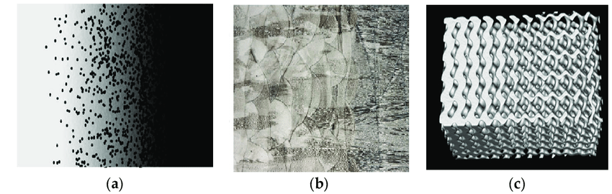
Functionally Graded Materials
Functionally Graded Materials are characterized by gradual variation in composition or material structure over the volume of the material. The gradual variation, results in the corresponding change in the response across material to an external influence like load, heat flux etc.
Fig 1 Gradual Variation of FGM (from left to right)
Contrasting functionality requirements across different layers of a structure like, high resistance to heat in the external surface and general mechanical strength in the structure can be achieved by FGM.

Slide 7
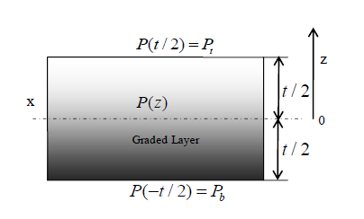
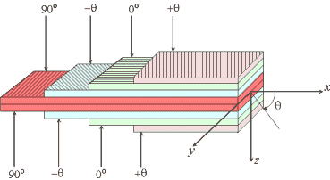
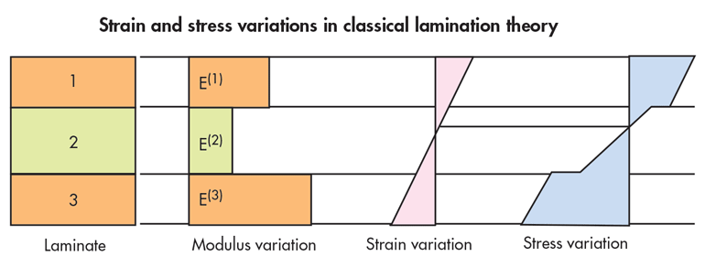
FGM vs Composites
FGM structure Composite structure
In composites the sudden change in material property in the lamina interface results in stress concentration and discontinuous stress distribution. This causes delimitation , FGM minimizes this effect.

Slide 8
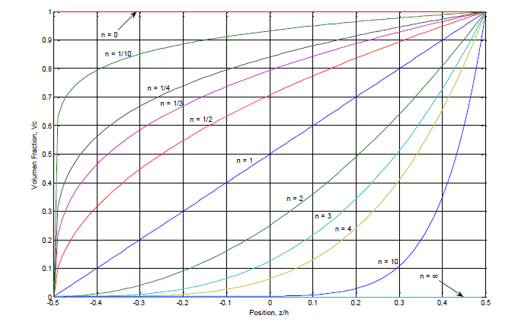
Material Composition Variation in FGM
Fig 2 FGM composition variation

Slide 9

FGM Model
The effective property of FGM at any layer is given by the following expression,
The variation of the composition of the material in the top layer is given by,
Where Z is the coordinate in the thickness direction and h is the thickness. ‘n’ is called the grading parameter.
Fig 3 FGM material
Where,
Pt – is the material property in the top layer.
Pb – is the material property at the bottom layer.
P(z) gives the effective proprty of FGM at any given layer.

Slide 10
Literature Survey: Numerical analysis of plates and shells
S.No: | Author | Title | Inference
1. | Partrick Joseph Kennedy P, 1996 (Thesis) | Thermal Analysis of Laminated composite shells | The author has studied the p-approximation of temperature field in the thickness direction with exact integration scheme. The layered structures has been the main interest.
2. | Bindu S, 2004. (Thesis) | Thermo-Mechanical Modeling of Thermal Protection system. | The author studies numerical modeling that precedes the FEM analysis of thermal protection system.
3. | Ahmed Hassan, Ibrahim Keles, 2017 | FGM modeling using dummy thermal loads applied with ANSYS APDL | The modeling of FGM with gradient material properties in ANSYS is explained in the paper.

Slide 11
S.No. | Author | Title | Inference
4. | W. P. Prema kumar, R. Palaninathan, 1995 | Finite Element Analysis of Laminated Shells with Exact through thickness integration | The conventional numerical integration in 3D are inefficient for multilayered shells. The author studies explicit integration scheme and gives a comparative study relating to computational efficiency and numerical accuracy.
5. | Ahmed S., Itons B.M. and Zienkiewic O.C (1970) | Analysis of Thick and Thin Shell Structure by Curved Finite Elements | Formulation of degenerated shell element. This element was first proposed by this team.
6. | V Balamurugan and S Narayanan (2008) | A piezolaminated composite degenerated shell finite element for active control of structures with distributed piezosensors and actuators | FEM analysis of piezo laminated FGM structures. Degenerated shell element has been used.

Slide 12
S. no | Author | Title | Inference
7. | Karan S. Surana & Robert K. Phillips (1987) | Three dimensional curved shell finite element for heat conduction | The author worked on the heat conduction phenomenon ,of curved shells. The work has been carried out by taking the nodal temperature as well as the gradient of temperature in the thickness direction as a degree of freedom.
8. | Karan S. Surana and G. Abusaleh (1989) | Curved shell elements for heat conduction with p-approximation in the shell thickness direction | Hierarchical function has been employed, wherein the degree of polynomial approximating the temperature along the thickness is varied to suit the requirement.
9. | Karan S. Surana & Orth J nilus (1989) | P-approximation axisymmetric shell element for heat conduction in laminated composites | The p- approximation of the temperature variation is extended to composite structures.

Slide 13
Research Methodology
Problem Identification
and
Definition of objective
Literature Survey
Finite Element Formulation
Generation of FEM code in
C language
Testing of code with Standard Analytical results
Validation and improvement of the program

Slide 14
Expected output
The output of the work is bring out an effective FEM program, that can perform efficient numerical analysis on FGM for coupled thermal and mechanical loads and obtain results as close to analytic results as possible.

Slide 15
Formulation

Slide 16
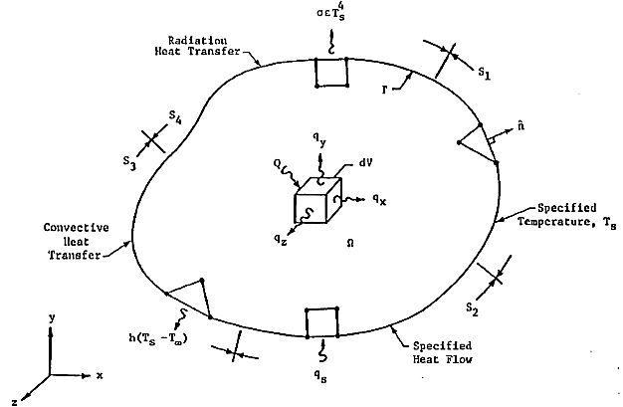
Modeling: Thermal System

Slide 17
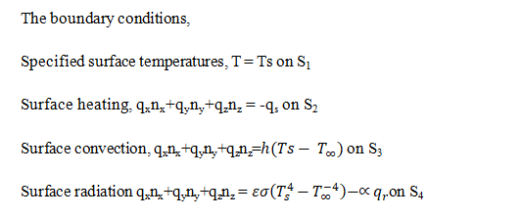

The governing equation for heat transfer is given by;
The weak form of the above equation is constructed and by minimization of potential energy the elemental equations are obtained.

Slide 18
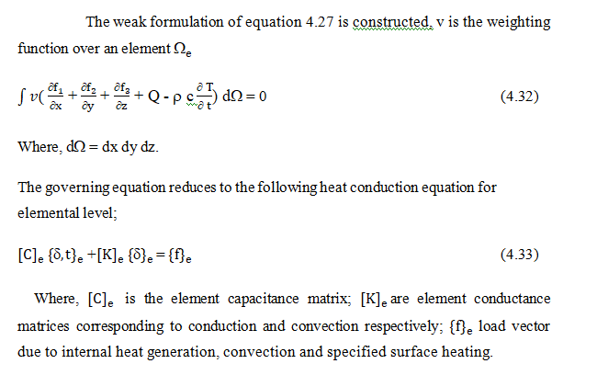

Slide 19
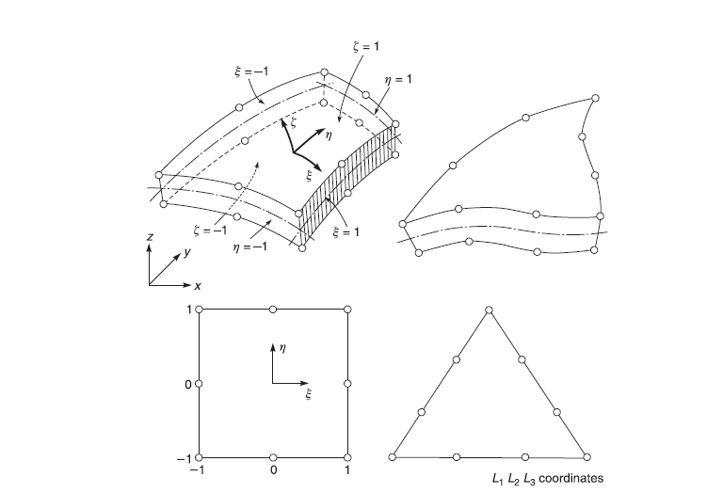
Degenerated shell Element

Slide 20
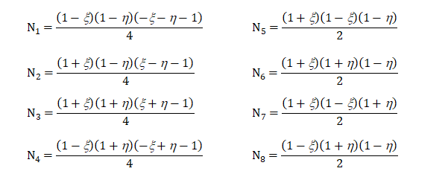
Shape function of Degenerated Element

Slide 21
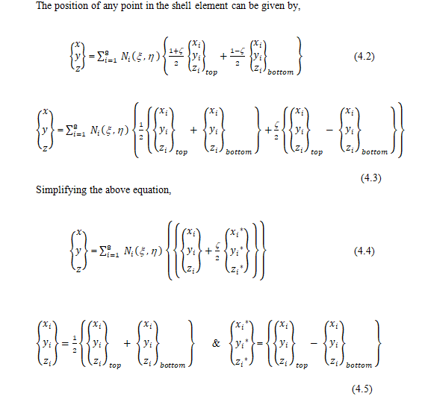

Slide 22
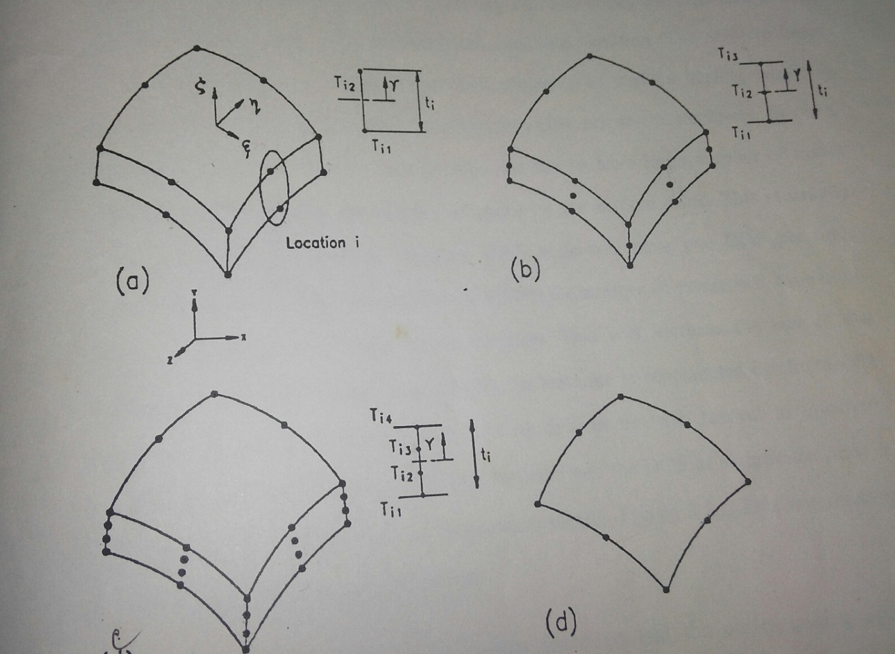
Shell Element

Slide 23
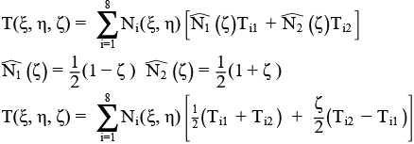
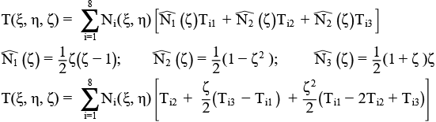
Shell Element
For Liner variation shell element:
For quadratic variation shell element:

Slide 24
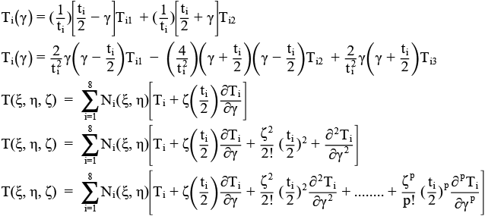
Lagrange Polynomial for temperature variation along the shell thickness:

Slide 25
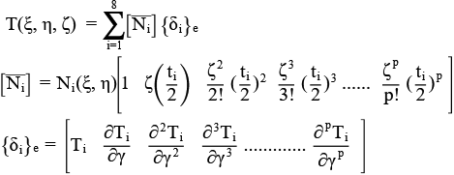
Shell Element

Slide 26
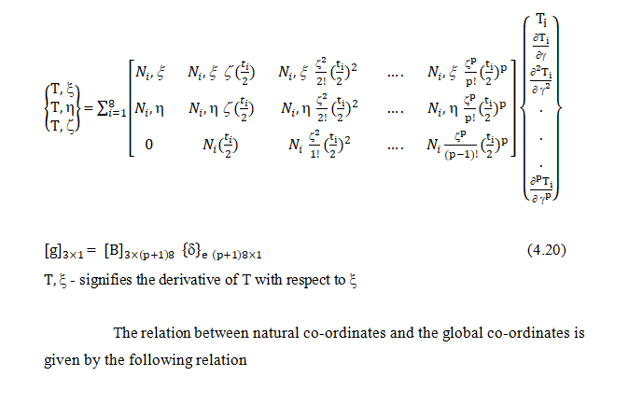

Slide 27
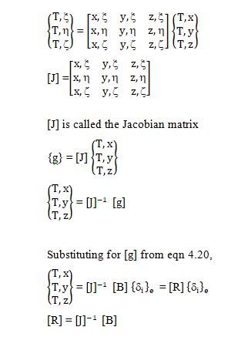

Slide 28
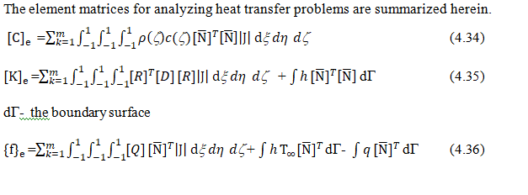
Final equations to be solved

Slide 29
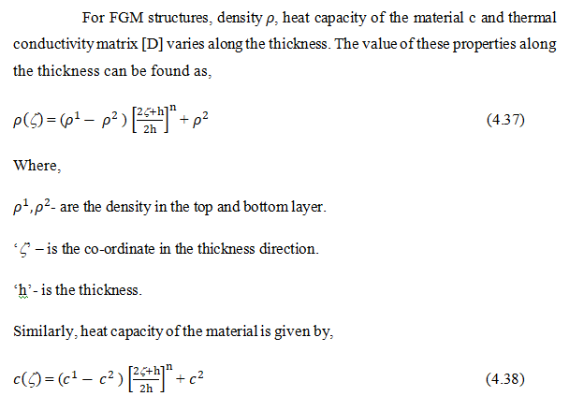
Modeling material properties

Slide 30
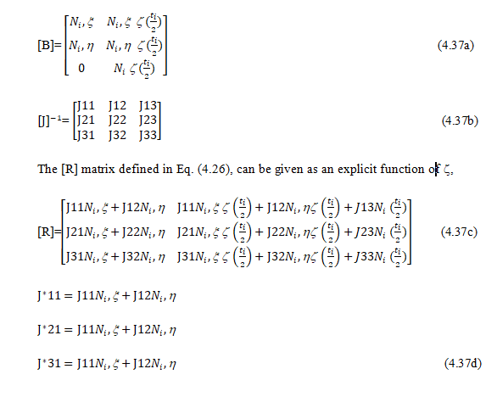
Exact integration scheme

Slide 31
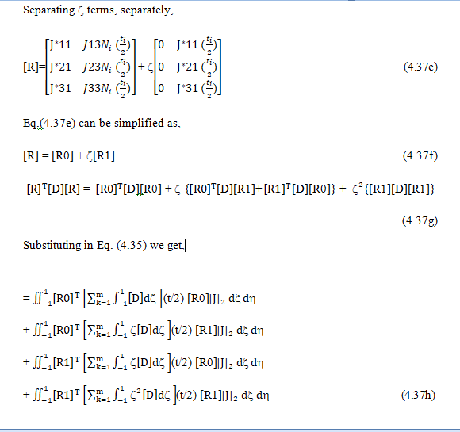

Slide 32
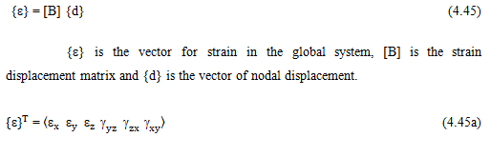
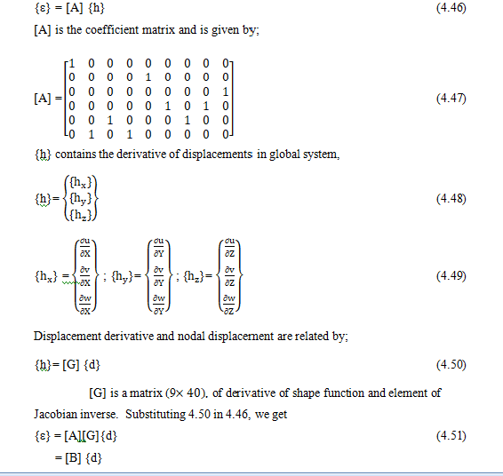
Thermo structural analysis

Slide 33
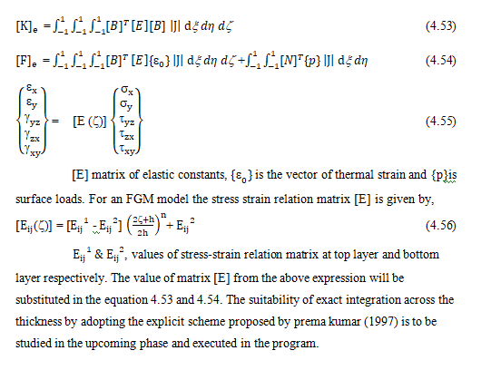

Slide 34
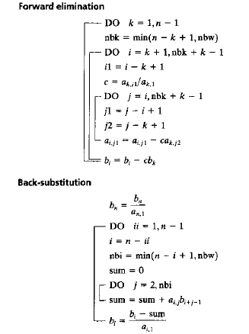
Solution Methodology

Slide 35
Results

Slide 36
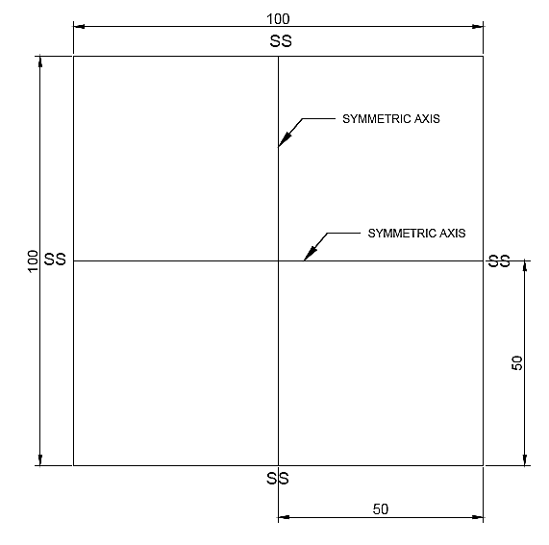
Validation of code

Slide 37
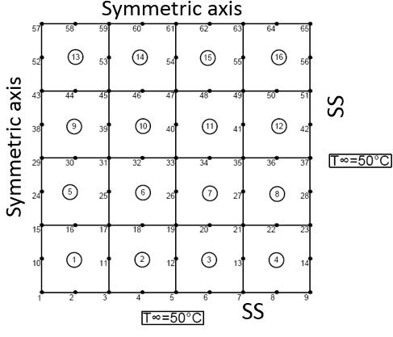
Finite element model

Slide 38
The above displayed finite element model is analysed for the isotropic material property specified below. Thermal conductivity k=30W/m K, Temperature boundary condition as depicted in the Figure earlier used and heat generation Q=10W/.

Slide 39
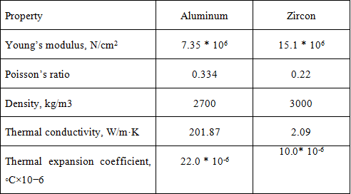
Material property considered

Slide 40
The finite element code is used to solve the thermal problem for isotropic plates made of Aluminium and Zirconium. The results are verified with the data in the literature. The material properties are given in the Table 5.1. The plates are subjected to internal heat generation thermal loads (Q=10W/. 4×4 mesh is employed to solve the numerical problem.

Slide 41
Results for Aluminium plate

Slide 42
Results for Zircon plate

Slide 43
Analysis of Shell Structure
A cylindrical shell of 12 unit length, 10.2 mean radius and 0.4 unit thickness is taken for analysis. The material model is assumed to be isotropic with K=3 (Co-efficient of thermal conduction). The structure is subjected to uniform heat flux in the internal surface and convection in the outer surface. The boundary condition does not vary with θ hence; a radial vector of 3 degree is taken considering aspect ratio consideration. And due to symmetry only one half of the length (6units) is taken.

Slide 44
Case a:
Heat flux q= 200 (at inner radius)
h= 5 & T∞ = 30 (at outer radius)
T=0 & T,γ = 0 at z=0
Case b:
Heat flux q= 200 (at inner radius)
h= 5 & T∞ = 30 (at outer radius)
T=0 at z=0& T,γ = 0 at all nodes.
Case c:
Heat flux q= 5 (at inner radius)
h= 0 (at outer radius)
T=0 & T,γ = 0 at z=0
Case d:
Heat flux q= 5 (at inner radius)
h= 0 (at outer radius)
T=0 at z=0 & T,γ = 0 at all nodes.

Slide 45
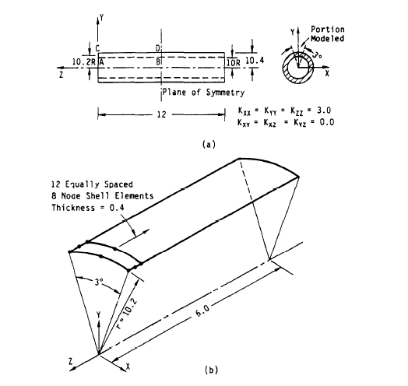
Physical model and FEM model

Slide 46
Results for shell structure

Slide 47
The thermal results obtained for case ‘a’, is compared with the results from literature and is tabulated.
Radius | Temperature (Ref [16]) | FEM model output
10.00 | 94.61 | 91.37
10.20 | 81.41 | 80.66
10.40 | 68.46 | 69.21

Slide 48
FINITE ELEMENT ANALYSIS OF FGM STRUCTURES
Case 1: Top: Aluminium Bottom: Zircon

Slide 49
Case 2: Top: Zircon Bottom: Aluminium

Slide 50
Thank you

