Slide 1
“Briefr” the News App

Slide 2
Abstract
The News Headline Application is a mobile app designed to deliver up-to-date news from various categories directly to users. Built with Flutter and leveraging NewsAPI, the application offers a seamless, responsive user experience for browsing news articles. Users can log in to access tailored content and read full articles through a 'Read More' feature. Flask API handles the user authentication, while SQLAlchemy manages the database for efficient and secure data handling. This project demonstrates a full-stack approach to mobile app development by combining an intuitive frontend with a robust backend.

Slide 3
Introduction
In an era where real-time information is critical, mobile news applications have become indispensable for keeping people informed. The News Headline Application aims to provide users with easy access to the latest news across categories like Technology, Sports, and Health. By utilizing Flutter for the frontend, we ensure a smooth, responsive interface that adapts to different screen sizes, while Flask and SQLAlchemy support secure user authentication and data storage on the backend. This project not only enhances the experience of staying informed but also demonstrates how to integrate multiple technologies in a mobile application.

Slide 4
Project description
1. Overview
The News Headline Application was created with the goal of delivering categorized news to users in a friendly, accessible format. Through Flutter, we developed an intuitive interface that organizes news into tiles, allowing users to browse easily and view articles based on their interests. By incorporating the NewsAPI, we fetch real-time articles and update the app dynamically.
2. Features
Tile-View News Display: News articles are presented in a tile view for easy navigation. Each tile displays an article’s headline, image, and a snippet, with an option to ‘Read More’ for the full story.
Categorized News: Users can select categories to focus on specific areas of interest, such as Technology, Sports, and Health, making it easier to find relevant news.
User Authentication: The app includes a secure sign-in and login system using a Flask API, ensuring that only authenticated users can access certain features.
Responsive Design: The application is optimized for various screen sizes, providing a smooth experience across mobile devices.

Slide 5
3. Tech Stack
Frontend: Developed using Flutter for cross-platform compatibility, ensuring the app is responsive and consistent on different devices.
Backend: Flask powers the backend authentication system, which communicates securely with the front end to handle user authentication.
Data Source: NewsAPI provides the latest news articles for multiple categories.
Database: SQLAlchemy is the database for user data, managing login credentials and securely storing user information.
4. Getting Started
Prerequisites: Ensure Flutter SDK, Python, Flask, and an active NewsAPI account are set up.
Set up the backend with Flask and configure SQLAlchemy for the database. Add your NewsAPI key for fetching articles.
5. Usage
Once users register or log in, they can navigate through different news categories and read full articles. Each page displays the news by section, allowing users to easily view, filter, and engage with content.

Slide 6
Project Main.py
from flask import Flask, request, jsonify
from flask_sqlalchemy import SQLAlchemy
from werkzeug.security import generate_password_hash, check_password_hash
from flask_cors import CORS
app = Flask(__name__)
CORS(app)
app.config['SQLALCHEMY_DATABASE_URI'] = 'sqlite:///users.db'
app.config['SQLALCHEMY_TRACK_MODIFICATIONS'] = False
db = SQLAlchemy(app)
class User(db.Model):
id = db.Column(db.Integer, primary_key=True)
username = db.Column(db.String(80), nullable=False)
email = db.Column(db.String(120), unique=True, nullable=False)
password = db.Column(db.String(200), nullable=False)

Slide 7
with app.app_context():
db.create_all()
@app.route('/signup', methods=['POST'])
def signup():
data = request.json
username = data.get('username')
email = data.get('email')
password = data.get('password’)
user = User.query.filter_by(email=email).first()
if user:
return jsonify({'message': 'User already exists'}), 409
hashed_password = generate_password_hash(password, method='pbkdf2:sha256')
new_user = User(username=username, email=email, password=hashed_password)

Slide 8
db.session.add(new_user)
db.session.commit()
return jsonify({'message': 'User created successfully'}), 201
@app.route('/login', methods=['POST'])
def login():
data = request.json
email = data.get('email')
password = data.get('password')
user = User.query.filter_by(email=email).first()
if not user or not check_password_hash(user.password, password):
return jsonify({'message': 'Invalid email or password'}), 401
return jsonify({'message': 'Login successful'}), 200
if __name__ == '__main__':
app.run(debug=True)

Slide 9
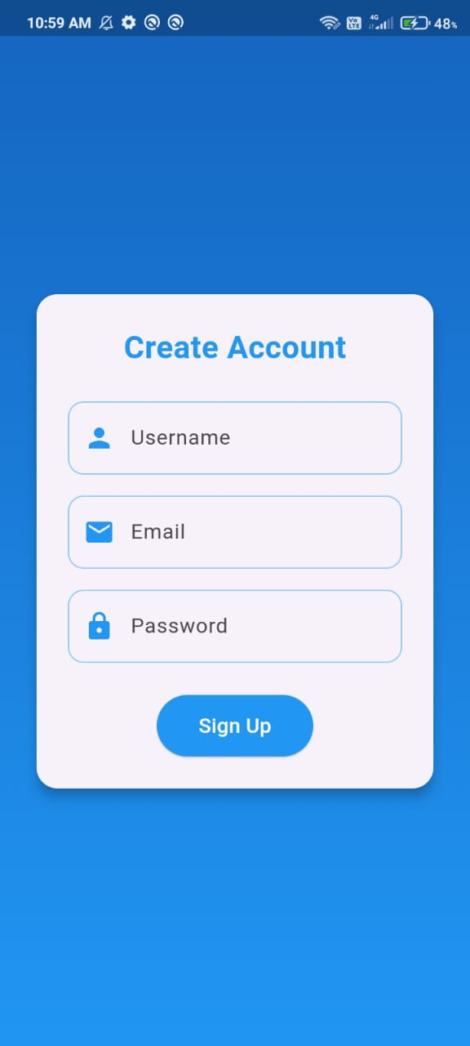
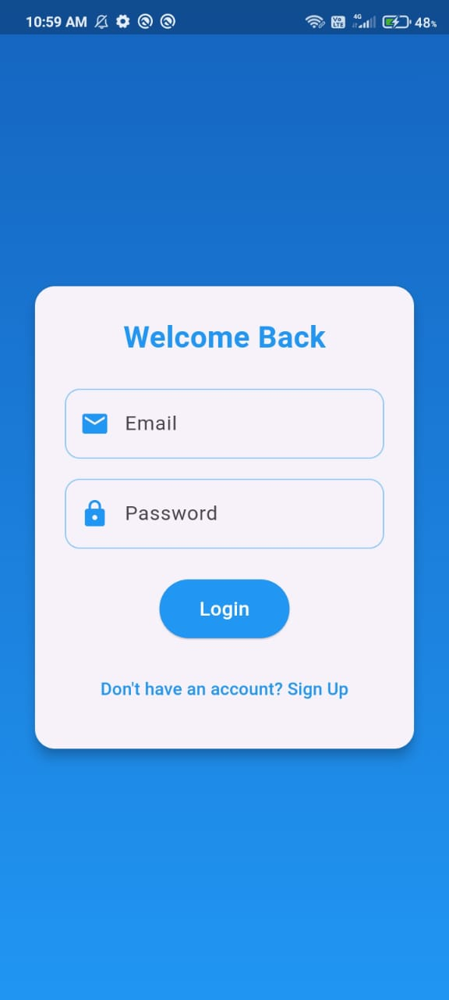
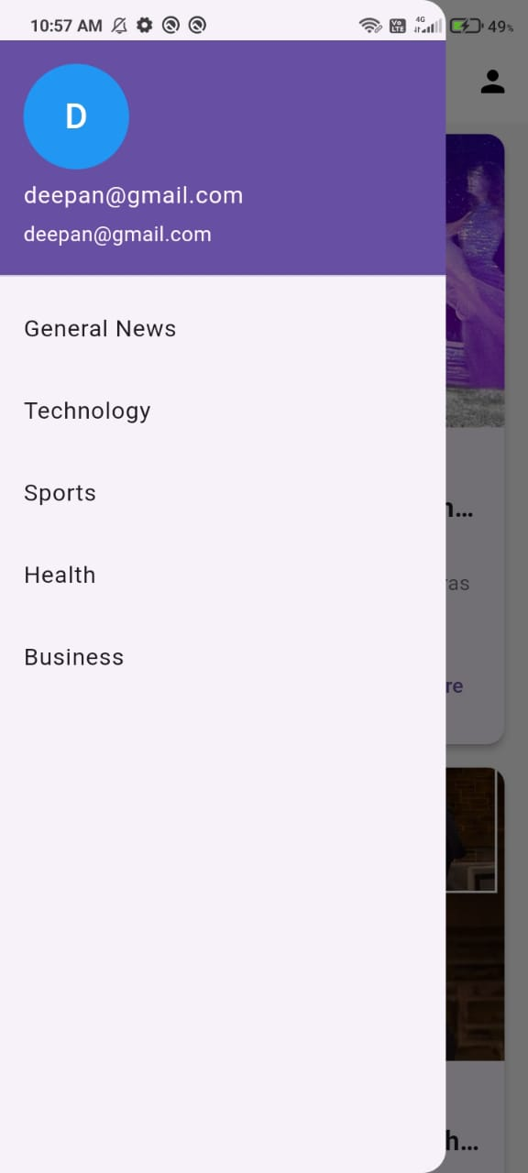
Project Output
Signup page
Login Page
Personalized Feed

Slide 10
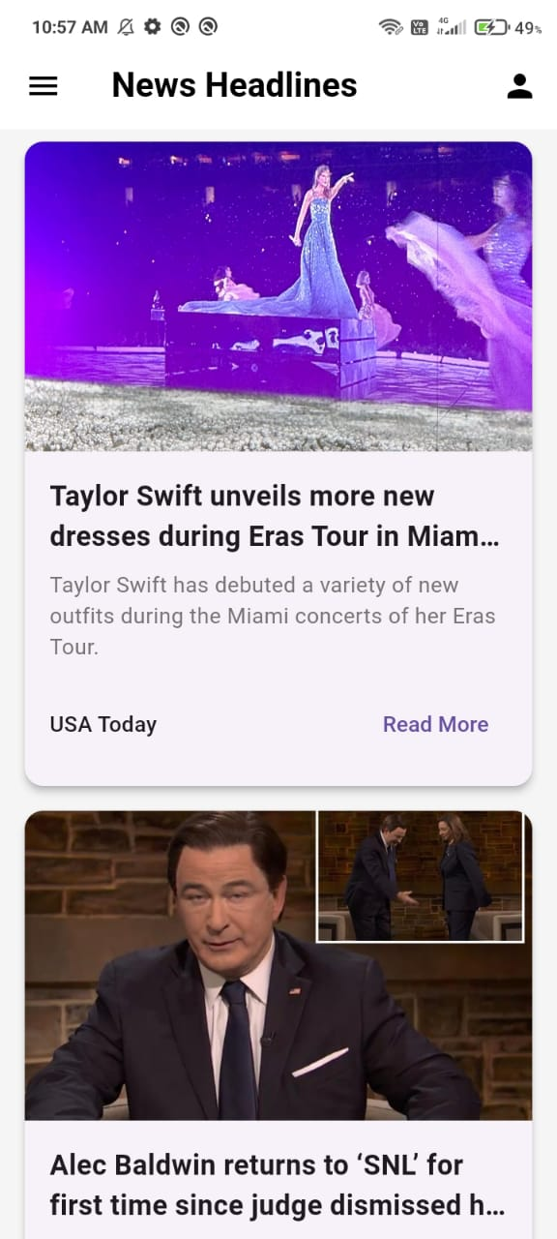

News Feed

