Slide 1
Insurance Claim Fraud Detection

Slide 2

Team Members
4/4 IT C BATCH NO - 18
Varigonda Sai Nirmal Vignu
Vasanth Chelpaka
Pathiwada Venkata Sita Ramaswamy Naidu
Gadiraju Pavan Kumar Varma
18B91A12F7
18B91A12F9
19B95A1212
19B95A1205
Project Guide :
Sri P.R.S.S.V. Raju (Assistant Professor)

Slide 3
ABSTRACT
Nowadays fraudulent insurance claims is the problem faced by many of the insurance companies which leads to huge ﬁnancial loss yearly.
These frauds have adverse consequences on society as the losses are settled down by increasing the premium cost of policy holders.
Also the traditional claim investigation process being time consuming generally leads to inaccurate results has been identiﬁed as main culprit.
we develop an automated fraud detection application framework based on machine learning algorithms.

Slide 4
INTRODUCTION
Fraud is a criminal misrepresentation which causes hindrance for both the individual and the organization.
The insurance industries now implementing various techniques for the effective management of fraud.
Types of insurance fraud claims
Inflating insurance claims.
Staging accidents.
Submitting claim forms for injuries or damage that never occurred.
False reports of stolen vehicles.
The Insurance Industry have a urgent need to develop a capability which can help them identify weather the given insurance claim is fraud or genuine with high degree of accuracy and with less amount of time. This will also help in maintaining the customers satisfaction and also the trust towards that insurance company.

Slide 5
SYSTEM REQUIREMENT
HARDWARE REQUIREMENTS:
System: Intel i3 Processor.
Hard Disk: 500 GB.
Monitor: 15’’ LED
Input Devices: Keyboard, Mouse
Ram: Min 4 GB
SOFTWARE REQUIREMENTS:
Operating system: Windows 10.
Coding Language: Python
Platform: Google collab

Slide 6
EXISTING SYSTEM
Traditionally, insurance companies have been relying on expert judgment of agents, adjusters, and special investigation units to detect and deal with frauds.
This approach worked to a certain degree in the past as the agents of fraud themselves were not as evolved as they are now.
Also, the number of claims were relatively small which made it humanly possible to keep a track on fraud.

Slide 7
PROBLEM STATEMENT
Fraudulent claims can be highly expensive for insurers. Therefore, it is important to know which claims are correct and which are not. It is not doable for insurance companies to check all claims personally since this will cost simply too much time and money.
Insurance fraud detection is a challenging problem, given the variety of fraud patterns and relatively small ratio of known frauds in typical samples. While building detection models, the savings from loss prevention needs to be balanced with the cost of false alerts. Machine learning techniques allow for improving predictive accuracy, enabling loss control units to achieve higher coverage with low false positive rates.
A comparison study has been performed to understand which ML algorithm suits best to the dataset. We are able to cut losses for the insurance company. Less losses equates to more earning.

Slide 8
PROPOSED SYSTEM
Uses machine learning and data analytics to automate the process of identifying fraudulent claims and can develop heuristics around fraud indicators.
Implementation of this model has a good impact on insurance company’s reputation in the market and on the customer’s satisfaction.
Our aim is to build an accurate machine learning model that can detect auto insurance fraud to prevent it.
GOAL
Reduce loss = More profit

Slide 9
Blueprint for Insurance claim fraud Detection
Hyperparameter tuning
Different ways to deal with imbalance
Ensemble
Explore and
understand the data
EDA
Modelling
Data cleaning
Pre-processing
Evaluation
One-hot encoding
Stratified train-test split
Choose & fit the best model

Slide 10
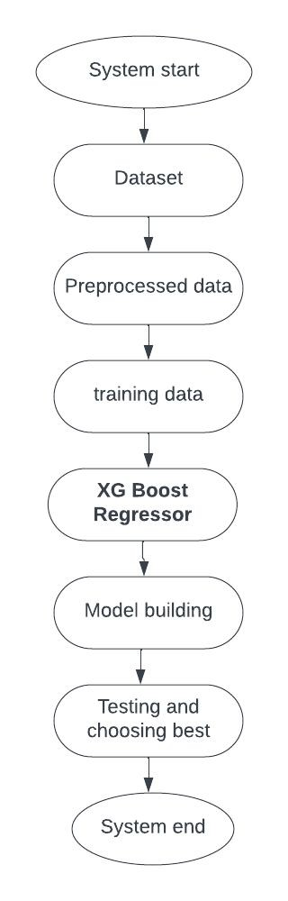
DESIGN
To start the model, we take the raw dataset and we will do data preprocessing and analysis the data.
We divide the data in two types i.e., training and testing data.
The training data undergoes various classification techniques like logistic regression, KNN algorithm, Random Forest, XGBoost and AdaBoost.
The model which predicts more accurately on our data set undergoes model building.
After model is tested on testing data, the model is evaluated and finalized.

Slide 11
ABOUT THE DATA
The inspiration for this project was to perform classification on imbalance class data sets, in particular fraud. Fraud datasets are very hard to come by and often unlabeled due to its sensitive nature.
Data Source: Kaggle
https://www.kaggle.com/code/buntyshah/insurance-fraud-claims-detection/data
The current data set was labelled with n=1000 samples. Unlike many other data sets, this one was less popular with only the author and one other having a notebook of it on Kaggle, making this data set one that was rather novel in nature
Sample size of 1000.
Auto incident claims in 3 states: Ohio, Illinois, Indiana.
From 01 Jan 2015 to 01 Mar 2015.
39 variables before feature engineering and preprocessing.

Slide 12
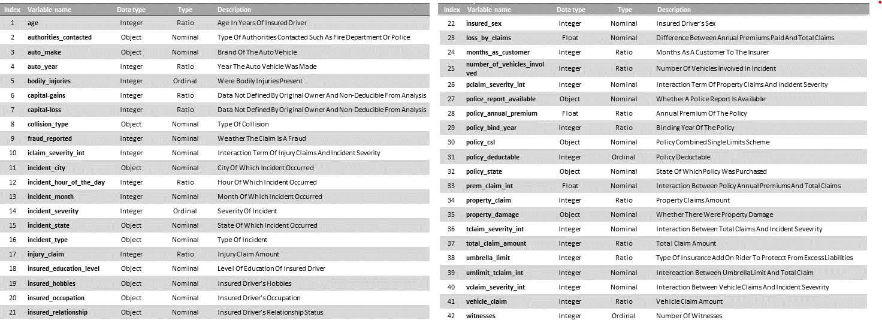
DATASET COLUMNS

Slide 13
DATA CLEANING
We can see '?' in some columns we have to handle that as we are not aware with the right value for '?' we can replace '?' with 'undocumented'
We have ‘?’ in ‘property damage’ , ‘police_report_available’ and ‘collision_type’ columns. As they are misleading to model we changed them to ‘undocumented’.
As we observed that there are no values in _c39. Which is useless so we have drop that column.
Umbrella limit is like an insurance topup that pays your liabilities in case you get sued, so we replaced it with positive values.

Slide 14
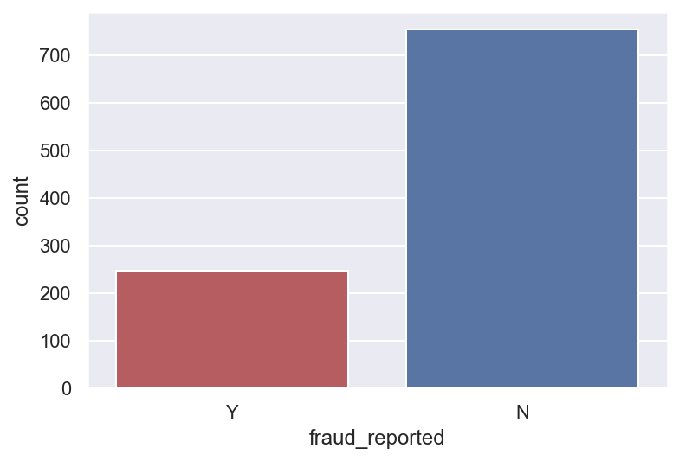
Fraud vs non-fraud claims
EXPLORATORY DATA ANALYSIS
Notes:
¾ are non frauds and ¼ are frauds , There were 247 frauds and 753 non-frauds. 24.7% of the data were frauds while 75.3% were non-fraudulent claims.

Slide 15
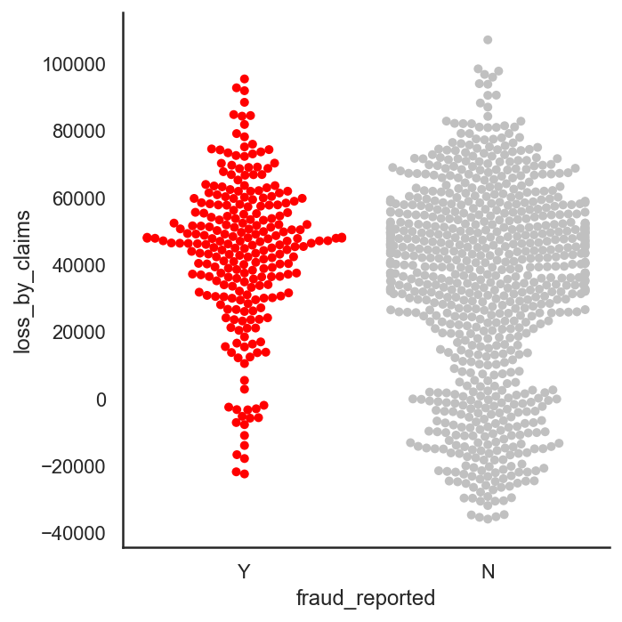
In 2 months, the insurance company lost $8,198,060.09 through fraudulent claims.
Frauds (M = 43752.03, SD = 21812.68) are significantly more expensive (p < .001) than non-frauds (M = 33368.68, SD = 29690.41).

Slide 16
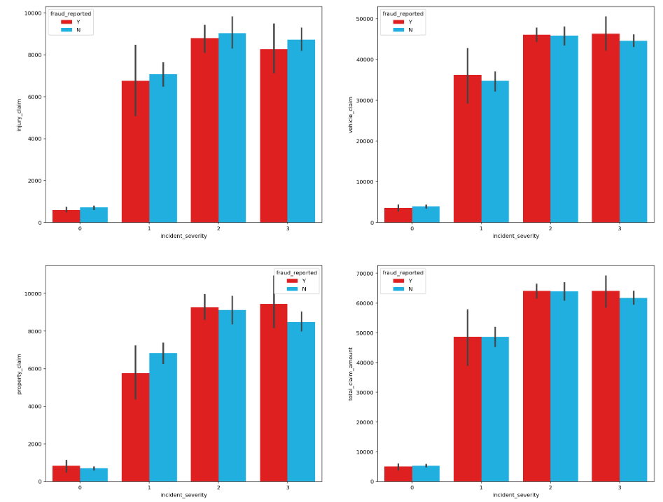
Interaction terms
property claim amount and incident severity,
vehicle claim amount and incident severity,
injury claim amount and incident severity,
total claim amount and incident severity,
policy annual premium and total claim amount,
umbrella limit and total claim amount..
Notes:
Can sort of see that frauds differ on different levels of claims and severity

Slide 17
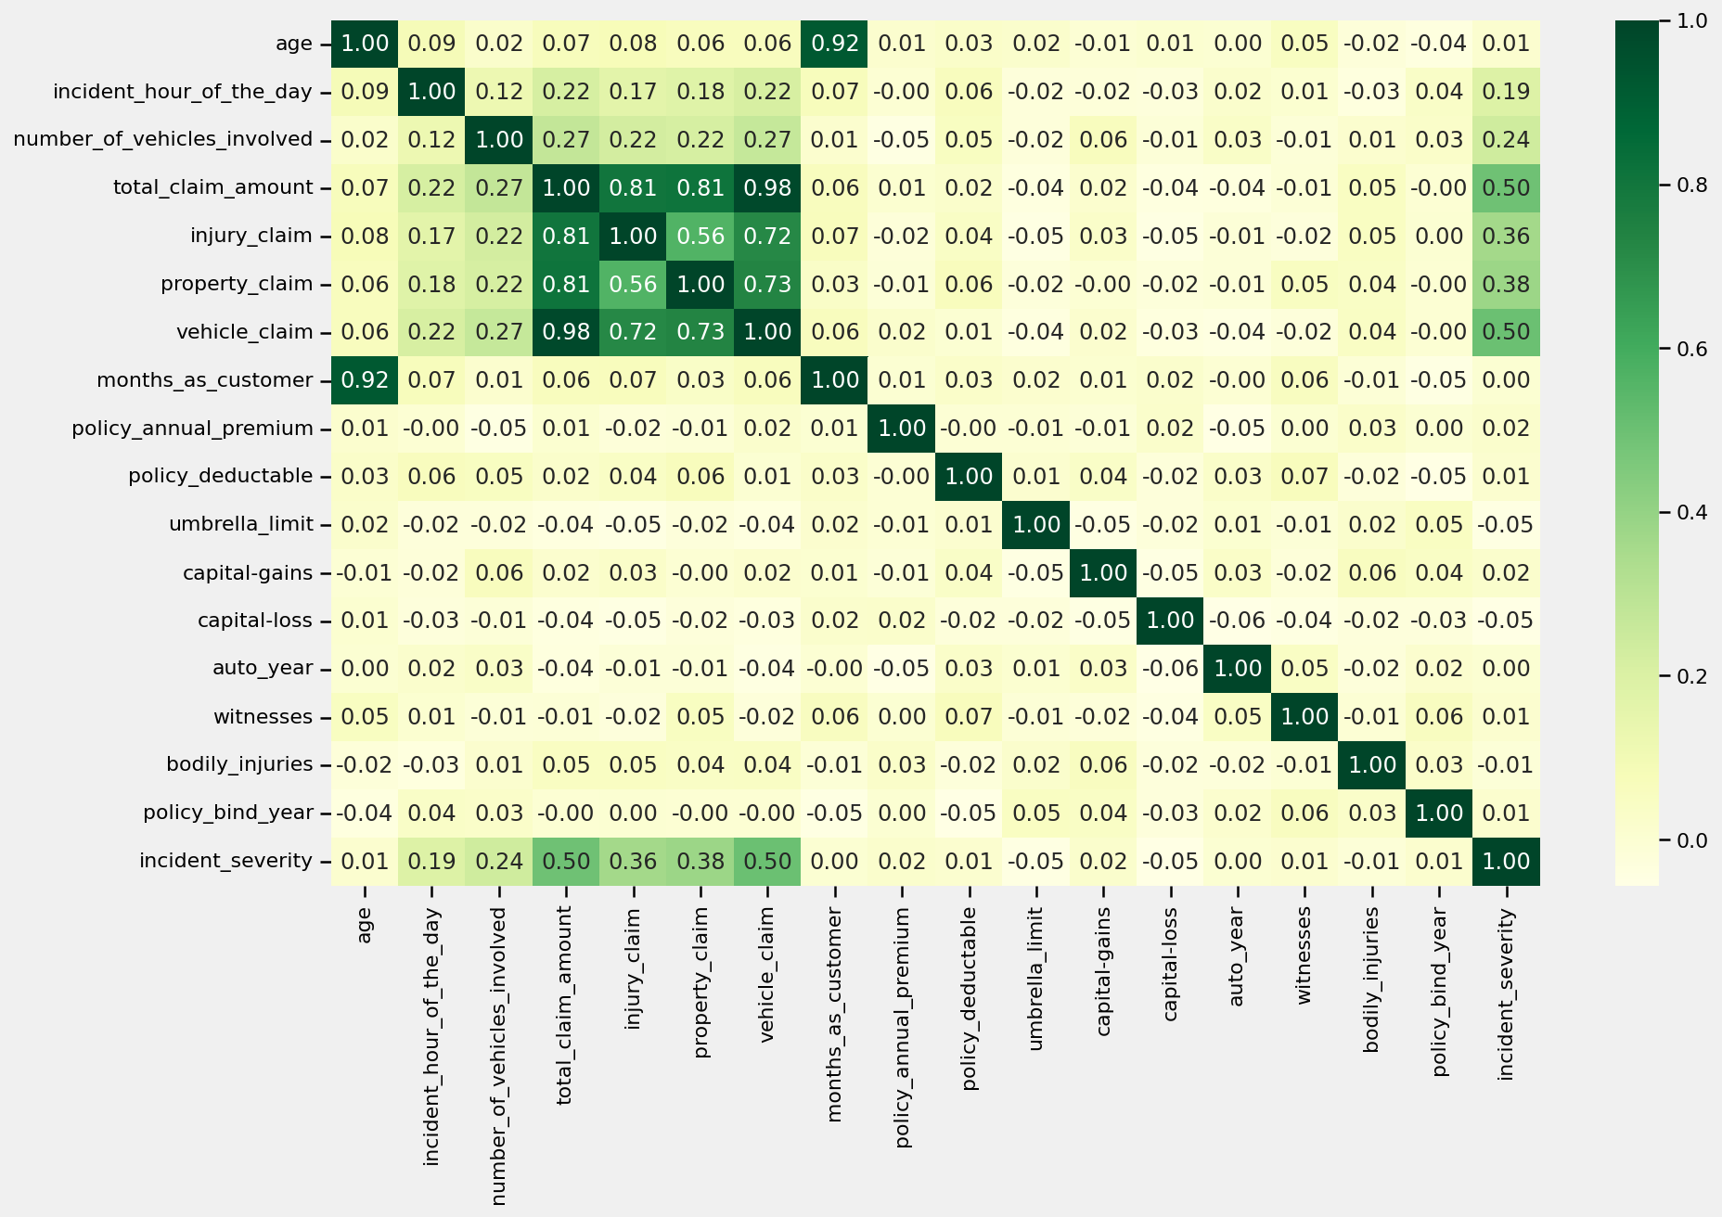
We can see there is highly correlation between columns vehical claim, total_claim amount and age and months as customer

Slide 18
PRE-PROCESSING
Interaction terms
Target variable coded as 1 for fraud, 0 for non-fraud.
Nominal variables were one-hot encoded.
Ordinal data was treated as continuous
Drop highly correlated columns from dataset which increases training speed of our algorithm
Data set was split into 75% train and 25% test set, stratified on fraud reported.

Slide 19
BASELINE SCORE
MODELING & EVALUATION
As our dataset is imbalance, accuracy is not a good measure of success. A high accuracy can be achieved by a poor model that only selects the majority class, hence, not detecting and measuring the accuracy of classifying the class of interest. In fact, predicting only the majority class will give an accuracy of 75%, specificity of 100% but a sensitivity of 0%.
As identifying as many frauds as possible is the goal, the F1 score of 0.397 was used as a baseline. However, investigations into frauds can be time consuming and expensive and may even affect customer experience. Thus, ROC AUC score will also be used to measure how well we distinguish between Fraud and legit claims. The baseline ROC AUC score is 0.50. I am to have a ROC AUC of at least 0.70.

Slide 20
Architecture for Modelling Insurance claim Fraud detection
Hyperparameter tuning without oversampling
Hyperparameter tuning with SMOTE
- Logistic regression
- K-nearest neighbors
- Random forest
- XGBoost
- AdaBoost
Evaluate all 20 models and pick the best model
Hyperparameter tuning with ADASYN
Hyperparameter tuning with bootstrap

Slide 21
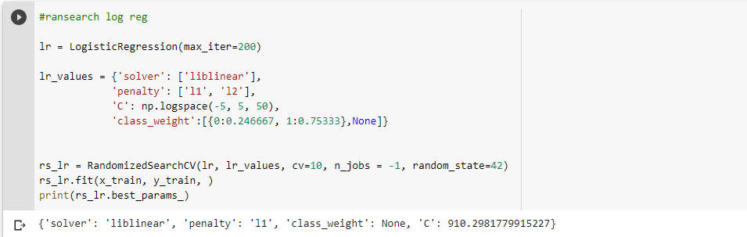
Models with class weighting and hyperparameter tuning
LOGISTIC REGRESSION
Logistic regression is a statistical method for predicting binary classes. The outcome or target variable is dichotomous in nature. Dichotomous means there are only two possible classes.

Slide 22
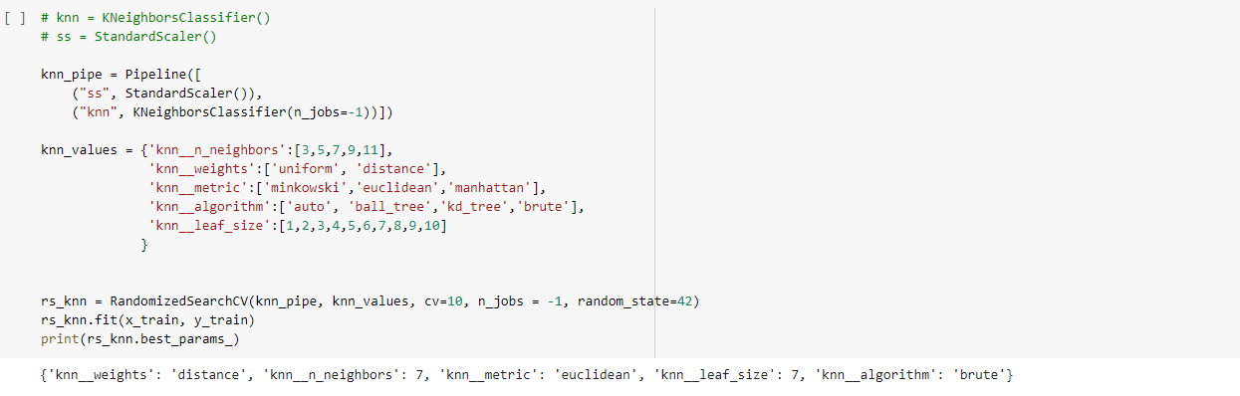
K Nearest Neighbors Classifier
K nearest neighbors (KNN) are known as one of the simplest nonparametric classifiers but in high dimensional setting accuracy of KNN are affected by nuisance features. In this study, we proposed the K important neighbors (KIN) as a novel approach for binary classification in high dimensional problems.

Slide 23
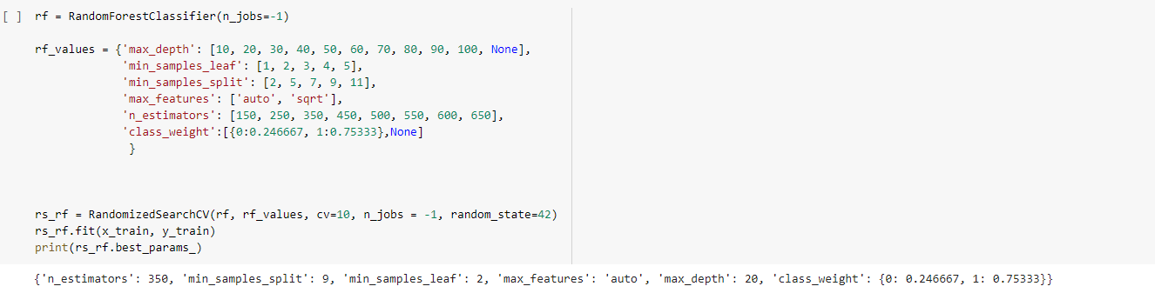
Random Forest Classifier
The random forest is an ensemble learning method, composed of multiple decision trees. By averaging out the impact of several decision trees, random forests tend to improve prediction

Slide 24
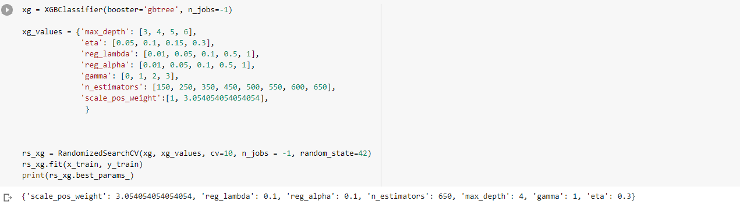
XGBoost Classifier
This modified version of XGBoost is referred to as Class Weighted XGBoost or Cost Sensitive XGBoost and can offer better performance on binary classification problems with a severe class imbalance.

Slide 25
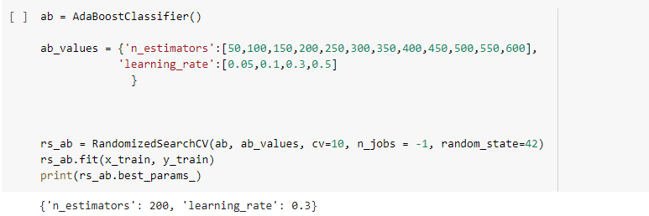
AdaBoost Classifier
AdaBoost is an ensemble learning method (also known as “meta-learning”) which was initially created to increase the efficiency of binary classifiers. AdaBoost uses an iterative approach to learn from the mistakes of weak classifiers, and turn them into strong ones

Slide 26
Models with hyper parameter tuning using oversampled data
In this step we are using the above mentioned models with hyper parameter tuning on the oversampled data.
There are two ways to handle imbalanced data:
Undersampling
Oversampling
Since undersampling results in minimizing the data which will not help us in getting best models as we were left with small dataset.
Where as Oversample equals the number of data samples for each class in our dataset, which will therefore increase the size of our data. As we get more data samples it helps us in training our model in better ways.
We used following oversampling techniques :
SMOTE
ADASYN
Bootstrapping

Slide 27
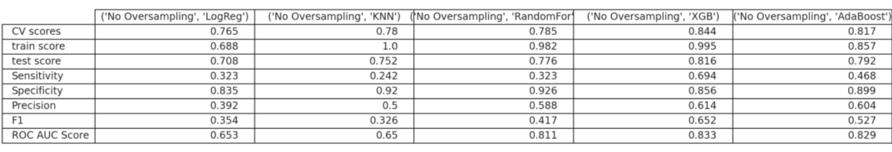
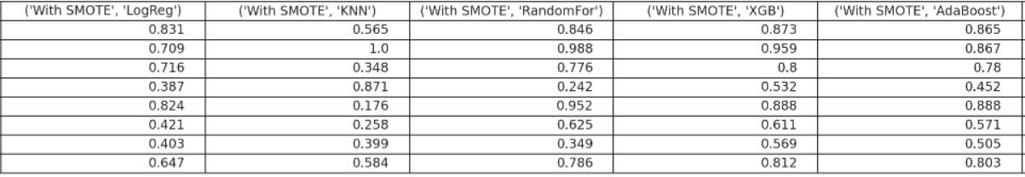
Performance metrics of each model

Slide 28
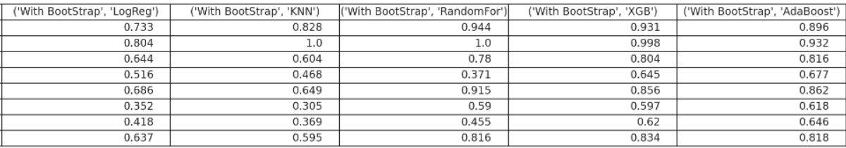
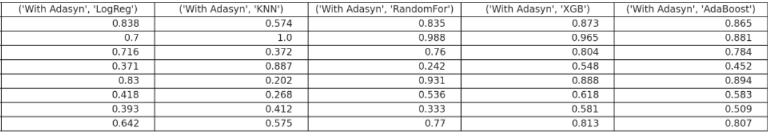
Performance metrics of each model(Cont..)

Slide 29
OBSERVATIONS
Comparing across models that were fitted on, no oversampling dataset, on SMOTE dataset, on ADASYN dataset and on bootstrapped dataset, I picked the logistic regression, KNN and CART model.
The best logistic regression model was the one trained on the ADASYN dataset. It had a F1 score of 0.403 and an AUC of 0.646
The best KNN model was the one trained on the ADASYN dataset. It had a F1 score of 0.42 and an AUC of 0.60.
CARTs performed very well on this data set. However, since CARTs' predictions are all highly correlated, the best of them were selected. The best CART model was the weighted XGBoost on the dataset with no oversampling. It yields a F1 score of 0.65 and an AUC of 0.83.
Overall, the ADASYN method seem to have the best F1 scores when compared to the other oversampling methods
From all observations we can say our final fitted model is Weighted XGBoost

Slide 30
Final Model: Weighted XGBoost
The final fitted model is the weighted XGBoost on the dataset with no oversampling. The best estimators of the model are as follows:
Scale_pos_weight: 3.054054054054054,
Reg_lambda (L2 regularization weight): 0.1,
Reg_alpha (L1 regularization weight): 0.05,
N_estimators: 650,
Max_depth: 4,
Gamma: 1,
Eta: 0.3
Notes:
scale_pos_weight = total_negative_examples / total_positive_examples

Slide 31
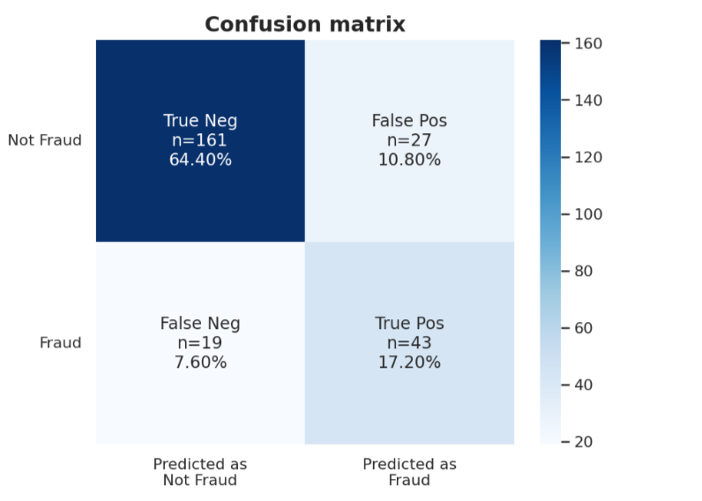
Train score: 0.992
Test score: 0.816
Train – Test = 0.176
CV score: 0.844
Sensitivity: 0.694
Specificity: 0.856
Precision: 0.614
F1: 0.652
The model had a training accuracy score of 0.992 and a test accuracy of 0.816. The high accuracy score hint of a low bias (it is only a hint as accuracy is not a good measure of bias in imbalance class problems). An accuracy score difference of 0.176 between train and test is relatively small. Thus, this model can be said to have low variance and is generalizable on unseen data.

Slide 32
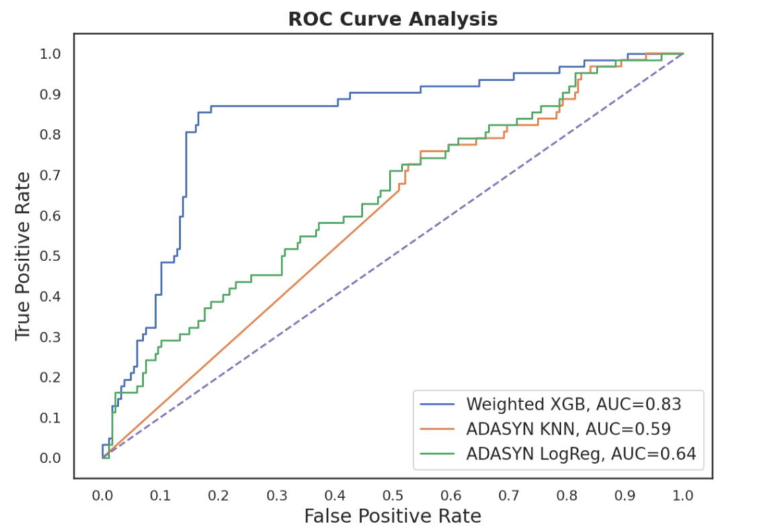
Although our model performed better in predicting non-fraud cases, the model has performed very well on fraud cases as well. We have a higher false alarm than frauds escaping the detection. It is better in our case to identify more frauds than to let fraud cases escape detection.
Thus, this model has succeeded in its purpose to detect fraud claims. Unlike the baseline model that sacrifices too much resources into investigations and hinder customer experience, we are also able to balance this out in this model. We can detect more fraud and we are able to balance this with correct prediction of non-fraud cases.

Slide 33
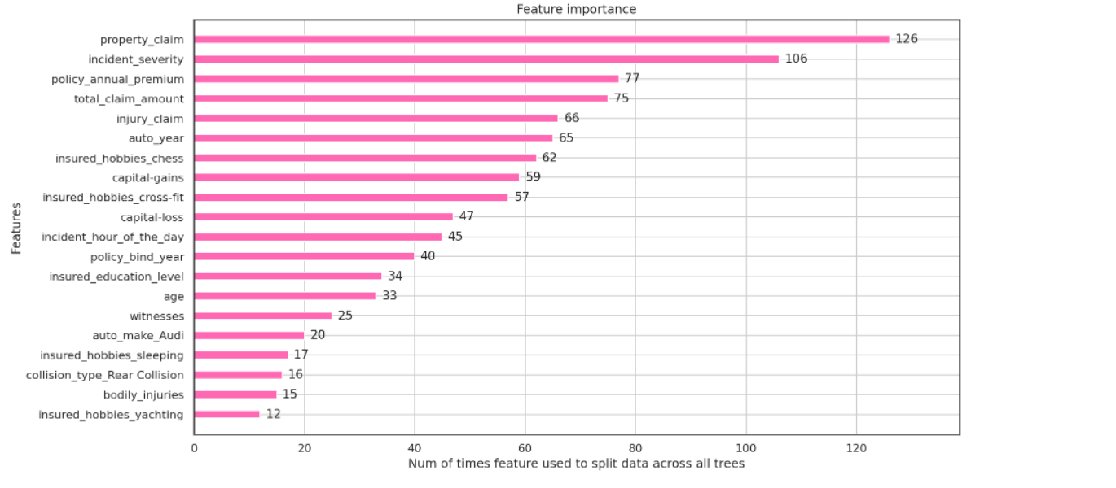
The figure above summarizes the top 20 ranked by feature importance, based on weight. Drivers with hobbies such as chess,crossfit seemed to be more prone to frauds. Incident severity and property claim are amongst the highest as well. Interaction terms such as premium and total claim amount, injury claim amount and incident severity were also top features by weight.
Notes:
Weight:
The number of times a feature is used to split the data across all trees. The final measure, implemented exclusively in XGBoost, is counting the number of samples affected by the splits based on a feature

Slide 34
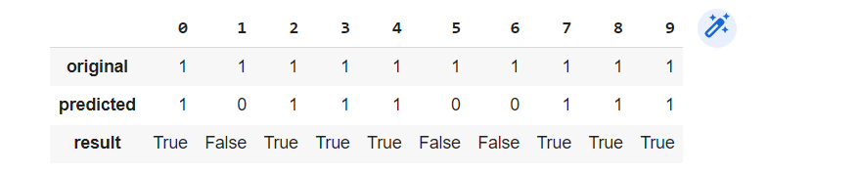
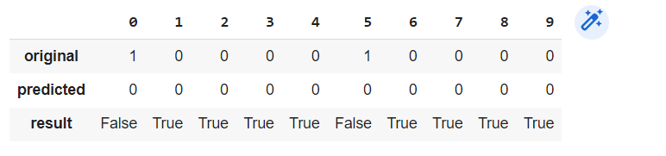
Prediction on unseen data related to fraud by using our final model
Prediction on unseen data related to non-fraud by using our final model

Slide 35
CONCLUSION
This project has built a model that can detect auto insurance fraud. In doing so, the model can reduces losses for insurance companies. The challenge behind fraud detection in machine learning is that frauds are far less common as compared to legit insurance claims.
Five different classifiers were used in this project: logistic regression, K-nearest neighbours, Random forest, XGBoost, AdaBoost. Four different ways of handling imbalance classes were tested out with these five classifiers: model with class weighting and hyperparameter tuning, oversampling with SMOTE, oversampling with ADASYN and oversampling with bootstrapping.
The best and final fitted model was a weighted XGBoost what yelled a F1 score of 0.65 and a ROC AUC of 0.83. In conclusion, the model was able to correctly distinguish between fraud claims and legit claims with high accuracy.
Notes:
Cut loss = more profit
Accuracy = no wasted resources on investigating false alarms
Without compromising customer experience
Fair to honest customers
Potentially offer more competitive pricing

Slide 36
LIMITATIONS
Dataset limited to first 2 months of 2015
Results limited generalizability to Ohio, Illinois, Indiana
Doesn’t define the type of auto insurance fraud
Very small dataset
Many times company or projects start out don’t have huge data if you wait until you have huge data
you may not be making the best date driven decisions until then
you may not even reach that stage
you may also be collecting data that may not be useful.
So you should start early!
Small steps in right direction will help you progress faster than not doing any analysis

Slide 37

THANK YOU

