Slide 1

ML SRKR
Machine Learning Code Gladiators 2021
TEAM MEMBERS
1. Varigonda Sai Nirmal Vignu(Leader)
2. Veeragani Uday Sandeep

Slide 2
Executive Summary
We worked on the Conversion fraud in Digital Advertising Data.
First we tried to understood about Essential Columns in the given data.
We made Plotting on various columns for viewing relation between the metrics.
Then we made EDA and Feature Engineering.
We Build different models with various algorithms and tested them for getting good accuracy.
Then we generated a result csv file for the submission.

Slide 3
Problem at hand
Conversion fraud in Digital Advertising
Our task is to segregate the test data between genuine and false conversions by identifying the maximum possible leads generated by the malignant technique.

Slide 4
My Best Scores
We achieved 96.9% accuracy with Random Forest Model
We achieved 95.23% accuracy with Decision Tree Model
We achieved 94.71% accuracy with Voting Model
We achieved 87.87% accuracy with KNN Model

Slide 5
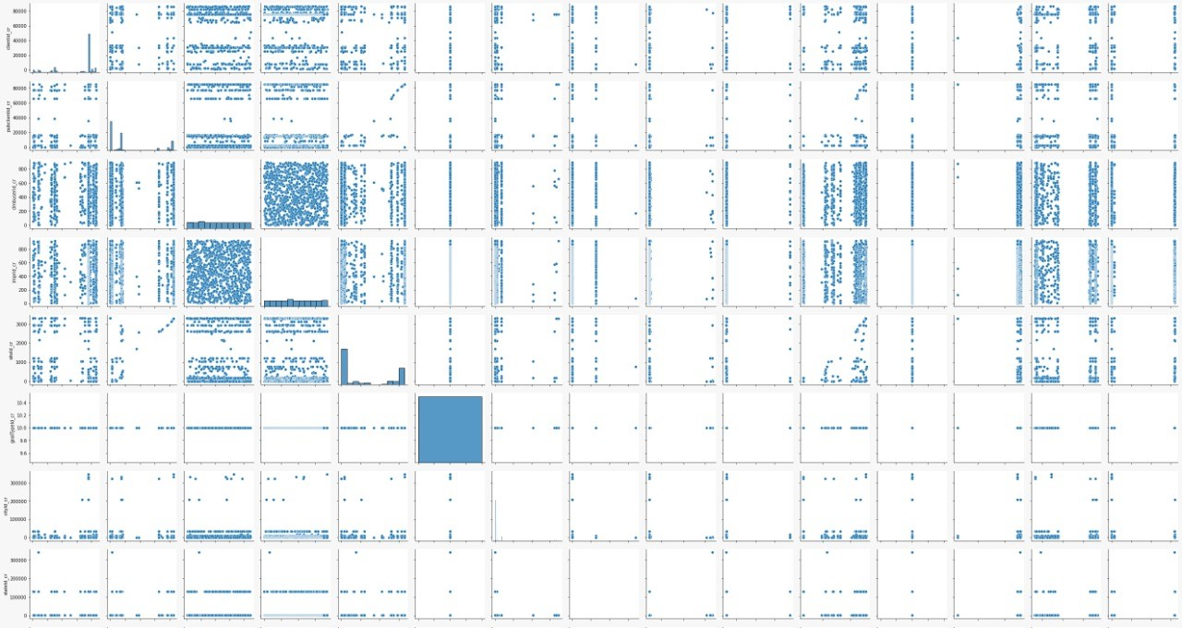

Slide 6
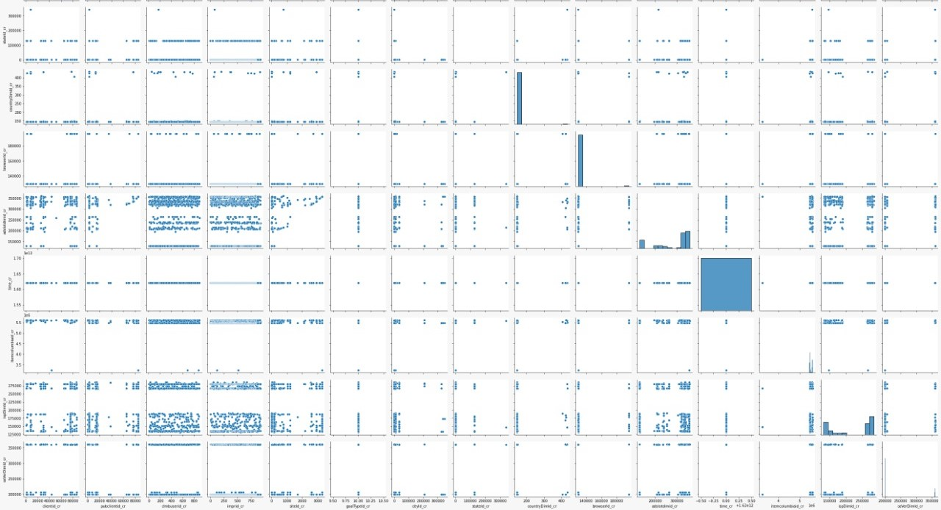

Slide 7
Tools Used
We Mainly used Machine Learning for Model Making with which we use them for Predictions on the test Data.
We use Seaborn, Sci-kit Learn, numpy, pandas as main modules for Exploring the Data
We choose Google Colab which is the best platform for DataScience Projects.

Slide 8
Why our team is the best!
We used our full potential to work as a Team and Shared our Ideas for getting good results.
We as a team have good Skill Set and worked on different Projects and shared our Knowledge through which we build good bond and understanding. Which creates good working environment.

Slide 9
Find us in LinkedIn and Github
Nirmal
Linkedin :- www.linkedin.com/in/vsnv
Github :- https://github.com/NirmalVignu
Uday
Linkedin :- https://www.linkedin.com/in/uday-sandeep-403b381a5/
Github :- https://github.com/TechUday

Slide 10
Thank you - ML SRKR

Slide 11
Challenges
We faced many Challenges with handling data as it contains more columns.
We solved these challenges with EDA by sharing insights with each other.
Our Main challenge is selecting best model, for which we overcome it by using sklearn metrics.

