Slide 1
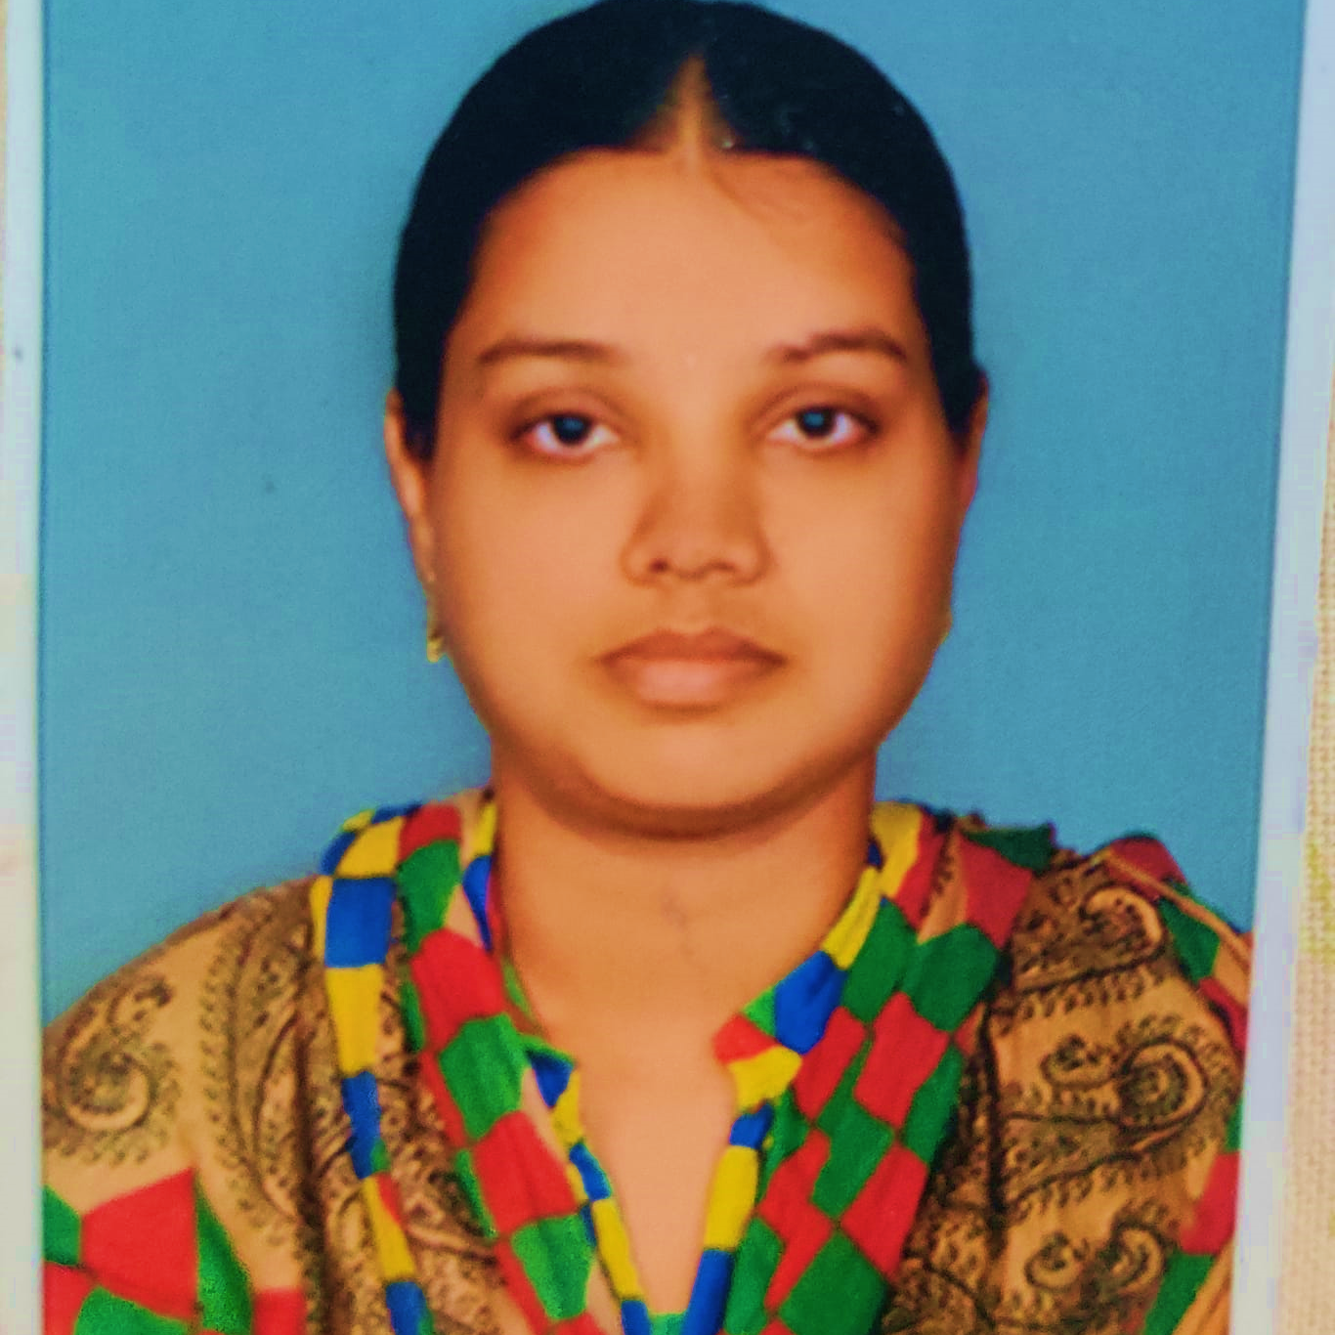



Nirmalajyothi Jagarlamudi
Analyst/Software Engineer
Bachelor of Engineering
Computer Science : 2015 - 2019
Skills
Bangalore
Java 8 /J2EE | Java Basics, OOPS, Generics, Collections, Arrays, Loops, Lambda Exp, Stream API Junit, Mockito, Servlets
Spring core | IOC & Dependency Injection, Autowire
Spring REST | REST controllers, Implementation of GET, POST, PUT & DELETE, Bean Validation & Exception Handling, Testing Services, Controller & Repository layer
Spring Data JPA | Implement DAO layer using spring Data repositories, Transaction Management
Spring Boot Microservices | Spring Boot Starters, annotations, Messaging Service, Sync/Async comms, Swagger API specifications
Spring Cloud | Eureka, Hystrix, Zuul & Config Server
React | Components, Hooks, Event handling, Redux, Reducers, Testing using Jasmin & Karma
Database | MongoDB No Sql Advanced RDS Basics
UI Tech | HTML 5 & CSS 3,JavaScript, ES6 & TypeScript Reusable templates, Optimized UI Designed
Tools | Git, Postman, Maven, IDE,PMD,Checkstyle
Add On skills | Communications, Team management. Peer learning
NIRMALA-JYOTHI.JAGARLAMUDI@CAPGEMINI.COM
+91 6304241940
A4
Hands on experience in developing web pages using HTML5, CSS3, Object Oriented Java script, ES6, JSON, XML. Good understanding of Document Object Model (DOM) and DOM Functions.
Proficient React developer with working knowledge on ReactJS(Hooks, redux).
Java Microservice Development knowledge using Spring boot and spring cloud framework on an intermediate level.
Implemented Nodejs in case study and upskilling his knowledge continuously.
Experienced in practicing TDD based development using tools like Mockito, Junit, Istanbul and ensuring quality
Online Railway Reservation System
Completed end to end case study of Online Railway Reservation System Application along with Swagger and Data validation for UI for Customer Login.UI and React Bootstrap used for user interface.

