Slide 1
Employee Data Analysis using Excel
STUDENT NAME: Nirmala. R
Reg No: 312209494
DEPARTMENT: B.COM(BANK MANAGEMENT)
COLLEGE: Anna Adarsh college for women chennai
1
Notes:
1

Slide 2

PROJECT TITLE
Employee Performance Analysis using Excel
2

Slide 3

AGENDA
Problem Statement
Project Overview
End Users
Our Solution and Proposition
Dataset Description
Modelling Approach
Results and Discussion
Conclusion
3/21/2024 Annual Review
3

Slide 4

PROBLEM STATEMENT
Primary Objectives:
Improved Performance: Identify areas of strength and weakness, set goals, and provide feedback to enhance employee performance.
Decision-Making: Inform decisions on promotions, demotions, transfers, or terminations.
Additional Benefits:
Aligns with Organizational Goals: Ensures employees' objectives are aligned with company strategic objectives.
Compliance and Risk Management: Documents performance issues, helping mitigate potential legal risks.
Boosts Productivity: Encourages accountability, efficiency, and effectiveness.
By conducting regular employee performance analysis, organizations can optimize talent utilization, drive business outcomes, and create a culture of continuous improvement.
4

Slide 5

PROJECT OVERVIEW
EMPLOYEE PERFORMANCE ANALYSIS
Employee performance analysis, also known as performance evaluation or appraisal, is a systematic process to assess an employee's work performance, accomplishments, and areas for improvement.
By implementing a structured employee performance analysis process, organizations can optimize talent utilization, drive business outcomes, and foster a culture of continuous improvement.
5

Slide 6




WHO ARE THE END USERS?
Managers
Employees
External Stakeholders
6

Slide 7
OUR SOLUTION AND ITS VALUE PROPOSITION
Conditional Formatting :
To highlight the Missing Value in the given data.
Filter:
To filter the Missing values in the given data.
Formula:
To calculate the Performance Level in the given data.
=IFS(Z2>=5,”very high”,Z2>=4,”high”,Z2>=3,”med”,”True”,”Low”)
Pivot Table:
To summaraize the given data.
Graph:
To visualize the given data in chart representation.
7

Slide 8
Dataset Description
Employee dataset from kaggle
26 features available, but considered only 9 features,They are:
EmpID = Numeric
FirstName = Text
LastName = Text
BusinessUnit = Text
EmployeeStatus = Text
EmployeeType = Text
EmployeeClassificationType = Text
Performance Score = Text
Current Employee Rating = Numeric

Slide 9

THE "WOW" IN OUR SOLUTION
Performance level Calculation:
=IFS(Z2>=5,”very high”,Z2>=4,”high”,Z2>=3,”med”,”True”,”Low”)
3/21/2024 Annual Review
9

Slide 10
MODELLING
Data Collection:
1) Download data from Skillsbuild platform.
2) Extracted the Zip. File.
3) Save the data into a excel file.
Feature Collection:
1) 26 Features in the dataset,but selected only 9 out of it.
Data Cleaning:
1) Highlighted the Missing Value in the given Dataset using Condiional Formatting.
2) Filtered the Blank cells using filter option.
Performance Level Calculation:
1) Using =IFS(Z2>=5,”very high”,Z2>=4,”high”,Z2>=3,”med”,”True”,”Low”) formula we calculated the Performance level.
2) Using Autofill we done the same thing to other rows.
Pivot Table:
We summarized the dataset.
Graph Chart:
1) Data visualization.
10

Slide 11
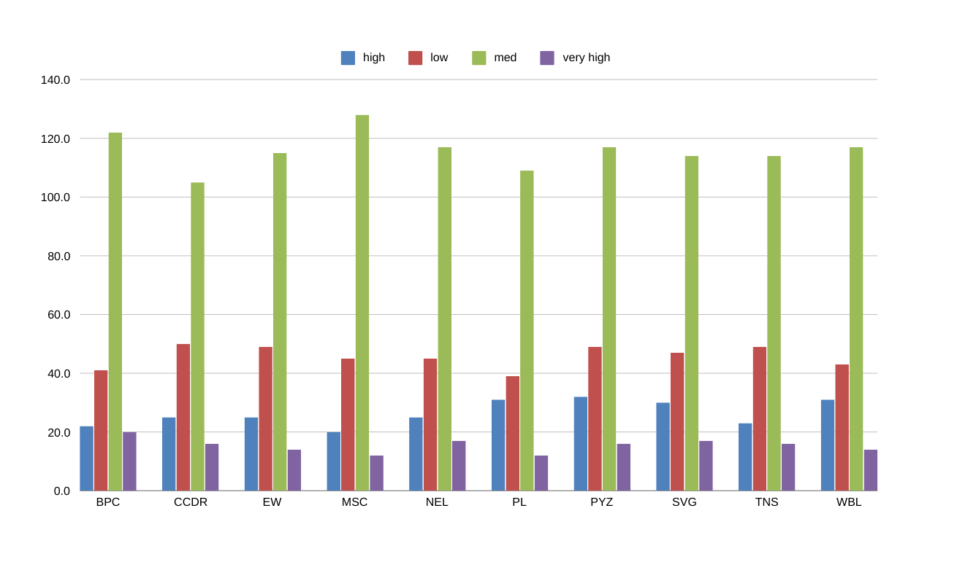
RESULTS
11

Slide 12
conclusion
By comparing the performance of the employees the no. of employees who are in medium level are in higher amount in the organization than very high and high performance employee we need to motivate the employee more to betterment the organization.
High and very high performance employees can train the low and medium level empolyees for the growth of the firm.

