Slide 1
PRODUCT WALKTHROUGH
Backend for
Everyone
Presentation flow
1
Problem
2
Create project
3
Connect PostgreSQL
A guided workflow for turning a frontend idea into a working PostgreSQL-backed API.
4
Guided Builder
5
Backend Ready
6
API key
7
Playground
8
Result
Detailed product walkthrough

Slide 2
The problem
A frontend can look finished while the product is still blocked by backend setup.
FRONTEND READY
The setup gap
What changes
The developer already has the app idea and interface.
✓
One guided sequence
Database
CRUD API
schema + connection
routes + validation
✓
PostgreSQL connection first
What they need next is real data, working operations, controlled access, and a way to prove the backend before integration.
✓
Backend described in app terms
Access
Testing
keys + authorization
requests + debugging
✓
Runtime access is explicit
✓
API can be tested immediately
Backend for Everyone turns the setup gap into a clear path: create → connect → describe → generate access → test.

Slide 3
How Backend for Everyone changes the workflow
The product turns repeated backend setup into one guided sequence.
1
2
3
4
5
6
7
Create project
Connect PostgreSQL
Guided Builder
Create backend
API key
Playground
Frontend
Core idea
Let the user describe the app in familiar terms first. The platform handles the repeated setup needed to turn that description into a database-backed API that can be tested immediately.

Slide 4
1
START THE BACKEND
Create a project
What the user does
What the platform handles
Create a backend project.
✓
Creates an owned project workspace.
Choose a project name.
✓
Uses the slug as the runtime namespace.
Use a globally unique API slug.
✓
Provides one place for database and API configuration.
Why this matters
The user begins with an app concept and a clear project identity—not with backend files.

Slide 5
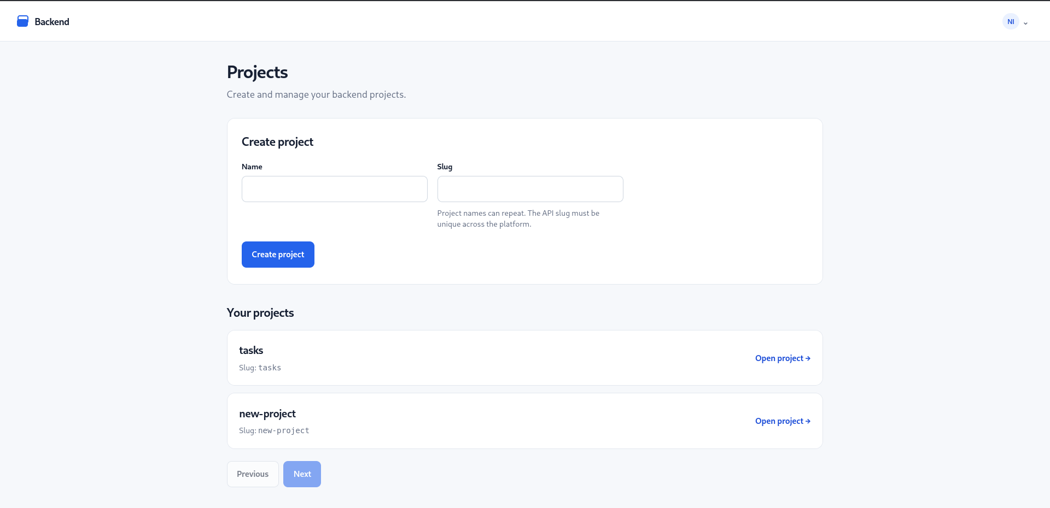
1
PRODUCT SCREEN
Create project — product screen
The project page keeps the first step simple: name the project, choose the API slug, and continue.

Slide 6
2
USE REAL APPLICATION DATA
Connect PostgreSQL
What the user does
What the platform handles
Enter host, port, database and schema.
✓
Checks connectivity and schema availability.
Provide database credentials.
✓
Stores connection configuration securely.
Test the saved connection.
✓
Keeps application rows in the connected database.
Why this matters
The database stays visible and customer-controlled while the platform removes the repetitive connection plumbing.

Slide 7
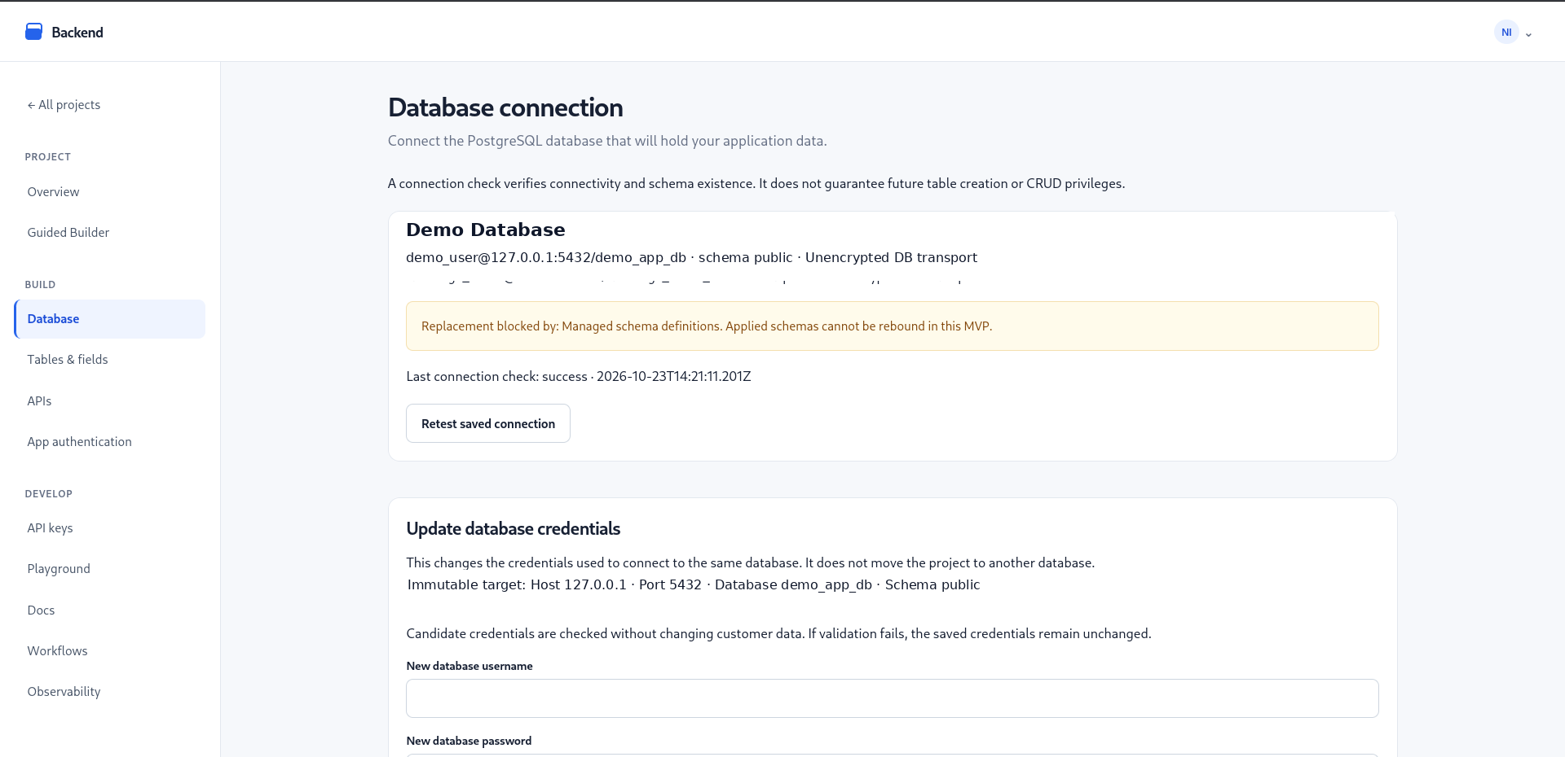
2
PRODUCT SCREEN
Database connection — product screen
The saved PostgreSQL target is visible, can be retested, and remains the storage location for the app data.

Slide 8
3
DESCRIBE THE APP, NOT THE PLUMBING
Guided Builder
What the user does
What the platform handles
Review the Task Manager template.
✓
Translates choices into managed schema metadata.
See fields such as title, description, completed and due date.
✓
Maps selected actions to CRUD configuration.
Choose the actions the app should support.
✓
Checks prerequisites before backend creation.
Why this matters
The user thinks in tasks, fields and actions before needing to think in SQL tables, handlers and route code.

Slide 9
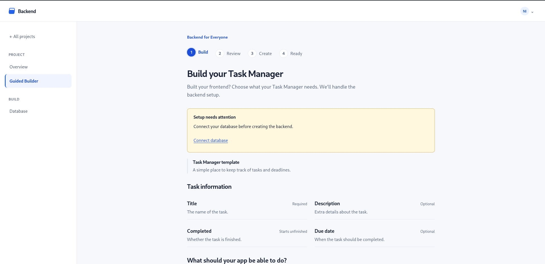
3
PRODUCT SCREEN
Guided Builder — product screen
The builder shows the Task Manager structure and clearly tells the user when setup still needs attention.

Slide 10
4
TURN THE CONFIGURATION INTO A USABLE BACKEND
Backend Ready
What the user does
What the platform handles
Review the backend before creation.
✓
Applies the managed schema to PostgreSQL.
Create the backend once prerequisites are satisfied.
✓
Enables the selected CRUD operations.
Use the displayed runtime API address.
✓
Detects the existing backend on reload instead of recreating it.
Why this matters
“Ready” is the moment the user moves from configuration to something the frontend can actually call.

Slide 11
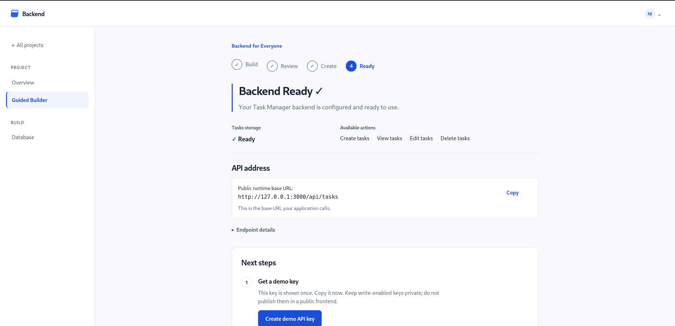
4
PRODUCT SCREEN
Backend Ready — product screen
The user gets one clear state: storage ready, actions available, runtime address visible, and next steps explained.

Slide 12
5
CHOOSE HOW THE RUNTIME IS ACCESSED
Generate an API key
What the user does
What the platform handles
Give the key a recognizable name.
✓
Creates project-scoped runtime credentials.
Choose a scope such as read-only or read-write.
✓
Stores the secret safely instead of exposing it repeatedly.
Revoke keys that should no longer be trusted.
✓
Separates backend creation from runtime authorization.
Why this matters
The user explicitly controls access instead of receiving an automatically exposed backend.

Slide 13
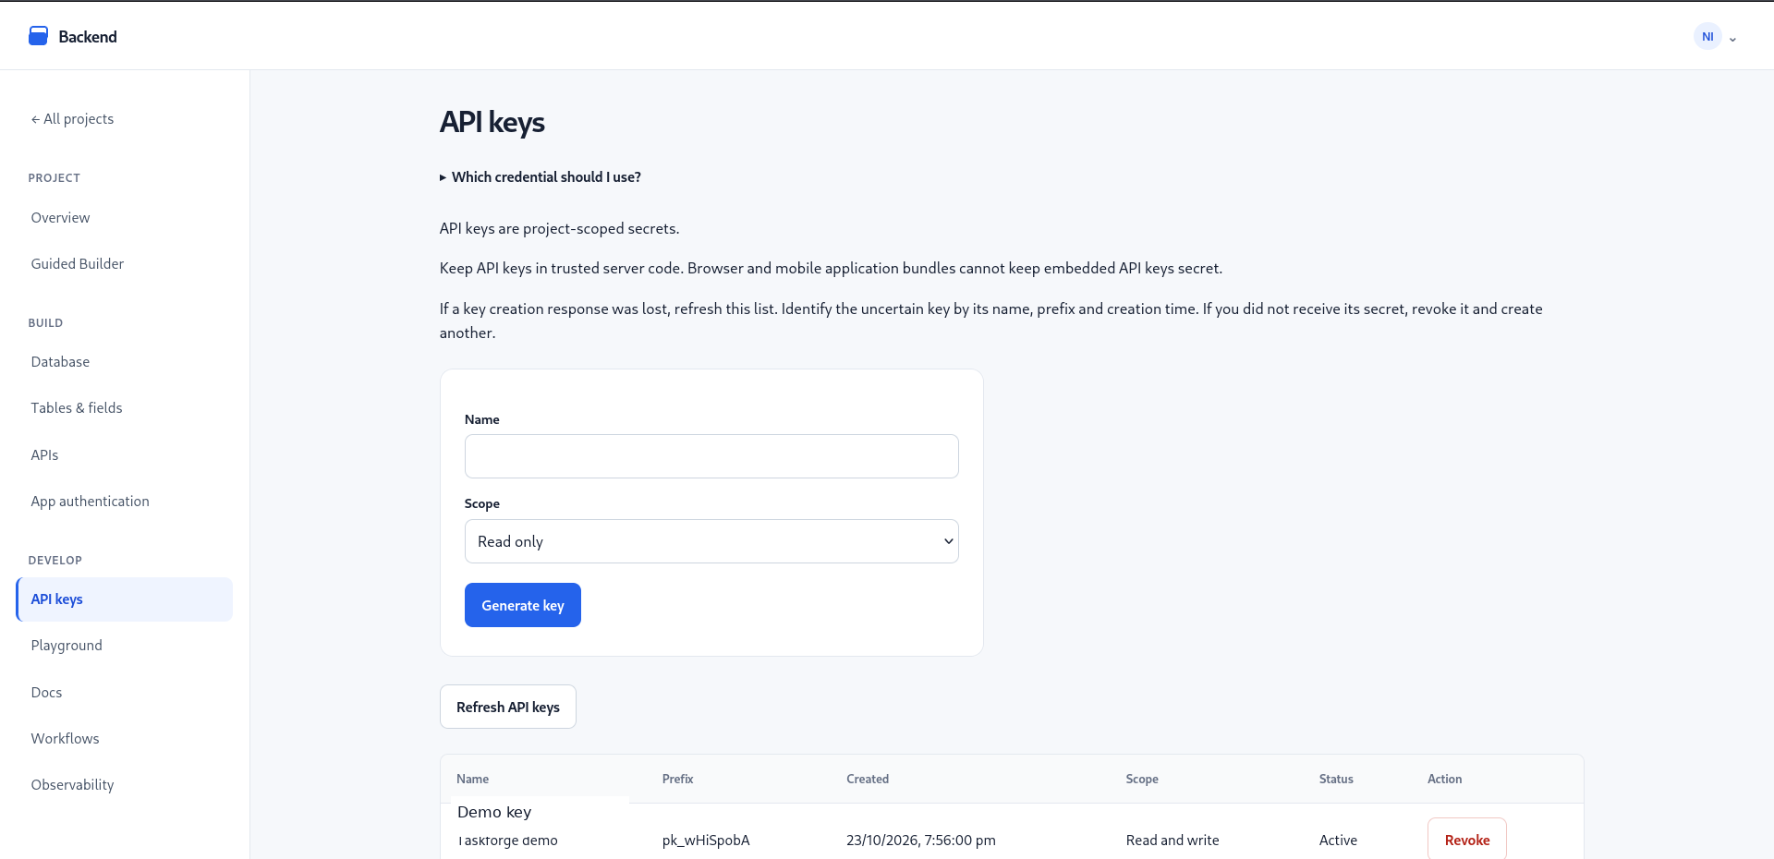
5
PRODUCT SCREEN
API keys — product screen
The API key page keeps credential generation, scope, status and revocation visible in one place.

Slide 14
6
PROVE THE BACKEND BEFORE INTEGRATING THE FRONTEND
Test in Playground
What the user does
What the platform handles
Choose a configured endpoint.
✓
Uses the generated runtime URL.
Provide the required credential mode.
✓
Runs the request against the connected PostgreSQL data.
Send real requests and inspect responses.
✓
Helps separate backend issues from frontend integration issues.
Why this matters
The first API test happens inside the product, so the developer does not need a separate client just to prove the backend works.

Slide 15
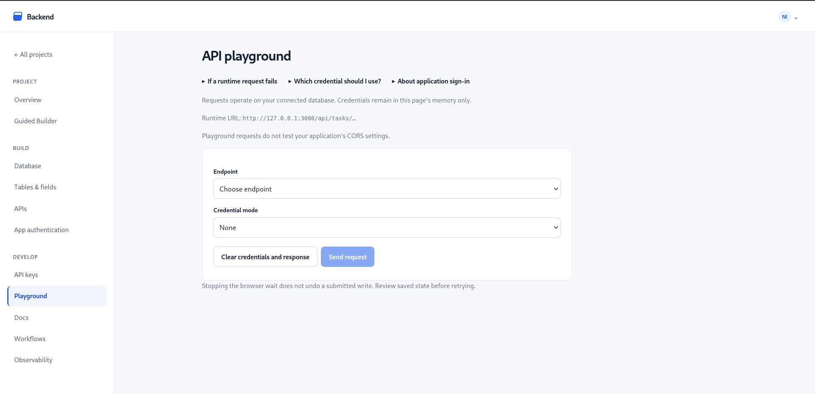
6
PRODUCT SCREEN
API Playground — product screen
The Playground exposes the runtime URL, endpoint selection, credential mode and request action in one place.

Slide 16
End-to-end proof
The complete workflow was tested against a real local PostgreSQL database, not a static mock.
What we verified
Persisted example
✓
Project created
title
Test Task
✓
PostgreSQL connection verified
Final integration test
description
✓
Guided Builder reached Backend Ready
completed
false
✓
Read-write API key created
✓
POST created a task
The same row existed in PostgreSQL and was returned through the runtime API.
✓
GET returned the same task
✓
Reload remained Backend Ready

Slide 17
The meaningful change
The project reduces the setup barrier between a frontend idea and a tested backend.
Without the guided workflow
With Backend for Everyone
Design schema manually
✓
Create project
Create CRUD handlers and routes
✓
Connect PostgreSQL
Set up credentials and authorization
✓
Use Guided Builder
Find an API testing workflow
✓
Generate controlled API access
Debug backend before frontend integration
✓
Test the runtime immediately

Slide 18
A simple mental model
Two paths make the product easy to understand: configure the backend once, then use the runtime repeatedly.
1 · CONFIGURE
Dashboard + Guided Builder
Platform configuration
Connected PostgreSQL
Project · fields · actions · access
Schema metadata · policies · endpoint setup
Managed structure is applied to the database you own
same database
2 · USE THE API
Frontend app
Runtime API
Application data
Uses the runtime URL + credential
Validates · authorizes · executes the operation
Real rows are read from and written to PostgreSQL
You describe the backend → the platform handles the plumbing → your application keeps using its own PostgreSQL data.

Slide 19
Backend for Everyone
A clearer path from frontend idea to a working backend.
Connect
Describe
Create
Test
PostgreSQL
the backend
runtime API
before integration
GitHub: Nirmalsiddh/backend-for-everyone

