Slide 1
E0 271
Graphics and Visualization
August 21
Course Project presentation on
Visualization of Vortex Shedding and tracking utilizing a Maximum-Weight Independent Set problem
By -
Samarth Singh
Nirmalya Gayen
Piyush Kumar Mishra
Graphics and Visualization

Slide 2
Problem Statement
In the 3-D flow field dataset provided, visualize the vortices formed by the flow around the edges of the cylindrical object. Track and visualize the vortex street pattern formed. Model the problem of tracking the vortices in a maximum weight independent set problem on a graph and solve that to track vortices. Visualize the results and evaluate.
Graphics and Visualization

Slide 3
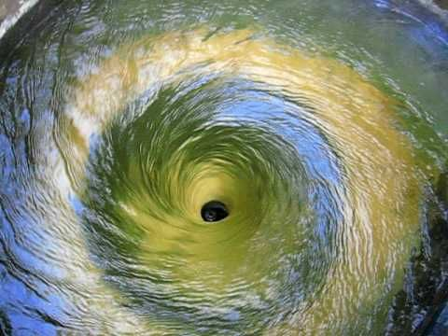
Motivation
A vortex is a region in the fluid where flow revolves around an axis. It is the swirling motion of the fluid in a region.
Vortices are of importance in many fields such as:
Vortices in Earth's atmosphere are important for meteorology.
Whirlpools and tornadoes are vortices.
Vortices are prominent features in other planets and starts.
Vortices play important role in electromagnetic fields and fluxes
Used to design the special suits for fighter jet pilots.
A vortex in water
A very important field where visualization of vortices is heavily used and studied is of aerodynamics.
Graphics and Visualization

Slide 4
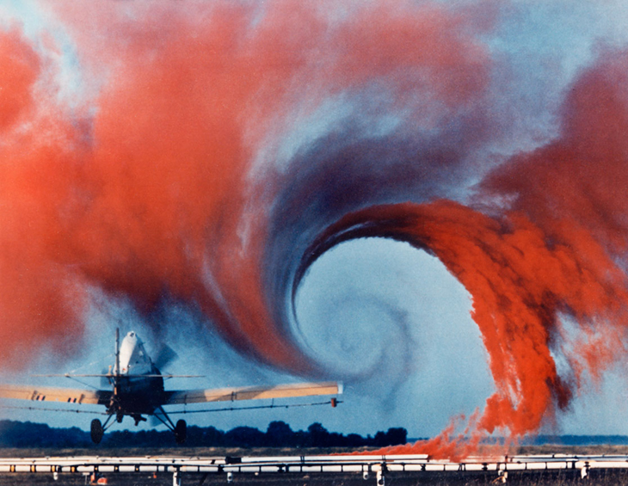
Motivation
Vortices in aerodynamics:
Vortices are formed at the tips of the wings of airplanes. These are called wingtip vortices and cause turbulence, drag and it even affects the lift coefficient of the wings.
Vortices also produce significant drag in other vehicles and is important also in racing cars and designing fuel efficient vehicles.
Various shapes and surfaces are thus studied that may reduce the formation of vortices, like addition of winglets at the end of the wing. Identification and visualization of vortices plays a very important part in it.
wingtip vortex
Graphics and Visualization

Slide 5
Work Done
Identification of vortices
Tracking of vortices with time in two steps -
Detection of continuation of vortices using maximum weight Bi-Partite matching.
Detection of splits and merges by greedily solving maximum weight Independent Set problem.
Additional tasks.
Graphics and Visualization

Slide 6
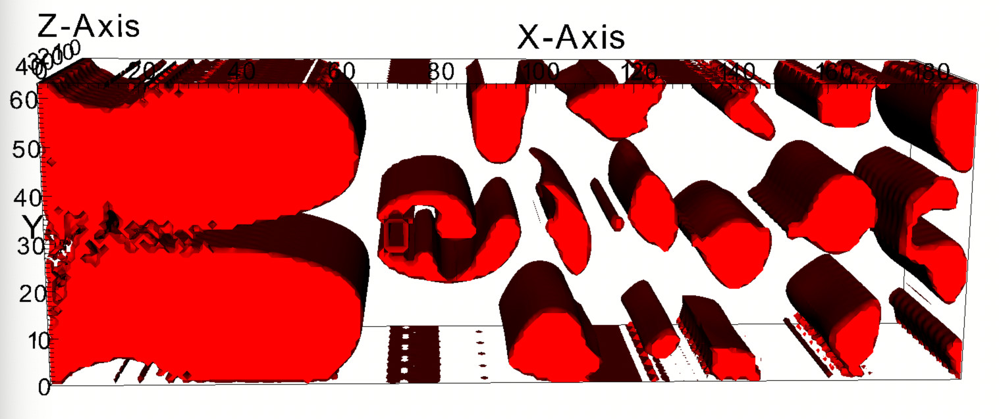
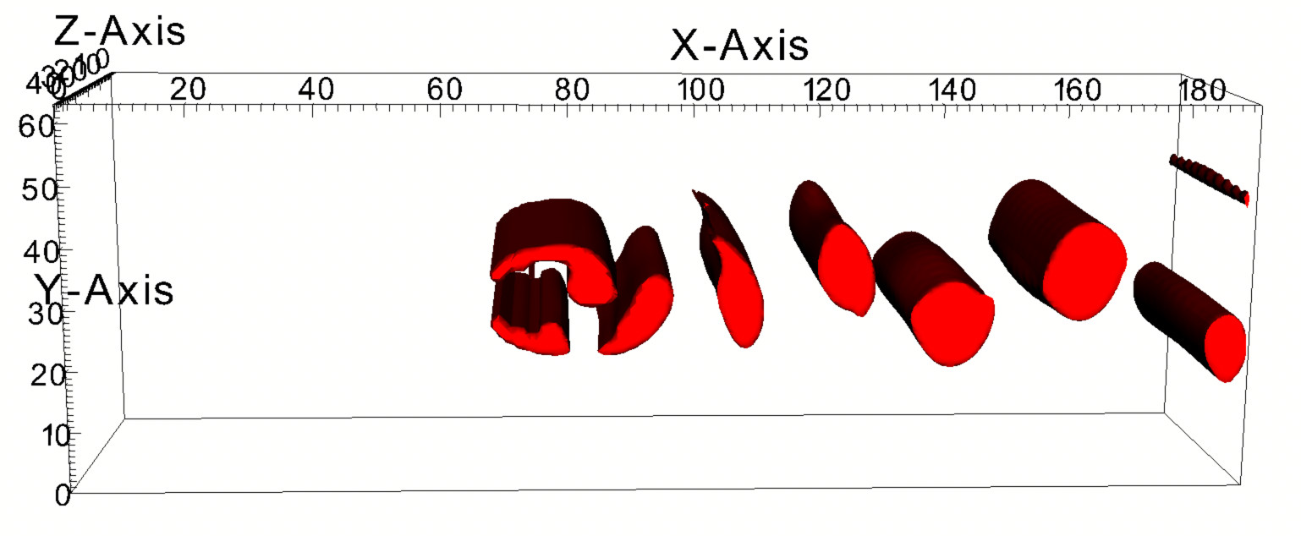
Identification of Vortices
We use Okubo-Weiss parameter for detection of vortices.
It is a measure of the relative importance of flow strain and vorticity.
Each component with a value greater than 0 represents a vortex.
Using raw O-W parameter
Identifying vortices directly using O-W parameter shows a lot of vortices and it is difficult to understand anything.
We thus, filter out the positive values less than 0.075 and then visualize the vortices.
Using filtered O-W parameter values, vortex street patterns are much more clearly visible.
Using filtered O-W parameter
Graphics and Visualization

Slide 7
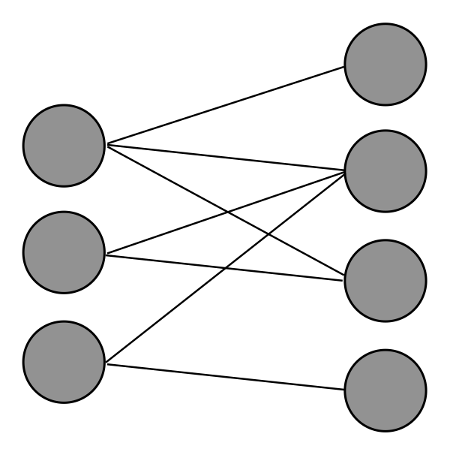
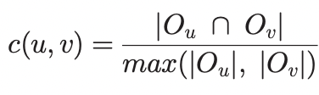
Tracking of Vortices
Vortices in each timestep are represented as nodes of a graph with edges between every vortex in two successive timesteps.
v1
Edges are assigned weights based on the similarity of the two vortices.
u1
v2
As in the original paper, we use normalized overlap volume as the similarity measure.
u2
v3
u3
v4
O_{u} and O_{v} represent the points in the corresponding vortices.
T_{n}
T_{n+1}
Vortices in successive timesteps are represented as nodes and edge weights represents similarity of vortices.
This results in a weighted bi-partite graph across two successive timesteps.
Graphics and Visualization

Slide 8
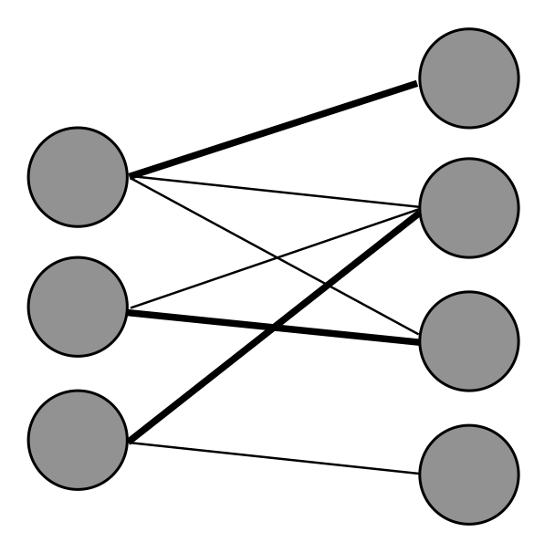
Tracking of Vortices
The higher weight represents similarity between the vortices across timesteps. Thus, the edges with maximum weights represent continuation of vortices with time.
v1
v1
u1
v2
u1
v2
Solving for maximum weight Bi-Partite matching gives the best possible events that represent continuation of vortices.
u2
v3
u2
v3
u3
u3
v4
v4
The matching gives us continuation of vortices, we still need to track splits and merges of the vortices.
Vortices in successive timesteps are represented as nodes and edge weights represents similarity of vortices.
Solving for maximum weight bi-partite matching gives 1:1 correspondence representing continuation of vortices.
Graphics and Visualization

Slide 9
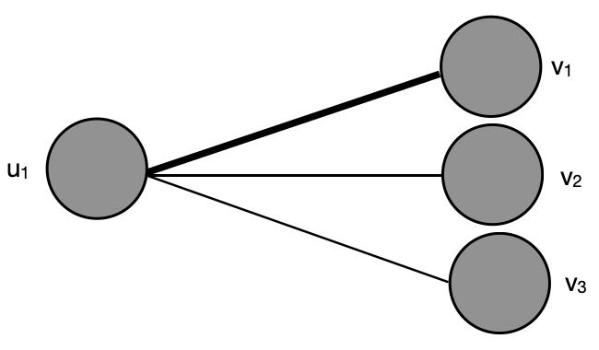
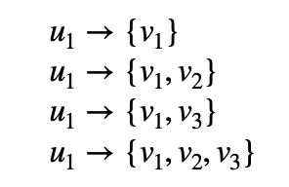

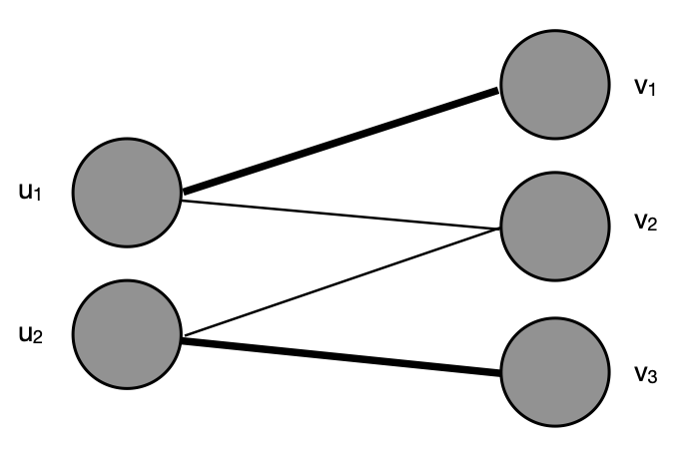
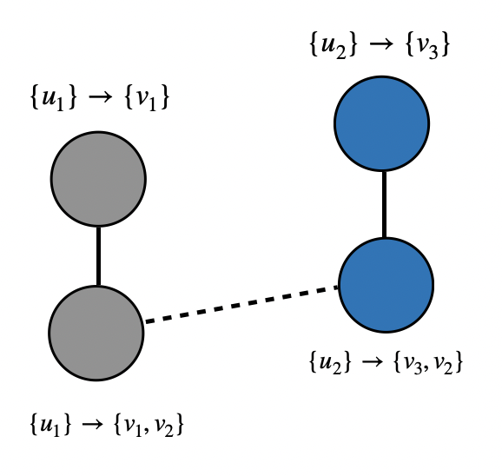
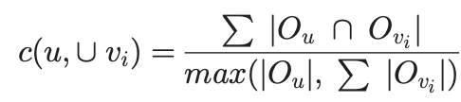
Tracking of Vortices
Along with v₁, {v₂,v₃} are also connected to u₁. Thus,
Represent all possible split explanations from u₁
Similarly, merges are also modeled.
By representing each of these explanations as nodes and edges between nodes which have some common vortex gives another graph, where each node represents a possible explanation.
Nodes are assigned weights based on union overlap normalized by union volume
Explanations resulting from each matching edge forms a clique in the graph and we can only pick one node from each clique so that there is no conflict.
To pick a node from each clique such that there is no conflict and overall weight is maximum gives most likely explanations and is same as solving a maximum weight independent set problem on a graph.
Graphics and Visualization

Slide 10
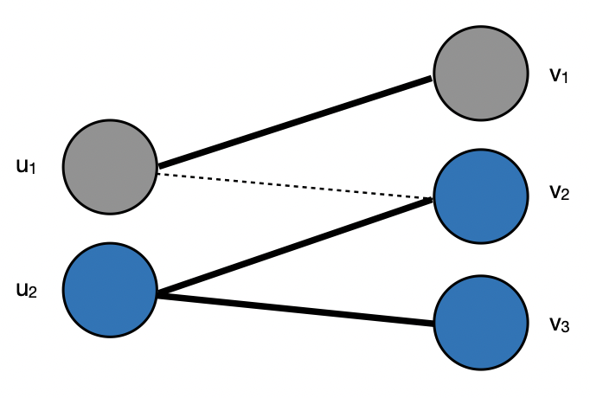
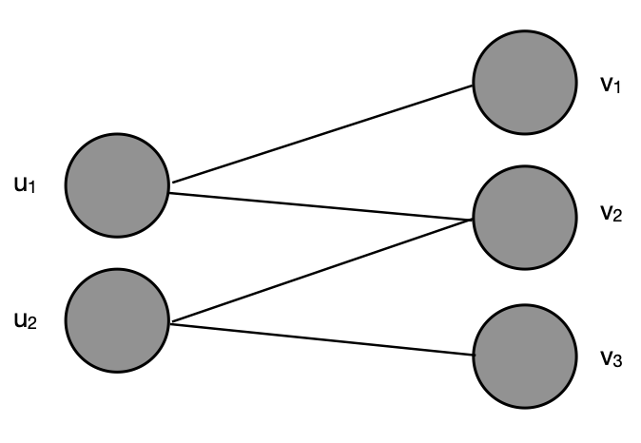
Tracking of Vertices
Each node represents a vortex and edges represent similarity of vortices in successive timesteps
1:1 correspondence representing continuation of vortex found by solving maximum weight Bi-partite matching.
Each node represents a possible explanation, thick edges represent connection within a clique, dashed show cross-clique connection.
Weight of each node is the similarity benefit.
To pick one explanation from each clique that has maximum weight, the problem is same as solving a maximum weight independent set problem.
Graphics and Visualization

Slide 11
Tracking of Vortices
Greedy event selection.
As we need to select only one node from each clique, the selection problem can be modelled as a Depth First Search tree.
To ensure that important explanations are selected, we first sort the cliques on decreasing order of difference of weights of two highest weighted explanations. This allows best choices to be selected first.
Now we traverse the entire DFS tree and pick the highest weighted not conflicting nodes from each clique.
By ordering the cliques based on decreasing weight difference of highest weighted explanations, we minimize the penalty of choosing the non highest weighted explanations (to prevent conflicts) in later stages.
Graphics and Visualization

Slide 12
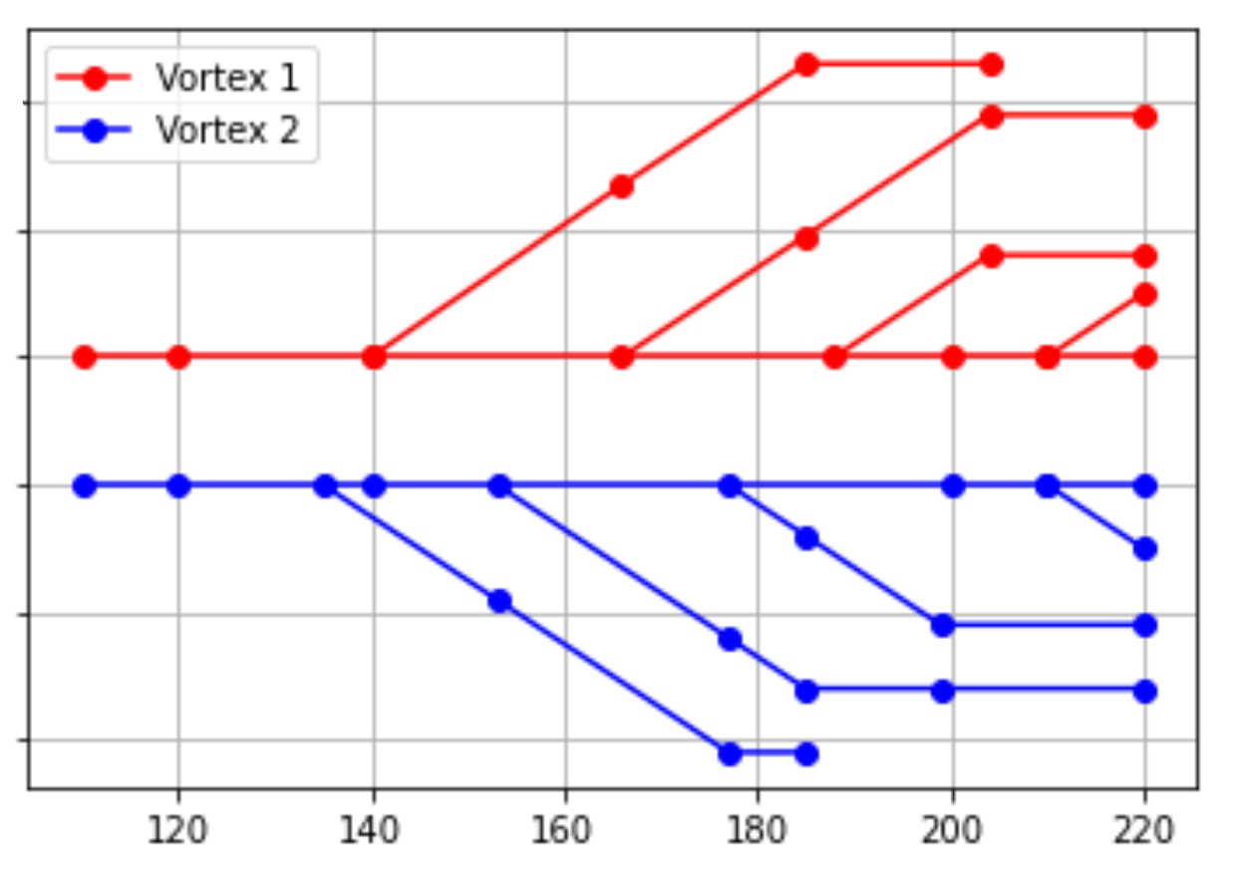
Results
The tracking graph generated using this approach is:
This graph shows how vortices are split from existing vortices in alternating order.
Evolution of vortices with time (time on x-axis)
Graphics and Visualization

Slide 13
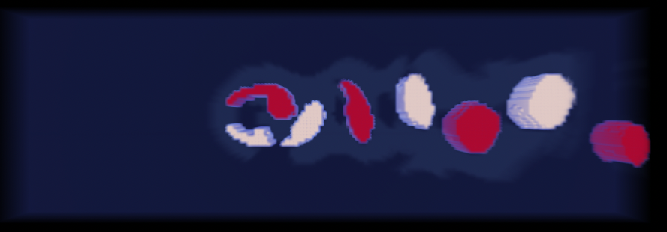
Results
By providing different colors to the two seed vortices, clear vortex street pattern is visible.
Generation of von Kármán vortex street pattern
Graphics and Visualization

Slide 14
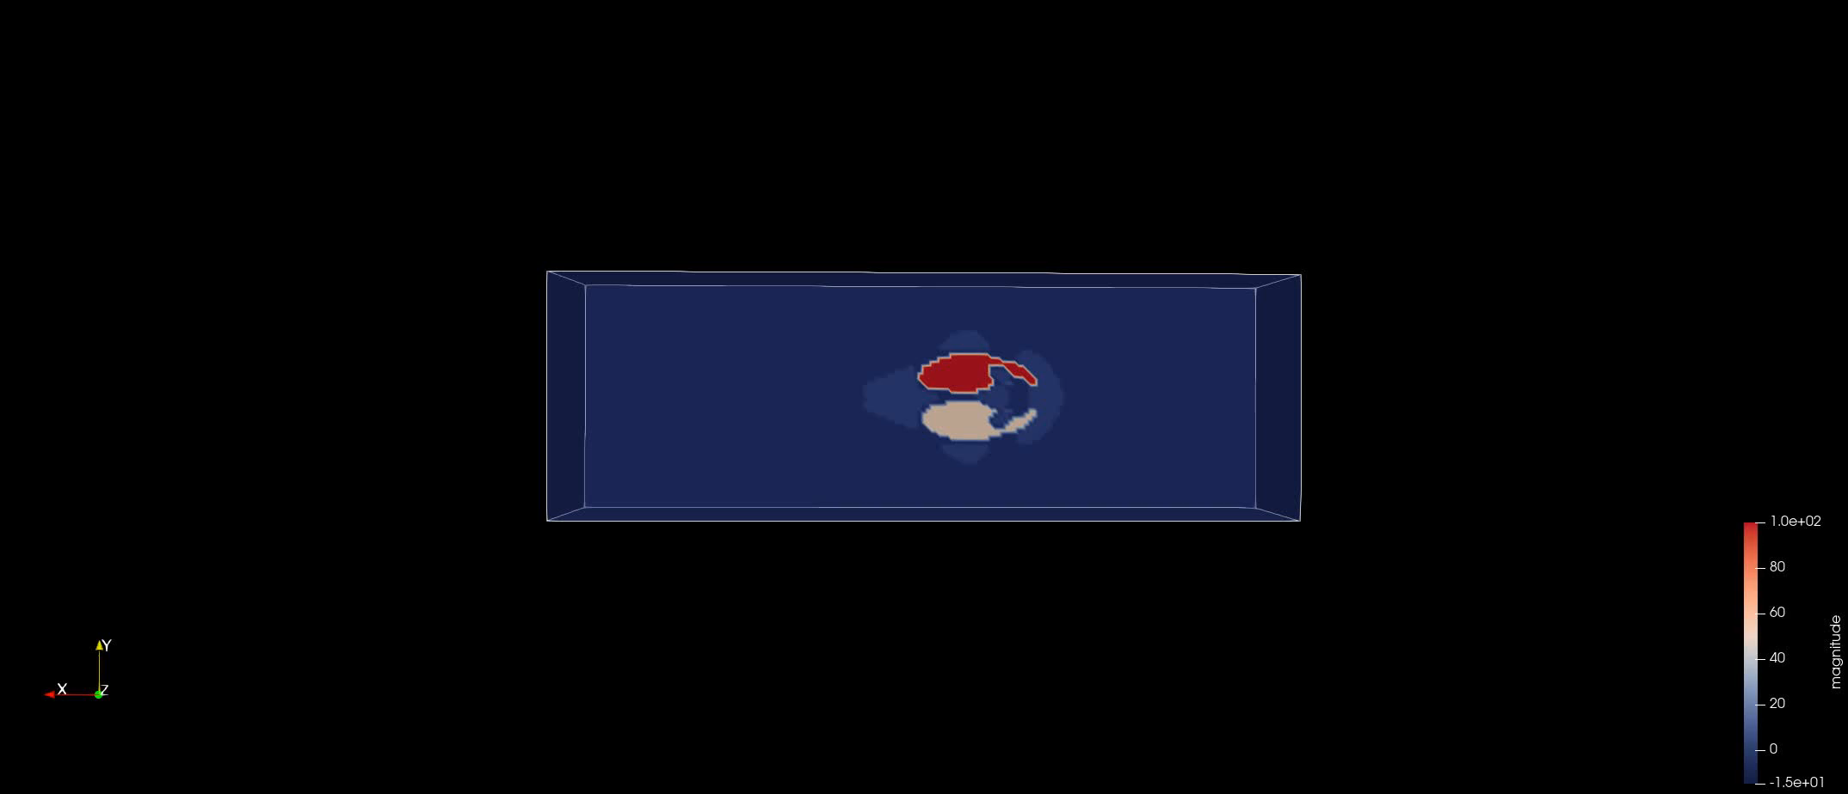
Results
Evolution of vortices with time
Graphics and Visualization

Slide 15
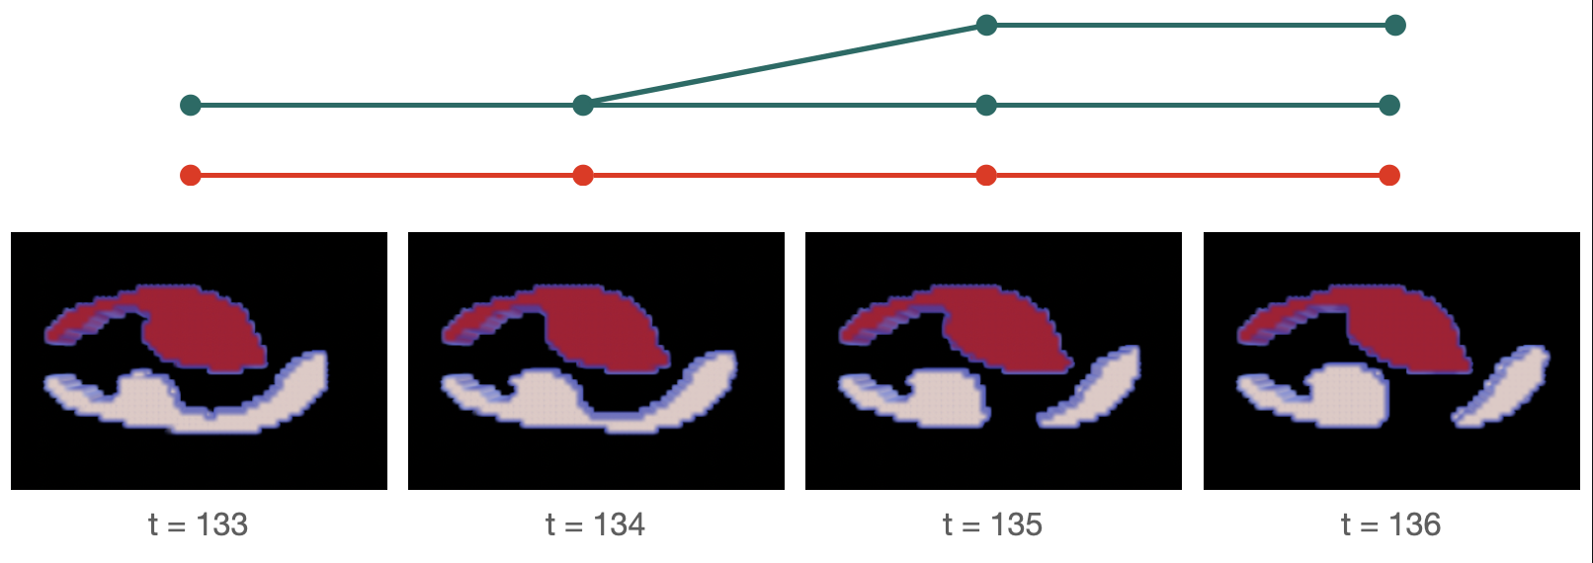
Results
Split in the tracking graph along with the visualization of vortices at the corresponding timesteps.
Graphics and Visualization

Slide 16
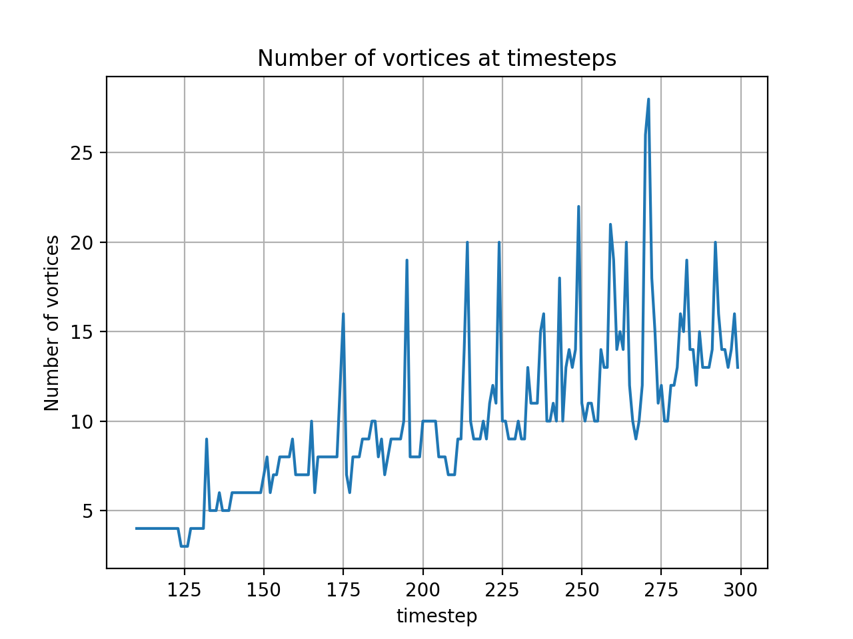
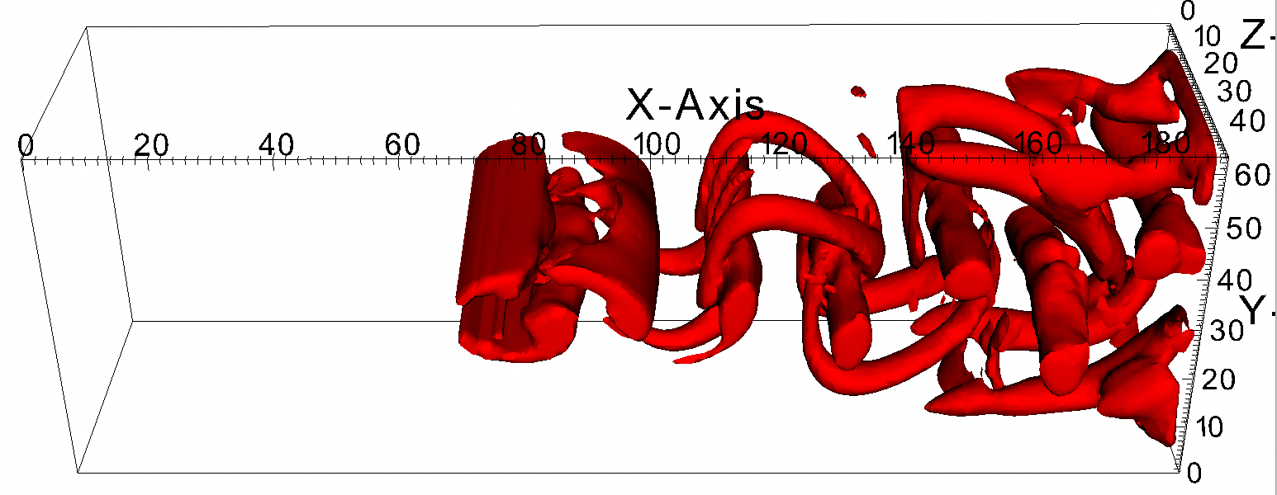
Results
Unstable flow and high number of vortices at a higher timestep.
Number of vortices vs timesteps
Number of vortices vs timesteps plot shows that with increase of time, the number of vortices increase as well. This means that the flow becomes unsteady with the increase of time.
Graphics and Visualization

Slide 17
Conclusion
We have implemented a greedy event detection strategy for feature tracking.
After implementing the project:
Features are perfectly found with a threshold of 0.075 on O-W parameter.
Our implementation seems to find splits and merges of features correctly based on visual implementation.
We find clear vortex-street pattern.
In our implementation, time taken on average per time step was 3.29 seconds.
Solving maximum weight independent set problem by traversing entire search tree would not be possible on datasets with higher number of features. It works well on datasets with sparse features.
Graphics and Visualization

Slide 18
Thank You!

