Slide 1
HR Analytics :
Employee Attrition Analytics

Slide 2
Capstone Project Members
Avtar Singh
Nirmal Tom
Pranav Kd
SaiKumar

Slide 3
Table Of Contents
1. Introduction
1.1 Overview of the problem
1.2 Objective
1.3 Implementation and Techniques
2 Data Preparation
2.1 Explanation of Source Data
2.2 Creation of Master Dataset and its Import
2.3 Cleaned Master Dataset
2.4 Summary of the Variables
4. Exploratory Data Analysis
4.1 Data visualization
5. Cluster analysis
6. Model building Roadmap
6.1 Segregating train and test
6.2 : Pre-processing
6.2 : Feature Scaling (Using MinMax Scaler)
7. Feature selection
7.1 Finalised Features
8. Model Development
8.1 Model Evaluation
9 Model Interpretation
9.1 Recommendations
9.2 Retention Measures

Slide 4
1.1 Overview of the problem
In this project we have to identify the factors contributing to attrition of the employees and recommend possible solutions.
We have been provided with the files containing complete staff utilization reports for all employees of the XYZ Corp. through 2016-2018.
The data contains details of employees as well as the details of the projects that they have worked on in the last two years.
The other file contains all the attrition in the organization for the years 2015-18 with details such as reason of attrition along with other employee details.
The data should be divided into train and test data set. We have to use the training data to build models/analytical solution and finally apply it to test data to measure the performance and robustness of the models.

Slide 5
1.2 Objective
There are three main objectives for this analysis.
Identify factors influencing attrition
Predict possible attritions
Identify possible ways to retain high performers

Slide 6
1.3 Implementation and Techniques
The dataset contains information on the Employee Number, Employee Name, Profit centre, Position, Location, Category, Supervisor name, join date, Termination date if resigned and current status of various Employees. It also contains monthly project details for 2 years.
The other file contains all the attrition in the organization for the years 2015-18 with details such as reason of attrition along with other employee details.
The cleaned data would be analyzed using EDA techniques and Customer segmentation techniques (such as clustering) in order to implement the objectives(mentioned in 1.2).
A Probabilistic Classification approach such as Logistic Regression would help identify the variable importance in determining Employee attrition.

Slide 7
Data Preparation
2.1 Explanation of Source Data
The data comes from XYZ Corp. and the 2 Excel files (Utilization dataset) contain complete staff utilization reports for all employees through 2016-2018. This data contains details of employees as well as the details of the projects that they have worked on in the last two years.
The other Excel file (Termination dataset) contains all the attrition in the organization for the years 2015-18 with details such as reason of attrition along with other employee details.
The Utilization dataset contains information on
Employee Number, Employee Name,
Profit centre, Employee Position,
Employee Location, People Group,
Employee Category, Supervisor name,
join date, Termination date(of resigned) and
current status of various Employees.
It also contains monthly project details like
Total Hours, Total Available Hours,
Work Hours, Leave Hours,
Training Hours, BD hours,
NC hours, Utilization%
from April 2016 to March 2017 and Total value for each employees for 2 years.

Slide 8
Data Preparation
2.1 Explanation of Source Data
The source data - (staff utlz latest 16-17_masked) has 789 observations and 115 variables
The source data - (staff utlz latest 17-18_masked) has 973 observations and 115 variables
The Terminations 15-18 dataset contains 293 observations and 9 variables
Employee No: Unique identifier for each employee
Office Location: Management-oriented organizational unit of the organization for the purpose of internal control
Employee Name: Name of Employee (Masked)
Employee Position: Employee designation within the organization
Employee Location: City in which employee is based out of
People Group: Employee type (client facing employee or support staff such as HR, payroll, etc).
Employee Category: Refers to status of employee such as part-time employee, full time employee, awaiting termination
Supervisor name:Manager of the said employee
Join Date: Joining date of employee in XYZ Corp.
Current Status: Current status of employee (Active, Resigned, etc)

Slide 9
Data Preparation
2.2 Creation of Master Dataset and its Import
In order to build models/analytical solutions, we have to create a Master Dataset from Utilization_Source dataset. The steps performed is displayed as follows.
Step 1 : Modified Utilization datasets.
We dropped 96 variables on Monthly Project details like
Total Hours, Total Available Hours, Work Hours, Leave Hours, Training Hours, BD hours, NC hours, Utilization% of 2 years from April 2016 to March 2017 and retained only Total value of each aforementioned variables of each employees on both excel files to reduce dimensionality.
This reduced the variables from 115 to 19 on each Excel files.
Step 2 : combined dataset
We Joined cells On Unique Employee Number of Modified Utilization dataset to create a combined dataset.
Except Employee number, we have duplicated separate x,y cols for each variables for 16-17 and 17-18 excel sheets which can be found here
Now we have 1111 rows and 37 columns.

Slide 10
Data Preparation
2.2 Creation of Master Dataset and its Import
In order to build models/analytical solutions, we have to create a Master Dataset from Utilization_Source dataset. The steps performed is displayed as follows.
Step 3 : Creation of a Final_Dataset
We combined separate x, y features of Employee Name, Profit centre, Employee Position, Employee Location, People Group, Employee Category, Supervisor name, CurrentStatus with the last Updated value which reduced dimensionality by 8 values.
we also extracted a new variable - " TenureYears " (Tenure in years) subtracting Termination date (of resigned employees) from Join date. 2018 is selected as the basedate for finding TenureYears of active employees.
We combined separate x, y features of Total Hours, Total Available Hours, Work Hours, Leave Hours, Training Hours, BD hours, NC hours, Utilization% together by taking average, which reduced the dimensionality by 8 values.
a New variable named " TotalNonbilled " which is the total sum of training hours, BD hours and NC hours was Feature engineered to reflect total Non billed hours.
5 New Variables namely PC_Change_Yes, Position_Promoted_Yes, Location_changed_yes, Employee Category_Change_yes, Supervisor_change_Yes were created to check whether there is a transition of values happened with profit centre, position, location, category, supervisor in the combined dataset.
A target field is created from CurrentStatus to identify whether an employee resigned or not. For resigned value is 1, otherwise 0.

Slide 11
Data Preparation
2.2 Creation of Master Dataset and its Import
Dimensionality of Master Dataset = 1111 Rows, 25 Columns.
Dropped columns from source data
96 variables on Monthly Project details like Total Hours, Total Available Hours, Work Hours, Leave Hours, Training Hours, BD hours, NC hours, Utilization% of 2 years from April 2016 to March 2017
Join Date and Termination Date (Tenure is extracted from these variables)
Feature Engineered variables from source data
TenureYears = Termination date (of resigned employees) - Join date. 2018 is selected as the basedate for finding TenureYears of active employees.
TotalNonbilled = Training hours + BD hours + NC hours
PC_Change_Yes = Profit_centre changead or not, if yes 1, else 0.
Position_Promoted_Yes = Position changed or not, if yes 1, else 0.
Location_changed_yes = Location changed or not, if yes 1, else 0.
Employee Category_Change_yes = Category changed or not, if yes 1, else 0.
Supervisor_change_Yes = Supervisor changed or not, if yes 1, else 0.
Supervisor_grade : Based on Weight of evidence and binning.

Slide 12
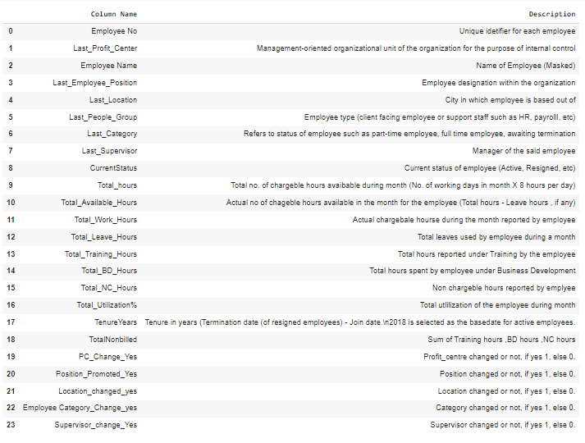
Data Preparation
2.3 Cleaned Master Dataset & Summary of the Variables

Slide 13
4. Exploratory Data Analysis
Descriptive Analysis
Segregating nominal and ordinal variables:
nominal:
Last_Profit_Center
Last_Location
Last_Category
Last_Supervisor
Last_People_Group
ordinal:
Last_Employee_Position
This dataset has 1111 samples, and 25 attributes(8 integer, 9 float, and 8 objects).
No variable column has null/missing values.
"Target" is the Dependent variable

Slide 14
4. Exploratory Data Analysis
Necessary corrections with EDA Insights
1.We carried out UVA and BVA on variables for finding any correlation and skewness.
2. Convert Negative values of TAH, BD, NC hours to zero.
3. Quantile-based Flooring and Capping outliers on Outliers on
Total_Leave_Hours
Total_BD_Hours
Total_NC_Hours
Total_Utilization%
TotalNonbilled
TenureYears

Slide 15
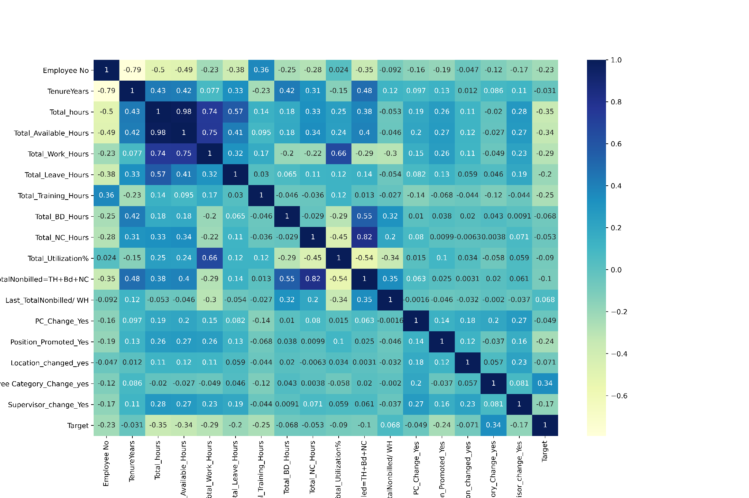
4. Exploratory Data Analysis
Heat Map to visualize Correlation among Numerical variables
As a general rule, we are dropping variables having Correlation Coefficient threshold greater than 0.7
Total_hours ∝ Total_Available_Hours : High_Correlation = 0.86
TotalNonbilled ∝ Total_NC_Hours : High_Correlation = 0.83
We are dropping Total_hours & TotalNonbilled variables.

Slide 16
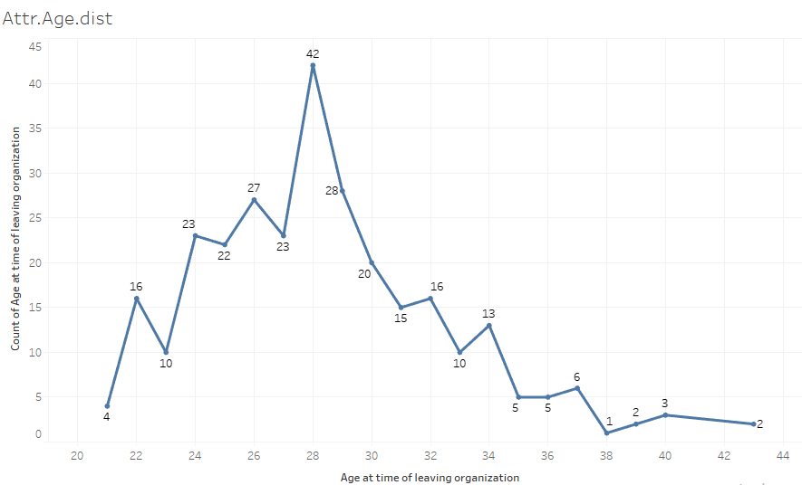
4. Exploratory Data Analysis
Data Analysis and Visualization Summary
Attrition Age Distribution

Slide 17
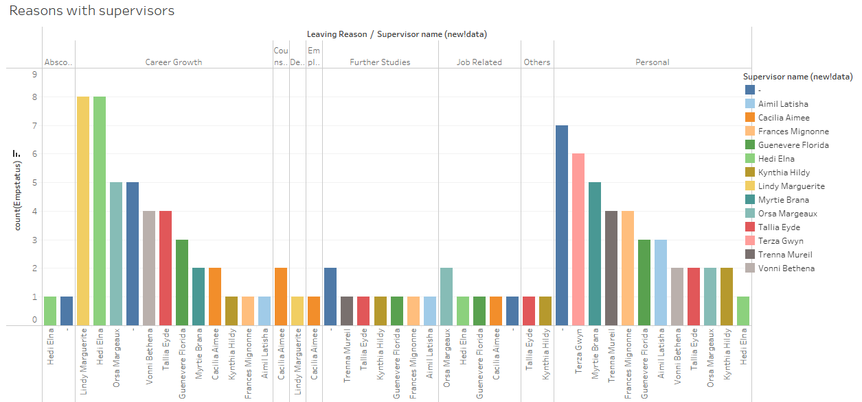
Supervisor wise Attrition Reason

Slide 18
Terminatination data Analysis
Position Level:
More no of resignations is observed at lower levels of Organization like
Level 8, Level 7, Level 6 etc
Profit centres :
PC3 , PC2 and PC1 face more resignation.
Location :
Location 7, Location 1, Location 3 have more attrition
Tenure :
Level ½, SVP/VP , Confirmed staff (Part time 4 hours & 6 Hours)
have more tenure than others.

Slide 19
Building a prediction model using Logistic regression & Decision Tree
Predictive Analysis
2

Slide 20
6. ROADMAP FOR MODEL BUILDING
SEGREGATING
DIMENSIONALITY REDUCTION
MODEL DEVELOPMENT
1
3
5
2
4
6
Feature Engg:
PREPROCESSING
FEATURE SELECTION
MODEL PERFORMANCE

Slide 21
Segregating Into Train, Validation and Test datasets
X_train shape: (777, 24)
y_train shape: (777,)
Attribute Relevance Analysis
TRAIN SET (70 %)
FEB
MAR
VALIDATION SET ( 15 %)
TEST SET ( 15% )
X_valid shape: (167, 24)
y_valid shape: (167,)
X_test shape: (167, 24)
y_test shape: (167,)

Slide 22
Pre-Processing
Feature Scaling
(Using MinMax Scaler)
Feature EXtraction using WOE scores
Total_hours
Total_Available_Hours
Total_Work_Hours
Total_Leave_Hours
Total_Training_Hours
Total_BD_Hours
Total_NC_Hours
Total_Utilization%
TotalNonbilled
Last_Supervisor_count
Applying WOE values to Last_Supervisor column
Binning Supervisor column based on WOE scores by grouping similar scores together
Feature Encoding
Label Encoding using Map Function
Last_Employee_Position
Supervisor grade
OneHot Encoding using pd.get_dummies function
Last_Profit_Center
Last_Location
Last_Category

Slide 23
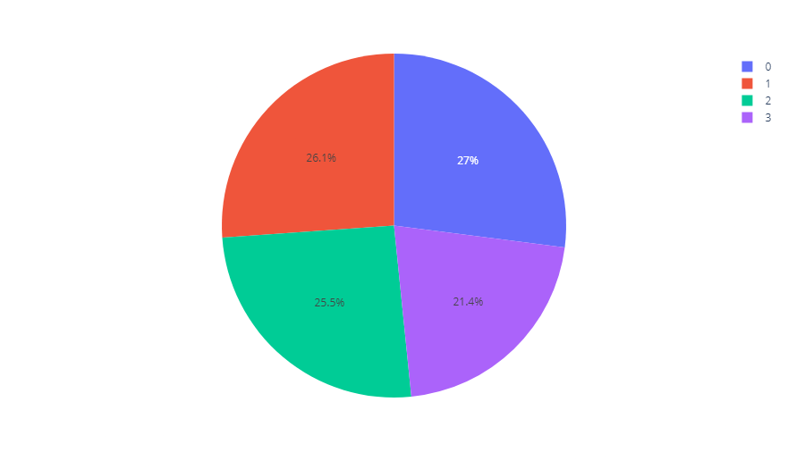
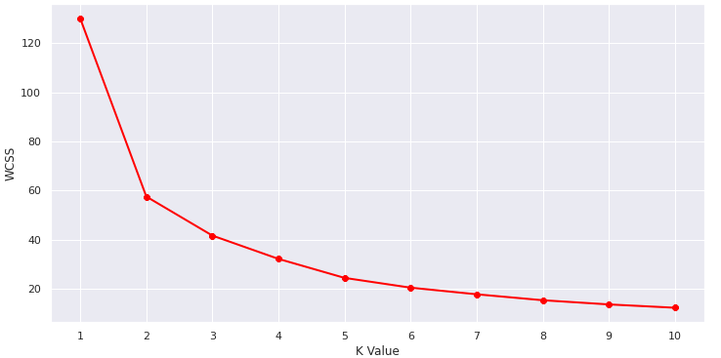
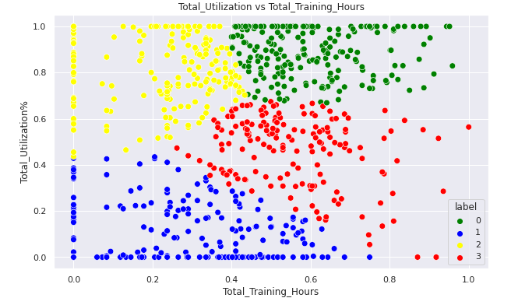
Cluster Analysis
k-Means Clustering based on 2 features:
Total_Available_Hours
Total_Utilization% ,
to find high performance Employees
* Label 0 ='GREEN' { 27 % }
* Label 1 ='BLUE { 26.1 % }
* Label 2 ='YELLOW { 25.5 % }
* Label 3 ='RED' { 21.4 % }
Elbow curve

Slide 24
Feature Selection / Dimensionality Reduction
Employee Name : only a label identifier.
Last_Supervisor : This variable has 152 unique values and Label encoding can result in very high dimensionality.
Last_People_Group : EDA shows us that 99% of values are Client Service Staff. variance is very low.
CurrentStatus : Target column is created from CurrentStatus. so dropping to avoid High multicollinearity
EDA Based Basic Filtering
Low variance Filter
High Correlation Filter
ProfCenter_PC - 8
ProfCenter_PC - 9
ProfCenter_PC - 11
category_Confirmed Staff (Part-Time 6 Hours)
SelectKBest
As a general rule, we are dropping variables having Correlation Coefficient threshold greater than 0.7
Total_hours ∝ Total_Available_Hours : High_Correlation = 0.86
TotalNonbilled ∝ Total_NC_Hours : High_Correlation = 0.83
We are dropping Total_hours & TotalNonbilled variables
Chi2 classification
RFE

Slide 25
Finalised Base Features
category_Confirmed Staff
category_Fixed term Staff
category_Serving Notice Period
category_Staff on Probation
category_Secondee-Outward-Without Pay
category_Awaiting Termination
Category_Change_yes
Supervisor_change_Yes
Position_Promoted_Yes
PC_Change_Yes
Total_Available_Hours
Total_Training_Hours
Total_Leave_Hours
Location_Location 8
Location_Location 2
Location_Location 7
ProfCenter_PC - 3
ProfCenter_PC - 4
ProfCenter_PC - 5
ProfCenter_PC - 6
Supervisor_grade

Slide 26
Modeling
Model Development
Model
Evaluation
Saving Best Model & Prediction

Slide 27
Model Development
We started Building 2 models on
Regularized Logistic Regression(C=10, class_weight='balanced', penalty='l1', random_state=42,solver='liblinear')
Decision trees: Default parameters
Dropped features of zero Coefficient strength and retrain again and made Predicting on Validation dataset:

Slide 28
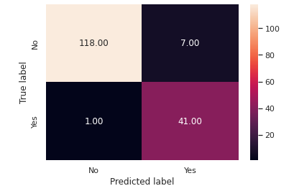
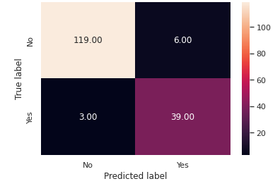
Model Evaluation
We have selected AUC ROC Curve & f1 score as the evaluation criteria.
Confusion Matrix of Logistic Regression
Confusion Matrix of Decision Tree

Slide 29
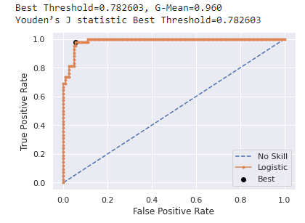
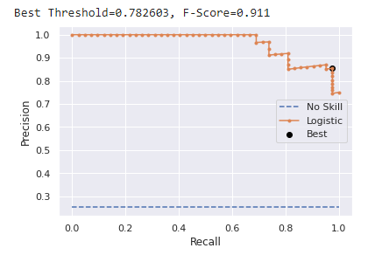
Model Evaluation
Optimal Cutoff Point
Using Precision -Recall curve
Using Youdens J statistic

Slide 30
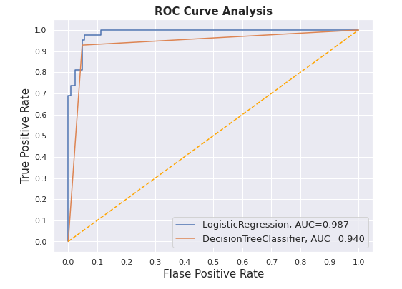
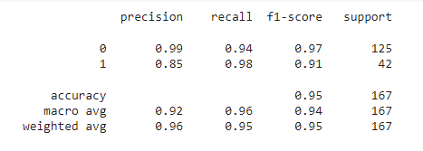
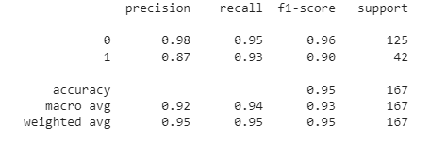
Model Evaluation
We have selected AUC ROC Curve & f1 score as the evaluation criteria.
we can see that Logistic Regression have the best roc_auc_score
Classification Report of Logistic Regression
Classification Report of Decision Tree

Slide 31
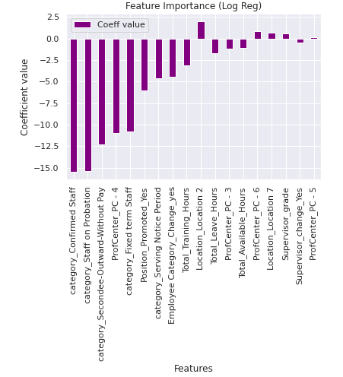
Saving Best Model & Prediction
Logistic Regression model is selected because
It has high roc_auc_score than Decision Tree
comparable F1 score percentage and low standard deviation than Decision Tree
Logistic Regression has high recall (0.98) than Decision Tree (0.93)
Factors
Preventing attrition
Affecting attrition
Total_Available_Hours
Total_Training_Hours
Total_Leave_Hours
Supervisor_change_Yes
Position_Promoted_Yes
category_Confirmed Staff
category_Fixed term Staff
category_Serving Notice Period
category_Staff on Probation
category_Secondee-Outward-Without Pay
Profit Centre - 5
Profit Centre - 6
Location 7
Location 2
Supervisor Grade

Slide 32
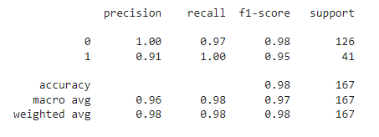
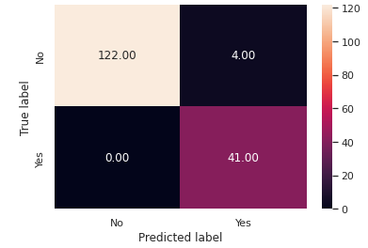
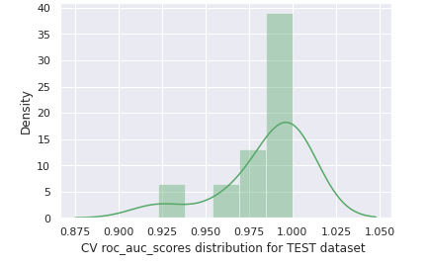
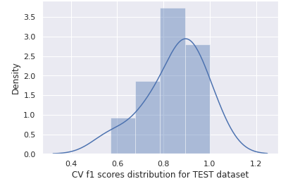
Evaluating Model performance on Test data
Confusion Matrix
** Cross validation results on TEST DATASET:**
Mean roc_auc_score Percentage for TEST dataset is: 98.487
Mean f1_scores Percentage for TEST dataset is: 84.81

Slide 33
9. Model Interpretation
Interpretation of factors identified as having positive impact:
Profit center 6 and 5 are positive variables, hence HR needs to look at what is happening in these location/center that is having a negative impact on the employee retention.
Inspect what is happening on Location 7 and 2
Profit center 3 and 4 are negative variables, hence HR needs to look at what is happening in these location/center that is having a positive impact on the employee retention.
Total Training hours , Total leave Hours , Total available hours are variables of interest, need to be ascertained as to why employees with better training are staying, and why are employees with less training hours prone to leaving.
Staff on probation, confirmed , secondee, on notice period and fixed staff are staying, if taken care of by providing adequate training and growth opportunities.
Supervisor_Grade have a role in attrition and those under danger category had to be given proper training
Employees who are Promoted are likely to stay

Slide 34
9. 1 Recommendations
Recommendations for retaining Employes:
Focus on Employee Training
Feeling of job security prevents attrition.
Mapping right set of employee to Right profile/profit center.
Employee welfare w.r.t leaves, Total work hours to be monitored.

Slide 35
Retention Measures
Supervisor
Under - and Hedi most number of resignation happened
More Personal issues with supervisors “_” and “Terza Gwyn”
Employees under
“Lindy marguerite” & “Hedi Elna” are concerned with career growth.
Time to Hire
More termination happened during september.
So it’s better to hire before September.
Channel for Recruitment
(Prev Employer)
New hires from syllible are churning more than any.
Reason for Leaving
Career growth is highest reason followed by personal and further studies
Males are citing career growth as the major reason.
High Performers
Level 10 has the highest avg Utilization percent
followed by -
Fixed term staff has high avg Utilization percent
Location 9, 8, 7 has most Avg Utilization Percentage

Slide 36
Thank you.

