Slide 1

Hack</>Nation- Hackathon
TITLE PAGE
  Theme- Cybersecurity
  PS Category- Software
  Team Name- TechSphere
  Team Leader: Sasmita Behera
  Institute: ITER, SOA

Slide 2
IDEA TITLE
  PROBLEM STATEMENT
  Phishing websites are increasing rapidly and look almost identical to real ones.
  Users can’t reliably detect new or zero-day malicious sites.
  Current browser protections miss freshly-created fake domains.
  One wrong click = stolen credentials, malware, financial loss.
  Need: a real-time, lightweight, browser-level threat detector.
Notes:
Users can’t reliably detect new or zero-day malicious sites.

Slide 3
Solutions
  • We created a lightweight Chrome extension that checks any website’s safety in one click.
  • A trained machine-learning model analyzes URL patterns and instantly predicts whether the site is SAFE or UNSAFE.
  The backend and extension work together by extracting key URL features and passing them to our trained ML model.
  • The model compares the URL’s features against learned patterns of phishing and safe sites.
  • This allows fast, real-time malicious URL detection without needing to scan page content.

Slide 4
TECHNICAL APPROACH
  Technologies Used:
  HTML, CSS, Python, Javascript, Php, Beautiful Soup, whois, Scikit-learn, Random Forest(ML Algorithm).
  Dataset- Phising Websites Dataset- UCI ML Repository
  Methodologies:
  Data Collection - Collected phishing & legitimate URLs from open datasets.
  Feature Extraction - Extracted URL-based features (length, HTTPS, special characters, keywords).
  Model Training- Trained ML model using Scikit-Learn (Random Forest/Logistic Regression).Achieved ~95% accuracy.
  Chrome Extension - Extension captures current URL & sends it to API.
  Displays SAFE / UNSAFE result instantly.

Slide 5
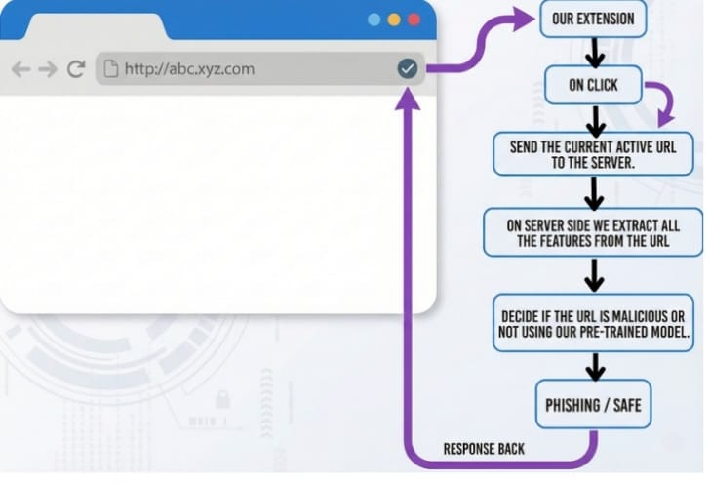
FLOWCHART

Slide 6
FEASIBILITY AND VIABILITY
Feasible because:
Lightweight extension
Freely available APIs
Small ML model, easy to deploy
Challenges:
API rate limits
ML model accuracy on new unseen phishing URLs
Zero-day domains may bypass detection
Speed vs security trade-off
Strategies:
We kept everything simple and fast—an ML model that works in real time with a clean, one-click extension.
Our focus was to make phishing detection easy for anyone to use, even during a quick demo.

Slide 7
IMPACT AND BENEFITS
Impact:
Protects users from phishing + malware
Reduces identity theft and data loss
Useful for students, employees, general users
Enterprise adoption for monitoring
Benefits:
Social: Safer browsing
Economic: Prevents financial scams
Educational: Awareness of cyber threats
Organizational: Secure browsing environment

Slide 8
RESEARCH AND REFERENCES
The following resources were used to design, train, and validate our malicious-URL detection system. These references include datasets for model training, API documentation for threat verification, and research papers that guided our feature-engineering and ML approach.
Phishing Websites Dataset – UCI Machine Learning Repository
PhishTank Community Feed (for malicious URL samples)
Malicious URL Detection based on Machine Learning
Detecting malicious URLs using machine learning techniques | IEEE Conference Publication | IEEE Xplore

