Slide 1
MSc Information Technology 7SENG013C.Y Software Development Project Gig Work Marketplace Software Project Student: Ms. Poddiwela Keerthirathna (20274450) 2023/24 Supervisor: Ms. Dileeka Alwis School of Computer Science & Engineering University of Westminster
Notes:
To better understand the story of this application, let me walk you through the user journey of someone who can use this application. Looing at a user’s real life experience would make this narrative more relatable.

Slide 2


Overview of Project Topic
Meet Rachel
Meet Kate
Poor communication
Messay communication
Unrelated messages
Irrelevant candidates
Manage applications
Complicated signup
Irrelevant tasks
Complicated interface
Notes:
Meet Rachel – a student who recently enrolled to a university in a new city and moved over to start her academic journey.
Rachel is studying full time and paying the course fee on her own. She wants to find part-time jobs that do not conflict with her university lectures.
She stumbles upon different job search and hiring platforms, and quickly ran into problems:
Most job search platforms are cluttered, and it is hard to find relevant, local tasks.
Some platforms required complicated sign-ups before she could even see available jobs.
Communication with potential employers was messy, often happening through external apps or email, making it easy to lose track of conversations.
Worse yet, many platforms overwhelmed users with unrelated messages and notifications not relevant to their work.
Meet Kate – a working mom with 2 years old baby boy.
Kate is working from home, but goes to the office occasionally for team meet-ups and events. She needs to find a reliable baby-sitter who can look after the baby when she’s going to the office.
She came across several challenges when trying to hire:
The platforms she used were too broad (flooded with irrelevant candidates).
She struggled with poor communication, often dealing with unreliable baby-sitters or failing to keep track of ongoing conversations.
She had trouble finding a straightforward, easy-to-use platform that allowed her to manage job applications and communications in one place.
Reviewing applicants was often time-consuming and disorganized.
Both Rachel and Kate faced different sides of the same challenge: A lack of a simple, reliable, and efficient platform that could truly connect the right workers with the right employers — without unnecessary complexity or communication gaps.

Slide 3
Project Aims & Objectives
(PA1) – Design and develop a user friendly, simple and intuitive digital platform that enables seamless task outsourcing for employers.
(PO1.1) Implement a responsive user interface that allows employers to easily post jobs.
(PO1.2) Develop a database to manage employer data and job postings securely and efficiently.
(PA2) – Design and develop a user friendly, simple and intuitive digital platform that facilitates efficient job seeking for part-time workers.
(PO2.1) Implement a responsive user interface that allows part-time workers to easily search and apply for jobs.
(PO2.2) Develop a database to manage employee data and applications securely and efficiently.
(PA3) - Enhance communication between employers and part-time workers to improve task outsourcing.
(PO3.1) Implement an in-app messaging system to facilitate seamless communication between employers and part-time workers.
(PO3.2) Develop a notification system to notify users about application statuses and messages.
Notes:
Recognizing these challenges, the WorkNet project was born. The goal was clear: Build a platform that directly addresses the frustrations of both workers and employers — by making job searching, hiring, and communication seamless, organized, and accessible.
PA1: To design and develop a web application that helps employers like Kate to effectively outsource work by posting jobs and managing them easily.
PA2: To design and develop a web application that helps workers like Rachel to find relevant jobs easily and manage their applications.
PA3: To enhance communication between employers and workers that allows focused, relevant communication without overwhelming users.
To bring these aims to life and truly solve Rahcel and Kate’s problems, we needed to design key features and functionalities that would shape the core of the WorkNet platform.

Slide 4
Essential System Functional Requirements
(FR1) User Registration and Authentication
Employers and workers can create accounts.
Secure login and password maintenance.
(FR2) Profile Management
Employers can create and manage company or individual profiles.
Workers can create and update personal profiles, including skills and experience.
(FR3) Job Posting and Management
Employers can post jobs with details such as job description, requirements, and budget.
Employers can manage and edit job postings.
(FR4) Job Search and Application
Gig workers can search for jobs based on various filters (location, pay, job type).
Workers can apply for jobs directly through the platform.
Notes:
These are the critical functionalities that the platform must deliver to ensure that users like Rachel and Kate have a seamless, frustration-free experience.
They need to be able to:
Create accounts securely
Manage detailed profiles
Employers like Kate should be able to:
Post job listings with detailed descriptions.
While it’s crucial to make things easy for employers, we also needed to empower workers like Rachel with intuitive tools to search for jobs and find the best opportunity.
In particular, they need to be able to:
Search for available jobs without logging in.
Apply for jobs easily and securely.
Send direct messages to employers about specific jobs.

Slide 5
Essential System Functional Requirements (contd….)
(FR5) Communication Tools
In-app messaging between employers and workers.
Notifications for job postings, applications, and messages.
(FR6) Application Tracking
Employers can track applications and manage the hiring process.
Workers can track the status of their applications.
(FR7) Ratings and Reviews
Employers can rate and review workers.
Notes:
After Rachel sends an application, Kate should be able to:
View and manage worker applications easily.
Communicate with potential hires through an integrated messaging system.
Update job status (e.g., Applications Received, Applicant Selected, In Progress, Completed).
After submitting the application, Rachel should be able to:
Track applications through a dedicated dashboard.
After Rachel completes the job, Kate should be able to:
Review and rate Rachel’s performance.
With the core features identified for both workers and employers, it became important to visualize how users would actually interact with the system in real-world scenarios.

Slide 6
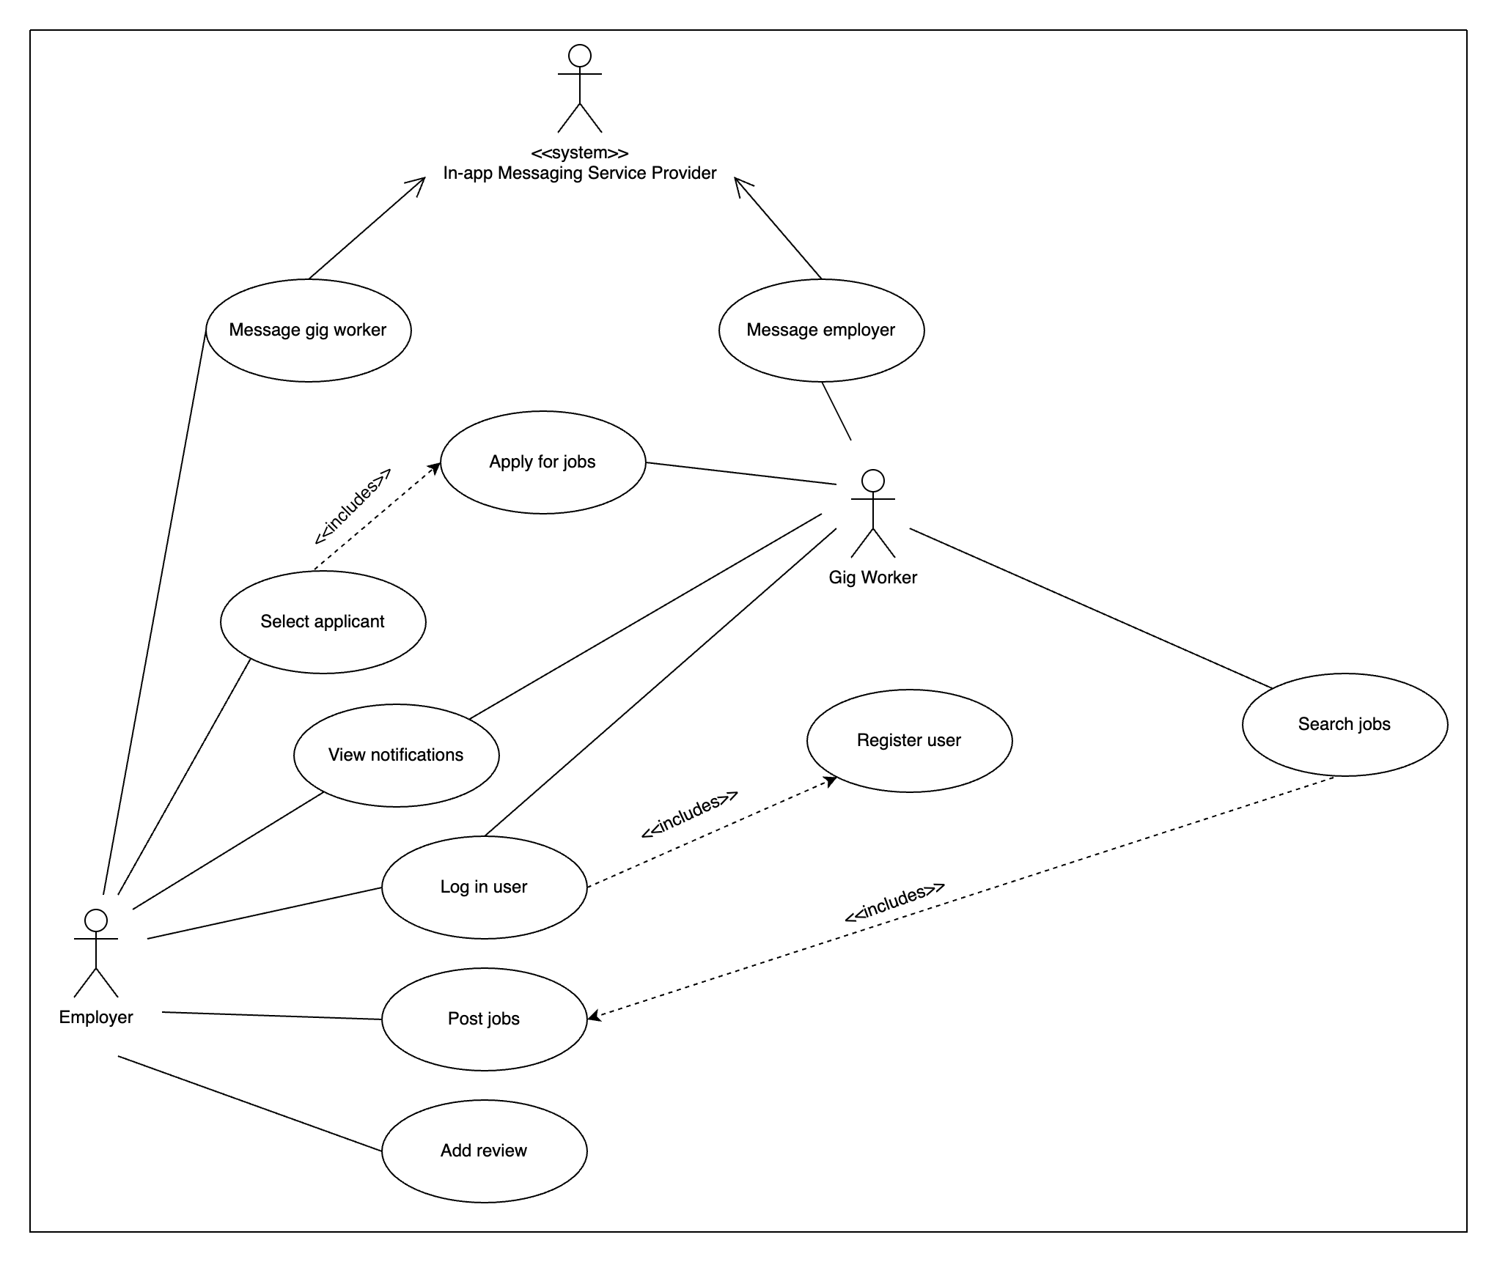
System Use Case Diagram
Notes:
The Use Case Diagram provides a clear picture of all the major interactions between users and the WorkNet system.
This diagram maps out the main actions our two primary user types — workers and employers — can perform within WorkNet.
Employers like Kate, can easily post new job opportunities, view applications as they come in, communicate with potential workers like Rachel, and update the status of their posted jobs. Once a job is completed, they can also leave reviews and ratings to help build worker profiles.
Workers like Rachel, on the other hand can search for available jobs, view job details, and apply directly through the platform. They can also message employers if they have any questions about a job posting, and track the status of all their applications in one place.
While the Use Case Diagram shows the interactions from the users' perspective, behind the scenes, the system needs to manage a lot of information — like users, jobs, applications, messages, and reviews.
To organize and manage all this data properly, I designed a System Class Diagram.

Slide 7
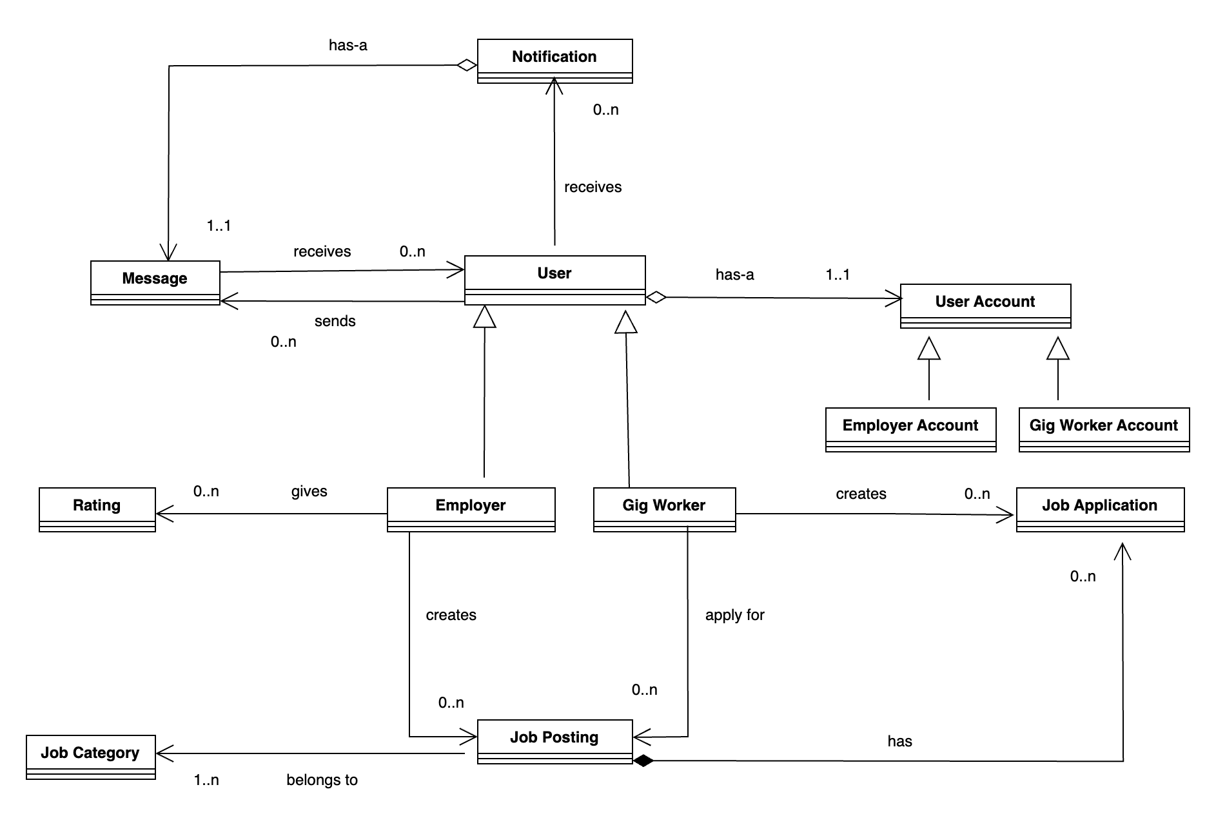
System Class Diagram
Notes:
This Class Diagram represents the main building blocks of the system — including the key data models like Users, Jobs, Applications, Messages, Notifications, and Reviews. It also shows how these different entities are related to each other, ensuring data is stored efficiently and interactions remain smooth.
To keep the diagram readable and easy to follow, I've focused only on the main classes and their relationships. Instead of listing every attribute and method, I’m highlighting just the key elements that drive the system. The comprehensive class diagram with all the attribute and methods is given in the project report. Let me explain a few important classes that drive the system.
First, we have the User class — this stores details about both workers and employers.
Next, the Job class — it represents all the jobs posted on the platform.
Then, the Application class — which connects workers to the jobs they apply for.
The Message class manages communications between users, so they can easily discuss jobs.
And finally, the Review class captures feedback once a job is completed, helping to build worker profiles.
After understanding the key classes that shape the application's internal structure, it's important to zoom out and see how everything fits together technically. Now, let's look at the overall system architecture that brings these pieces to life.

Slide 8
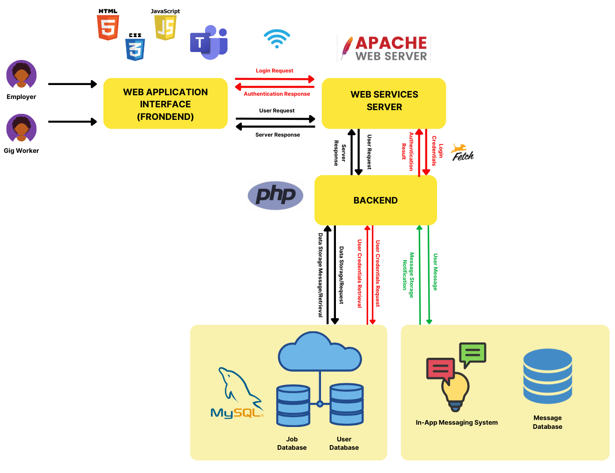
System Architecture Diagram
Notes:
This architecture diagram shows how different layers of the system interact — from the user interface, to the backend server, and finally to the database where all the information is stored. It ensures that users have a smooth, responsive experience while the system remains organized and scalable behind the scenes.
Frontend Layer: This is what users interact with — the browser, the job search page, messaging forms, etc.
Backend Server: Handles user actions — applying for jobs, sending messages, posting tasks — and processes them securely.
Database Layer: Stores persistent information like users, jobs, messages, and applications.
Now that we understand the system’s overall architecture the next step is to explore how these parts were actually built in practice. Let’s look at the key technologies and techniques used to bring this system to life.

Slide 9

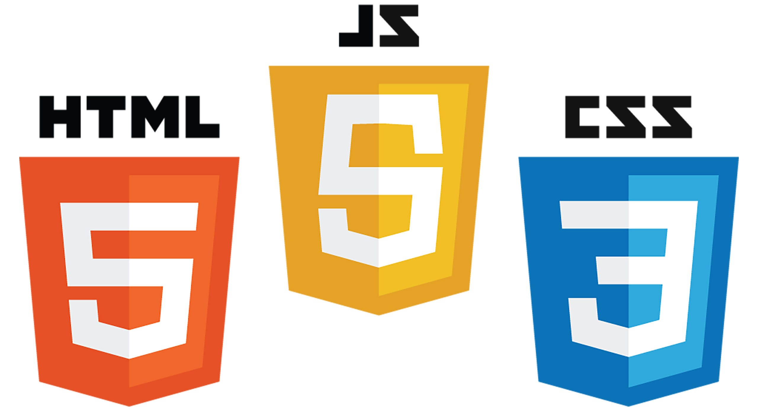



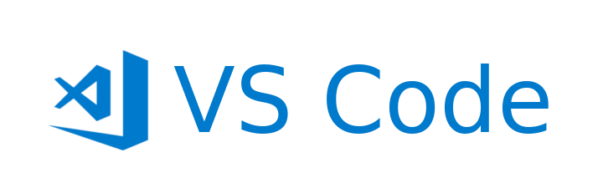
Implementation Techniques & Technologies
Hardware
Frontend development
Backend development
Database management
Text editor
Development environment
Notes:
For the implementation, I chose a combination of proven web technologies
For the development environment, I used a MacBook running on macOS Sonoma 14.5, providing a stable and efficient setup for full-stack development.
On the technology side:
Frontend: I used HTML, CSS, and JavaScript to create a responsive and interactive user interface.
Backend: PHP handled server-side operations, ensuring security and efficiency.
Database: MySQL was used to manage structured relational data.
Visual Studio Code served as my primary code editor, offering powerful extensions and tools to streamline coding, debugging, and version control.
To simulate a live server environment locally, I used XAMPP, allowing me to work with Apache, PHP, and MySQL together during development.
Using this technology stack and setup, I was able to successfully start developing and building the different features of the system.
However, like any real-world development process, everything did not go perfectly on the first try.
Along the way, I encountered several implementation challenges that required careful problem-solving and adaptation.

Slide 10
Implementation Issues
Issue 1 - Choosing frontend and backend development tools.
Issue 2 - Protecting user data from unauthorized access.
Issue 3 - Designing a responsive and user-friendly client interface.
Issue 4 - Implementing messaging capabilities.
Issue 5 - Implementing a rating system
Notes:
Let’s now take a look at some of the key implementation issues I faced during development — and how I tackled them to keep the project moving forward.
First, choosing different frontend and backend development tools that are compatible with the available hardware was challenging.
I selected the tools described in the previous slide - implementation technologies, for frontend and backend development
Then, Protecting user data from unauthorized access became a significant issue as the system stores users’ personal information and transmits that information in several functional flows.
Password hashing technique is implemented where passwords entered at signup and login are hashed when saving in the database.
Next, Designing a responsive and user-friendly client interface that improves user experience became an important aspect of this project.
Implemented responsive design techniques that provides a simple and clear navigation path to the user using CSS features.
Implementing messaging capabilities for communication between users was also challenging.
Building an in-app messaging service was chosen over integrating with third party applications to improve overall user experience.
Final issue was Implementing a rating system for employers to rate gig workers.
This was solved by implementing a star based rating system using javascript.
Overcoming all these challenges, the application finally came to life, ready to serve users like Rachel and Kate. Now, let's step into their world and see how the system truly works in action.

Slide 11
Application Demonstration
Rachel and Kate’s journey on WorkNet.
Notes:
Kate logs into WorkNet, quickly posts a job for babysitting, specifying all details...
filling form, submitting
Rachel browses available jobs without logging in. She finds Kate’s job, needs to know more information, sends Kate a message, is prompted to log in
search page, message option, logging in if needed
Kate receives Rachel’s message, reads it easily through the notification panel, and replies back within the same system.
Employer’s side receiving the message, worker’s notification area, opening the application, viewing the message.
Happy with Kate’s response, Rachel clicks 'Apply’, and then applies immediately.
search page, applying for a job,
Kate can view Rachel’s application, selects her for the job
changing job statuses
Rachel sees the application status change to selected.
changing job statuses
Rachel performs the job, Kate marks it as 'In Progress' and eventually 'Completed.
changing job statuses
After the successful job completion, Kate leaves a 5-star review and a thank-you note for Rachel’s great work.
Show the rating and commenting functionality on worker profiles.
Through this seamless journey, both Kate and Rachel experience a platform that simplifies finding work, connecting, and collaborating — all in one place, with no unnecessary complexity.

Slide 12
Conclusion
Seamless, visually appealing and intuitive platform for on-demand job seeking and hiring.
In-app messaging and notification capabilities for focused communication.
Convenient user journey through enhanced accessibility – job search without logging in, redirecting to login when necessary.
Rating capabilities to help workers establish their gig work footprint.
Notes:
In following Rachel and Kate’s story, we witnessed how a thoughtfully designed system can bridge the gap between job seekers and job providers. Through WorkNet, we successfully solved the problem of fragmented gig connections — creating a platform that is simple, reliable, and custom-tailored to the users' needs. The project not only addressed the technical and functional requirements but also remained deeply focused on the real human problems it set out to solve. With a robust foundation in place, there is plenty of room to expand and continue making the lives of users like Rachel and Kate even easier.
This marks the conclusion of the project journey — but just the beginning of WorkNet’s impact.

Slide 13
References
Abramowski, N. (2023). What is CSS? A Beginner's Guide. CareerFoundry. Available from https://careerfoundry.com/en/blog/web-%20%20development/what-is-css/ [Accessed 23 March 2025].
AppMaster (2023). The Role of HTML in Website Development. AppMaster. Available from https://appmaster.io/blog/html-website-development [Accessed 23 March 2025].
De Stefano, V. & Aloisi, A. (2018). European legal framework for ‘digital labour platforms’. Luxembourg: Publications Office of the European Union. Available from https://www.researchgate.net/publication/330683831_European_legal_framework_for_digital_labour_platforms [Accessed 03 February 2025].
Joshi, M. (2023). A detailed guide on JavaScript Web Development. BrowserStack. Available from https://www.browserstack.com/guide/javascript-web-development [Accessed 23 March 2025].
MDN Web Docs (no date). What software do I need to build a website?. MDN Web Docs. Available from https://developer.mozilla.org/en-US/docs/Learn_web_development/Howto/Tools_and_setup/What_software_do_I_need [Accessed 16 February 2025].
Ray, B., Sengupta, A. and Varma, A. (2024). The gig verse: building a sustainable future. International Journal of Organizational Analysis, 32 (10), 2275-2298. Available from https://www.emerald.com/insight/content/doi/10.1108/ijoa-08-2023-3946/full/pdf?title=the-gig-verse-building-a-sustainable-future [Accessed 26 January 2025].
Notes:
While the majority of the content in this project is based on original development work and personal experience, a few standard resources were consulted during the research, system design and implementation process. The references listed here acknowledge these supporting materials.

Slide 14
Thank you!
Notes:
Thank you all for joining me in this journey through Rachel and Kate’s world — and through the creation of WorkNet.
Wrapping up for now, bye.

