Slide 1
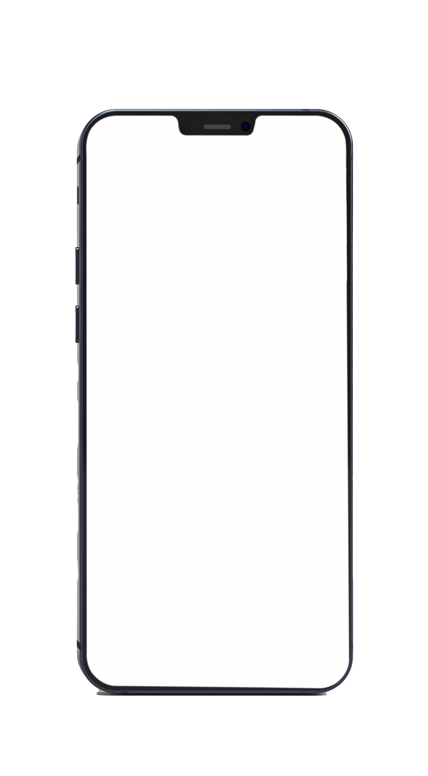

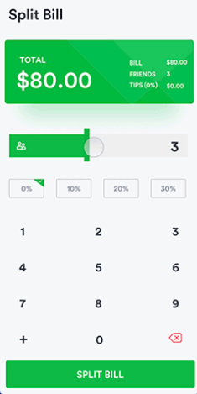
SPLITWISE
Presenters: Nirmi Patel &
Harvi Sheth
ID: 20ce095 & 20ce136
An android application that splits trip and restaurants bill!
Guided by: Ms. Dhruvi Trivedi

Slide 2
About the project
You've just finished a big meal with a big group of people. Everyone is full and happy, but ready to go home. You ask for the bill, and now, instead of relaxing after a great meal, you're scratching your head trying to do complicated math so that each person only pays for what they're responsible for. This app makes the process of splitting a complicated bill much easier by guiding you through it in a step-by-step manner and displaying detailed results on-screen for everyone to see.

Slide 3
Description
All you need is your bill and your Android mobile device! You can split the entire bill evenly among all of your party members.
Split a Bill Evenly
To split a bill evenly among all party members, simply tap the "Evenly" button on the home screen. Next, type in the grand total (after tax) at the bottom of your bill. Select the number of people in your party, then tap the "Split" button. Your results will be displayed at the bottom of the screen.

Slide 4
Overview
Features
Support
Installation
Small size apk
Easy-to-use and user-friendly
Android 4.0 +
To build and run the app, clone this project, open it as an existing project in Android Studio and click Run.

Slide 5
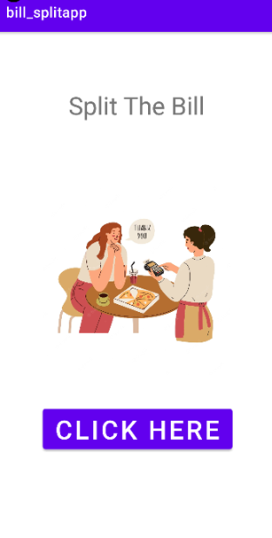
Home Page
This is the launch screen of our application.
By clicking on the button here users can redirect to the main page where they can easily split their bills.

Slide 6
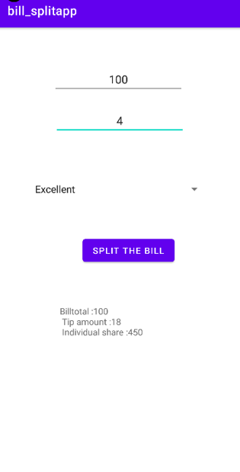
Split the Bill
Here user needs to enter the bill amount and number of persons in their group and as soon as they click on the button result will be displayed.
The displayed result shows the total amount along with the tax and individual share.

Slide 7
Android concepts used:
Intent
Spinner
Text view
Image View
Button
Edit text

Slide 8
Thank You!

