Slide 1














Quiz
Application

Slide 2

Synopsis
This project is a Quiz Management System built using Django, designed for three roles: Admin, Teacher, and Student. The system allows teachers to create quizzes, add questions, options, and answers, and view students' results. Students can register, take quizzes, and view their scores. The Admin has full control over managing teachers, students, and quizzes.

Slide 3
Description
The Quiz Web Application is an interactive and user-friendly platform designed to create, manage, and participate in quizzes. It enables users to test their knowledge on various subjects and track performance. The system ensures data integrity, scalability, and a seamless user experience.
It is a system by which students can appear in a quiz from anywhere of the world where there is no interaction between pencil and paper rather interaction between computer and human being
One of the main benefits of our system is automated marking, that is, teachers do not need to check the answers as they do in manual quiz. It saves valuable time of a teacher. On the other hand, students can get there results instantly as soon as they perform final submit and can also see the results of previous quizzes they have attended

Slide 4
User Side :
Authentication
Profile
Quiz
Result
01.
Modules
Professor Side :
Authentication
Profile
Manage Quiz
See Results
02.
A Module is a self-contained, Functional unit within a project that focuses on a specific task or functionality. It is designed to be independent, making it easier to manage, develop, test and maintain various aspects of a project.
Admin Side :
Manage Students(User)
Manage Professors
Manage Quiz
See Results
03.

Slide 5
Database Design
TABLE FOR STATES:
TABLE FOR CITIES:
tbl_stateMaster
Constraint | Fields | Data Types
P.K | state_id | int
 | state_name | varchar(150)
 | state_isAct | bit
tbl_cityMaster
Constraint | Fields | Data Types
P.K | city_id | int
F.K | state_id | int
 | city_name | varchar(150)
 | city_isAct | bit

Slide 6
Database Design
TABLE FOR ROLES:
TABLE FOR CATEGORIES:
tbl_roleMaster
Constraint | Fields | Data Types
P.K | role_id | int
 | role_name | varchar(10)
 | role_isAct | bit
tbl_categoryMaster
Constraint | Fields | Data Types
P.K | category_id | int
 | category_name | varchar(250)
 | category_isAct | bit

Slide 7
Database Design
TABLE FOR COURSE:
TABLE FOR QUIZ:
tbl_courseDetails
Constraint | Fields | Data Types
P.K | course_id | int
 | course_name | varchar(150)
 | course_isAct | bit
tbl_quizDetails
Constraint | Fields | Data Types
P.K | quiz_id | int
 | quiz_rules | varchar(150)
F.K | user_id | Int
F.K | category_id | int
F.K | course_id | int
 | quiz_isAct | bit

Slide 8
Database Design
TABLE FOR QUESTIONS:
TABLE FOR OPTIONS:
tbl_questionMaster
Constraint | Fields | Data Types
P.K | question_id | int
 | question_text | varchar(150)
F.K | quiz_id | int
 | question_isAct | bit
tbl_optionMaster
Constraint | Fields | Data Types
P.K | option_id | int
 | option_text | varchar(150)
F.K | question_id | int
 | Option_isCorrect | bit

Slide 9
Database Design
TABLE FOR USER DETAILS:
tbl_userDetails
Constraint | Fields | Data Types
P.K | user_id | int
F.K | state_id | int
F.K | city_id | int
F.K | role_id | int
F.K | course_id | int
 | user_firstName | varchar(150)
 | user_lastName | varchar(150)
 | user_gender | bit
 | user_email | varchar(100)
 | user_phNo | numeric(10,0)
 | user_isAct | bit

Slide 10
Database Design
TABLE FOR RESPONSES:
TABLE FOR RESULTS:
tbl_userResponses
Constraint | Fields | Data Types
P.K | response_id | int
F.K | option_id | int
F.K | question_id | int
F.K | user_id | int
tbl_resultDetails
Constraint | Fields | Data Types
P.K | result_id | int
F.K | user_id | int
F.K | quiz_id | int
 | scored_marks | int
 | total_marks | int

Slide 11
Page Designs
In the project, We have focused on creating visually appealing and functional page designs using HTML, CSS, and JavaScript. The objective was to design a user-friendly interface while ensuring that the pages are responsive and accessible across various devices and screen sizes.
Considering the time constraints by now we are only able to partially complete the designing for student module, for admin module we have used built-in Django admin panel while designing for the professor module is still in progress and not entirely completed.
So now let’s take a look at Page Designs of student module.

Slide 12
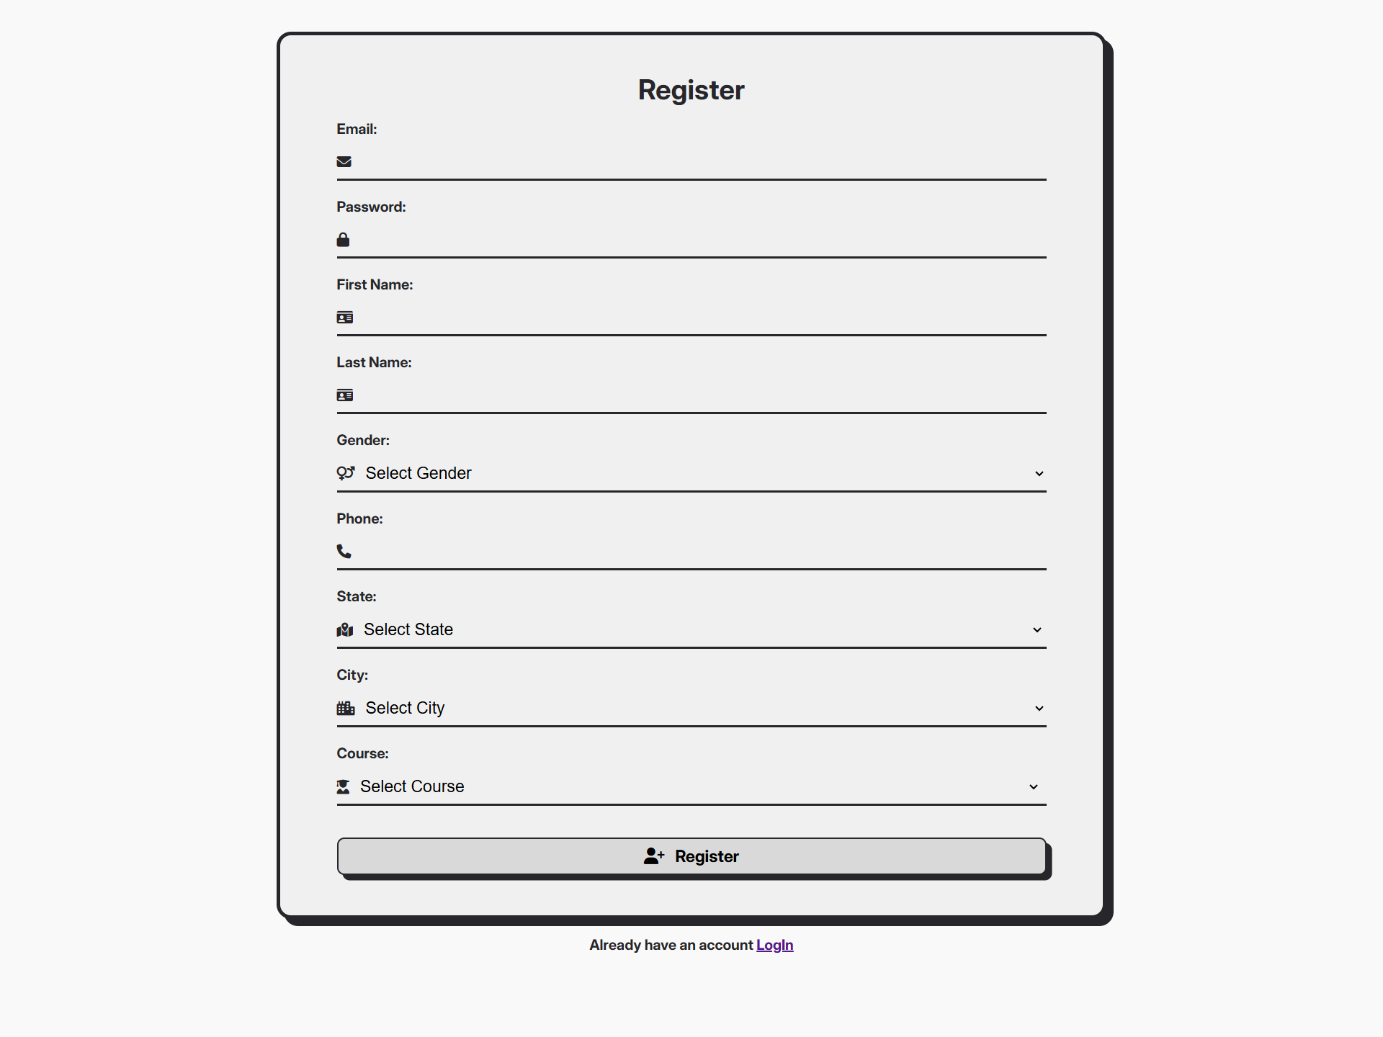
Sign Up Page:

Slide 13
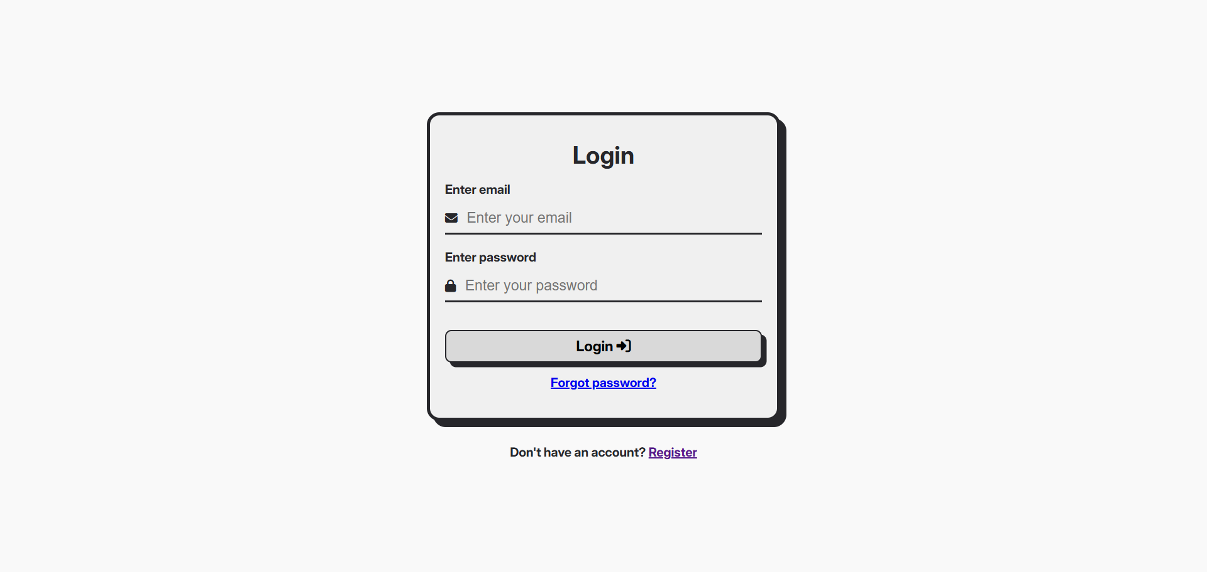
Login Page:

Slide 14
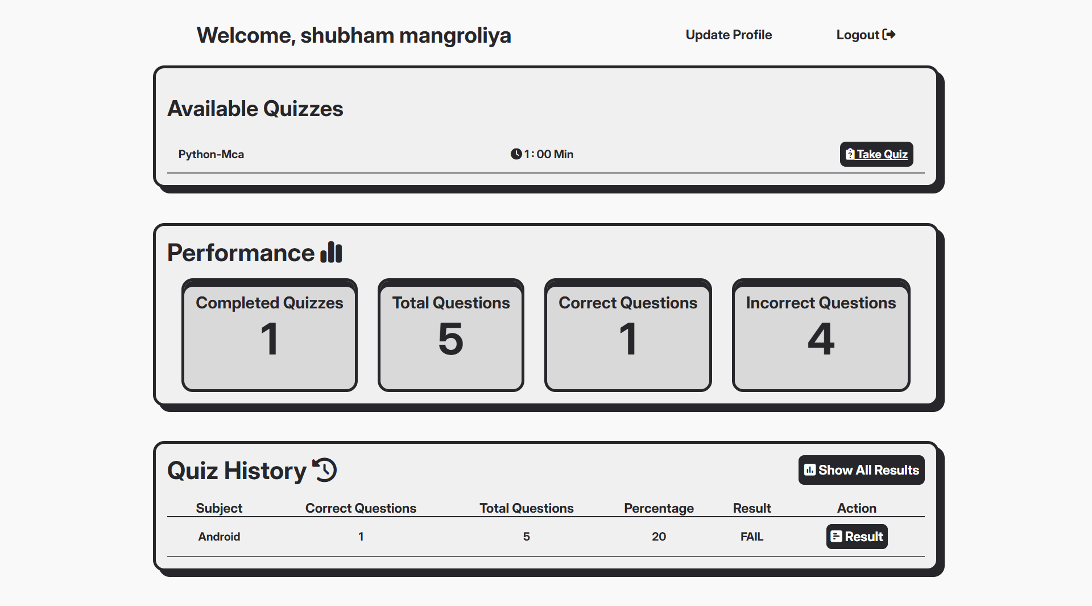
Home Page:

Slide 15
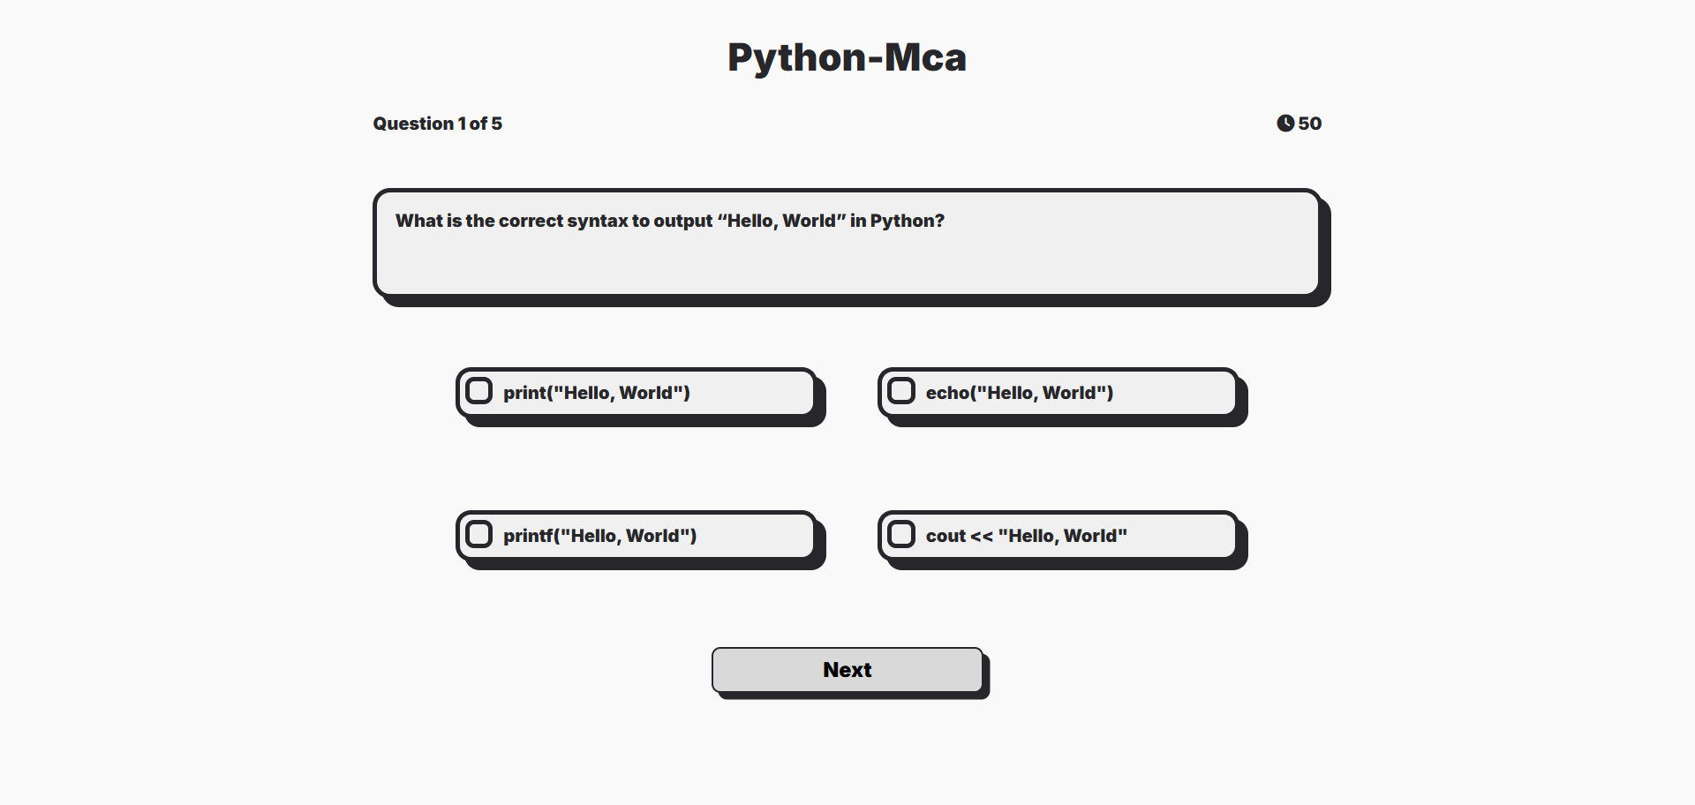
Take Quiz page:

Slide 16
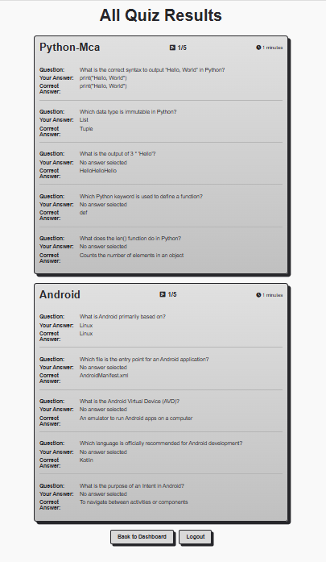
All Results page:

Slide 17
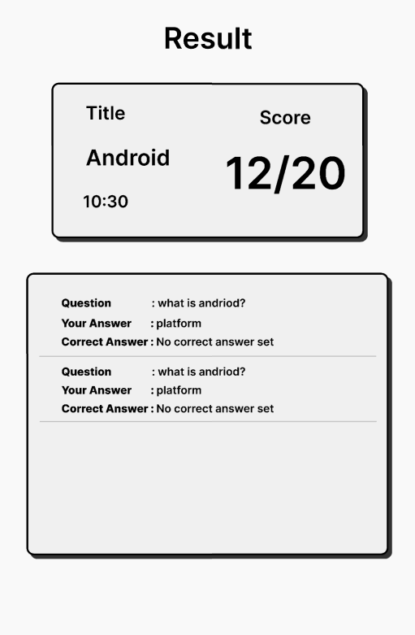
Individual Result page:

Slide 18
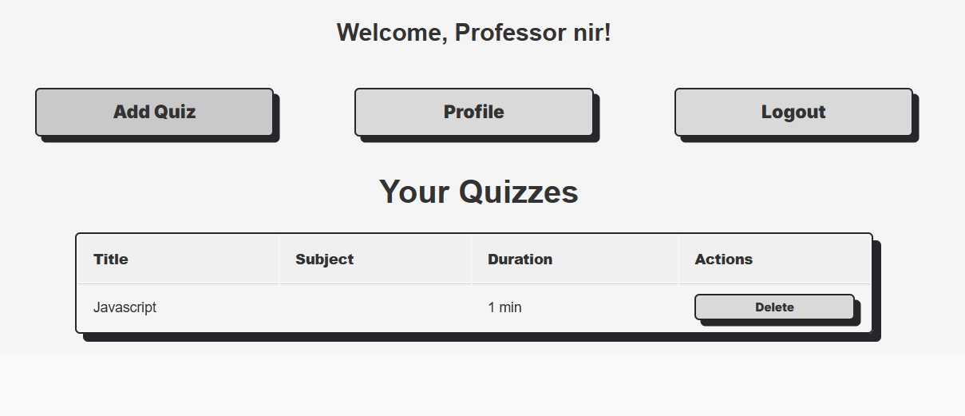
Professor dashboard page:

Slide 19
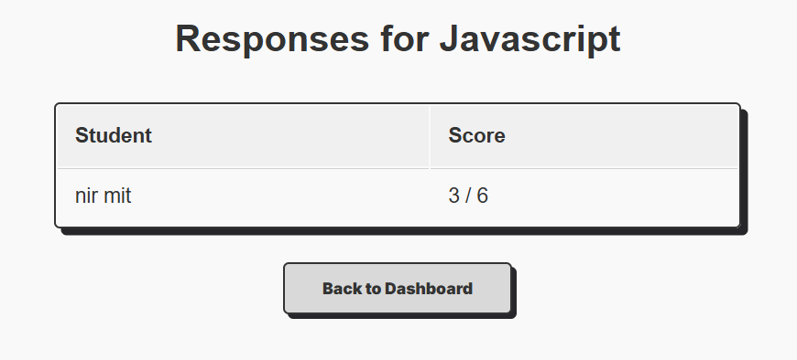
Responses page:

Slide 20
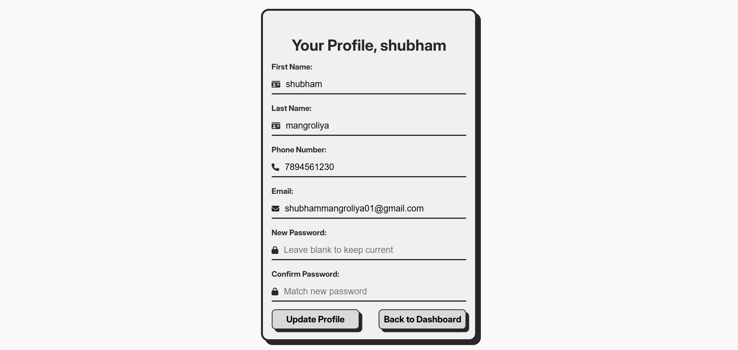
Update profile page:

Slide 21
Conclusion
The Quiz Application successfully implements a robust and scalable platform for managing and delivering quizzes in an academic environment. Designed using the Django framework, the application supports role-based access control for administrators, professors, and students, ensuring secure and structured interactions.
Key features include:
Custom user management.
Role management for defining access levels (student, professor, admin).
Dynamic quiz creation tied to subjects and courses.
A question and option bank supporting multiple-choice quizzes.
Persistent tracking of user responses for assessment and analytics.
With modular architecture and clean separation of concerns across models, views, and templates, this project lays a solid foundation for future enhancements such as real-time quiz monitoring, result analytics, and gamification features. Overall, the system offers a complete backend infrastructure for digital learning assessment and is ready for integration with modern frontend technologies or mobile platforms.

Slide 22
Thank you very much!

