Slide 1



Project Phase 3: Database Implementation for Soccer/Football Management
Nicholas Brown
Sai Srujan Vemula
Nirmit Dagli
1

Slide 2

Introduction
Phase 1: ER Model
Developed an Entity-Relationship (ER) model to represent the soccer ecosystem.
Identified key entities like Players, Teams, Matches, and their relationships.
Introduction
Phase 3: Database Implementation
SQL Database: Created tables and implemented the relational schema in MySQL. Populated mock data for key entities.
Defined five use cases with SQL queries incorporating JOIN, GROUP BY, and HAVING.
NoSQL Database: Designed MongoDB collections to handle hierarchical and flexible data requirements. Compared SQL and NoSQL approaches with examples.
Phase 2: Relational Database Design
Transformed the ER model into a relational schema.
Defined tables, keys, and constraints to establish relationships between entities.
2

Slide 3
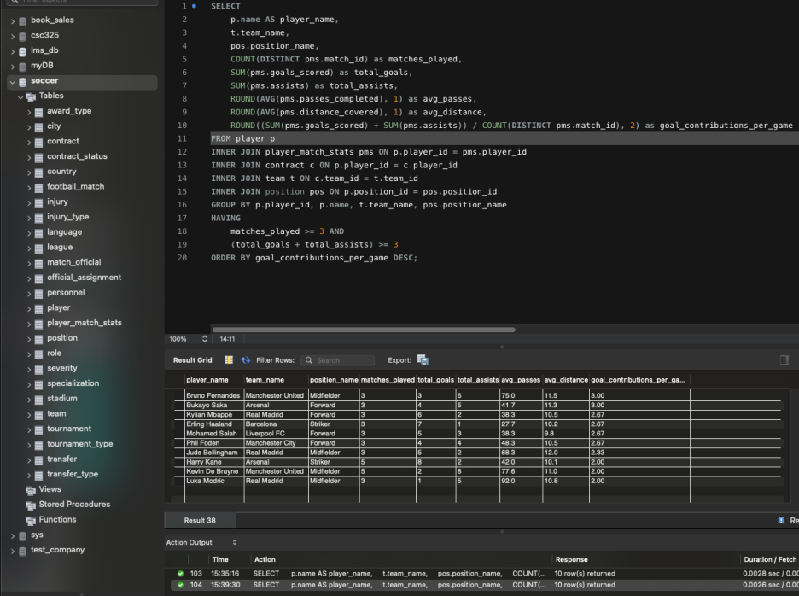
Usecase-1 : Technical Analysis for Player Evaluation
3

Slide 4
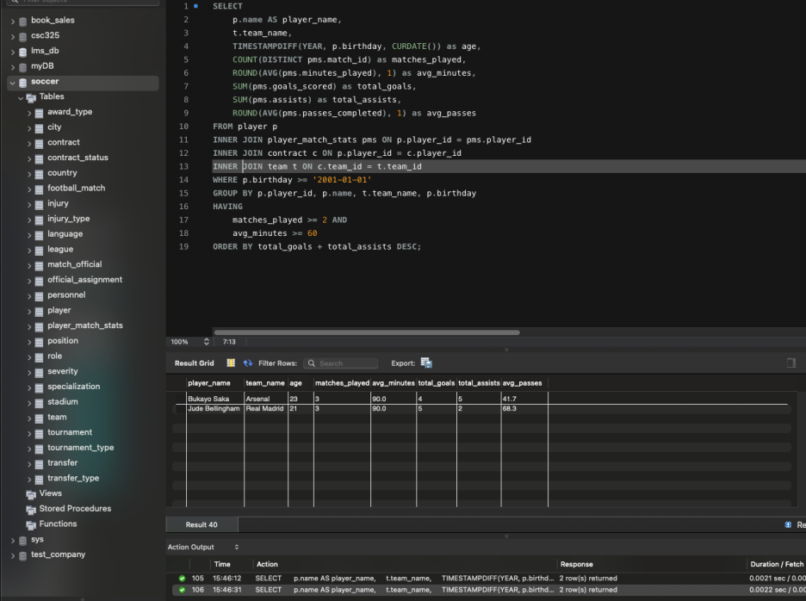
Use case-2 Youth Talent Scouting and Development
4

Slide 5
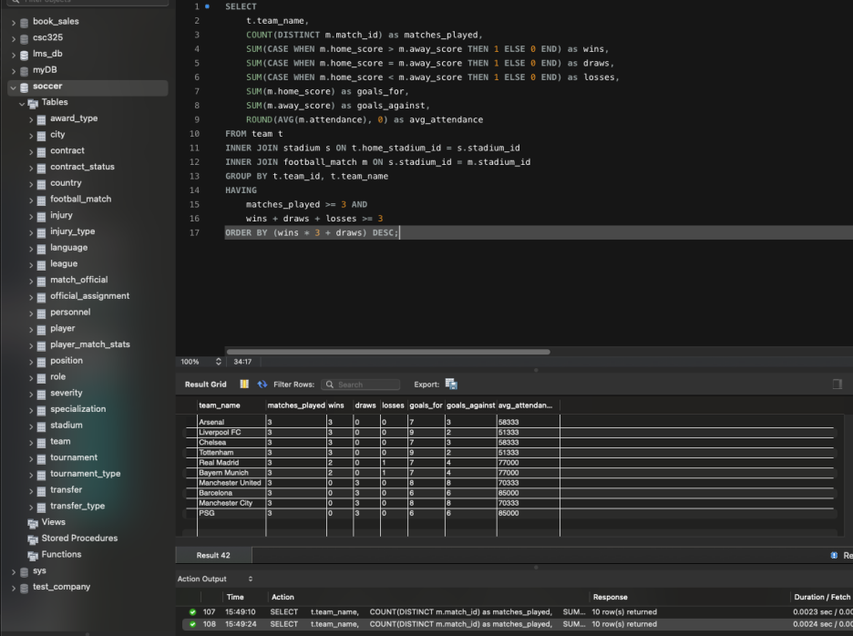
Use case-3: Team Performance Monitoring and Reporting
5

Slide 6
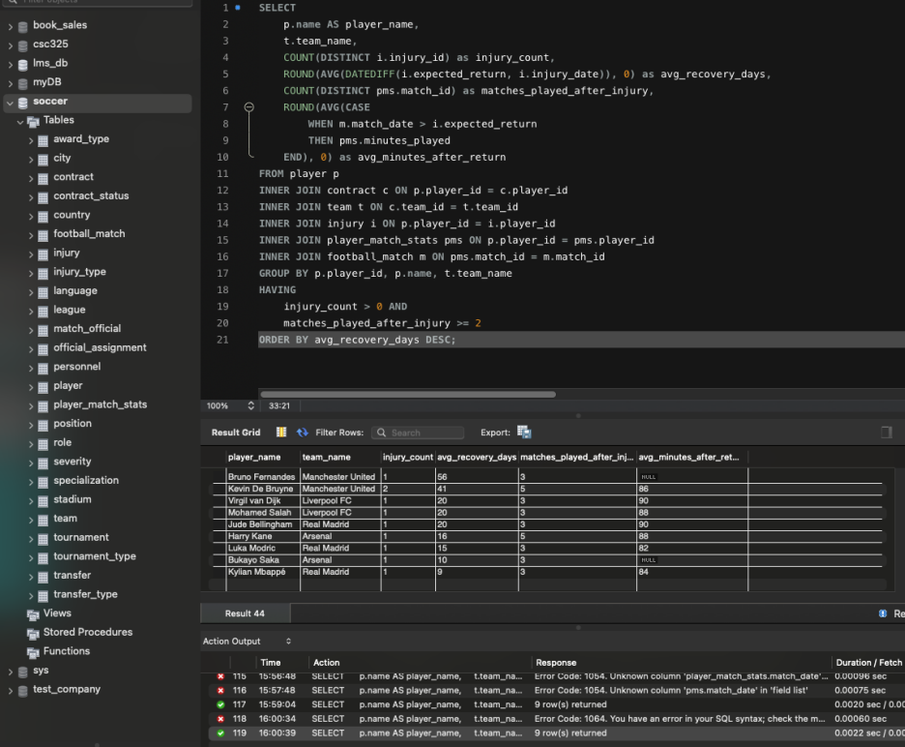
Use case-4: Medical and Performance Impact Assessment
6

Slide 7
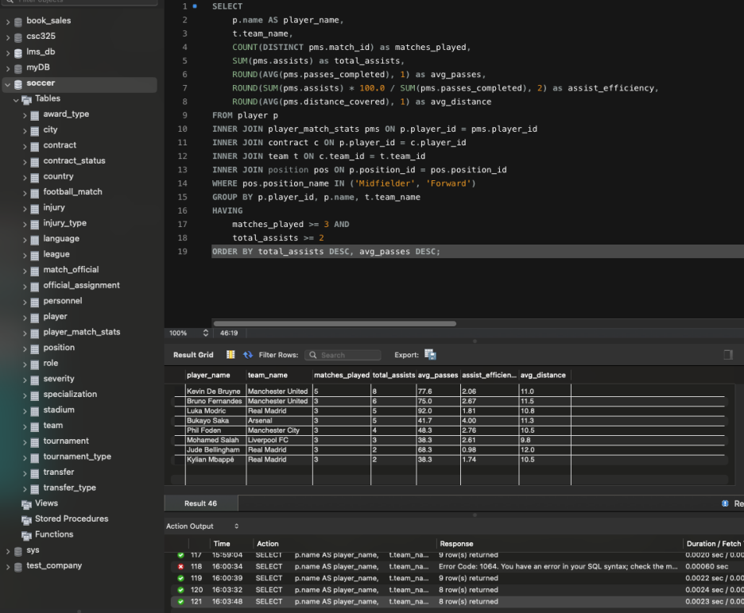
Use case-5: Creative Player Assessment
7

Slide 8
MongoDB Database Design for Sports Analytics
By integrating all related data into a single document, the structure now captures players, teams, matches, and statistics in one place.
This design avoids redundancy, simplifies queries, and aligns with real-world use cases where players are the primary unit of analysis.
Key Entity: Player
Primary Focus on Individual Performance:
The main goal of the database is to track individual players’ stats, injuries, transfers, and career progression.
Players are the central unit of analysis, and their data spans multiple teams and tournaments.
8

Slide 9
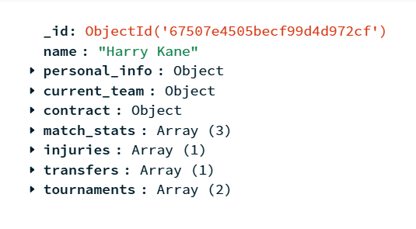
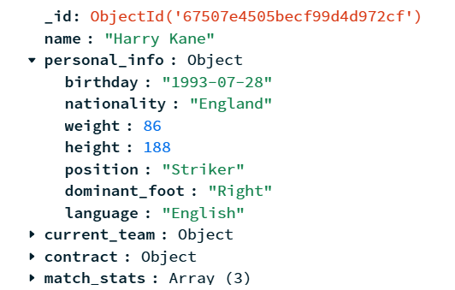

9

Slide 10
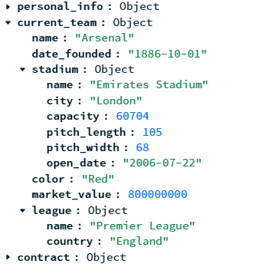
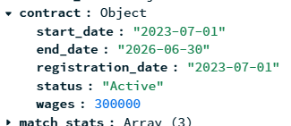
10

Slide 11
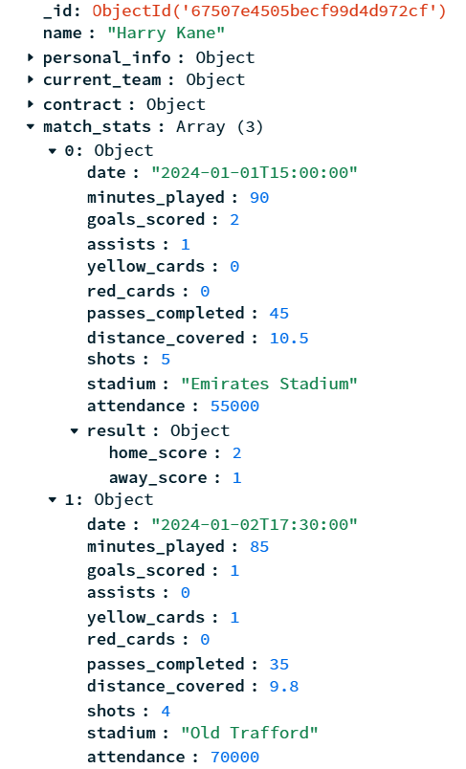
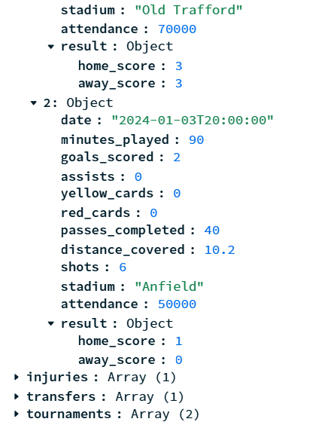
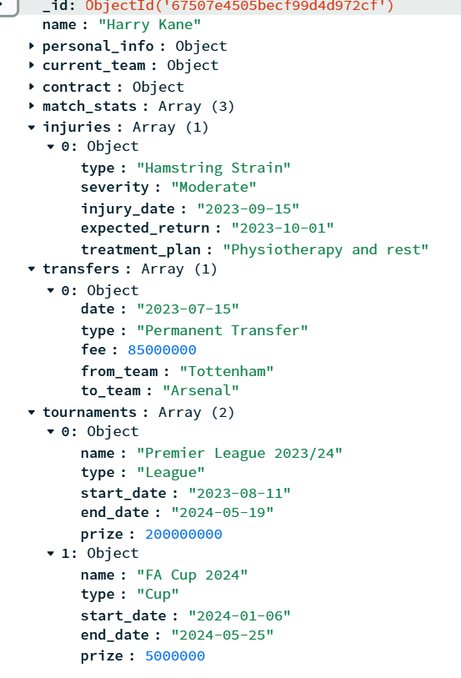
11

Slide 12
Reasoning of MongoDB
3
Flexibility: Schema-less design allows adding new fields (e.g., advanced analytics) without modifying the existing structure.
Performance: Embedded documents reduce the need for joins, optimizing query performance.
Scalability: Supports large datasets, making it suitable for growing databases with extensive match and player records
12

Slide 13

Conclusion
THIS PROJECT SIMULATES REAL-WORLD DATABASE MANAGEMENT CHALLENGES IN SPORTS ANALYTICS, SHOWCASING OUR ABILITY TO DESIGN AND IMPLEMENT BOTH RELATIONAL (SQL) AND NOSQL (MONGODB) SOLUTIONS
EXPLORED THE STRENGTHS AND TRADE-OFFS OF SQL AND NOSQL APPROACHES FOR PRACTICAL APPLICATIONS.
13

Slide 14
Q&A
14

