Slide 1
MASTER'S THESIS DEFENCE · MAY 2026
HERO
Hybrid Quantum-AI Models for Cybersecurity
on Cloud Platforms
Accuracy · Latency · Energy
Nirmit Dagli
Master of Science in Computer Science
Quinnipiac University · Hamden, Connecticut
Advisor: Prof. Taskin · Committee: Prof. Kruti, Prof. Lin
github.com/Nirmitdagli/quantum-thesis-demo · nirmitdagli.github.io/quantum-thesis-demo/

Slide 2
HERO · Defense · 2/13
Nirmit Dagli · Quinnipiac · 2026
Why Are We Here?
Cybersecurity is exploding. Quantum is hyped. Cloud bills are real.
Cybersecurity scale
Quantum hype
Cloud costs are real
Networks generate billions of security events per day. Classical AI is keeping up — for now.
"Quantum will revolutionise security!" Really? At what cost? In how many years?
AWS Braket: $0.30/task on QPU. AWS EC2: $0.71/hour. Which tier should you pay for?
The question nobody has answered:
Given a cybersecurity workload, on which cloud tier should it run (CPU, GPU, or QPU) to minimise cost + energy + latency together — without losing accuracy?
This thesis answers that question with measurement, not opinion.

Slide 3
HERO · Defense · 3/13
Nirmit Dagli · Quinnipiac · 2026
Think of It Like a Restaurant Kitchen
How CPU + GPU + QPU divide the work
CPU The Head Chef
GPU 20 Sous-Chefs
QPU The Magic Taste-Tester
Coordinates everything. Reads orders, decides what to do. Smart but only one thing at a time.
Chops vegetables in parallel. All 20 cooks at once. Great for repetitive AI tasks.
Tastes ALL ingredient combinations at once. Tells you the BEST one. Magical but expensive and rare.
Data prep · Classical ML · Control
Neural networks · Parallel kernels
Quantum kernels · Optimisation · Search
You don't fire the head chef and replace them with a magic taste-tester.
You use ALL THREE — each for what it does best.

Slide 4
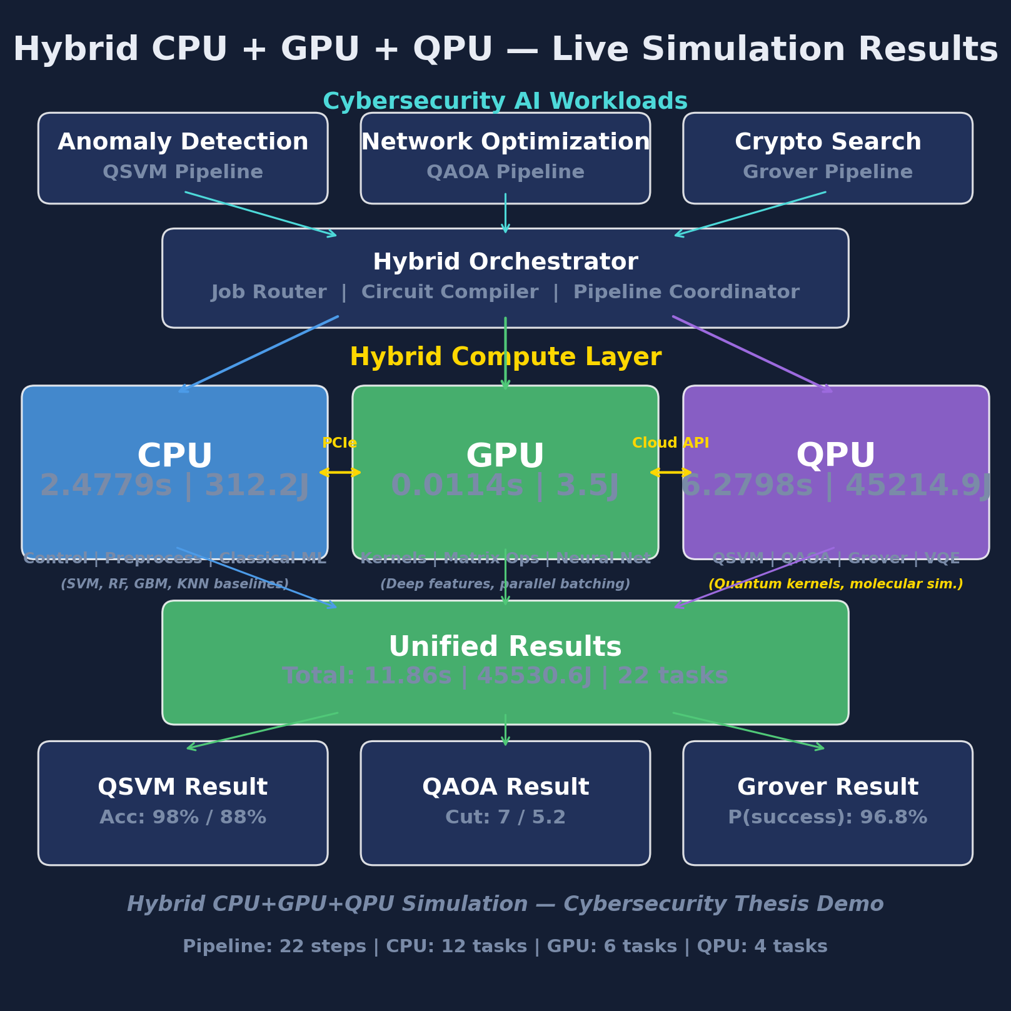
HERO · Defense · 4/13
Nirmit Dagli · Quinnipiac · 2026
HERO — A Measurement Framework
Heterogeneous Energy-aware Runtime Orchestrator
What HERO does
• Sends the same workload to all 3 tiers (CPU, GPU, QPU)
• Measures runtime, energy, accuracy per task
• Converts to 2026 cloud dollar cost
• Repeats 30× for statistical confidence
• Picks the Pareto-optimal tier
• Returns a recommendation
Backend-agnostic — swap the simulator for real IBM/AWS/Azure QPU in one line.

Slide 5
HERO · Defense · 5/13
Nirmit Dagli · Quinnipiac · 2026
Algorithm 1 — One Page, Five Steps
Allocation → Measurement → Aggregation → Pareto → Selection
1
2
3
4
5
ALLOCATE TIER
MEASURE 30×
AGGREGATE
PARETO
RECOMMEND
Look at the workload type and size. Use the rule book to pick a tier: molecular & big? → QPU. tabular & small? → CPU. Image? → GPU.
Run on every tier 30 times. Record: accuracy, latency, energy (joules), cost (USD).
Mean ± standard deviation. Wilcoxon p-values vs baseline. Box plots.
Drop methods that are worse than another on every axis (cost, energy, latency, accuracy).
Argmin over the Pareto set with the user's weighting of cost vs energy vs latency vs accuracy.
Same algorithm, any workload. Same algorithm, any future hardware.

Slide 6
HERO · Defense · 6/13
Nirmit Dagli · Quinnipiac · 2026
Two Workloads, Two Verdicts
Quantum isn't always better. Quantum isn't always worse.
Workload 1 — Cybersecurity
Workload 2 — Molecular Simulation
KDD Cup 99 intrusion detection
VQE on the H₂ molecule
• 494,021 real network connections
• 22 attack types (DoS, scanning, botnets)
• Methods: SVM, RF, GBM, KNN, QSVM
• 30-seed Wilcoxon validation
• Verdict: classical wins by 12,970×
• 2 qubits (parity-reduced)
• Hardware-efficient ansatz, COBYLA
• Classical exact diagonalisation as truth
• Achieves chemical accuracy (< 1.6 mHa)
• Verdict: classical wins for H₂…
Reality check for quantum cybersecurity hype.
…but classical scales O(2ⁿ). Quantum wins above n=50.

Slide 7
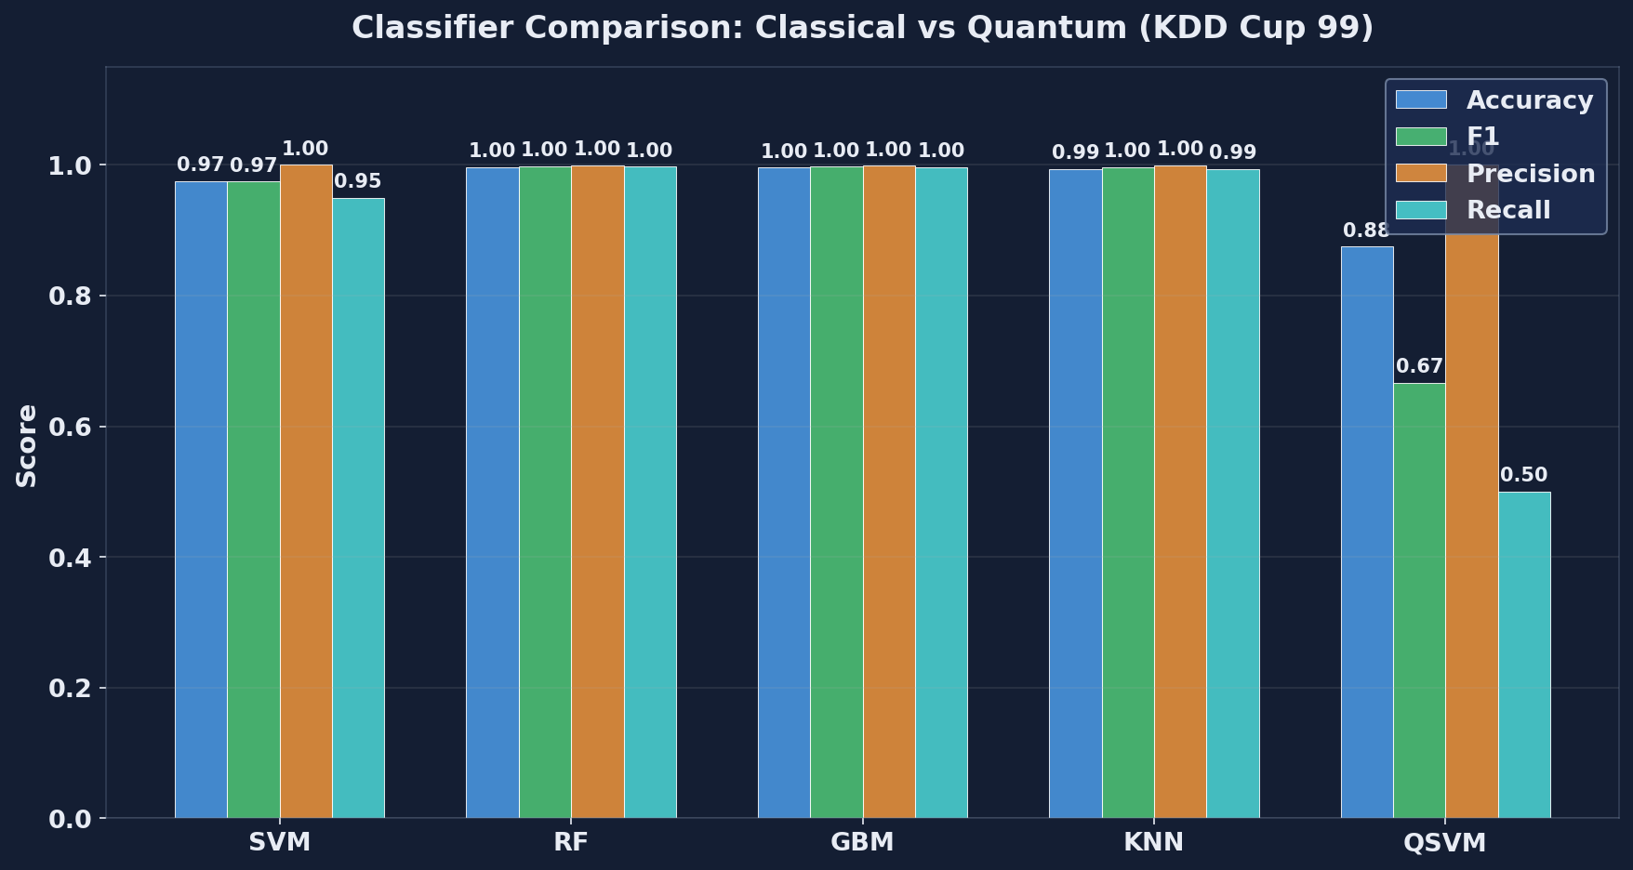
HERO · Defense · 7/13
Nirmit Dagli · Quinnipiac · 2026
Cybersecurity — Classical Wins by 12,970×
30 runs · KDD Cup 99 · 5 classifiers head-to-head
Headline Numbers
Random Forest
F1 = 0.998
QSVM
F1 = 0.667
Energy (RF)
22 J/task
Energy (QSVM)
8,315 J/task
Cost RF/1M
$1.99 USD
Cost QSVM/1M
$2,100,000
QSVM also recalls only 50% of attacks. Operationally unacceptable for IDS today.

Slide 8
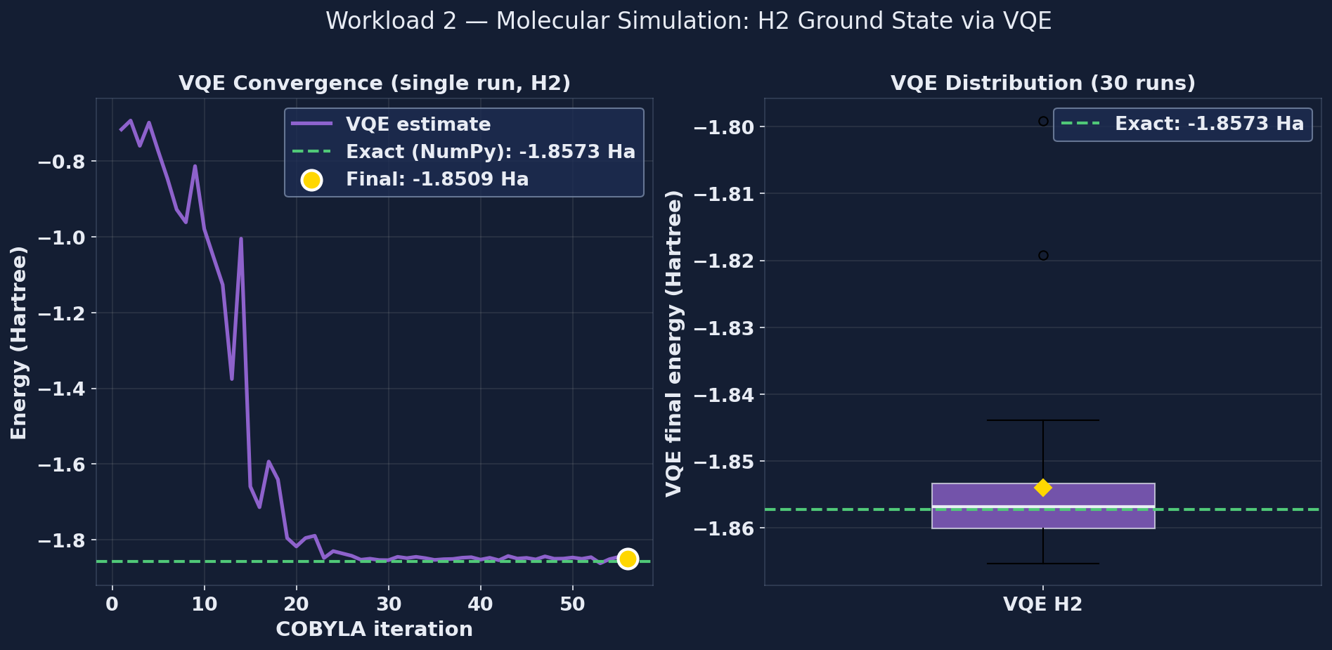
HERO · Defense · 8/13
Nirmit Dagli · Quinnipiac · 2026
Molecular Simulation — VQE Works, but Wait
30 runs · H₂ ground state · VQE vs exact diagonalisation
What we measured
Exact (NumPy)
−1.857275 Hartree
VQE estimate
−1.857 ± 0.012 Ha
Error vs exact
0.007 Ha (chem. accurate)
But for H₂ today…
Classical wins 700,000×
Why VQE matters: classical needs 16 PB of RAM at 50 qubits. Quantum stays polynomial. The crossover IS coming.

Slide 9
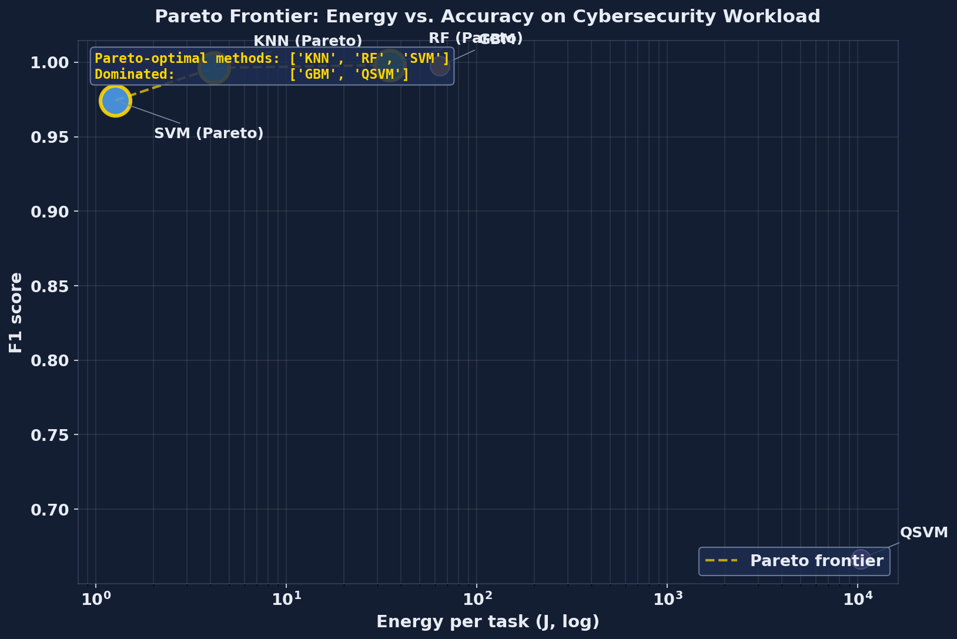
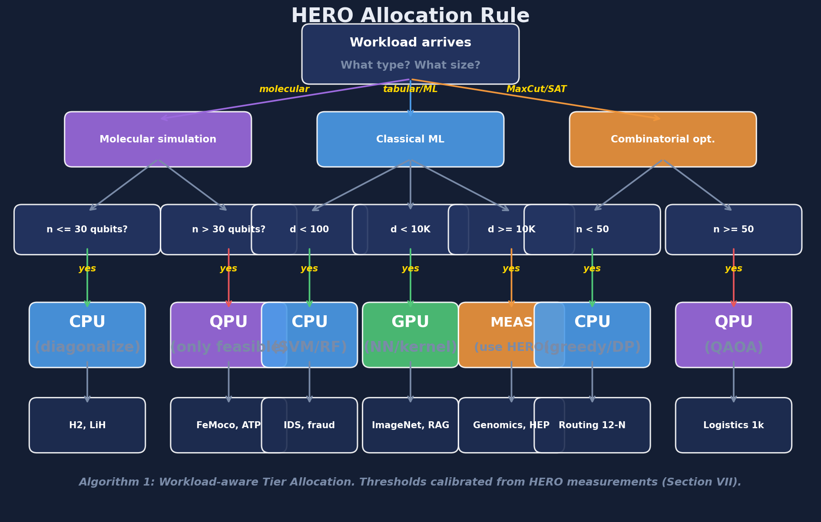
HERO · Defense · 9/13
Nirmit Dagli · Quinnipiac · 2026
Pareto Frontier + Allocation Rule
From measurements to a one-page decision rule
Pareto-optimal on cybersecurity: SVM (cheapest) and Random Forest (most accurate). Everything else is dominated.

Slide 10
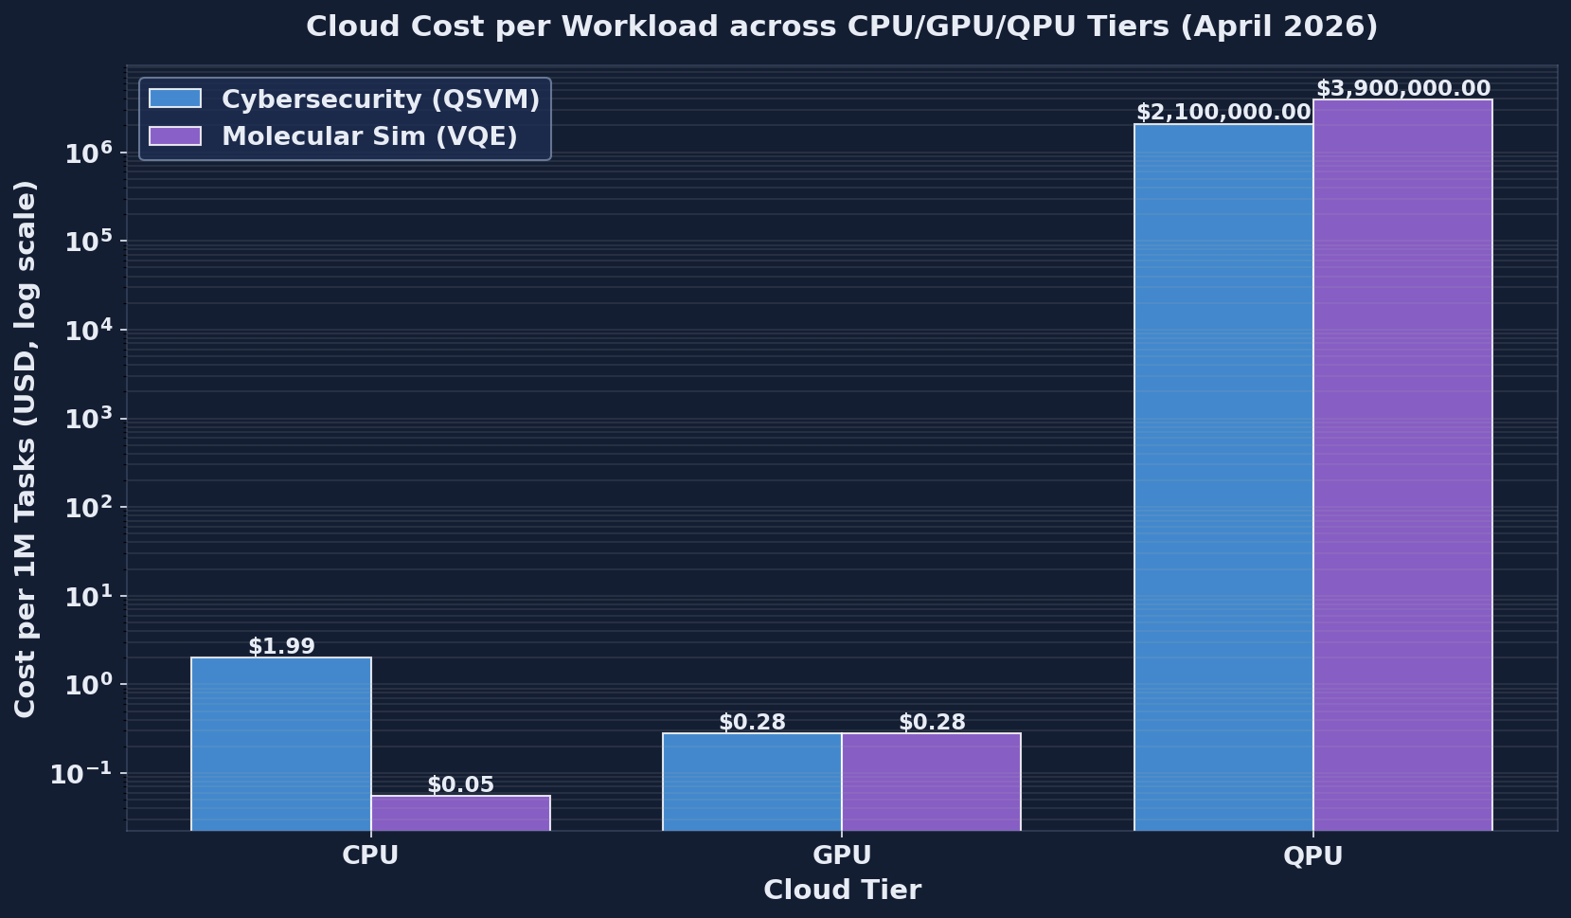
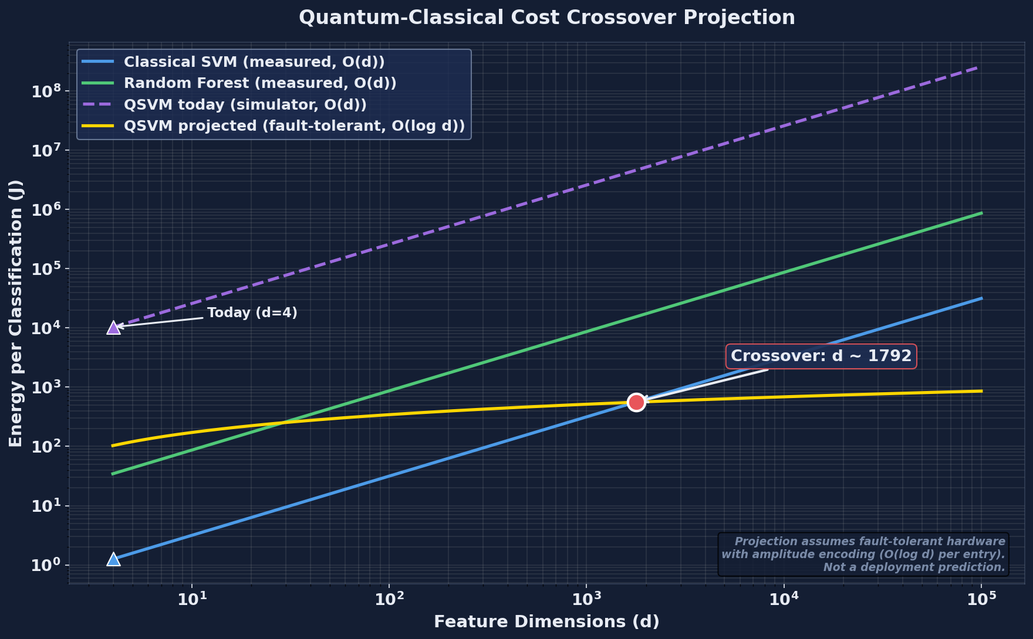
HERO · Defense · 10/13
Nirmit Dagli · Quinnipiac · 2026
What Does It Cost in 2026 Dollars?
AWS EC2 · AWS g5 · AWS Braket · IBM Quantum · Azure Quantum
$1.99 (CPU) vs $2,100,000 (QPU) per million classifications. Classical wins TODAY. Crossover projected at ~10⁴ features with fault-tolerant hardware.

Slide 11
HERO · Defense · 11/13
Nirmit Dagli · Quinnipiac · 2026
Live Demo — Try It Yourself
Open-source artifact: 151 MB of code, data, figures, papers
Live Website
Live Simulator
Open Code Repo
nirmitdagli.github.io/ quantum-thesis-demo/
nirmitdagli.github.io/ quantum-thesis-demo/ simulator.html
github.com/Nirmitdagli/ quantum-thesis-demo
Polished narrative summary of the thesis
Configure a workload, see HERO's decision
MIT licensed. Fork it. Run it.
Reproduce in 5 minutes
$ git clone https://github.com/Nirmitdagli/quantum-thesis-demo.git
$ python -m hybrid_simulation.run_hybrid

Slide 12
HERO · Defense · 12/13
Nirmit Dagli · Quinnipiac · 2026
Limitations & Future Work
What this thesis does NOT claim — and what's next
Limitations (honest)
Future Work
• No real quantum hardware (Qiskit Aer simulator only)
• Small quantum sample (120 points — kernel cost is O(n²))
• QPU energy is modelled, not measured (no facility telemetry)
• Only KDD Cup 99 for cross-tier comparison
• Only H₂ for VQE — LiH and BeH₂ supported but not run
• Cloud pricing is an April 2026 snapshot
• Migrate QPU tier to IBM Eagle / AWS Braket Rigetti
• Compare noiseless simulator vs real-hardware QSVM
• Add LiH, BeH₂, larger molecules to VQE
• RAPL / NVML live energy telemetry
• Kubernetes operator for production deployment
• Cloud billing API for live cost (vs static dict)
The framework is designed to absorb every one of these as cloud QPU hardware matures.

Slide 13
HERO · Defense · 13/13
Nirmit Dagli · Quinnipiac · 2026
Conclusion
What you should remember
It's a measurement framework
Two contrasting verdicts
Workload-aware allocation rule
HERO doesn't claim quantum advantage. It measures CPU + GPU + QPU honestly across cost, energy, latency, accuracy.
Cybersecurity: classical wins by 12,970× Molecular sim: classical wins TODAY, but loses scaling-wise above n = 50 qubits.
Concrete decision tree from measurements. Open source, reproducible in 5 minutes, extensible to any new workload or backend.
Thank you. Questions?
github.com/Nirmitdagli/quantum-thesis-demo
nirmitdagli.github.io/quantum-thesis-demo/
Nirmit Dagli · Quinnipiac University · May 2026

