Slide 1
MACHINE LEARNING PROJECT
Mental Health Condition
Predictor
Predicting Anxiety, Burnout, Depression and Normal states from everyday lifestyle and psychological indicators
Random Forest Classifier • 94.9% Test Accuracy • Streamlit Web App
Presented by [GROUP NAME] [SRMCEM / BTECH-CSE(AIML)] 10 July 2026

Slide 2
MOTIVATION
The Problem
Mental health conditions like anxiety, burnout, and depression often build up gradually through everyday habits, long before a person seeks clinical help.
WHY IT MATTERS
1 in 8
Traditional screening depends on clinical interviews — costly, slow, and often out of reach until symptoms are already severe.
people globally live with a mental health condition (WHO)
Early signs
often show up first in sleep, stress, and social habits
Goal: use routine, self-reportable lifestyle data to give people an early, accessible signal — not a diagnosis, but a nudge toward awareness.
Self-screening
can encourage people to seek support sooner
Mental Health Condition Predictor
2

Slide 3
Project Objectives
1
2
3
4
5
Collect & Clean Data
Engineer Features
Train & Evaluate
Explain the Model
Deploy
Structure demographic, lifestyle and psychological features; remove leakage columns
Encode categorical fields; assemble a clean 15-feature input vector
Build a Random Forest classifier across 4 mental health classes
Identify which lifestyle factors matter most via feature importance
Ship an interactive Streamlit app for real-time, self-service prediction
Mental Health Condition Predictor
3

Slide 4
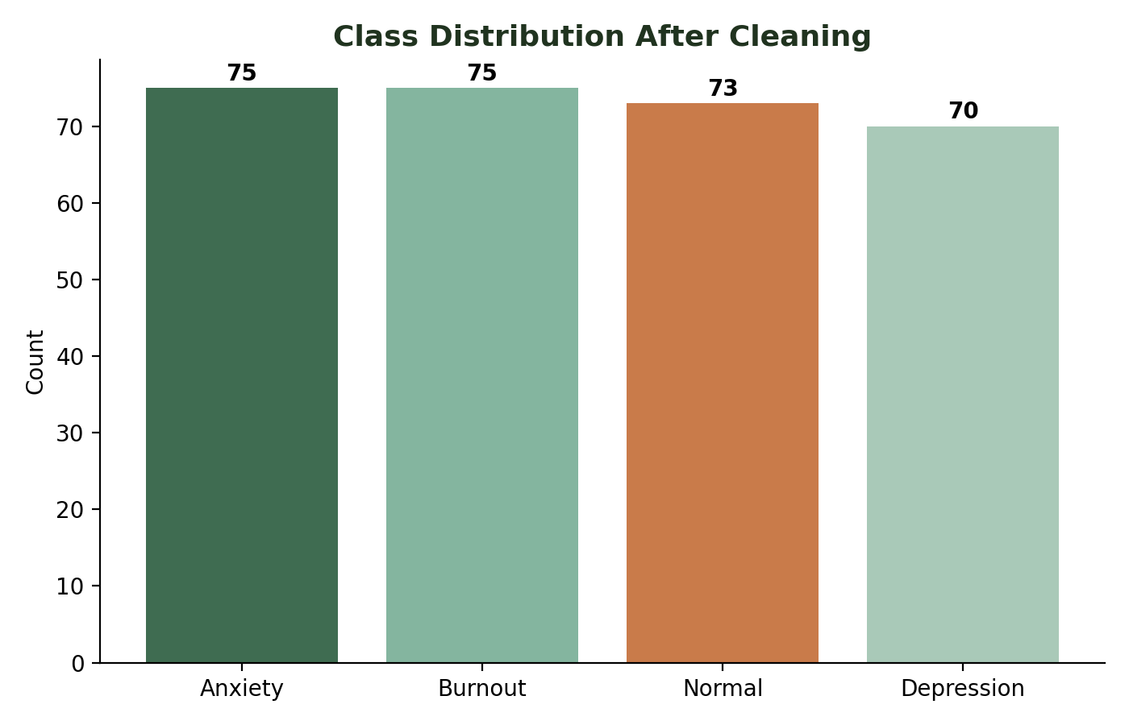
Dataset Overview
500
18
293
4
raw records
columns
clean records used
target classes
FEATURE GROUPS
Category | Example Features
Demographics | age, gender, occupation
Lifestyle | sleep_hours, social_media_hours, physical_activity_days
Psychological | stress_level, anxiety_score, depression_score, mood_score
Environment | academic_work_pressure, work_life_balance, social_support
Class balance is reasonable across all four
outcome categories after cleaning.
Leakage columns severity & treatment are dropped before training.
Mental Health Condition Predictor
4

Slide 5
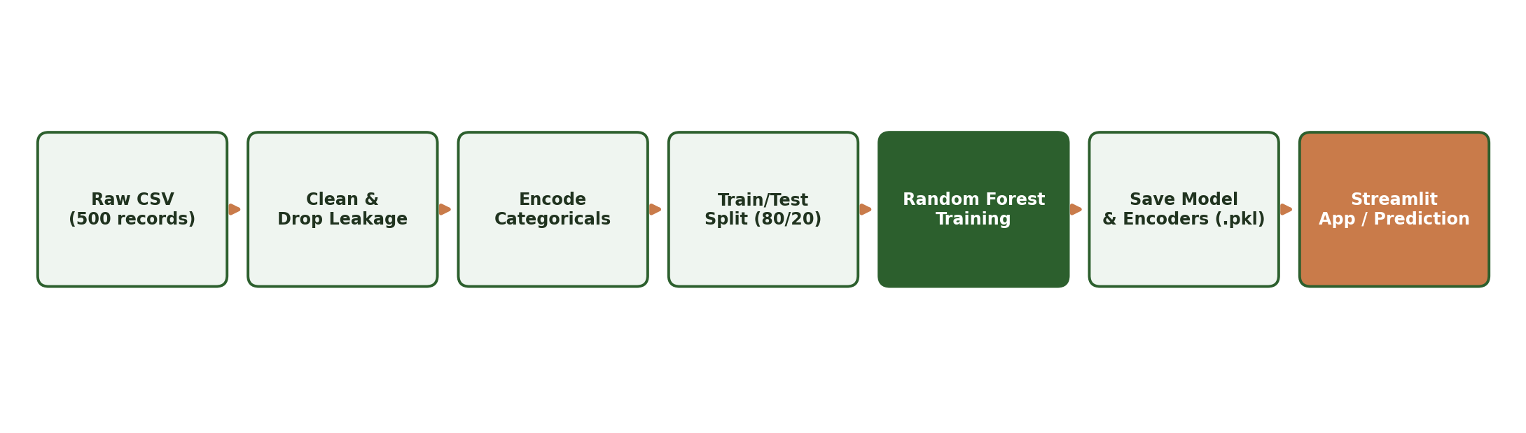
METHODOLOGY
End-to-End Pipeline
Missing rows dropped (dropna) — 293 of 500 records retained
severity & treatment removed to prevent data leakage
gender / occupation / target label-encoded with scikit-learn
80 / 20 train-test split, random_state = 42 for reproducibility
Mental Health Condition Predictor
5

Slide 6
Model: Random Forest Classifier
An ensemble of decision trees, each trained on a bootstrapped sample of the data. Predictions are made by majority vote across all trees — strong performance on structured, tabular data with minimal tuning.
WHY RANDOM FOREST?
✓
Handles mixed numeric & categorical features well
✓
Resistant to overfitting vs. a single decision tree
Algorithm
RandomForestClassifier (scikit-learn)
Input features
15 (demographic + lifestyle + psychological)
Built-in feature importance for interpretability
✓
Output classes
Normal, Anxiety, Burnout, Depression
Train / test split
80% / 20%, random_state = 42
✓
Robust to noisy or imperfectly scaled inputs
Train accuracy
100%
✓
Fast to train on datasets of this size
Test accuracy
94.9%
Mental Health Condition Predictor
6

Slide 7
MODEL PERFORMANCE
Results
94.9%
Class | Precision | Recall | F1
Anxiety | 0.86 | 0.92 | 0.89
Burnout | 0.94 | 1.00 | 0.97
Depression | 1.00 | 0.86 | 0.92
Normal | 1.00 | 1.00 | 1.00
TEST ACCURACY
100%
Anxiety and Depression show the most overlap — consistent with real-world symptom similarity between the two conditions.
TRAIN ACCURACY
59 test samples • 4 balanced classes • Random Forest, random_state = 42
Mental Health Condition Predictor
7

Slide 8
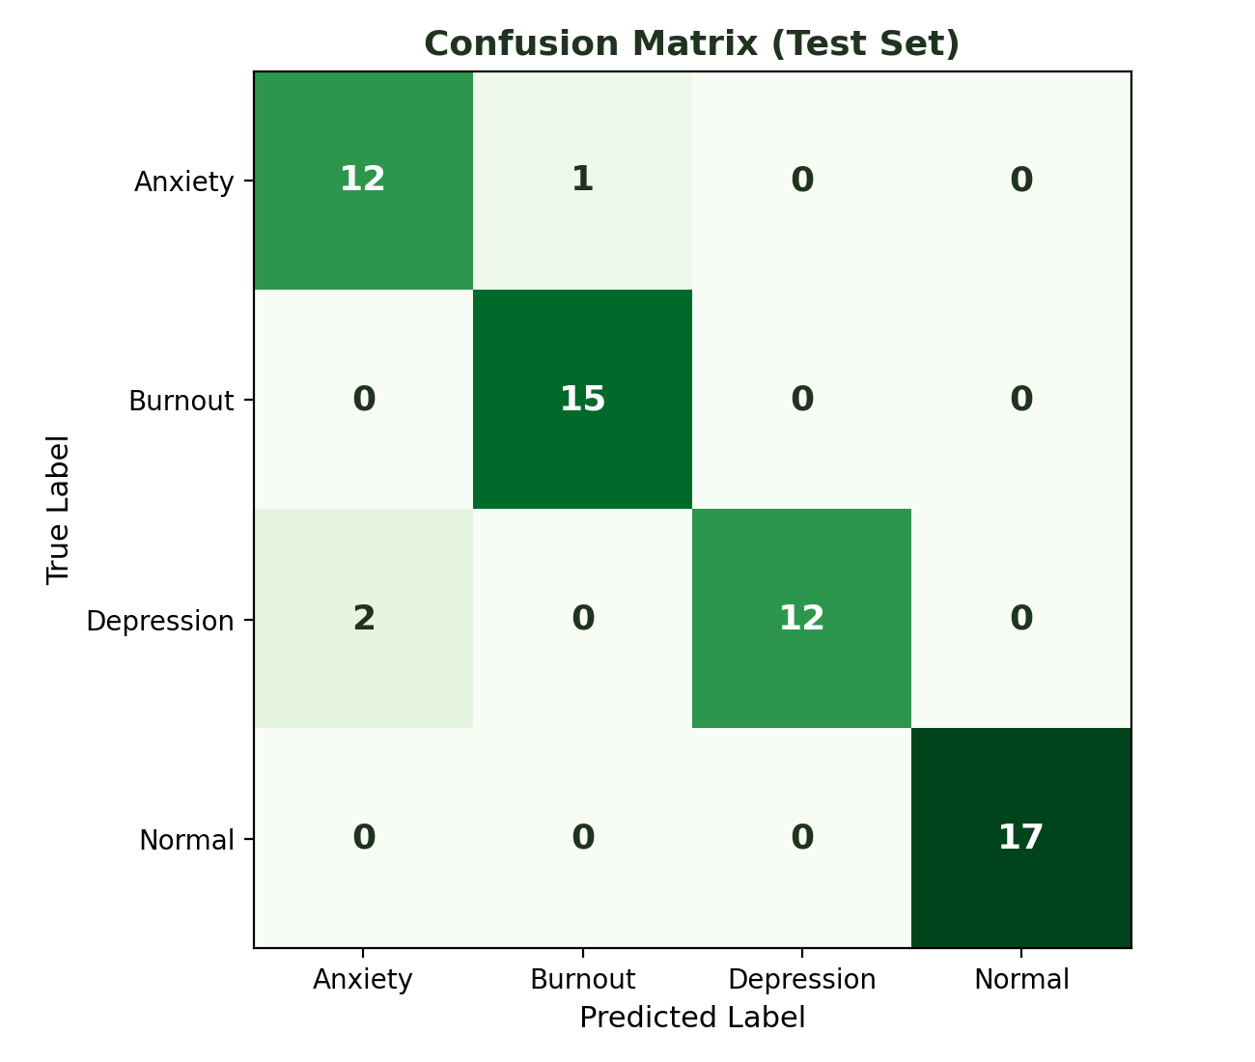
MODEL PERFORMANCE
Confusion Matrix
Mental Health Condition Predictor
8

Slide 9
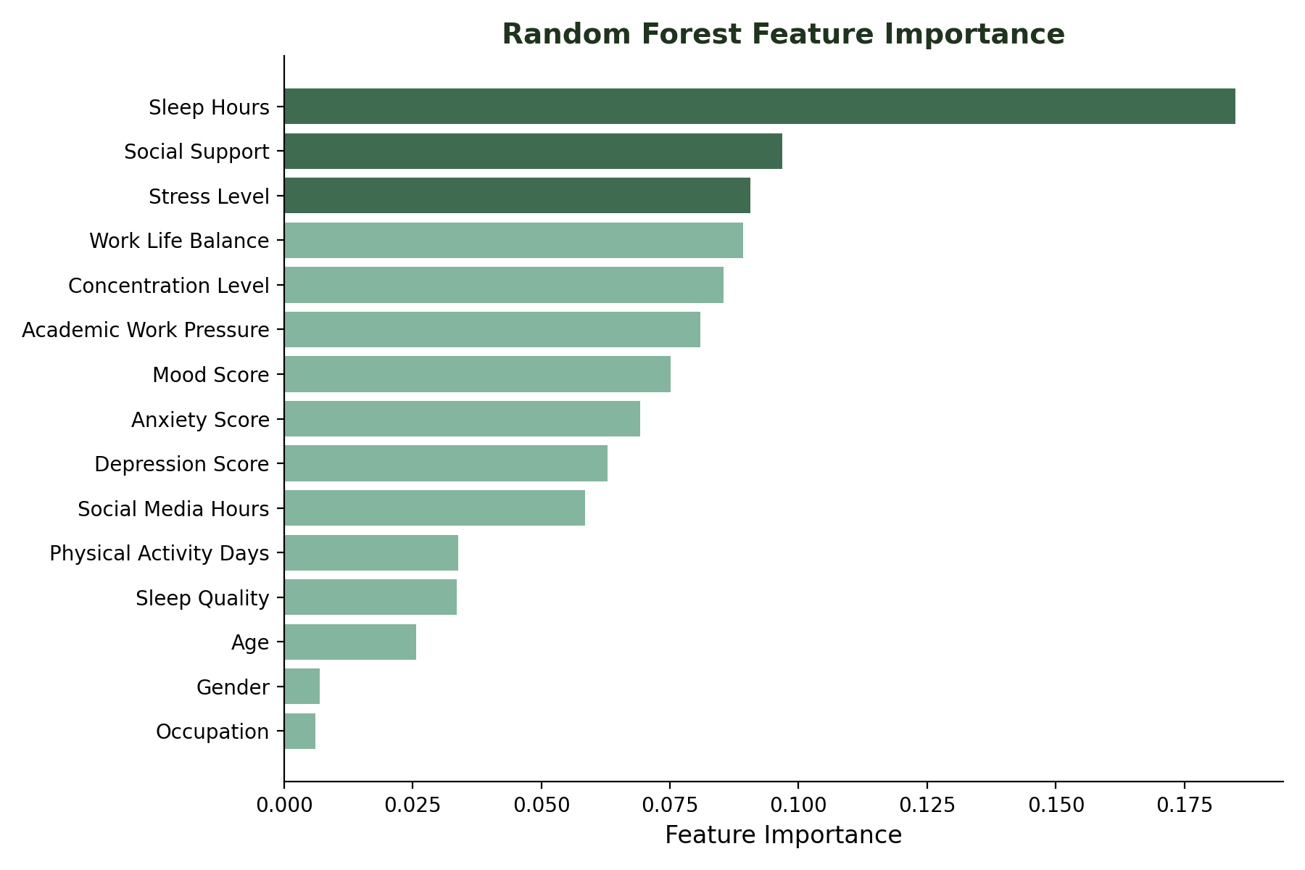
FEATURE IMPORTANCE
What Drives the Prediction?
TOP TAKEAWAYS
Sleep hours
the single strongest predictor
Social support
second most influential factor
Stress level
consistently ranks in the top 3
Demographics
age/gender/occupation matter least
Mental Health Condition Predictor
9

Slide 10
Deployment: Streamlit App
The trained model and encoders are loaded into an interactive Streamlit application. Users answer a short set of sliders and dropdowns and get an instant, plain-language prediction.
streamlit run app.py
Mental Health Condition Predictor
1
User enters lifestyle & psychological details
Age
2
App encodes categorical inputs (gender, occupation)
Gender
Occupation
3
Feature vector sent to the trained Random Forest model
Sleep Hours
4
Prediction decoded back into a readable label
Stress Level
Social Support
5
Result shown instantly: “Predicted condition: Anxiety”
Predict
Mental Health Condition Predictor
10

Slide 11
Conclusion & Future Work
CONCLUSION
FUTURE WORK
A Random Forest model trained on everyday lifestyle and psychological indicators predicts mental health condition with 94.9% test accuracy. Removing leakage-prone fields (severity, treatment) keeps the evaluation realistic, and feature importance shows sleep, social support, and stress drive most predictions — wrapped in a usable Streamlit app for instant self-screening.
→
Add SHAP explanations for per-user prediction reasoning
→
Expand dataset diversity (age, culture, occupation)
→
Track predictions over time via a lightweight database
→
Containerize with Docker; deploy to the cloud
→
Benchmark against XGBoost & Logistic Regression
Mental Health Condition Predictor
11

Slide 12
Thank You
Questions & Discussion
Mental Health Condition Predictor — Random Forest + Streamlit

