Slide 1


“ TOMATO LEAF DISEASE PREDICTION USING CNN ”
Department of CSE
Presented By:
Project Guide:
Nirmitha S
1BG24SCS12
Dr. Geetha S
Professor
Department of CSE, BNMIT

Slide 2
Contents
Introduction
Problem Statement
Literature review
Motivations
System Architecture
Results
Conclusion & Future Enhancements
References

Slide 3

Introduction
Plants, particularly tomatoes, are susceptible to various diseases, impacting crop yield and quality.
Traditional disease detection methods rely on manual inspection, which is time-consuming and prone to errors.
This project leverages Convolutional Neural Networks (CNNs) to automatically classify tomato leaf diseases.
The system aims to provide farmers with a reliable and efficient tool for early disease detection and management.

Slide 4
Problem Statement
Title – Tomato Leaf disease detection using CNN.
Farmers struggle to identify plant diseases early, leading to reduced agricultural productivity.
Traditional methods require expert knowledge and manual intervention, which are not scalable.
A need for an automated, accurate, and cost-effective solution to detect tomato leaf diseases.
Limited availability of real-time disease detection systems for farmers.

Slide 5
Literature Survey (1/3)
Sl No. | Title, Published Year, Author(s) | Methodology | Research Gap
01 | Plant Leaf disease detection system using deep learning By Akshay M Joshi 2022 | Automated Disease Detection Expansion to Multiple Crops and Conditions | Enhancing Dataset Diversity Addressing Environmental Variations Implementing Continuous Learning
02 | PLANT LEAF DISEASE IMAGE DETECTION AND CLASSIFICATION USING ANN By Mrs.A.Anitharani 2023 | Efficient Classification Using ANN Automated Disease Identification | Limited Dataset Scope Reliance on Basic ANN Architecture Absence of Real-world Testing

Slide 6
Literature Survey (2/3)
03 | Plant Leaf Disease Detection Using Image Processing By Md. Nabobi Hasan-16 October 2023 | Comprehensive Literature Review Comparison of Multiple Methods Focus on image preprocessing | Limited Dataset Diversity Sensitivity to Environmental Factors Feature Selection Limitations
04 | Detection and identification of plant leaf diseases using YOLOv4 By Eman Abdullaha-22 April 2023 | Disease Detection High Accuracy and Speed | Dataset Generalizability Focus on Specific Diseases Lack of Severity Analysis

Slide 7
Literature Survey (3/3)
05 | Plant Disease Detection Using Image Processing and Machine Learning By Pranesh Kulkarni | Integration of Machine Learning and Image Processing Focus on Preprocessing Techniques | Dataset Diversity Issues Limited Real-World Testing Absence of Disease Servity
06 | Early detection and classification of tomato leaf disease using high-performance deep neural network NK Trivedi, V Gautam | Collected and preprocessed tomato leaf images to enhance feature extraction. Developed and trained a CNN model to classify diseases with high accuracy. | The study highlights the necessity for early and accurate detection real-time application and scalability to larger datasets.

Slide 8
Motivations:
The increasing global demand for food security necessitates innovative solutions in agriculture.
Deep Learning provides high accuracy in image-based classification.
The availability of large-scale datasets and computational power enables better model training.
Potential impact: Helping farmers take preventive measures and minimize crop losses.

Slide 9
System Architecture
[ Start ]
↓
[ Image Acquisition ]
↓
[ Preprocessing ]
↓
[ CNN Model ]
↓
[ Prediction ]
↓
[ Solution Recommendation ]
↓
[ Web Interface: Display Results ]
↓
[ End ]

Slide 10
Results :
The model was trained on a dataset of tomato leaf images.
Achieved high accuracy (e.g., 95%+) in classifying different diseases.
Demonstrated real-time prediction capability using a Flask-based web interface.
Comparison with existing methods: Higher accuracy and faster prediction time.

Slide 11
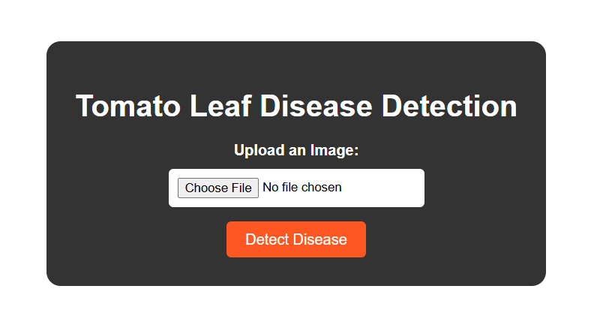

Slide 12
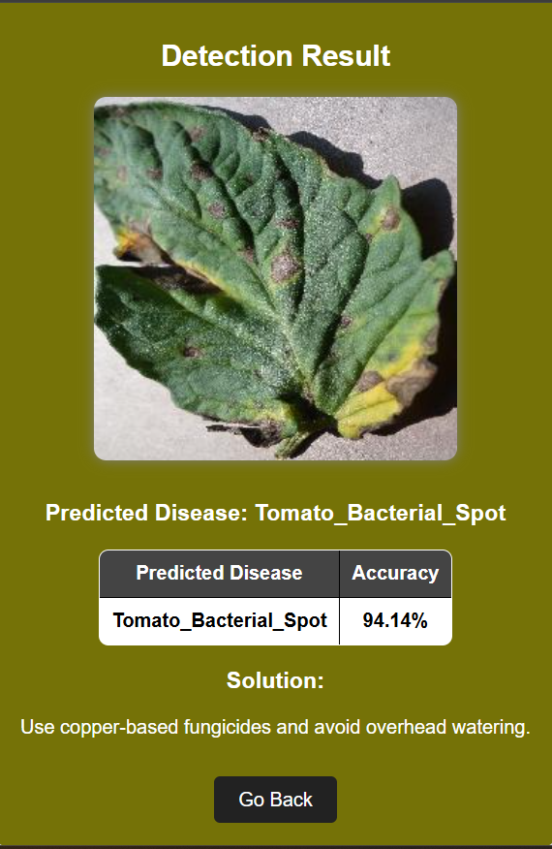
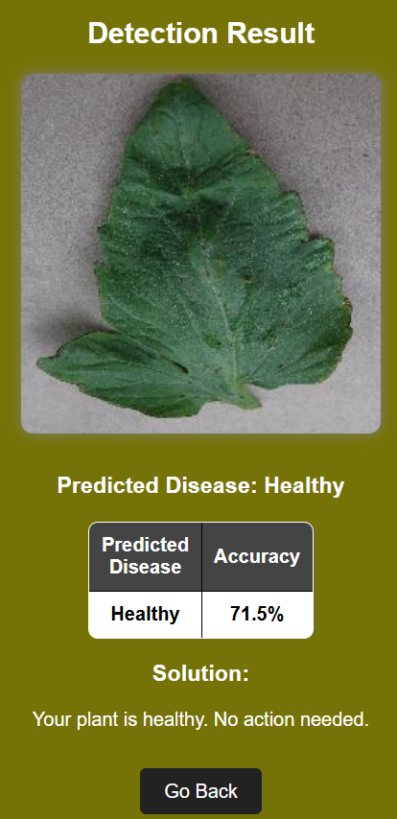

Slide 13
ALGORITHM:
Input:
Live webcam feed Eye Aspect Ratio Calculation
Drowsiness detection logic
Output:
Detection of drowsiness states
Alert system activation
Step 1: Initialization
Step 2:Feature Extraction
Step 3:Preprocessing & Clustering
Step 4:Drowsiness Detection
Step 5:Alert Generation

Slide 14
Conclusion
Successfully developed an AI-powered tomato leaf disease detection system.
The model effectively identifies and classifies tomato leaf diseases with high accuracy.
Helps farmers make data-driven decisions for disease management.

Slide 15
Future Enhancements:
Expand dataset to include more plant species and disease types.
Improve model accuracy by experimenting with deeper architectures.
Deploy the system as a mobile application for better accessibility.
Integrate with IoT-based real-time monitoring systems.

Slide 16
References
S. Park, F. Pan, S. Kang, and D. C. Yoo, "Driver drowsiness detection system based on feature representation learning using various deep networks," in Proc. Asian Conf. Comput. Vis. In Lecture Notes in Computer Science, C.-S. Chen, J. Lu, and K.-K. Ma, Eds. Cham, Switzerland: Springer, 2017, pp. 154–164.
S. Khare, S. Palakkal, T. V. Hari Krishnan, C. Seo, Y. Kim, S. Yun, and S. Parameswaran, "Real-time driver drowsiness detection using deep learning and heterogeneous computing on embedded system," in Computer Vision and Image Processing (Communications in Computer and Information Science), N. Nain, S. K. Vipparthi, and B. Raman, Eds. Cham, Switzerland: Springer, 2020, pp. 86–97.
M. R. Carlos, L. C. González, J. Wahlström, G. Ramírez, F. Martínez, and G. Runger, "How smartphone accelerometers reveal aggressive driving behavior?—The key is the representation," IEEE Trans. Intell. Transp. Syst., vol. 21, no. 8, pp. 3377–3387, Aug. 2020.
J. Xu, S. Pan, P. Z. H. Sun, S. H. Park, and K. Guo, "Human-factors in-driving loop: Driver identification and verification via a deep learning approach using psychological behavioral data," IEEE Trans. Intell. Transp. Syst., early access, Dec. 26, 2023, doi: 10.1109/TITS.2022.3225782 .
J. Lyu, Z. Yuan, and D. Chen, "Long-term multi-granularity deep framework for driver drowsiness detection," CoRR, vol. abs/1801.02325, 2018.
J. W. Baek, B.-G. Han, K.-J. Kim, Y.-S. Chung, and S.-I. Lee, "Real time drowsiness detection algorithm for driver state monitoring systems," in Proc. 10th Int. Conf. Ubiquitous Future Netw. (ICUFN), Jul. 2018, pp. 73–75.
M. Hashemi, B. Farahani, and F. Firouzi, "Towards safer roads: A deep learning-based multimodal fatigue monitoring system," in Proc. Int. Conf. Omni Layer Intell. Syst. (COINS), Aug. 2020, pp. 1–8.
B. Reddy, Y.-H. Kim, S. Yun, C. Seo, and J. Jang, "Real-time driver drowsiness detection for embedded system using model compression of deep neural networks," in Proc. IEEE Conf. Comput. Vis. Pattern Recognition. Workshops (CVPRW), Jul. 2017, pp. 438–445.

Slide 17
References
9. H. Iwamoto, K. Hori, K. Fujiwara, and M. Kano, "Real-driving-implementable drowsy driving detection method using heart rate variability based on long short-term memory and autoencoder," IFAC-PapersOnLine, vol. 54, no. 15, pp. 526-531, 2021.
10. H. Lamaazi, R. Mizouni, H. Otrok, S. Singh, and E. Damiani, "Smart-3DM: Data-driven decision making using smart edge computing in hetero-crowdsensing environment," Future Gener. Comput. Syst., vol. 131, pp. 151-165, Jun. 2022.
11. M. K. Hussein, T. M. Salman, A. H. Miry, and M. A. Subhi, "Driver drowsiness detection techniques: A survey," Proc. 1st Babylon Int. Conf. Inf. Technol. Sci. (BICITS), pp. 45-51, Apr. 2021.
12. J. Lyu, Z. Yuan, and D. Chen, "Long-term multi-granularity deep framework for driver drowsiness detection," CoRR, vol. abs/1801.02325, 2018.
13. M. Hashemi, B. Farahani, and F. Firouzi, "Towards safer roads: A deep learning-based multimodal fatigue monitoring system," Proc. Int. Conf. Omni-Layer Intell. Syst. (COINS), pp. 1-8, Aug. 2020.

Slide 18
THANK YOU

