Slide 1
System Resource Info Tool
Display Size and Limits of C Data Types
Submitted By:
Nirnay Sinha
Under the Guidance of:
Miss Naina Devi
Subject:
Programming Fundamentals with C
College:
Rungta International Skills University

Slide 2
Agenda 📌
📘 Project Introduction
🛠️ Tools & Technologies Used
💻 System Resource Info Tool – Code
🧠 Code Explanation
📊 Program Output
🔍 Output Explanation
🌍 Applications
⭐ Advantages
🚀 Future Scope
✅ Conclusion

Slide 3
Project Introduction
System Resource Info Tool is a C-based program.
It displays:
  Memory size of C data types
  Their minimum and maximum limits
Uses standard header files for portability.
Helps understand system-dependent behavior of C programs.

Slide 4
Tools & Technologies Used
Programming Language: C
IDE: Visual Studio Code
Compiler: GCC / MinGW
Header Files Used:
  stdio.h
  limits.h
  float.h
Operating System: Windows / Linux

Slide 5
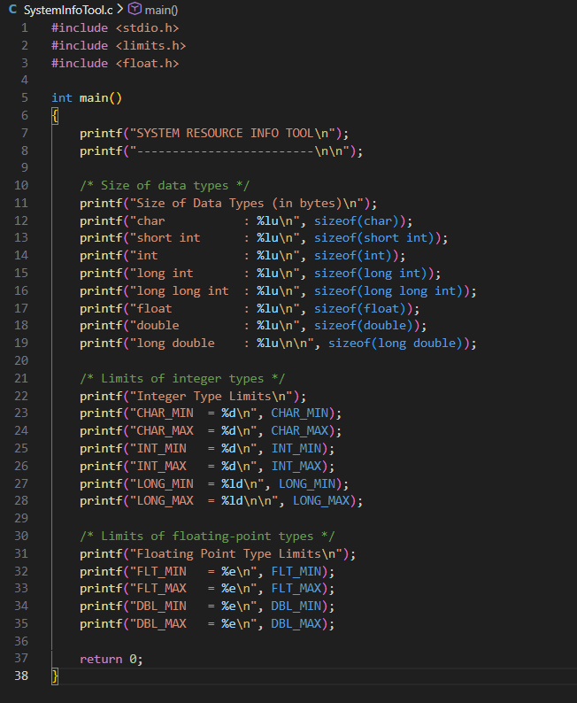
System Info Tool

Slide 6
Code Explanation
The program starts by including standard header files:
stdio.h for input and output operations
limits.h to obtain minimum and maximum values of integer data types
float.h to obtain range information of floating-point data types
The main() function is the entry point of the program.
The sizeof() operator is used to determine the memory size (in bytes) of various C data types such as:
char, int, long, float, double, etc.
Predefined macros like INT_MAX, CHAR_MIN, FLT_MAX, and DBL_MAX are used to display the limits of data types.
printf() statements are used to format and display all information clearly on the screen.
The program terminates successfully using return 0.

Slide 7
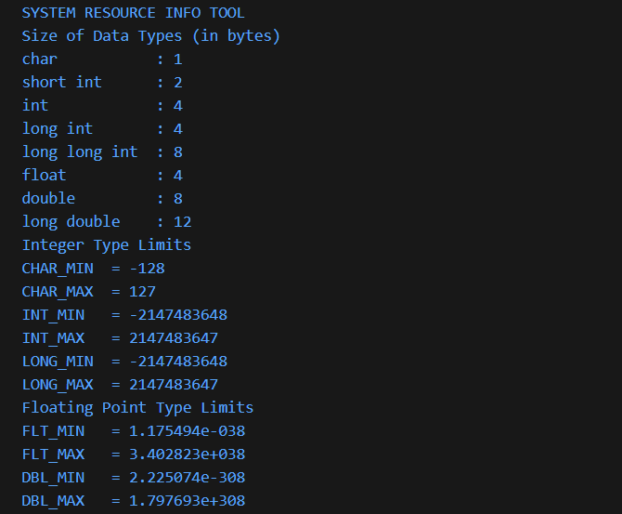
Output

Slide 8
Output Explanation
The output displays system-specific information about C data types.
It shows the memory size (in bytes) consumed by each data type using the sizeof() operator.
Integer limits such as minimum and maximum values are obtained from limits.h.
Floating-point ranges and precision are obtained from float.h.
The displayed values may vary across different systems and compilers, proving that C is system dependent.
This output helps programmers select appropriate data types, ensuring safe, efficient, and portable programs.

Slide 9
Applications
Real-world Applications of System Resource Info Tool:
Ensures portable and reliable C programs across different systems
Helps developers in embedded systems with limited memory resources
Useful for system-level and low-level programming (drivers, OS modules)
Assists in memory optimization and management analysis
Serves as an educational tool for learning C data types and system behavior

Slide 10
Advantages
Key Benefits of the Tool:
Simple and efficient way to obtain system-specific data type info
Helps prevent overflow and underflow errors in programs
Relies on standard C libraries for accuracy and portability
Enhances understanding of how data types interact with system memory
Flexible and easy to extend for additional features in future

Slide 11
Future Scope
Potential Enhancements:
Add a menu-driven interface for interactive user selection
Include user-defined and complex data types like structures and unions
Compare system resource info across multiple platforms and compilers
Export collected data to text or CSV files for analysis
Develop a GUI version for easier visualization and professional use

Slide 12
Conclusion
Summary of the Project:
The System Resource Info Tool successfully displays the size and limits of all C data types
Highlights system-dependent behavior, emphasizing portability and reliability
Acts as a reference for safe and optimized programming
Fulfills the project objectives of educating users about memory usage and data type constraints

Slide 13


