Slide 1
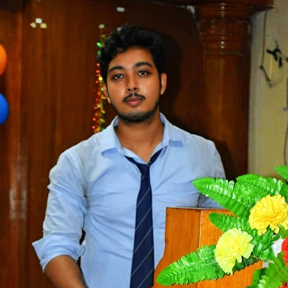



Nirnoy Saha
Analyst/Software Engineer
Bachelor of Technology
Information Technology: 2018-2022
Skills
Java 8 /J2EE | Java Basics, OOPS, Generics, Collections, Arrays, Loops, Lambda Exp, Stream API Junit, Mockito, Servlets
Spring core | IOC & Dependency Injections
Spring REST | REST controllers, Implementation of GET, POST, PUT & DELETE, Bean Validation & Exception Handling, Testing Services, Controller & Repository layer
Spring Data JPA | Implement DAO layer using spring Data repositories, Transaction Management
Spring Boot Microservices | Spring Boot Starters, annotations, Messaging Service, Sync/Async comms, Swagger API documents
Spring Cloud | Eureka, Netflix Ribbon, Feign Client, Netflix Hystrix, Netflix Zuul & Config Server
React | Components, Hooks, Event handling, Redux, Reducers, Testing using Jasmin & Karma
Database | MongoDB No Sql Basics My SQL RDS Basics
UI Tech | HTML 5 & CSS 3,JavaScript, ES6 & TypeScript Reusable templates, Optimized UI Designed
Tools | Git, Postman, Maven, IDE, STU
Add On skills | Communications, Team management. Peer learning , Team Leader, Problem Solving
Bangalore
nirnoysaha114@gmail.com
(+91) 9836716378
A4
Full Stack Developer
Hands on experience in creating microservices with Spring Boot, Spring Security, Spring Cloud API Gateway, Eureka server, load balancing.
Proficient in creating Single page Web Application in React with Authentication with route guards, React reactive forms, Redux, routing, Tailwind CSS
Hands on experience in implementing Microservices architecture with spring boot
Experience in creating documentation with Java docs and swagger and in unit testing using Junit, Mockito.
Hands on experience in implementing MongoDB and PostgreSQL.
Basic knowledge of Cloud.
E-Commerce Shopping Cart Application
Completed end to end case study of Shopping Cart Application using HTML 5, CSS 3, Bootstrap 4, JavaScript ES6, PostgreSQL, ReactJS, Redux, Type Script, Git, MySQL, Postman.
Online Hotel Management System
The Reservation System using and creating microservices with Spring Boot, Spring Security, Spring Cloud API Gateway, Eureka server, Swagger, HTML 5, CSS 3 with bootstrap 4, JavaScript, ReactJS.
Check out my work on GitHub & Video Profile

