Slide 1

Smart Coffee Machine
Programming for Everyone:
An Introduction to Visual Languages

Slide 2
Student Details
Idan Moshe
Nir Kedem
Department: Learning Technologies
Institute: HIT
Department: Computer Science
Institute: HIT
Igor Pugach
Dekel Peer
Department: Electrical Engineering
Institute: HIT
Department: Industrial Engineering
Institute: HIT

Slide 3
A Smart Coffee Machine
The system is a smart coffee machine that uses coffee beans.
It makes sure that the quantity required for all the drinks is sufficient for the continuation of the operation requested by the users, performs the operations and gives special alerts about malfunctions and finally announces that the coffee is served with a small speaker.

Slide 4
Input
Output
01 button on/off
01 coffee (the drink itself)
02 touch screen
02 error messages
03 sound (drink is ready)

Slide 5
Example of Reactivity
A system that will be operated by the user and will enable the following functions:
01
Since turning on the machine and until the end of the preparation of the drink, a temperature test is performed continuously to make sure that machine doesn’t overheat.
02
The system regularly checks the quantity of water and milk and sends alerts of malfunctions accordingly.

Slide 6
01
Yakindu

Slide 7
States
01
02
09
16
03
10
17
04
11
18
05
12
19
06
13
20
07
14
21
08
15
22
off
The machine is off
on
HaveMessage
DontEnoghtBeans
The machine is turned on
The screen display show a message
The amount of beans isn’t sufficient
waiting
Frothing
EnoghtMilk
The machine waits for the user to choose a drink
The machine is frothing the milk
The amount of milk is sufficient
Espresso
NotFrothing
DontEnoghtMilk
The machine isn’t frothing the milk
The amount of milk isn’t sufficient
Latte
Stop
EnoghtWater
The amount of water is sufficient
Home
Grinds
DontEnoghtWater
The screen is in home made
The machine grinds the beans
The amount of water isn’t sufficient
DontHaveMessage
Brewing
Regular
The screen display doesn’t show a message
The machine is brewing the espresso
The temperature of the machine is normal
Making coffee
EnoghtBeans
OverHeat
The machine make the coffee
The amount of beans is sufficient
The machine is overheating

Slide 8
Requirement
01
After pressing the "on" button, the system changes to the "on" state.
The system displays the home page and uses swiping right/swiping left to navigate through the options in order to choose the desired coffee.
02
03
By pressing on the the desired coffee type the system starts the "making coffee "state".
After being alerted by message of an existing shortage of ingredients the user gets the option of pressing "okay" once he handled the said shortage.
04
05
In case the user chose "latte" as his drink of choice the system will start frothing the milk.

Slide 9
Requirement
As long as the system is "on" it will actively conduct checks of whether the amount of milk\coffee'\water is sufficient in case of shortage the system will display the appropriate message.
06
As long as the system is "on" it will actively check the temperature ,in case the temperature is too high the system sends the appropriate message and shuts down.
07
08
As long as the system awaits the user to choose his preferred coffee of choice the making process is on STOP.
09
The choosing of the coffee triggers the grinding of the coffee.
10
Once the system is done grinding the coffee the Brewing of it starts.

Slide 10
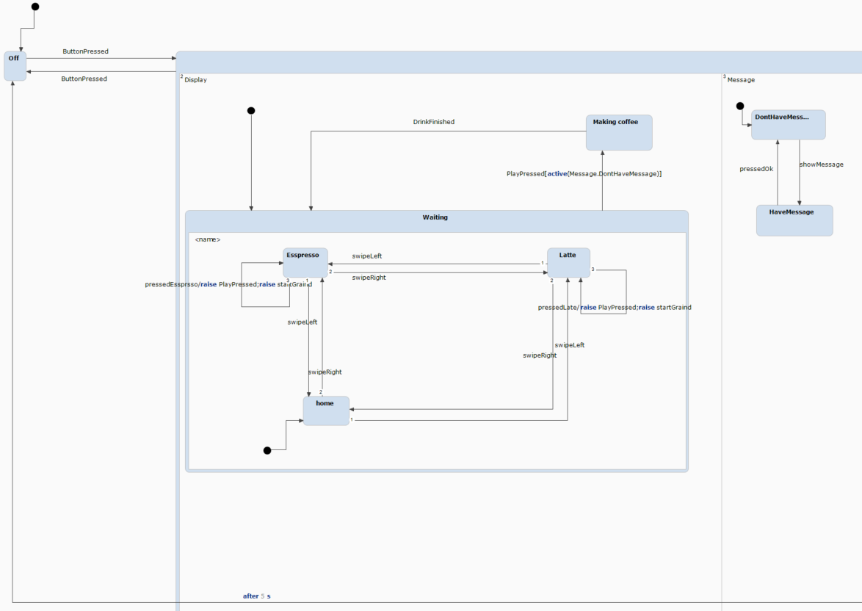
The Statecharts

Slide 11
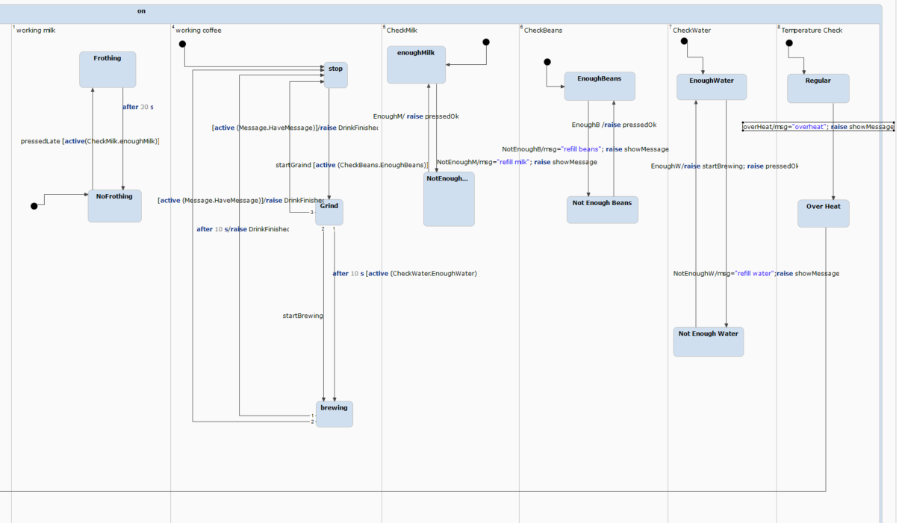
The Statecharts

Slide 12
02
Scratch

Slide 13
Behavior Requirements
01
When someone enters the kitchen the coffee machine asks if you would like to drink coffee. Then if the answer is yes the machine starts heating the water (30 seconds).
02
While boiling the water the machine says, "What coffee would you like to drink"”.
03
When someone chooses a type of coffee, the machine starts shredding the coffee beans for 10 seconds.
04
At the end of the grinding, the machine pours coffee and then says “the coffee is ready”.

Slide 14
Controlled Language
When a person enters the kitchen, then the coffee machine plays the sound “Would you like to drink a coffee?”.
01
When a person answers, if the answer is “yes”, then the coffee machine starts boiling the water and the coffee machine plays the sound “Which type of coffee would you like to drink?” and the clock ticks for 30 seconds.
02
03
When a person chooses a type of coffee then the coffee machine starts shredding the coffee beans and the clock ticks for 10 seconds.
04
When the clock stops ticking then the coffee machine plays sound “your coffee is ready”.

Slide 15
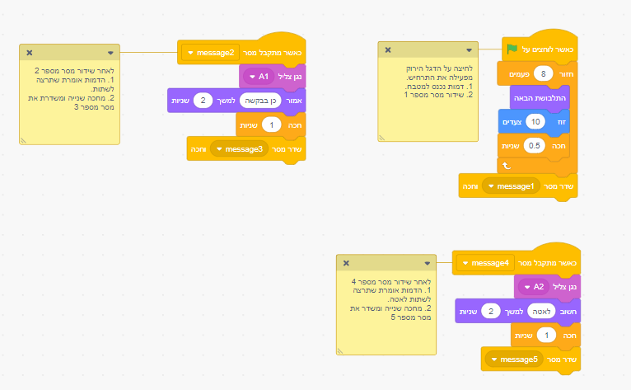
Object 1: person

Slide 16
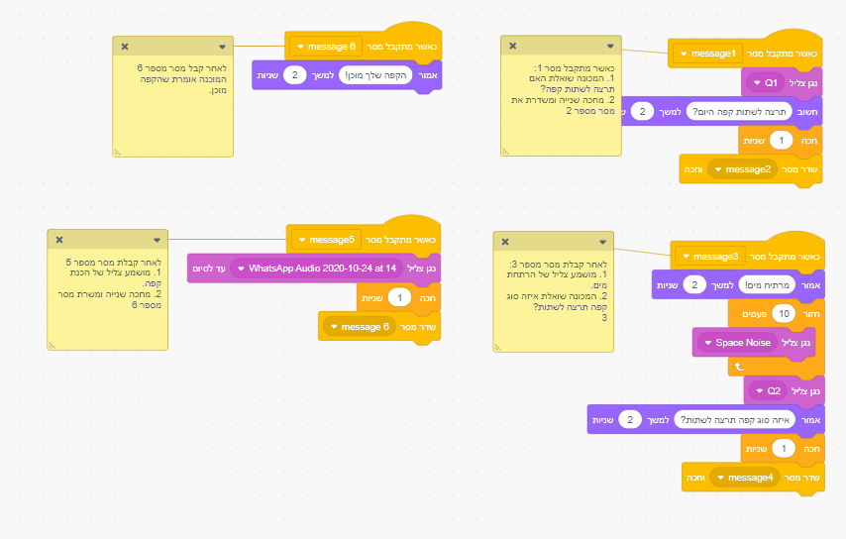
Object 2: Coffee machine

Slide 17
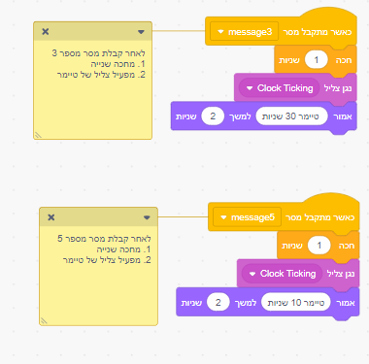
Object 3: clock

Slide 18
03

Slide 19
Contrast Languages
After we worked with both languages, we think that one difference between statecharts and behavioral programming, is that visualization is more native to common user, that not necessary familiar with coding. So this is one big pro for visual programming.
On the other hand, statecharts allows to it’s users program faster, so it is a pro for someone who is familiar with both types of programing.
To conclude, in our opinion behavioral programming is simpler to use, but for complex projects, we would prefer to work with statecharts.

Slide 20
Reflection
Dekel
The course helped me to develop a different kind of systematic thinking, it helped me to experience and learn the making process of a project\product, and those are important values in the field of industrial engineering and management. The hybrid structure helped the course since it helped me to revisit subject, I had struggled with without the time pressure, and because of that I had a better understanding of the material.
Idan
I think the material is relevant to my studies because, in my studies, I study programming and design and visual languages deal with both. The course was challenging because it was in English and it helped me a lot. Also, the hybrid learning helped me to manage my time more efficient.

Slide 21
Reflection
Nir
As a student in the field of computer science i was taught to understand programming in a certain way, during the course i learned of a new way to perceive code one that does it in a visual way. This new way helps me to convey the behavior of systems\objects to colleagues who work with me and helps me imagine how complex systems work with ease.
The hybrid way of learning online was a joyful experience which i would gladly repeat again. I liked learning the material in my own pace ,the website where the material is located delivers it to the student in a easy and efficient way. Making a project on our own gives us the opportunity to apply the studied material together with other students who study it, which greatly lightens the mood.

Slide 22
Reflection
Igor
1. I am studying electrical engineering and I still not sure if this curse will be relevant to my job in the future, but I can say that the curse was interesting, and that I found out for myself a whole new side of old “boring” programming, and for the first time I liked to program. So, thank you very much for this interesting curse.
2. About the hybrid style of teaching, it was okay. I guess if I was learning in this hybrid stile 2 years ago, I would say, that it is great, but almost every curse now been teached in this way, so it is just regular and fine.
2.1. I have to say that I liked to do projects. It was entertaining and fun. And part of making us make projects together with students from another faculties is very important, because in future we will have to work together with another people that we don’t know. So, it is important as well, and I glad that you make us to work together with new people!

Slide 23
Link To Movie

