Slide 1


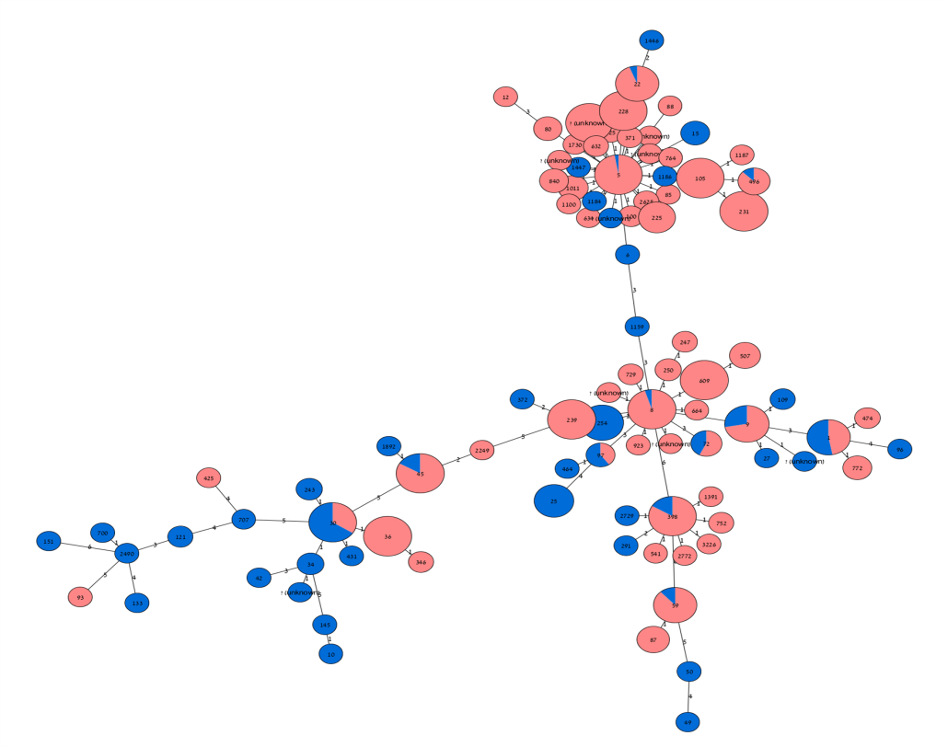
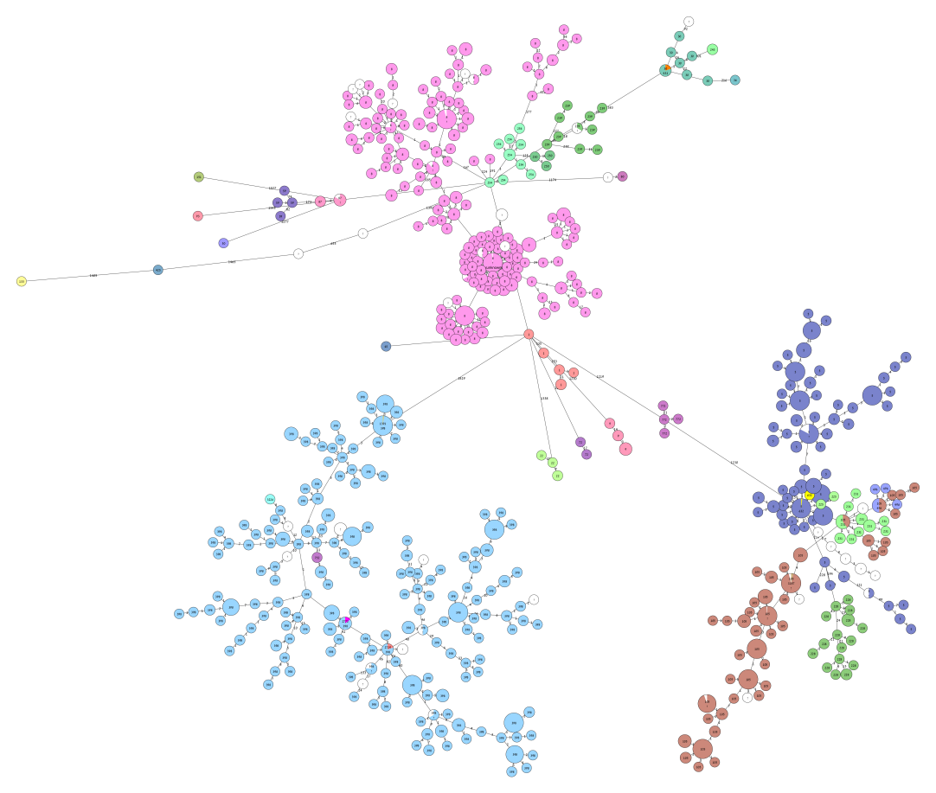

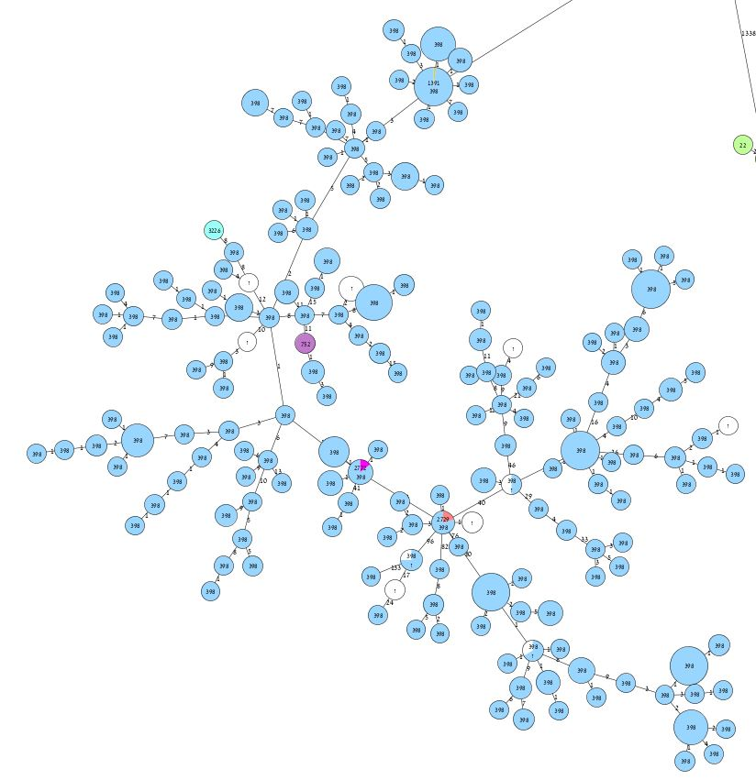
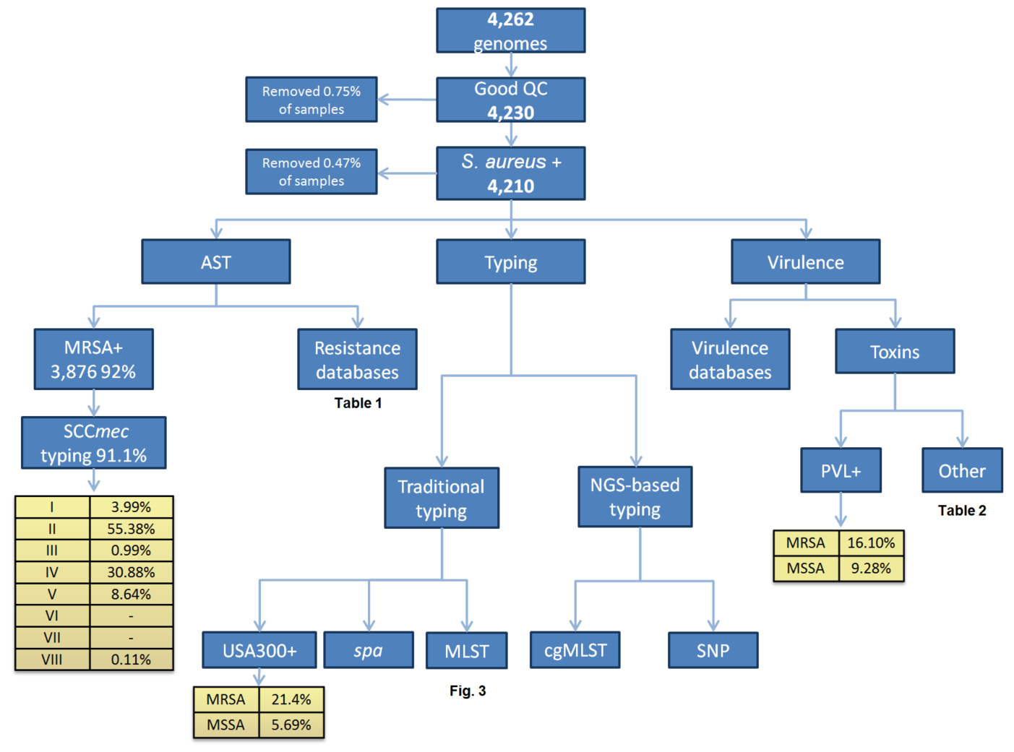
Practicability of Molecular Typing Schemes for
Staphylococcus aureus in the Genomic Era
Nir Gilad¹, Michal Ziv-Ukelson¹, Vered Chalifa-Caspi¹ and Jacob Moran-Gilad^{1,2,3}
¹Ben-Gurion University of the Negev, Beer Sheva, Israel; ²Public Health Services, Ministry of Health, Jerusalem, Israel;
³ESCMID Study Group for Molecular Diagnostics
Contact details:
Prof. Jacob Moran-Gilad
giladko@post.bgu.ac.il
Introduction
Methods
Phylogenetic analysis by MLST and cgMLST
There are several accepted typing schemes for S. aureus which may be used for outbreak investigation and microbial population analysis such as spa typing and MLST.
The introduction of whole genome sequencing (WGS) mandates the development of new typing schemes whilst maintaining reverse compatibility.
Indeed, a core genome (cg) based MLST has recently been proposed as a highly discriminatory yet standardized approach.
We sought to evaluate the practicability of applying these typing scheme on a large convenience sample of publicly available S. aureus genomes.
S. aureus genome assemblies were downloaded from NCBI and a local database was created
Genomes were checked for quality using QUAST, and subsequently analyzed using an in house S. aureus pipeline (Fig. 1).
Typing was performed by extracting the spa locus as well as the 7 MLST gene loci and querying against the respective databases
cgMLST analysis and construction of minimum spanning trees was performed using SeqSphere v.3.0.1 (Ridom GmbH, Munster, Germany).
The Simpson’s diversity index (DI) was calculated for each method to compare performance.
A
B
Results
C
Overall, 4,207 genomes were analyzed, of which 4,032 were typeable by MLST (95.8%).
There were 84 identified STs of which ST5 accounted for 40%, ST8 18%, ST398 15% and ST105 13% of samples.
Additional 38 STs included 2 or more samples (range 2 to 84) and 42 STs were singletons.
Novel STs were found in 28 samples.
spa typing was unsuccessful for 557 samples and in in 274 presumably new types were found.
For cgMLST, a ‘cluster type’ was assigned for 2,412 samples (57%) and included 121 different types according to the current scheme.
However, the vast majority of samples were typeable when ‘unknown targets’ were not excluded.
S. aureus bioinformatics pipeline
Minimum spanning tree of typed MRSAs and MSSAs by MLST (tree A) and cgMLST (tree B); Colours in tree B denote STs; Area marked by red rectangle shows the enhanced resolution achieved by cgMLST
A
B
Simpson’s DI for typing schemes
Conclusions
Method | loci in scheme | % Typeablity | No. of types | DI | DI Confidence interval
MLST | 7 | 95.8% | 84 | 0.764 | [0.755 - 0.773]
spa | 1 | 86.8% | 283 | 0.860 | [0.85 - 0.869]
cgMLST Cluster Types | 1,861 | 56. 9% | 121 | 0.888 | [0.881 - 0.894]
cgMLST with unknown targets | 1,861 | 100% | 4,029 | 1 | [1.0 - 1.0]
Analysis of a large sample of genomes demonstrated satisfactory reverse compatibility of WGS with MLST. whereas spa typing showed a higher DI compared to MLST but also a higher failure rate that should be further investigated.
cgMLST exhibited a maximal DI that emphasizes its potential to become a standard typing tool for WGS typing of S. aureus should the nomenclature is implemented.
Application of the schemes on a large collection of publicly available genomes adds to the understanding of the global diversity of S. aureus.

