Slide 1
Dissertation: An Adaptive AI-Driven Framework for Real -Time Insider Threat Detection and Automated Remediation
Niroop Reddy Patimeedi
BITS ID: 2024MT03524
Degree Program: MTech Cloud Computing
Research Area: Cloud & Enterprise Security
Organisation: BA Continuum India Pvt Ltd, HYD (Bank of America)

Slide 2
Problem Statement and Motivation
Expanding Attack Surface: The transition from legacy monolithic architectures to cloud-native microservices managed by Kubernetes has significantly expanded the operational attack surface.
Inefficiency of Traditional Defences: Traditional perimeter defences and static vulnerability scanners are ineffective at detecting runtime insider threats where malicious actions resemble legitimate system behaviour.
Telemetry & Parsing Bottlenecks: Traditional signature-based Security Information and Event Management (SIEM) solutions cannot efficiently parse high-velocity container telemetry.
Operational Latency: Human-in-the-loop incident response workflows introduce critical latency, providing attackers a window to exfiltrate data or compromise adjacent workloads.

Slide 3
Proposed Innovation & Framework Overview
Core Proposal: A practical, real-time AI-driven security framework specifically tailored for Amazon Elastic Kubernetes Service (EKS).
Runtime Telemetry: Utilization of Extended Berkeley Packet Filter (eBPF) technology (e.g., Falco/Tetragon) for non-intrusive, low-overhead event extraction directly from the Linux kernel.
Behavioral Anomaly Detection: Application of unsupervised Machine Learning models (Isolation Forest or Autoencoder) hosted on AWS SageMaker for near-real-time User and Entity Behavior Analytics (UEBA).
Automated Remediation: A serverless, event-driven orchestration workflow using AWS EventBridge and AWS Lambda to execute sub-second, closed-loop workload containment without human intervention.

Slide 4
Project Objectives
Environment Setup: Provision a multi-tenant Amazon EKS cluster via Infrastructure-as-Code (Terraform/AWS CDK) with baseline Role-Based Access Control (RBAC) and Network Policies.
eBPF Pipeline: Deploy Falco/Tetragon as a DaemonSet to capture kernel-level system calls, focusing on process execution and socket connections, routing events to Amazon CloudWatch.
Feature Engineering & ML: Extract behavioral feature vectors from eBPF traces and deploy an unsupervised anomaly detection model on an AWS SageMaker Serverless Inference endpoint.
Serverless Orchestration: Construct an event-driven pipeline (AWS EventBridge and AWS Lambda) for immediate pod network quarantining.
Validation: Evaluate the framework against simulated insider threat vectors mapped to the MITRE ATT&CK for Containers framework.
Benchmarking: Measure detection accuracy (F1-Score, False Positive Rate), Mean Time to Remediate (MTTR), and host resource overhead (CPU/RAM).

Slide 5
System Architecture Diagram
Amazon EKS Environment
EKS Linux Cluster
Kernel syscalls
eBPF Probes:
Falco/Tetragon
Structured Logs
Telemetry & ML Pipeline
Amazon Cloudwatch
Apply Deny-All Network Policy / Cardon Pod
Feature Vectors
AWS Sagemaker Serverless Endpoint
Isolation Forest/Autoencoder
Risk Threshold Met?
Yes - Anomaly Detected
No
Automated Remediation
AWS Eventbridge
Standard Audit Logging
AWS Lambda
Trigger

Slide 6
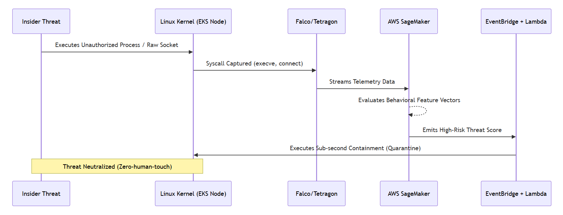
Process Flow - Closed-Loop Remediation

Slide 7
Project Scope & Boundaries
Target Environment:
  In-Scope: Single-region Amazon EKS Linux cluster using Terraform/AWS CDK.
  Out-of-Scope: Multi-region, multi-cloud, or Windows-based nodes.
Data & Telemetry:
  In-Scope: Kernel-level eBPF events (execve, connect/accept).
  Out-of-Scope: Deep packet inspection (DPI) and Layer 7 payload parsing.
Machine Learning:
  In-Scope: Unsupervised models (Isolation Forest, Autoencoders) on AWS SageMaker.
  Out-of-Scope: Continuous online streaming model retraining.
Remediation:
  In-Scope: Serverless orchestration (Lambda/EventBridge) for applying Deny-All Network Policies and cordoning pods.
  Out-of-Scope: Dynamic IAM credential revocation or enterprise firewall modifications.

Slide 8
Validation Methodology & Benchmarks
Simulated Threat Scenarios: Empirical testing will be conducted against two controlled MITRE ATT&CK for Containers scenarios:
  Privileged Pod Escape / Shell Execution.
  Unauthorized Data Exfiltration via Raw Sockets.
Key Performance Indicators (KPIs):
  Accuracy: Measured via F1-Score and False Positive Rate.
  Latency: Mean Time to Remediate (MTTR) measured in milliseconds.
  Efficiency: Node resource overhead specifically tracking CPU and RAM utilization.

Slide 9
Plan of Work (Timeline)
Dissertation Outline (1 Week): Foundation, literature review, and methodology finalization.
Phase 1 (2 Weeks): AWS EKS infrastructure provisioning via Terraform/AWS CDK.
Phase 2 (2 Weeks): Telemetry pipeline deployment (Falco/Tetragon DaemonSet) and baseline feature extraction.
Phase 3 (2 Weeks): Prototype remediation using EventBridge/Lambda and Mid-Term Evaluation.
Phase 4 (2 Weeks): ML anomaly model development (training and hosting on SageMaker).
Phase 5 (2 Weeks): Closed-loop automation integration and MITRE benchmarking.
Phase 6 & 7 (2 Weeks total): Dissertation review, feedback compilation, and final submission.

