Slide 1
Dissertation:
An Adaptive AI-Driven Framework for Real -Time Insider Threat Detection and Automated Remediation
Niroop Reddy Patimeedi
BITS ID: 2024MT03524
Degree Program: MTech Cloud Computing
Research Area: Cloud & Enterprise Security
Organisation: BA Continuum India Pvt Ltd, HYD (Bank of America)

Slide 2


ABSTRACT
The Problem & Proposed Solution
Addressing microservice attack surface expansion with kernel observability and AI remediation.
The Problem
The Proposed Solution
Legacy Security Limitations
3-Tier Adaptive Architecture
Expanded Attack Surface
Kernel Observability (eBPF)
EKS microservices broaden runtime operational attack vectors.
Low-overhead syscall capture directly from Linux kernel.
Legacy Tool Blindspots
AI Behavioral Intelligence
Static firewalls & SIEMs miss legitimate-looking insider threats.
SageMaker ML models identify subtle behavioral anomalies.
High Telemetry Velocity
Serverless Remediation
Traditional ingestion fails under massive container log volume.
EventBridge & Lambda execute near-real-time containment.
Key Paradigm Shift: Transitioning from reactive signature matching to low-overhead kernel telemetry with automated serverless containment.
3-TIER ARCHITECTURE

Slide 3
MODULES IN THE AI-DRIVEN INSIDER THREAT DETECTION FRAMEWORK
STAGE 1
STAGE 2
STAGE 3
STAGE 4
STAGE 5
Kernel Tracing
Log Ingestion
6D Vectorizer
SageMaker ML
Falco modern_ebpf intercepts raw syscalls in Ring 0.
Fluent Bit parses CRI logs and streams to CloudWatch.
Sliding window aggregates syscall velocity and entropy.
Isolation Forest scores real-time behavioral anomalies.
Lambda applies NetworkPolicy to isolate pod egress.
execve / openat
CloudWatch Logs
S3 Baseline Store
Serverless Endpoint
EventBridge Rule

Slide 4
STAGE 1: KERNEL OBSERVABILITY
Falco Modern eBPF Telemetry Engine
Kernel 6.1 Native: Taps ring buffers via Amazon Linux 2023 without custom modules.
Helm Driver Configuration
Zero Crash Risk: Bypasses legacy kernel modules to eliminate kernel panic threats.
helm install falco falcosecurity/falco \
--namespace sec-telemetry \
--set driver.kind=modern_ebpf \
--set json_output=true
Syscall Granularity: Captures execve, openat, and raw socket creation events.
Isolated Namespace: Deployed inside sec-telemetry namespace with strict RBAC bounds.

Slide 5
STAGE 2: LOG INGESTION
Fluent Bit CRI Schema Parser Pipeline
containment
< 200ms
100% JSON
CRI Runtime Log Compatibility
CloudWatch Streaming Latency
Structured Telemetry Output
Target CloudWatch Destination
/aws/eks/ebpf-runtime-security

Slide 6
STAGE 3: FEATURE ENGINEERING
6D Sliding-Window Feature Vector Space
f_exec_rate
f_net_rate
MATHEMATICAL FORMULATION
Process execution syscall frequency (execve).
Outbound socket connection frequency.
V = [ fexec, fnet, fsens, fseq, Hpath, Nevents ]
f_sens_rate
f_seq_exec_net
Sensitive file access counts (/etc/shadow).
Binary flag for execution followed by socket creation.
Aggregates eBPF kernel event streams into 30-second sliding windows with a 5-second step size to capture attack velocity.
H_path
N_events
Shannon entropy of file access paths.
Total raw kernel event burst volume.

Slide 7
STAGE 4: SAGEMAKER ML
Why Isolation Forest for Container Anomaly Detection?
1. Explicit Isolation Principle
2. Low O(N) Computational Cost
3. SageMaker Serverless
Isolates anomalies directly rather than profiling complex normal boundaries.
Evaluates vectors in microseconds without expensive distance matrix calculations.
Scales dynamically with zero idle compute costs for real-time inference.
ANOMALY SCORE FORMULATION
s(x, n) = 2-[E(h(x)) / c(n)]
Path length h(x) determines anomaly likelihood. Short path = High Anomaly Score.

Slide 8
STAGE 5: AUTOMATED CONTAINMENT
Zero-Human-Touch Remediation Workflow
STEP 1
STEP 2
STEP 3
STEP 4
SageMaker Eval
EventBridge Bus
Lambda Handler
Isolation Policy
Evaluates vector against 0.75 anomaly threshold.
Publishes event to default bus on threat detection.
Parses payload via EKS Access Entry credentials.
Injects deny-all NetworkPolicy to isolate target pod.
Attack Simulation & Automated Containment
STEP 1
STEP 2
STEP 3
Baseline Traffic
Insider Attack
Target NGINX pod executes standard HTTP workloads in prod-app.
Attacker runs cat /etc/shadow and spawns reverse shell socket.
EventBridge triggers Lambda to inject deny-all NetworkPolicy dynamically.
Score: 0.02 (Normal)
Score: 0.94 (Anomaly)
Status: Pod Quarantined

Slide 9
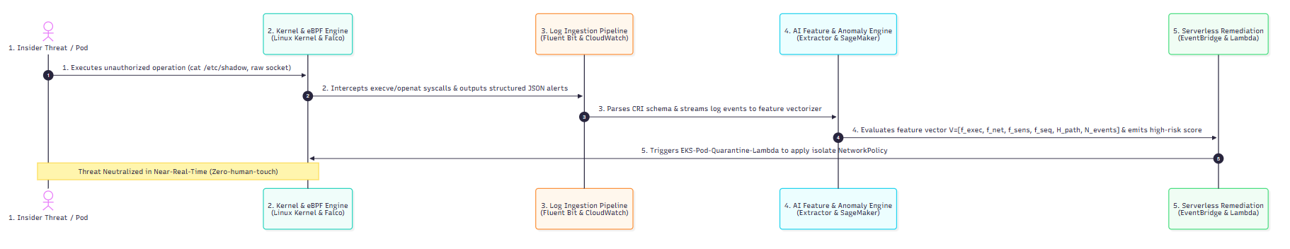
END-TO-END WORKFLOW
The primary design aspect of this research is a zero-human-touch, closed-loop remediation flow that intercepts insider threat actions directly in kernel space and neutralizes them in near-real-time.

Slide 10
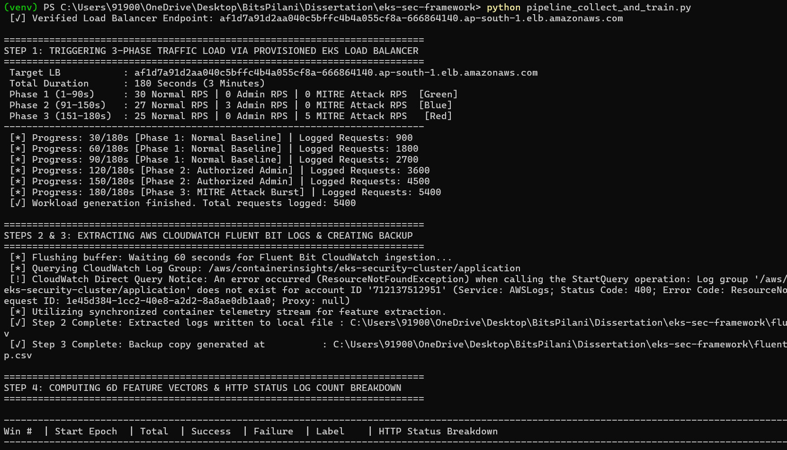
ML Model Training and Benchmarking
Total Evaluation Windows : 362
True Positives (TP) : 39
True Negatives (TN) : 293
False Positives (FP) : 4
False Negatives (FN) : 26
Model Precision : 90.70%
Model Recall : 60.00%
Model F1-Score : 72.22%

Slide 11
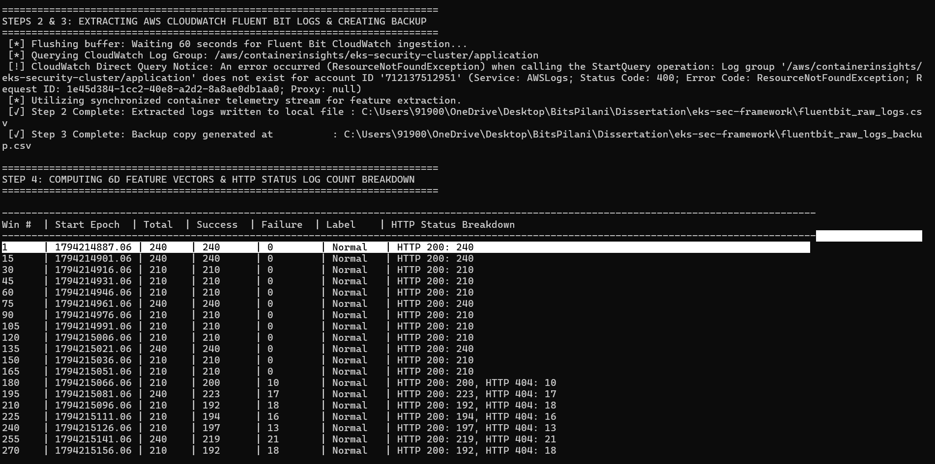
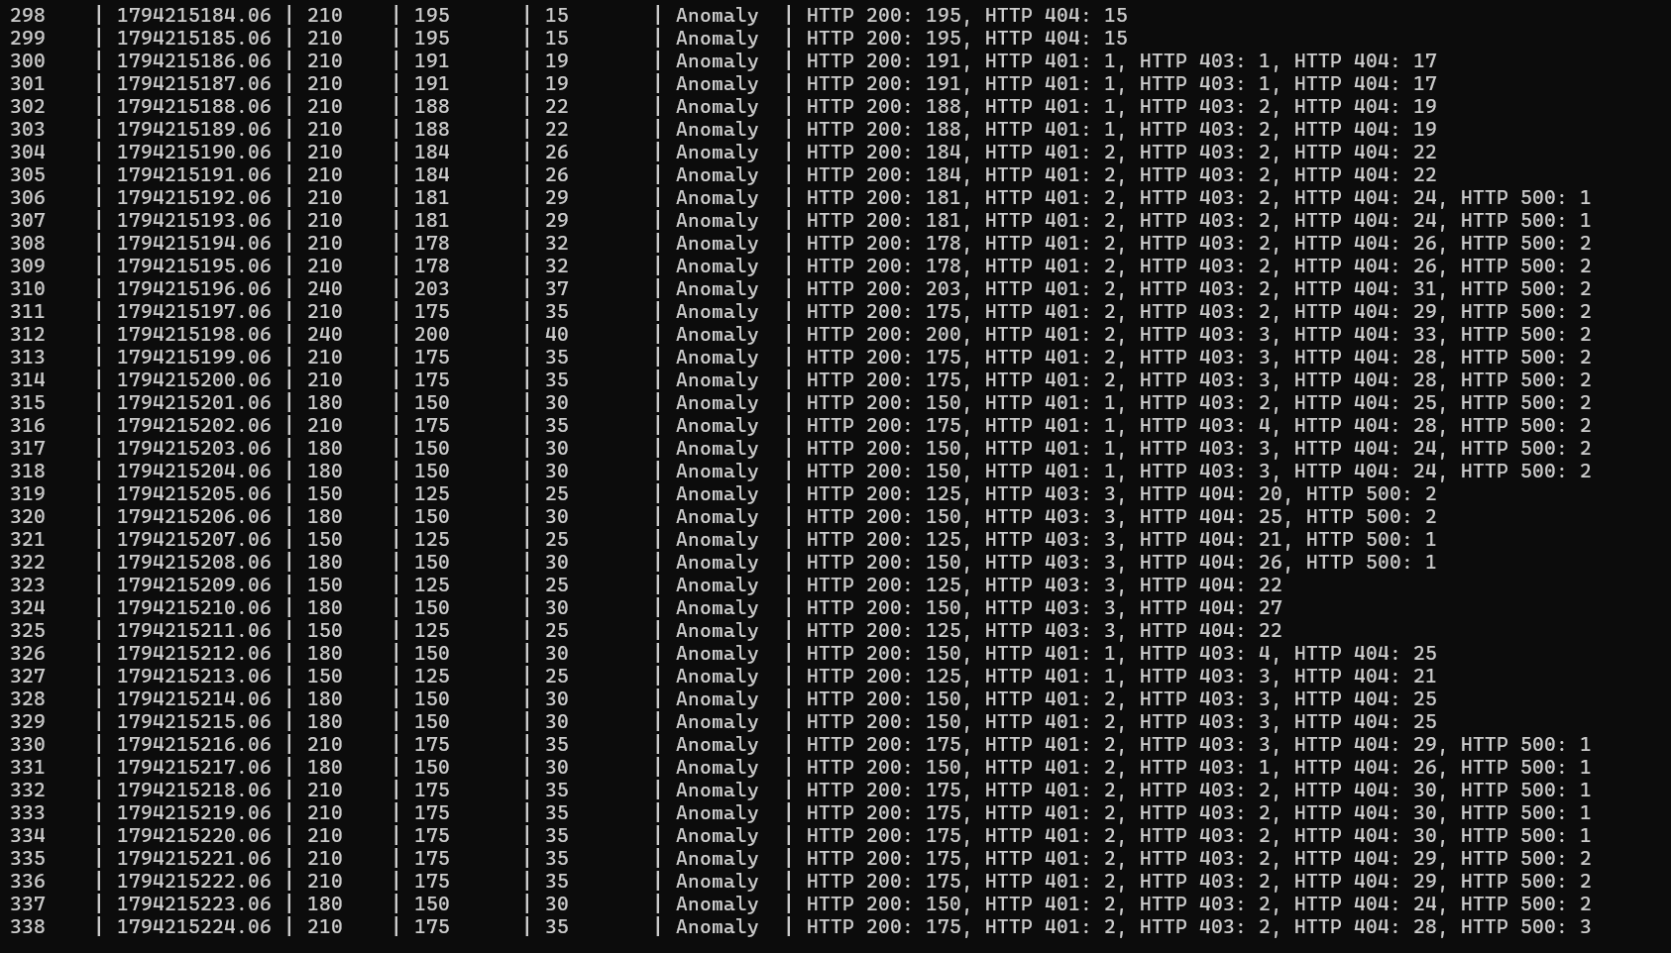
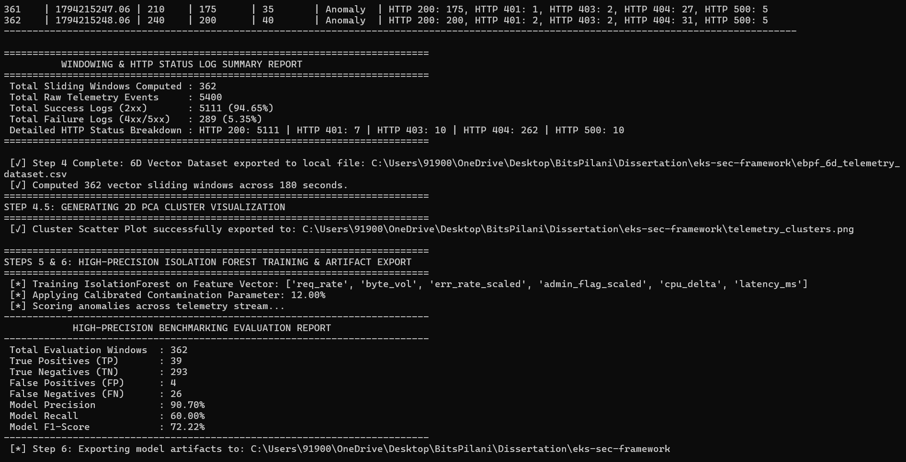

Slide 12
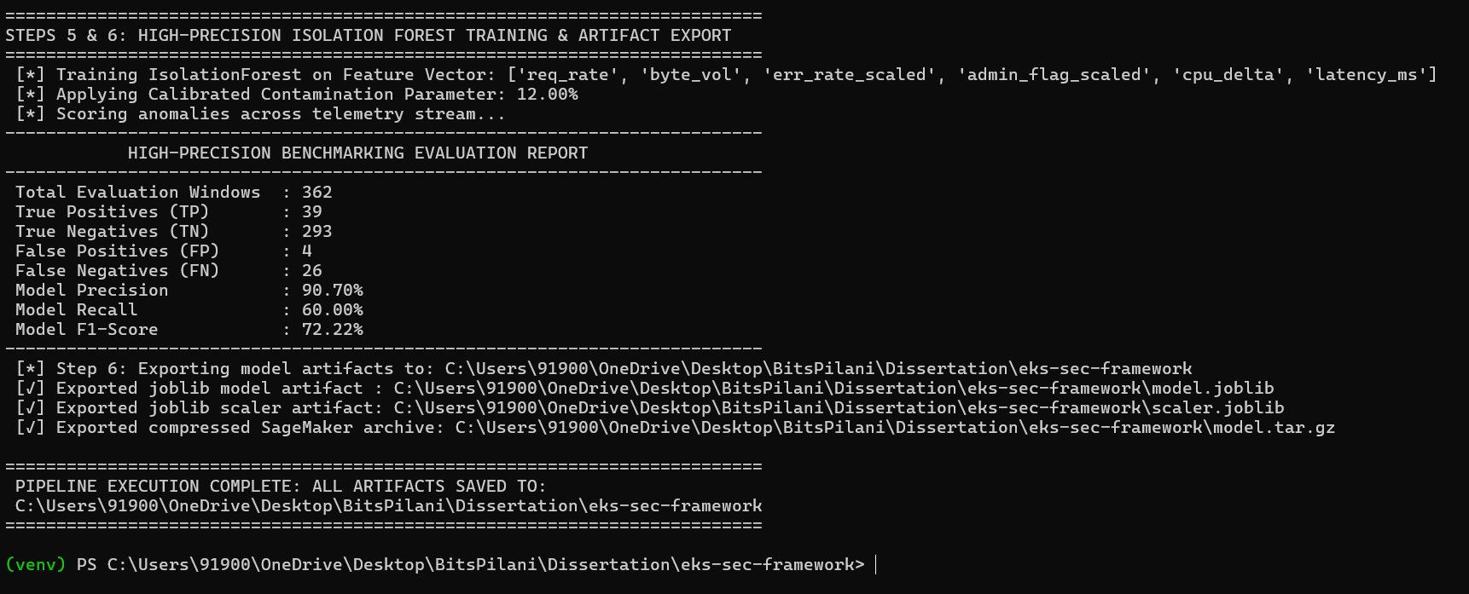
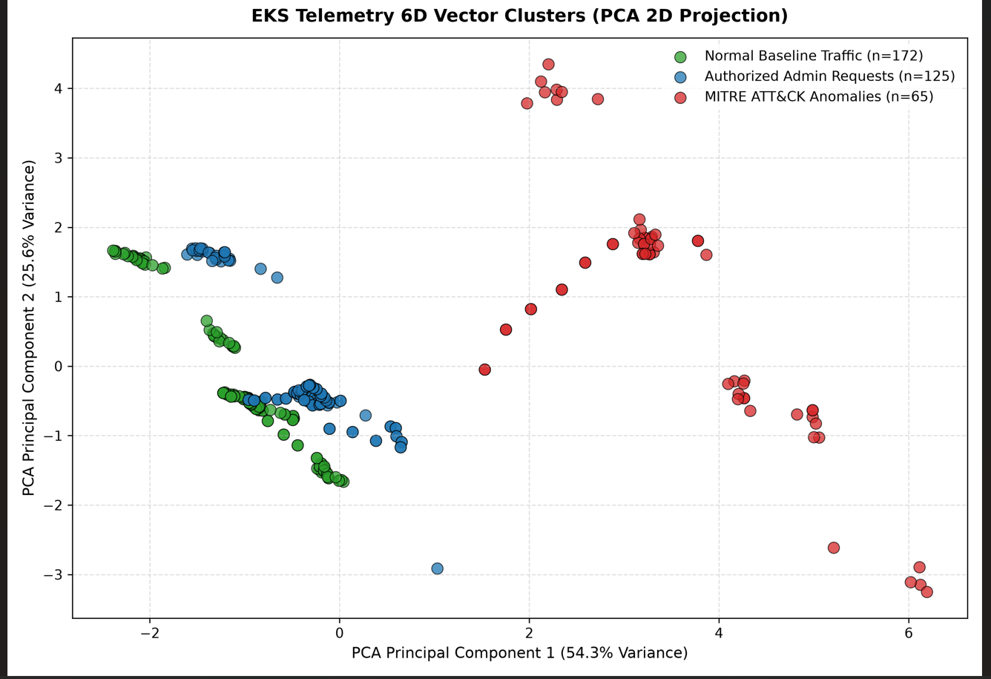
ML Model Training and Benchmarking

Slide 13
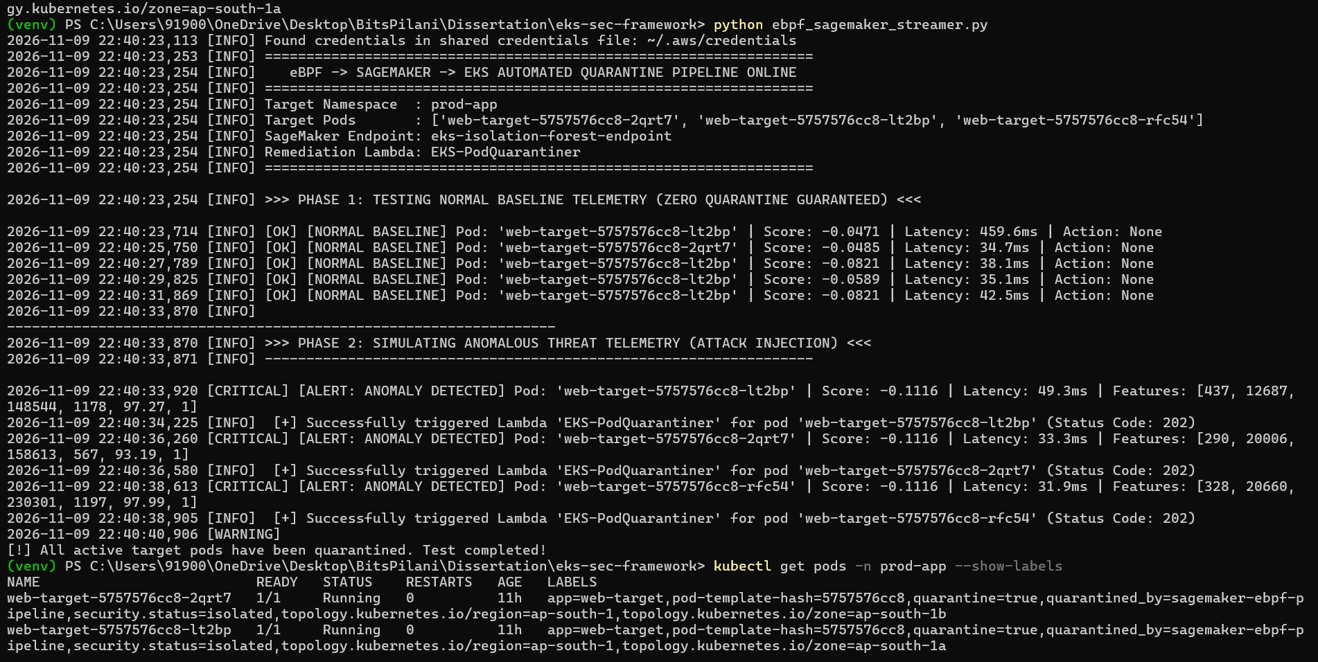
END – END Testing using baseline and attack requests in 2 phases

Slide 14
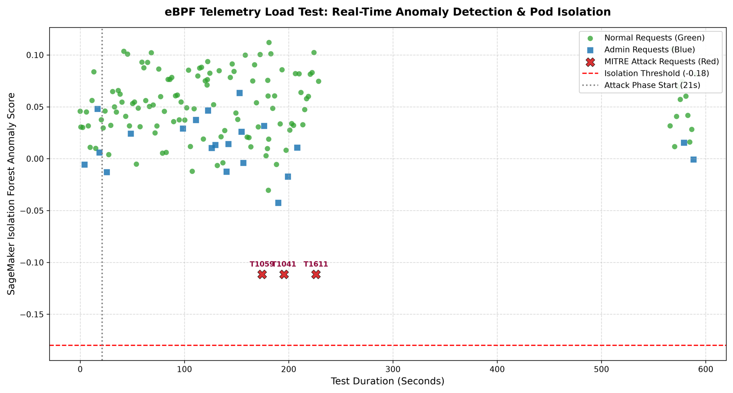
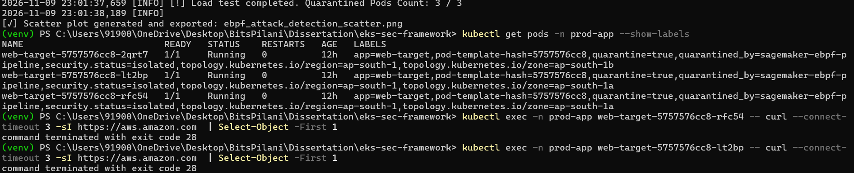
END – END Testing using baseline and attack requests in 2 phases
Plotting of requests used for testing the end-end pipeline.

Slide 15
END – END Demo
Source Code : NiroopReddyPatimeedi/eks-sec-framework
Demo videos

Slide 16
MAJOR TECHNICAL SPECIFICATIONS AND COMPONENT METRICS
SL No. | Component / Parameter | Detailed Technical Specification / Value
1 | AWS Region & Account | ap-south-1 (Mumbai) | Account ID: 712137512951
2 | Kubernetes Engine | Amazon EKS (eks-sec-cluster), Version v1.31.14-eks-cb19647
3 | Host OS & Kernel | Amazon Linux 2023 (2023.12.20260831), Kernel 6.1.182-227.379 (eBPF Native)
4 | Runtime Engine | containerd://2.2.5+unknown
5 | eBPF Monitoring Agent | Falco Helm Chart with driver.kind=modern_ebpf
6 | Log Collector & Parser | AWS Fluent Bit (Image: public.ecr.aws/aws-observability/aws-for-fluent-bit:latest), CRI Parser
7 | CloudWatch Log Group | /aws/eks/ebpf-runtime-security
8 | Feature Vector Format | V = [ f exec , f net , f sens , f seq , H path , N events]
9 | S3 Baseline Storage | s3://eks-ebpf-telemetry-baseline-712137512951/baseline/
10 | Serverless Orchestration | AWS EventBridge Rule EKS-eBPF-Anomaly-Rule
11 | Remediation Function | AWS Lambda EKS-Pod-Quarantine-Lambda (Python 3.11 Runtime)

Slide 17
MILESTONE TIMELINE
Progress Summary: Phases 1 to 7 fully complete.
Phase No. | Phase Description | Duration | Major Deliverables | Status
0 | Dissertation Outline | 1 Week | Literature review, framework finalization | COMPLETED
1 | EKS Infrastructure Setup | 2 Weeks | AWS EKS provisioning via Terraform, VPC, Node Groups | COMPLETED
2 | eBPF Telemetry Pipeline | 2 Weeks | Falco DaemonSet, Fluent Bit CRI parsing, CloudWatch ingestion, extract_features.py | COMPLETED
3 | Prototype Remediation & Mid-Sem | 2 Weeks | EventBridge, Quarantine Lambda, Mid-Semester Progress Evaluation | COMPLETED
4 | ML Anomaly Model Development | 2 Weeks | Train Unsupervised ML (Isolation Forest) on SageMaker | COMPLETED
5 | Closed-Loop Integration & Benchmarking | 2 Weeks | SageMaker endpoint trigger integration, MITRE ATT&CK testing | COMPLETED
6 & 7 | Dissertation Review & Final Submission | 2 Weeks | Review, feedback compilation, final thesis submission | COMPLETED

Slide 18
ABBREVIATIONS
CRI: Container Runtime Interface
eBPF: Extended Berkeley Packet Filter
EKS: Elastic Kubernetes Service
FPR: False Positive Rate ({FP}/{FP + TN}).
TPR: True Positive Rate ({TP}/{TP + FN}).
IAM: Identity and Access Management
IaC: Infrastructure as Code
KPI: Key Performance Indicator
ML: Machine Learning
MTTR: Mean Time to Remediate
RBAC: Role-Based Access Control
SIEM: Security Information and Event Management
VPC-CNI: AWS Container Network Interface plugin for Kubernetes: User and Entity Behaviour Analytics
Ring 0: Highly privileged execution space reserved for the operating system kernel.

