Slide 1
Data Engineering
Case Study
Nirosh Kumar R• AA.SC.P2MCA2107478
Project link https://github.com/NiroshKumarR/etlretailsales

Slide 2
Introduction
This project focuses on performing Extract, Transform, and Load (ETL) operations on a Retail Sales dataset.
The objective is to process the raw data, transform it into a suitable format for analysis, and store it in a PostgreSQL database.

Slide 3
Data Transformation
The raw data was analyzed and transformed using Python and the Pandas library.
Data transformation steps included cleaning, filtering, aggregating, and structuring the data.
The transformed data provides valuable insights into sales trends, popular products, and category performance.

Slide 4
Data Storage and Retrieval:
The transformed data is stored in a PostgreSQL database for efficient storage and retrieval.
The psycopg2 library is used to establish a connection to the database and execute SQL queries.
The database schema is designed to accommodate the transformed data, ensuring easy access for analysis.

Slide 5
Data Analysis and Insights:
The transformed data enables comprehensive analysis of retail sales performance.
Key insights include monthly sales trends, top-selling products, and revenue by region.
Visualizations and charts are used to present the findings and aid in understanding the data.

Slide 6
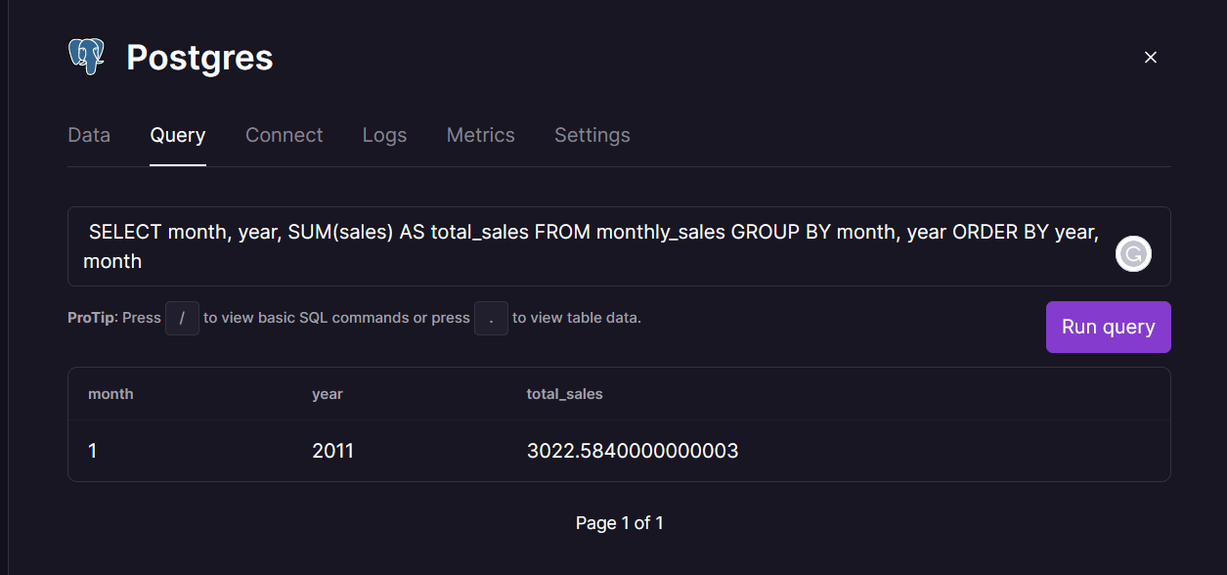
Business Questions:
Monthly sales trends over the years

Slide 7
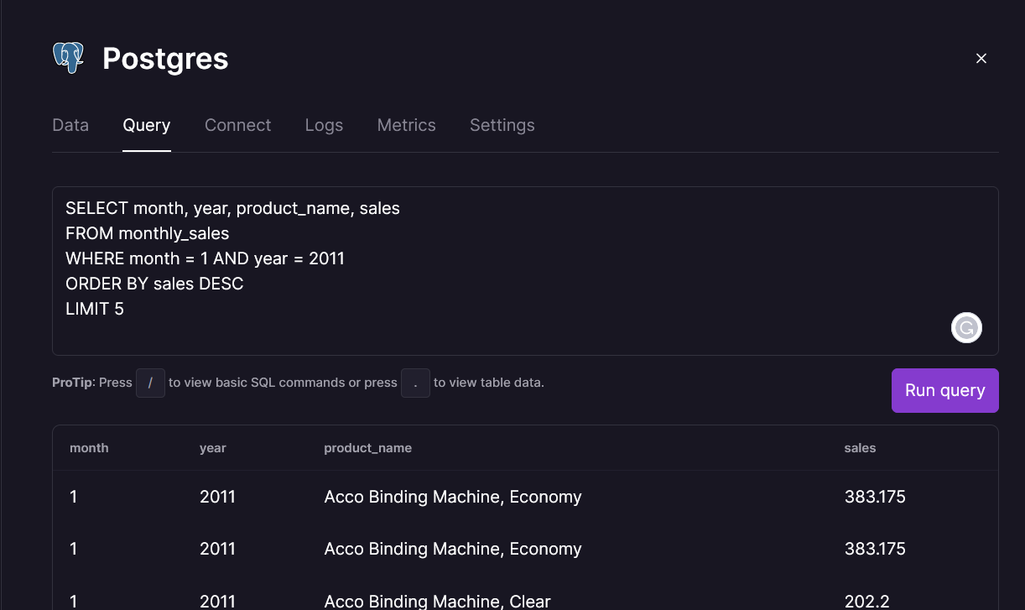
Business Questions:
Top-selling products in a given month and year

Slide 8
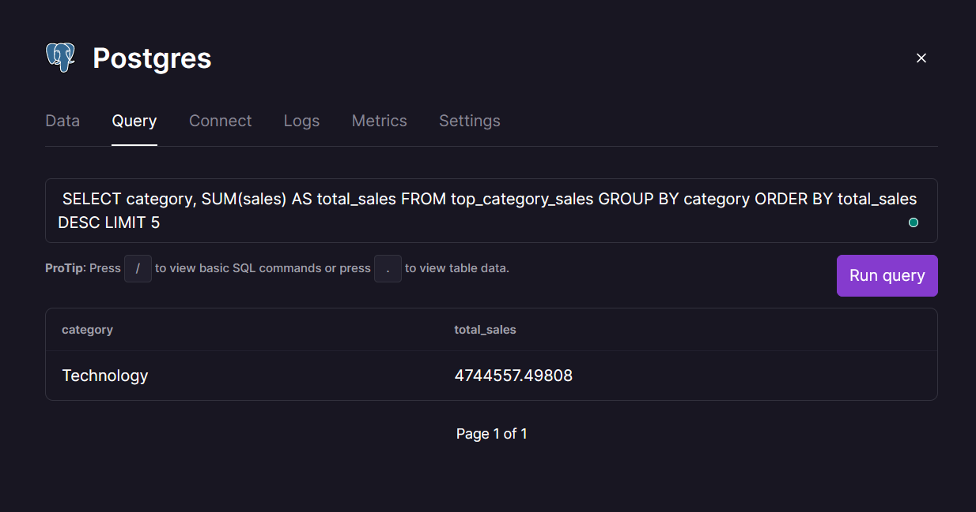
Business Questions:
What are the top-selling product categories overall?

Slide 9
Conclusion:
The ETL Retail Sales Data Engineering Project demonstrates the importance of data preparation for meaningful analysis.
The project highlights the use of Python, Pandas, and PostgreSQL for efficient data processing and storage.
The insights gained from the transformed data can drive informed business decisions and identify areas for improvement.

Slide 10
Thank You

