Slide 1
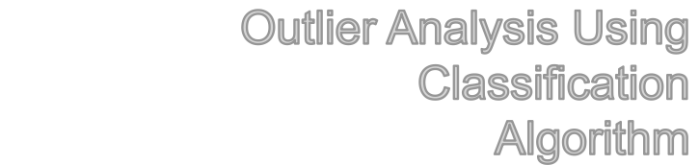

Slide 2
Outlier
Outlier is a data object that deviates significantly from the normal objects as if it were generated by a different mechanism
  Ex.: Unusual credit card purchase, sports,Education,Medicine.

Slide 3
Problem Statement
Here we are Performing a Outlier analysis for the student performence based on that internel marks.
We are using a different classification algorithm for identifying the Outlier.

Slide 4
Algorithm
Random Forest
Naviye Base
K Nearest Neighbors Algorithm.

Slide 5
Data Set
Student internel mark data set variable
data.frame': 120 obs. of 7 variables:
$ C21 : Subject 1.
$ C22 : Subject 2.
$ C23 : Subject 3.
$ C24 : Subject 4.
$ C25 : Subject 5.
$ C26 : Subject 6.
$ GRADE: Factor w/ 5 levels "A","B","C","D",”U”

Slide 6
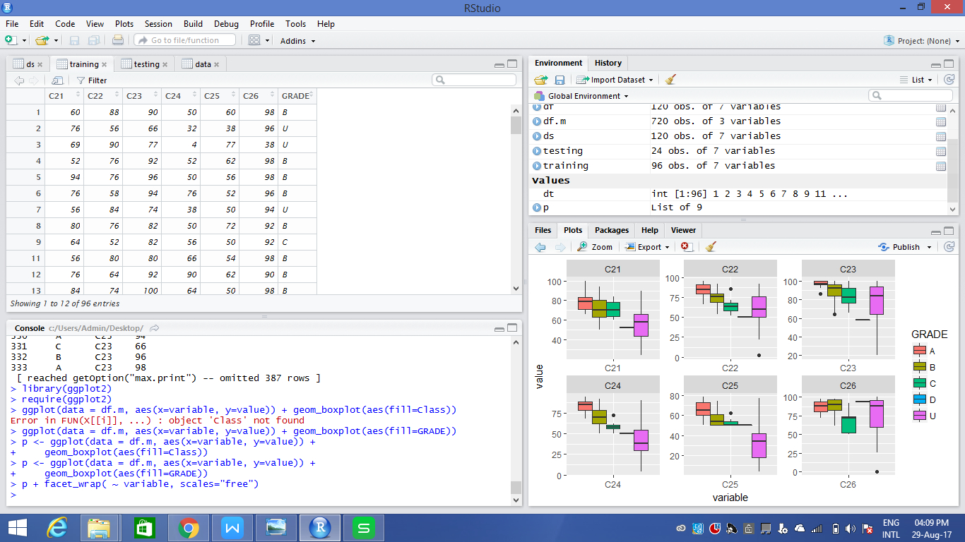
Box plot For Outlier identification

Slide 7
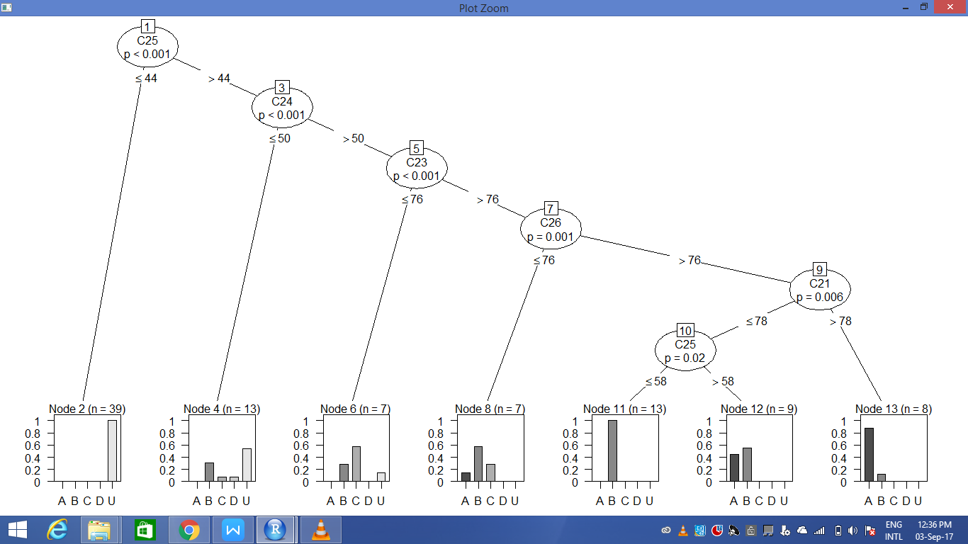
Decision Tree

Slide 8
Confusion Matrix for test data set
Confusion Matrix and Statistics
Overall Statistics:
Accuracy : 0.8333
Precision : 0.9090
F Score : 10
PREDICTION | A | B | C | D | U
A | 2 | 2 | 0 | 0 | 0
B | 0 | 8 | 0 | 0 | 0
c | 0 | 0 | 0 | 0 | 0
D | 0 | 0 | 0 | 0 | 0
U | 0 | 0 | 2 | 0 | 10

Slide 9
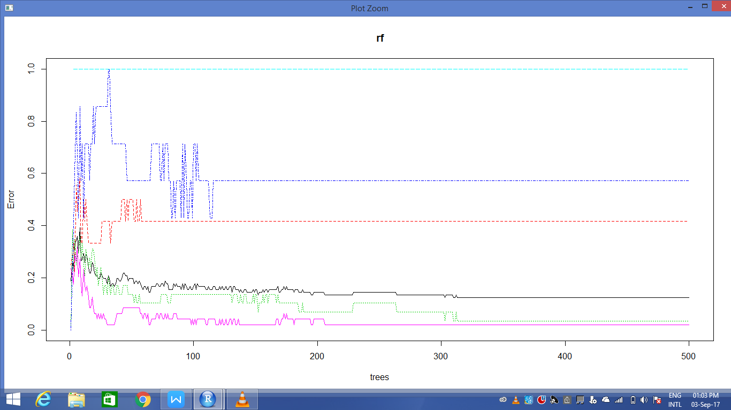
Error rate

Slide 10
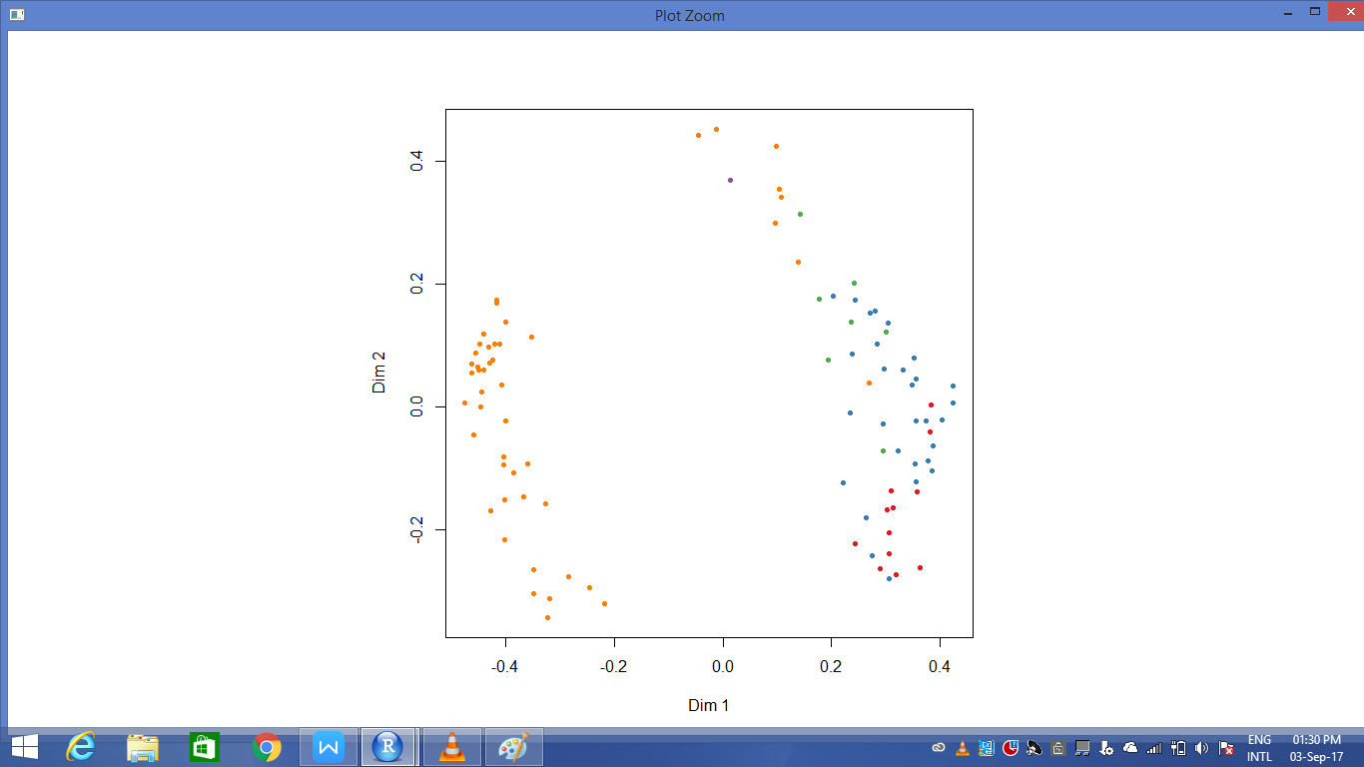
Mds plot

Slide 11
K Nearest Neighbors Algorithm

Slide 12
Procedure:
> table(dj$GRADE)
A B C D U
14 39 9 1 57
> summary(dj)
C21 C22 C23 C24
Min. : 11.00 Min. : 2.00 Min. : 20.00 Min. : 4.00
1st Qu.: 55.50 1st Qu.:58.00 1st Qu.: 75.50 1st Qu.:39.50
Median : 66.00 Median :71.00 Median : 89.00 Median :59.00
Mean : 64.25 Mean :67.62 Mean : 82.98 Mean :57.67
3rd Qu.: 78.00 3rd Qu.:80.00 3rd Qu.: 96.00 3rd Qu.:76.00
Max. :100.00 Max. :96.00 Max. :100.00 Max. :94.00

Slide 13
cont..
C25 C26 GRADE
Min. : 4.00 Min. : 0.00 A:14
1st Qu.:37.00 1st Qu.: 72.00 B:39
Median :50.00 Median : 90.00 C: 9
Mean :45.34 Mean : 81.08 D: 1
3rd Qu.:56.00 3rd Qu.: 96.00 U:57
Max. :78.00 Max. :100.00
> It is in Unnormalized Form, So next setp to Normalize the table.

Slide 14
Normalizing
Generating random value:
> dg<-runif(nrow(dj))
Normalize convert the Maximum value to 1 and Minmum value 0.
> normalize <- function(x) {
return((x-min(x)/max(x)-min(x))) }

Slide 15
confussion matrix
p <- knn(train = testing,test = testing, cl=testing_target,k=11)> table(testing_target,p) Output:
PREDCTION | A | B | C | D | U
A | 3 | 0 | 0 | 0 | 0
B | 6 | 0 | 0 | 0 | 0
C | 0 | 3 | 0 | 0 | 0
D | 0 | 0 | 0 | 0 | 0
U | 0 | 2 | 0 | 0 | 10

Slide 16
RESULT
Accuracy : 0.1083
Precision: 13
Fscore: 7. 15

Slide 17
Naviye Base

Slide 18
confusion Matrix for test data
Conditional probabilities:
C21
Y [,1] [,2]
A 78.40000 10.057612
B 70.37500 11.566777
C 72.00000 8.280787
D 52.00000 NA
U 58.46667 14.298124
C22
Y [,1] [,2]
A 83.60000 9.605554
B 75.25000 9.126353
C 65.50000 10.295630
D 50.00000 NA
U 62.08889 17.637540

Slide 19
contin...
C23
Y [,1] [,2]
A 97.00000 4.447221
B 89.68750 9.812558
C 80.75000 12.139075
D 58.00000 NA
U 79.93333 17.756433
C24
Y [,1] [,2]
A 85.00000 5.517648
B 70.68750 12.604243
C 59.25000 6.318906
D 50.00000 NA
U 42.66667 19.418829

Slide 20
contin....
C25
Y [,1] [,2]
A 64.80000 11.003030
B 55.93750 6.899918
C 52.00000 4.276180
D 50.00000 NA
U 31.71111 15.238442
C26
Y [,1] [,2]
A 86.60000 8.591986
B 89.00000 9.954736
C 72.00000 15.565530
D 94.00000 NA
U 77.64444 23.925220

Slide 21
Output for naivebays
ACC PRECISION1 PRECISION2 PRECISION3 PRECISION4 PRECISION5 F11
91.66667 100.00000 87.50000 0.00000 0.00000 92.30769 85.71429
F12
93.33333

