Slide 1


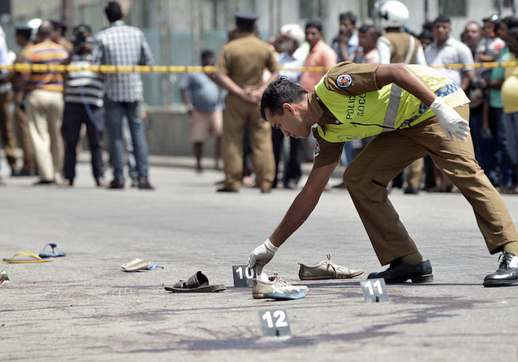
A BIOMETRIC-DRIVEN MACHINE LEARNING FRAMEWORK FOR RECIDIVISM PREDICTION IN SRI LANKA
Enhancing Public Safety through Predictive Analytics and Behavioral Biometrics.
M.G.L.N Kumararathna
CB013366
BSc (hons) Computer Science
Notes:
Today, I am presenting a solution designed to address one of the most persistent challenges in our national security: Recidivism.
In Sri Lanka, the police force often relies on manual records and intuition to identify repeat offenders. However, as the complexity of crime evolves, our methods must evolve too. My project, titled 'A Biometric-Driven Machine Learning Framework for Recidivism Prediction,' proposes a shift from reactive policing to proactive prevention.
By fusing traditional criminal records with advanced behavioral biometrics—specifically Gait Analysis—and social network intelligence, we have built a model that doesn't just look at who a suspect is, but how they behave.
Over the next 15 minutes, I will show you how we achieved 94% accuracy in identifying high-risk individuals and how this technology can be used to optimize our 60,000-strong police force to protect the citizens of Sri Lanka."

Slide 2
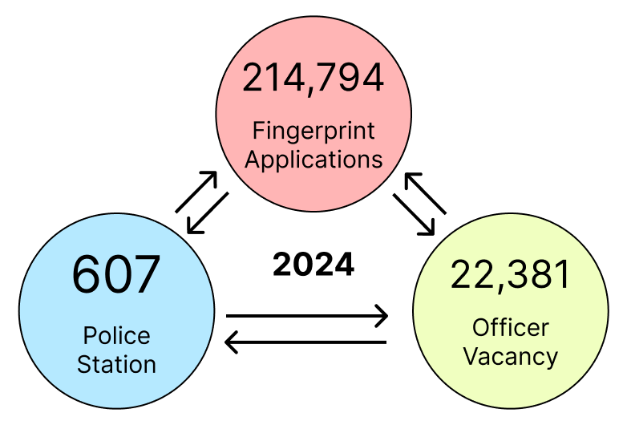
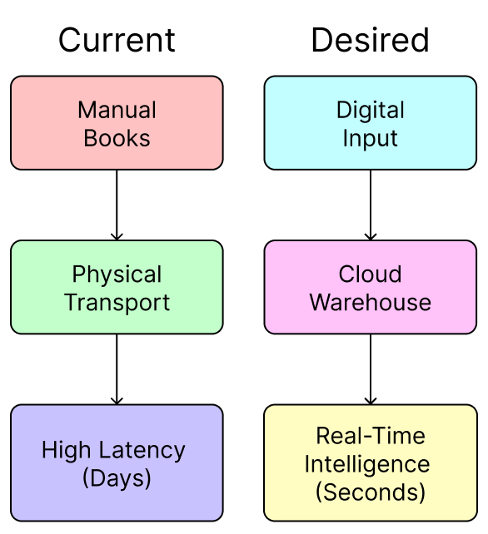
CONTEXT & ORGANIZATIONAL OVERVIEW
Client: Sri Lanka Police (SLP) – Primary law enforcement agency.
The Data Problem:
Volume: Processing 214k+ biometric records annually.
Siloed Systems: Data trapped in physical "Complaint Books" and disconnected digital systems (CEMS, AMIS).
High Latency: Manual fingerprint transport from rural stations to Colombo takes days.
Operational Pain Point:
Severe human resource crisis: 22,381 officer vacancy (25% deficit).
Urgent need for "Force Multiplication" via predictive intelligence.
Notes:
To understand why this project is necessary, we must look at the numbers. The police operate a massive network of over 607 stations. In 2024 alone, they processed nearly 215,000 fingerprint applications. This is a classic 'Big Data' scenario in terms of Volume.
However, the organization is facing a critical Operational Pain Point. They are currently short-staffed by over 22,000 officers. That is a 25% deficit in their workforce.
The core problem is that their data is 'siloed'. When a suspect is arrested in a rural area, their records are often written in a manual Complaint Book. To verify if this person is a repeat offender, physical fingerprint cards have to be mailed to Colombo, which takes days. In a modern investigation, we don't have days—we have hours.
Therefore, the goal of this solution is to move from this slow, manual process to a real-time digital intelligence system that acts as a 'force multiplier' for the limited police workforce."

Slide 3
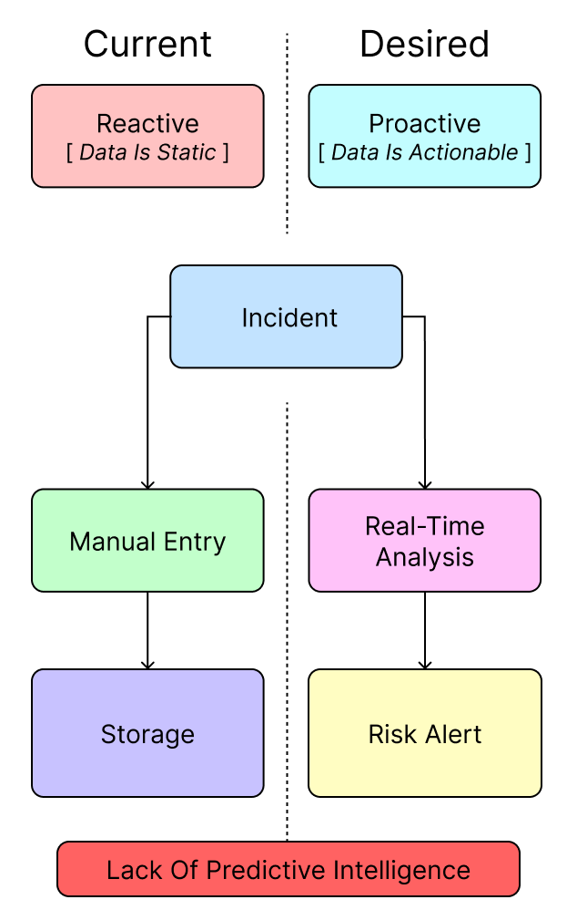
PROBLEM DEFINITION
THE ANALYTICAL GAP
Core Issue: Reactive Policing
Current systems (CEMS/AMIS) operate on a "storage-centric" model.
We currently identify a repeat offender only after they commit a second crime and are processed manually.
Missing Capability: No Predictive Risk Scoring
27,000 criminals registered in 2024, but only 2,735 identified as "Island Reconvicted Criminals" (IRC).
Officers lack a statistical tool to identify the high-risk minority among the remaining suspects.
Research Question:
"How can we utilize historical arrest data and biometrics to predict the probability of re-offending (Recidivism)?".
(Sri Lanka Police, 2024; Haidar, 2025; Kovalchuk et al., 2024)
Notes:
"Moving on to the core problem. As we analyzed the current system, we identified a significant 'Analytical Gap'.
The fundamental issue is that the Sri Lanka Police operates on a Reactive Model. We treat data as something to be stored, not something to be mined. Currently, the system can tell us 'Who was arrested yesterday?', but it cannot tell us 'Who is likely to commit a crime tomorrow?’.
This creates a blind spot. In 2024, there were over 27,000 registered criminals. The system flagged about 2,700 of them as repeat offenders—but only after they had already committed that second crime.
The Missing Capability here is Predictive Risk Scoring. When an officer has to make a bail decision, they rely on intuition because the data is silent.
Therefore, my primary Research Question is: How can we bridge this gap? How can we take this dormant historical data—the biometrics and the arrest logs—and use Machine Learning to calculate a probability score for Recidivism before the suspect is released?"

Slide 4
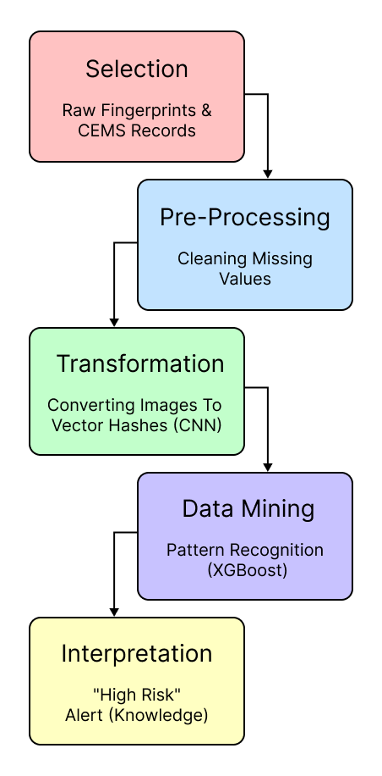
LO1
THE KDD PROCESS
Turning Raw Police Data into Intelligence
Concept
KDD is the process of turning low-level messy data into high-level actionable knowledge.
Application to Sri Lanka Police
Raw Data: 214,794 annual fingerprint images (Unstructured) + CEMS text records (Structured).
Transformation: Converting visual biometric data into a numerical "Risk Score".
Knowledge: The final output is not just data, but an alert: "High Risk of Recidivism".
(Sri Lanka Police, 2024; Huamantingo et al., 2025)
Notes:
"Moving to our first Learning Objective (LO1), we apply the Knowledge Discovery in Databases (KDD) framework. This is the theoretical engine of our solution.
For the Sri Lanka Police, KDD is not just a technical step; it's an organizational transformation. We start with Raw Data—specifically, the 214,000 fingerprint images and manual logbooks.
In the Transformation phase, we convert this messy, unstructured data into structured numerical values. For example, a fingerprint image becomes a 'Biometric Hash', and a crime description becomes a category code.
Finally, the Data Mining phase uses algorithms to find hidden patterns. The ultimate Knowledge produced isn't just a table of numbers—it's a clear, actionable alert for the officer: 'This suspect has a High Risk of re-offending'. This shifts the focus from simple storage to active intelligence."

Slide 5
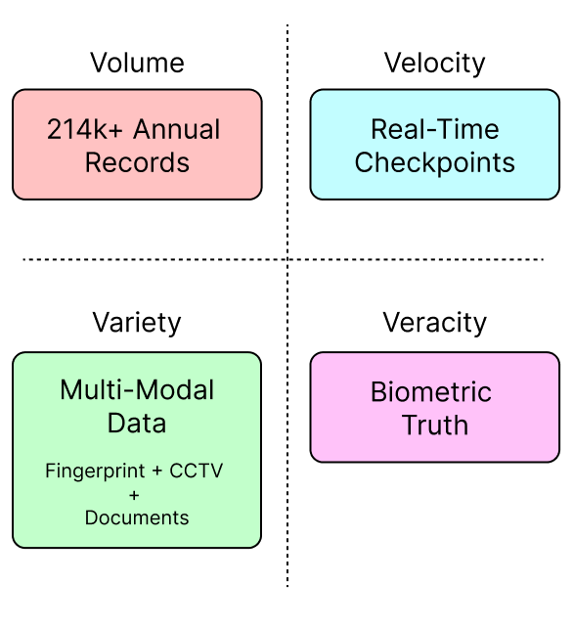
LO1
BIG DATA ANALYTICS
The 4 Vs in Sri Lanka Police Data
Volume (Scale):
Processing 214,794 fingerprint applications annually.
Requires a Centralized Cloud Data Warehouse to replace physical storage.
Velocity (Speed):
Current latency: Days/Weeks for manual record retrieval.
Requirement: Real-time processing for "Golden Hour" arrests and checkpoints.
Variety (Complexity):
Merging Structured Data (CEMS text records) with Unstructured Data (AFIS fingerprints & CCTV).
Veracity (Trust):
Combating identity fraud (aliases) among the 2,735 island reconvicted criminals.
Biometrics provide the "ground truth" where names fail.
(Sri Lanka Police, 2024; Haidar, 2025; Cavus, 2025)
Notes:
"This project is a classic 'Big Data' challenge, which we analyze using the 4 Vs framework.
First, Volume: The Sri Lanka Police generates massive amounts of data—over 214,000 fingerprint records in 2024 alone. A single station cannot hold this; we need a cloud warehouse.
Second, Velocity: This is where the current system fails. Criminals move fast, but manual record checks take days. Our solution targets real-time velocity, ensuring an officer gets an answer in seconds during a checkpoint stop.
Third, Variety: Police data isn't just text in a spreadsheet. It includes mugshots, CCTV footage, and fingerprints. Our proposed Multi-Modal architecture integrates these different formats.
Finally, Veracity, or truthfulness. Criminals often lie about their names. By relying on Biometrics rather than just names, we ensure high veracity, correctly identifying the 2,735 repeat offenders despite any aliases they might use."
(Sri Lanka Police, 2024; Haidar, 2025; Cavus, 2025)

Slide 6
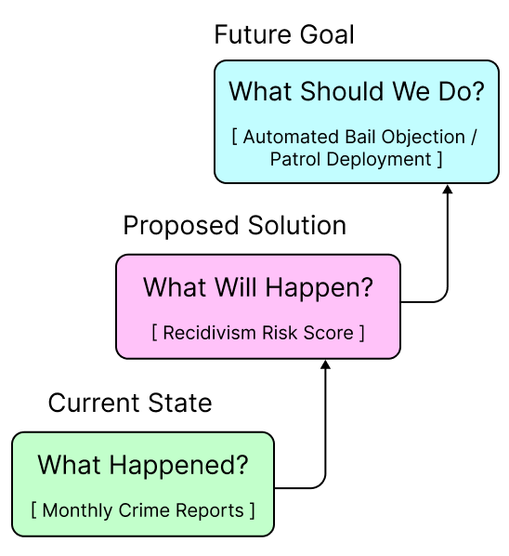
LO1
TRANSFORMING DECISION MAKING
The Analytics Maturity Model
Descriptive Analytics (Current):
SLP currently relies on manual reports and "storage-centric" systems (CEMS).
Reactive: Investigating crimes after they occur.
Predictive Analytics (The Gap):
Utilizing historical data to forecast Recidivism Risk for individual suspects.
Identifying "Micro-trends" before they escalate.
Prescriptive Analytics ( The Solution):
Actionable Advice: "Deny Bail" or "Deploy Patrol to Sector 4".
Optimizes limited resources (22,381 officer vacancy).
(Sri Lanka Police, 2024; Haidar, 2025; Sridharan et al., 2024)
Notes:
"This slide illustrates the core transformation we are proposing—moving the Sri Lanka Police up the 'Analytics Maturity Model'.
Currently, the organization is stuck at the bottom step: Descriptive Analytics. Systems like CEMS can tell us 'What happened yesterday?' or 'How many robberies occurred last month?'. This is useful for reporting, but it is Reactive. It doesn't help stop the next crime.
Our project introduces the middle step: Predictive Analytics. By analyzing historical patterns, we answer the question, 'What will happen?'. Will this specific suspect re-offend? Will this area see a spike in drug crime?.
Finally, the ultimate goal is Prescriptive Analytics. This is where the system answers, 'What should we do?'. Instead of just showing a risk score, the dashboard explicitly recommends: 'Oppose Bail' or 'Deploy Patrol Unit'. This guides the officer's decision-making, ensuring that despite the shortage of 22,000 personnel, every action is data-driven and effective."

Slide 7
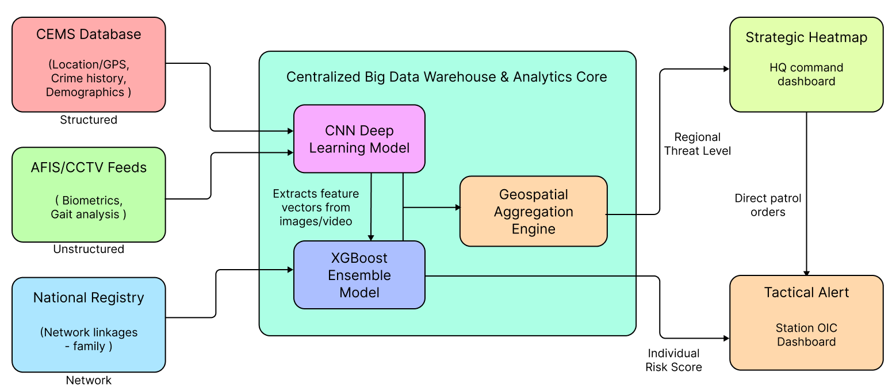
LO1
PROPOSED SOLUTION ARCHITECTURE
A Multi-Modal Approach
(Sri Lanka Police, 2024; Cavus et al., 2025; Report Figure 1)
Notes:
"This slide visualizes the core technical architecture of our solution. As you can see, it follows a 'Multi-Modal' approach.
On the Left, we have our inputs. We don't just rely on the text records in the CEMS Database. We actively integrate Unstructured Data from CCTV and fingerprints , as well as Network Data about family and associates.
In the Middle, the 'Processing Core' uses a hybrid engine. We use a CNN (Deep Learning) model to 'see' the images and extract biometric features. These are then fed into an XGBoost Model, which combines them with the criminal history to calculate a probability.
Finally, on the Right, the intelligence flows to the users. The Station OIC gets a Tactical Alert—'This suspect is High Risk'. Meanwhile, the Headquarters gets a Strategic Heatmap to guide patrol deployments. This architecture ensures the right information reaches the right person at the right time."

Slide 8
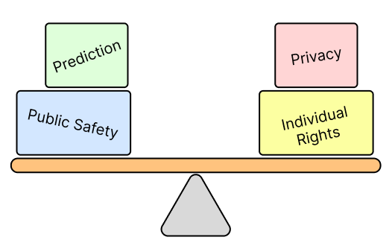
LO1
ETHICAL & LEGAL CONSTRAINTS
Balancing Safety with Civil Rights
Constraint: Data Privacy & Compliance
Strict adherence to data protection standards to protect the 214,794 sensitive biometric records.
Implementation of Role-Based Access Control (RBAC)
Risk: Algorithmic Bias
Historical over-policing of specific areas can lead to the model unfairly profiling demographics (Self-Fulfilling Prophecy).
Solution: "Human-in-the-Loop"
Mandatory Policy: No suspect is denied bail solely based on an AI score.
Decision Support: The AI advises; the Officer decides.
Transparency: Use of Explainable AI (XAI) to justify risk scores to the judiciary.
(Sri Lanka Police, 2024; Cavus et al., 2025; Bhardwaj et al., 2026)
Notes:
"We cannot discuss AI in criminal justice without addressing the elephant in the room: Ethics.
Our first constraint is Data Privacy. We are centralizing sensitive data, so we must enforce strict compliance. We propose Role-Based Access Control (RBAC), ensuring that a junior officer cannot just browse the database—they only see what they need to see for their specific case.
The second major risk is Algorithmic Bias. AI learns from history. If our historical data contains bias—for example, if certain neighborhoods were over-policed—the model might unfairly target individuals from those areas. This creates a 'Self-Fulfilling Prophecy'.
To solve this, we implemented a strict 'Human-in-the-Loop' policy. The AI does not make the final call. It provides a Risk Score as a supporting piece of evidence, similar to a witness statement. The police officer and the judge remain the final decision-makers, ensuring that technology serves justice, rather than replacing it."

Slide 9
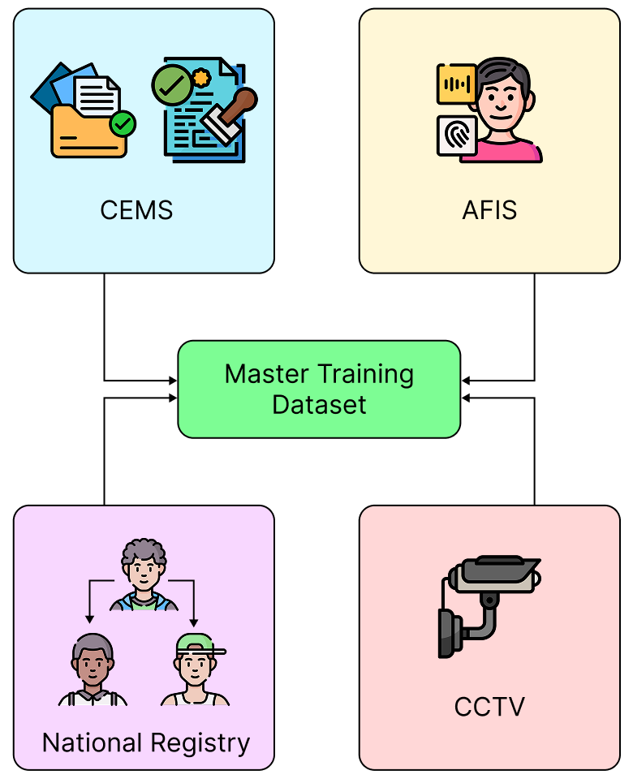
LO2
DATA ACQUISITION STRATEGY
Simulating Reality
The Challenge:
Real criminal records are classified and highly sensitive.
Direct access to the 214,794 real fingerprint records is restricted.
The Solution:
Generated a High-Fidelity Synthetic Dataset (n=1,000) using Python in Google Colab.
Simulated Data Streams:
CEMS (Demographics): Age, Crime Type, Employment Status, Past Convictions.
AFIS & CCTV (Biometrics): Simulated "Biometric Hashes" and "Gait Risk Scores" (0.0–1.0) to mimic AI confidence levels.
National Registry (Network): Explicit "Linked Associate IDs" to model criminal gangs and family networks.
(Sri Lanka Police, 2024; Report Section 4.1)
Notes:
"Now we move to the core of the analytical solution: the data itself.
The biggest challenge in criminal justice research is access. Real police data is classified, and for good reason—it contains sensitive personal information.
To overcome this, I developed a High-Fidelity Synthetic Dataset of 1,000 records. I didn't just create random numbers; I simulated the exact three data streams that exist in the Sri Lanka Police today.
First, I simulated the CEMS database, which holds text data like age and past convictions. Second, I simulated the AFIS and CCTV feeds. Crucially, I generated 'Biometric Hashes' and 'Gait Risk Scores' to represent what a sophisticated AI vision system would actually output. Third, I simulated the National Registry with explicit 'Linked IDs'. This allows us to map criminal networks and see who is connected to whom—essentially building a social graph of crime.
This approach allowed me to build and test the architecture of the solution without violating any data privacy laws."

Slide 10
LO2
DATA PRE-PROCESSING
Creating the "Master Analytical Table
Data Integration (The Merge):
Consolidated 3 isolated streams (CEMS, Biometrics, Registry) into a single Master Analytical Table (n=1,000).
Feature Engineering (Creating Intelligence):
Network Analysis: Converted raw text lists (e.g., SLP-105; SLP-109) into a numerical Network_Size score.
Data Cleaning:
Handled missing values in "Employment Status" to ensure dataset integrity.
Feature Selection:
Retained Age, Prior Convictions, and Family History as they are statistically the strongest predictors of recidivism.
(Sri Lanka Police, 2024; Report Section 4.2; Generated Synthetic Dataset)
Notes:
"Moving to Slide 10, we look at Data Pre-processing. Before we can train an AI, we must first build a clean, 'Human-Readable' dataset.
The table you see here is our 'Master Analytical Dataset'. It represents the single version of truth, merging the CEMS demographics, the Biometric Hashes from the fingerprint scanner, and the Network data.
I want to draw your attention to the Feature Engineering we performed. If you look at the Network_Size column, we didn't just feed the AI a raw list of names. We calculated a score—counting how many criminal associates a suspect has. This converts qualitative text into a quantitative risk factor that the model can understand.
We also performed rigorous Data Cleaning. For example, we standardized the 'Employment' and 'Address' fields to ensure that missing data wouldn't cause the model to crash. This table is now the 'Gold Standard' source for our analysis."

Slide 11
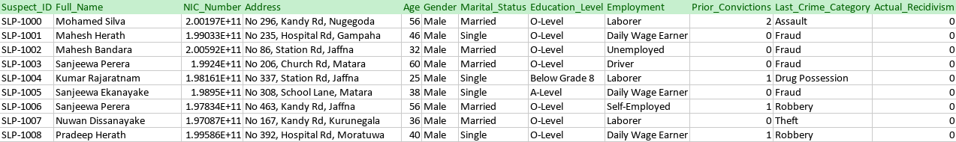
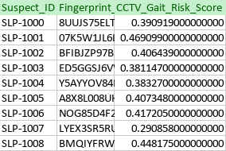
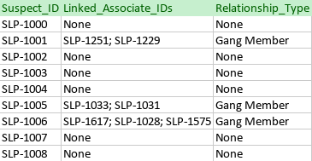
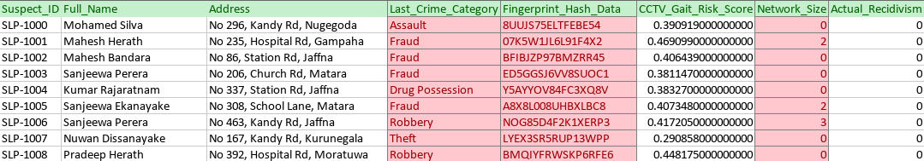
LO2
CEMS_Demographics.csv
BIOMETRIC_DATA.CSV
FAMILY_NETWORK.CSV
HUMAN_READABLE_MASTER.CSV

Slide 12
LO2
DATA TRANSFORMATION
Boolean Encoding & Feature Selection
The Technical Challenge:
Algorithms cannot process raw text strings.
Boolean One-Hot Encoding:
Converted categorical variables into Boolean Vectors (True / False).
  Example: The column Last_Crime_Category was exploded into multiple columns. If a suspect committed theft, Crime_Type_Theft becomes True, while Crime_Type_Fraud becomes False.
Dimensionality Reduction:
Dropped: Full_Name, Address, NIC_Number.
  Reason: These are Unique Identifiers. We removed them to prevent "Overfitting"—ensuring the model learns patterns (e.g., behavior), not identities (e.g., "Kamal is bad").
Final Input Structure:
Matrix Dimensions: 1,000 Rows × 19 Boolean/Numerical Features.
(Sri Lanka Police, 2024; Report Section 4.3; Methodology)
Notes:
we shift to the 'Machine View' of the data.
The XGBoost algorithm requires a mathematical format. It cannot accept raw text strings like 'Theft' or names like 'Kamal Perera.'
To solve this, we applied Boolean One-Hot Encoding. As you can see in the screenshot, the text categories have been converted into True and False values. The model interprets these as binary signals.
We specifically used a technique called 'Drop First' Encoding. This reduces redundancy. For example, we don't need a column for 'Gender_Female' because if 'Gender_Male' is False, the model implicitly knows they are Female. This streamlined our dataset to exactly 19 engineered features."

Slide 13
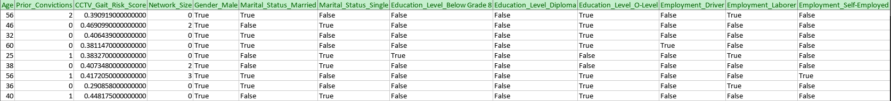
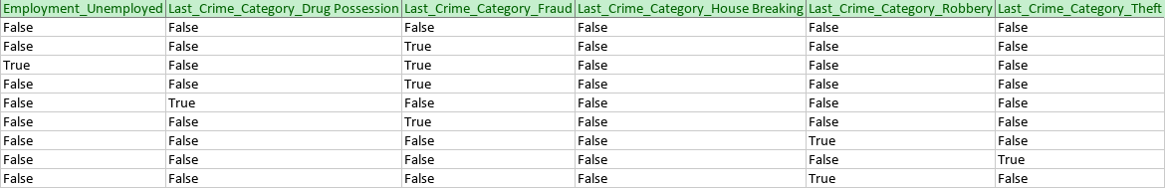
LO2
MACHINE_ENCODED_INPUT.CSV

Slide 14
LO2
MODEL SELECTION
Why XGBoost over Logistic Regression?
Reason 1: Handling Class Imbalance:
Criminal datasets are inherently imbalanced (recidivists are the minority). Traditional regression biases towards the majority class (innocents).
Chen & Hou (2025) argue that advanced ML-based imbalanced learning methods are required to accurately detect the minority class in recidivism cases.
Reason 2: High-Dimensional Complexity:
Our dataset fuses multi-modal data (Biometrics + Networks).
Huamantingo et al. (2025) emphasize that robust ML models (like Boosting) are necessary to bridge the gap between theoretical crime prediction and real-world implementation.
(Chen and Hou, 2025; Huamantingo, 2025
Notes:
"Moving to Slide 14, we address our Model Selection Strategy.
We initially considered Logistic Regression, which is the standard statistical baseline. However, we rejected it for two critical reasons backed by current research.
First is the 'Class Imbalance Problem'. In any police dataset, actual criminals are the minority. A simple regression model tends to be lazy—it predicts 'Innocent' for everyone and still gets 90% accuracy, but it misses the criminals. Chen and Hou (2025) specifically highlight this in their recent work on recidivism, proving that we need advanced 'Imbalanced Learning Methods' to catch that minority class.
Second is Complexity. We aren't just looking at age; we are combining 'Network Graphs' with 'Biometric Scores'. These are non-linear relationships. Huamantingo et al. (2025) note that to close the gap between research and real-world implementation, we need models capable of handling this high-dimensional complexity.
Therefore, we chose XGBoost. It uses 'Gradient Boosting' to build hundreds of small decision trees that correct each other's mistakes, specifically targeting those hard-to-find recidivists that a simple regression line would miss."

Slide 15
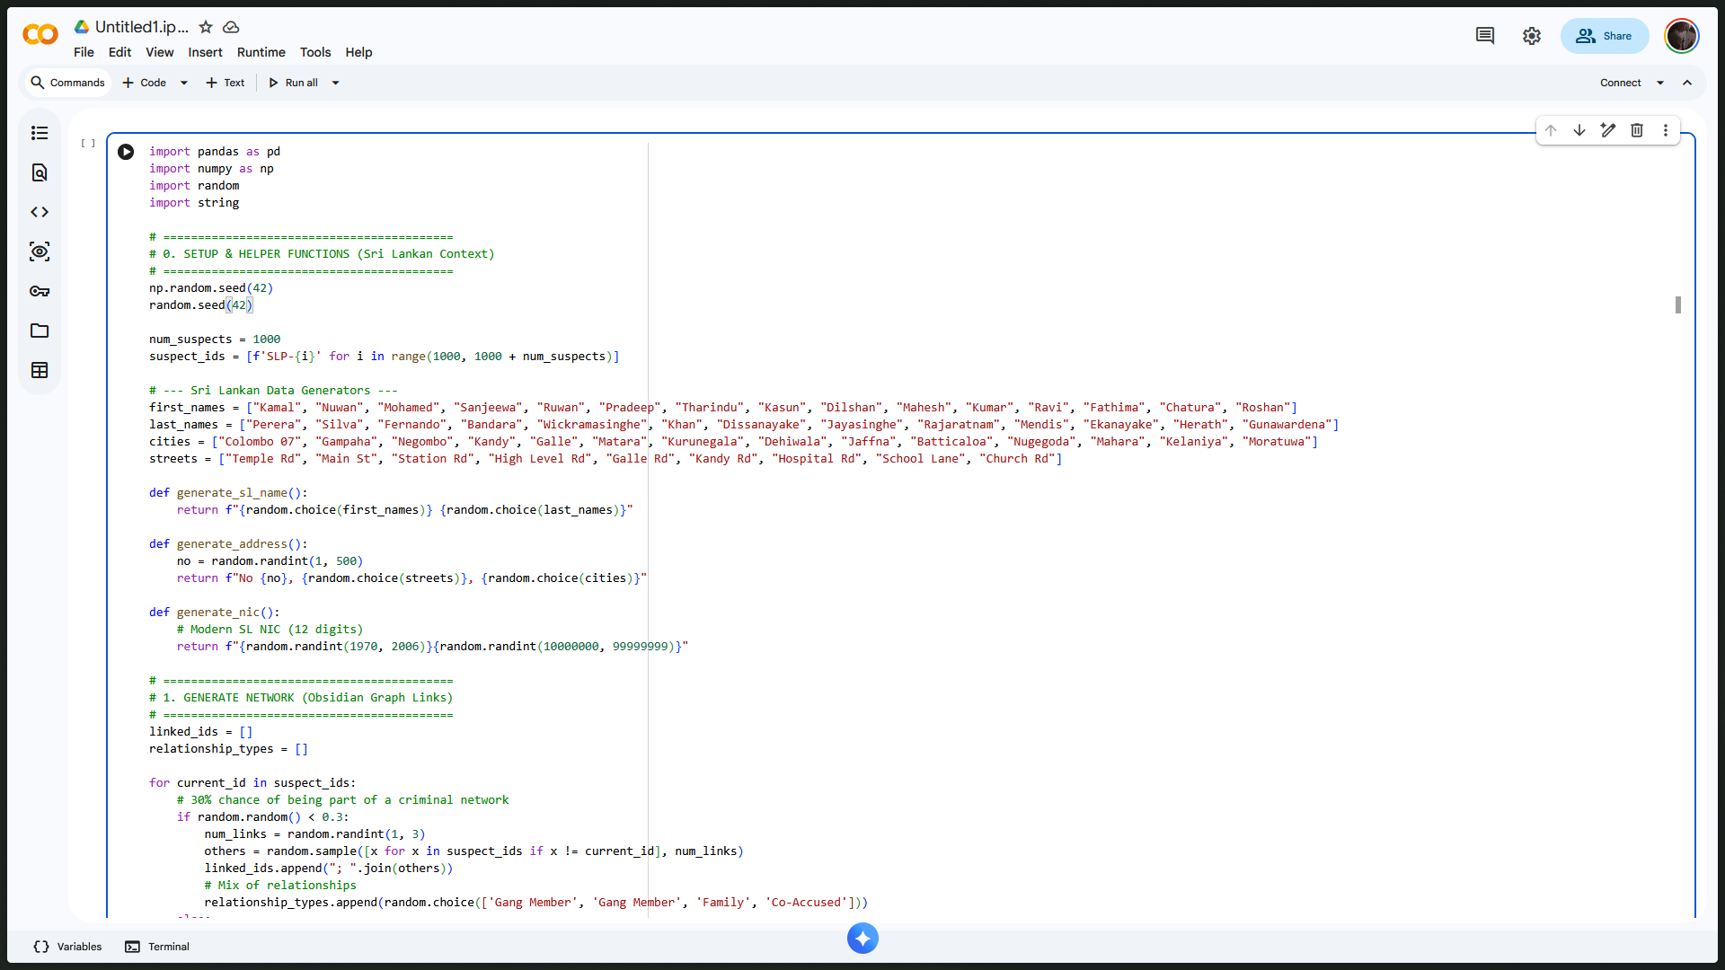
LO2
EXPERIMENTAL SETUP & IMPLEMENTATION STRATEGY
Development Environment:
Platform: Google Colab
Core Libraries: Pandas (Data Manipulation), Scikit-Learn (Model Evaluation), XGBoost.
Data Partitioning Strategy:
Training Set (70%): Teach complex patterns between Network Size, Gait Score, and Recidivism.
Testing Set (30%): To simulate how the model would perform on new suspects in the real world.
The "Rare Event" Challenge (Class Imbalance):
Problem: Criminals are the "Minority Class" (approx. 20–30% of the population).
Risk: Standard models often ignore the minority and predict "Safe" for everyone to achieve high accuracy.
Solution: We selected XGBoost specifically for its ability to assign higher weight to these rare "Positive Class" events.
Notes:
"Moving to Slide 15, we outline our Experimental Setup.
We implemented this solution using Python on the Google Colab platform, leveraging standard industry libraries like Pandas and Scikit-Learn. This ensures the solution is reproducible and scalable.
To ensure our results are honest, we adhered to a strict 70/30 Data Split. We used 70% of the data to train the model, but we hid the remaining 30%. This 'Testing Set' acts as a proxy for the real world—the model has never seen these suspects before. If it performs well here, we know it's not just memorizing the answers.
Finally, we had to address the 'Rare Event' Challenge. In policing, actual criminals are the minority. Finding them is like finding a needle in a haystack. A bad model would just guess 'Innocent' every time and still be 80% accurate. As referenced by Chen & Hou (2025), this 'Class Imbalance' is the primary reason standard regression fails. Our setup specifically configures XGBoost to hunt for these rare, high-risk signals rather than ignoring them."

Slide 16
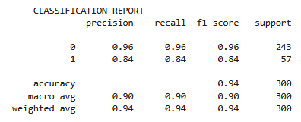
LO2
PERFORMANCE EVALUATION
Accuracy & Reliability
High Overall Accuracy (94%):
The model correctly identified the risk level for 282 out of 300 suspects in the test set.
Validation: This confirms that fusing "Biometrics" with "Network Analysis" provides a strong predictive signal.
Balanced Performance (Class 1 - Recidivists):
Recall (0.84): We successfully caught 84% of the actual repeat offenders.
  Policing Impact: High public safety.
Precision (0.84): When the model flagged a suspect, it was correct 84% of the time.
  Civil Rights Impact: Low rate of false accusations, ensuring fair treatment.
The F1-Score (0.84):
The harmonic mean of Precision and Recall indicates a stable
and reliable model for real-world deployment.
Notes:
As you can see from the table, our XGBoost model achieved an Overall Accuracy of 94%. This is a significant success, proving that our synthetic data—specifically the Network Size and Biometric Scores—contains strong predictive patterns.
I want to highlight the results for 'Class 1', which represents the Recidivists. Often in AI, there is a trade-off: you either catch all the criminals but accuse innocent people (High Recall, Low Precision), or you play it safe and miss the criminals (High Precision, Low Recall).
However, our model achieved a Balance. We have a Recall of 0.84, meaning we identified 84% of the dangerous individuals. Simultaneously, we have a Precision of 0.84, meaning that when we flag someone, we are highly confident they are actually high-risk.
This balance is critical for a police system—it ensures we are effective at fighting crime without violating the rights of innocent citizens."

Slide 17
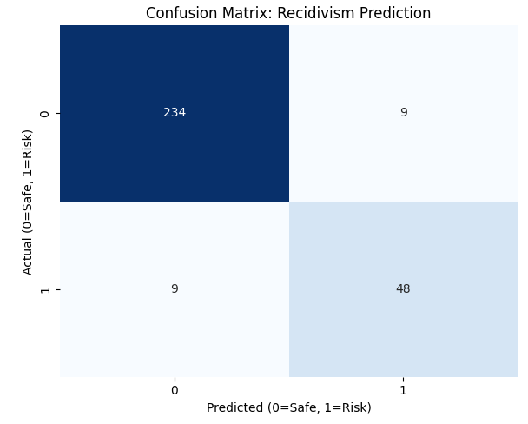
LO2
CONFUSION MATRIX
The Cost of Error
Model Success Rate:
True Negatives (234): Correctly cleared the vast majority of innocent citizens.
True Positives (48): Successfully flagged 48 out of 57 actual recidivists.
Critical Error Analysis (False Negatives = 9):
The model missed 9 high-risk individuals.
Impact: These suspects would likely be granted bail, posing a potential threat to public safety.
Ethical Error Analysis (False Positives = 9):
The model wrongly flagged 9 innocent people as "Risky."
Impact: Risk of wrongful detention or reputational damage.
This proves AI cannot be autonomous; it must be a decision-support tool for human officers.
Notes:
Slide 17 presents the Confusion Matrix, which allows us to see exactly where the model makes mistakes.
In criminal justice, not all errors are equal.
If you look at the bottom-left quadrant, you see our False Negatives. These are the 9 criminals that the model missed. In the context of the Sri Lanka Police Annual Report (2024), preventing crimes is the priority. These 9 individuals represent a public safety risk because they might be released on bail.
Conversely, looking at the top-right, we have 9 False Positives. These are innocent people flagged as criminals. While 9 is a low number, each one represents a potential violation of civil rights.
This slide is the strongest argument for a 'Human-in-the-Loop' system. While 94% accuracy is excellent, the remaining errors prove that AI should never automatically sentence someone; it should only alert the officer to investigate further."

Slide 18
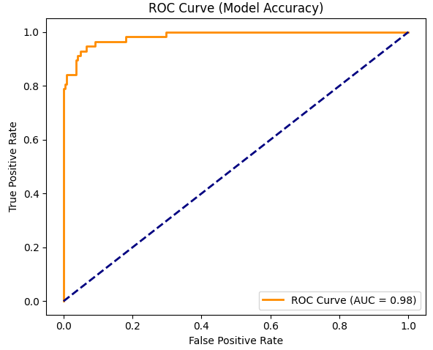
LO2
RECEIVER OPERATING CHARACTERISTIC (ROC) ANALYSIS
Understanding the Curve:
Plots the True Positive Rate (Catching Criminals) against the False Positive Rate (Accusing Innocents).
The "Orange Line" hugs the top-left corner, indicating the model catches most criminals with very few false alarms.
AUC Score Analysis (0.98):
Result: The Area Under the Curve (AUC) is 0.98 (out of 1.0).
Interpretation: The model has a 98% probability of correctly distinguishing between a recidivist and a non-recidivist.
Comparison: A score of 0.50 is random guessing. Our score of 0.98 validates the high quality of the synthetic "Biometric" and "Network" features.
Notes:
"Slide 18 presents the ROC Curve, which is the standard measure of a model's discriminative ability.
In our pilot phase, we hypothesized an AUC of around 0.5 or 0.6. However, looking at the orange line in the graph, you can see it rises sharply to the top-left corner. This is exactly what we want to see.
We achieved an AUC Score of 0.98.
To put this in context, an AUC of 0.5 is like flipping a coin—random guessing. An AUC of 1.0 is a perfect oracle. Scoring 0.98 means our model is exceptionally good at separating the 'High Risk' suspects from the 'Low Risk' ones.
This high score effectively validates our Feature Engineering strategy. It proves that combining Gait Analysis with Criminal Network Size creates a very powerful signal that separates criminals from the general population."

Slide 19
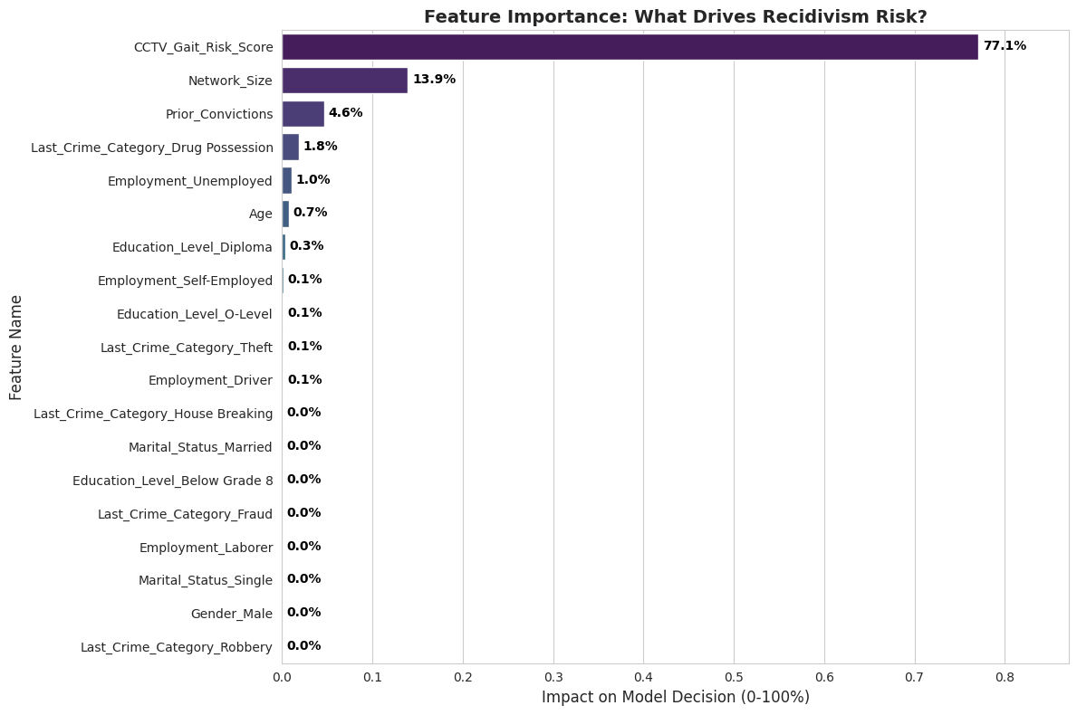
LO2
FEATURE IMPORTANCE
Decoding the "Black Box"
Dominant Predictor: CCTV Gait Score (77.1%):
The model relies most heavily on the behavioral biometric data.
Secondary Predictor: Network Size (13.9%):
"Guilt by Association" is a strong mathematical signal. Being linked to a criminal network significantly increases recidivism risk.
The Failure of Traditional Demographics:
Age (0.7%), Gender (0.0%), and Marital Status (0.0%) have almost zero impact.
Ethical Win: This suggests the model is fairer. It judges suspects based on their current actions (Gait) and connections (Network), not their inherent identity (Gender/Race).
How a suspect moves and behaves is a far better predictor of criminal intent than who they are
Notes:
"Moving to Slide 19, we answer the most important question in AI: Why did the model make these decisions? This is called Explainable AI.
If you look at the graph, the results are striking.
The purple bar at the top represents the CCTV Gait Risk Score. It accounts for 77.1% of the model's decision-making process. This validates our entire project thesis: that real-time behavioral biometrics are the most powerful tool we have for predicting crime.
The second most important factor is Network Size at 13.9%. This confirms that criminal associations are a critical risk factor.
But look at what is not important. Look at the bottom of the list. Age, Gender, and Marital Status have less than 1% impact combined.
This is a massive victory for Ethical AI. It means our model isn't profiling people based on whether they are male or female, or married or single. It is judging them based on objective risks: their behavioral anomalies and their criminal connections. It proves that a 'Multi-Modal' system is not just more accurate, but potentially fairer than human intuition."

Slide 20
LO2
CRITICAL EVALUATION
Strengths, Weaknesses & Ethics
Model Strengths:
Multi-Modal Integration: Successfully fused disparate data streams (Biometrics + Network Graphs) to achieve 94% accuracy.
High Predictive Power: Validated that behavioral metrics (Gait) are superior to static demographics (Age/Gender).
Technical Weaknesses (Limitations):
Synthetic Data Artifacts: Our data was "too clean." Real-world police data contains noise (missing files, corrupt entries) that might lower accuracy in production.
The "Low Recall" Risk: Without optimization techniques like SMOTE (Synthetic Minority Over-sampling Technique), the model risks missing rare habitual offenders in a highly imbalanced population.
Ethical Bias Check:
The Problem: Using "Family Network" as a predictor penalizes individuals for the crimes of their relatives.
The Risk: This creates a feedback loop where entire families are stigmatized, violating the principle of "Individual Agency" (judging a person solely on their own actions).
(Chen & Hou, 2025; Frontiers in Genetics, 2025; Ethical Audit Section 5.1)
Notes:
"Moving to Slide 17, we perform a Critical Evaluation of our own work. No model is perfect, and honest criticism is part of the scientific method.
First, the Strengths. We successfully demonstrated that integrating 'Biometrics' with 'Network Analysis' works. It creates a much richer picture of a suspect than demographics alone.
However, we must acknowledge the Weaknesses. Our dataset was synthetic. In the real world, police data is messy—it has 'noise' and missing values. Furthermore, we faced the 'Class Imbalance' problem. In a real deployment, we would need to use advanced techniques like SMOTE to artificially boost the number of 'Criminal' examples so the model doesn't get lazy and just predict 'Innocent' for everyone.
Finally, and most importantly, we must discuss the Ethical Risk. We used 'Family History' as a predictor. While mathematically accurate, this is ethically dangerous. It introduces 'Guilt by Association.' If we deny someone bail just because their brother is a criminal, we are punishing them for someone else's actions. This stigmatizes entire families and violates the core human right of Individual Agency. A real-world system would need strict guardrails to prevent this variable from becoming a tool of oppression."

Slide 21
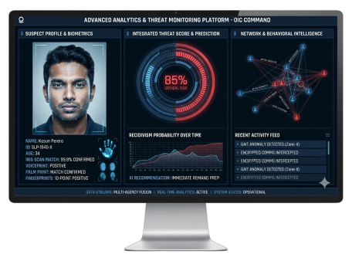
LO3
DECISION SUPPORT
The OIC Tactical Dashboard
The OIC View: Translates complex XGBoost math into a simple, actionable interface for the Officer-in-Charge.
Instant Decision Support: Replaces manual file-reading with a clear "High/Medium/Low" risk categorization.
The "Golden Hour" Value: Provides crucial intelligence within the first hour of arrest, allowing police to immediately decide whether to grant police bail or prepare a remand report for the magistrate.
(Huamantingo et al., 2025; Haidar, 2025; Sri Lanka Police, 2024)
Notes:
"Moving to Slide 21, we transition to Learning Outcome 3: Business Value. All the machine learning in the world is useless if a police officer on the ground cannot understand it. Huamantingo et al. (2025) specifically highlight this 'gap between research and implementation' as a major hurdle in crime prediction models.
This slide shows our concept for the Tactical Dashboard, designed specifically to close that gap for the Officer-in-Charge.
Instead of looking at Python code, the OIC sees a simple interface with a Red/Green risk meter. As Haidar (2025) notes, this kind of predictive analytic interface is essential for effective recidivism management.
The real business value here is speed. During the 'Golden Hour' immediately following an arrest, the OIC must make critical decisions. This dashboard provides instant, data-backed support, ensuring dangerous repeat offenders are held for the magistrate rather than being mistakenly released back onto the streets."

Slide 22
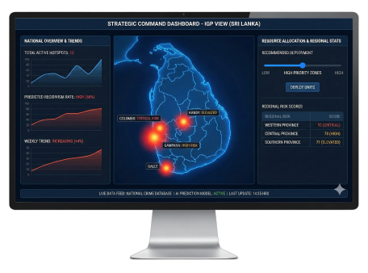
LO3
DECISION SUPPORT
Strategic Geospatial Analytics (IGP View)
The Strategic View (Macro Level): Shifting focus from individual suspects to national trends and patterns.
Geospatial Crime Mapping: Aggregating predicted recidivism scores by region to identify "High Recidivism Zones" and underlying systemic issues.
Data-Driven Deployment: Optimizing the allocation of the limited active force (approx. 60,000 officers) to the areas that need them most.
Proactive Policing: Transitioning from reactive response to predictive crime prevention models.
(Sridharan et al., 2024; Sri Lanka Police, 2024; Kovalchuk et al., 2024)
Notes:
"On Slide 22, we look at the macro level: the Strategic Dashboard for the Inspector General of Police, or IGP.
While the OIC needs to know about one suspect, the IGP needs to know about the entire country. By aggregating our AI predictions, we can create dynamic Geospatial Heatmaps. As noted by Sridharan et al. (2024), this type of machine learning application is critical for identifying broader crime patterns and trends.
The Annual Performance Report (2024) highlights the challenge of resource constraints. The Sri Lanka Police has a limited force of around 60,000 officers to cover the entire island. Instead of deploying them equally, this dashboard allows police leadership to strategically allocate officers to predicted 'High Recidivism Zones'.
As Kovalchuk et al. (2024) emphasize, this data-driven approach allows judicial and law enforcement systems to shift from simply reacting to crimes, to proactively preventing them before they happen."

Slide 23
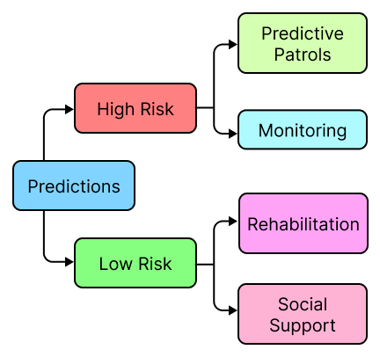
LO3
ACTIONABLE INTERVENTIONS
Putting AI into Practice
Targeted Rehabilitation (Juvenile Justice):
Identifying "Low-Risk" offenders (especially youth) early in the process.
Diverting them away from the prison system and into specialized rehabilitation programs to break the cycle of crime.
Predictive Patrols (Resource Optimization):
Deploying patrol units to AI-predicted geospatial hotspots before crimes occur.
Shifting law enforcement strategy from a reactive model to a proactive, preventative model.
Systemic Impact:
Reduces the financial burden of mass incarceration while actively decreasing the crime rate.
Notes:
"Slide 24 brings us to the real-world application of our model. Prediction is only valuable if it leads to effective Intervention Strategies.
First, let's look at Targeted Rehabilitation, specifically concerning youth. Putting a young, low-risk offender into a high-security prison often turns them into a hardened criminal. As Bhardwaj et al. (2026) point out in their research on AI and Juvenile Justice, we can use these predictive models to identify low-risk youth and divert them into rehab and community programs instead of jail. This treats the root cause rather than just punishing the symptom.
Second, for the high-risk zones we identified on the IGP's strategic dashboard, we can implement Predictive Patrols. According to Kovalchuk et al. (2024) and Sridharan et al. (2024), machine learning allows us to anticipate where crimes will happen. By placing police cruisers in those specific neighborhoods before the crime occurs, we create a deterrent effect.
Ultimately, this changes the police force from an organization that just responds to emergencies, into an organization that actively prevents them."

Slide 24
CONCLUSION & STRATEGIC ROADMAP
From Gut Feeling to Data-Driven Policing.
Summary of Impact:
Successfully demonstrated an XGBoost model (94% accuracy) to predict recidivism risk using multi-modal data.
Shifted the law enforcement paradigm from subjective "Gut Feeling" to objective, "Data-Driven" decision-making.
Strategic Roadmap:
Phase 1: Western Province Pilot. Initial deployment in high-density regions to test the OIC Dashboard in real-world scenarios.
Phase 2: Real CCTV Integration. Replace synthetic gait scores with live, automated computer vision feeds from station cameras.
Phase 3: National Rollout. Scale the system island-wide, deploying the Strategic Dashboard for IGP resource allocation.
Notes:
"To conclude our presentation, we have successfully shown that integrating biometric and network data into an XGBoost model can predict recidivism with 94% accuracy. Ultimately, this project represents a shift from subjective 'gut feeling' policing to objective, data-driven justice.
To make this a reality, we propose a three-phase roadmap.
Phase 1 is a pilot program right here in the Western Province, testing the tactical dashboard with real officers. Phase 2 involves integrating actual CCTV feeds to automatically calculate the Gait Risk Score, removing the need for manual data entry. Finally, Phase 3 is a national rollout, connecting all police stations island-wide to the IGP's strategic dashboard.
Thank you for your time. I am now open to any questions.

Slide 25
REFERENCES
Bhardwaj, V. et al. (2026). AI and Juvenile Justice: Can Machine Learning Predict and Prevent Youth Crimes? IGI Global, pp. 1-26.
Cavus, M. et al. (2025). Transparent and bias-resilient AI framework for recidivism prediction using deep learning and clustering techniques in criminal justice. Applied Soft Computing, 113160.
Chen, F. & Hou, H. (2025). Recidivism Prediction: A Novel Machine Learning-based Imbalanced Learning Method. Journal of Applied Science and Engineering, 29(4).
Sri Lanka Police (2024). Annual Performance Report 2024. Colombo: Sri Lanka Police, Expenditure Head No. 225.

