Slide 1
Lecture 3 static techniques
Static Techniques and the Test Process
Review Process
Static Analysis by Tools

Slide 2
Static vs Dynamic?
Unlike dynamic testing, which requires the execution of software, static testing techniques rely on
Manual examination of Code (reviews)
Automated analysis (static analysis) of code
Review of project documentation

Slide 3
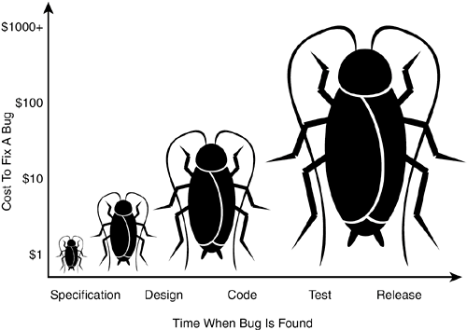
Purpose of Reviews
Reviews are a way of testing software work products (including code) and can be performed well before dynamic test execution.

Slide 4
What to Review
Requirements specifications
Design specifications
Code
Test plans
Test specifications
Test cases
Test scripts
User guides
Web pages.

Slide 5
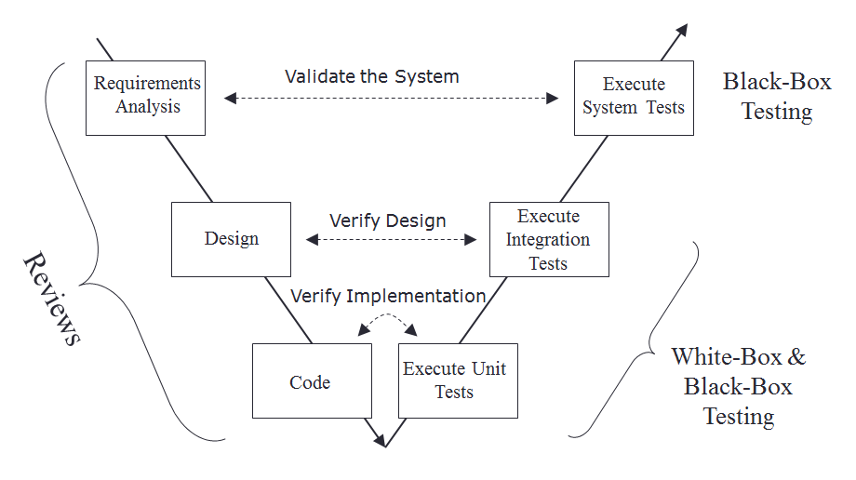
Verification and Validation

Slide 6
People techniques
individual:
  desk-checking, data-stepping, proof-reading
group:
  Reviews (informal & formal): for consensus
  Walkthrough: for education
  Inspection (most formal): to find faults

Slide 7
Benefits of Reviews
Early defect detection and correction
Development productivity improvements
Reduced development timescales
Reduced testing cost and time
Lifetime cost reductions
Fewer defects and improved communication
Reviews can find omissions in requirements
Find causes of failures (defects)

Slide 8
Reviews are cost-effective
10 times reduction in faults reaching test, testing cost reduced by 50% to 80%
reduce faults by a factor of 10
25% reduction in schedules, remove 80% - 95% of faults at each stage, 28 times reduction in maintenance cost, many others

Slide 9
Testing vs. Debugging
Verification and Validation
  looking and categorizing existence of system defects
  “What?”
Debugging
  locating and correcting these defects
  “Why?”

Slide 10
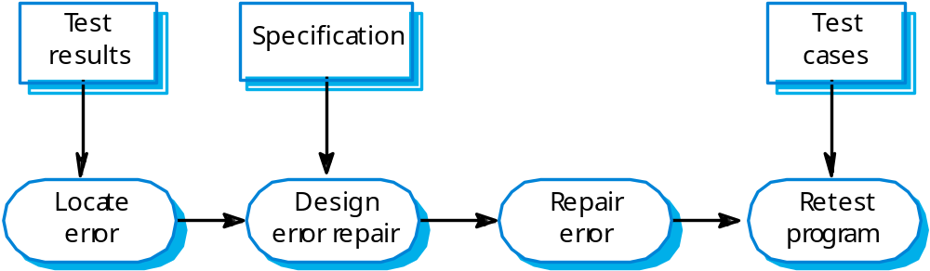
The Debugging Process

Slide 11
Lecture Contents
Static Techniques and the Test Process
Review Process
Static Analysis by Tools

Slide 12
Types of Reviews
Informal Review
undocumented
widely viewed as useful and cheap (but no one can prove it!) A helpful first step for chaotic organizations.

Slide 13
Types of Reviews
Walkthroughs
author guides the group through a document and his or her thought processes, so all understand the same thing, consensus on changes to make

Slide 14
Types of Reviews
Technical Review (Peer Review)
includes peer and technical experts, no management participation. Normally documented, fault-finding. Can be rather subjective.

Slide 15
Types of Reviews
Inspection
    Formal individual and group checking, using sources and standards, according to generic and specific rules and checklists, using entry and exit criteria, Leader must be trained & certified, metrics required

Slide 16
Objectives / Goals for Reviews
validation & verification against specifications & standards
achieve consensus (excluding Inspection)
process improvement (ideal, included in Inspection)

Slide 17
Activities in Inspection / Reviews
Planning
Overview / kick-off meeting (Inspection)
Individual preparation / individual checking
Review meeting
Rework
Follow-up

Slide 18
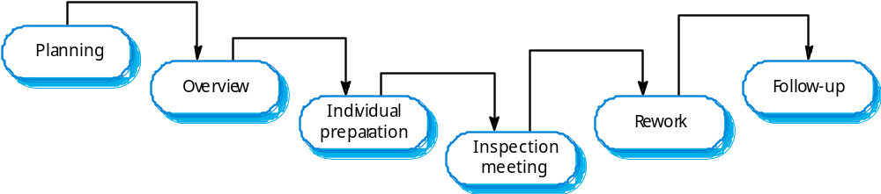
The Inspection process

Slide 19
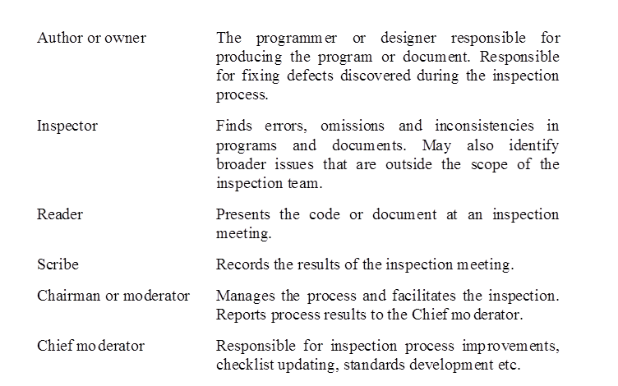
Inspection roles

Slide 20
Software Inspections - Sample procedure:
Announce review meeting in advance (a week?)
Provide design document, implementation overview, and pointer to code
Reviewers read code (and make notes) in advance of meeting
During meeting, directives recorded by Scribe
Testers/documenters attend too

Slide 21
Advantages of SW Inspections over Testing
Many different defects may be discovered in a single inspection. In testing, one defect, may mask (hide) another (interaction between errors) so several executions are required.

Slide 22
Lecture Contents
Static Techniques and the Test Process
Review Process
Static Analysis by Tools

Slide 23
Value of Static Analysis
Early detection of defects prior to test execution
Early warning about suspicious aspects of the code or design by the calculation of metrics, such as a high complexity measure
Identification of defects not easily found by dynamic testing
Detecting dependencies and inconsistencies in software models such as links
Improved maintainability of code and design
Prevention of defects, if lessons are learned in development

Slide 24
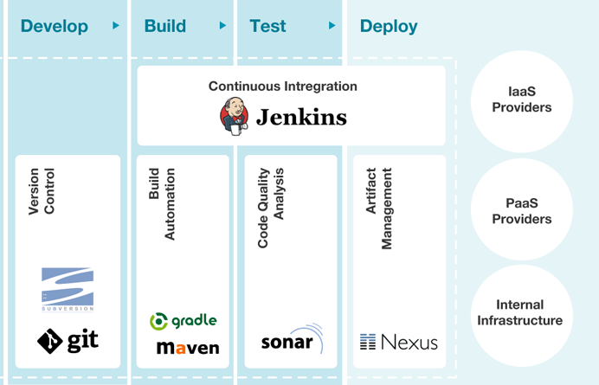
Static Analysis Overview

Slide 25
Typical defects discovered by static analysis
Unreachable code
Objects declared and never used
Parameters type/number mismatch
Variable used before initialization
Variable is assigned to twice, without using the first value
Function results not used
Possible array bound violations
Syntax violations of code and software models

Slide 26
Data flow analysis
This is the study of program variables
  variable defined* where a value is stored into it
  variable used where the stored value is accessed
  variable is undefined before it is defined or when it goes out of scope
x is defined, y and z are used
x = y + z
IF a > b THEN read(S)
a and b are used, S is defined

Slide 27
Data flow analysis faults
n := 0
read (x)
n := 1
while x > y do
begin
read (y)
write( n*y)
x := x - n
end
Data flow anomaly: n is
re-defined without being used
Data flow fault: y is used
before it has been defined
(first time around the loop)

Slide 28
Control flow analysis
nodes not accessible from start node
infinite loops
multiple entry to loops
whether code is well structured, i.e. reducible
whether code conforms to a flowchart grammar
any jumps to undefined labels
any labels not jumped to
cyclomatic complexity and other metrics

Slide 29
Cyclomatic complexity
cyclomatic complexity is a measure of the complexity of a flow graph
  (and therefore the code that the flow graph represents)
the more complex the flow graph, the greater the measure
it can most easily be calculated as:
  complexity = number of decisions + 1

Slide 30
Which flow graph is most complex?
1
What is the cyclomatic complexity?
5
2
3

Slide 31
Covering quality on 7 Axes –
The 7 deadly sins
Bugs and Potential Bugs
Coding Standards Breach
Duplications
Lack of Unit Tests
Bad Distribution of Complexity
Spaghetti Design
Not Enough or Too Many Comments

Slide 32
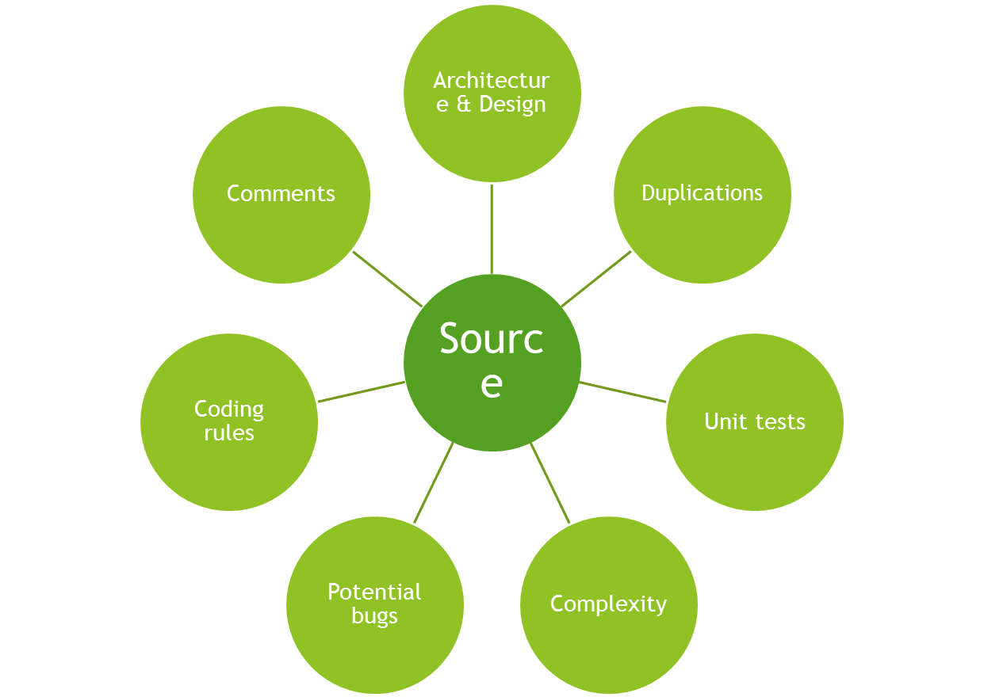
Covering quality on 7 Axes
Technical
Debt

Slide 33
Technical Debt
Duplicated blocks
Failed unit tests
Insufficient branch coverage by unit tests
Insufficient comment density
Insufficient line coverage by unit tests
Skipped unit tests

Slide 34
Static Analysis Tools
Descended from compiler technology
A compiler statically analyses code, and “knows” a lot about it, e.g. variable usage; finds syntax faults
Static analysis tools extend this knowledge
Can find unreachable code, undeclared variables, parameter type mis-matches, uncalled functions & procedures, array bound violations, etc.

Slide 35

Static Analysis Tool - Sample
Supported languages
ABAB, C, C++, C#, Cobol, Flex, Groovy, Java, JavaScript, Natural, Pacbase, PHP, PL/I, PL/SQL, Python, VB.NET, Visual Basic, Web (HTML, JSP, Php, Ruby), XML

Slide 36
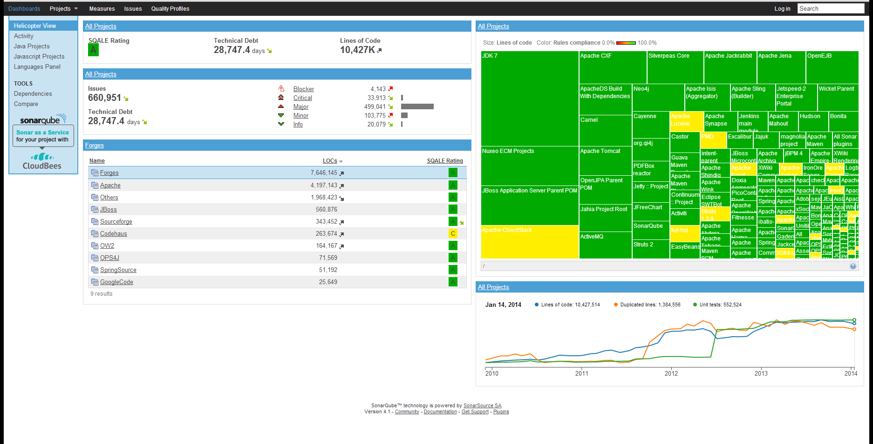
Static Analysis Tool - Sample

Slide 37
Summary: Key Points
Reviews help to find faults in development and test documentation, and should be applied early
Types of review: informal, walkthrough, technical / peer review, Inspection
Static analysis can find faults and give information about code without executing it

Slide 38

Questions?

