Slide 1
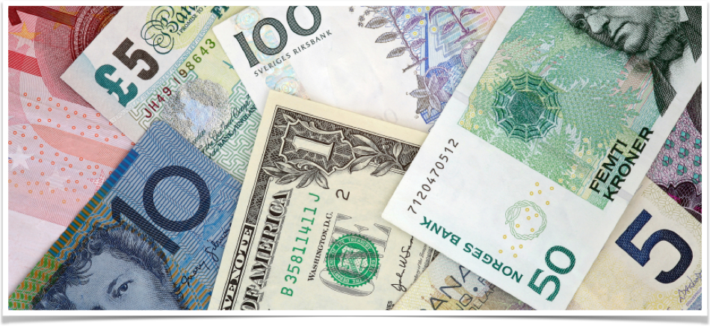
Foreign Exchange Directionality Prediction
Zhengyang Zuo <zzuo@andrew.cmu.edu>
11-676 Big Data Analytics
Notes:
My name is Zhengyang Zuo. The project I want to introduce is “foreign exchange directionality prediction”.

Slide 2
Project Purpose
Problem:
Foreign exchange market is rapidly changing and difficult to find pattern or trend
Purpose:
Use machine learning methodology to predict trend in foreign exchange
Value proposition if solution found:
Find factors affecting bid price changes
Help traders to make decision on exchanging currency at a point
Notes:
So, why do we want to work on the project?
The reason we want to do this project is that we want to predict the pattern or trend of foreign exchange market.
As we all know, the foreign exchange market is changing rapidly, and we hardly can find some rules or patterns from the exchange price and rate.
So in this project, we want to use machine learning methods to predict trend in foreign exchange price and rate.
We want to find factors that have influence on foreign exchange price and rate, or to be specific, the bid price. And we want to help traders to make decision of whether to exchange between currencies at a time point given previous currency data.

Slide 3
Analytic Approach
Predict the directionality of the bid price of two currencies
Features:
Average bid price in a time period (5 minutes)
Difference of max and min of bid price in 5 minutes
Difference of last bid price and bid price 5 minutes ago
Difference of last 2 bid prices
Difference between last bid price and ask price
Features transformed into binary values
Notes:
In this project, we focused on predicting the directionality of bid price of two currencies. By saying directionality, it means whether the current bid price is higher than the bid price of previous transaction. To be specific, we used Euro to US Dollar as the pair of currencies to predict on.
If we want to use machine learning approaches to do predictions, we need features for the machine learning model to do training and predictions. In this project, we used the following features. First feature is the average bid price in a given previous time period. To be specific, we used 5 minutes as the length of the time period. Second feature is the difference of maximum and minimum of bid price during the 5 minutes time period. Third feature is the difference of bid price in last transaction and the bid price in the transaction 5 minutes ago. Fourth feature is the difference between bid prices in last 2 transactions. The last feature is the difference between last bid price and ask price.
As you know, the features are continuous. Foe easiness, we transformed the features into binary values (TRUE or FALSE) using thresholds.

Slide 4
Analytic Approach
Used Java and Cassandra for preparing data.
Used Spark Pipeline with Scala to:
Transform features
Train the model
Make predictions (classifications)
Used Random Forest as the model (classifier)
Notes:
In this project, we used Java and Cassandra, which is a NoSQL database, for preparing the data we need for use of machine learning approaches.
We used Spark as the platform, which is a fast and general engine for big data processing. We used the Spark Pipeline APIs for transforming the features, training the model, and making predictions. This part is implemented in Scala, which is a JVM-based general purpose language. The pipeline in Spark is a structured way to represent the process of implementing machine learning approaches. It consists of transformers, which manipulates data, extract and transform features, and estimator, which represents a learning algorithm or any algorithm that fits or trains on data.
We used random forest as the model. A random forest is just like a forest, which consists of multiple decision trees. And by saying “random”, it means that each decision tree uses random subset of features, and random subset of data.

Slide 5

Results
50 trees in the random forest
Used sample data of EUR/USD exchange in Oct. 2010
Test on the test data set with 3960 instances
Classification accuracy: 0.5735
Confusion Matrix:
TRUE means positive directionality, FALSE means negative or neutral directionality
Notes:
Now I want to talk about the final result.
We generated 50 trees for the random forest model, and used sample data of the Euro to US Dollar data set in Oct. 2010. We split the data into training data and testing data, and the testing data consists of 3960 instances in total.
After testing on the test data, we got the classification accuracy as 57%. And we has a confusion matrix as follows. In the matrix, TRUE means positive directionality, in another word, the current bid price is higher than previous bid price. On contrary, FALSE means negative or neutral directionality, which means current bid price is lower or equal to previous bid price.
In the matrix, the columns mean instances that are classified as corresponding labels, while the rows mean instances that are actually in the label values.

Slide 6
Error Analysis
Confusion matrix again:
Most of the instances (99%) are classified as FALSE
In dataset, 56.9% of instances has label as FALSE
Analysis:
The number of features is not many, and not distinguishable enough
Each decision tree has few features, distribution of label has high effect
Most decision trees predict FALSE for most times
Random forest predicts FALSE due to majority vote
Notes:
Now, the error analysis for the results.
As we can see from the confusion matrix, most of the instances, or to be specific, 99% of instances are classified as FALSE. Only a few are classified as TRUE.
By investigating the test data, we found that 57% of instances actually have FALSE labels, which is very close to the classification accuracy. This means that the classification is almost like a majority vote on labels. So why is this? I think the reason is as follows.
We don’t have too many labels, and the labels are not distinguishable enough. Thus, each decision tree only has a few (2~3) features, and because it make decisions by doing majority vote on leaf nodes, the prior distributions of labels have high influence on the decision. Thus, most of the decision trees vote FALSE for most times. Further because the random forest use majority vote among decision trees to make predictions, it predicts FALSE for most times.

Slide 7
Future Work
Following steps on the project:
Extract more features
Try different models
Do feature selection
Do parameter tuning
For next project, we can do more sophisticated predictions
Which pair of currencies is most profitable to exchange on
How much is the profit for exchange on a given currencies pair
Notes:
From the error analysis, we can see that there are plenty of space for improvement in this project. For example, we can try to extract more features, probably from other currencies, and do some feature engineering to generate more complex features. We can also try different models other than random forest, do feature selection, and tune model parameters to get a best result.
For the next project following this project, I think we can do more sophisticated predictions, such as predicting which pair of currencies is most profitable to exchange on, or how much is the profit for exchange on a give currencies pair.

Slide 8
Thanks!
Notes:
That’s all for my presentation, thanks for attention.

