Slide 1
+
+
FinGuard AI
Multi-Agent Fraud Risk Detection
500 transactions | 4-agent pipeline | 100% Critic pass rate
github.com/Nirrmam2211/finguard-ai
Symbiosis Institute of Technology / SEM-5 Flexi Project
+
+

Slide 2
Introduction
What it is
Design principles
FinGuard AI chains four autonomous agents
to investigate a single financial transaction
and produce an explainable risk score.
Planner checks that all required fields are
present and creates the investigation task list.
Research collects transaction context and
flags relevant behavioural patterns.
Executor calls the Python risk engine and
scores the transaction against five rules.
Critic independently recomputes the score
and rejects any inconsistent assessment.
Output: a risk tier, triggered rules, and a
JSON report the analyst can download.
No ML models — scoring is rule-based.
Every flag has a plain-language reason.
Fail-closed: invalid input goes to manual
review. The pipeline never manufactures data.
Critic uses the same risk engine as Executor.
There is no separate or easier scorer for it.
Synthetic data only. Safe to share, run, and
demonstrate without any PII risk.
17 unit tests ship with the code. Changing a
rule breaks a test before it breaks a demo.
Scores are illustrative. The system recommends
human review and cannot block transactions.

Slide 3
Problem Statement
"Fraud teams spend most of their time deciding what to look at, not actually looking at it."
Black-box detection
Unstructured triage
No accessible baseline
A neural network outputs a probability — not a
reason. In a compliance meeting, "87% fraud" is
not an answer. A triggered rule list is.
Without a fixed investigation workflow, two
analysts reviewing the same transaction apply
different checks and reach different conclusions.
Production fraud stacks need ML engineers and
live data pipelines. Students and small teams
have no working reference to learn from.
FinGuard AI gives teams a transparent, step-by-step workflow they can read, audit, and extend.

Slide 4
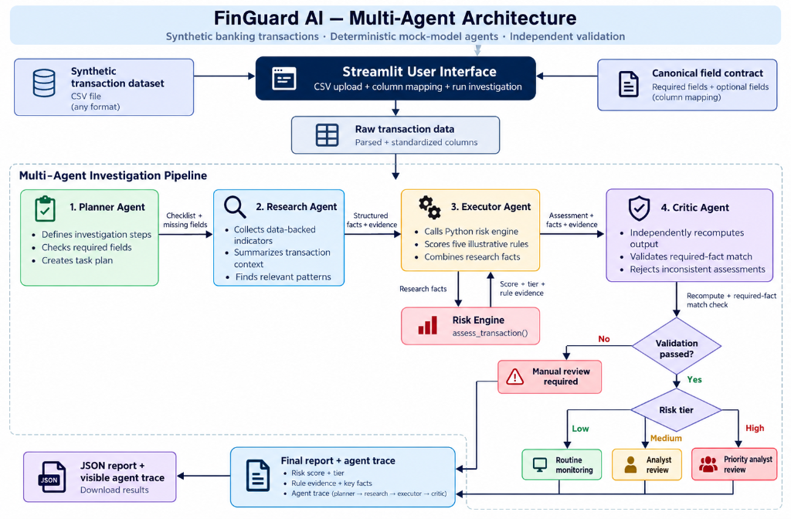
Architecture
Critic recomputes via the same risk_engine.assess_transaction() call — no separate scorer.

Slide 5
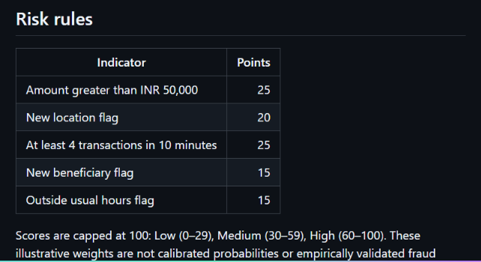
The App — Streamlit Dashboard
Five scoring rules
Amount > INR 50,000 25 pts
New location flag 20 pts
4+ txns in 10 minutes 25 pts
New beneficiary flag 15 pts
Outside usual hours 15 pts
Scores cap at 100.
Low: 0–29 / Medium: 30–59
High: 60–100
Each flag that fires is listed in
the final report with its point value
so the analyst knows exactly why
a transaction was escalated.
Weights are illustrative — not calibrated against verified fraud outcomes.

Slide 6
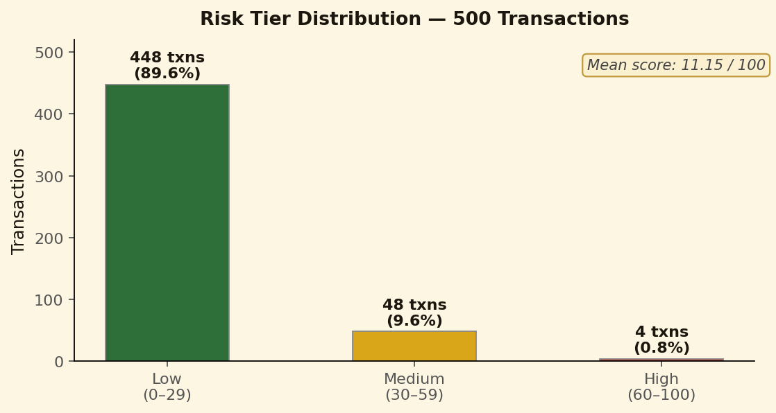
Results & Evaluation
Run summary
Dataset data/transactions.csv
Records 500 synthetic rows
Pipeline Planner > Research
> Executor > Critic
Low tier 448 txns 89.6%
Medium 48 txns 9.6%
High 4 txns 0.8%
Mean score 11.15 / 100
Critic pass 500 / 500 (100%)
Unit tests 17 passed
Transaction Score Tier Triggered rules
TXN00001 0 Low — Routine monitoring None
TXN00003 100 High — Priority analyst review High amount, new location, high frequency, new beneficiary, unusual time
TXN00004 35 Medium — Analyst review New location, new beneficiary

Slide 7
Honest Limitations
What this system cannot tell you
Classification accuracy: not available.
The CSV has no verified fraud/legitimate labels. Accuracy, precision, recall, F1, and ROC-AUC
cannot be calculated honestly from this dataset. The score is a rule total, not a fraud probability.
Performance benchmark: not measured.
500 rows ran successfully. That confirms the pipeline works — it is not a latency or
throughput benchmark, and no competing system was compared.
Critic blind spot: Executor and Critic use the same scoring function.
A shared defect in risk_engine.py would not be caught by the Critic's recomputation.
Synthetic data only.
No conclusions about real customers or real fraud patterns can be drawn from these results.
Rule weights are illustrative.
The point values were not calibrated against any verified outcome dataset.

Slide 8
Repository
github.com/Nirrmam2211/finguard-ai
risk_engine.py Scoring rules, validation, thresholds
orchestrator.py Pipeline state machine
agents/planner.py Checks fields, creates task list
agents/research.py Collects transaction evidence
agents/executor.py Runs risk engine, produces assessment
agents/critic.py Recomputes and validates
app.py Streamlit entry point
data/transactions.csv 500-row synthetic dataset
tests/ 17 unit tests
streamlit run app.py python -m unittest discover -s tests -v

Slide 9
+
+
Thank You
Questions welcome.
github.com/Nirrmam2211/finguard-ai
500 transactions | 17 unit tests | 100% Critic pass rate
Symbiosis Institute of Technology / SEM-5 Flexi / 2026
+
+

