Slide 1
Distributed Systems & Database

Slide 2
Distributed system is a collection of autonomous computers linked by a computer network
Co-ordinates System activities
Share resources
Overcome single point of failure

Slide 3
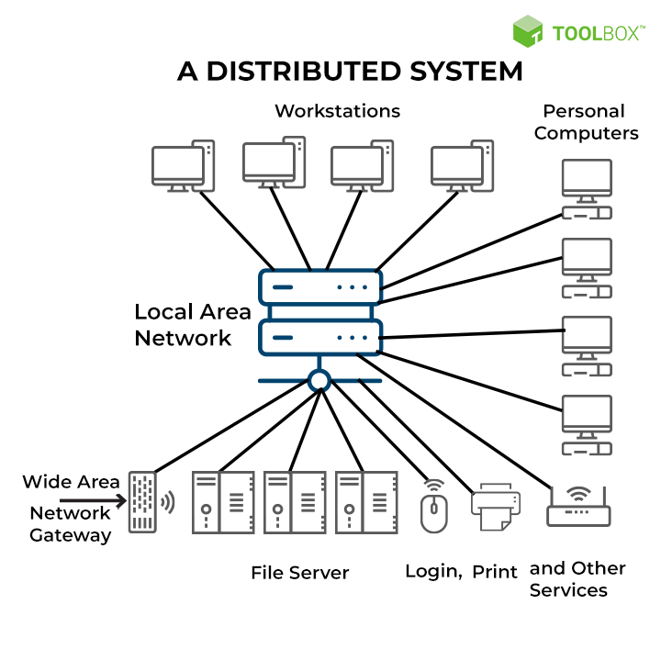

Slide 4
characteristics of a distributed system
Scalability
Concurrency
Availability/fault tolerance
Transparency
Heterogeneity
Replication

Slide 5
Distributed computing

Slide 6
Distributed computing is a model in which components of a software system are shared among multiple computers.
Distributed Computing Environment
Different locations

Slide 7
characteristics of a distributed computing
Scalability
Availability/fault tolerance
Multiple architectures
Redundancy

Slide 8
Distributed storage

Slide 9

A distributed storage system is infrastructure that can split data across multiple physical servers, and often across more than one data center.
A distributed storage system can relate to any of the 3 types of storage
Block storage
File storage
Object

Slide 10
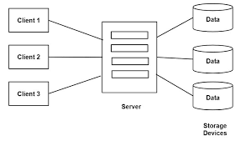

Slide 11
CHARACTERISTICS OF A DISTRIBUTED Storage
FLEXIBILITY
SPEED
COST

Slide 12
Data modelling

Slide 13
Data models provide a blueprint for designing a new database
Types of data model
1) Conceptual data model
2) Logical data model
3) Physical data model

Slide 14
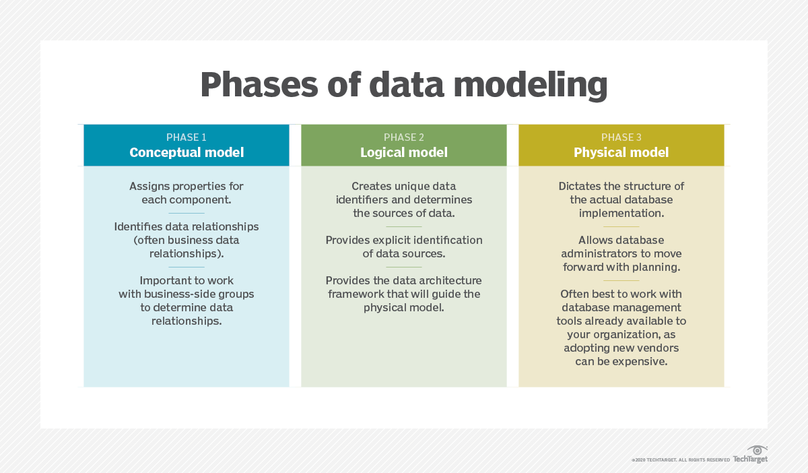

Slide 15
Imperative Programming paradigm

Slide 16
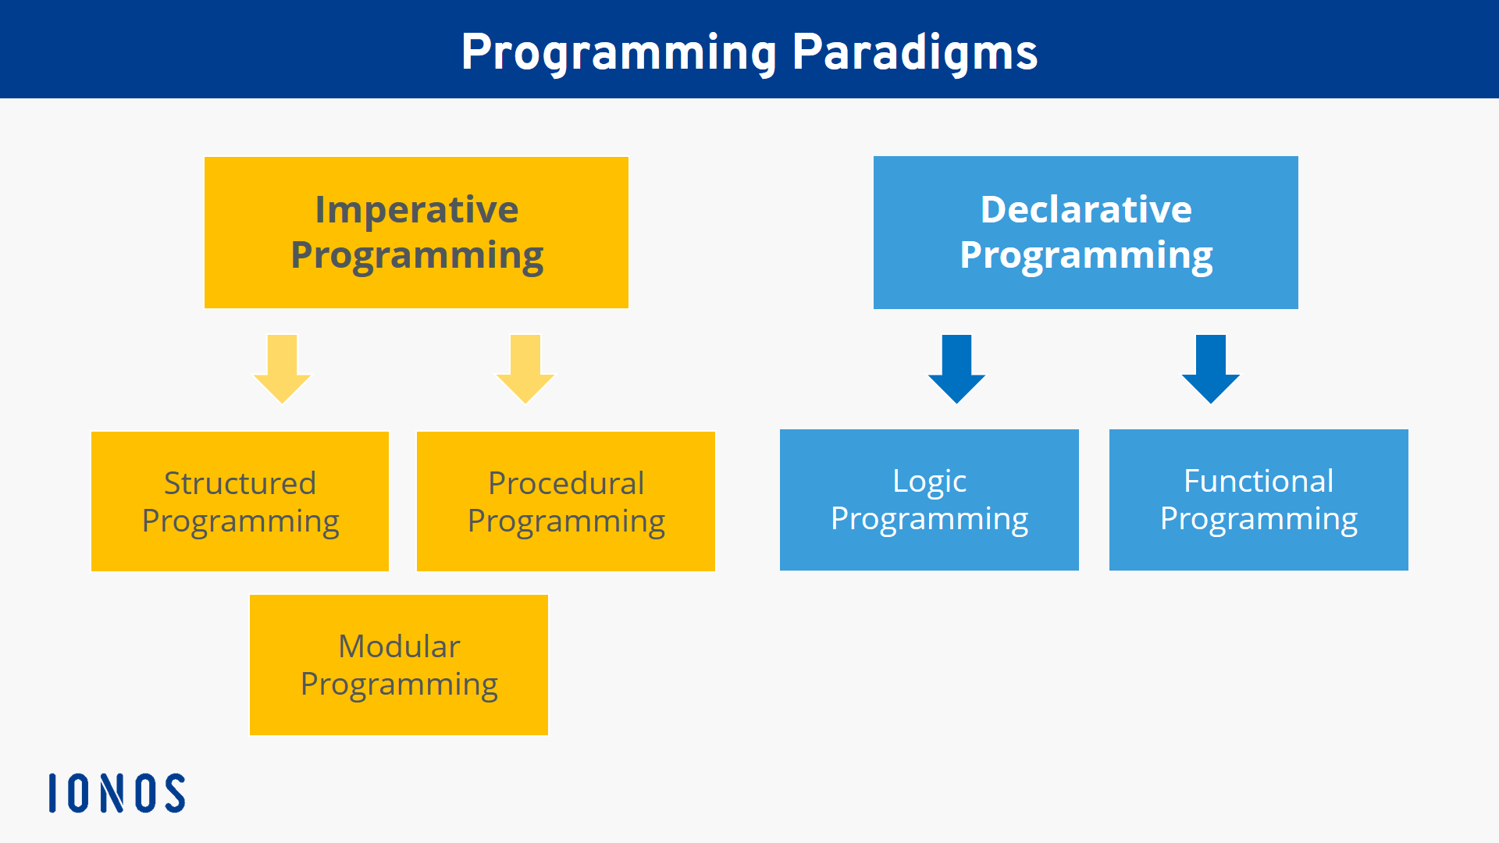

Slide 17
Imperative programming is a programming paradigm of software that uses statements that change a program's state
Structured programmig
Procedural programming

Slide 18
These are the best-known imperative programming languages:
Fortran
Java
Pascal
ALGOL
C
C#
C++
Assembler
BASIC
COBOL
Python
Ruby

