Slide 1


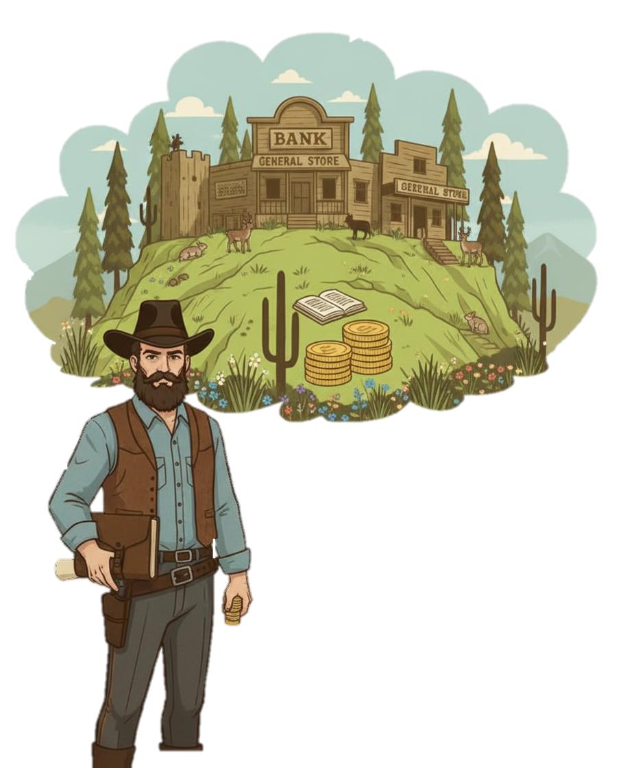


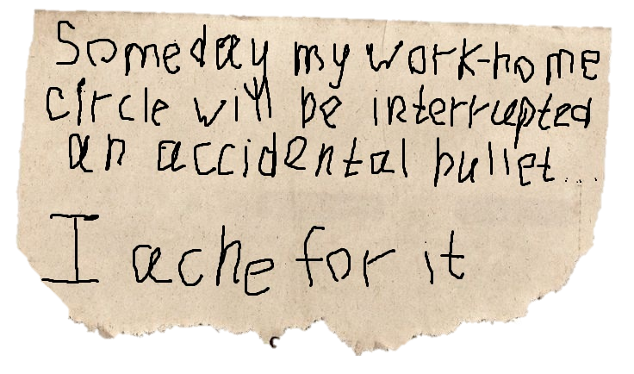
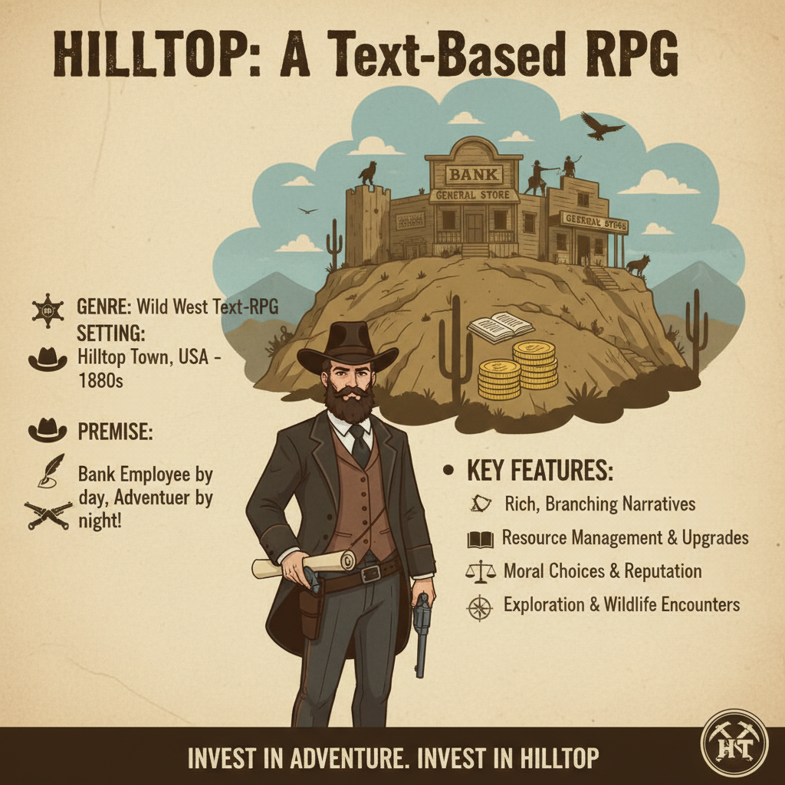
HILLTOP
A text-based western RPG
WHO YOU ARE
Bank clerk
Not a hero. No skills.
Only your choices.
WHERE IT HAPPENS
Lost town of HillTop
Lake • Prairies • Forests
"Where shepherds never go alone"
HOW TO SURVIVE
Duels are on you
No stats.
Just YOUR reaction.
QTE: Fast = shot.
Slow = dead.
WHAT YOU DO
Explore • Talk • Choose
Saloon • Bank • Sheriff
Every talk can lead to conflict
WildZaklinie • PC (C++) • Text RPG • Western

