Slide 1
Compare
Name | Dharini Baskaran
Identity Key | dhba5060
 | Level | Completed
 | Beginner | 9
 | Intermediate | 6
 | Advanced | 1
 | Expert | 0
Goal
4722 | 13
5722 | 15
Total Completed
0

Slide 2
Compare
CSCI 5722/4722: Computer Vision
Spring 2024
Dr. Tom Yeh
Dr. Mehdi Moghari

Slide 3
Compare Pixels

Slide 4
Q: Which looks like X the most? A or B?
X
A
B
2 | 1 | 0
0 | 1 | 3
-3 | 1 | 2
2 | 1 | 3
0 | 1 | 3
4 | 1 | -2
1 | 1 | 0
2 | 1 | 4
-2 | 1 | 3

Slide 5
Count Different Pixels
{ distance | similarity }
X
A
X != A
∑
{ min | max }
2 | 1 | 0
0 | 1 | 3
-3 | 1 | 2
2 | 1 | 0
0 | 1 | 3
4 | 1 | -2
B
X != B
1 | 1 | 0
2 | 1 | 4
-2 | 1 | 3

Slide 6
L1
{ distance | similarity }
a.k.a. ___________________
X
A
|X – A|
∑
{ min | max }
2 | 1 | 0
0 | 1 | 3
-3 | 1 | 2
2 | 1 | 0
0 | 1 | 3
4 | 1 | -2
B
|X – B|
1 | 1 | 0
2 | 1 | 4
-2 | 1 | 3

Slide 7


L1 Distance
X
A
|X – A|
∑
{ min | max }
0 | 1 | 2
1 | 1 | 3
3 | 0 | 2
2 | 1 | 0
0 | 1 | 3
4 | 1 | -2
a
B
|X – B|
1 | 1 | 0
2 | 1 | 4
-2 | 1 | 3
b
🔑 a + b = 23

Slide 8

L2
{ distance | similarity }
a.k.a. ___________________
X
A
(X – A)²
∑
{ min | max }
2 | 1 | 0
0 | 1 | 3
-3 | 1 | 2
2 | 1 | 0
0 | 1 | 3
4 | 1 | -2
B
(X – B)²
1 | 1 | 0
2 | 1 | 4
-2 | 1 | 3

Slide 9



L2 Distance
X
A
(X – A)²
∑
{ min | max }
0 | 1 | 2
1 | 1 | 3
3 | 0 | 2
2 | 1 | 0
0 | 1 | 3
4 | 1 | 0
a
B
(X – B)²
1 | 1 | 0
2 | 1 | 4
2 | 1 | 3
b
🔑 a + b = 25

Slide 10
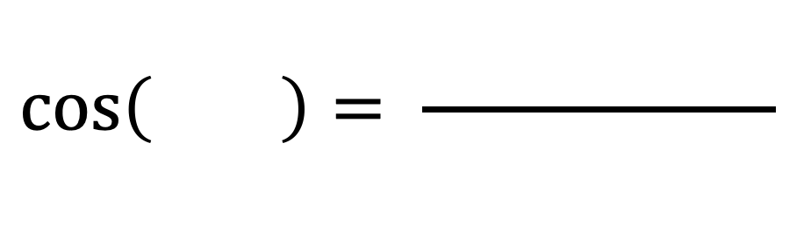
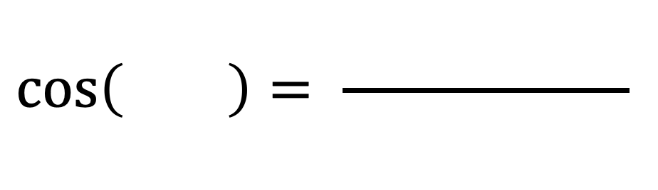
Cosine
$$\cos\left( \right)= \frac{ }{ }$$
$$\cos\left( \right)= \frac{ }{ }$$

Slide 11


Cosine
{ distance | similarity }
{ min | max }
X
A
X .* A
∑
A .* A
2 | 1 | 0
0 | 1 | 3
-3 | 1 | 2
2 | 1 | 0
0 | 1 | 3
4 | 1 | -2
∑
B
X .* B
∑
B .* B
1 | 1 | 0
2 | 1 | 4
-2 | 1 | 3
∑

Slide 12


Cosine Similarity
X
A
X .* A
∑
A .* A
a
0 | 1 | 1
2 | 0 | 2
2 | 1 | 0
3 | 0 | 3
3 | 0 | 0
0 | 0 | 3
b
∑
B
X .* B
∑
B .* B
c
0 | 2 | 0
2 | 0 | 2
2 | 0 | 3
d
∑
🔑 a+b=45; c+d=39

Slide 13
Scoreboard: Who is more like X?
Metric | A | B
Diff
L1
L2
Cosine

Slide 14
Similarity vs. Distance
 | distance | θ | cos(θ) | similar | difference
alike
not alkie

Slide 15
Compare Many Images

Slide 16
Find images similar to a query image (L1 < 3)
Time Complexity
0 | 0 | 1
7 | 1 | 1
1 | 0 | 1
0 | 1 | 0
2 | 0 | 0
0 | 1 | 2
1 | 0 | 0
0 | 1 | 0
0 | 0 | 1
0 | 1 | 0
2 | 4 | 0
9 | 1 | 2
1 | 0 | 0
0 | 1 | 0
0 | 1 | 1
1 | 0 | 0
0 | 1 | 0
0 | 0 | 1

Slide 17

Find similar images by L1 < 2
0 | 0 | 1
0 | 1 | 1
1 | 0 | 1
0 | 1 | 0
0 | 0 | 0
0 | 1 | 0
0 | 0 | 1
0 | 1 | 0
0 | 0 | 0
0 | 1 | 0
0 | 1 | 0
1 | 0 | 1
1 | 0 | 1
0 | 1 | 0
1 | 0 | 0
0 | 0 | 1
0 | 1 | 0
1 | 0 | 0
a
b
c
d
e
🔑 a+b+c+d+e = 12

Slide 18
Find images similar to a query image (cosine)
0 | 0 | 1
7 | 1 | 1
1 | 0 | 1
0 | 1 | 0
2 | 0 | 0
0 | 1 | 2
1 | 0 | 0
0 | 1 | 0
0 | 0 | 1
0 | 1 | 0
2 | 4 | 0
9 | 1 | 2
0 | 1 | 0
0 | 3 | 0
1 | 1 | 2
1 | 0 | 0
0 | 1 | 0
0 | 1 | 1
……..
1 | 0 | 0
0 | 1 | 0
0 | 0 | 1

Slide 19
Cosine similarity for many images via Matrix Multiplication
Q
1
0
0
0
1
0
0
0
1
K₁^{T}
K₂^{T}
K₃^{T}
K₄^{T}
K₅^{T}
0 | 0 | 1 | 7 | 1 | 1 | 1 | 0 | 1
0 | 1 | 0 | 2 | 0 | 0 | 0 | 1 | 2
1 | 0 | 0 | 0 | 1 | 0 | 0 | 0 | 1
0 | 1 | 0 | 0 | 3 | 0 | 1 | 1 | 2
1 | 0 | 0 | 0 | 1 | 0 | 0 | 1 | 1

Slide 20
Calculate
Q
1
0
0
0
1
0
0
0
1
K₁^{T}
K₂^{T}
K₃^{T}
K₄^{T}
K₅^{T}
0 | 0 | 1 | 7 | 1 | 1 | 1 | 0 | 1
0 | 1 | 0 | 2 | 0 | 0 | 0 | 1 | 2
1 | 0 | 0 | 0 | 1 | 0 | 0 | 0 | 1
0 | 1 | 0 | 0 | 3 | 0 | 1 | 1 | 2
1 | 0 | 0 | 0 | 1 | 0 | 0 | 1 | 1

Slide 21
Time Complexity

Slide 22
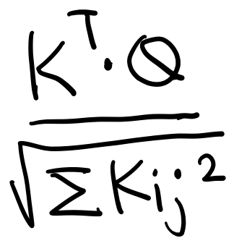







Is Q more similar to K1 or to K2? (cosine)
Q
0 | 1 | 0
1 | 1 | 0
0 | 1 | 0
Q
Answer:________
K₁
K₂
4 | 1 | 1
0 | 2 | 1
0 | 1 | 1
2 | 0 | 0
0 | 2 | 0
0 | 1 | 0
🔑 a+b=7; c+d=8
Flatten by row major, c-style
K₁^{T}
K₂^{T}
a
c
b
d

Slide 23
Compare Many by Features

Slide 24
Find Similar Images in the Feature Space
0 | 0 | 1
7 | 1 | 1
1 | 0 | 1
0 | 1 | 0
2 | 0 | 0
0 | 1 | 2
1 | 0 | 0
0 | 1 | 0
0 | 0 | 1
0 | 1 | 0
0 | 3 | 0
1 | 1 | 2
1 | 0 | 0
0 | 1 | 0
0 | 1 | 1
1 | 0 | 0
0 | 1 | 0
0 | 0 | 1

Slide 25
L1
Time Complexity

Slide 26
Cosine

Slide 27
Compare Moments

Slide 28
Image and Image Moments (M)
 |  |  |  |  |  |  |  |  |  | 1
 |  |  |  |  |  |  |  |  |  | 1
 |  |  |  |  |  |  |  |  | 1 | 1 | 1
 |  |  |  |  |  |  |  | 1 |  |  |  | 1
 |  |  |  |  |  |  | 1 |  |  |  |  |  | 1
 |  |  |  |  |  | 1 | 1 |  |  |  |  |  |  | 1
 |  |  |  |  |  |  | 1 | 1 | 1 | 1 | 1 | 1 | 1
 |  |  |  |  |  |  | 1 | 1 |  | 1 |  | 1 | 1
 |  |  |  |  |  |  | 1 | 1 | 1 | 1 | 1 | 1 | 1
 |  |  |  |  |  |  | 1 | 1 | 1 | 1 | 1 | 1 | 1
 |  |  |  |  |  |  | 1 | 1 | 1 | 1 | 1 | 1 | 1

Slide 29
Math

Slide 30
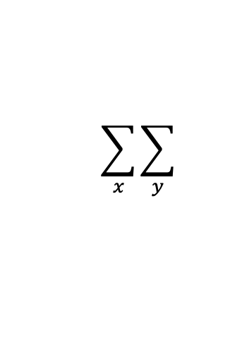
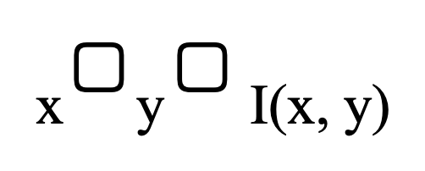
M₀₀
I(x, y)
x ▢ y ▢ I(x, y)
$$\sum_{x}{\sum_{y}{}}$$
Y
4
3
2
1
1 | 1 | 1 | 1
1 | 1 | 1 | 1
Ex. 1
1 | 2 | 3 | 4
X
Y
4
3
2
1
 |  |  | 1
1 | 1 | 1
 |  | 1
 |  |  | 1
Ex. 2
1 | 2 | 3 | 4
X

Slide 31
M₁₀
I(x, y)
x ▢ y ▢ I(x, y)
$$\sum_{x}{\sum_{y}{}}$$
Y
4
3
2
1
1 | 1 | 1 | 1
1 | 1 | 1 | 1
Ex. 1
1 | 2 | 3 | 4
X
Y
4
3
2
1
 |  |  | 1
1 | 1 | 1
 |  | 1
 |  |  | 1
Ex. 2
1 | 2 | 3 | 4
X

Slide 32
M₀₁
I(x, y)
x ▢ y ▢ I(x, y)
$$\sum_{x}{\sum_{y}{}}$$
Y
4
3
2
1
1 | 1 | 1 | 1
1 | 1 | 1 | 1
Ex. 1
1 | 2 | 3 | 4
X
Y
4
3
2
1
 |  |  | 1
1 | 1 | 1
 |  | 1
 |  |  | 1
Ex. 2
1 | 2 | 3 | 4
X

Slide 33
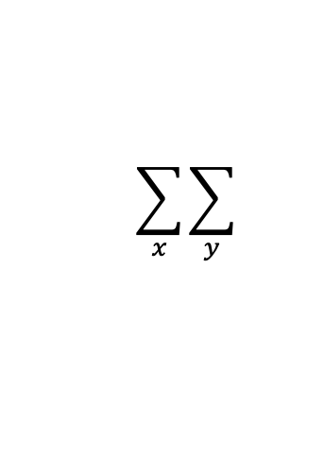
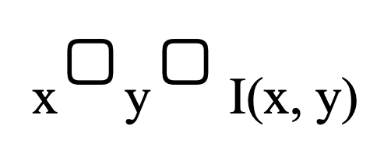
M₂₁
x ▢ y ▢ I(x, y)
$$\sum_{x}{\sum_{y}{}}$$
I(x, y)
Y
4
3
2
1
 |  | 1
1
1 | 1
 |  |  | 1
1 | 2 | 3 | 4
X

Slide 34

M₂₀
x ▢ y ▢ I(x, y)
$$\sum_{x}{\sum_{y}{}}$$
I(x, y)
Y
b
4
3
2
1
 |  | 1
1
1 | 1
 |  |  | 1
a
1 | 2 | 3 | 4
X
🔑 a + b = 40

Slide 35

M₁₂
x ▢ y ▢ I(x, y)
$$\sum_{x}{\sum_{y}{}}$$
I(x, y)
Y
b
4
3
2
1
 |  | 1
1
1 | 1
 |  |  | 1
a
1 | 2 | 3 | 4
X
🔑 a - b = 25

Slide 36
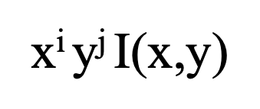
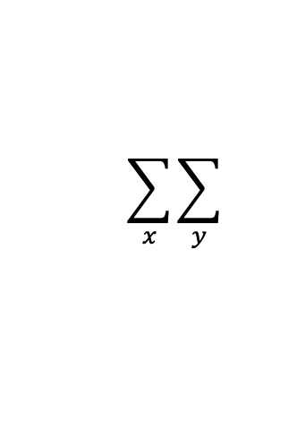
M_{2x2}
x^{i} y^{j} I(x,y)
$$\sum_{x}{\sum_{y}{}}$$
X
j = 0
j = 1
j = 0
j = 1
I(x, y)
i = 0
i = 0
Y
4
3
2
1
1
 | 1
1 |  |  | 1
i = 1
M(X)
1 | 2 | 3 | 4
X
i = 1

Slide 37



M_{2x2}
x^{i} y^{j} I(x,y)
$$\sum_{x}{\sum_{y}{}}$$
A
j = 0
j = 1
j = 0
j = 1
I(x, y)
a
b
i = 0
i = 0
Y
4
3
2
1
 | 1
1
1
 | 1 |  | 1
i = 1
c
d
M(A)
1 | 2 | 3 | 4
X
i = 1
🔑 a + b + c + d = 45

Slide 38


M_{2x2}
x^{i} y^{j} I(x,y)
$$\sum_{x}{\sum_{y}{}}$$
B
j = 0
j = 1
j = 0
j = 1
I(x, y)
a
b
i = 0
i = 0
Y
4
3
2
1
 | 1
1 |  |  | 1
 | 1 | 1
i = 1
c
d
M(B)
1 | 2 | 3 | 4
X
i = 1
🔑 a + b + c + d = 50

Slide 39

Compare X to A and B by L1 of their 2x2 Moments
M(X)
M(A)
|M(X) – M(A)|
∑
argmin
a
You must solve the previous two activities to calculate M(A) and M(B) before you can solve this.
M(B)
|M(X) – M(B)|
b
🔑 a + b = 27
Notes:
12+17= 29. Linkedin post said people getting 29

Slide 40
Compare Distributions

Slide 41
Pixels → Histograms → Distributions
1 | 1 | 3 | 3
1 | 1 | 3 | 3
2 | 2 | 4 | 4
2 | 2 | 4 | 4
2 | 2 | 2 | 2
2 | 2 | 3 | 3
2 | 2 | 3 | 3
4 | 4 | 4 | 4
2 | 3 | 3 | 3
2 | 3 | 3 | 3
2 | 2 | 2 | 3
2 | 2 | 2 | 3
4 | 4 | 4 | 4
4 | 4 | 4 | 4
4 | 4 | 4 | 4
4 | 4 | 4 | 4
X₁
X₂
X₃
X₄
H₁ | H₂ | H₃ | H₄
1
2
3
4
P₁ | P₂ | P₃ | P₄

Slide 42
How do we compare distributions?
P₁ | P₂ | P₃ | P₄
0.25 | 0 | 0 | 0
0.25 | 0.5 | 0.5 | 0
0.25 | 0.25 | 0.5 | 0
0.25 | 0.25 | 0 | 1

Slide 43
Cross-Entropy: Definition
Cross-Entropy is a measure of the
{ similarity | difference } between two
{ probability distributions | log likelihoods } for a given random variable or set of events

Slide 44
Entropy
P₁ | P₂ | P₃ | P₄
0.25 | 0 | 0 | 0
0.25 | 0.5 | 0.5 | 0
0.25 | 0.25 | 0.5 | 0
0.25 | 0.25 | 0 | 1
X | log₂^{X}
1 | 0
0.5 | -1
0.25 | -2
0.125 | -3
2⁻³² | -32
0 | NaN

Slide 45




Compute Entropy
P₁ | P₂
0.25 | 0.125
0.5 | 0.5
0 | 0.25
0.25 | 0.125
X | log₂^{X}
1 | 0
0.5 | -1
0.25 | -2
0.125 | -3
2⁻³² | -32
0 | NaN
- log₂^{P}
- P log₂^{P}
a
b
c
d
- Σ P log₂^{P}
🔑 a + b + c + d = 7.5

Slide 46
Cross Entropy
Q₁ | Q₂ | Q₃ | Q₄
0.25 | 0 | 0 | 0
0.25 | 0.5 | 0.5 | 0
0.25 | 0.25 | 0.5 | 0
0.25 | 0.25 | 0 | 1
X | log₂^{X}
1 | 0
0.5 | -1
0.25 | -2
0.125 | -3
2⁻³² | -32
0 | NaN
P
0.25
0.25
0.25
0.25

Slide 47
Matrix Multiplication Form
Q₁ | Q₂ | Q₃ | Q₄
0.25 | 0 | 0 | 0
0.25 | 0.5 | 0.5 | 0
0.25 | 0.25 | 0.5 | 0
0.25 | 0.25 | 0 | 1
2 | 32 | 32 | 32
2 | 1 | 1 | 32
2 | 2 | 1 | 32
2 | 2 | 32 | 0
P^{T}
0.25 | 0.25 | 0.25 | 0.25
2 | 9.25 | 16.5 | 24

Slide 48


Find Q most similar to P by Cross Entropy
Q₁ | Q₂ | Q₃ | Q₄
X | log₂^{X}
1 | 0
0.5 | -1
0.25 | -2
0.125 | -3
2⁻³² | -32
0 | NaN
0.25 | 0.25 | 0.5 | 2⁻³²
0.25 | 0.5 | 2⁻³² | 1
2⁻³² | 0.25 | 0.5 | 2⁻³²
0.5 | 2⁻³² | 2⁻³² | 2⁻³²
- log₂^{Q}
P^{T}
0 | 0.5 | 0.5 | 0
- Σ P log₂^{Q}
a
b
c
d
🔑 a+b = 18.5; c+d =32.5
argmin

Slide 49
NumPy by Hand ✍️ Rearranging

Slide 50
Transpose (1D)
I
0 | 1 | 2 | 3 | 4 | 5
a
a = np.transpose(I)

Slide 51
Transpose (2D)
I
0 | 1 | 2
3 | 4 | 5
a = np.transpose(I)
a

Slide 52
Reshape 1D → 2D
I
7 | 3 | 2 | 8 | 9 | 4
a = np.reshape(I,(3,2))
b = np.reshape(I,(2,3))
c = np.reshape(I,(2,2))

Slide 53

Reshape 2D → 2D
I
7 | 3 | 2 | 8
2 | 1 | 0 | 4
3 | 4 | 9 | 2
a = np.reshape(I,(4,2))
b = np.reshape(I,(2,6))
c = np.reshape(I,(6,-1))

Slide 54
Flatten
I
7 | 3 | 2
2 | 1 | 0
a = np.flatten(I)
b = a.copy()

Slide 55
Ravel
I
7 | 3 | 2
2 | 1 | 0
a = np.ravel(I)
b = a.copy()

Slide 56

Execute by ✍️
I
8 | 3 | 2
0 | 1 | 4
3 | 4 | 7
9 | 2 | -1
X = np.transpose(I)
Y = np.reshape(X, (2,-1))
(Draw the shapes of X and Y, and fill in their values)
X
Y

Slide 57
NumPy by Hand ✍️ Shifting

Slide 58
Negative indexing
I
5 | 7 | 1 | 4 | 3 | 8
a = I[:]
b = I[:-1]
c = I[:-2]

Slide 59
Shift Right by 1
I
5 | 7 | 1 | 4 | 3 | 8
a = np.zeros(6)
b = I[:-1]
a[1:] = b

Slide 60
Shift Right by 2
I
5 | 7 | 1 | 4 | 3 | 8
a = np.zeros(6)
b = I[:-2]
a[2:] = b

Slide 61
Shift Left by 1
I
5 | 7 | 1 | 4 | 3 | 8
a = np.zeros(6)
b = I[1:]
a[:-1] = b

Slide 62
Shift Left by 2
I
5 | 7 | 1 | 4 | 3 | 8
a = np.zeros(6)
b = I[2:]
a[:-2] = b

Slide 63

Shift
I
5 | 7 | 9 | 6 | 1 | 4 | 3 | 8
a = np.zeros(6)
a[:-3] = I[3:]
b[3:] = I[:-3]
a
What are the values of a and b?
b

Slide 64
Roll (right)
I
5 | 7 | 1 | 4 | 3 | 8
a = np.roll(I,1)
b = np.roll(I,2)

Slide 65
Roll (left)
I
5 | 7 | 1 | 4 | 3 | 8
a = np.roll(I,-1)
b = np.roll(I,-2)

Slide 66

Roll
I
1 | 2 | 4 | 5 | 7 | 9 | 4 | 3 | 8
7 | 9 | 4 | 3 | 8 | 1 | 2 | 4 | 5
a
X
X = np.roll(I,+____)
or
X = np.roll(I,-____)
b
Complete the code by filling in the blanks.
🔑 a + b = 1

Slide 67


Execute by ✍️
I
5 | 7
1 | 4
3 | 8
a = np.flatten(I)
b = np.roll(I,-2)
c = np.reshape((3,-1))
What is the effect?
Roll columns left by 1
Roll columns right by 1
Roll rows up by 1
Roll rows down by 1
Answer: _________

