Slide 1
GAN
Name | Dharini Baskaran
Identity Key | dhba5060
 | Level | Completed
 | Beginner | 0
 | Intermediate | 0
 | Advanced | 0
 | Expert | 0
Goal
4722 | 15
5722 | 17
Total Completed
0

Slide 2
Generative Adversarial Network (GAN)
CSCI 5722/4722: Computer Vision
Spring 2024
Dr. Tom Yeh
Dr. Mehdi Moghari

Slide 3
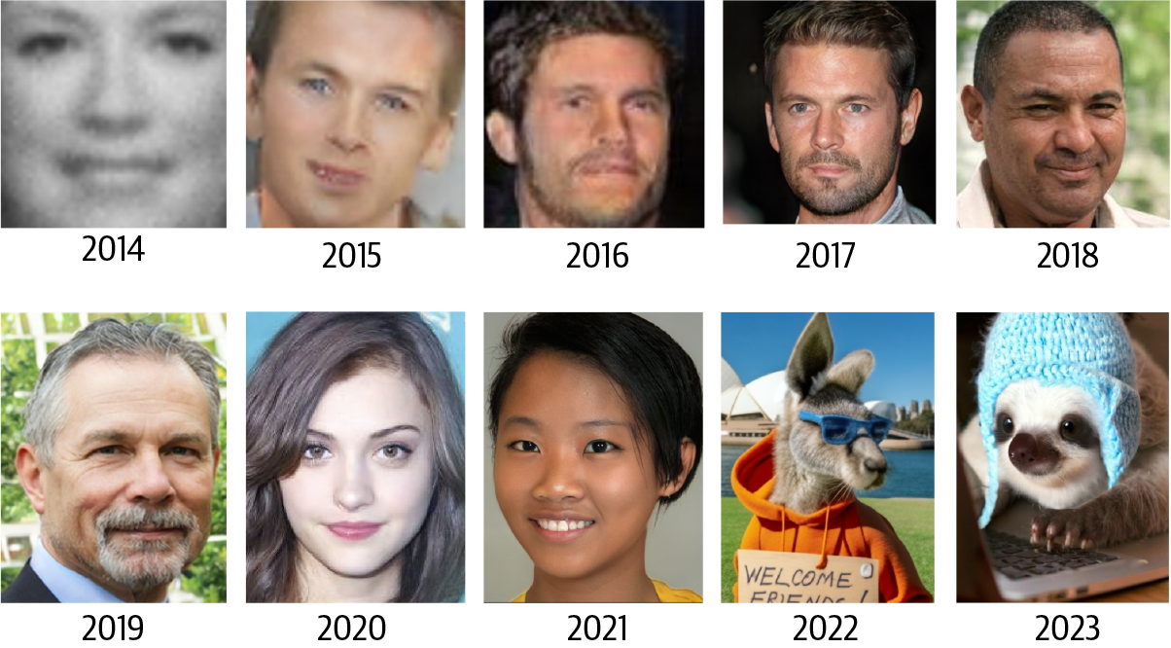
https://www.oreilly.com/library/view/generative-deep-learning/9781098134174/ch01.html

Slide 4
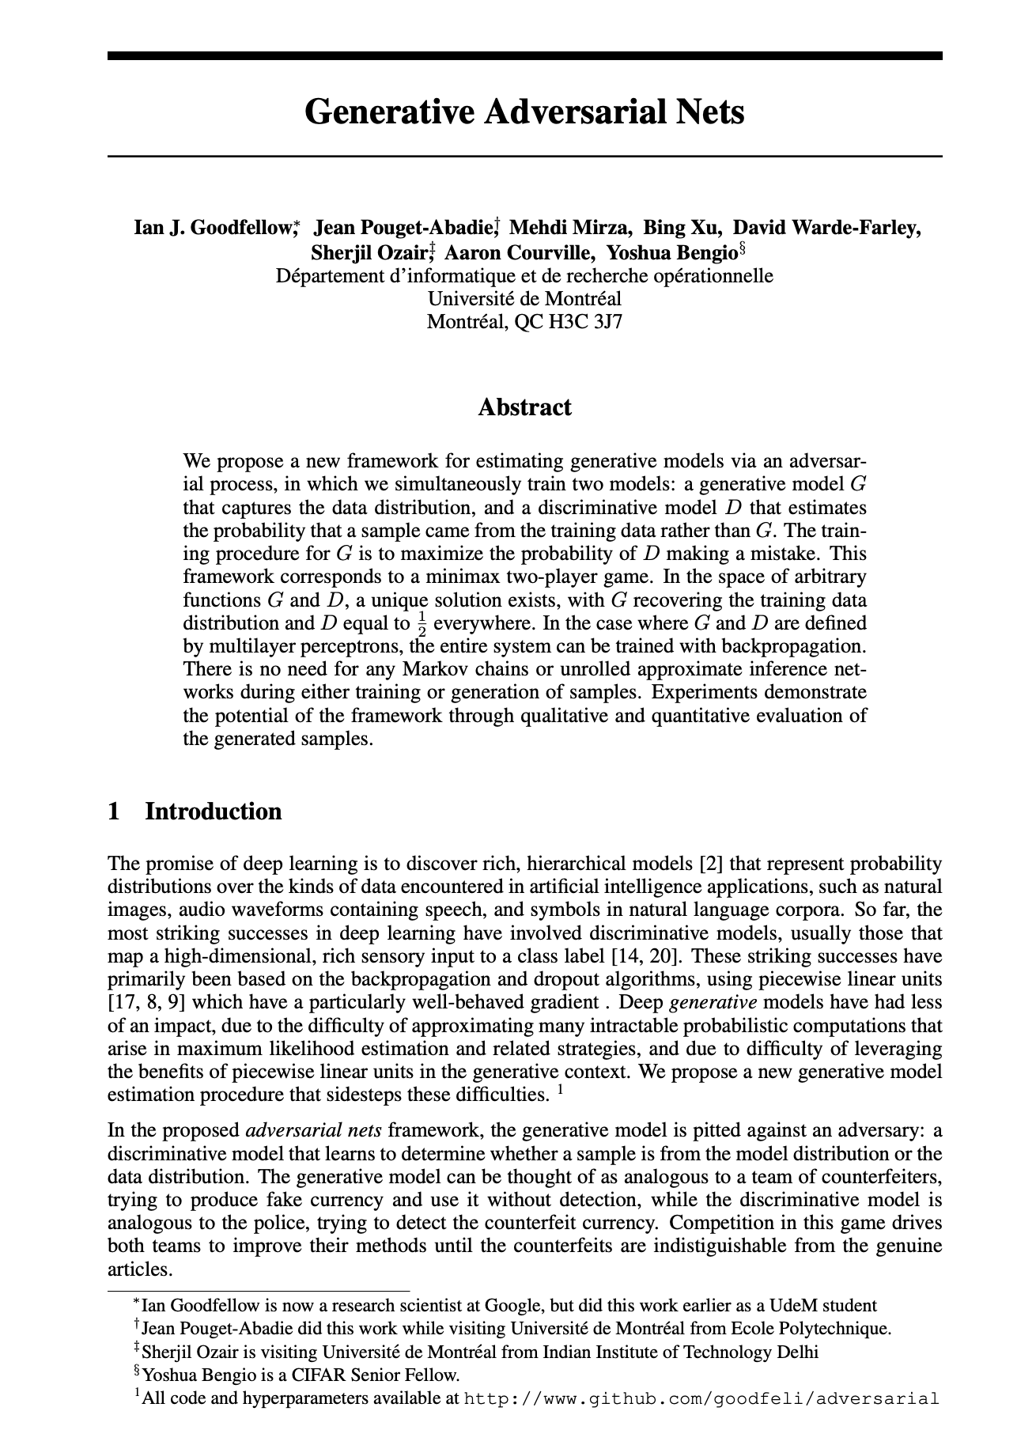

Slide 5

Share your AI-generated image of an ANN
https://www.linkedin.com/feed/update/urn:li:activity:7160617831787548672
Visit the link above
Add a comment
Attach your image

Slide 6
GAN Architecture

Slide 7
Architecture Diagram

Slide 8
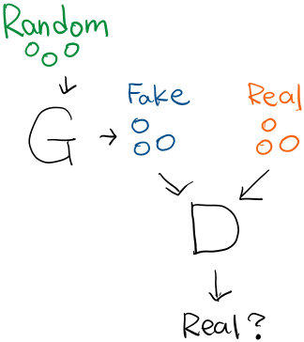
Diagram → ANN
Random
1 | 1 | -1
1 | -1 | 1
1 | 1 | 1
Real
Fake
1 | 0 | -2
0 | 2 | 1
-1 | -1 | -3
3 | -1 | 3
0 | 0 | -1
3 | -1 | 1
1 | 1 | 1
1 | 1 | 1
1 | 0 | 1
0 | 1 | 1
1 | 1 | 1
1 | 1 | 1
1 | 1 | -3
Pred
.3 | .2 | .4
.5 | .3 | .7

Slide 9
Generator

Slide 10
Generator
-3 | -2 | -1 | 0 | 1 | 2 | 3
1 | 1 | -1
1 | -1 | 1
3
2
1
0
-1
-2
-3
1 | 1 | 1
1 | 0 | -2
0 | 2 | 1

Slide 11
Discriminator

Slide 12
Discriminator
A | B | C
D | E | F
-1 | -1 | -3
3 | -1 | 3
0 | 0 | -1
3 | -1 | 1
-3 | -2 | -1 | 0 | 1 | 2 | 3
3
2
1
0
-1
-2
-3
1 | 1 | 1
1 | 1 | 1
1 | 0 | 1
0 | 1 | 1
1 | 1 | 1
1 | 1 | 1
1 | 1 | -3

Slide 13
x >= 1
x >= 1
A | B | C
D | E | F
-1 | -1 | -3
3 | -1 | 3
0 | 0 | -1
3 | -1 | 1
-3 | -2 | -1 | 0 | 1 | 2 | 3
-3 | -2 | -1 | 0 | 1 | 2 | 3
3
2
1
0
-1
-2
-3
C |  | A | D
 |  | F
 |  | B | E
3
2
1
0
-1
-2
-3
C |  | A | D
 |  | F
 |  | B | E
1 | 1 | 1
1 | 1 | 1
V₁
V₂

Slide 14
y >= 1
y >= 1
A | B | C
D | E | F
-1 | -1 | -3
3 | -1 | 3
0 | 0 | -1
3 | -1 | 1
-3 | -2 | -1 | 0 | 1 | 2 | 3
-3 | -2 | -1 | 0 | 1 | 2 | 3
3
2
1
0
-1
-2
-3
C |  | A | D
 |  | F
 |  | B | E
3
2
1
0
-1
-2
-3
C |  | A | D
 |  | F
 |  | B | E
1 | 1 | 1
1 | 1 | 1
H₁
H₂

Slide 15
Activation Field (ReLU)
V: x = -1
H: y = -1
*
*
-3 | -2 | -1 | 0 | 1 | 2 | 3
-3 | -2 | -1 | 0 | 1 | 2 | 3
3
2
1
0
-1
-2
-3
3
2
1
0
-1
-2
-3
1
V
H

Slide 16

Activation Field (b = 0)
L: x+y = 0
a: ReLU(x+y)
*
*
a
b
L
-3 | -2 | -1 | 0 | 1 | 2 | 3
1
ReLU
≈
3
2
1
0
-1
-2
-3
L
1 | 1 | 0
*
?
a
c
🔑 sum(a) = 7; sum(b) = 11; sum(c) = 3
(Drag L to the right)

Slide 17
Activation Field (b = -3)
L: x+y = 3
a: ReLU(x+y-3)
*
*
-3 | -2 | -1 | 0 | 1 | 2 | 3
a
1
ReLU
≈
3
2
1
0
-1
-2
-3
L
a
1 | 1 | -3
*
?
b
🔑 sum(a) = 8 ; sum(b) = 0

Slide 18
Weighted Sum Field
L: 2*x+y = 0
*
*
a
-3 | -2 | -1 | 0 | 1 | 2 | 3
3
2
1
0
-1
-2
-3
 |  | 1 | 3 | 5
 |  | 0 | 2 | 4
-5 | -3 |  |  |  | 5 | 7
-6 | -4 |  |  |  | 4 | 6
-7 | -5 |  |  |  | 3 | 5
 |  | -4 | -2 | 0
 |  | -5 | -3 | -1
c
1
L
2 | 1 | 0
?
b
🔑 sum(a) = -10; sum(b) = 3; sum(c) = 30;

Slide 19
Activation Field (b = -2)
L: 2*x+y = 2
a: ReLU(2*x+y – 2)
*
*
a
-3 | -2 | -1 | 0 | 1 | 2 | 3
b
1
ReLU
≈
3
2
1
0
-1
-2
-3
L
a
2 | 1 | -2
*
?
d
c
🔑 sum(a) = 7; sum(b) = 22; sum(c) = 6;

Slide 20
Logit Field (b = 0)
V:
H:
*
*
-3 | -2 | -1 | 0 | 1 | 2 | 3
3
2
1
0
-1
-2
-3
1
*
*
*
*
1
1 | 1
H
V

Slide 21
Logit Field (b = -3)
V: x = -1
H: y = -1
a₁: ReLU(x+1)
a₂: ReLU(y+1)
z = a₁+a₂
*
*
-3 | -2 | -1 | 0 | 1 | 2 | 3
1
ReLU
≈
3
2
1
0
-1
-2
-3
4 | 4 | 4 | 5 | 6 | 7 | 8
3 | 3 | 3 | 4 | 5 | 6 | 7
2 | 2 | 2 | 3 | 4 | 5 | 6
1 | 1 | 1 | 2 | 3 | 4 | 5
 |  |  | 1 | 2 | 3 | 4
 |  |  | 1 | 2 | 3 | 4
 |  |  | 1 | 2 | 3 | 4
V
a₁
1 | 0 | 1
0 | 1 | 1
*
*
*
*
H
a₂
1
1 | 1
?
z
H
V

Slide 22
Logit Field (b = 0)
V: x = 1
H: y = 1
*
*
-3 | -2 | -1 | 0 | 1 | 2 | 3
a
1
ReLU
≈
3
2
1
0
-1
-2
-3
V
1 | 0 | -1
0 | 1 | -1
*
*
*
*
H
b
1
c
1 | 1 | 0
?
H
V
(Drag H, V to the right places)
🔑 sum(a) = 7; sum(b) = 3;

Slide 23

Logit Field
L₁: x+y = 2
L₂: x+y = -2
a₁: ReLU(x+y-2)
a₂: ReLU(-x-y-2)
z: a₁+a₂
a
-3 | -2 | -1 | 0 | 1 | 2 | 3
*
*
3
2
1
0
-1
-2
-3
b
1
ReLU
≈
L₁
*
*
*
*
a₁
L₂
a₂
c
d
1
1 | 1 | 0
?
z
🔑 sum(a) = 3; sum(b) = 16; sum(c) = 4

Slide 24
Logit Field
L: x+y = -1
V: x = 1
a₁: ReLU(x+y+1)
a₂: ReLU(x-1)
z: a₁+a₂
*
*
a
-3 | -2 | -1 | 0 | 1 | 2 | 3
3
2
1
0
-1
-2
-3
 |  |  |  |  | 1 | 3
b
1
ReLU
≈
L
1 | 1 | 1
1 | 0 | -1
*
*
*
*
a₁
V
a₂
c
d
1
1 | 1 | 0
?
z
🔑 sum(a) = 16; sum(b) = 30;

Slide 25
Logit Field → Output Probability Field
V: x = -1
H: y = -1
a₁: ReLU(x+1)
a₂: ReLU(y+1)
z = a₁+a₂-3
*
*
-3 | -2 | -1 | 0 | 1 | 2 | 3
1
ReLU
≈
3
2
1
0
-1
-2
-3
1 | 1 | 1 | 2 | 3 | 4 | 5
0 | 0 | 0 | 1 | 2 | 3 | 4
-1 | -1 | -1 | 0 | 1 | 2 | 3
-2 | -2 | -2 | -1 | 0 | 1 | 2
-3 | -3 | -3 | -2 | -1 | 0 | 1
-3 | -3 | -3 | -2 | -1 | 0 | 1
-3 | -3 | -3 | -2 | -1 | 0 | 1
V
a₁
1 | 0 | 1
0 | 1 | 1
*
*
*
*
H
a₂
1
1 | 1 | -3
z
H
V

Slide 26
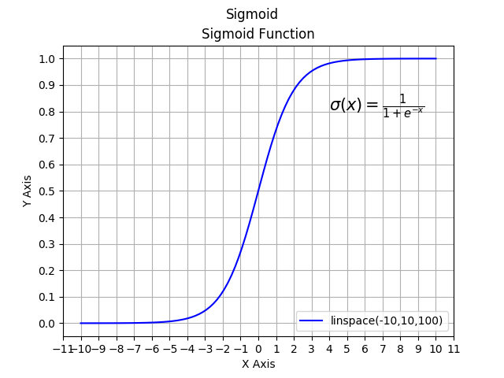
Approximate Sigmoid Function by Hand ✍️
σ(<=-3) ≈
σ(-2) ≈
σ(-1) ≈
σ(0) ≈
σ(-1) ≈
σ(-2) ≈
σ(>=3) ≈
Image Credit: Alexander | Hackaday.io

Slide 27
Output Probability Field
-3 | -2 | -1 | 0 | 1 | 2 | 3
*
*
3
2
1
0
-1
-2
-3
1 | 1 | 1 | 2 | 3 | 4 | 5
0 | 0 | 0 | 1 | 2 | 3 | 4
-1 | -1 | -1 | 0 | 1 | 2 | 3
-2 | -2 | -2 | -1 | 0 | 1 | 2
-3 | -3 | -3 | -2 | -1 | 0 | 1
-3 | -3 | -3 | -2 | -1 | 0 | 1
-3 | -3 | -3 | -2 | -1 | 0 | 1
σ(<=-3) ≈ 0
σ(-2) ≈ 0.1
σ(-1) ≈ 0.3
σ(0) ≈ 0.5
σ(-1) ≈ 0.7
σ(-2) ≈ 0.9
σ(>=3) ≈ 1
1
ReLU
≈
1 | 0 | 1
0 | 1 | 1
1
1 | 1 | -3

Slide 28
GAN
C |  | A | D
 |  | F
 |  | B | E
Noise
1 | 1 | -1
1 | -1 | 1
1 | 1 | 1
Real
Fake
A | B | C
D | E | F
1 | 0 | -2
0 | 2 | 1
-1 | -1 | -3
3 | -1 | 3
0 | 0 | -1
3 | -1 | 1
1 | 1 | 1
1 | 1 | 1
1 | 0 | 1
0 | 1 | 1
.7 | .7 | .7 | .9 | 1 | 1 | 1
.5 | .5 | .5 | .7 | .9 | 1 | 1
.3 | .3 | .3 | .5 | .7 | .9 | 1
.1 | .1 | .1 | .3 | .5 | .7 | .9
0 | 0 | 0 | .1 | .3 | .5 | .7
0 | 0 | 0 | .1 | .3 | .5 | .7
0 | 0 | 0 | .1 | .3 | .5 | .7
[ReLU]
1 | 1 | 1
1 | 1 | 1
1 | 1 | -3

Slide 29
Binary Cross Entropy (BCE) Loss

Slide 30

Categorical → Binary CE
😺 | 🐮 | 🐷 | 🐷 | 🐶
P₁ | P₂ | P₃ | P₄ | P₅
Q₁ | Q₂ | Q₃ | Q₄ | Q₅
-log(0) ≈32
-log(-1) ≈ 3
-log(0.9) ≈ 0.2
-log(1) = 0
dog
cat
cow
pig
dog
cat
cow
pig
0 | 0 | .9 | .1 | 1
0 | .9 | .1 | .9 | 0
.1 | .1 | 0 | 0 | 0
.9 | 0 | 0 | 0 | 0
dog | cat | cow | pig
P₁
P₂
P₃
P₄
P₅

Slide 31
Binary CE Loss
😺 | 🐮 | 🐷 | 🐷 | 🐶
-log(0) ≈32
-log(0.1) ≈ 3
-log(0.9) ≈ 0.2
-log(1) = 0
P₁ | P₂ | P₃ | P₄ | P₅
Q₁ | Q₂ | Q₃ | Q₄ | Q₅
dog
!dog
dog
!dog
0 | 0 | .9 | .1 | 1
dog | !dog
P₁
P₂
P₃
P₄
P₅

Slide 32
Math: BCE Loss
😺 | 🐮 | 🐷 | 🐷 | 🐶
P₁ | P₂ | P₃ | P₄ | P₅
Q₁ | Q₂ | Q₃ | Q₄ | Q₅
dog
!dog
0 | 0 | 0 | 0 | 1
dog
!dog
0 | 0 | .9 | .1 | 1
dog | !dog
P₁
P₂
P₃
P₄
P₅
0
0
0
0
1

Slide 33
BCE Loss
😺 | 🐮 | 🐷 | 🐷 | 🐶
-log(0) ≈32
-log(0.1) ≈ 3
-log(0.9) ≈ 0.2
-log(1) = 0
P₁ | P₂ | P₃ | P₄ | P₅
Q₁ | Q₂ | Q₃ | Q₄ | Q₅
pig
!pig
pig
!pig
0 | 1 | .9 | .1 | 0
pig | !pig
a
P₁
P₂
P₃
P₄
P₅
b
c
d
e
🔑 a+b+c+d+e = 35.2;

Slide 34
GAN’s Loss

Slide 35
Discriminator Loss
Fake
Real
-1 | -1 | -3
3 | -1 | 3
0 | 0 | -1
3 | -1 | 1
-log(0) ≈32
-log(0.1) ≈ 3
-log(0.3) ≈ 2
-log(0.5) ≈ 1
-log(0.7) ≈ 0.5
-log(0.9) ≈ 0.2
-log(1) = 0
P₁ | P₂ | P₃ | P₄ | P₅ | P₆
.7 | 0 | .7
.9 | .1 | .3
P₁
P₂
P₃
P₄
P₅
P₆

Slide 36
Generator Loss
Fake
Real
-1 | -1 | -3
3 | -1 | 3
0 | 0 | -1
3 | -1 | 1
-log(0) ≈32
-log(0.1) ≈ 3
-log(0.3) ≈ 2
-log(0.5) ≈ 1
-log(0.7) ≈ 0.5
-log(0.9) ≈ 0.2
-log(1) = 0
P₁ | P₂ | P₃ | P₄ | P₅ | P₆
.7 | 0 | .7
.9 | .1 | .3
P₁
P₂
P₃
P₄
P₅
P₆

Slide 37
Discriminator Loss
Fake
Real
-log(0) ≈32
-log(0.1) ≈ 3
-log(0.3) ≈ 2
-log(0.5) ≈ 1
-log(0.7) ≈ 0.5
-log(0.9) ≈ 0.2
-log(1) = 0
P₁ | P₂ | P₃ | P₄ | P₅ | P₆
D
real
!real
0 | 0 | 0 | 0 | 1 | 1
1 | 1 | 1 | 1 | 0 | 0
.3 | .7 | .5 | .3 | .1 | 1
Y
1-Y
-log
real | !real
P₁
P₂
P₃
P₄
P₅
P₆
0 | 1
0 | 1
0 | 1
0 | 1
1 | 0
1 | 0
a
b
c
d
e
f
🔑 a+b+c+d+e+f = 7;

Slide 38
Generator Loss
Fake
Real
-log(0) ≈32
-log(0.1) ≈ 3
-log(0.3) ≈ 2
-log(0.5) ≈ 1
-log(0.7) ≈ 0.5
-log(0.9) ≈ 0.2
-log(1) = 0
P₁ | P₂ | P₃ | P₄ | P₅ | P₆
D
real
!real
1 | 1 | 1 | 1 | 0 | 0
0 | 0 | 0 | 0 | 0 | 0
.3 | .7 | .5 | .3 | .1 | 1
Y
1-Y
-log
real | !real
P₁
P₂
P₃
P₄
P₅
P₆
1 | 0
1 | 0
1 | 0
1 | 0
0 | 0
0 | 0
a
b
c
d
e
f
🔑 a+b+c+d+e+f = 5.5;

Slide 39
Discriminator Loss
Fake
Real
-log(0) ≈32
-log(0.1) ≈ 3
-log(0.3) ≈ 2
-log(0.5) ≈ 1
-log(0.7) ≈ 0.5
-log(0.9) ≈ 0.2
-log(1) = 0
P₁ | P₂ | P₃ | P₄ | P₅ | P₆
D
real
!real
.3 | .1 | .5 | .9 | .1 | 0
Y
1-Y
-log
real | !real
P₁
P₂
P₃
P₄
P₅
P₆
a
b
c
d
e
f
🔑 a+b+c+d+e+f = 36.9;

Slide 40
Generator Loss
Fake
Real
-log(0) ≈32
-log(0.1) ≈ 3
-log(0.3) ≈ 2
-log(0.5) ≈ 1
-log(0.7) ≈ 0.5
-log(0.9) ≈ 0.2
-log(1) = 0
P₁ | P₂ | P₃ | P₄ | P₅ | P₆
D
real
!real
1 |  | 1 |  | 1
.3 | .1 | .5 | .9 | .1 | 0
Y
1-Y
-log
real | !real
P₁
P₂
P₃
P₄
P₅
P₆
1
1
1
a
b
c
d
e
f
🔑 a+b+c+d+e+f = 6;

Slide 41
BCE Loss Gradients

Slide 42
Update a parameter
1 | 1 | 1 | 2 | 3 | 4 | 5
0 | 0 | 0 | 1 | 2 | 3 | 4
-1 | -1 | -1 | 0 | 1 | 2 | 3
-2 | -2 | -2 | -1 | 0 | 1 | 2
-3 | -3 | -3 | -2 | -1 | 0 | 1
-3 | -3 | -3 | -2 | -1 | 0 | 1
-3 | -3 | -3 | -2 | -1 | 0 | 1
.7 | .7 | .7 | .9 | 1 | 1 | 1
.5 | .5 | .5 | .7 | .9 | 1 | 1
.3 | .3 | .3 | .5 | .7 | .9 | 1
.1 | .1 | .1 | .3 | .5 | .7 | .9
0 | 0 | 0 | .1 | .3 | .5 | .7
0 | 0 | 0 | .1 | .3 | .5 | .7
0 | 0 | 0 | .1 | .3 | .5 | .7
*
*
1
1 | 0 | 1
0 | 1 | 1
1 | 1 | -3
Fake
Real
.7 | 0 | .7 | .9 | .1 | .3

Slide 43
Discriminator Loss Gradients
σ(<=-3) ≈ 0
σ(-2) ≈ 0.1
σ(-1) ≈ 0.3
σ(0) ≈ 0.5
σ(1) ≈ 0.7
σ(2) ≈ 0.9
σ(>=3) ≈ 1
-log(0) ≈32
-log(0.1) ≈ 3
-log(0.3) ≈ 2
-log(0.5) ≈ 1
-log(0.7) ≈ 0.5
-log(0.9) ≈ 0.2
-log(1) = 0
Fake
Real
-1 | -1 | -3 | 0 | 0 | -1
3 | -1 | 3 | 3 | -1 | 1
D
1 | -3 | 1 | 2 | -2 | -1
.7 | 0 | .7 | .9 | .1 | .3
-log
Target

Slide 44
Generator Loss Gradients
σ(<=-3) ≈ 0
σ(-2) ≈ 0.1
σ(-1) ≈ 0.3
σ(0) ≈ 0.5
σ(1) ≈ 0.7
σ(2) ≈ 0.9
σ(>=3) ≈ 1
-log(0) ≈32
-log(0.1) ≈ 3
-log(0.3) ≈ 2
-log(0.5) ≈ 1
-log(0.7) ≈ 0.5
-log(0.9) ≈ 0.2
-log(1) = 0
Fake
Real
-1 | -1 | -3 | 0 | 0 | -1
3 | -1 | 3 | 3 | -1 | 1
D
1 | -3 | 1 | 2 | -2 | -1
.7 | 0 | .7 | .9 | .1 | .3
-log
Target

Slide 45
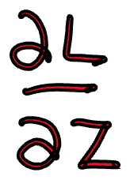
Discriminator Loss Gradients
σ(<=-3) ≈ 0
σ(-2) ≈ 0.1
σ(-1) ≈ 0.3
σ(0) ≈ 0.5
σ(1) ≈ 0.7
σ(2) ≈ 0.9
σ(>=3) ≈ 1
-log(0) ≈32
-log(0.1) ≈ 3
-log(0.3) ≈ 2
-log(0.5) ≈ 1
-log(0.7) ≈ 0.5
-log(0.9) ≈ 0.2
-log(1) = 0
Fake
Real
D
Z
-2 | 1 | 2 | 0 | -1 | 3
Pred
-log
Target
a
🔑 |sum(a)| = .5

Slide 46
Generator Loss Gradients
σ(<=-3) ≈ 0
σ(-2) ≈ 0.1
σ(-1) ≈ 0.3
σ(0) ≈ 0.5
σ(1) ≈ 0.7
σ(2) ≈ 0.9
σ(>=3) ≈ 1
-log(0) ≈32
-log(0.1) ≈ 3
-log(0.3) ≈ 2
-log(0.5) ≈ 1
-log(0.7) ≈ 0.5
-log(0.9) ≈ 0.2
-log(1) = 0
Fake
Real
D
Z
-2 | 1 | 2 | 0 | -1 | 3
Pred
-log
Target
a
🔑 |sum(a)| = 1.3

Slide 47
Adversarial Training

Slide 48
Train Discriminator
1 | 1 | -1
1 | -1 | 1
1 | 1 | 1
Real
Fake
1 | 0 | -2
0 | 2 | 1
-1 | -1 | -3
3 | -1 | 3
0 | 0 | -1
3 | -1 | 1
1 | 1 | 1
1 | 1 | 1
1 | 0 | 1
0 | 1 | 1
1 | 1 | 1
1 | 1 | 1
1 | 1 | -3
Pred
.3 | .2 | .4
.5 | .3 | .7
Target
Loss Gradients

Slide 49
Train Generator
1 | 1 | -1
1 | -1 | 1
1 | 1 | -1
1 | -1 | 1
1 | 1 | 1
Real
1 | 1 | 1
Fake
Fake
1 | 0 | -2
0 | 2 | 1
-1 | -1 | -3
3 | -1 | 3
0 | 0 | -1
3 | -1 | 1
1 | 0 | -2
0 | 2 | 1
-1 | -1 | -3
3 | -1 | 3
1 | 1 | 1
1 | 1 | 1
1 | 0 | 1
0 | 1 | 1
1.1 | 0 | 1
0 | 1 | 1
1 | 1 | 1
1 | 1 | 1
1 | 1 | 1
1 | 1 | -3
1 | 1 | -3
Pred
.3 | .2 | .4
.5 | .3 | .7
.2 | .1 | .3
Target
Loss Gradients

Slide 50
1 | 1 | -1
1 | -1 | 1
1 | 1 | -1
1 | -1 | 1
1 | 1 | -1
1 | -1 | 1
1 | 1 | 1
Real
1 | 1 | 1
1 | 1 | 1
Fake
Fake
Fake
Real
1 | 0 | -2
0 | 2 | 1
-1 | -1 | -3
3 | -1 | 3
0 | 0 | -1
3 | -1 | 1
1 | 0 | -2
0 | 2 | 1
-1 | -1 | -3
3 | -1 | 3
1 | 0 | -1
0 | 2 | 0
0 | 0 | -2
2 | -2 | 2
0 | 0 | -1
3 | -1 | 1
1 | 1 | 1
1 | 1 | 1
1 | 1 | 1
1 | 1 | 1
1 | 0 | 1
0 | 1 | 1
1.1 | 0 | 1
0 | 1 | 1
1 | 0 | 1
0 | 1 | 1
1 | 1 | 1
1 | 1 | 1
1 | 1 | 1
1 | 1 | 1
1 | 1 | 1
1 | 1 | -3
1 | 1 | -3
1 | 1 | -3
Pred
.3 | .2 | .4
.5 | .3 | .7
.2 | .1 | .3
.4 | .2 | .5
.6 | .4 | .8
Target
Loss Gradients

Slide 51
ROC Curve

Slide 52
Discriminator = Binary Classifier
1*
1 | 0 | 1
0 | 1 | 1
1*
1 | 1 | -3
Pred
.7 | .1 | .5 | .7 | .1 | .3 | .7 | 0 | 0 | .1
Target
1 | 1 | 0 | 1 | 0 | 1 | 0 | 1 | 0 | 0

Slide 53
Threshold vs. TPR / FPR
.7 | .7 | .7 | .9 | 1 | 1 | 1
.5 | .5 | .5 | .7 | .9 | 1 | 1
.3 | .3 | .3 | .5 | .7 | .9 | 1
.1 | .1 | .1 | .3 | .5 | .7 | .9
0 | 0 | 0 | .1 | .3 | .5 | .7
0 | 0 | 0 | .1 | .3 | .5 | .7
0 | 0 | 0 | .1 | .3 | .5 | .7
.7 | .7 | .7 | .9 | 1 | 1 | 1
.5 | .5 | .5 | .7 | .9 | 1 | 1
.3 | .3 | .3 | .5 | .7 | .9 | 1
.1 | .1 | .1 | .3 | .5 | .7 | .9
0 | 0 | 0 | .1 | .3 | .5 | .7
0 | 0 | 0 | .1 | .3 | .5 | .7
0 | 0 | 0 | .1 | .3 | .5 | .7
.7 | .7 | .7 | .9 | 1 | 1 | 1
.5 | .5 | .5 | .7 | .9 | 1 | 1
.3 | .3 | .3 | .5 | .7 | .9 | 1
.1 | .1 | .1 | .3 | .5 | .7 | .9
0 | 0 | 0 | .1 | .3 | .5 | .7
0 | 0 | 0 | .1 | .3 | .5 | .7
0 | 0 | 0 | .1 | .3 | .5 | .7
.7 | .7 | .7 | .9 | 1 | 1 | 1
.5 | .5 | .5 | .7 | .9 | 1 | 1
.3 | .3 | .3 | .5 | .7 | .9 | 1
.1 | .1 | .1 | .3 | .5 | .7 | .9
0 | 0 | 0 | .1 | .3 | .5 | .7
0 | 0 | 0 | .1 | .3 | .5 | .7
0 | 0 | 0 | .1 | .3 | .5 | .7
+
+
+
+
+
+
+
+
_
_
_
_
+
+
+
+
_
_
_
_
_
_
_
_
+
+
+
+
_
_
_
_
_
_
_
_
+
+
+
+

Slide 54
Threshold vs. TPR / FPR
.7 | .7 | .7 | .9 | 1 | 1 | 1
.5 | .5 | .5 | .7 | .9 | 1 | 1
.3 | .3 | .3 | .5 | .7 | .9 | 1
.1 | .1 | .1 | .3 | .5 | .7 | .9
0 | 0 | 0 | .1 | .3 | .5 | .7
0 | 0 | 0 | .1 | .3 | .5 | .7
0 | 0 | 0 | .1 | .3 | .5 | .7
.7 | .7 | .7 | .9 | 1 | 1 | 1
.5 | .5 | .5 | .7 | .9 | 1 | 1
.3 | .3 | .3 | .5 | .7 | .9 | 1
.1 | .1 | .1 | .3 | .5 | .7 | .9
0 | 0 | 0 | .1 | .3 | .5 | .7
0 | 0 | 0 | .1 | .3 | .5 | .7
0 | 0 | 0 | .1 | .3 | .5 | .7
.7 | .7 | .7 | .9 | 1 | 1 | 1
.5 | .5 | .5 | .7 | .9 | 1 | 1
.3 | .3 | .3 | .5 | .7 | .9 | 1
.1 | .1 | .1 | .3 | .5 | .7 | .9
0 | 0 | 0 | .1 | .3 | .5 | .7
0 | 0 | 0 | .1 | .3 | .5 | .7
0 | 0 | 0 | .1 | .3 | .5 | .7
.7 | .7 | .7 | .9 | 1 | 1 | 1
.5 | .5 | .5 | .7 | .9 | 1 | 1
.3 | .3 | .3 | .5 | .7 | .9 | 1
.1 | .1 | .1 | .3 | .5 | .7 | .9
0 | 0 | 0 | .1 | .3 | .5 | .7
0 | 0 | 0 | .1 | .3 | .5 | .7
0 | 0 | 0 | .1 | .3 | .5 | .7
+
+
+
+
+
+
+
+
_
_
_
_
+
+
+
+
_
_
_
_
_
_
_
_
+
+
+
+
_
_
_
_
_
_
_
_
+
+
+
+

Slide 55
>=.7
>=.5
>=.3
+
+
+
_
_
.5 | .5 | .7 | .9 | .7
.3 | .3 | .5 | .7 | .5
.1 | .1 | .3 | .5 | .3
0 | 0 | .1 | .3 | .1
0 | 0 | 0 | .1 | 0
_
_
_
_
+
.5 | .5 | .7 | .9 | .7
.3 | .3 | .5 | .7 | .5
.1 | .1 | .3 | .5 | .3
0 | 0 | .1 | .3 | .1
0 | 0 | 0 | .1 | 0
.5 | .5 | .7 | .9 | .7
.3 | .3 | .5 | .7 | .5
.1 | .1 | .3 | .5 | .3
0 | 0 | .1 | .3 | .1
0 | 0 | 0 | .1 | 0
+
+
_
_
_
+
+
+
+
+
+
_
_
_
_
_
_
a
b
c
TPR = _________
FPR = _________
TPR = _________
FPR = _________
TPR = _________
FPR = _________
d
d
f
🔑 a+b+c = 2.25; d+e+f = 1

Slide 56
Receiver Operating Characteristic (ROC) Curve

Slide 57
Area Under ROC Curve (AUC)

Slide 58
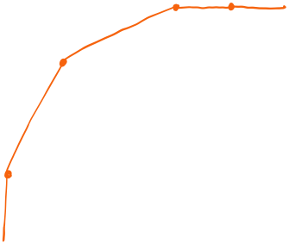
Calculate the improvement in AUC
a
Answer = _______________
🔑 a mod 7 = 3

Slide 59
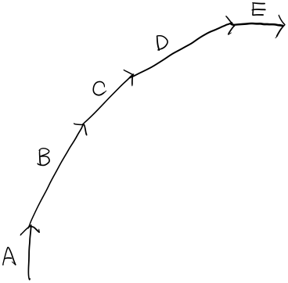
Match each movement segment to the correct interpretation of the changes in TP and FP
More true positives but at the cost of a lot more false positives.
More true positives without any new false positives.
No more true positives, just more false positives.
More true positives, but at the cost of about the same number of false positives.
More true positives at the cost of additional, but relatively fewer false positives.
TPR
FPR

Slide 60
NumPy by Hand ✍️ [Entropy]

Slide 61
Cross Entropy by @
p
q
.7 | .3
0 | .5
.3 | .1
0 | .1
g = -1 * np.log(q)
pt = np.transpose(p)
CE = pt @ g
-log(0) ≈32
-log(0.1) ≈ 3
-log(0.3) ≈ 2
-log(0.5) ≈ 1
-log(0.7) ≈ 0.5
-log(0.9) ≈ 0.2
-log(1) = 0

Slide 62
Cross Entropy by *
p
q
.7 | .3
0 | .5
.3 | .1
0 | .1
g = -1 * np.log(q)
pg = p * g
CE = np.sum(b)
-log(0) ≈32
-log(0.1) ≈ 3
-log(0.3) ≈ 2
-log(0.5) ≈ 1
-log(0.7) ≈ 0.5
-log(0.9) ≈ 0.2
-log(1) = 0

Slide 63
Categorical CE
p
q
0 | .3
1 | .5
0 | .1
0 | .1
g = -1 * np.log(q)
pt = np.transpose(p)
CE = pt @ g
-log(0) ≈32
-log(0.1) ≈ 3
-log(0.3) ≈ 2
-log(0.5) ≈ 1
-log(0.7) ≈ 0.5
-log(0.9) ≈ 0.2
-log(1) = 0

Slide 64
Categorical CE
p
q
0 | .3
1 | .5
0 | .1
0 | .1
g = -1 * np.log(q)
pg = p * g
CE = np.sum(pg)
-log(0) ≈32
-log(0.1) ≈ 3
-log(0.3) ≈ 2
-log(0.5) ≈ 1
-log(0.7) ≈ 0.5
-log(0.9) ≈ 0.2
-log(1) = 0

Slide 65
Batch Categorical CE
.3 | .1 | .1
.5 | .5 | .1
.1 | .3 | .5
.1 | .1 | .3
1 | 0 | 0
0 | 1 | 0
0 | 0 | 0
0 | 0 | 1
g = -1 * np.log(q)
pg = p * g
CE = np.sum(pq)
q
p
-log(0) ≈32
-log(0.1) ≈ 3
-log(0.3) ≈ 2
-log(0.5) ≈ 1
-log(0.7) ≈ 0.5
-log(0.9) ≈ 0.2
-log(1) = 0

Slide 66
Batch Categorical CE
.3 | .1 | .1
.5 | .5 | .1
.1 | .3 | .5
.1 | .1 | .3
0 | 1 | 3
q1 = q[c, [0,1,2]]
g = np.log(q1)
CE = np.sum(g)
q
c
-log(0) ≈32
-log(0.1) ≈ 3
-log(0.3) ≈ 2
-log(0.5) ≈ 1
-log(0.7) ≈ 0.5
-log(0.9) ≈ 0.2
-log(1) = 0

Slide 67
Binary Cross Entropy
y
.7
1
q = np.vstack((y, 1 – y))
p = np.vstack((t, 1-t))
g = -np.log(q)
pg = p * g
CE = np.sum(pg)
t
-log(0) ≈32
-log(0.1) ≈ 3
-log(0.3) ≈ 2
-log(0.5) ≈ 1
-log(0.7) ≈ 0.5
-log(0.9) ≈ 0.2
-log(1) = 0

Slide 68
Batch BCE
y
.7 | .3 | .9
1 | 0 | 1
q = np.vstack((y, 1 – y))
p = np.vstack((t, 1-t))
g = -np.log(q)
pg = p * g
CE = np.sum(pg)
t
-log(0) ≈32
-log(0.1) ≈ 3
-log(0.3) ≈ 2
-log(0.5) ≈ 1
-log(0.7) ≈ 0.5
-log(0.9) ≈ 0.2
-log(1) = 0

Slide 69
BCE
y
.3 | .1 | .7 | .9 | 0 | 1
1 | 0 | 0 | 0 | 1 | 1
t
q = np.vstack((y, 1 – y))
p = np.vstack((t, 1-t))
g = -np.log(q)
pg = p * g
CE = np.sum(pg)
q
p
g
-log(0) ≈32
-log(0.1) ≈ 3
-log(0.3) ≈ 2
-log(0.5) ≈ 1
-log(0.7) ≈ 0.5
-log(0.9) ≈ 0.2
-log(1) = 0
pg
Show your work
CE
🔑 CE * 10 % 7 = 3

