Slide 1
Integrated Public TransportATION System
Team Members:
Surya Rajendran
Dharini Baskaran

Slide 2
Presentation Outlines:
Project Goal
Components
Architecture Diagram
Debugging and Testing
Learning and what to do differently?

Slide 3
Components:
SQL Database - Postgres
Key-value store - Dynamo DB
Containers
Docker
Messaging Queue - Redis
Cache - Redis

Slide 4
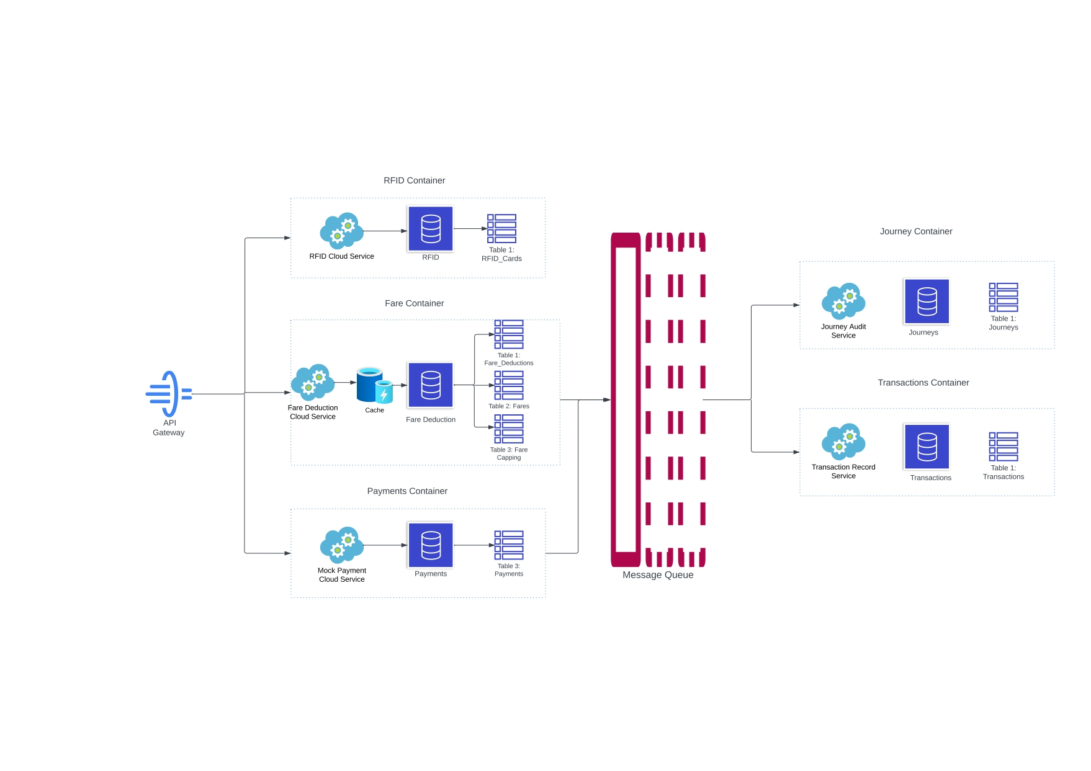
Architecture Diagram:

Slide 5
Debugging and Testing
Used Redis MQ for logging mechanism Asynchronous. Live.
Used Postman for load testing Changed our postgres DB connection method.

Slide 6
Learning and Future Scope:
How to modularize in containers
How to use Redis MQ efficiently
REST-API First Approach
Kubernetes for container orchestration
Frontend for payment
Ride suggestions
Fare deduction based on user type - first responders, senior citizens, students, …

Slide 7
Thank You

