Slide 1


INDIRA GANDHI INSTITUTE OF TECHNOLOGY , SARANG
Skill Project on
“Stock Price Prediction Using
Long Short Term Memory”
Submitted To:-
Dr. Srinivas Sethi
Professor
IGIT, Sarang Kumari Nirupa
Submitted By:-
Priyansu P. Bhoi
Binay Prasad
Saswat Sabaro
Alok Kumar Sahoo
Kumari Nirupa Lenka

Slide 2
OVERVIEW
ABSTRACT
INTRODUCTION
PROPOSED SYSTEM
LSTM : AN OVERVIEW
ARCHITECTURE SYSTEM DESIGN
ARCHITECTURE DATA FLOW DIAGRAM
STOCK PREDICTION ALGORITHMS
TERMINOLOGIES USED
IMPLEMENTATION ALGORITHM
RESULTS & DISCUSSIONS
CONCLUSION

Slide 3
ABSTRACT
The future is unknown and uncertain, but there are ways to predict future events and reap the rewards safely. One such opportunity is the application of machine learning and data science for stock market prediction. Therefore, through this medium of skill project we intend to prognosticate the next state of future prices through a Long Short Term Memory (LSTM) method. Predicting stock market prices is a complex task that traditionally involves extensive human-computer interaction. Due to the correlated nature of stock prices, conventional batch processing methods cannot be utilized efficiently for stock market analysis. We propose an online learning algorithm that utilizes a kind of recurrent neural network (RNN) called Long Short Term Memory (LSTM), where the weights are adjusted for individual data points using stochastic gradient descent. This will provide more accurate results when compared to existing stock price prediction algorithms. The network is trained and evaluated for accuracy with various sizes of data, and the results are tabulated. A comparison with respect to accuracy is then performed against an Artificial Neural Network.
Key Words: stock prediction, Long Short Term Memory, Recurrent Neural Network, online learning, stochastic gradient descent.

Slide 4
INTRODUCTION :
The stock market is a vast array of investors and traders who buy and sell stock, pushing the price up or down. The prices of stocks are governed by the principles of demand and supply, and the ultimate goal of buying shares is to make money by buying stocks in companies whose perceived value (i.e., share price) is expected to rise. Stock markets are closely linked with the world of economics —the rise and fall of share prices can be traced back to some Key Performance Indicators (KPI's). The five most commonly used KPI's are the opening stock price (`Open'), end-of-day price (`Close'), intraday low price (`Low'), intra-day peak price (`High'), and total volume of stocks traded during the day (`Volume'). Due to the sheer volume of money involved and number of transactions that take place every minute, there comes a trade-off between the accuracy and the volume of predictions made; as such, most stock prediction systems are implemented in a distributed, parallelized fashion. These are some of the considerations and challenges faced in stock market analysis.

Slide 5
PROPOSED SYSTEM:
We propose an online learning algorithm for analysing and predicting
What was the change in price of the stock overtime?
What was the daily return of the stock on average?
What was the moving average of the various stocks?
What was the correlation between different stocks?
How much value do we put at risk by investing in a particular stock?
How can we attempt to predict future stock behaviour? (Predicting the closing price stock price of APPLE Inc. using LSTM)

Slide 6
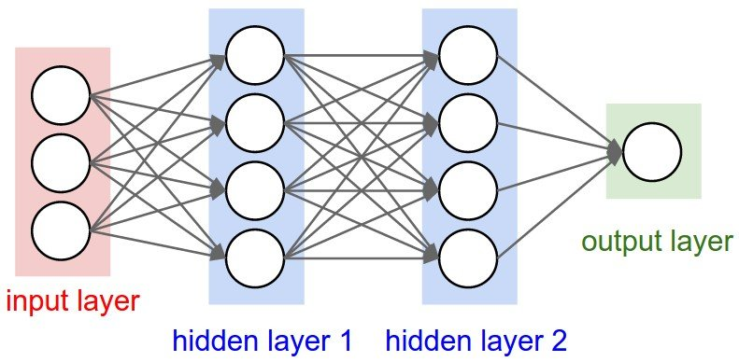
LSTM : AN OVERVIEW
Long Short-Term Memory (LSTM) is one of many types of Recurrent Neural Network RNN, it’s also capable of catching data from past stages and use it for future predictions. In general, an Artificial Neural Network (ANN) consists of three layers:
1) input layer
2) Hidden layers
3) output layer

Slide 7
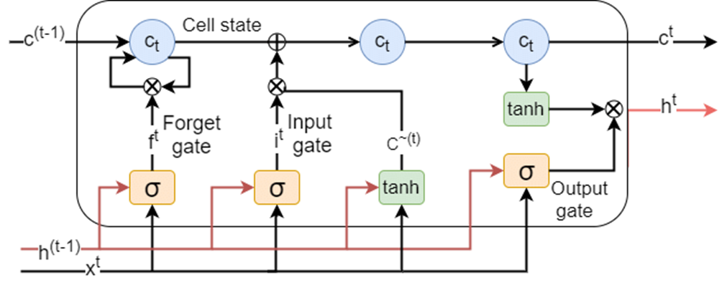
An LSTM memory cell, as depicted in Figure, has the following three components, or gates:
Forget gate: the forget gate decides when specific portions of the cell state are to be replaced with more recent information. It outputs values close to 1 for parts of the cell state that should be retained, and zero for values that should be neglected.
Input gate: based on the input (i.e., previous output o(t-1), input x(t), and previous cell state c(t-1)), this section of the network learns the conditions under which any information should be stored (or updated) in the cell state
Output gate: depending on the input and cell state, this portion decides what information is propagated forward (i.e., output o(t) and cell state c(t)) to the next node in the network.

Slide 8
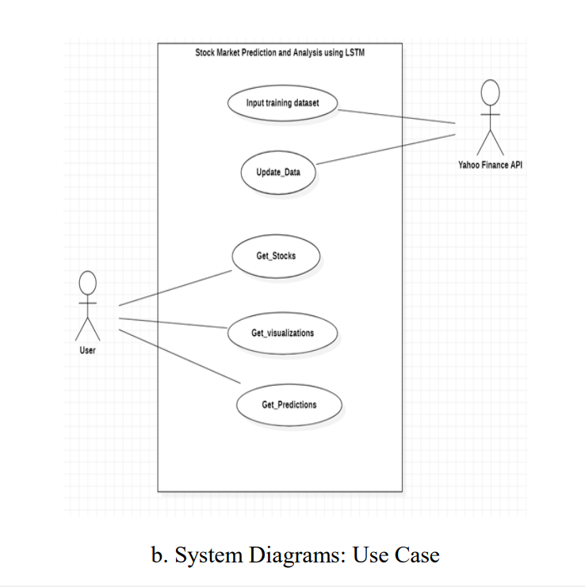
ARCHITECTURE SYSTEM DESIGN
USE CASE DIAGRAM:
Data is initially collected from online sources or the stock exchange.
Data is then used to train the system.
Trained model is saved.
User views the trade exchange and stock of a company.
Using the model, closing prices are predicted.

Slide 9
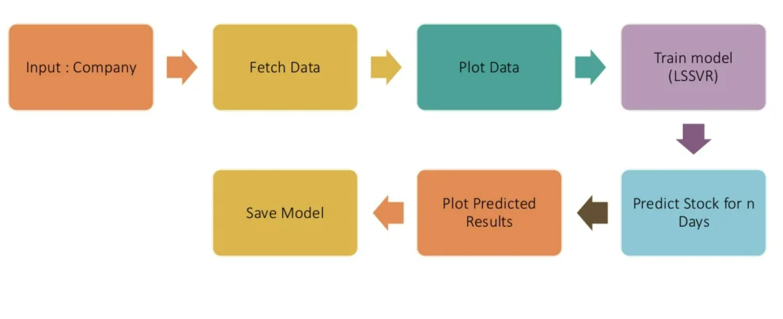
Architecture DATA FLOW Diagram
Train Model
( LSTM )

Slide 10
1. Date: of the observation
2. Opening price: of the stock
3. High: highest intra-day price reached by the stock
4. Low: lowest intra-day price reached by the stock
5. Volume: number of shares or contracts bought and sold in the market during the day.
The obtained data contained five features:

Slide 11
Stock prediction algorithm
Algorithm 1: LSTM stock prediction algorithm
Input: Historical stock price data
Output: Prediction for stock prices based on stock price variation
1. Start
2. Stock data is taken and stored in a NumPy array of 3 dimensions (N,W,F)
where :
N is number of training sequences,.
W is sequence length.
F is the number of features of each sequence.

Slide 12
3. A network structure is built with [l,a,b,l] dimensions, where there
is l input layer, a neurons in the next layer, b neurons in the subsequent layer,
and a single layer with a linear activation function.
4. Train the constructed network on the data.
5. Use the output of the last layer as prediction of the next time step.
6. Repeat steps 4 and 5 until optimal convergence is reached.
7. Obtain predictions by providing test data as input to the network.
8. Evaluate accuracy by comparing predictions made with actual data.
9. End

Slide 13
Terminologies used
1. Training set: subsection of the original data that is used to train the neural
network model for predicting the output values.
2. Test set: part of the original data that is used to make predictions of the output
value, which are then compared with the actual values to evaluate the
performance of the model.
3. Validation set: portion of the original data that is used to tune the parameters
of the neural network model.
4. Activation function: in a neural network, the activation function of a node
defines the output of that node as a weighted sum of inputs.
Activation Function = Σ (Input * weights) + Bias
Here, the sigmoid and ReLU (Rectified Linear Unit) activation functions were
tested to optimize the prediction model.

Slide 14
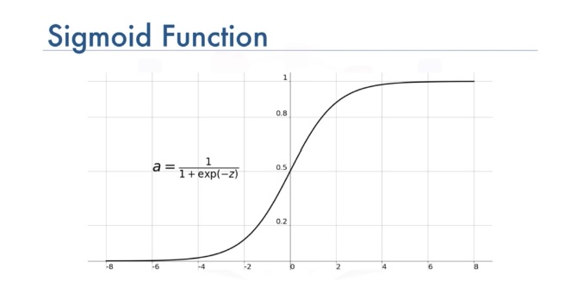
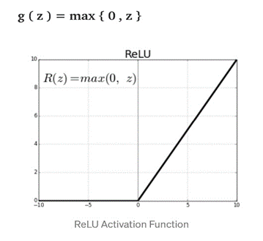
a. Sigmoid – has the following formula
y = 1/(1+e*-x)
and graphical representation
b. ReLU – has the following formula
y=max (0, x)
and graphical representation

Slide 15
5. Batch size: number of samples that must be processed by the model before updating the weights of the parameters
6. Epoch: a complete pass through the given dataset by the training algorithm
7. Dropout: a technique where randomly selected neurons are ignored during training i.e., they are “dropped out” randomly. Thus, their contribution to the activation of downstream neurons is temporally removed on the forward pass, and any weight updates are not applied to the neuron on the backward pass.
8. Loss function: a function, defined on a data point, prediction and label, that measures a penalty such as square loss which is mathematically explained as follows –
l(f(xi), yi) = (f(xi)-yi) ²
9. Cost function: a sum of loss functions over the training set. An example is the Mean Squared Error (MSE), which is mathematically explained as follows:
MSE () = ΣNi=l(f(xi) - y) ²/N

Slide 16
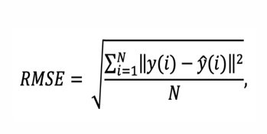
10. Root Mean Square Error (RMSE): measure of the difference between values predicted by a model and the values actually observed. It is calculated by taking the summation of the squares of the differences between the predictedvalue and actual value, and dividing it by the number of samples. It is mathematically expressed as follows:
In general, smaller the RMSE value, greater the accuracy of the predictions made.

Slide 17
Implementation algorithm
Algorithm: StockPrediction
Input: COMP, D_RANGE, N_PRED [company, date range, n-day predictions]
Output : A vector of predicted prices and graph, RESULT
1. data-fetch stock for COMP in date range D_RANGE
2. plot(data)
3. train_data + sliding Window(data) //perform sliding window operation on data
4. RESULTS-0 //set accuracy vector to zeroes
5. for each day in N_PRED:
1. model-LSTM(train_data) //pass the training data to LSTM
2. pred predict(model,day) //predict the price given model and day
3. remove first item from train_data //removing last item and adding predicted value
4. train_data-add pred to train_data //Last In, First Out.
5. RESULTS add pred to RESULTS
6. end for
7. print (RESULTS)
8. plot(RESULTS)
9. return

Slide 18
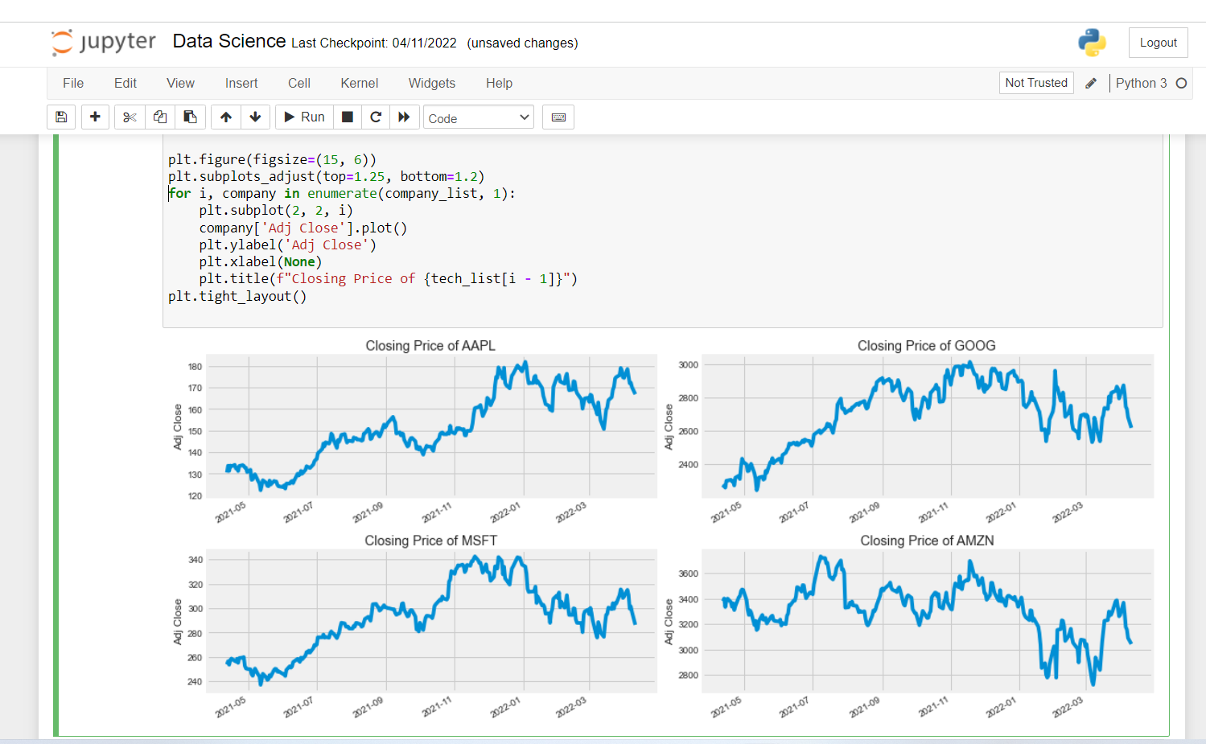
RESULTS & DISCUSSIONS Change in price of Stock Overtime
First of all we find out the change in price of the stock overtime by visualizing the closing price of each stock

Slide 19
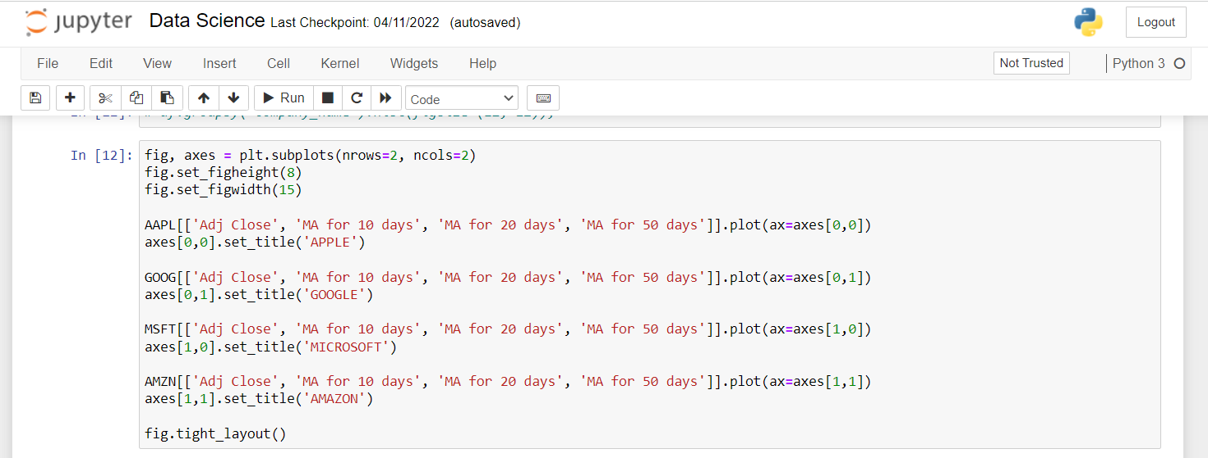
Finding Moving Average

Slide 20
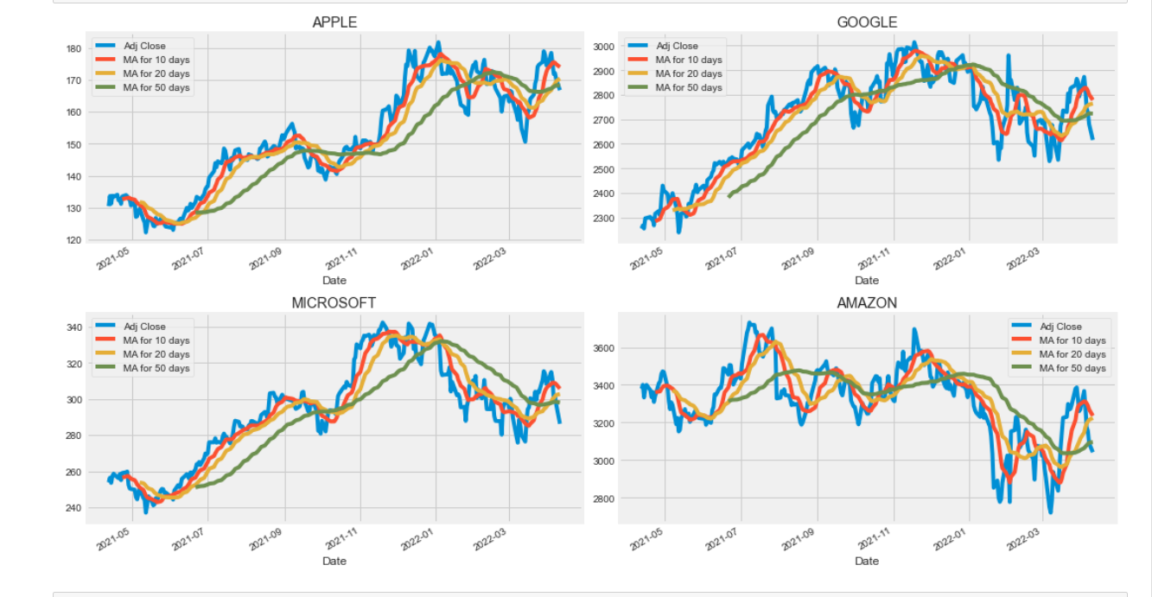

Slide 21
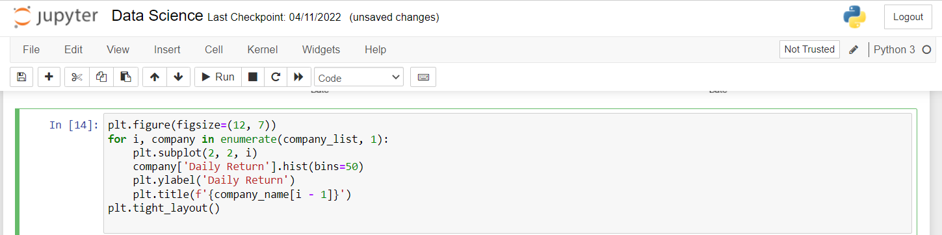
Daily Return of Stock on average To analyse the risk of the stock , we'll need to take a closer look at the daily changes of the stock, and not just its absolute value. Let's go ahead and use pandas to retrieve the daily returns for the Apple stock.

Slide 22
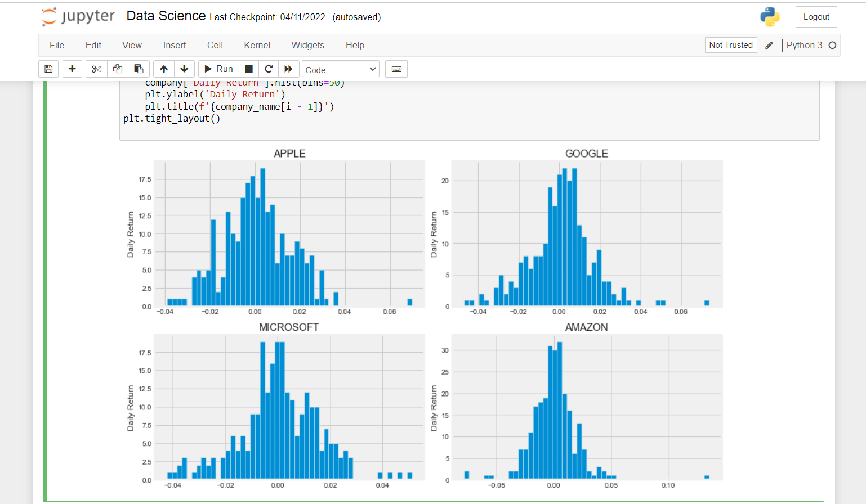

Slide 23
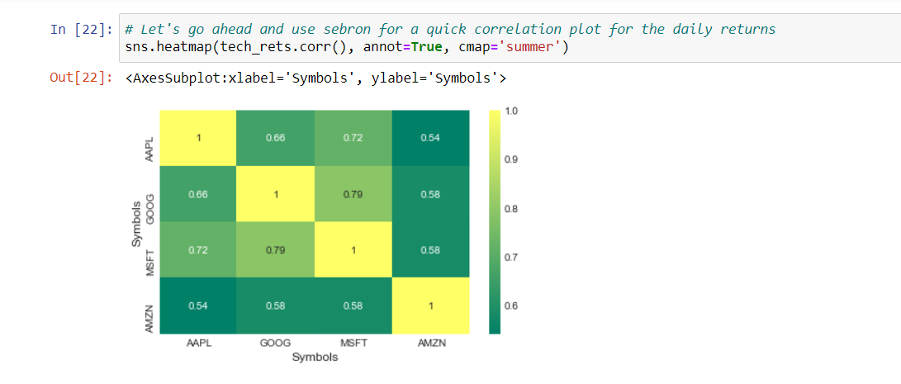
Correlation between different stocks closing prices
Now we can compare the daily percentage return of two stocks to check how correlated. Finally, we could also do a correlation plot, to get actual numerical values for the correlation between the stocks' daily return values. By comparing the closing prices, we see an interesting relationship between Microsoft and Apple.

Slide 24
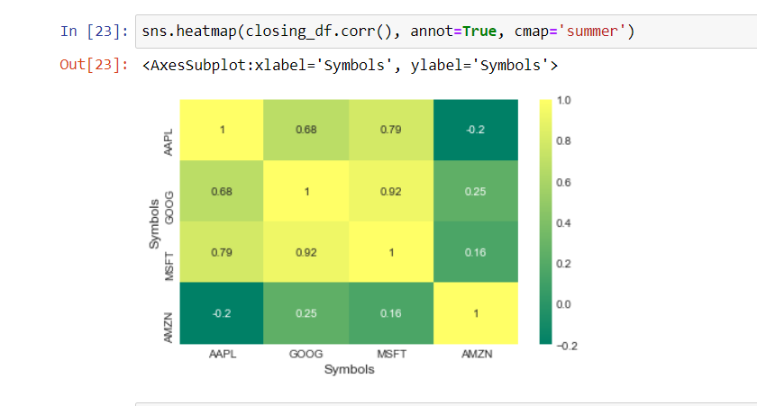
we suspected in our PairPlot here numerically and visually that Microsoft and Amazon had the strongest correlation of daily stock return. It's also interesting to see that all the technology companies are positively correlated.

Slide 25
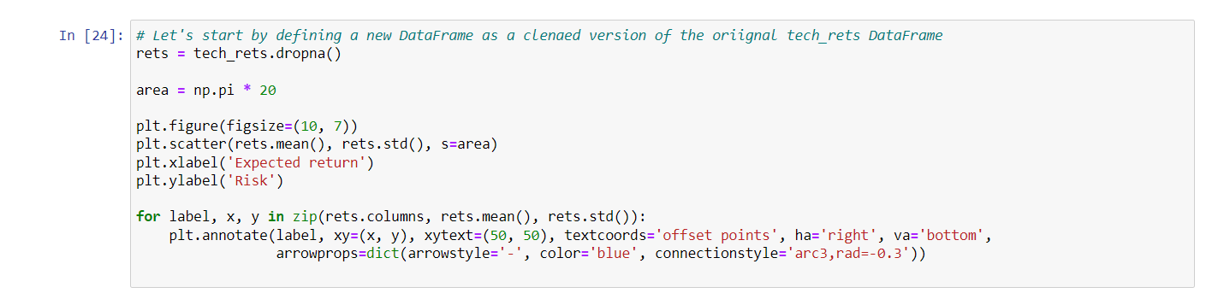
How much value do we put at risk by investing in a particular stock?
There are many ways we can quantify risk, one of the most basic ways using the information we've gathered on daily percentage returns is by comparing the expected return with the standard deviation of the daily returns.

Slide 26
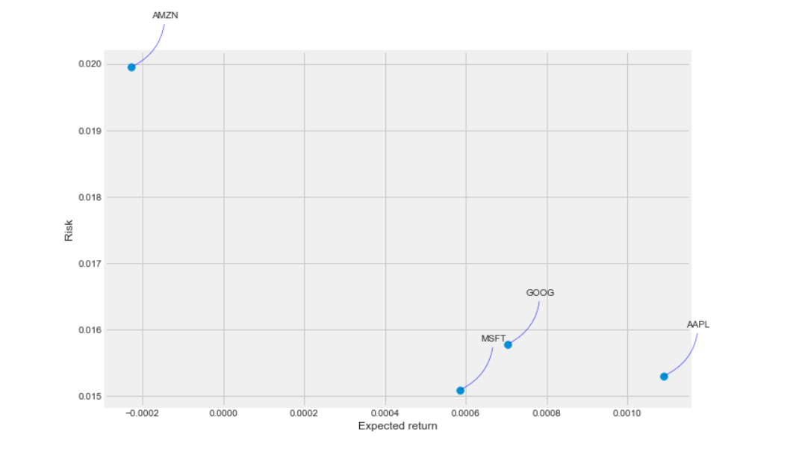

Slide 27
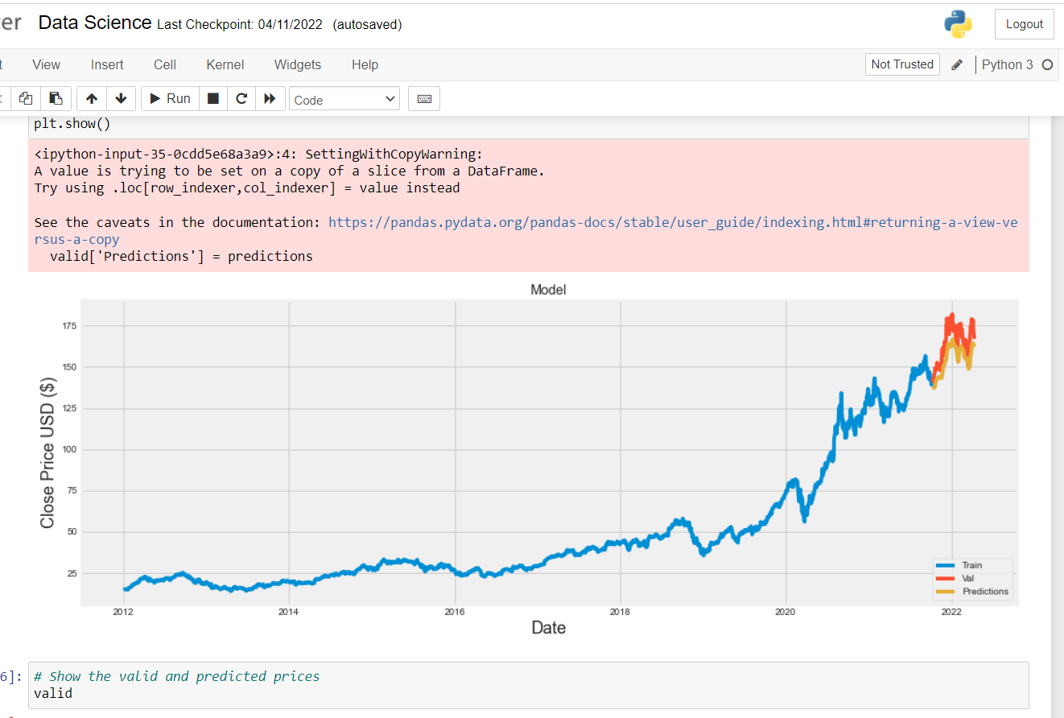
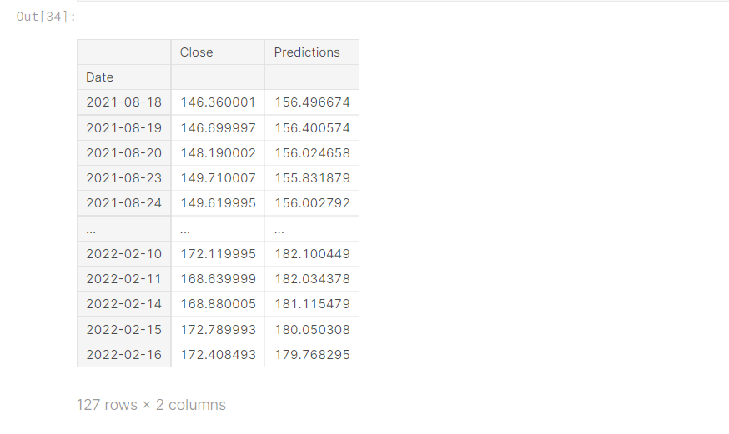
Predicting the closing stock price of APPLE Inc.

Slide 28
CONCLUSIONS
Determining the stock market forecasts is always been a challenging work.
Thus, Project applies the data mining technology of neural network to stock price forecast and receives a preferable result, which will provide the research of the stock market development a new thought & We attempted to make use of huge textual data to predict the stock market indices.

Slide 29
THANK YOU

