Slide 1
Hotel Bookings Management System
Group Number - 4
Mentor : Kathiresan Natarajan
Notes:
Add instructor notes here.

Slide 2
Team Members
Nirupam Debnath
Akash Kumar Sahoo
Harinath
Celes Monica
Nagajothi
Soundhariya

Slide 3
Objectives
Project Understanding
Approach used
Project Execution
Modules
Learning
Best Practices
Opportunity for improvement
Demo and Code Walkthrough
Notes:
Add instructor notes here.

Slide 4
Project Understanding
The project is aimed developing Online Hotel Bookings Management System.
It is an integrated system that contains the User, Employee & the Admin.
The System can be used to add hotel details, delete hotel details & display all hotel details across the location.

Slide 5
Approach used
For Front End and Web Components:
  Core Java
Database :
  Oracle 11g
Development tools:
  Eclipse

Slide 6
Project Execution
User Module
Employee Module
Admin Module

Slide 7
User Module
  Register
  Login to the system using his/her credentials
  Search for hotel rooms
  Book hotel rooms
  View Booking Status

Slide 8
Employee Module
Login
Search for hotel rooms
Book hotel rooms
View Booking Details
Logout

Slide 9
Admin Module
Login
Add Hotels
Update Hotels
Delete Hotels
Add Rooms
Update Rooms
Delete Rooms
Logout

Slide 10
Modules
Login module is common for all the users of the system i.e. Admin, Employee and customer.
Basic functionality of module are as follows:
  Taking login credentials from the user.
  If given credentials are wrong, show appropriate message.
  If login succeeds, user will be navigated to his/her respective page as per his/her role.

Slide 11
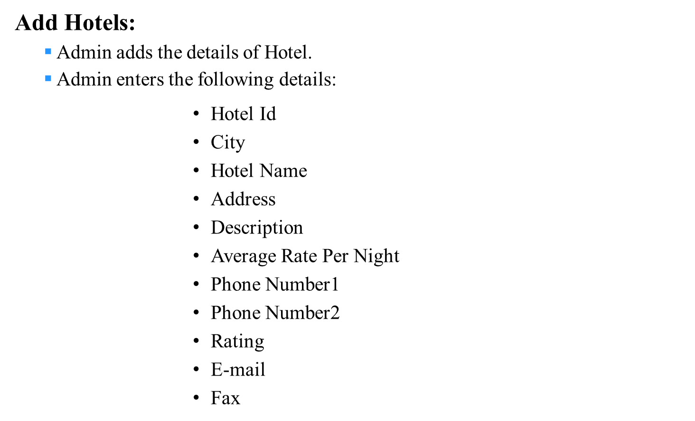
Admin Modules

Slide 12
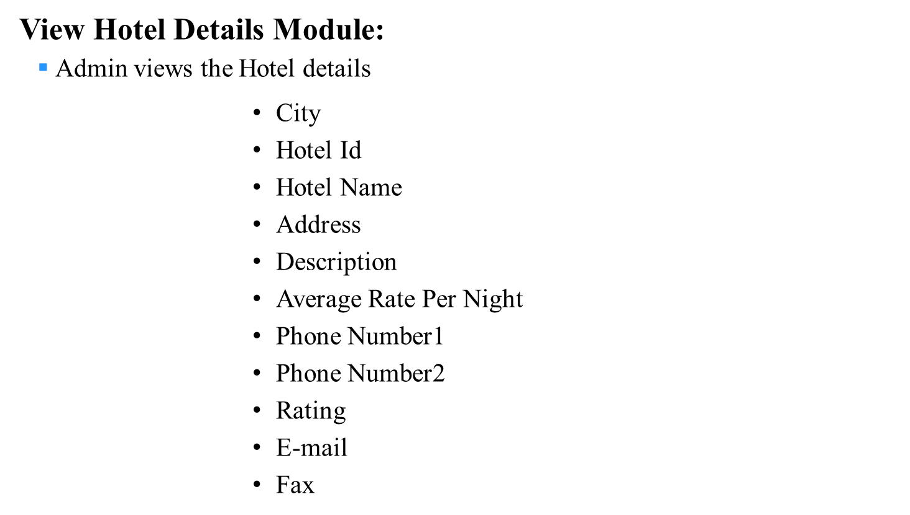
Admin Modules

Slide 13
Admin Modules
Delete Hotel details Module:
Admin can delete the Hotel Details by:
        using Hotel Id

Slide 14
Modules
Logout Module:
  User, Employee and Admin can Logout of their account from home page.

Slide 15
Learning
We have implemented the project Online Hotel Management System, using core java.
We have learned to work as a team.
Usage of updated template conforming to company standards.
Time Management and division of work.

Slide 16
Best Practices
Followed placing comments in appropriate places.
Followed naming conventions.
Followed proper indentation.

Slide 17
Opportunity for improvement
Facility of searching hotel by city.
Getting feedback from the user.
Generate monthly and yearly income of a hotel.
Facility of cancelling a booking can be added.

Slide 18


