Slide 1
VenData Team
Learn-a-thon | Hackathon: AI / ML
2022-Dec-06
Deloitte India
Nirupam Nishant – nnishant@deloitte.com
Vignesh N- nvignesh@deloitte.com
Sahil Bundela - sabundela@deloitte.com
Sagar Bhat - sagbhat@deloitte.com
Abantika Roy - abanroy@deloitte.com
Avishka Gupta - avisgupta@deloitte.com
Sucharita Bhur - sbhur@deloitte.com

Slide 2







Vendata Delta Lakehouse
Reports and Dashboards are Directly refreshed from final layer
Power BI
AI ML
Delta Lakehouse medallion architecture
Azure DevOps for serving as code repository.
Can be used for deployment.
Azure Data Factory to orchestrate the ingestion and transformation pipelines for full scalability
Azure Data Factory to orchestrate the ingestion and transformation pipelines for full scalability
GOLD: Data is transformed based on the Business Logic and Various aggregation levels. Create Fact and Dimensions
Azure Databricks to connect and transform data through stages
Azure Logic App for serverless implementations
Like alerts and trigger PBI refresh
SILVER: Data is cleaned and validated with basic data quality checks. Data loaded in delta tables
BLOB storage (cheap and separation for security)
SILVER: Data is cleaned and validated with basic data quality checks. Data loaded in delta tables
Sales raw data
BRONZE: Data Available in raw Files moved to Landed layer in form of Delta tables or retained in its original form.
ADLS Gen2

Slide 3
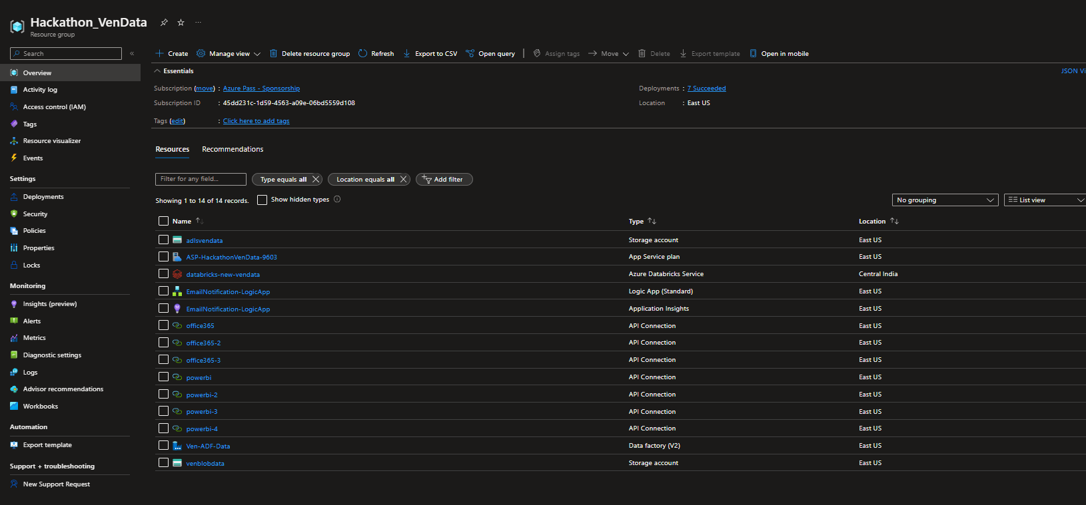
Data Engineering
DataEngg_01_ResourceGroupAzurePortal

Slide 4
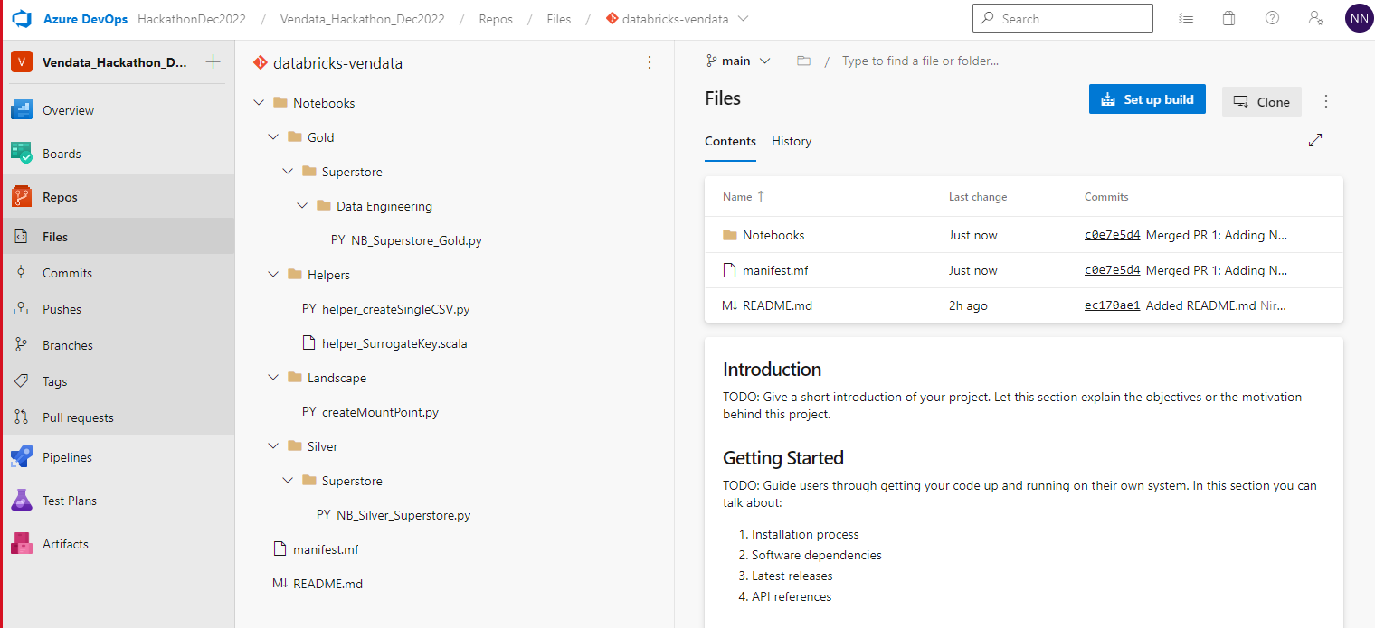
Data Engineering
DataEngg_02_AzureDevOps_Repo

Slide 5
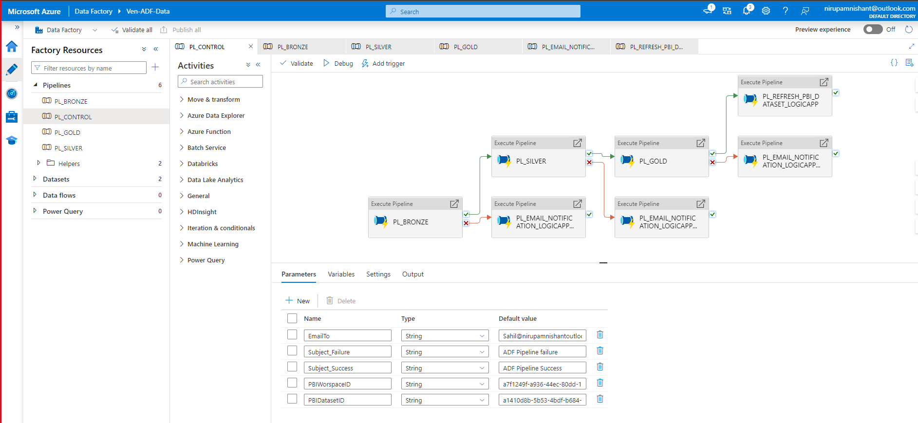
Data Engineering
DataEngg_03_ADF_Pipeline

Slide 6
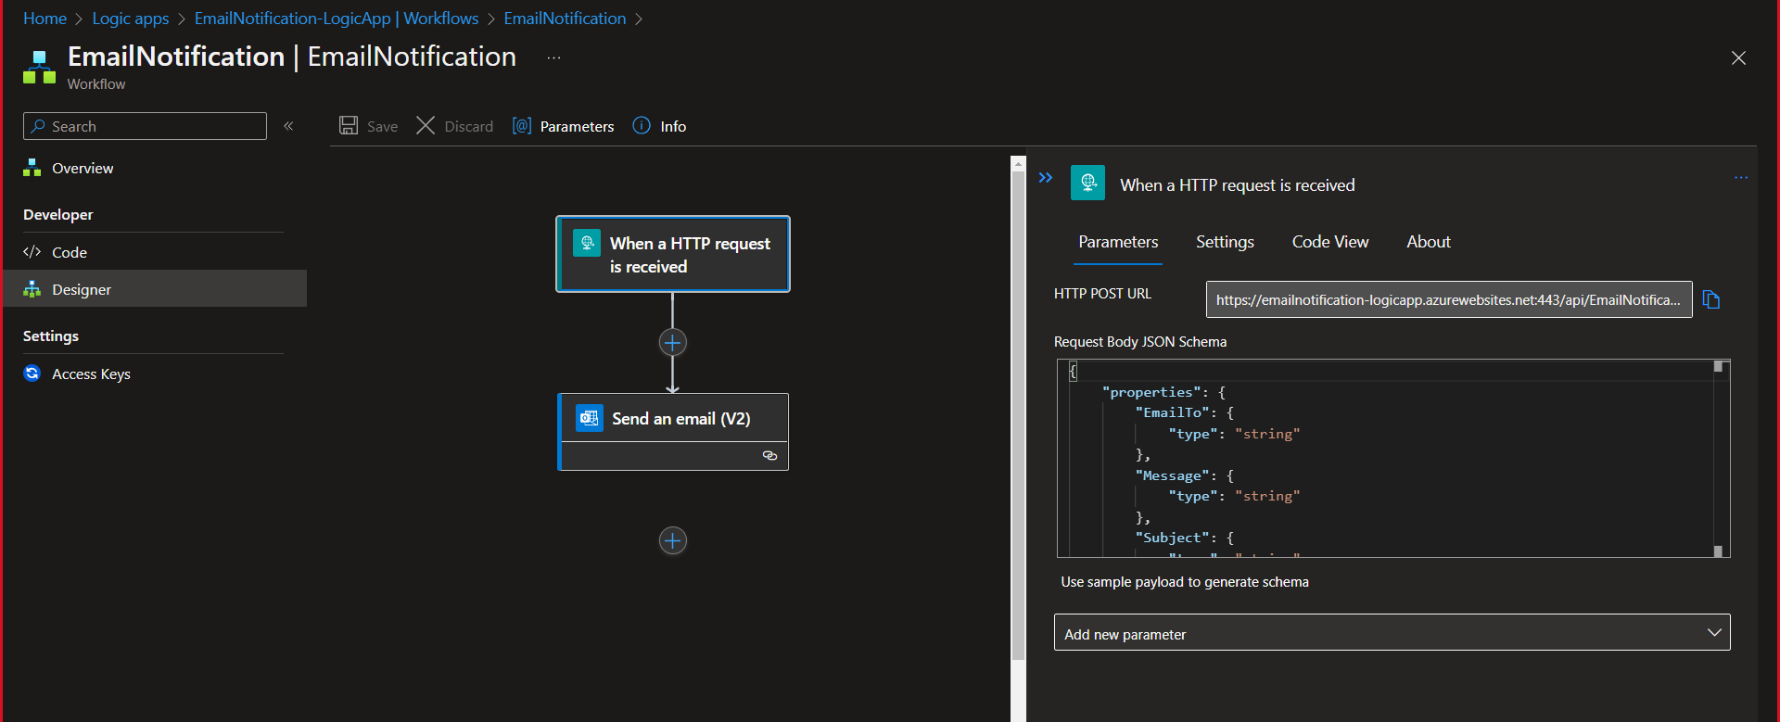
Data Engineering
DataEngg_04_LogicApp_EmailAlert

Slide 7
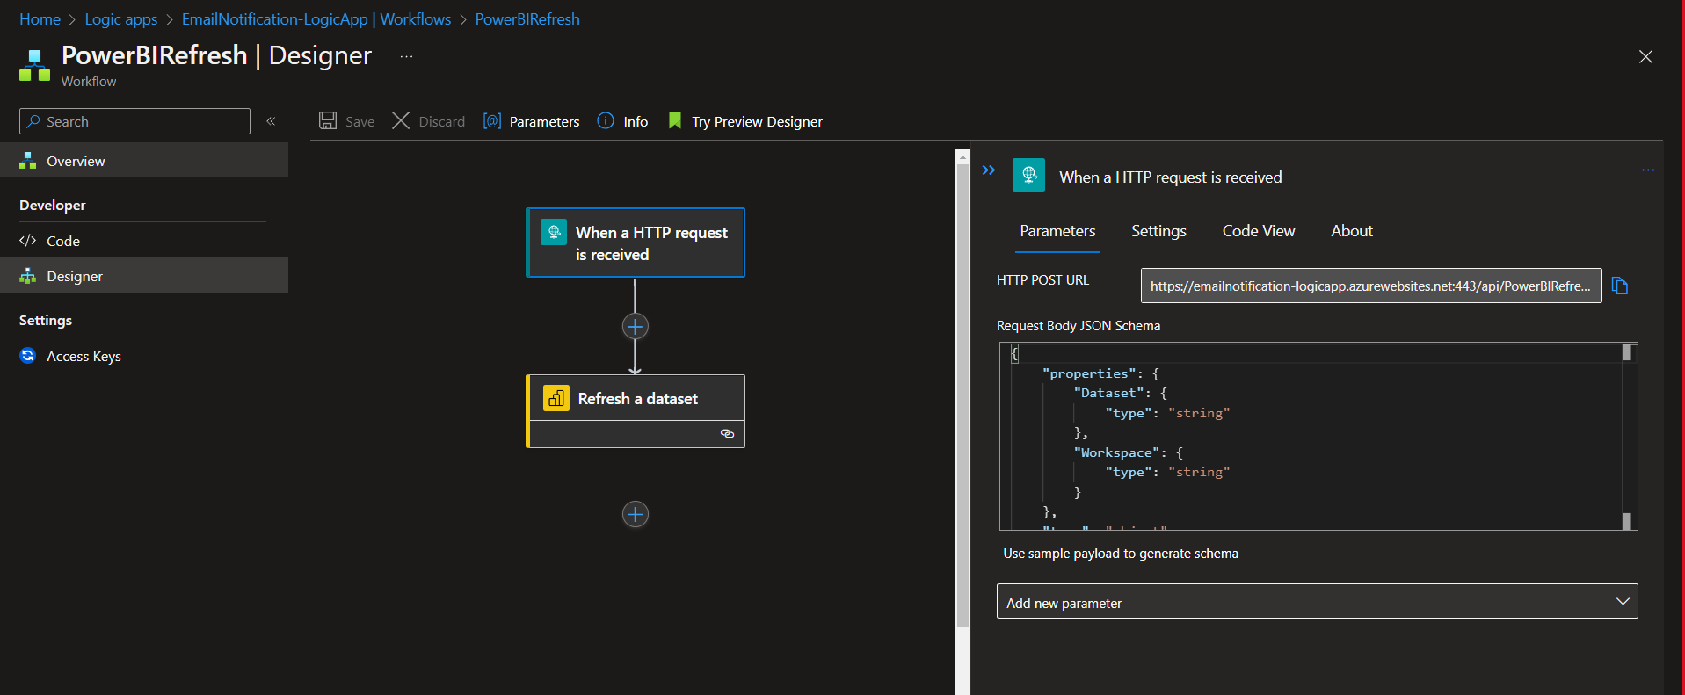
Data Engineering
DataEngg_05_LogicApp_UpdatePBIDataset

Slide 8
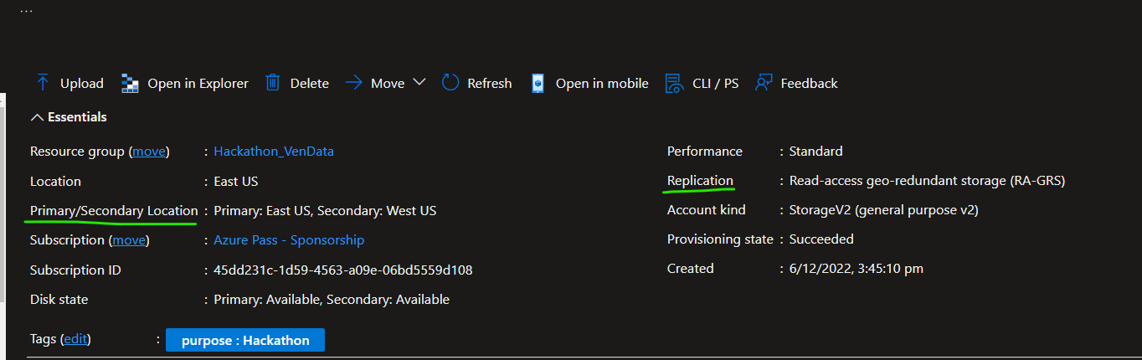
Data Engineering
DataEngg_06_ADLSReplicationForDR_EmailAlert

Slide 9
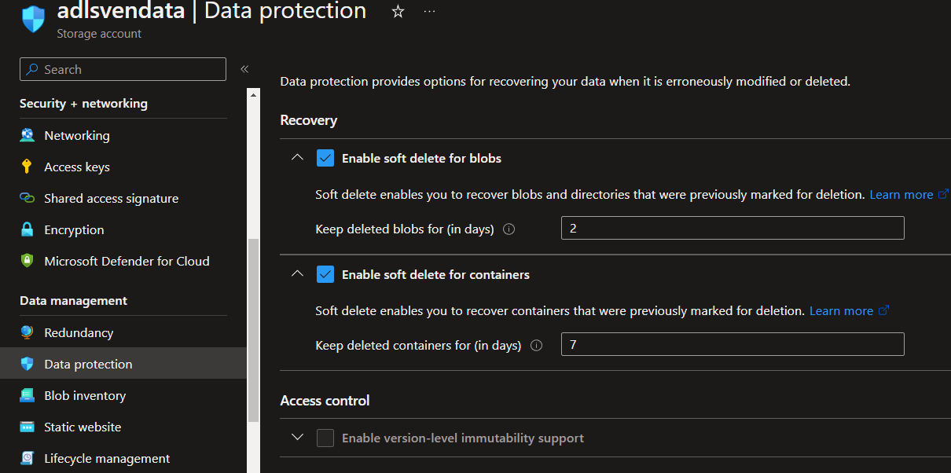
Data Engineering
DataEngg_07_ADLSDataProtection_EmailAlert

Slide 10
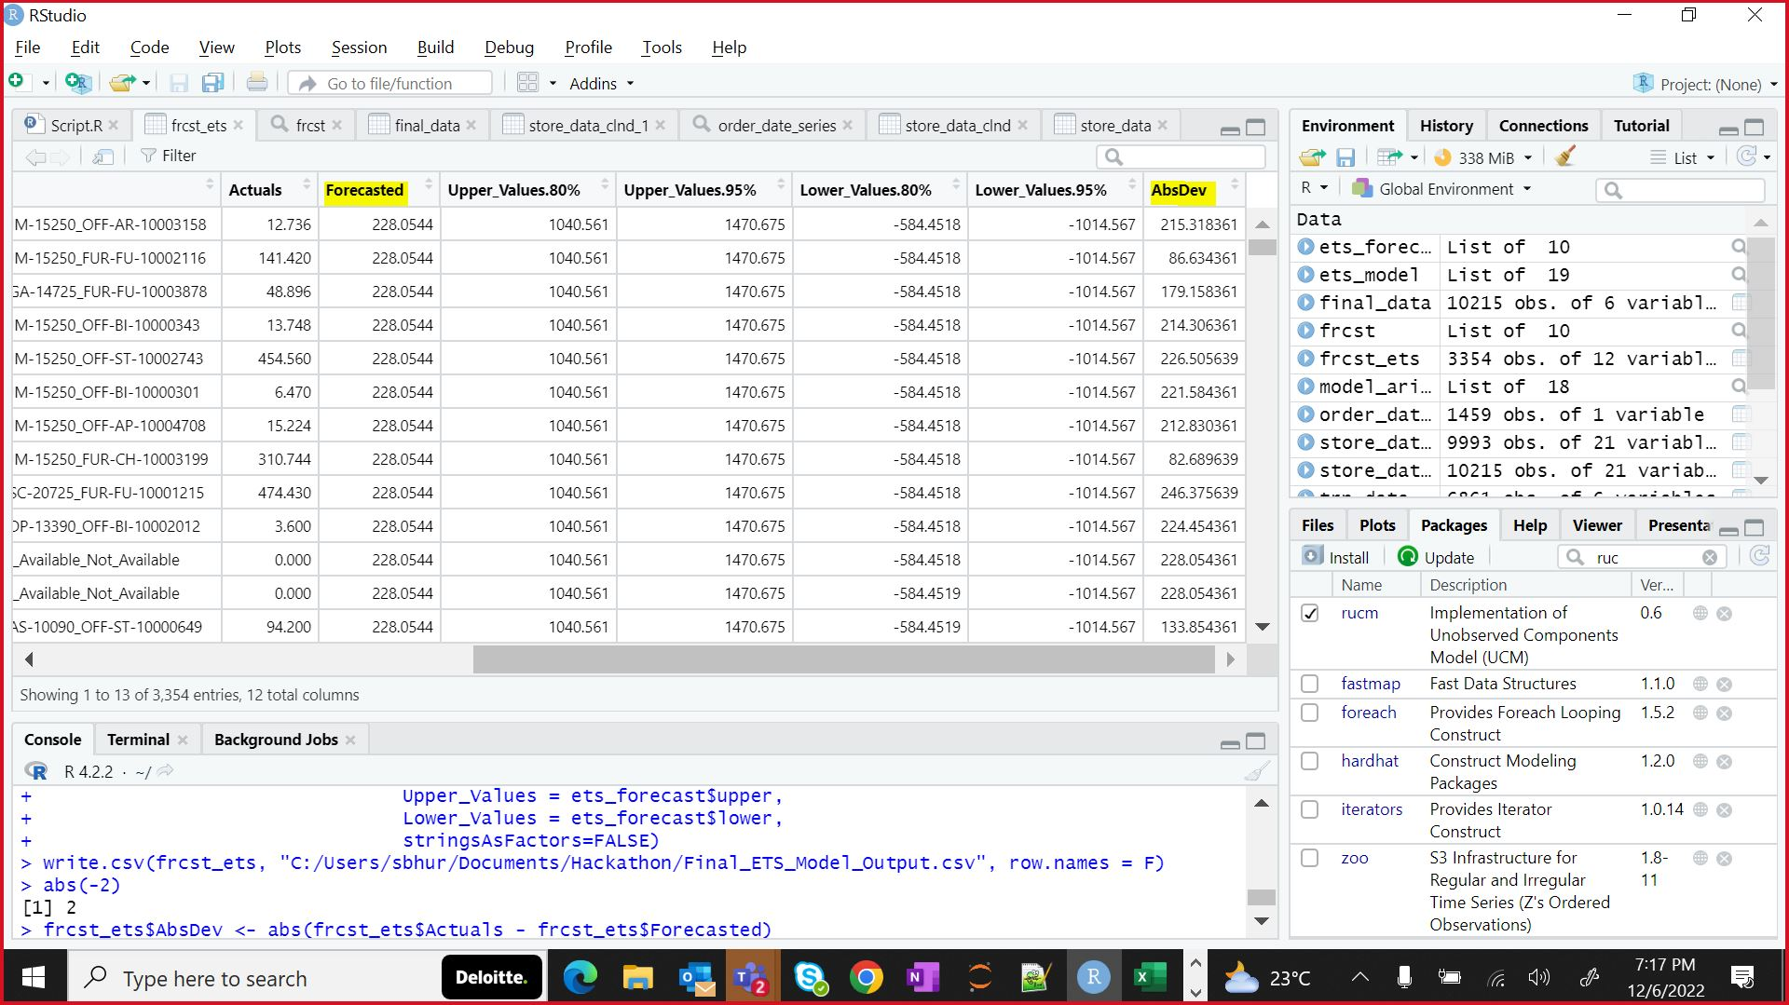
AI ML Model
We also tried models
Arima: Rejected because there are no causal factors
UCM: Rejected because processing duration was high
Model Chosen: Exponential Time Series model
Reason: This is time and sales data and there are no independent variables
Snippet of code along with output is shown below.

Slide 11
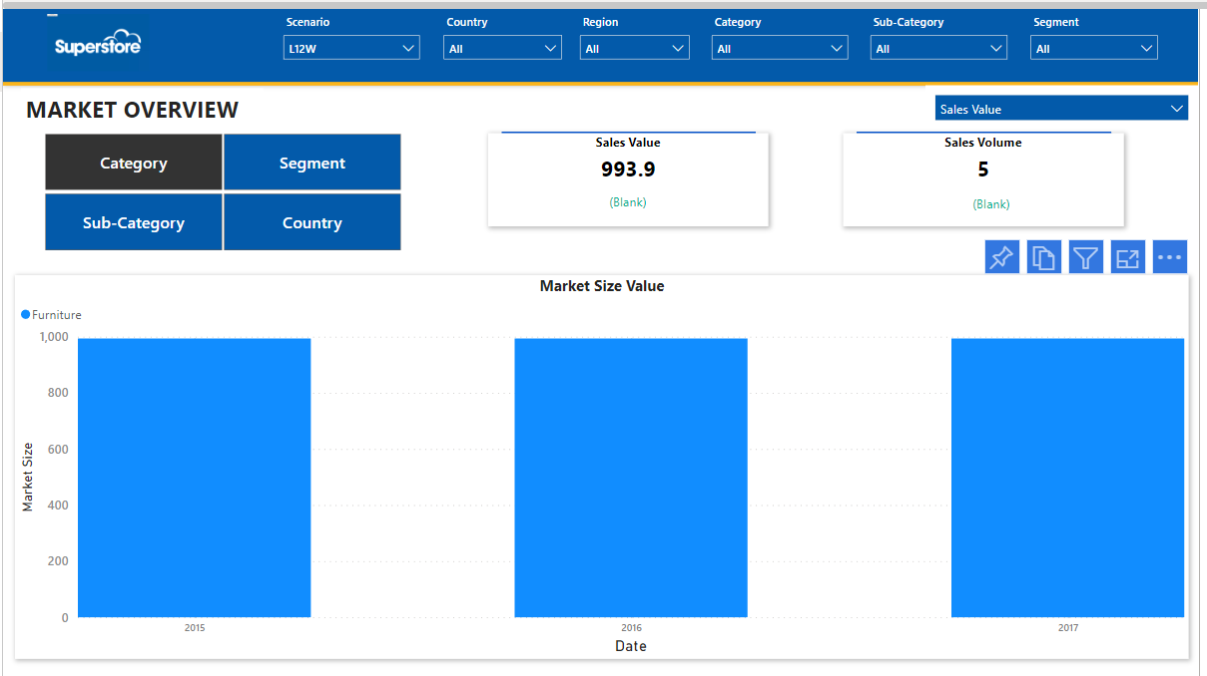
Power BI
Descriptive Report

Slide 12
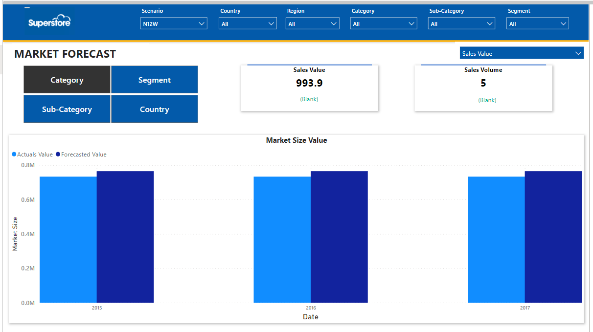
Power BI
Predictive Report

