Slide 1
A mini project on ONLINE MEDICINE SHOPPING Under the guidance of Prof .Mamatha
Presented By
Asma Hebbal
Vidya Bhagannanavar

Slide 2
contents
Introduction to My-sql
Introduction to php
Online Medicine Shopping
System requirements
Implementation
Use case diagram
Conclusion
bibliography

Slide 3
INTRODUCTION TO MYSQL
A light weight database server
It is fast
Easy to install
Support to all type windows
Easy to use

Slide 4
Introduction to PHP.
PHP stands for Hypertext Preprocessor.
PHP is server side scripting language, usually written in HTML context.
PHP code is usually processed by a PHP interpreter implemented as a module in the web server or as a Common Gateway Interface (CGI) executable.
PHP code may also be executed with a Common Line Interface(CLI) and can be used to implement stand alone graphical applications.

Slide 5
ONLINE MEDICINE SHOPPING
It is the management of the database of the medicine shop.
This is done by creating a database of the available medicines in the shop
platform technologies for the Indian pharmaceutical industry;

Slide 6
SYSTEM REQUIREMENTS
Hardware Requirements:-
Pentium-IV (Processor)
256 MB Ram
512 KB Cache Memory
Hard disk 10 GB
Microsoft Compatible 101 or more Key Board
Software Requirements:
Operating System : Windows
Web-Technology : PHP
Front-End: PHP,CSS,
Back-End: My SQL
Web Server: WAMP SERVER

Slide 7
IMPLEMENTATION
We have developed the prototype implementation that was using SQL server
Software architecture consists of eight major components covering each of the elements of pharmaceutical logistics
pharmacy intravenous admixture services system and system control management

Slide 8
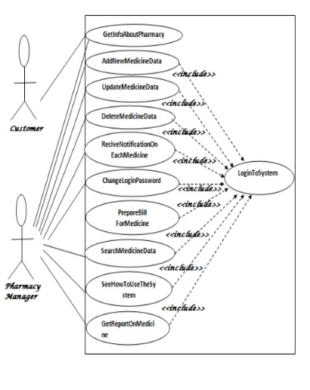
Use case diagram

Slide 9
CONCLUSION
transaction of items are fast
it is help to find items or an inventories easily
this database understand easily
use this database system the printed bill is generated

Slide 10
BIBLIOGRAPHY
1.Database Management system -- Ramakrishnan and Gehrke
2. Database system concepts -- Silberschatz Korth and Sudharshan
3. Database principles fundamentals of design – Coronel, Morris and Rob
4.Database Management system –Raghu Ramakrishnan
5.An introduction to database System---- Bipin desai

Slide 11
THANK TOU

