Slide 1
SEGMENTATION AND PAGING IN OPERATING SYSTEMS
Exploring the fundamental concepts of segmentation and paging in memory management.
NIRUPOM SAHA

Slide 2
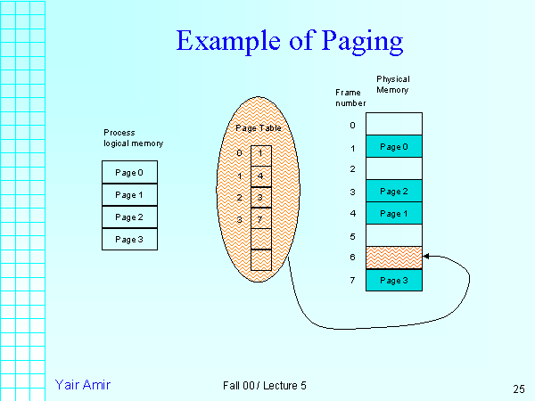
What is Paging?
Paging is a memory management technique in which memory is divided info fix size pages.
Paging is use for faster access to data.
It is a logical concept.

Slide 3
Why we use paging ?
Paging is a memory management technique.
Paging allows the physical address space of the process to be
non contiguous.
Paging is use for faster access to data.
It is a logical concept.

Slide 4
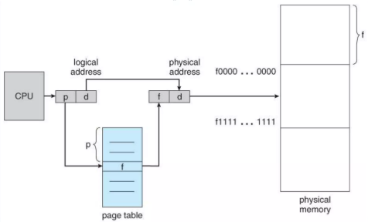
Paging Hardware

Slide 5
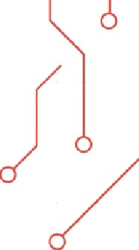
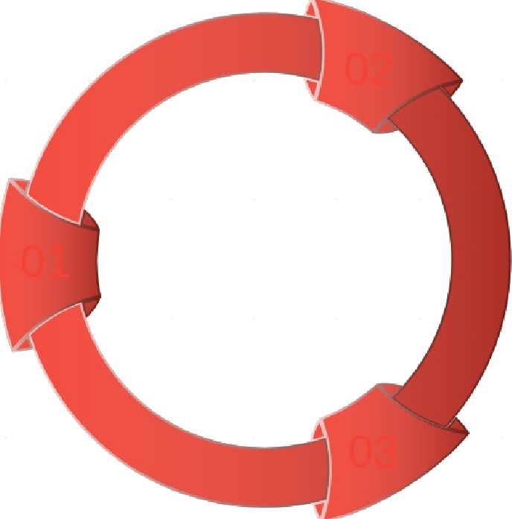
UNDERSTANDING PAGING IN MEMORY
MAPPING PAGES TO FRAMES
In this example, Page 2 is mapped to Frame 5. This mapping is crucial for the operating system to keep track of where data is stored in physical memory.
PAGE SIZE DEFINITION
The page size is set at 4KB, which is a standard size used in many systems for memory management. This size determines how data is divided into pages for efficient memory use.
ADDRESS CALCULATION
The formula for calculating tRe address involves multiplying the frame number by the page size and adding tRe offset. The address for Page 2 in Frame 5 is calculated as (5•4096)•Offset.
^œn'ea 1°nç
preseutotions

Slide 6
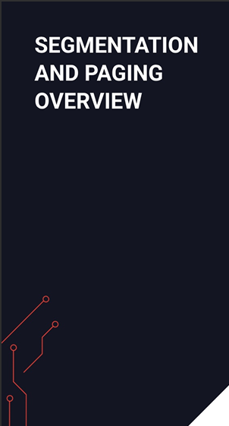
Advantages and disadvantages of paging
• Advantages :
no external fragmentation.
Simply memory management algorithm.
Swapping is easy(equal sized pages and page frame).
• Disadvantages:
Internal fragmentation.
Page tables may consume more memory.
^œn'ea 1°nç
preseutotions

Slide 7
What is Segmentation ?
Segmentation is one of the most common ways to achieve memory protection.
The user will view as a combination of segments.
Each memory segment is associated with a specific
length and set of permissions.

Slide 8
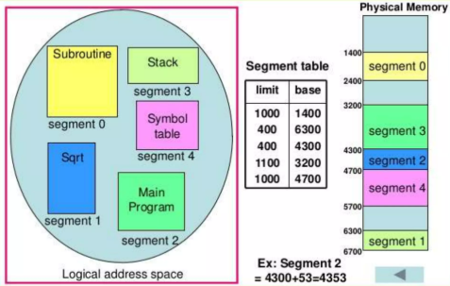
Example of Segmentation

Slide 9
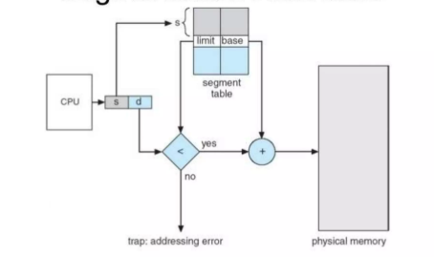
Segmentation Hardware

Slide 10
Advantages and disadvantages of segmentation
Advantages :
no internal fragmentation.
Segment tables consume less memory than page.
Lends itself to sharing data among processes.
Lends itself to protection.
Disadvantages:
Costly memory management algorithm.
^œn'ea 1°nç
preseutotions

Slide 11


SEGMENTATION VS PAGING OVERVIEW
SEGMENTATION IS A LOGICAL DIVISION
In segmentation, memory is divided into variable-sized segments based on the logical structure of the |arogram, such as functions or data types, enhancing modularity.
PAGING USES FIXED-SIZE BLOCKS
Paging divides memory into equal-sized blocks called pages. This technique allows for efficient memory allocation and eliminates the need for contiguous memory allocation.
PAGING SIMPLIFIES MEMORY MANAGEMENT
EXTERNAL FRAGMENTATION IN SEGMENTATION
Segmentation can lead to external fragmentation, where free memory is split into small now-contiguous blocks, making it difficult to allocate larger segments.
Paging simplifies memory management by allowing the operating system to manage memory in fixed-size units, reducing complexity in allocation and deallocation.
SEGMENTATION ENHANCES MODULARITY
Due to its logical structure, segmentation allows programs to be more modular and facilitates easier sharing and protection of segments between processes.
INTERNAL FRAGMENTATION IN PAGING
Paging may cause internal fragmentation, where allocated pages may have unused space if the data does not completely fill the page, leading to wasted memory.
^œn'ea 1°nç
preseutotions

Slide 12
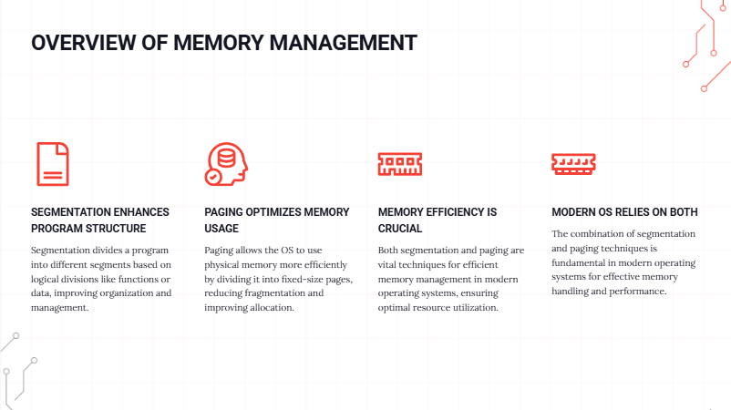

Slide 13
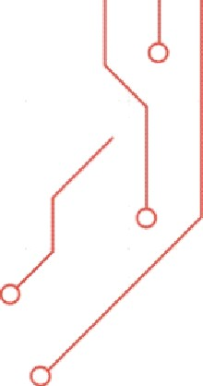
Thank You

