Slide 1
RETAIL AI TICKET ANALYZER
Team NEURON
Gopika SG
Mubeen Thekkethala Muhammedali
Niranjan Reddy Aare
Poojari Sasi Kumar
Vismaya B
Sneha Susan Rajesh

Slide 2
PROBLEM STATEMENT AND PROPOSED SOLUTION
01

Slide 3
PROBLEM STATEMENT
Retail enterprises receive a high volume of support and incident tickets from POS systems, payment platforms, inventory management systems, and customer service channels.
Manual ticket processing often leads to delayed resolution, inconsistent prioritization, and inefficient escalation workflows, adversely affecting operational efficiency and customer experience.
These challenges further increase response times, operational overhead, and the likelihood of SLA non-compliance.

Slide 4
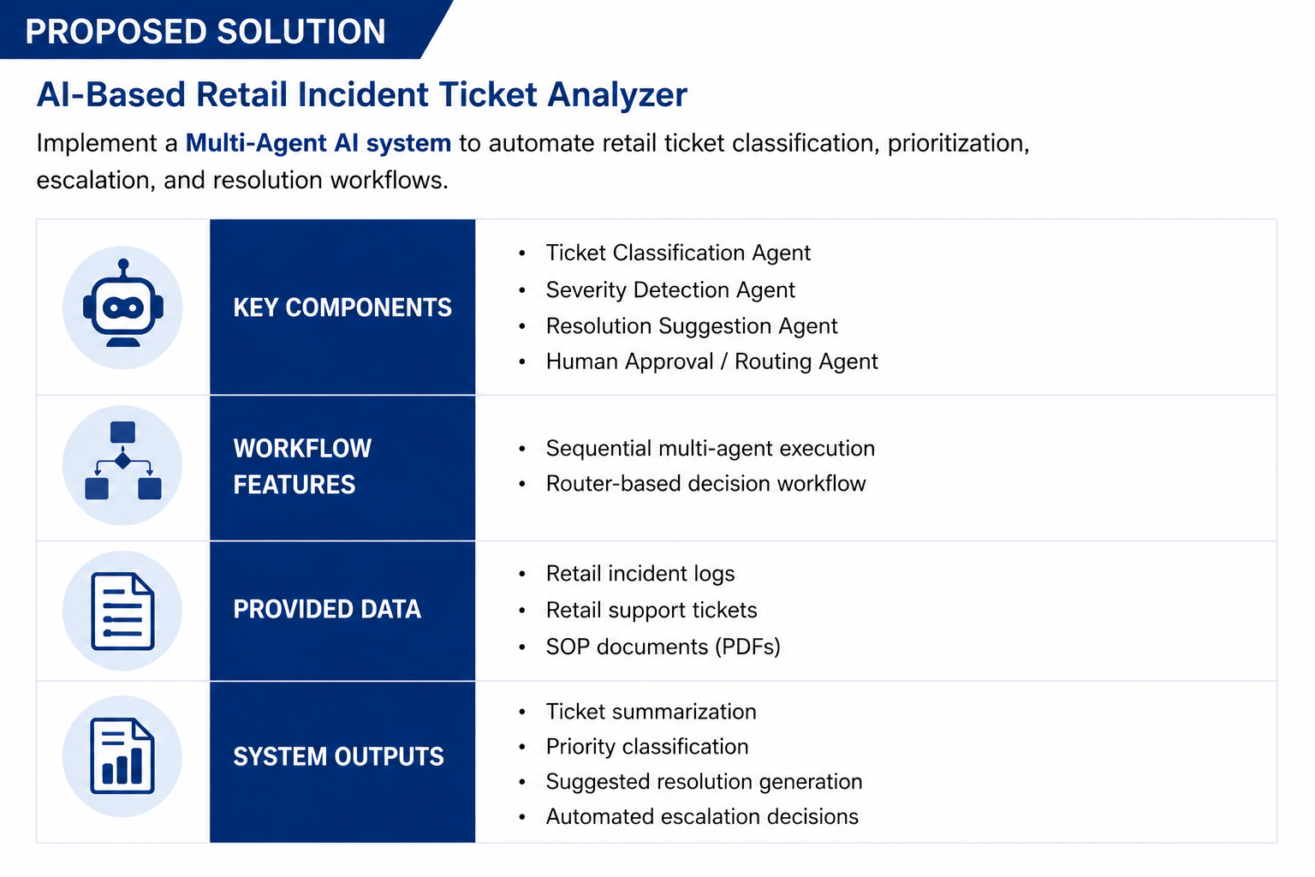
PROPOSED SOLUTION

Slide 5
ARCHITECTURE DIAGRAM
02

Slide 6
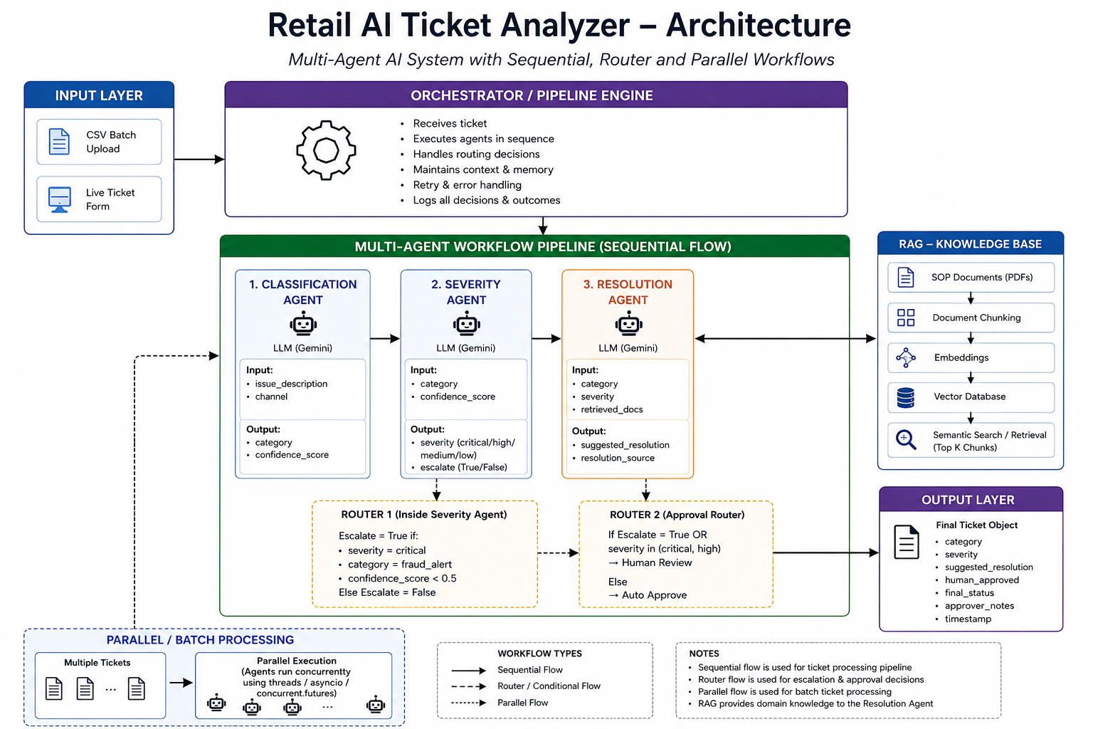

Slide 7
WORKFLOW
03

Slide 8
Ticket Classification Agent
• Classifies tickets into:
- Billing
- Technical Support
- Feature Request
- Account Access
• Predicts:
- Priority → LOW / MEDIUM / HIGH / CRITICAL
- Sentiment → Positive / Neutral / Angry / Frustrated
- Summary → One-line issue explanation
• Main Responsibilities:
- Automates helpdesk ticket analysis
- Detects critical incidents
- Improves SLA response handling
- Reduces manual support workload
- Enables smart ticket routing
• Human approval triggered for CRITICAL tickets

Slide 9
Severity Detection Agent
Why This Agent Matters:
Manual processing is too slow
Payment failures need instant flagging
Customer protection
Severity Detection Pipeline:
1 Receives classified ticket
Category, confidence score and description passed from the Classification Agent.
2 Calls LLM
Context-rich prompt includes SLA status, customer tier, and system health for accurate severity judgment.
3 Applies business rules
Fraud → critical override, keyword escalation, SLA breach bumps severity one level up.
4 Outputs severity + escalation
Severity level (CRITICAL/HIGH/MEDIUM/LOW), escalation flag, and Risk Score 0-100 written to the pipeline.
Risk Score: 0 - 100 per ticket
Auto-Escalates: Fraud / Payment / Network Outage

Slide 10
Resolution Suggestion Agent
The Resolution Suggestion Agent generates actionable support resolutions for retail tickets using:
Ticket context
RAG-based SOP retrieval
Gemini LLM generation
Inputs
Reads from ticket object:
issue_description
category
severity
Calls:
retrieve_documents()

Slide 11
Resolution Suggestion Agent
Workflow
Receive classified ticket
Retrieve top relevant SOP chunks from FAISS vector DB
Build LLM prompt using:
issue description
category
severity
retrieved SOP context
Generate resolution using Gemini API
Return updated ticket object
Outputs Written
retrieved_docs
suggested_resolution
resolution_source

Slide 12
Resolution Suggestion Agent
Key Features Implemented
RAG-Based Context Retrieval
Error Logging
Safe Fallback Handling
Failure Type | Action Taken
Empty ticket | Return structured fallback response
No SOP match | Return generic fallback resolution
Gemini API failure | Return escalation response to human support
Retriever failure | Return empty retrieved_docs safely

Slide 13
Human-in-the-Loop
AI processes tickets and generates recommendations.
Sensitive or high-impact tickets are sent for human review.
The human reviewer can:
Approve the AI recommendation
Reject the recommendation
Modify the suggested resolution before closure
Ensures trust, accuracy, and accountability.

Slide 14
CHALLENGES FACED
Generating realistic retail incident ticket data
Handling API limit issues and response delays
Integrating UI with backend AI workflows
Maintaining accuracy across multiple AI agents

