Slide 1

Approximation Algorithm IT 584
Minimum Weight Triangulation
Prof. Rachit Chhaya

Slide 2
Prepared By – Group Members
Nirva Patel – 202201071
Vidhi Dhanani – 202201076
Kashvi Bhanderi – 202201149
Gunjan Saroliya – 202201225
Aastha Bhavsar – 202201259

Slide 3
Introduction
Triangulation is a fundamental problem in computational geometry with important applications in computer graphics, geographical information systems, mesh generation, and f inite element analysis.

Slide 4
Triangularization

Slide 5

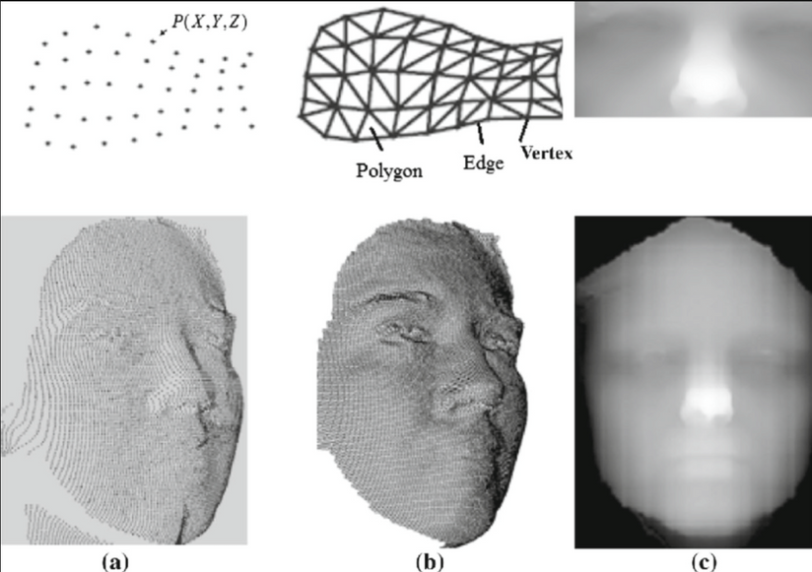
Applications
Reconstructing a 3D face model from keypoints in a facial recognition system.

Slide 6
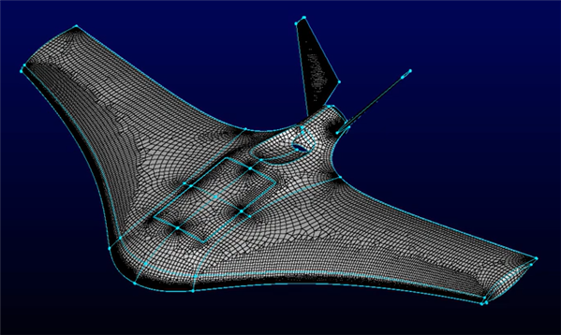
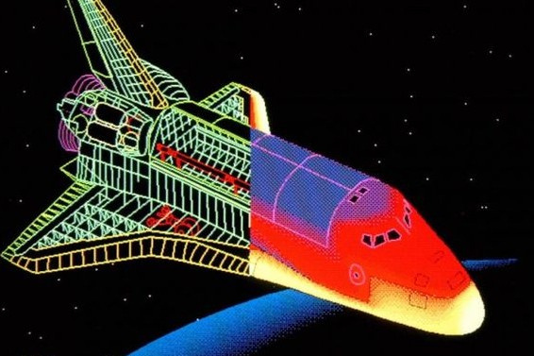
Applications
Air-Craft Designing...

Slide 7

Applications
Satellite image taken by NASA, representing the key features of geometry, reducing the space by compressing it with geometrical points for less data storage.

Slide 8
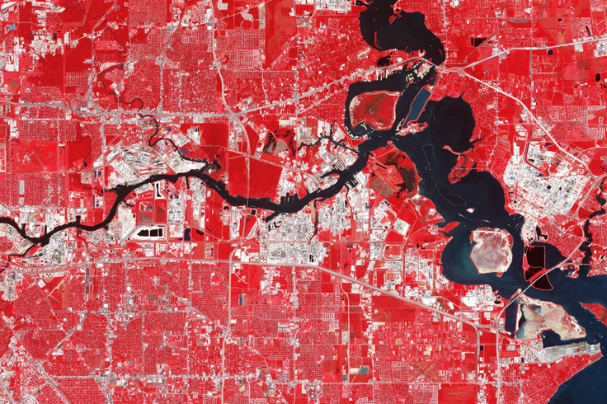
Applications
NASA’s Terra satellite captured this image of Baytown, Texas, in October, 2003.

Slide 9
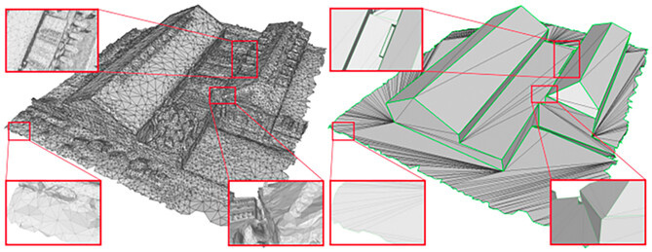
Applications
Terrain modeling involves discretizing a geometric domain into simpler elements (e.g., triangles) for numerical simulations.

Slide 10
Problem Statement
Minimum Weight Triangulation (MWT) problem aims to connect a set of n points in the plane with non-overlapping edges to form a valid triangulation, such that the total length of all edges used in the triangulation is minimized,
given constraint that the triangulation must cover all points with a set of triangles.

Slide 11
Mathematical Formulation
Let P be a set of n distinct points in 2D space:
P = {p₁,p₂,...,pₙ}, pᵢ = (xᵢ ,yᵢ ) ∈ ℝ²
Define T (set of non-intersecting triangles) as a triangulation over P.
Each triangle in T is of the form:
∆ᵢ,ⱼ,ₖ , where i ≤ j < k ≤ n.
Objective : Minimize the triangulation cost c(T). So the objective function is as follows:
Min ∑ w(∆ᵢ,ⱼ,ₖ)
T
∆ᵢ,ⱼ,ₖ ∈ T

Slide 12
NP Hard
It is an NP Hard problem
Reduced to 3 SAT problem

Slide 13
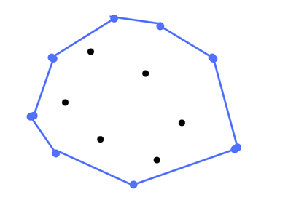
Convex Hull
The convex hull of a set of points P in the plane is the smallest convex polygon that can be drawn using the outermost points, such that it contains all the points in P.

Slide 14
Exponential Time Algorithm
Generate all triangulations.
𝒯(𝑃) = {𝑇₁, 𝑇₂, ..., 𝑇ₖ} (all valid triangulations of 𝑃)
Compute total weight for each triangulation 𝑇ᵢ:
W(𝑇ᵢ) = Σ |e| (for all edges e ∈ 𝑇ᵢ)
Total number of triangles: 2*n - h - 2, where h is number of convex hull points.
Select triangulation with minimum total weight:
T* = arg min W(𝑇ᵢ)
Time complexity for this algorithm is known to be asymptotically O(4ⁿ).
(1 ≤ i ≤ k)

Slide 15
Graphical Understanding
Possible Triangulations (Example) :
(a) (b) (c) (d)

Slide 16
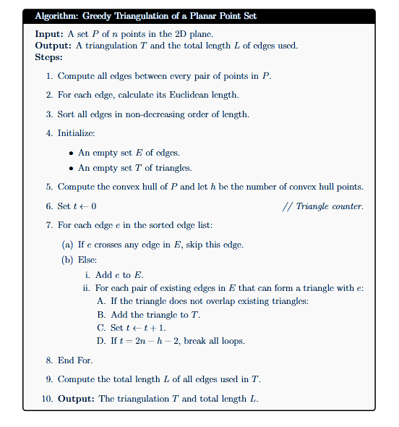
Greedy Algorithm for Minimum Weight Traigulation

Slide 17
Time Complexity Analysis
Generating all edges: O(n²)
Sorting edges by length : O(n²log⁡n²)=O(n²log⁡n)
Edge Processing :
For each of the O(n²) edges
Check for intersection with up to O(n²) existing edges
Worst-case complexity: O(n²×n²)=O(n4)
Total Time complexity : O(n4)

Slide 18
Example:
Input : set of 10 points on 2D plane
Points
A (0, 1), B (1, 1), C (-5, 0), D (-1, -1), E (-6, -3),F (-1, -5), G (2, -2), H (1, -3),
I (3, -3), J (1, -6)

Slide 19
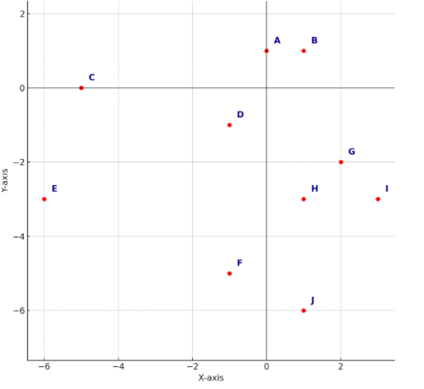
Set of 10 point in 2D plane

Slide 20
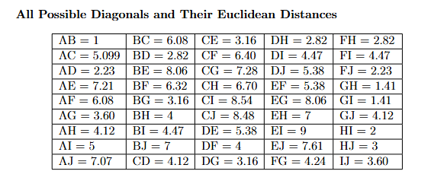
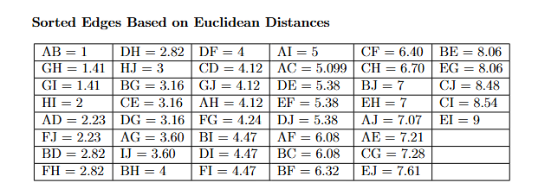

Slide 21
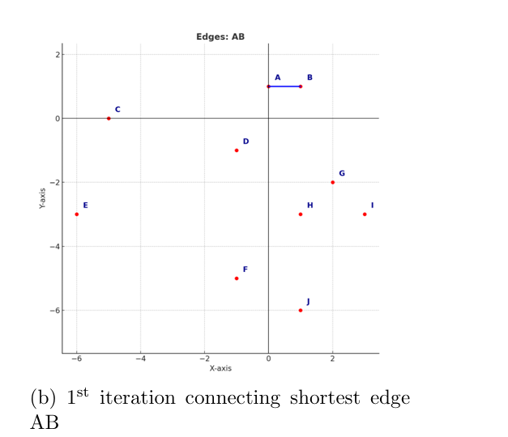
Iteration 1
AB=1

Slide 22
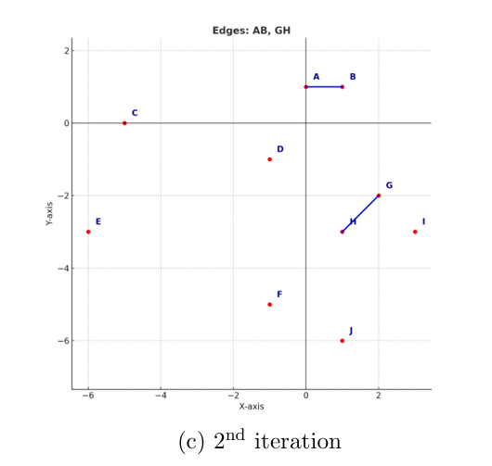
Iteration 2
GH=1.41

Slide 23
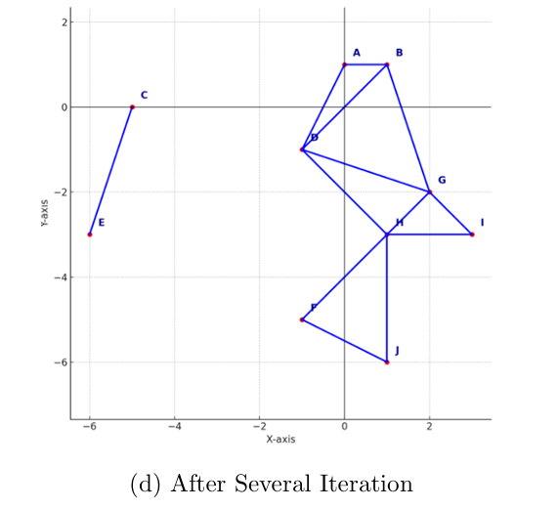
Now joint GI,HI,AD,FJ,BD,FH,DH,HJ,BG,CE; according to increasing length because their are not intersect with others.

Slide 24
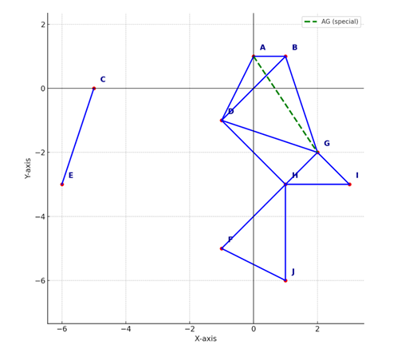
We cannot include the edge AG because it intersects with other existing edges. So we discard it.

Slide 25
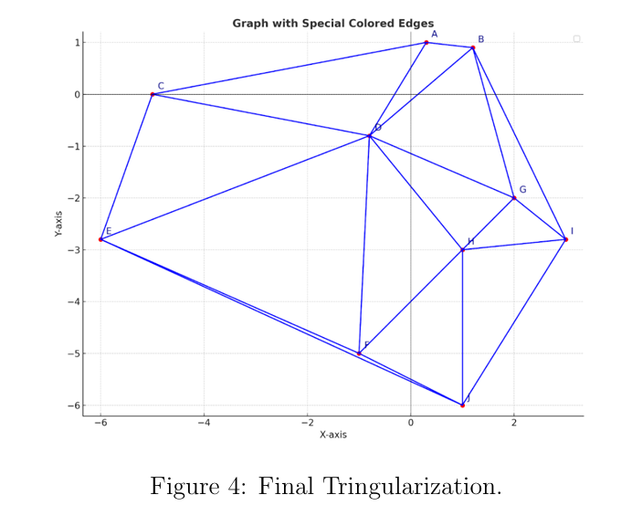
The final triangulation is obtained using a greedy method. The total number of Triangles is given by the formula:
2n−h−2,
where n is the total number of points and h is the number of points on the convex hull.
Total weight is 70.9586

Slide 26
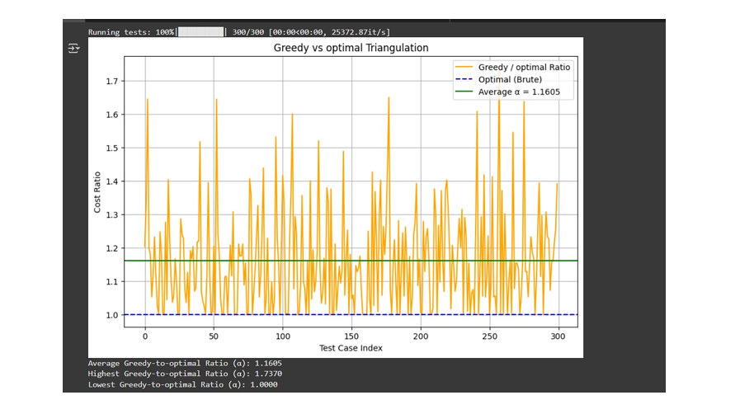
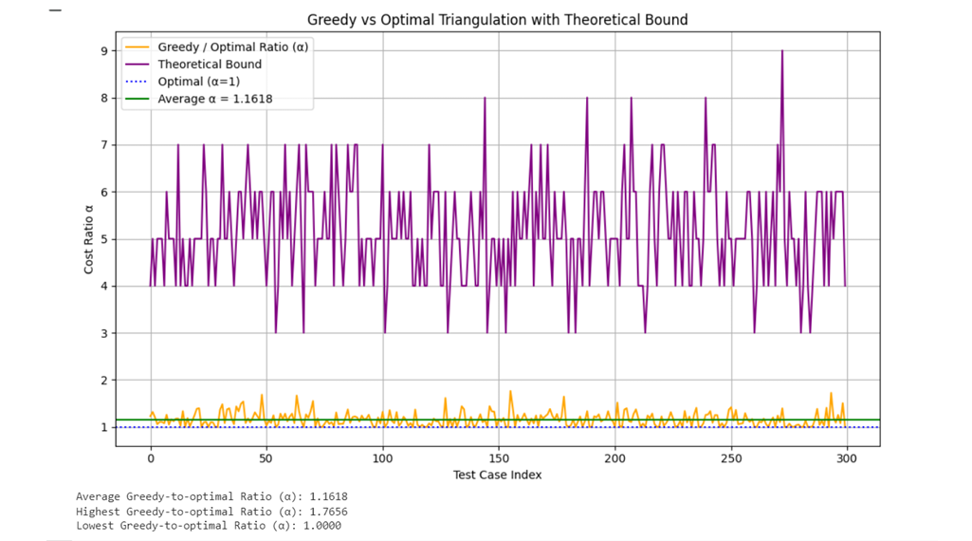
Theoretical vs. Practical Performance Comparison

Slide 27
Dynamic Programming
Algorithm - Stepwise Process
Compute convex hull
Separate interior points
Triangulate convex hull via DP
Insert interior points
Calculate total perimeter

Slide 28
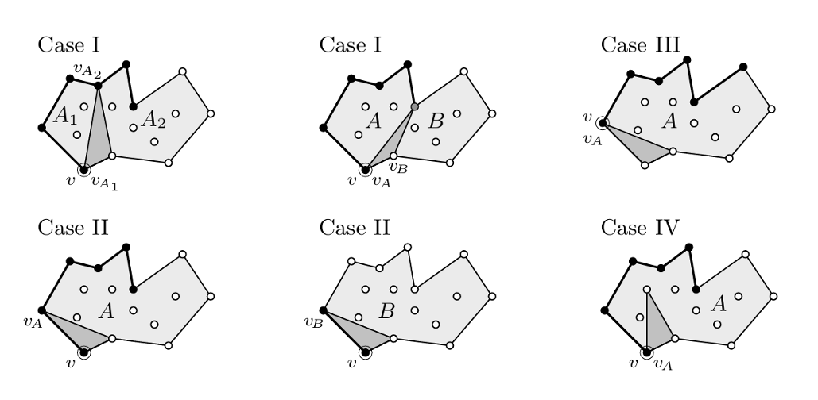
Case I: Split the polygon into two parts by connecting a vertex v to an intermediate vertex. Recursively triangulate both parts, then add the triangle formed by v, the f irst part’s vertex and the second part’s vertex.
CaseII: Split the polygon at an intermediate vertex vA. Form a triangle (v,vA,vA+1) and recursively triangulate the remaining polygon.
Case III: A small triangle is formed directly by three adjacent vertices (v,vA,vA+1), and the rest of the polygon is solved recursively.
Case IV: A point v is inserted inside an existing triangle. The triangle is then replaced with three smaller triangles connecting v to each pair of the original tri angle’s vertices

Slide 29
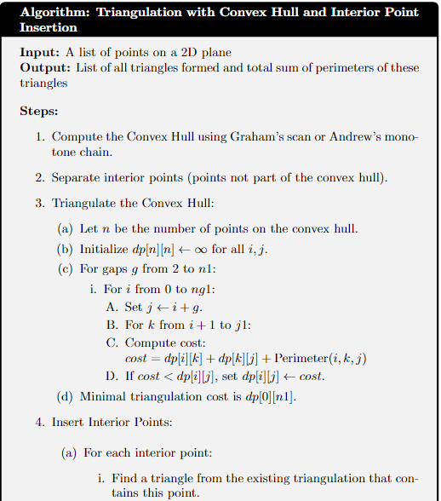
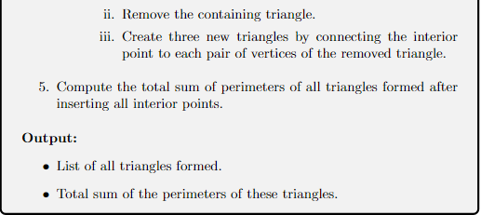
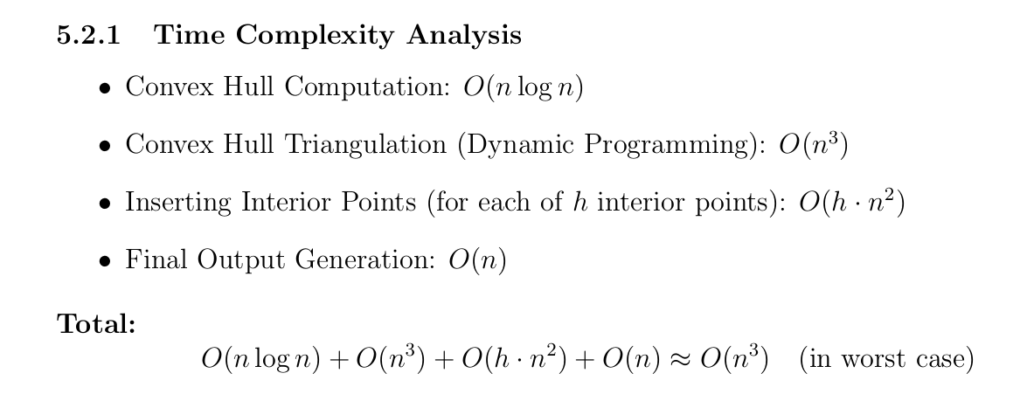

Slide 30
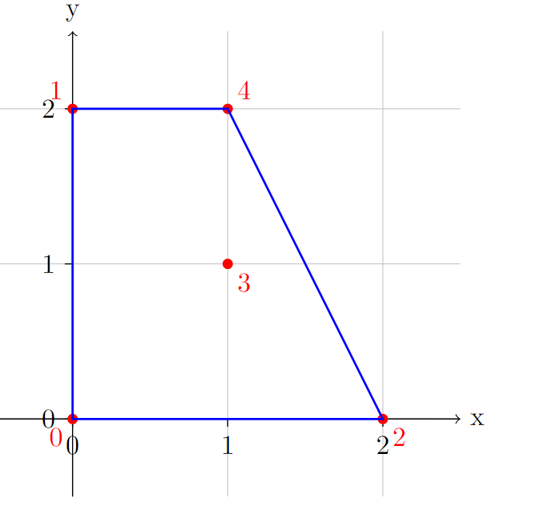
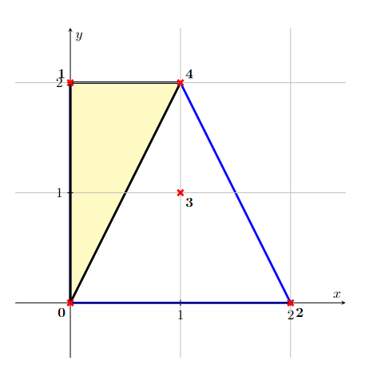
Illustrative Example
Iteration 1

Slide 31
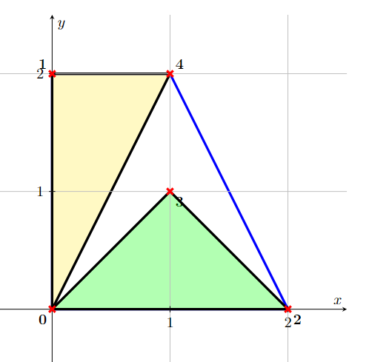
Iteration 2

Slide 32
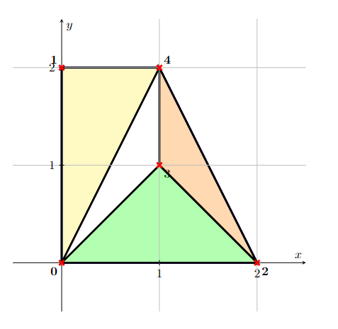
Iteration 3

Slide 33
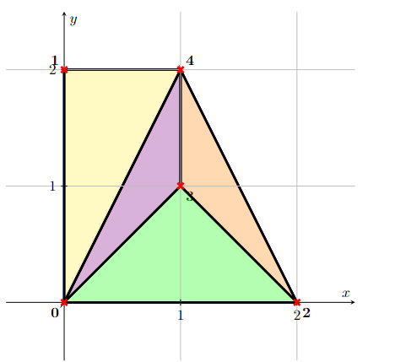
Iteration 4
Final Total Weight = 13.30

Slide 34
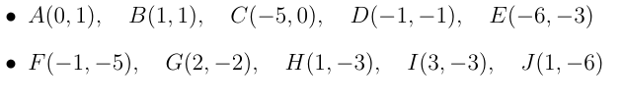
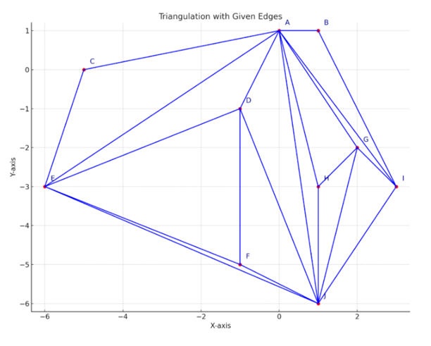
Greedy VS DP

Slide 35
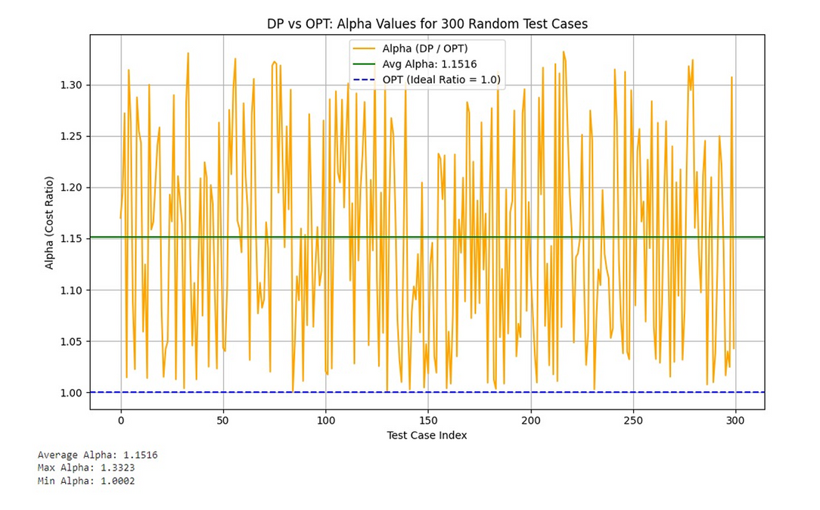
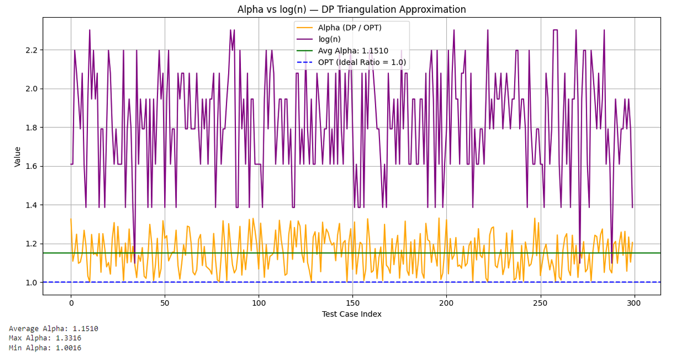
Theoretical vs. Practical Performance Comparison

Slide 36
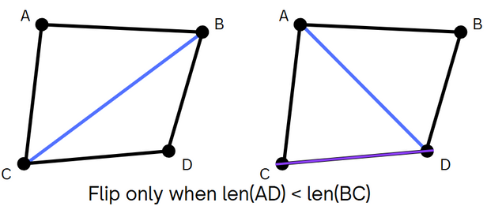
Local Search Algorithm
Construct a triangulation of n points and compute the triangulation cost.
For each pair of adjacent triangles, purpose an edge flip (flip the diagonal). Now compute the triangulation cost.
If it’s less than the previous one, then update the triangulation and the cost.
Do this for all pair of adjacent triangles. Repeat this until no flip is performed.
Total Time complexity : O(n * I) ;
where I is the number of iterations

Slide 37
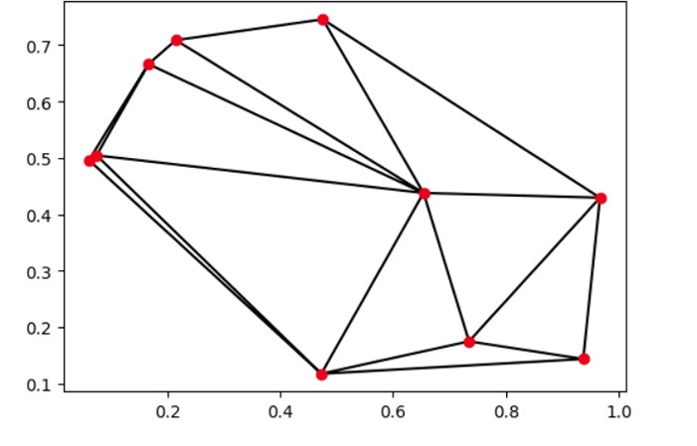
Local Search Algorithm
Initial Triangulation

Slide 38
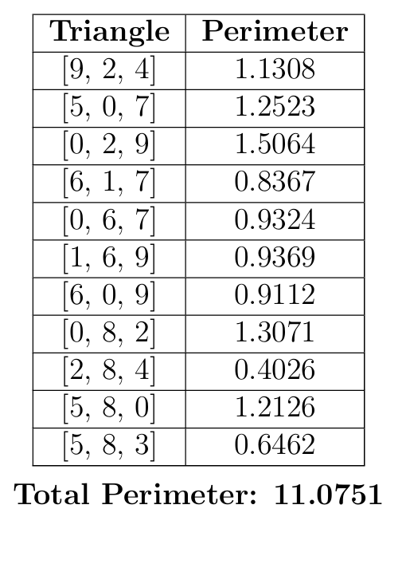
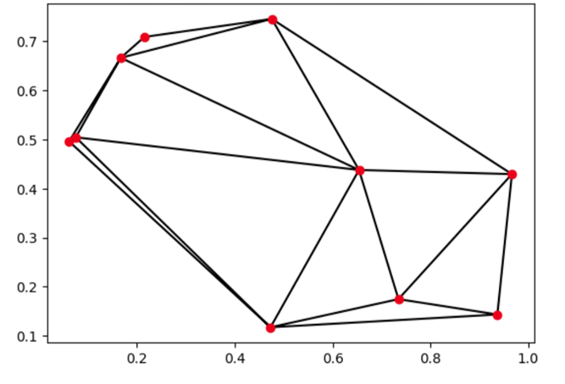
Local Search Algorithm
1st iteration

Slide 39
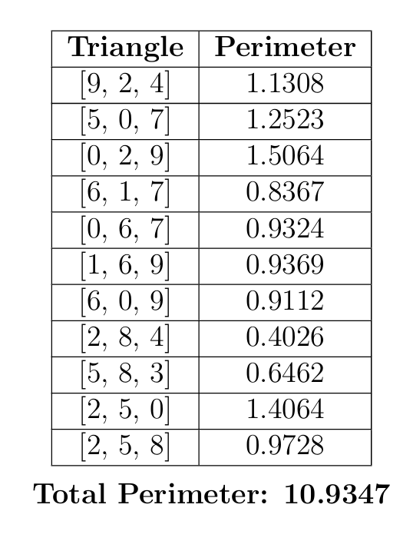
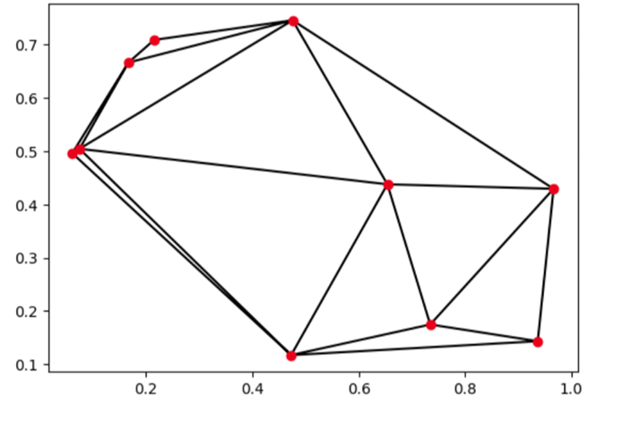
Local Search Algorithm
2nd iteration

Slide 40
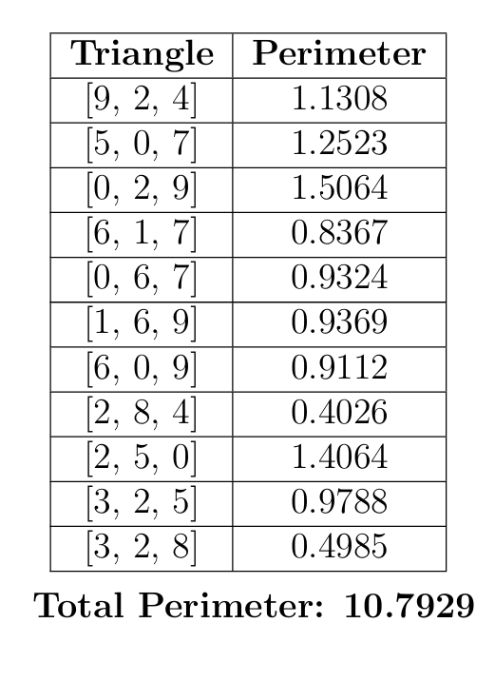
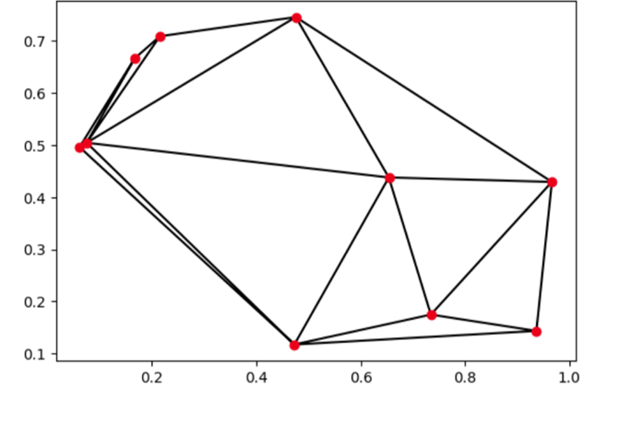
Local Search Algorithm
3rd iteration

Slide 41
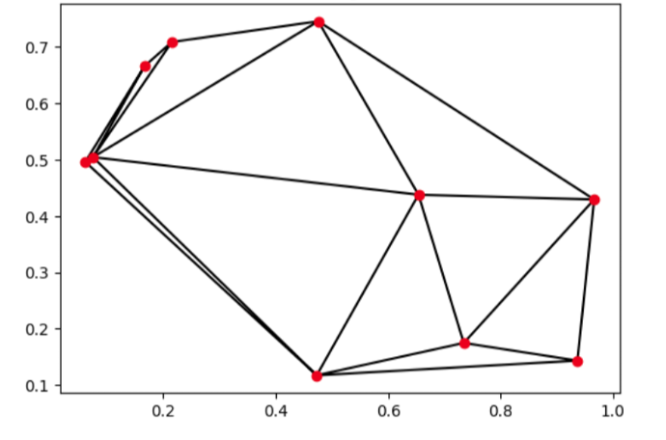
Local Search Algorithm
Final iteration (Optimal Triangulation)

Slide 42
Grid Based Algorithm

Slide 43
Grid Based Algorithm

Slide 44
Grid Based Algorithm

Slide 45
Grid Based Algorithm

Slide 46
Grid Based Algorithm

Slide 47
Grid Based Algorithm

Slide 48
Grid Based Algorithm

Slide 49
Grid Based Algorithm

Slide 50
Grid Based Algorithm

Slide 51
Grid Based Algorithm

Slide 52
Grid Based Algorithm
(High level idea)
Complexity Analysis:
• Bounding box: O(n)
• Recursive partitioning (Quad-tree): O(n*log n)
• Local Triangulation (4 points): O(1)
• Merging the Triangulations (boundary points): O(n*log n)
• Output the Triangulation: O(1)
Thus, overall Time Complexity is: O(n*log n)

Slide 53
Thank you

