Slide 1
8051 BASED Automatic Restroom System
By Nirvan Tamhane

Slide 2
Block Diagram

Slide 3
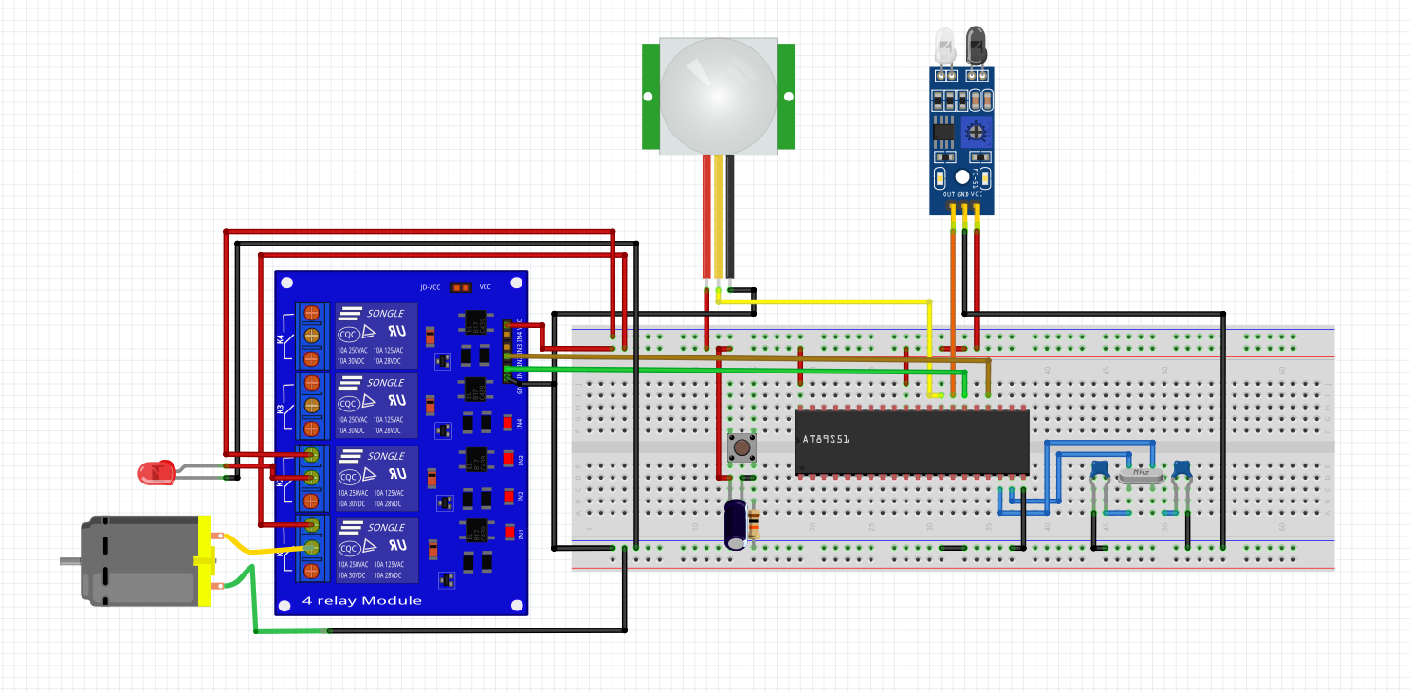
Circuit Diagram

Slide 4
Advantages of the system
Being contactless, it is very hygienic.
Saves water.
Saves electricity.
Very easy to use by people of all ages.
Majorly automated.

Slide 5
Disadvantages of the system
IR sensor won’t differentiate between people and objects.
PIR delay stays same irrespective of process carried out.
Will use same quantity of water irrespective matter flushed.

Slide 6
Challenges faced
Unable to program the microcontroller as the module couldn’t recognise device signature.
Ambient movement was affecting the PIR sensor output values.
IR sensor was unable to detect motion.
Motor consumes very high amount of power, so external power supply needed to be given.

Slide 7
Solutions to challenges faced
Learnt how to connect PIR and IR sensor with 8051 through various electronic blog posts and forums.
Used the Arduino Uno R3 board as the primary ISP programmer for 8051 interfacing.

Slide 8
Thank You!

