Slide 1

Symbiosis Institute of Technology, Pune
Foundations of Agentic AI | Continuous Assessment 3 (CA-3)
ReturnWise
A Multi-Agent AI System for Intelligent E-commerce Return and Refund Resolution
Submitted by
Faculty guide
Nirvan Uttamchandani
PRN: 24070126125
Neel Lakhani
PRN: 24070126120
Dr. Harshal Raut
Proof of Concept: Streamlit UI with synthetic data
Notes:
Introduce the project, the team and the faculty guide. ReturnWise is a five-agent system that recommends refund, replacement, rejection or manual review for e-commerce return requests, using synthetic data only. The logo on this slide is a placeholder; replace it with the official SIT Pune logo (right-click, Change Picture).

Slide 2
Project requirements and where each one is covered
# | Requirement set by the faculty | Covered in
1 | Problem statement and domain justification | Slides 3-4
2 | Existing business challenge and proposed solution | Slides 4-5
3 | Agent roles, responsibilities and orchestration workflow | Slides 6-7, 10-11
4 | Complete architecture diagram: agents, data flow, tools, decisions | Slides 8-13
5 | Working Streamlit UI proof of concept (synthetic data) | Slides 14-17
6 | Output validation, results, limitations and future scope | Slides 18-22
7 | This presentation: problem, solution, architecture, demonstration | All slides
All data in the demonstration is synthetic: 20 fictional orders, 8 product categories and fictional store policies.
Notes:
This slide maps each of the seven required items to the slides where it is addressed, so the evaluator can navigate quickly.

Slide 3




Problem statement and domain justification
Problem statement
Support teams must decide, for every return request, whether to refund, replace, reject or escalate. Doing this by hand means checking the order, the product policy, the return window and the amount each time, which is slow, inconsistent and hard to audit.
Why e-commerce returns suit a multi-agent system
Rule-driven domain
Costly mistakes
Needs an audit trail
Naturally staged
Eligibility depends on explicit facts: order status, category, days since delivery, reason. Each fact can be checked by a program.
A wrong amount or an approved non-returnable item is real money lost, so decisions need an independent second check.
Every decision must be explainable afterwards: which data was read, which rule passed or failed, who decided what.
Intake, research, rule check, decision and review are distinct jobs, so each maps to a specialised agent.
Notes:
State the problem in one sentence, then justify why e-commerce returns are a good domain for a multi-agent design: the rules are explicit, the cost of a wrong decision is financial, and an audit trail is needed.

Slide 4
Existing business challenge and proposed solution
Existing challenge (manual process)
Proposed solution: ReturnWise
An agent opens the order, finds the policy and counts days by hand for each ticket
Two agents can decide the same case differently
Refund amounts are typed manually, so slips happen
Restricted items (digital licences, hygiene) can be approved by mistake
Ambiguous cases are not clearly flagged for review
No consistent record of why a decision was made
Five specialised agents run in a fixed order; each output is the next agent's input
Same rules applied every time, so the same case gives the same answer
Refund amount is read from the order record, never typed
A Critic agent re-checks the decision with 8 independent checks and can force one correction
Unclear cases go to manual review instead of being guessed
Every step, input, output and verdict is stored for audit
Notes:
Left side: how returns are typically handled today and where it hurts. Right side: what ReturnWise changes. Note that the system only RECOMMENDS; no payment is made, a human stays in control.

Slide 5
Solution overview: what ReturnWise does and what it deliberately does not
5
8
1
12
specialised agents
independent Critic checks
bounded correction loop
demo scenarios, all passing
What it does
What it deliberately does not do
Recommends refund, replacement, rejection or manual review
Shows each agent's input, output and hand-off in the UI
Detects and corrects a wrong amount or action
Saves the whole run in one database transaction
Move money: it never claims an order was refunded
Use an LLM or API key: rules are plain Python
Guess on missing or inconsistent data: it escalates
Use real customer data: everything is synthetic
Notes:
Emphasise the design decisions. Agents are deterministic Python so results are reproducible and testable, with no API key. The system recommends; it never says Refunded.

Slide 6
Agent roles and responsibilities
# | Agent (role) | Responsibility | Reads | Produces
1 | Intake and Planning (Planner) | Validates the order ID, normalises the reason, flags risky words in the description, builds the task plan | Form input | order_id, reason, description_flags, task_plan
2 | Order and Policy Research (Research) | Reads the order and product policy from SQLite, computes days since delivery and the window check, reports data inconsistencies | Intake output | order, policy, days_since_delivery, within_window, data_issues, evidence
3 | Eligibility Evaluation (Executor) | Applies four policy rules and guardrails (refund cap, missing dates); calculates the refund amount | Research output + reason | eligibility, permitted_actions, refund_amount, rule_checks, failed_rules
4 | Resolution (Business Automation) | Chooses refund, replacement, reject or manual review from the permitted actions and explains why | Intake + Research + Eligibility | recommended_action, refund_amount, policy_explanation, confidence
5 | Validation (Critic) | Runs 8 independent checks; on failure proposes corrected values for one correction pass and revalidates | Resolution + Research + Eligibility | validation_status, detected_errors, corrected_action / amount
The orchestrator (workflow.py) is the hub: it calls each agent, passes outputs along, stops early on an agent error and saves the run.
Notes:
Walk through the five agents left to right. Point out the Reads and Produces columns: they show that each agent consumes the previous agent's output. The Critic does not trust Eligibility or Resolution.

Slide 7
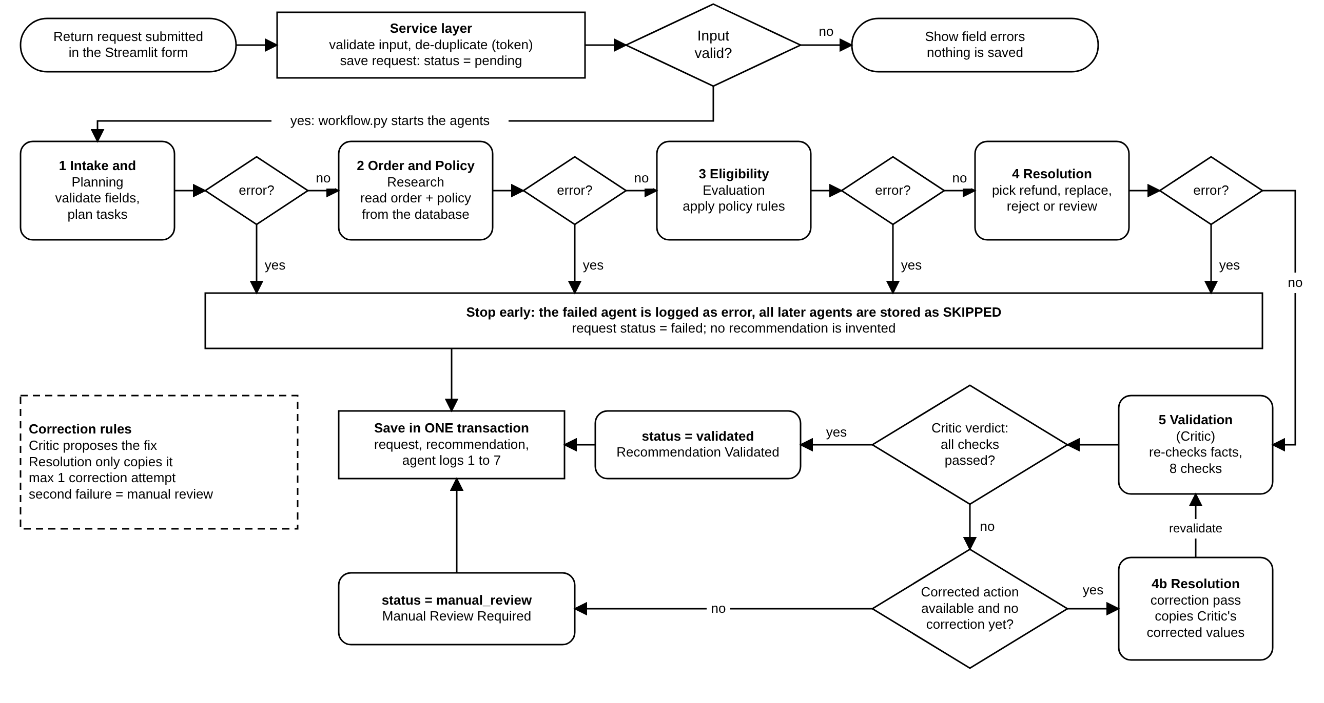
Orchestration workflow
Notes:
Explain the numbered flow. The orchestrator is a hub-and-spoke controller. Steps 6 and 7 only happen when the Critic fails the first validation, and the loop is bounded to one correction. If the correction does not fix it, the case goes to manual review.

Slide 8
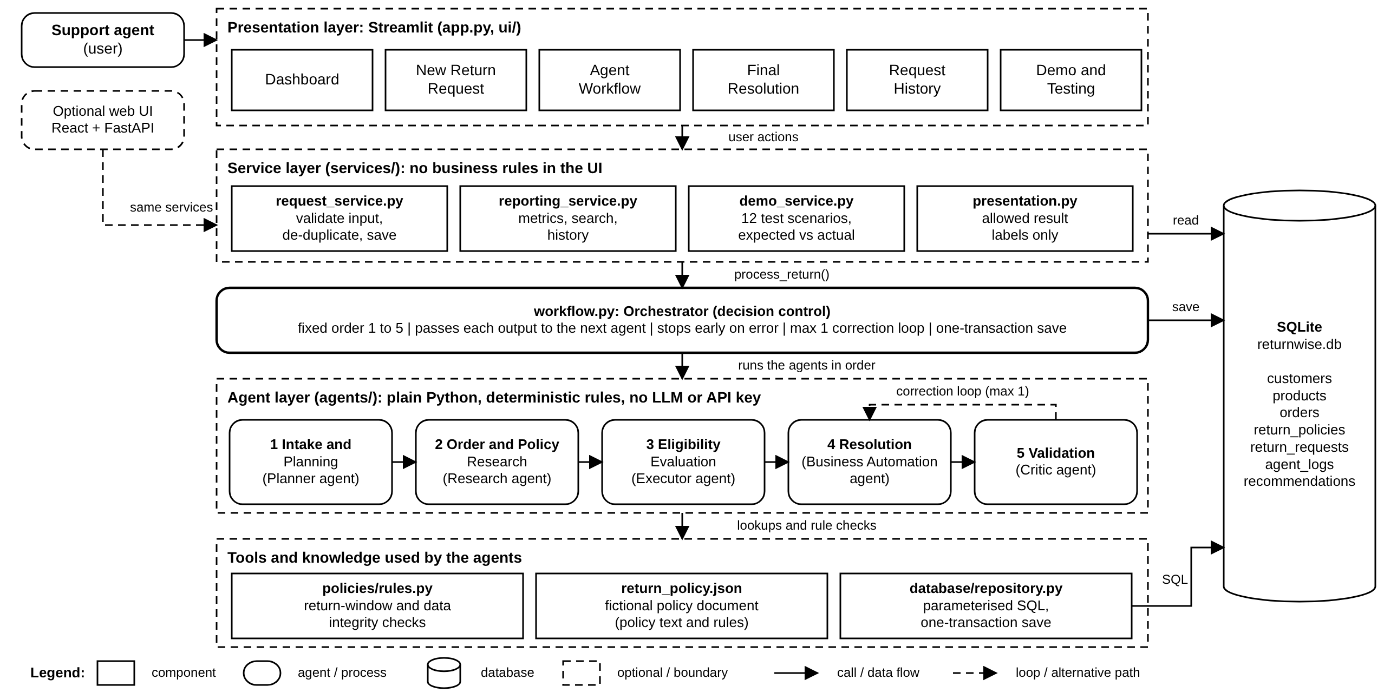
System architecture: layers, agents, tools and data stores
Notes:
Top to bottom: Streamlit UI, service layer, orchestrator, the five agents, tools (policy engine, repository, config) and SQLite. This diagram is also provided as an editable draw.io file.

Slide 9
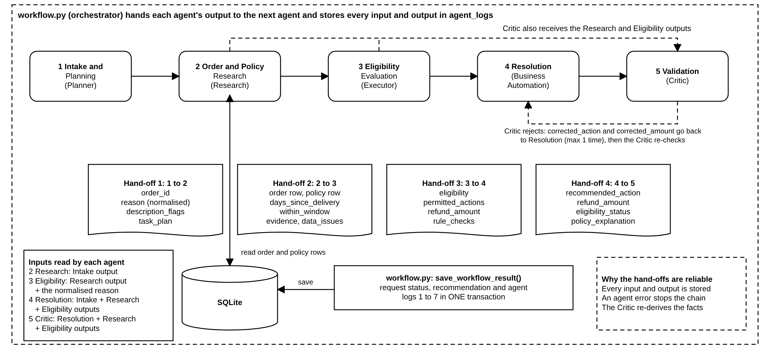
Agent collaboration: the data flowing from one agent to the next
Notes:
Each box lists the fields an agent hands on. This is verified by tests: 100 runs (20 orders x 5 reasons) check that the order ID, refund amount and eligibility are carried unchanged from agent to agent.

Slide 10
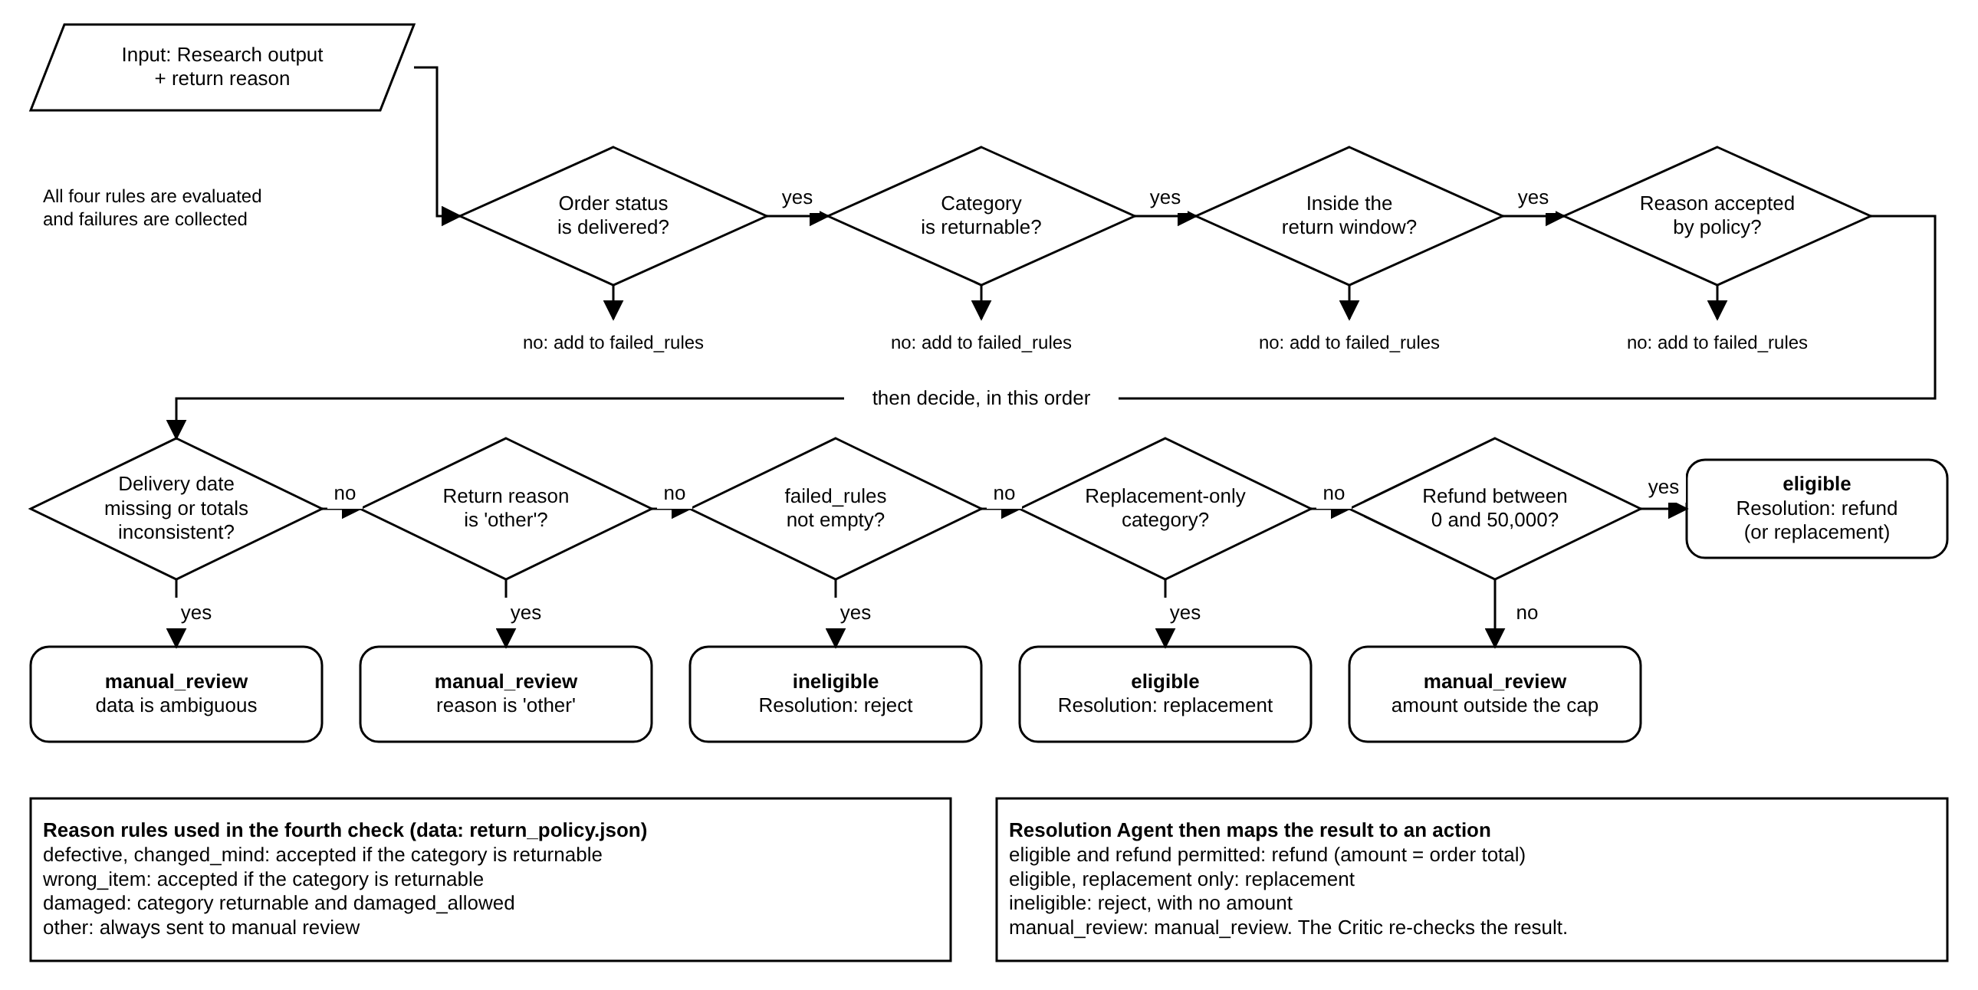
Decision-making: eligibility rules and outcome logic
Notes:
The Eligibility agent collects four rule results, then applies an ordered decision. Data problems and reason 'other' go to manual review before rules are considered; failed rules mean ineligible; replacement-only categories give replacement; otherwise refund after a cap check.

Slide 11
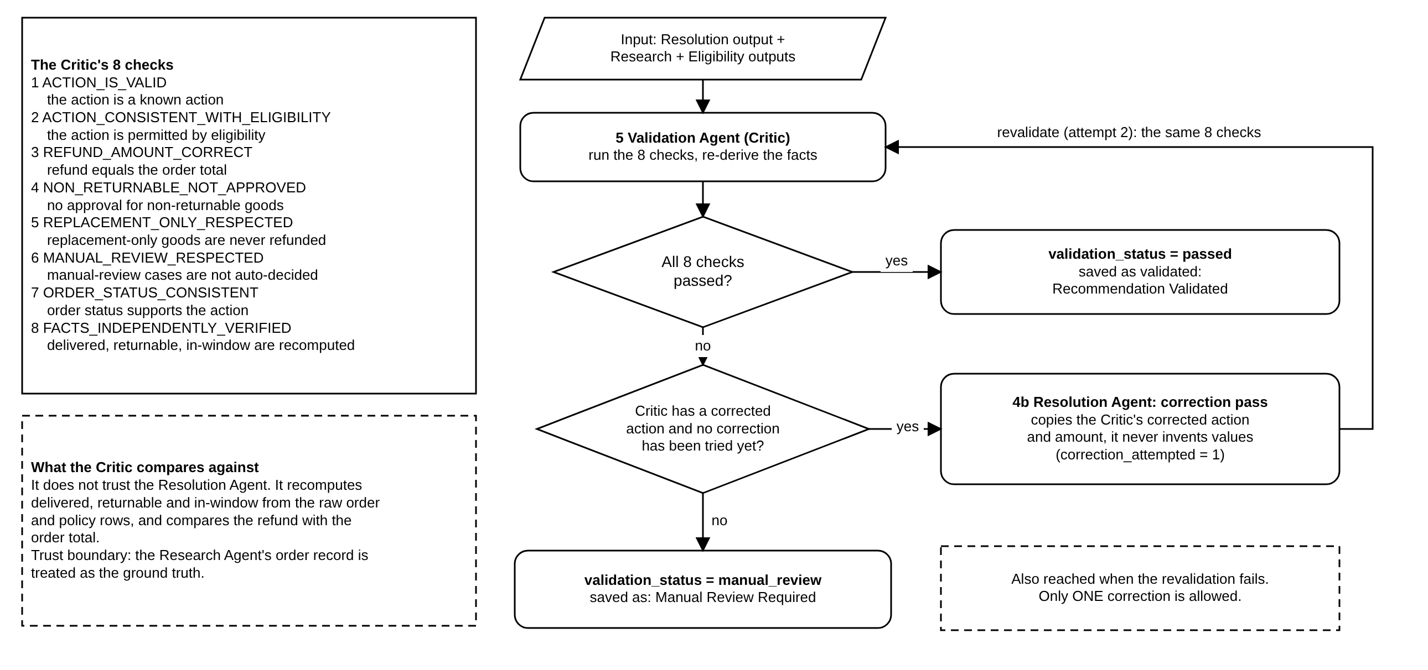
Decision-making: Critic validation and the bounded correction loop
Notes:
The Critic runs 8 checks. If any fails, the Resolution agent applies only the values the Critic proposes, then the Critic revalidates once. A second failure ends in manual review, so the loop cannot run forever.

Slide 12
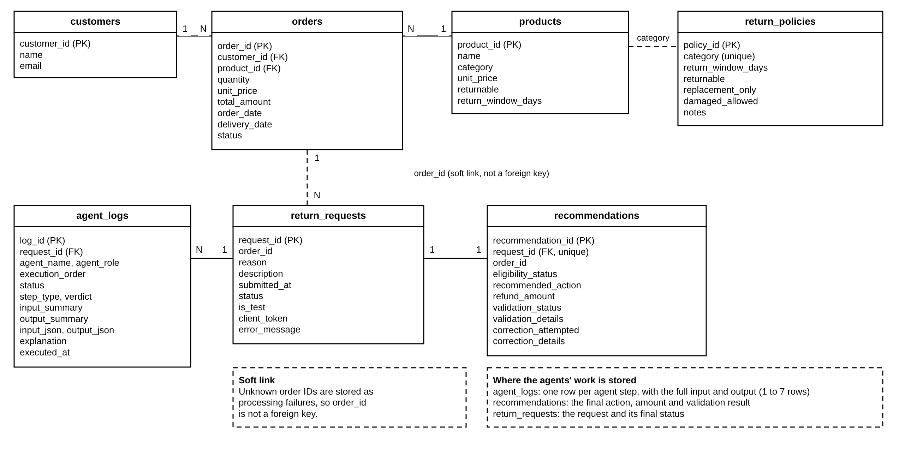
Data store: database schema (SQLite)
Notes:
Seven tables. return_requests.order_id is a deliberate soft link so a request for an unknown order can still be stored as a failed request. agent_logs holds every step's input and output summary.

Slide 13





Tools and technology stack
Testing
Data
pytest (206 backend tests), Streamlit AppTest, Playwright browser checks
SQLite with 20 synthetic orders, 8 product categories, store policies
Agents and logic
User interface
Python 3 agent modules, policy engine, orchestrator (workflow.py)
Streamlit 1.66 with six pages: Dashboard, New Return Request, Agent Workflow, Final Resolution, History, Demo and Testing
Optional web layer
Diagrams
FastAPI + React/TypeScript front end reusing the same Python backend (not required for the PoC)
Editable draw.io files plus SVG and PNG, black and white, one coordinate set
Notes:
All tools are open source and run locally. Python agents are plain functions, which makes them easy to test.

Slide 14
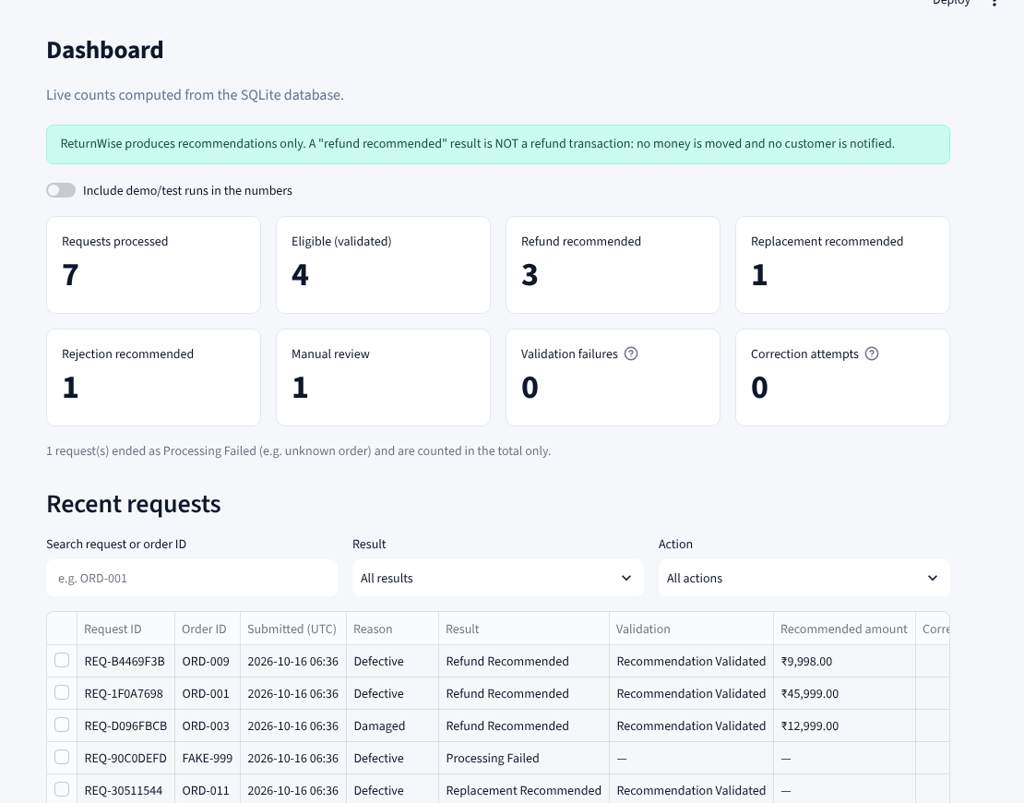
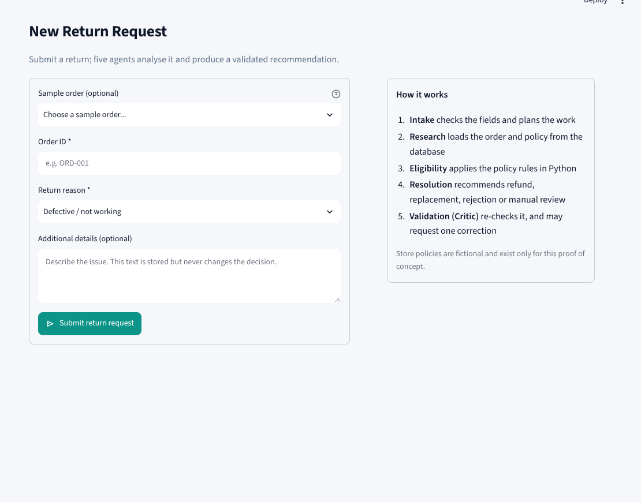
Streamlit PoC: dashboard and new return request
Dashboard: KPIs and recent requests, all read from SQLite
New Return Request: order ID, reason, optional description
Six pages: Dashboard, New Return Request, Agent Workflow, Final Resolution, Request History, Demo and Testing
A one-time token blocks duplicate submissions; labels say Refund Recommended, never Refunded, and no payment is made
Notes:
Show the live app here. The dashboard numbers come from the database. On the New Return Request page you enter an order ID and reason, or pick one of the sample orders. Everything is synthetic data.

Slide 15
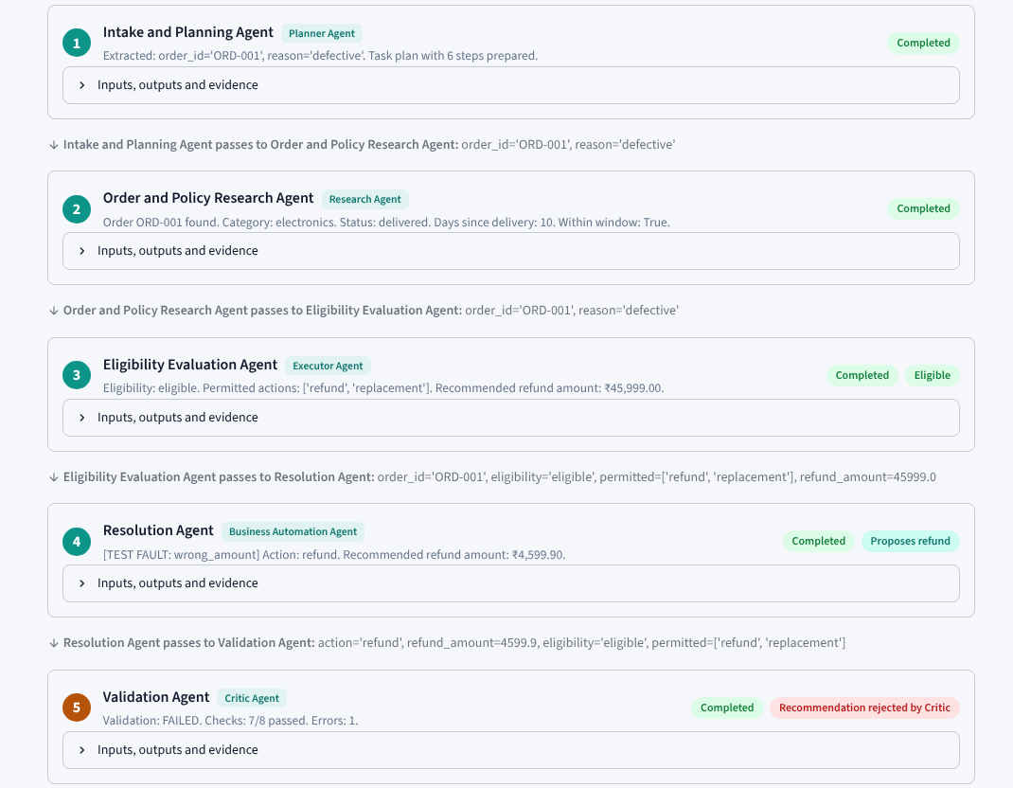
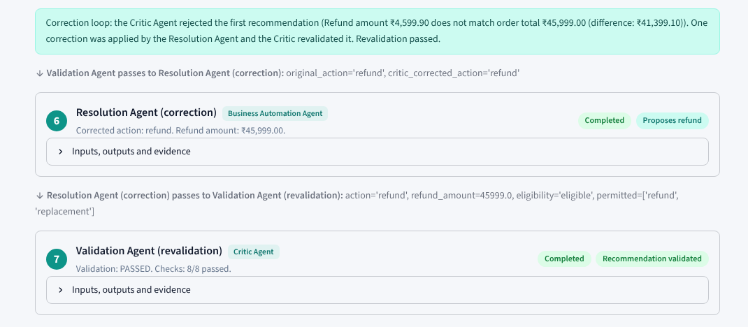
Demonstration: all five agents with the hand-off between them
Each agent is its own step; the arrow lines name the exact values handed on (for example refund_amount=45999.0)
Here the Resolution amount was deliberately corrupted (Rs. 4,599.90); the Validation agent fails it (7/8 checks)
One correction runs, the Critic revalidates (8/8) and the request is validated
Unknown order: later agents show Skipped, status Failed
Scenario SC-09, real run from the Streamlit app (Agent Workflow page)
Notes:
This is a real run of scenario SC-09, where an error is injected into the Resolution output. Read the screenshot top to bottom: every arrow line says which agent passes what to the next one. The Critic fails the first validation, Resolution is corrected, and the Critic revalidates and passes.

Slide 16
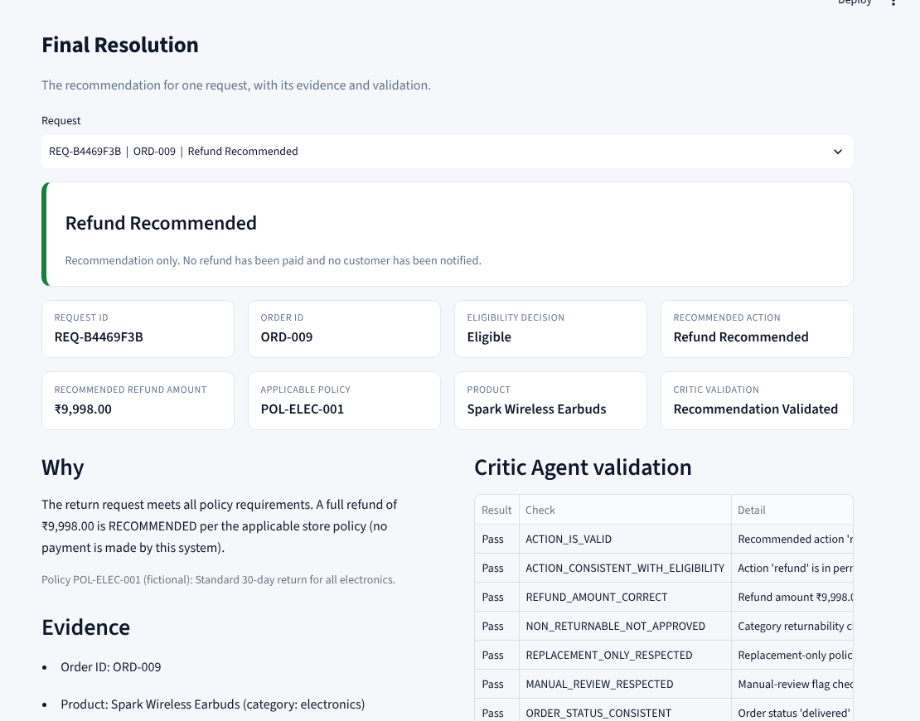
Demonstration: final resolution and Critic validation
What the page proves
Recommendation, amount and confidence in one card
Order facts and the policy ID that justified the decision
Every Critic check listed with pass or fail
Wording is always a recommendation
Example: ORD-001 (defective, delivered within the window) gives Refund Recommended for the full order total of Rs. 45,999.00, validated by the Critic.
Notes:
The Final Resolution page shows the recommendation with its label, the order and eligibility details, the supporting evidence, and the Critic's validation table. No payment is made.

Slide 17
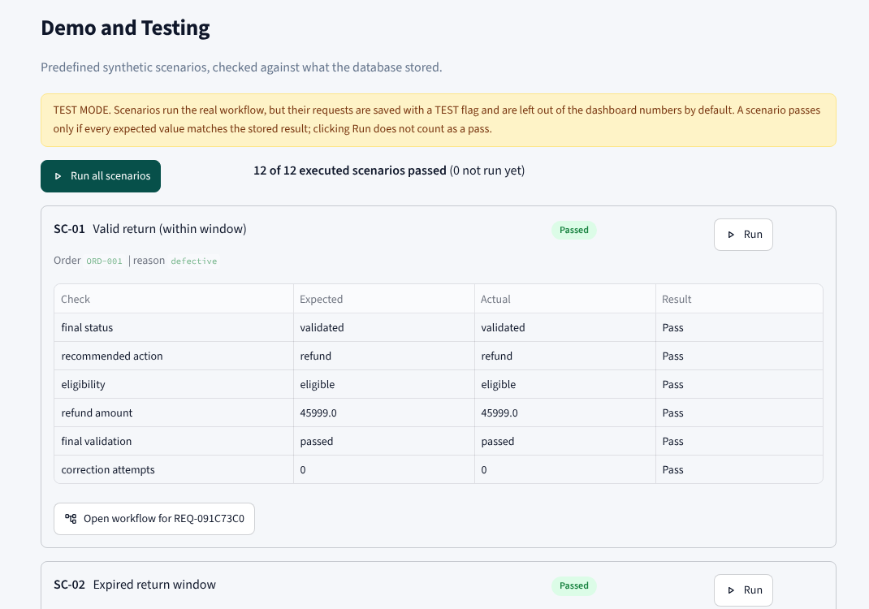
Demonstration: built-in test scenarios (Demo and Testing page)
How the scenarios are judged
Each scenario states its expected outcome up front
Pass is computed from checks on the stored result, not typed in
Includes fault injection (wrong amount, wrong action, persistent error)
12 of 12 executed scenarios pass
Run it yourself: streamlit run app.py then open Demo and Testing and press Run all scenarios.
Notes:
The Demo and Testing page runs 12 scripted scenarios against the real agents and marks each as pass or fail only from its own checks. Twelve of twelve pass. SC-06 writes nothing, so 11 requests are stored.

Slide 18


Output validation: how the results were checked
At run time
Critic agent: 8 independent checks on every decision, with one bounded correction and revalidation.
Automated tests
206 backend tests plus 8 browser tests and 18 front-end tests; 100-run collaboration matrix; fault-injection tests.
Manual inspection
Pages opened in Chromium at 1440 x 900 and screenshots reviewed; not a substitute for user testing.
Last run: 206 passed in 8.5 s (backend). Browser and front-end suites were run separately.
Notes:
Three layers: the Critic agent at run time, automated tests, and a manual visual check. Be clear about the split: the tests check logic and text; the appearance was checked by viewing screenshots in Chromium.

Slide 19
Results: the 12 demonstration scenarios
ID | Scenario | Expected and observed outcome | Result
SC-01 | Valid return, within window | Refund Rs. 45,999 | Pass
SC-02 | Expired return window | Reject | Pass
SC-03 | Damaged product, within window | Refund Rs. 12,999 | Pass
SC-04 | Restricted product (digital licence) | Reject | Pass
SC-05 | Unknown order | Failed; agents 3-5 skipped | Pass
SC-06 | Missing order ID | Rejected at intake; nothing saved | Pass
SC-07 | Reason = other | Manual review | Pass
SC-08 | Replacement-only category | Replacement | Pass
SC-09 | Injected wrong amount | Critic fails it; corrected to Rs. 45,999; revalidated | Pass
SC-10 | Injected wrong action | Critic fails it; corrected to Reject; revalidated | Pass
SC-11 | Correction cannot fix the error | Escalated to manual review | Pass
SC-12 | Already-returned order | Reject | Pass
12 of 12 executed scenarios pass. Pass or fail is computed from checks on the stored result.
Notes:
Every scenario matched its expected outcome. The four rows with a correction show the Critic loop working: SC-09 and SC-10 are fixed after one correction; SC-11 cannot be fixed and is escalated to manual review.

Slide 20
Limitations
Synthetic data only
Rule-based agents, no LLM
20 fictional orders and invented policies; the reference date is pinned to 2025-02-15 so results are reproducible.
Agents are deterministic Python. The free-text description is only keyword-flagged, not understood.
Critic trust boundary
Narrow business scope
The Critic re-verifies Eligibility and Resolution but treats the order record read by Research as ground truth.
Full refunds only: no partial refunds, restocking fees, shipping costs, photo evidence or fraud signals.
No integrations
Scale and screens
No real payment, notification or order-system connection; no login or roles.
SQLite is single-writer; layout was tested at laptop size (1440 x 900), not on phones.
Notes:
Be upfront about these. The Critic trust boundary is a real design limit: it re-checks Eligibility and Resolution, but takes the Research agent's order record as ground truth.

Slide 21
Future scope
1
2
3
Add an LLM carefully
Stronger Critic
Richer policies
Use an LLM only to summarise or classify the description. Treat its output as untrusted; it can never override the rules.
Let the Critic re-read the order from the database itself so it no longer trusts the Research agent's record.
Partial refunds, restocking fees, photo evidence and fraud signals, with a policy editor.
4
5
6
Real integrations
Production backend
Evaluation at scale
Connect to payment, order management and notifications, with human approval before any money moves.
Move from SQLite to a server database with a job queue; add login, roles and monitoring.
Test on anonymised real returns and measure agreement with human decisions.
Notes:
These are proposed next steps, not things that exist today. The key principle for any LLM addition: its output is untrusted and may never override the rules.

Slide 22

Conclusion
Problem and domain
Return decisions are rule-driven, costly if wrong and need an audit trail.
Solution
Five agents with explicit hand-offs, orchestrated by one controller, with a Critic and a bounded correction loop.
Evidence
12 of 12 scenarios pass; 206 backend tests pass; a 100-run matrix confirms outputs flow from agent to agent.
Honest limits
Synthetic data, rule-based agents and a documented Critic trust boundary.
Thank you. Questions?
Nirvan Uttamchandani (24070126125) | Neel Lakhani (24070126120) | Guide: Dr. Harshal Raut
Notes:
Close by tying back to the seven requirements. Invite questions and offer a live demo of the Streamlit app.

