Slide 1

Data Salon
Zhang Yi
Nov. 05, 2019

Slide 2
Data Salon
Generating Sentences from a Continuous Space
Oriol Vinyals, Andrew M. Dai, Rafal Jozefowicz & Samy Bengio
Presenter: Zhang Yi

Slide 3
Motivation
Generative models for natural language sentences :
Machine translation
Image captioning
Dataset summarization
Chatbots...
Want to explicitly model holistic properties of sentences such as style, topic, and high-level syntactic features.
Notes:
图片字幕 数据集汇总 聊天机器人
整体属性

Slide 4
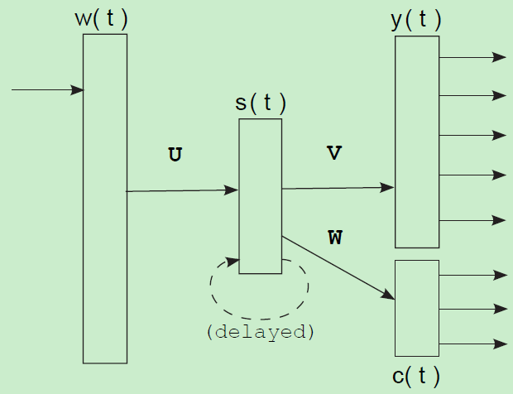
Introduction: RNNLM
Recurrent Neural Network Language Model:
The state-of-the-art generative model for natural language.
A standard RNN language model predicts each word of a sentence conditioned on the previous word and an evolving hidden state.
Drawback: it only looks at the relationships between consecutive words→ can not capture the global characteristics of a sentence.

Slide 5
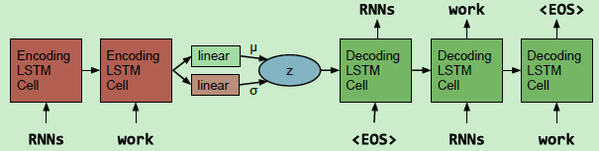
Introduction
Variational Autoencoder for Natural Language Sentences:
Bring the idea of Variational Autoencoder (VAE) into natural language sentences.
z -- not a representation vector, but a continuous latent space.

Slide 6
Introduction: Contribution
Proposed the variational autoencoder architecture for text sentence.
Evaluated the performance on the language modeling task and the missing word imputing task comparing to RNNLM.
Conducted qualitative / quantitative analysis on the proposed model.

Slide 7
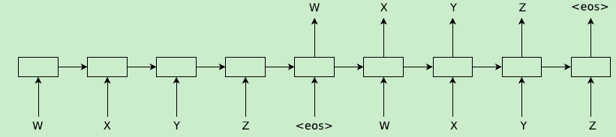
Background: Mapping a sentence to a latent space
Sequence Autoencoders
Using seq2seq architecture as an autoencoder.
Both encoder and decoder are RNNs.
Andrew M. Dai and Quoc V. Le. 2015. Semisupervised sequence learning. In Proc. NIPS.

Slide 8
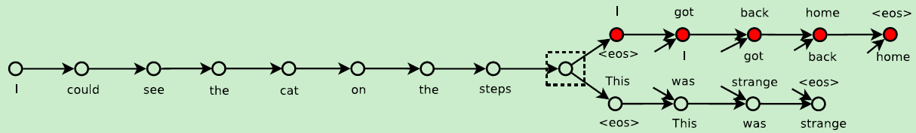
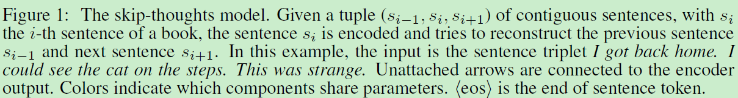
Background: Mapping a sentence to a latent space
Skip Thought Vector
One encoder and two decoder to predict previous sentence and next sentence.
Ryan Kiros, Yukun Zhu, Ruslan Salakhutdinov, Richard S Zemel, Antonio Torralba, Raquel Urtasun, and Sanja Fidler. 2015. Skip-thought vectors. arXiv preprint arXiv:1506.06726.

Slide 9
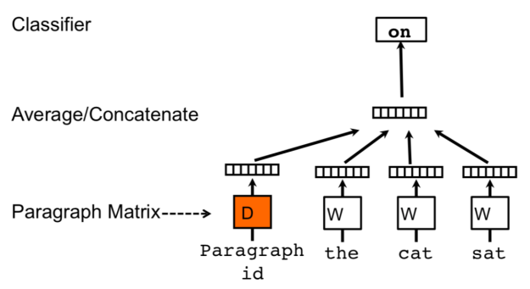
Background: Mapping a sentence to a latent space
Paragraph Vector
Trains W to predict next words using D as contexts/memory.
Paragraph matrix D →sentence, Vocabulary matrix W →word.
non-RNN model.
Quoc V. Le and Tomas Mikolov. 2014. Distributed representations of sentences and documents. In Proc. ICML.

Slide 10
Background: Mapping a sentence to a latent space
Attention.
Multi-task learning.
Conversations learning.
https://zhuanlan.zhihu.com/p/54874433.
Notes:
https://blog.acolyer.org/2016/06/01/distributed-representations-of-sentences-and-documents/

Slide 11
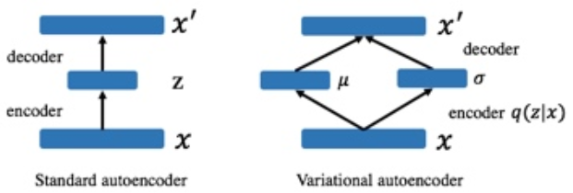
Background: Variational autoencoder
Regular autoencoders learn only discrete mappings from point to point.
Learns inputs not as single points, but as regions in the latent space.
Replace the deterministic encoder φ_{enc} with a probability distribution, q(z|x).
KL divergence is introduced to make q(z|x) close to a prior p(z).
If learned with just a reconstruction loss, variances in q(z|x) get extremely small (=q(z|x) becomes deterministic).

Slide 12
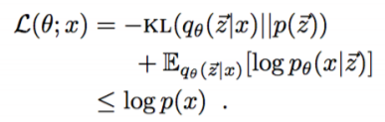
Background: Variational autoencoder
Modified loss function:
The regular autoencoder’s loss function would be encouraged to learn posteriors as close to discrete as possible – in other words, Gaussians that are clustered extremely tightly around their means.
If learned with just a reconstruction loss, variances in q(z|x) get extremely small (=q(z|x) becomes deterministic).
In order to enforce the posterior’s similarity to a well-formed Gaussian, a KL divergence term is introduced.

Slide 13
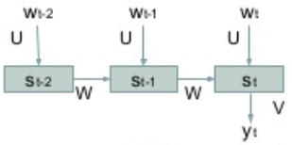
VAE for sentences
Use single-layer LSTM for both the encoder and decoder.
The decoder can be regarded as a special version of RNNLM conditioned by the hidden code.
Explored some variations → no significant improvements.
Concatenating z every time step.
Soft-plus activation.
Feedforward between (encoder, latent variable) and (decoder, latent variable).
Variational autoencoder
RNNLM

Slide 14
VAE for sentences: similar models
Variational Recurrent Autoencoder (VRAE). [Fabious and van Amersfoort, 2014]
Continuous latent variables with RNN-style modeling. [Bayer and Osendorfer, 2015]
→ Latent variables are separated per timestep.
Not suitable to capture the general sentence characteristics.
VAE-based document-level language model [Mial et al., 2015].
→ Input texts are models as bags of words.
→ Not suitable to capture the sequential characteristics.

Slide 15
Optimization Challenges
KL divergence tends to become zero. (=q(z|x)~p(x), equal to RNNLM).
Gives up capturing z and goes after explaining each sample with an optimized decoder.
→ KL cost annealing.
→ Word dropout and historyless decoding.

Slide 16

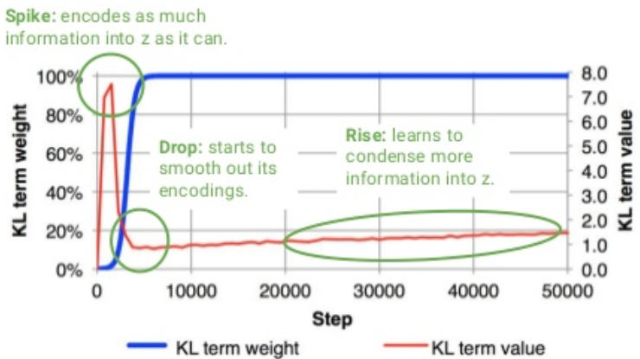
Optimization technique 1: KL cost annealing
Notes:
模型很简单，但实际训练时有一个很严重的问题：KL 会迅速降到0，后验失效了。原因在于，由于 RNN-based 的 decoder 有着非常强的 modeling power，直接导致即使依赖很少的 history 信息也可以让 reconstruction errors 降得很低，换句话说，decoder 不依赖 encoder 提供的这个 z 了，模型等同于退化成 RNNLM。
作者引入一个权重 w 来控制这个 KL 项，并让 w 从 0 开始随着训练逐渐慢慢增大。作者的意思是一开始让模型学会 encode 更多信息到 z 里，然后随着 w 增大再 smooth encodings。其实从工程/代码的角度看，因为 KL 这项更容易降低，模型会优先去优化 KL，于是 KL 很快就降成 0。但如果我们乘以一开始很小的 w，模型就会选择忽视 KL（这项整体很小不用降低了），选择优先去降低 reconstruction errors。当 w 慢慢增大，模型也慢慢开始关注降低 KL 这项了。

Slide 17
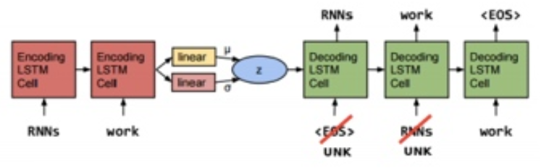
Optimization technique 2: Word dropout and historyless decoding
Weaken the decoder by replacing a fraction of words with the generic unknown word token UNK.
Notes:
在训练阶段，我们将decoder 的部分输入词替换为UNK，也就是说 RNN 无法仅依靠前面的生成的词来预测下一个词了，因此需要去多依赖 z。

Slide 18
Results: Language modeling
Objective: is a continuous latent variable helpful for a standard task (language modeling)?
Methods:
Baseline: RNNLM (non-variational)
Proposal: VAE (variational)
Dataset: Penn Treebank
Measurement: Likelihood (Disadvantage for VAE)
Baseline: True test likelihood
Proposal: Variational lower bound of likelihood

Slide 19
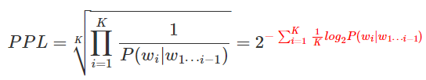
Restricted Boltzmann Machines
Perplexity(PPL) 迷惑度/困惑度/混乱度:
Perplexity is closely related to the cross entropy between the model and some test data
exponential of average per-word entropy of some test data
w -- word sequence
Notes:
2的指数部分与交叉熵非常相似，因此PPL可以理解为测试集中的单词平均熵的指数放大。所以，PPL实际上是放大了交叉熵，低PPL与低熵一样，都是能清晰地传递信息的词序列。

Slide 20
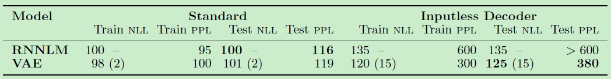
Results: Language modeling
NLL: negative log-likelihoods, PPL: perplexities.
Lower is better for both. () shows the KL loss.
Standard:
VAE’s performance is slightly worse than RNNLM.
Without optimization technique (KL annealing and dropout), the performance becomes the same as RNNLM.
Inputless decoder (dropout keep rate = 0 )
KL loss become huge, but VAE shows better performance than RNNLM.
Notes:
当我们使用softmax 函数作为 output function的时候, y=softmax(z) zz 在这里只表示某些需要优化的参数。
我们需要选择 negiative log-likelihood 作为代价函数( cost function), 也被称作 Cross-Entropy cost function.

Slide 21
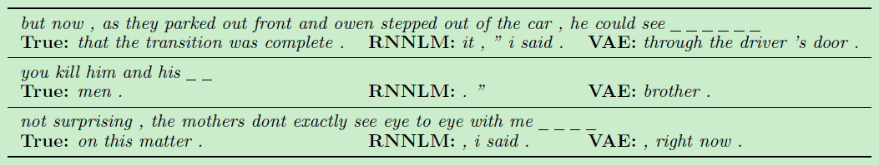
Results: Imputing missing words
VAE’s global sentence features are suited to do the task of imputing missing words.
Computing the likelihood is intractable. (Need to calculate for every vocabulary V each step!)
Introduces adversarial evaluation for quantitative evaluation.
Adversarial evaluation: How well the output can deceive the classifier to train.
Notes:
受到 GAN 的启发，作者还提出了一个 Adversarial evaluation，用一半真一半假的数据作为样本训练出一个分类器，再对比不同模型生成的句子有多少能骗过这个分类器，这个 evaluation 被用在 Imputing missing words 这个任务上，VAE 的表现同样比 RNNLM 出色。

Slide 22
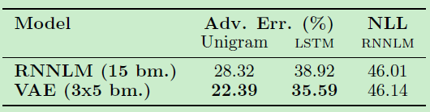
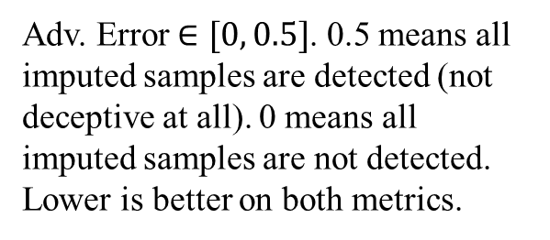
Results: Imputing missing words
Task: infer missing words in a sentence given some known words (imputation)
Classifier to train: A bag-of-unigrams & LSTM logistic regression classifier.
VAE shows lower adversarial error (= much deceptive) than RNNLM.
Negative log-likelihood is comparable.
RNNLM can make NLL lower by making “safe” answers.
(e.g. complete the sentence with “, he said.”)
RNNLM yields less diverse samples than VAE, but produces natural sentences by favoring generic high-probability endings.
Adv. Error $∈[0, 0.5]$. 0.5 means all imputed samples are detected (not deceptive at all). 0 means all imputed samples are not detected. Lower is better on both metrics.
Notes:
词袋模型

Slide 23
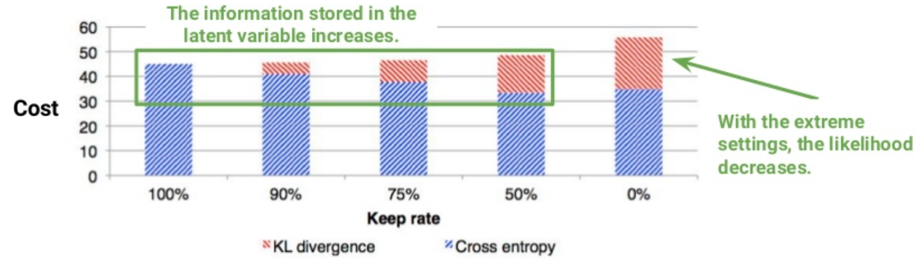
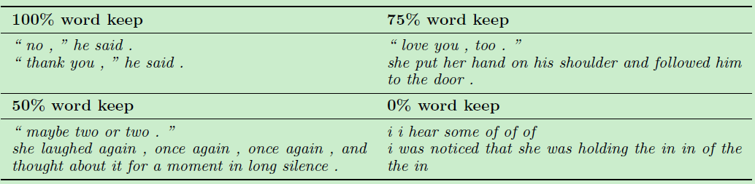
Analysis: The impact of word dropout
Too typical, not much topics are captured.
Far less typical. Has a clear topic.
Cease to be plausible English sentences.

Slide 24
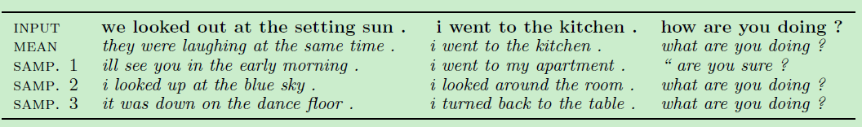
Analysis: Sampling from the posterior
Analysis on reconstructed input texts:
This is variational. It’s not re-outputting memorized samples.
It seems capturing the length and topic of given sentences.
As the sentence gets longer, the output becomes various.
Three sentences which were used as inputs to the vae, presented with greedy decodes from the mean of the posterior distribution, and from three samples from that distribution.

Slide 25
Analysis: Homotopies
Homotopy
Linear interpolations in sentence space between the codes for two sentences.
Outputs are grammatical and have consistent topic.
Similar syntax and topic but flipped sentiment can be problematic sometimes.
“the pain was unbearable"
“the thought made me smile”
have similar embeddings, a phenomenon which has been observed with single-word embeddings.
the vectors for “bad" and “good" are often very similar due to their similar distributional characteristics.
Notes:
同伦

Slide 26
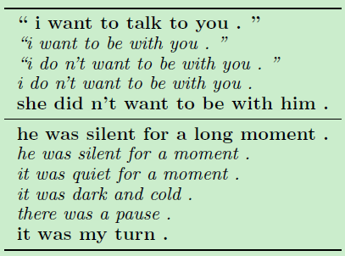
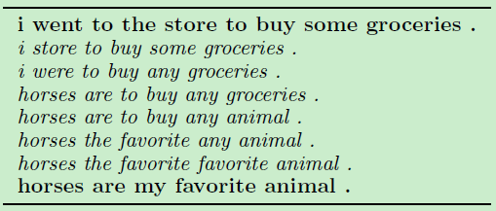
Analysis: Homotopies
Variational autoencoder outputs:
Sequence autoencoder outputs:
Sentences produced by greedily decoding from points between two sentence encodings with a conventional autoencoder. The intermediate sentences are not plausible English.
Paths between pairs of random points in vae space: Note that intermediate sentences are grammatical, and that topic and syntactic structure are usually locally consistent.

Slide 27
Conclusion
This paper introduces the use of a variational autoencoder for natural language sentences.
The novel techniques are useful to train model successfully.
The model is effective for impute missing words.
It is able to generate coherent and diverse sentences with smooth interpolation.
Future work
Factorization of the latent space.
Incorporating conditional settings.
Learning sentence embeddings with semi-supervised fashion learning.
Going beyond adversarial evaluation to a fully adversarial training objective.

Slide 28
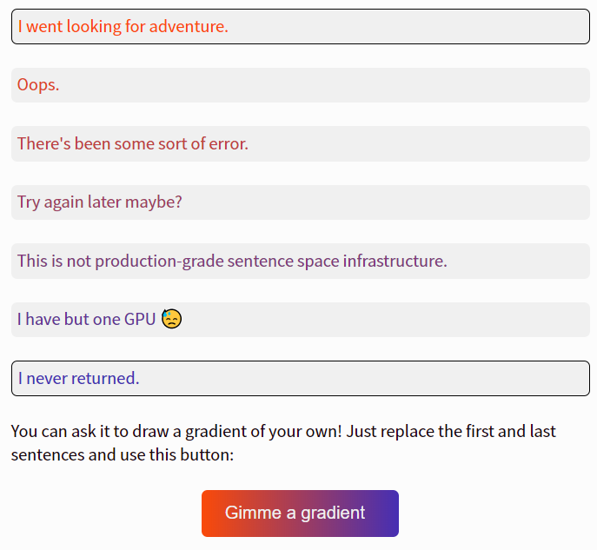
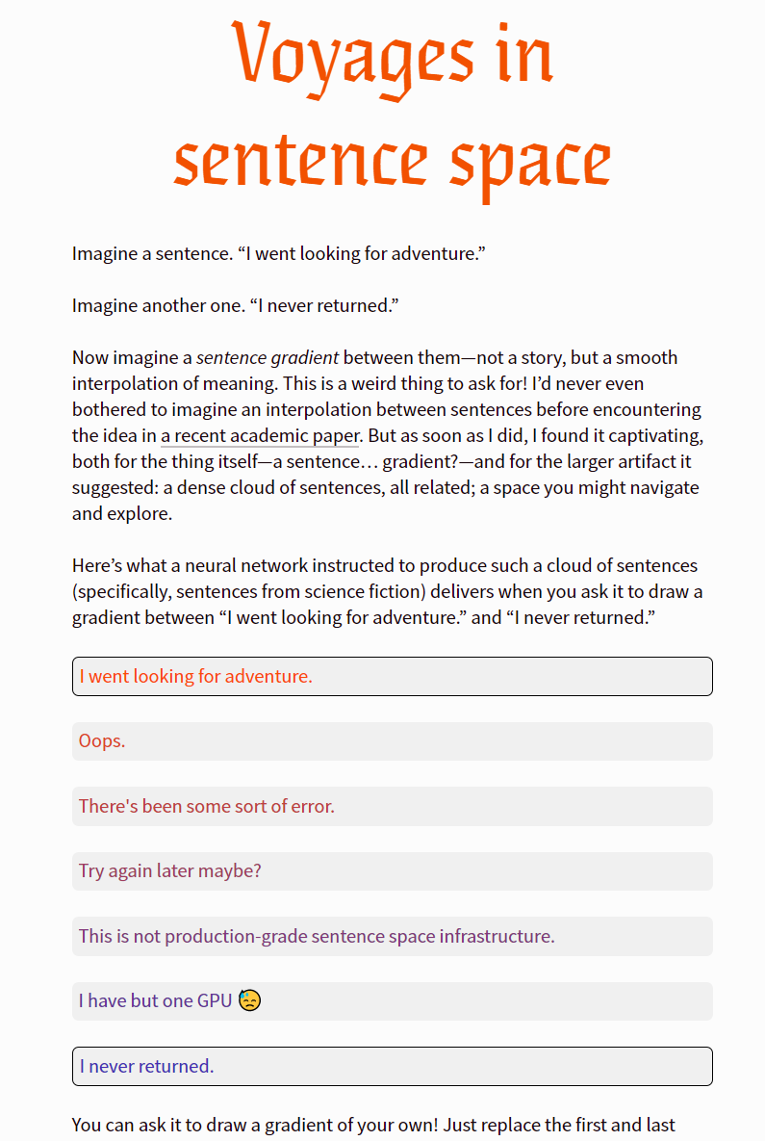
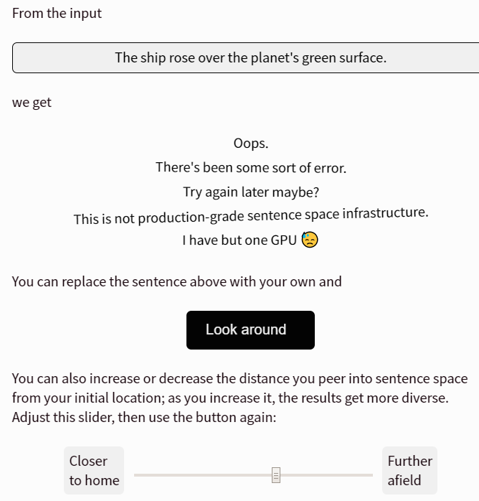
https://www.robinsloan.com/voyages-in-sentence-space/

Slide 29
Thank you !

