Slide 1



HTML Images
Images are a powerful tool for enhancing web pages. They can add visual interest, convey information, and even drive user engagement. This presentation explores key aspects of HTML images to help you master their use.
Notes:
1

Slide 2
Embedding Images
The img tag is the fundamental element for embedding images in HTML. The src attribute specifies the path to the image file.
The alt attribute provides alternative text for screen readers and users who cannot see the image. It's crucial for accessibility.
<img src="path/to/image.jpg" alt="Image description">
Notes:
2

Slide 3
Image Formats
PNG
JPEG (JPG)
Great for logos, graphics, and images with sharp lines. It's a lossless format, preserving all image data, but generally larger file sizes.
Best for photographs and images with smooth gradients. It's a lossy format, meaning some image data is removed, but it offers excellent compression.
SVG
GIF
Ideal for animated images and simple graphics. It's a lossless format, but it's limited in color depth and can be large for complex images.
Vector-based format, perfect for scalable graphics and icons. It's small in size and can be easily resized without losing quality.
Notes:
3

Slide 4
Image Dimensions
The width and height attributes specify the image's dimensions in pixels. This helps the browser reserve space for the image before it loads, enhancing page load speed.
It's best to set both width and height to avoid distortion. Use percentage values for responsive scaling.
<img src="image.jpg" alt="Image description" width="500" height="300">
Notes:
4

Slide 5
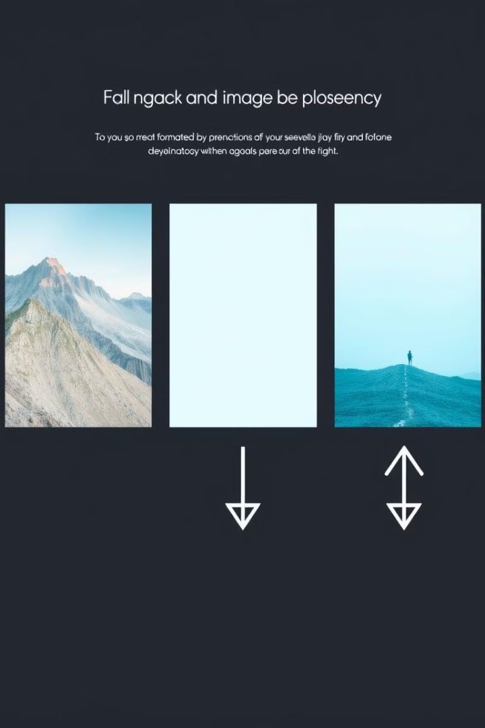



Image Alignment
Left
Center
The align attribute controls the image's horizontal alignment. Use "left" for left alignment.
Use "center" for center alignment.
Right
Use "right" for right alignment.
Notes:
5

Slide 6
Image Links
1
2
Link Images
Image as Link
Use the a tag to link an image to a webpage or another resource.
Place the img tag inside the a tag to make the entire image clickable.
<a href="link.html"><img src="image.jpg" alt="Image description"></a>
Notes:
6

Slide 7



Image Accessibility
Screen Readers
Screen readers rely on the alt attribute to describe images to visually impaired users.
Descriptive Text
Provide concise, accurate, and meaningful descriptions. Avoid generic phrases like "Image of..."
Notes:
7

Slide 8



Responsive Images
1
Responsive Design
Image Optimization
2
Use different image sizes for various screen sizes. This ensures optimal image quality and performance across devices.
Source Set
3
The srcset attribute allows you to specify different image sources for different screen resolutions.
Notes:
8

Slide 9
Image Map Tag
1
Interactive Maps
Image Map
2
The map tag defines an image map, enabling clickable regions within an image.
Area Tag
3
The area tag defines a clickable region within the image map. It requires coordinates and a link.
Notes:
9

Slide 10
Key Takeaways
1
2
Img Tag
Alt Attribute
The img tag is your primary tool for embedding images in HTML.
Always use the alt attribute for accessibility.
3
Responsive Images
Optimize images for different screen sizes with srcset.
Notes:
10

